Slide 1
Obesity treatments
The 3 pillars of obesity management
By Dr. Melanie MacNeil and Dee Badcock BN RN

Slide 2
The 3 pillars of Obesity Management
Weight management
Medical nutrition therapy & physical activity
Psychological & behavioural interventions
Pharmacotherapy
Bariatric
surgery
support the outcomes of better ability to adhere to healthier lifestyle
1. Wharton et al. Obesity in adults: a clinical practice guideline. CMAJ. 2020 August 4;192:E875-91. doi: 10.1503/cmaj.191707.
Notes:
Dr. MacNeil

Slide 3
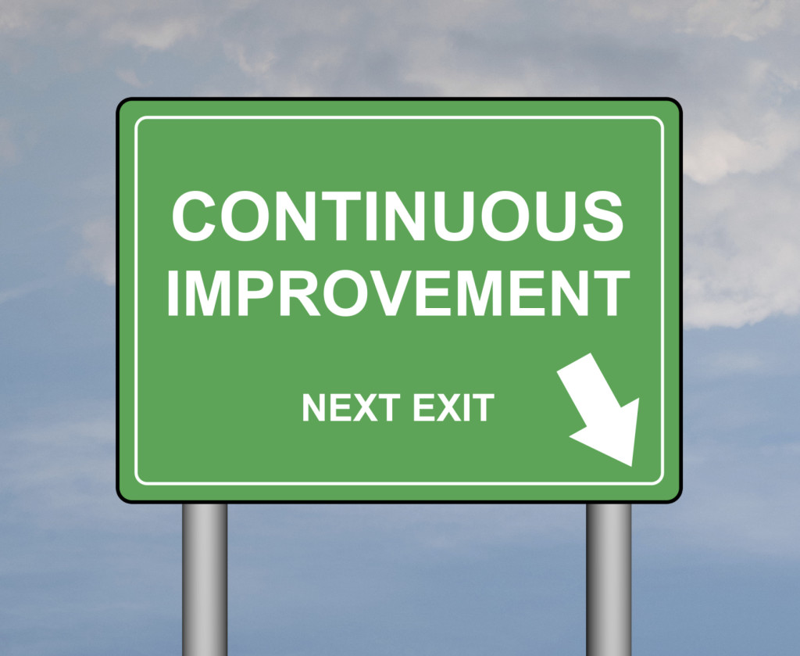
Nutrition and Exercise
No matter our size – we all benefit from healthy eating and exercise :)
This Photo by Unknown author is licensed under CC BY-SA.

Slide 4
The foundation for chronic disease management
Medical nutrition therapy | Physical activity
Personalized counselling by a registered dietitian, if possible, for evidence-based medical nutrition therapy Focus on achieving health outcomes for chronic disease risk reduction and long-term adherence Emphasize individualized eating patterns, food quality and a healthy relationship with food No one-size-fits-all eating pattern recommendation Patient resources: 811 HealthLine, Overeaters Anonymous | a small amount of weight and fat loss improvement in cardiometabolic parameters, and weight loss maintenance Tailor physical activity to the individual
30–60+ min moderate-vigorous aerobic activity most days, 150+ min/wk
strength (resistance) activity 2+ days/wk
↓ the amount of daily sedentary time
1. Wharton et al. Obesity in adults: a clinical practice guideline. CMAJ. 2020 August 4;192:E875-91. doi: 10.1503/cmaj.191707.
Notes:
Dr. MacNeil
Nutrition
Previous Guidelines: Optimal “dietary plan” should be developed with an experienced professional—recommending a high-protein or a low-fat diet as a reasonable short-term treatment option (reduce energy intake by 500–1000 kcal/day)
This has been replaced by medical nutrition therapy
CPGs has a table, Summary of Clinical Outcomes for Nutrition Interventions, that lists different diets
Caloric restriction can achieve short-term reductions in weight (i.e.,< 12 months) but has not shown to be sustainable long-term (i.e., > 12 months). Caloric restriction may affect neurobiological pathways that control appetite, hunger, cravings and body weight regulation that may result in increased food intake and weight gain.
People living with obesity are at increased risk for micronutrient deficiencies including but not limited to vitamin D, vitamin B12 and iron deficiencies. Restrictive eating patterns and obesity treatments (e.g. medications, bariatric surgery) may also result in micronutrient deficiencies and malnutrition. Assessment including biochemical values can help inform recommendations for food intake, vitamin/mineral supplements and possible drug-nutrient interactions.
What is the “best” diet?
There isn’t one!
Meta-analyses have shown significant weight loss with any low-carbohydrate or low-fat diet, with no major differences between individual named diets
Consider the patient!
Best results occur when diet plans match the individual patient to ensure long-term sustainability
Obesity Canada has a Summary of Clinical Outcomes for Nutrition Interventions, highlighting effects of the various nutrition interventions such as weight change and quality of life indicators
1. Wharton et al. Obesity in adults: a clinical practice guideline. CMAJ. 2020 August 4;192:E875-91. doi: 10.1503/cmaj.191707; 2. Johnston B et al. JAMA. 2014;312(9):923-933; Lau et al. CMAJ 2007;176(8 suppl):Online-1–117.
Physical activity
Aerobic and resistance exercise can favour the maintenance or improvements in cardiorespiratory fitness, mobility, strength and muscle mass during weight management interventions
Weight loss should not be the sole outcome by which the success of physical activity therapy is judged There is limited evidence to recommend physical activity alone to improve QoL, mood disorders, or body image in PwO but it can be used as a preventative measure
“I don’t have time to exercise”
Yes, you do when the small things add up!
Remember: Exercise is cumulative. Every 10 minutes of activity counts!
E.g., gardening, playing with kids, walking in a store, taking the stairs …etc.

Slide 5
What to eat???
What makes you happy, healthy and you can sustain for the long term.....different for everyone!!!

Slide 6
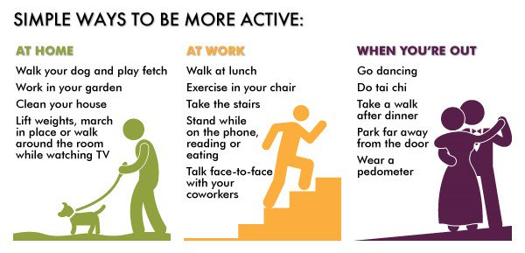
"NEAT" activities

Slide 7
PILLAR ONE:
The How!
This Photo by Unknown Author is licensed under CC BY-NC

Slide 8
Psychological/behaviourial Interventions in Managing Obesity:
What is difference between our goals and values???
Goals – something we strive for, check it off, set new ones
Values – cannot be "achieved" or "finished" ...always a source of motivation
Example:

Slide 9
Values:
Figuring out the "WHY"
Why do you want to manage your weight? I want to be healthy..
Why do you want to be healthy?? I want to feel better and have more energy...
Why do you want to have more energy?? I want to be active with my friends and family
Why is being active and doing more things with family and friends important to you? I want to live a long healthy life and not be limited by my weight...it's important to me
How do we
determine them???

Slide 10
The importance of reflection......
Take a moment and reflect on your day....do the choices you make align
with your values??
Yes
How did it make you feel?
No
How did it make you feel?

Slide 11
Combining interventions leads to greater weight loss
Anticipated weight loss by intervention type
Behavioural (3–5%)
Behavioural + anti-obesity drugs (5–15%)
Weight change (%)
Behavioural + bariatric surgery (20–40%)
Time
1. Pedersen SD, et al. Canadian Adult Obesity Clinical Practice Guidelines: Pharmacotherapy in Obesity Management. Available from: https://obesitycanada.ca/guidelines/pharmacotherapy. Retrieved November 2020; 2. Lau DCW, Wharton S. Canadian Adult Obesity Clinical Practice Guidelines: The Science of Obesity. Available from: https://obesitycanada.ca/guidelines/science.. Retrieved November 2020; 3. Biertho L, Hong D, Gagner M. Canadian Adult Obesity Clinical Practice Guidelines: Bariatric Surgery: Surgical Options and Outcomes. Available from: https://obesitycanada.ca/guidelines/surgeryoptions. Retrieved November 2020; 4. Kuk JL, Wicklum SC, Twells LK. Canadian Adult Obesity Clinical Practice Guidelines: Prevention and Harm Reduction of Obesity (Clinical Prevention). Available from: https://obesitycanada.ca/guidelines/prevention. Retrieved November 2020.
Notes:
Dr. MacNeil

Slide 12
The role of pharmacotherapy
When we lose weight:
Pharmacotherapy counteract these signals by:
↓ appetite
↓ cravings
Why start pharmacotherapy?
Weight loss due to behavioural modifications is often not sustainable
Weight regain when treatment is stopped highlights the need for long
term management
● hunger signaling hormones
● satiety signaling hormones
● metabolism
+
→
desire to eat
1. Wharton et al. Obesity in adults: a clinical practice guideline. CMAJ. 2020 August 4;192:E875-91. doi: 10.1503/cmaj.191707. Accessed September 1, 2021. 2. Wadden TA, et al. Intensive behavioral therapy for obesity combined with liraglutide 3.0 mg: A randomized controlled trial. Obesity (Silver Spring). 2019;27(1):75-86. Accessed September 1, 2021. 3. Chao AM, et al. Effects of liraglutide and behavioral weight loss on food cravings, eating behaviors, and eating disorder psychopathology. Obesity (Silver Spring). 2019;27(12):2005-2010. 4. Wadden TA, et al. Weight maintenance and additional weight loss with liraglutide after low-calorie-diet-induced weight loss: the SCALE Maintenance randomized study. Int J Obes (Lond). 2013;37(11):1443-1451. 5. Yanovski SZ, et al. Long-term drug treatment for obesity: A systematic and clinical review. Jama. 2014;311(1):74-86.

Slide 13
Su ita b le cand ida tes for pharm acotherapy¹
Place in therapy
Pharm acotherapy is an add-on to health behaviour changes, m ed ica l nutrition therapy, and physical activity
BMI ≥30 kg/ m ² or BMI ≥27 kg/ m ² with adiposity-related com plications. BMI ≥27 kg/ m ² with Type 2 d ia betes.
Pharm acotherapy m ay be used to m a intain weight loss that has been ach ie ved by health behaviour changes, and to prevent weight regain.
BMI ≥27kg/ m ² and prediabetes, pharm acotherapy is recom m ended to de lay or prevent type 2 diabetes.*
•
•
•
•
Note: The Clin ical Practice Guide lin es were deve lo ped without consideration for Hea lth Canada approved uses of pharm acotherap ie s and these recom m endations a re not in line with the approved labels for any Canadian anti-obes ity m ed ica tio n . Pedersen SD, et a l. Canadian Adult Obesity Clin ical Practice Guide lin es: Pharm acotherapy in Obesity Managem ent. Ava ilab le from : https:// obesitycanada.ca/guidelines/ pharm acotherapy. Accessed August 10, 2020.

Slide 14
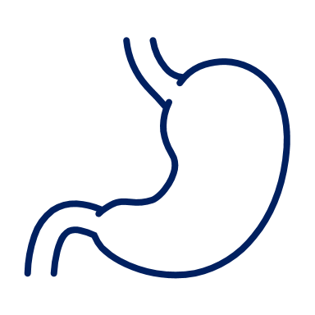
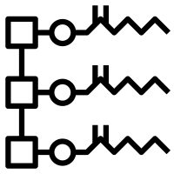
How do these options work?
liraglutide 3.0 mg
orlistat
Human GLP-1 analog
Pancreatic lipase inhibitor
Satiety
Hunger
Gastric emptying
Inhibits breakdown of triglycerides into free fatty acids
Does not target appetite or satiety mechanisms
Glucose levels and glucagon secretion
Insulin release
Half-life 13h
Half-life 1-2h
Emerging OPTION
Human GLP-1 analog
naltrexone/bupropion
Appetite regulation
Hunger
Opioid receptor antagonist
Energy intake
Satiety
Cravings
Hunger
Glucose levels and glucagon secretion
Insulin release
Half-life 5h for naltrexone, 21h for bupropion
Half-life 1 wk
Semaglutide 2.4 mg is Health Canada approved but is not commercially available.
1. Pedersen SD, et al. Canadian Adult Obesity Clinical Practice Guidelines: Pharmacotherapy in Obesity Management. Available from: https://obesitycanada.ca/guidelines/pharmacotherapy. Accessed November 15, 2021. 2. Xenical® Product Monograph. Hoffmann-La Roche Limited. November 18, 2015. 3. Saxenda® (liraglutide) Product Monograph. Novo Nordisk Canada Inc. July 12, 2017. 4. Contrave®. Product Monograph, Valeant Canada LP, February 2018. 5. Wegovy (semaglutide 2.4 mg) Product Monograph, Novo Nordisk Canada Inc., November 2021.
Notes:
Orlistat:
Semisynthetic derivative of lipstatin
Potent and selective inhibitor of pancreatic lipase
Inhibits the breakdown of dietary triglycerides into absorbable free fatty acids
Does not speciﬁcally target appetite or satiety mechanisms
Liraglutide 3.0 mg
Human GLP-1 analog
Acts on POMC/CART neurons to improve satiation and satiety and reduce hunger
Transient effect to decrease gastric emptying
Increases insulin release and suppresses glucagon with glucose increase
Naltrexone/bupropion
Opioid receptor antagonist
Induces satiety by enhancing production & release of α-MSH and β-endorphin from POMC cells in hypothalamus
Disrupts auto-inhibitory effect of β-endorphin on POMC cells by blocking the μ-opioid receptors
Influences the mesolimbic reward system to reduce cravings
Semaglutide 2.4 mg
Human GLP-1 analog
Reduced appetite and food cravings, and improved control of eating
Reduced energy intake
Reduced body weight, predominantly via loss of fat mass
In the control of eating questionnaire (CoEQ), semaglutide 2.4 mg had the greatest effect on craving control and craving for savory foods, with significant improvements vs. placebo remaining at week 104 (STEP 5)

Slide 15
Expectations of treatment
at 1 year
at 68 weeks
Emerging OPTION
orlistat
liraglutide 3.0 mg
naltrexone/bupropion
semaglutide 2.4 mg
% loss
(placebo-subtracted)
-2.9%
-5.4%
-4.8%
-12.4%
% of pts achieving
≥ 5% loss
54% (vs. 33% in placebo)
63.2% (vs. 27.1% in placebo)
48% (vs. 16% in placebo)
86.4% (vs. 31.5% in placebo)
33.1% (vs. 10.6% in placebo)
26% (vs. 14% in placebo)
25% (vs. 7% in placebo)
69.1% (vs. 12.0% in placebo)
% of pts achieving
≥ 10% loss
% of pts achieving
≥ 15% loss
50.5% (vs. 4.9% in placebo)
-
-
-
Effect on
weight maintenance
2.4 kg less weight regain (vs. placebo over 3 years)
-6.0% added weight loss at 1 year (placebo-subtracted)
-17.4% weight loss (vs. 6.9% in placebo weeks 20 – 68)*
Not studied
*All subjects received semaglutide 2.4 mg from weeks 0 – 20. From weeks 20 – 68, subjects were randomized to semaglutide 2.4 mg or placebo.
Semaglutide 2.4 mg is Health Canada approved but is not commercially available.
1. Pedersen SD, et al. Canadian Adult Obesity Clinical Practice Guidelines: Pharmacotherapy in Obesity Management. Available from: https://obesitycanada.ca/guidelines/pharmacotherapy. Accessed November 15, 2021. 2. Wilding JPH et al., Once-Weekly Semaglutide in Adults with Overweight or Obesity. NEJM. 2021:doi: 10.1056/NEJMoa2032183. Epub ahead of print. 3. Rubino D et al., Effect of Continued Weekly Subcutaneous Semaglutide vs Placebo on Weight Loss Maintenance in Adults With Overweight or Obesity. The STEP 4 Randomized Clinical Trial. JAMA. 2021; doi:10.1001/jama.2021.3224.

Slide 16
Patient tips: orlistat
One 120 mg capsule TID with each main meal (no more than 1 hour after)
If a meal is missed or contains no fat the dose can be omitted
Ensure a nutritionally balanced, mildly hypocaloric diet
Distribute daily intake of fat, carbohydrate and protein over three main meals
Take a multivitamin at bedtime (away from orlistat dosing) that includes fat-soluble vitamins and β-carotene to ensure adequate nutrition
Diet should contain ≤30% of calories from fat
Common side effects: Loose, oily stools, flatus
1. Xenical® (orlistat) Product Monograph. CHEPLAPHARM Arzneimittel GmbH. September 27, 2017.

Slide 17
Counselling tips: liraglutide 3.0 mg
Daily SC injection with slow dose escalation intended to reduce GI symptoms
0.6mg
1.2mg
1.8mg
3.0mg
2.4mg
WEEK 1 | WEEK 2 | WEEK 3 | WEEK 4 | WEEK 5
Common side effects: nausea, constipation, diarrhea, vomiting
If patients do not tolerate an increased dose, delay dose escalation by up to 7 days
Inject once a day, regardless of mealtime
Attach a new needle
Select the dose
Inject the dose; count slowly to 6
1. Saxenda® (liraglutide) Product Monograph. Novo Nordisk Canada Inc. November 3, 2021.

Slide 18
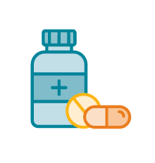
Counselling tips: naltrexone/bupropion
Two 8 mg/90 mg tablets BID with titration; should not be taken with high-fat meals
Discuss other comorbidities and the need for increased monitoring or dose adjustments (e.g., seizures, blood pressure, heart rate, liver/renal impairment)
Discuss patient’s use of other prescription and OTC drugs and assess potential drug interactions
Common side effects: nausea, constipation, headache, dry mouth, dizziness, diarrhea
WEEK 1 | WEEK 2 | WEEK 3 | WEEK 4
1. Contrave® Product Monograph, Valeant Canada LP, February 2018.
Notes:
Should not be taken with a high-fat meal because of a resulting significant increase in bupropion and naltrexone systemic exposure

Slide 19
Counselling tips: semaglutide 2.4 mg
Weekly SC injection with slow dose escalation intended to reduce GI symptoms
0.25mg
0.5mg
1.0mg
2.4mg
1.7mg
WEEK 1 | WEEK 5 | WEEK 9 | WEEK 13 | WEEK 17
Common side effects: nausea, diarrhea, vomiting, constipation, abdominal pain, headache, fatigue
If patients do not tolerate an increased dose, delay dose escalation by up to 4 weeks
Inject once a week, regardless of mealtime
Attach a new needle
Select the dose
Inject the dose; count slowly to 6
Semaglutide 2.4 mg is Health Canada approved but is not commercially available.
1. Wegovy (semaglutide 2.4 mg) Product Monograph, Novo Nordisk Canada Inc., November 2021.

Slide 20
Lifestyle tips to help manage GI side effects:
Drink plenty of fluids throughout the day to help prevent dehydration. | Eat less at a time but eat more often and listen to your body. Stop eating when you feel full. | Set realistic expectations
Eat plain foods, like crackers, toast, and rice, and foods that contain water, like soup. | Avoid foods that cause you to feel sick, such as spicy foods with strong smells, fried foods, and very fatty foods. | Avoid exercise right after eating.
For liraglutide 3.0 mg and semaglutide 2.4 mg
We can delay dose escalation
Semaglutide 2.4 mg is Health Canada approved but is not commercially available.
1. Pedersen SD, et al. Canadian Adult Obesity Clinical Practice Guidelines: Pharmacotherapy in Obesity Management. Available from: https://obesitycanada.ca/guidelines/pharmacotherapy. Accessed November 15, 2021. 2. Mayo Clinic. Nausea and vomiting. Available from: https://www.mayoclinic.org/symptoms/nausea/basics/definition/sym-20050736. Accessed November 12, 2021. 3. Cleveland Clinic. Nausea & Vomiting. Available from: https://my.clevelandclinic.org/health/symptoms/8106-nausea--vomiting. Accessed November 12, 2021. 4. Saxenda® (liraglutide) Product Monograph. Novo Nordisk Canada Inc. July 12, 2017. 5. Wegovy (semaglutide 2.4 mg) Product Monograph, Novo Nordisk Canada Inc., November 2021.
Notes:
Naltrexone/bupropion
There are multiple potential drug interactions with naltrexone/bupropion, which stem from the effect of bupropion and its metabolites to inhibit the hepatic CYP2D6 enzyme system. Physicians and pharmacists must be aware of the importance of evaluating potential drug interactions prior to initiating naltrexone/bupropion. Among patients already receiving naltrexone/bupropion, medications metabolized by CYP2D6 should be started at the lower end of their recommended dosage range with cautious titration (e.g., selective serotonin reuptake inhibitors, beta blockers, antipsychotic agents, type 1C antiarrhythmic agents and many tricyclic antidepressants, such as citalopram, metoprolol, risperidone, propafenone and desipramine, respectively).32 For patients already receiving these medications, consideration should be given for dose reduction when starting naltrexone/bupropion. Bupropion may result in reduced efficacy of tamoxifen and should therefore not be used in combination with it.
Bupropion is primarily metabolized by the CYP2B6 enzyme system. Therefore, naltrexone/bupropion dosing should not exceed one tablet twice daily when used with CYP2B6 inhibitors (e.g., ticlopidine, clopidogrel).33 Naltrexone/bupropion should be avoided in patients taking CYP2B6 inducers as these may reduce efficacy of naltrexone/bupropion by reducing bupropion exposure (e.g., ritonavir, lopinavir, efavirenz, carbamazepine, phenobarbital, phenytoin).32 Central nervous system toxicity can occur when naltrexone/bupropion is used concomitantly with dopaminergic drugs (e.g., levodopa, amantadine).

Slide 21
Surgery
Improves life expectancy
For severe obesity, surgery offers superior outcomes vs. best medical management
For QoL, long-term weight loss, and resolution of obesity-related diseases, especially T2DM, sleep apnea, fatty liver disease and hypertension
Place in therapy
should be considered for people with BMI ≥ 40 kg/m² or BMI ≥ 35 kg/m² with 1+ adiposity-related disease
should be considered for patients with poorly controlled T2DM and Class I obesity (BMI 30-35 kg/m²) despite optimal medical management
may be considered for weight loss and/or to control adiposity-related diseases in persons with Class 1 obesity, in whom optimal medical and behavioral management have been insufficient to produce significant weight loss
BMI, body mass index; QoL, quality of life, T2DM, type 2 diabetes mellitus.
1. Wharton et al. Obesity in adults: a clinical practice guideline. CMAJ. 2020 August 4;192:E875-91. doi: 10.1503/cmaj.191707.
Notes:
Dr. MacNeil

Slide 22
Surgical options
Sleeve gastrectomy
Roux-en-Y gastric bypass
Biliopancreatic diversion with duodenal switch
The choice of bariatric procedure should be tailored to patients’ needs.
Obesity Canada suggests that adjustable gastric banding not be offered and single-anastomosis gastric bypass not be rou­tinely offered.
1. Wharton et al. Obesity in adults: a clinical practice guideline. CMAJ. 2020 August 4;192:E875-91. doi: 10.1503/cmaj.191707; 2. Piche et al. Can J Cardio. 2015;31:153-166; 3. ASMBS Bariatric Surgery Procedures 2014. Available at: http://asmbs.org/patients/bariatric-surgery-procedures
Notes:
Dr. MacNeil
Laparoscopic approach
Bariatric procedures fall into three broad categories: restrictive, malabsorptive and a combination of the two. Restrictive procedures limit the amount of food that the digestive system can hold. Malabsorptive procedures prevent a portion of ingested food from being absorbed by the body.
AGB Adjustable gastric band (restrictive)
An inflatable band is used to create a small pouch, which limits food consumption. Reversible.
VSG Vertical sleeve gastrectomy (restrictive)
Permanently removes most of the stomach, leaving a sleeve-shaped pouch; results in ⬇ ghrelin (hunger hormone)
RYGB Roux-en-Y gastric bypass (restrictive & malabsorptive)
Creates a smaller stomach and bypasses part of the intestine; results in ⬆ GLP-1 (satiety hormone)
BPD Bileopancreatic diversion (restrictive & malabsorptive)
Similar to Roux-en-Y. A variant called a duodenal switch retains the pyloric valve
Obesity Canada:
“The choice of bariatric procedure should be tailored to patients’ needs, in collaboration with a multi-disciplinary team and based on the discussion of risks, benefits and side effects.”
“We suggest that adjustable gastric banding not be offered due to unacceptable complications and long-term failure. We suggest that single-anastomosis gastric bypass not be rou­tinely offered, due to long-term complications in comparison with standard Roux-en-Y gastric bypass.”

Slide 23
Surgical outcomes
Adjustable gastric band
Sleeve gastrectomy
Roux-en-Y gastric bypass
Duodenal switch
Weight loss (%) | 20 | 25 | 30 | 40
Remission of T2DM (%) | 20 | 30 | 40 | 80
Remission of hypertension (%) | 20 | 30 | 40 | 60
Remission of sleep apnea/ hypopnea syndrome (%) | 30 | 40 | 50 | 70
Mortality rate (%) | 0.01 | 0.01 | 0.01 | 0.02
Serious adverse events (%) | 2 | 3 | 3 | 5
T2DM, type 2 diabetes mellitus.
1. Adapted from Wharton et al. Obesity in adults: a clinical practice guideline. CMAJ. 2020 August 4;192:E875-91. doi: 10.1503/cmaj.191707; 2. Piche et al. Can J Cardio. 2015;31:153-166; 3. ASMBS Bariatric Surgery Procedures 2014. Available at: http://asmbs.org/patients/bariatric-surgery-procedures
Notes:
Dr. MacNeil

Slide 24
Access to surgery remains a challenge in Canada
Wait times for bariatric surgery are the longest of any surgically treatable condition
Access is still limited in most provinces and nonexistent in the 3 territories
Referred patients can wait up to 8 years before meeting a specialist or receiving the surgery
Bariatric surgery is available to only 1 in 171 (0.58%) of eligible adult Canadians/year
8 yrs
1. Wharton et al. Obesity in adults: a clinical practice guideline. CMAJ. 2020 August 4;192:E875-91. doi: 10.1503/cmaj.191707.
Notes:
Dr. MacNeil

Slide 25
Questions?

