Slide 1
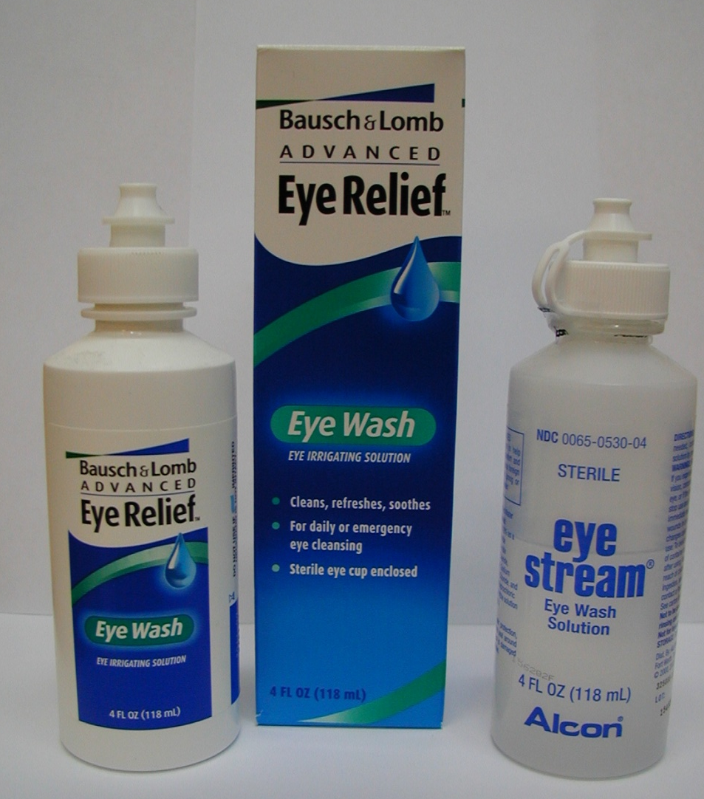
The following Items may be helpful in caring for the eyes after surgery and can be purchased over the counter at most pharmacies or drug stores.
1246 E. Arrow Hwy., Ste. A 16031 Tuscola Rd.
Upland, CA 91786 Apple Valley, CA 92307
Office (909) 931-9675 Fax (909) 931-3239 Toll Free (866) 516-8069
www.strabismus.net
POSTOPERATIVE EYE CARE
Sunglasses
Artificial Tears/Lubricant Eye Drops
Sterile Gauze Pads
Sterile Eye Wash
Tylenol or Acetaminophen
Brands of Artificial Tears
Systane
Blink Tears
Optive
Celluvisc
Genteal
Tears Naturale
Refresh
Moisture Eyes
*To be used for any eye itching, burning, or irritation after surgery.
Sterile Eye Wash for cleaning around the eyes. Best to use by saturating sterile gauze pads and wiping the eyelids. No need to rinse the eye or spray directly into the eye.
NOTE: Please do not get non-sterile water into eyes for 2 weeks and no heavy lifting, bending or strenuous activities. Please call (909)931-9675 if you have any questions or concerns regarding your eyes after surgery.

