Slide 1
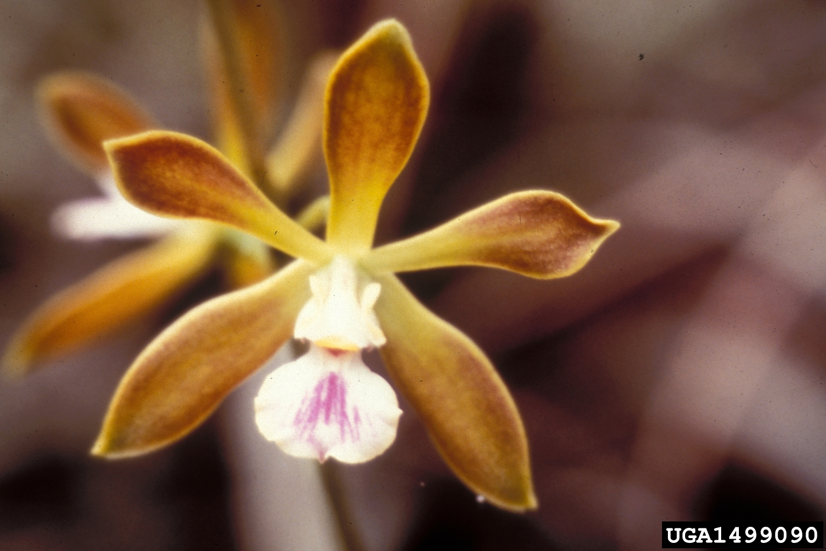
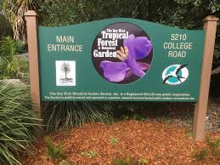
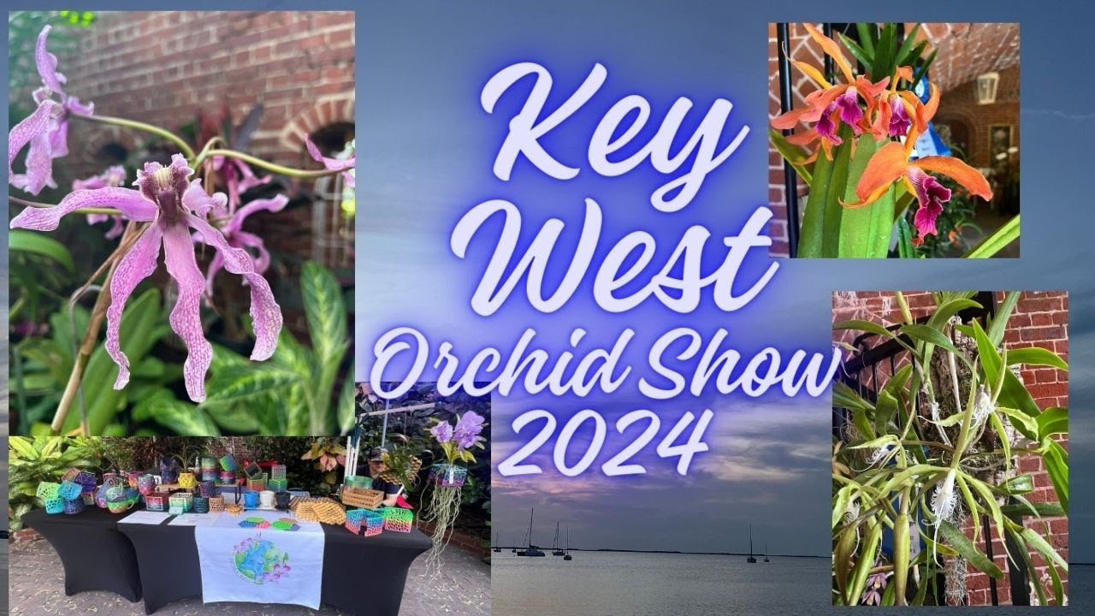
To Save an Orchid
A Joint Project between the
Key West Tropical Forest & Botanical Garden
and the Key West Orchid Society
20 April 2024
Orchid data and most photographs courtesy of the International Orchid Species Photographic Encyclopedia. https://www.orchidspecies.com/index.htm

Slide 2
What is an Orchid ?

Slide 3
Orchid Facts
Orchids are the second largest family of flowering plants (Asteraceae) with 28,000 described species and almost 200,000 registered hybrids. New species being discovered every year. Many species have multiple, naturally occurring color forms and some can even cross-breed creating a natural primary hybrid
Orchids grow on every continent except Antarctica
Orchids are epiphytic, lithophytic and even grow and flower underground where 1 species is known to be pollinated by termites
Orchids have the smallest seeds of any plant (up to 3 million per seedpod) and rely on fungi to germinate which they parasitize to obtain nutrients for energy
Orchid flowers are upside down (resupinate vs. non-resupinate)
Many orchids have aerial roots that can photosynthesize. Some have no leaves at all (Dendrophylax lindenii- the ghost orchid)
Orchids are masters of deception
Vanilla beans comes from the seed pod of an orchid
An orchid plant can live for decades and are believed to have begun to evolve as much as 83 million years ago in North America (Kew)

Slide 4
The State of Orchids
In October 2023, Kew issued a report which suggests that: “Up to 45 per cent of all known flowering plant species across the globe could be under threat of extinction with the plant family Orchidaceae (orchids) among the most threatened”
According to UF, Florida is home to at least 106 native orchid species. Unfortunately, 58 of these are listed as endangered by the Atlas of Florida Plants. Another 18 species are threatened.
As the Florida East Coast Railroad (which included the Overseas Railroad) expanded, orchids were among the first natural resources to be exploited. Flowering orchids were ripped from the trees and packed into railroad cars, destined to be sold as disposable potted plants in northern flower shops.
The Keys remaining known native orchid population has been reduced to just a handful of species in very remote areas. That population is likely at least half of the number of species and a very small % of the individual plants that were present less than 125 years ago.
Can this trend be slowed or maybe even reversed?

Slide 5
2 Organizations with a Common Vision and complimentary skills and knowledge
KWTF & BT : Preservation & Development, Education and Historical Significance
To showcase the historical significance of flora that are native to South Florida, Cuba and the Caribbean and emphasize cultivation of threatened and endangered species of the Florida Keys
The Key West Orchid Society's purpose is to enhance the knowledge of orchids and their culture in the unique environment of the Florida Keys.

Slide 6
A Great Collaborative Opportunity
To collectively pursue a conservational and educational approach to identifying all orchids native to the Florida Keys and the Caribbean basin with specific emphasis on those considered rare or endangered. To endeavor to acquire seeds or seedlings of these plants to be raised on site at the KWTF&BG for the purpose of populating the Garden with those species that could thrive in that natural environment, thereby fulfilling the mission of both organizations and make Key West a focal point for the conservation and public education of these exotic species

Slide 7
The Fairchild BT Million Orchid Project (MOP) Model
In 2013, Fairchild Tropical Botanic Garden established the Million Orchid Project (MOP), now the largest public outreach program focused on orchids in the world. The program is propagating rare and native orchids and planting them into urban landscapes in greater Miami, Florida, USA.
Over 20 community partners and more than 100 schools, have been enlisted to grow orchids in their classrooms and surrounding neighborhoods. With the help of these students and volunteers we are now propagating ten species of rare native orchid from seed using micro-propagation. Plants are also produced on The STEMLab; Fairchild’s mobile micro-propagation laboratory built within the frame of a decommissioned school bus. To date, school landscapes, hospitals, and urban tree plantings have been the primary recipients of the reintroduction initiatives.
At its core, The Million Orchid Project is a massive science experiment that allows us to make important discoveries about how native orchids grow and reproduce while educating and informing the public. Our citizen science approach actively engages the community in the conservation actions. Additionally, the science of The Million Orchid Project may help us develop more general strategies for orchid conservation and rescuing rare plants within a highly developed urban environment.

Slide 8
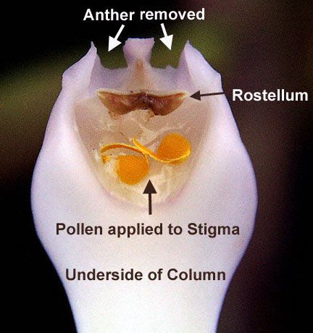
How it’s Done
#1 Pollination
#2 Seed Pod
https://www.youtube.com/watch?app=desktop&v=tf8o7heBxAQ

Slide 9
How it’s Done
#3 Timing
#4 Sterilization &Sowing

Slide 10
How it’s Done
#5 Success
#6 Getting Close
Multiple re-platings to fresh agar are required as the plants grow

Slide 11
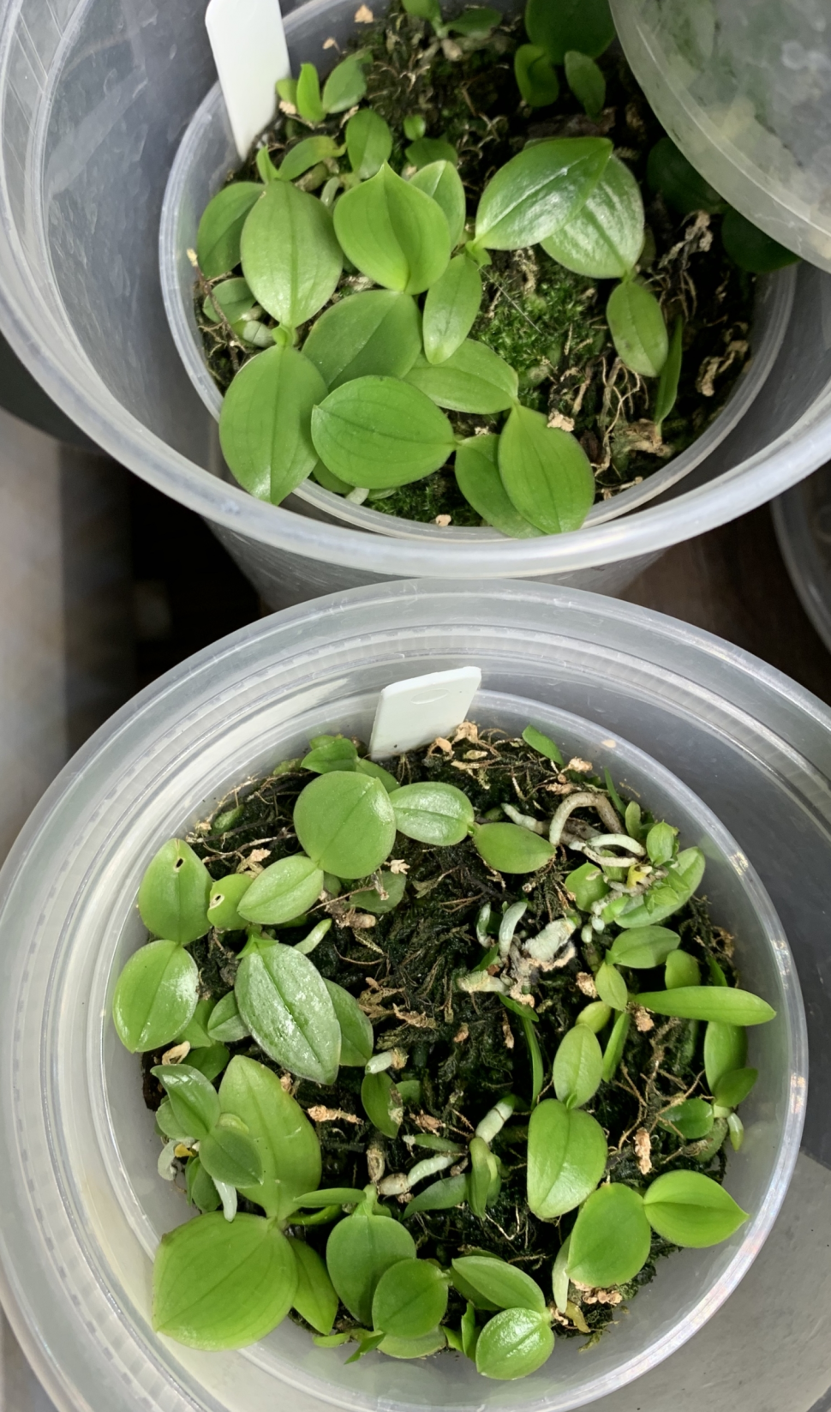
How it’s Done
#7 Flask to CommPot
#8 CommPot to Small Pot

Slide 12
Finally Home (elapsed time roughly 2 years)
2 additional years required before transplanting into the garden

Slide 13
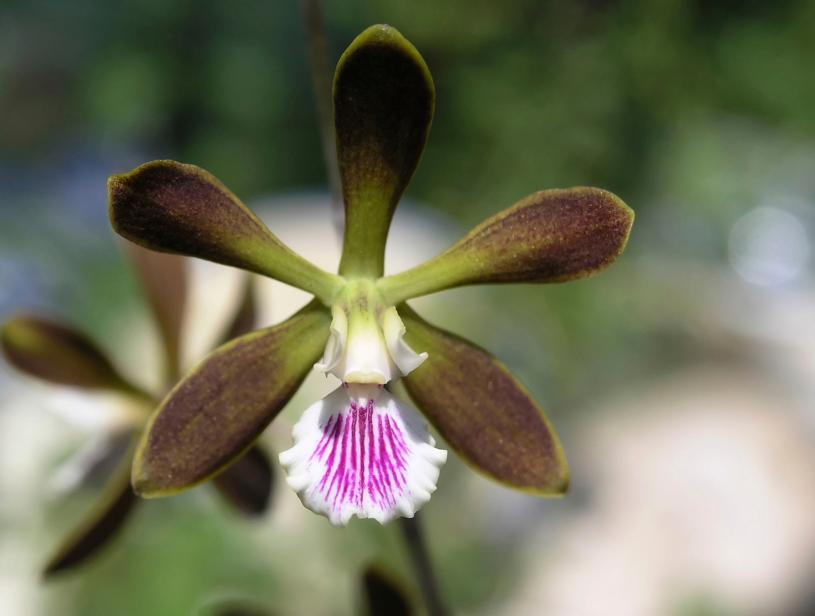
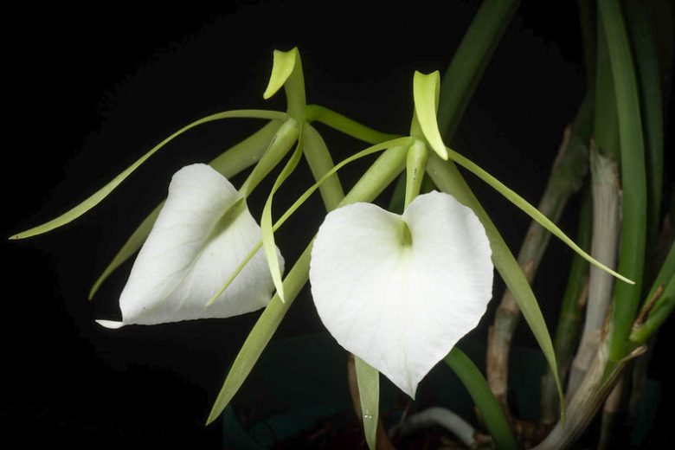
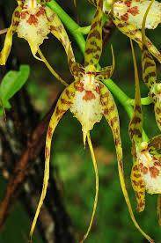
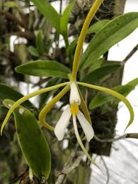
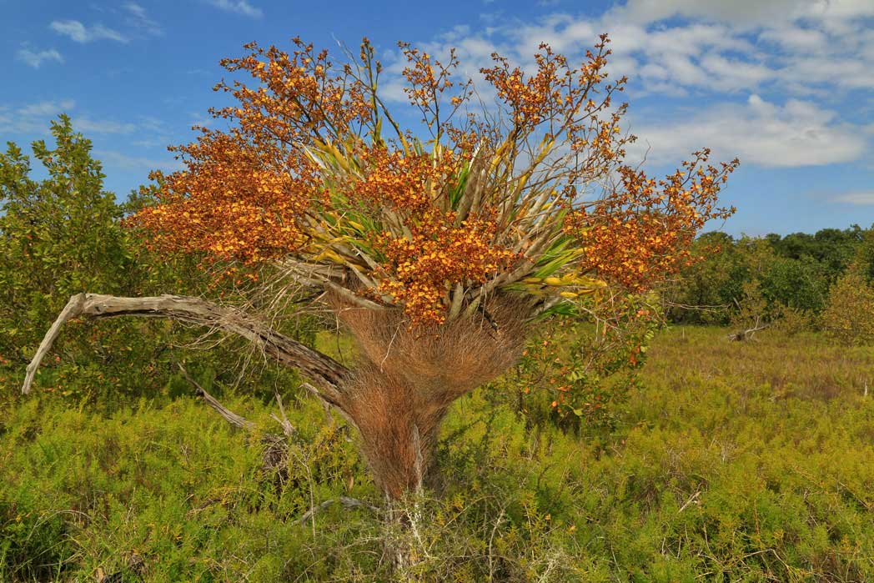
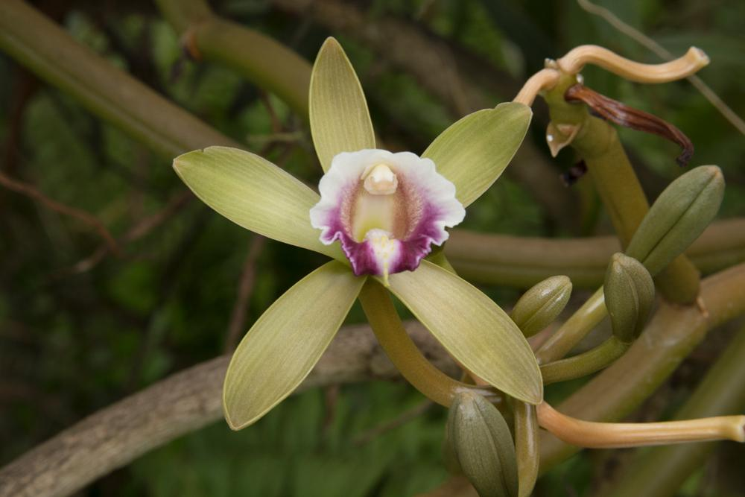
The Initial Target Species
Encyclia tampensis Brassavola nadosa
Brassia caudata Epidendrum nocturnum
Cyrtopodium punctatum Vanilla barbellata
There are thousands of orchid species that are native to the Caribbean basin that may make good future candidates

Slide 14
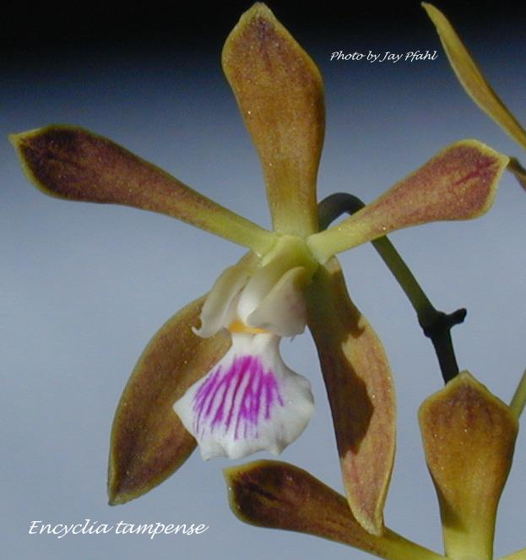
Encyclia tampensis
Common name: Butterfly Orchid
Epiphyte
Range: Florida & Bahamas
Blooms: Late spring to mid summer
Lower light
Flower size- 1 ¼”
Fragrant

Slide 15
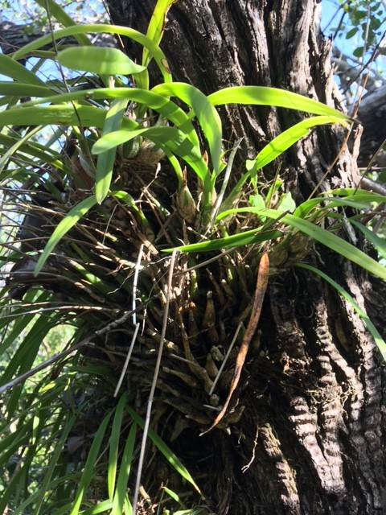
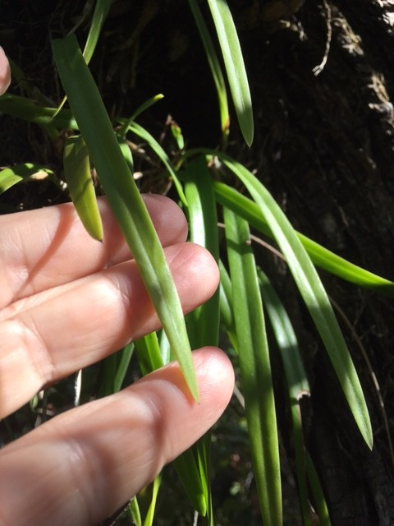
Encyclia tampensis is in the Lab (photos in situ in the Lower Keys)

Slide 16
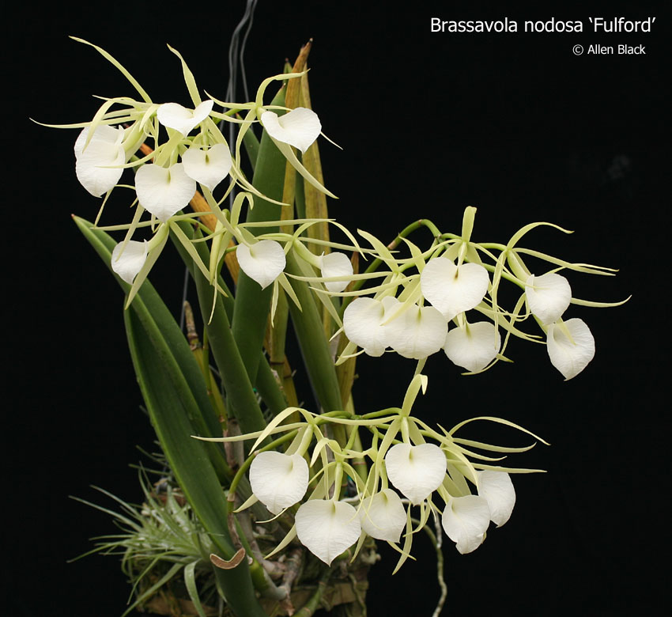
Brassavola nadosa
Common name: Lady of the night
Epiphyte or lithophyte
Range: Mexico south to Brazil including the ABC Islands and the Cayman’s
Blooms: Off and on year round. Best in fall.
Medium light
Flower size: 3-4”
Highly fragrant

