Slide 1
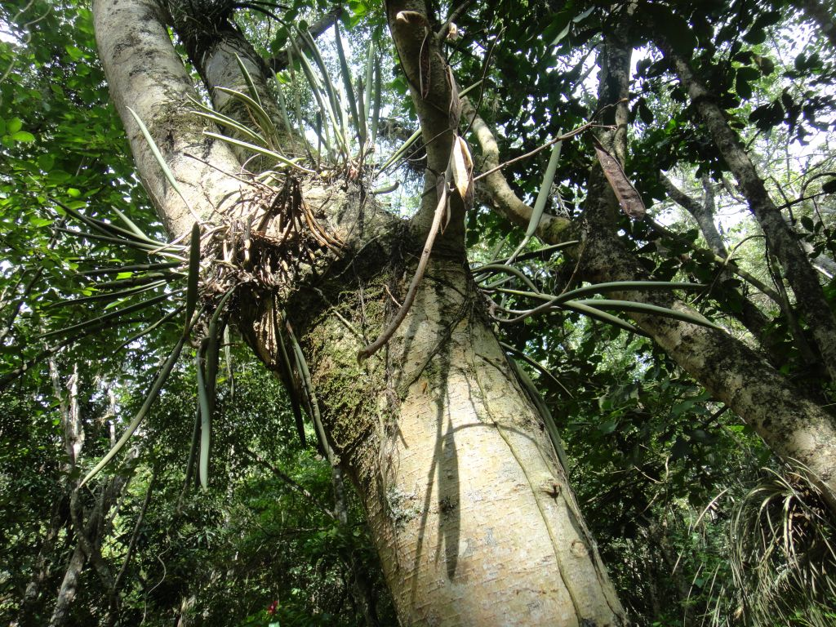

Slide 2
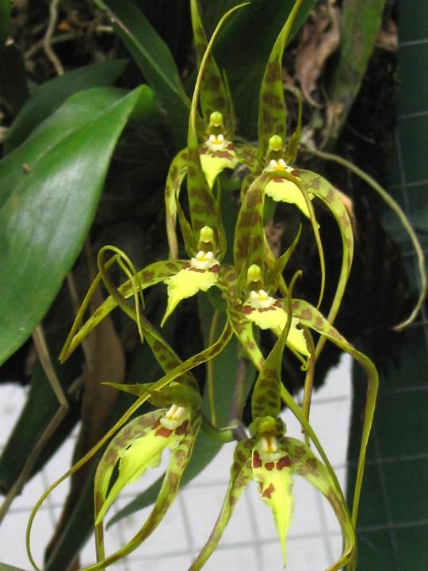
Brassia caudata
Common name: the tailed brassia
Epiphyte
Range: Florida to Brazil and throughout the Caribbean
Blooms: spring & fall
Light: lower light
Flower size: 1 ½” x up to 6”
Light occasional fragrance

Slide 3
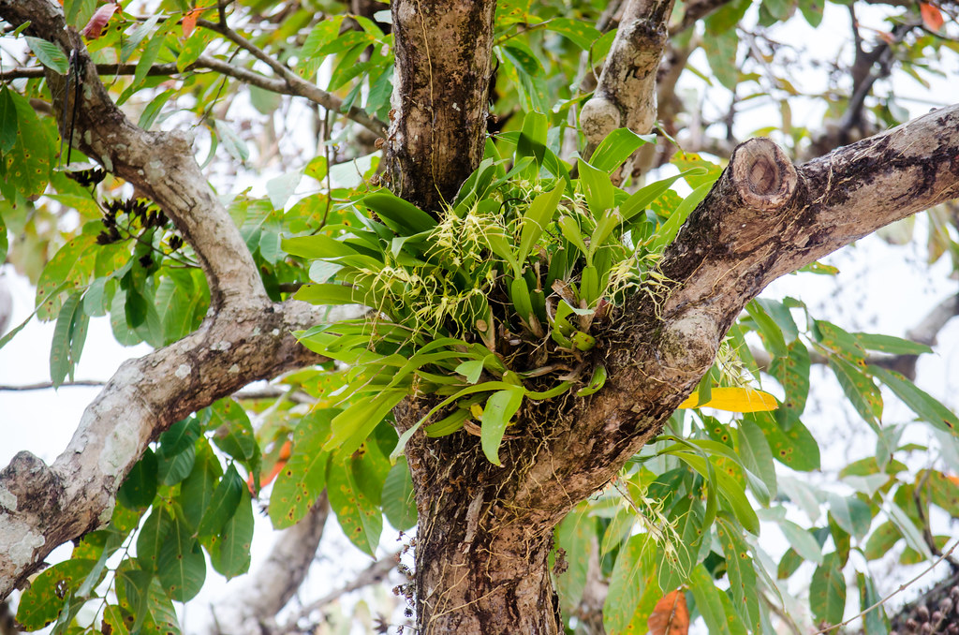

Slide 4
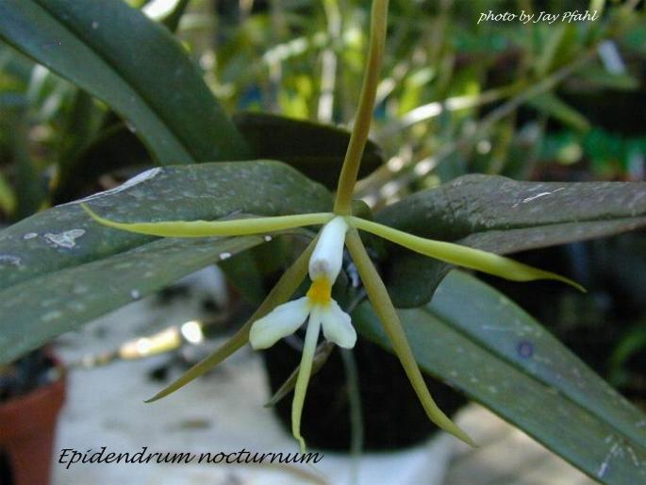
Epidendrum nocturnum
Common name: the night scented epidendrum
Epiphyte
Range: Florida to S. America and throughout the Caribbean
Blooms: summer to fall
Light: lower light
Flower size: 3” to 5”
Highly fragrant

Slide 5
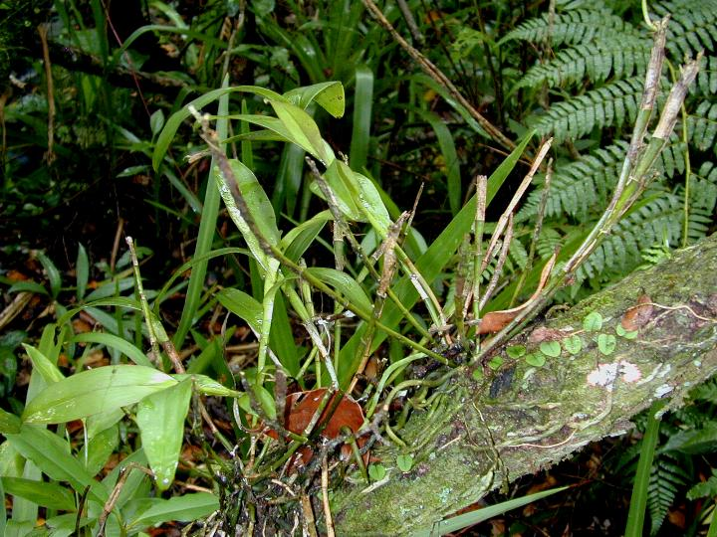

Slide 6
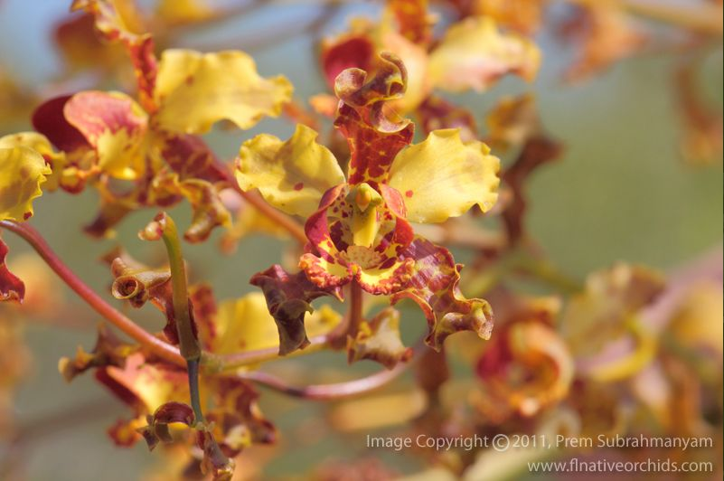
Cyrtopodium punctatum
Common name: the cow horn or cigar orchid
Epiphyte and occasionally terrestrial
Range: Florida to S. America and throughout the western Caribbean
Blooms: spring
Light: full sun
Flower size: 1 ½”
Can become massive

Slide 7
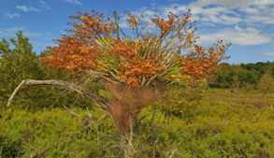

Slide 8
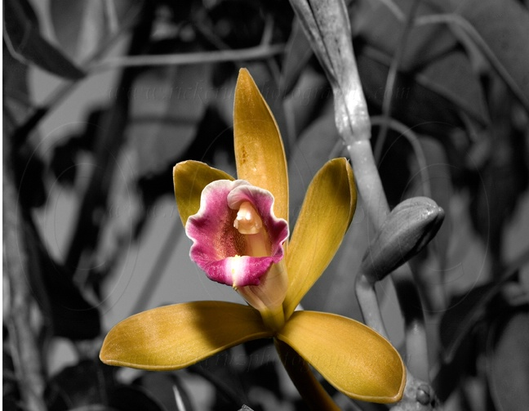
Vanilla barbellata
Common name: snake orchid
Epiphyte
Range: S. Florida to Leeward Islands
Blooms: Late spring to summer
Full sun
Flower size- 2”
Fragrant

Slide 9
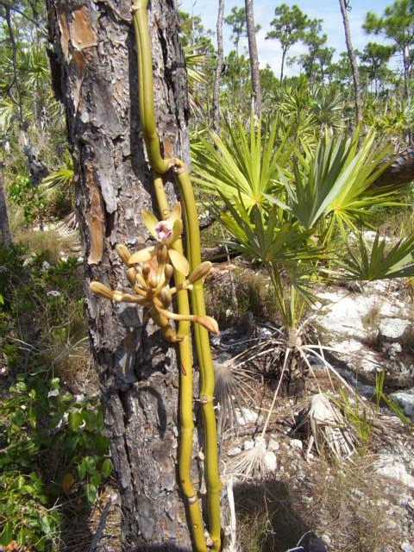

Slide 10
The Plan
Start 2-3 new species per year
Erect & Equip Shade house in 2025
First tenants arrive in late 2025
Transplant to KWTF&BT can hopefully begin by 2027 with Encyclia tampensis
We will do our own breeding of native or “near-native” species or acquire seedpods or flasks for more rare and protected species in order to insure as closely as possible the correct genome type plants for our specific environment. Raising all seedlings in a shade house in situ at KWTF&BG will help ensure “hardening” to this environment prior to transplant
Dendrophylax lindenii? (Ghost orchid) Let’s make sure we have our process nailed down first

Slide 11
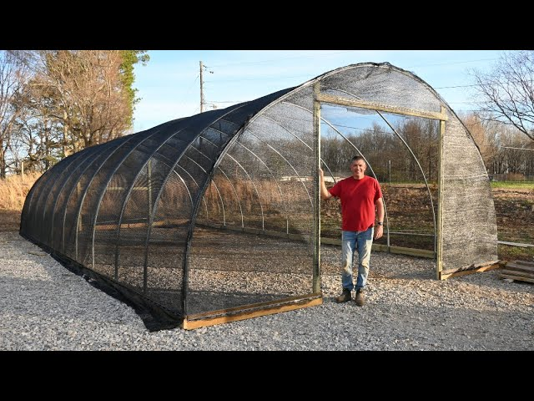
Infrastructure
The Shade House (40 ft x 24 ft) to accommodate 20,750 seedlings in 2x2 pots
Lab expenses, Shadehouse, Benches, fans (electricity), irrigation (water & plumbing), construction/installation, timers, storage shed, pots, potting media, fertilizer & other miscellaneous tools and supplies
Estimated Investment $35,000-$40,000

Slide 12
Floorplan

Slide 13
Why Do It?
This project is in the sweet spot for 2 organizations that when working together have the knowledge and expertise to be successful
KWTF&BG is an ideal site to “re-populate” orchids as several species were likely native here when the first permanent settlers arrived.
There are thousands of orchid species that fit the “Florida Keys & Caribbean Basin” charter of KWTF&BG that should thrive here.
We have a successful model to follow (Fairchild Million Orchid Project) and Fairchild has been encouraging and offered their expertise and experiences. They are excited to have this interest in the Keys.
A substantial and scientifically important orchid collection, in a native environment, will really put KWTF&BG and all of Key West on the horticultural map with a very unique collection in the United States
A fabulous opportunity to engage younger generations in a hands on STEM project that could serve them for a lifetime
BECAUSE WE CAN!

Slide 14
Where Do We Go From Here
Commencing grant writing. We are aware of multiple funding opportunities locally and nationally.
Currently engaged with Fairchild BG who volunteered to grow out our first seed pods. Investigate need and process to multi-source lab work to better manage risk, especially if we are fortunate to get into rare and endangered species. Eventually offer an opportunity as a local school lab science project.
Begin permitting, site prep and procurement of capital facilities and equipment as we wait for plants.
Conduct a thorough site plan of the Garden and determine most promising sites for re-introduction by species. Where, when, how, how many.
If our success exceeds the needs of the Garden, create a plan to handle excess inventory. Make plants available to City of Key West and residents to make KW the “Orchid City”?
Begin local fundraising
Stay engaged with Fairchild
Make it happen!

Slide 15
Off we go!

Slide 16
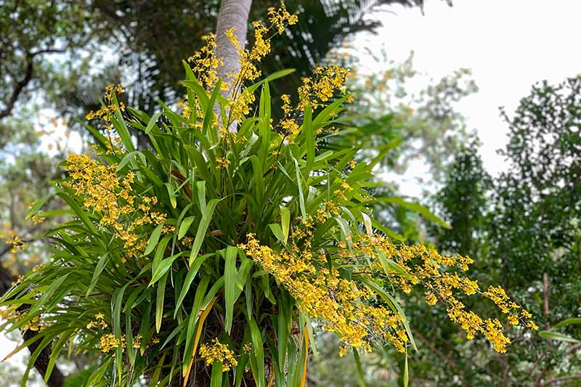
Questions??

