Slide 1
Nantucket Zoning Board of Appeals
Surfside Crossing Application for Comprehensive Permit
John R Coon, JD, PhD
16 January, 2019

Slide 2
M.G.L. 40B of the Massachusetts Comprehensive Permit Act G.L. c. 40B §§20-23(act).
Balancing the need for affordable housing vs. local needs of the community, including:
  the need to protect the health or safety of the occupants of the proposed housing, or of the city or town;
  to promote better site and building design in relation to the surroundings, or
  to preserve open space.

Slide 3


Slide 4

Ecosystem Based Governance
Governance capable of integrating ecological protection and restoration with human needs to strengthen the essential connection between economic prosperity and environmental well-being.

Slide 5

Overview of EBG Characteristics
Management for Resilience
Significant, meaningful public participation
Integrated, Collaborative Government Involvement
Governance is Adaptive
Overarching lead or joint institution
Precautionary approach to decision making

Slide 6
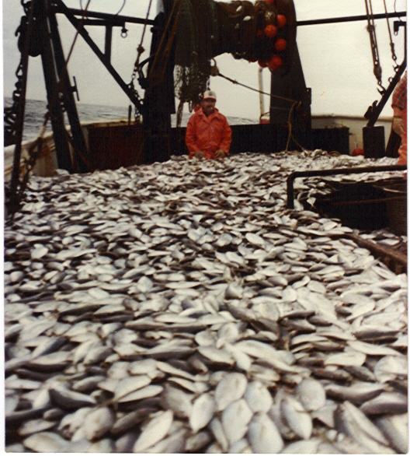
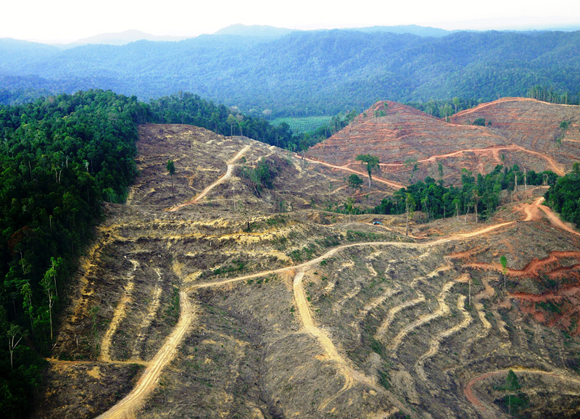
EBG Characteristics
- Management for resilience
- Focus: the natural processes necessary to sustain ecosystem structure and function

Slide 7
Science of Surprise
(i) Wealth or the prospect of wealth generates political and social power that is used to promote unlimited exploitation of resources.
(ii) Scientific understanding and consensus is hampered by the lack of controls and replicates, so that each new problem involves learning about a new system.
(iii) The complexity of the underlying biological and physical systems precludes a reductionist approach to management. Optimum levels of exploitation must be determined by trial and error.
(iv) Large levels of natural variability mask the effects of overexploitation. Initial overexploitation is not detectable until it is severe and often irreversible
(Ludwig, Hilborn et al. 1993, 17).

Slide 8
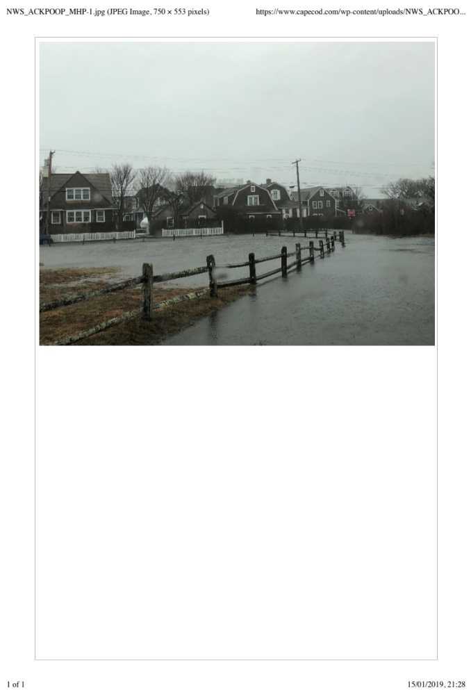
Nantucket: What threats to aquifer?
Climate change
Development
Pollution
Photo: CapeCod.com

Slide 9
Climate Change
Sea Level Rise
  Higher, more frequent, tidal surges
  Salt water intrusion
Changes in total precipitation via more frequent, intense storms
Hotter summers with longer, more intense drought
Stronger tropical storms

Slide 10
Development
Sole source aquifer
  Current: 11,600 housing units: 64% seasonal, 36% year round
  16 multiunit developments approved by Town
    594 additional units over next 5 years
  Additional water demand
    140,000 gallons per day (gpd)
    350,500 peak day demand (ppd)
  Plus Surfside Crossing? 100 units?

Slide 11
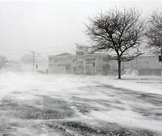
Contaminants
Sole Source Aquifer
PFAS/PFOS/PFPA C8
Stormwater runoff
Water table rise
Salt water intrusion

Slide 12
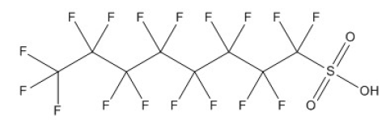
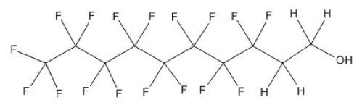
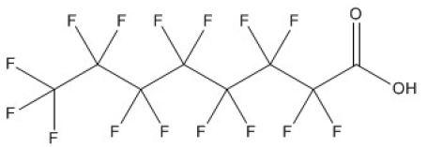
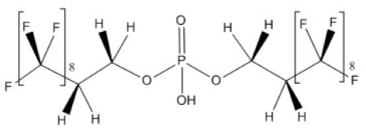
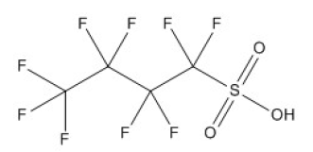
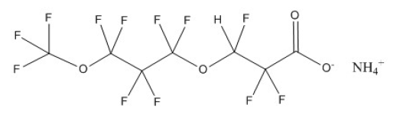
CHEMICAL STRUCTURES
Perfluorooctane sulfonic acid (PFOS)
8:2 Fluorotelomer alcohol (8:2 FTOH);
also known as 2-perfluorooctylethanol
Perfluorooctanoic acid (PFOA)
8:2 Polyfluoroalkylphosphate diester
Perfluorobutane sulfonic acid (PFBS)
Ammonium 4,8-dioxa-3H-perfluorononanoate (ADONA)

Slide 13
Uncertainty
Where there are threats of serious or irreversible damage, lack of scientific certainty shall not be used as a reason for postponing cost-effective measures to prevent environmental degradation

Slide 14
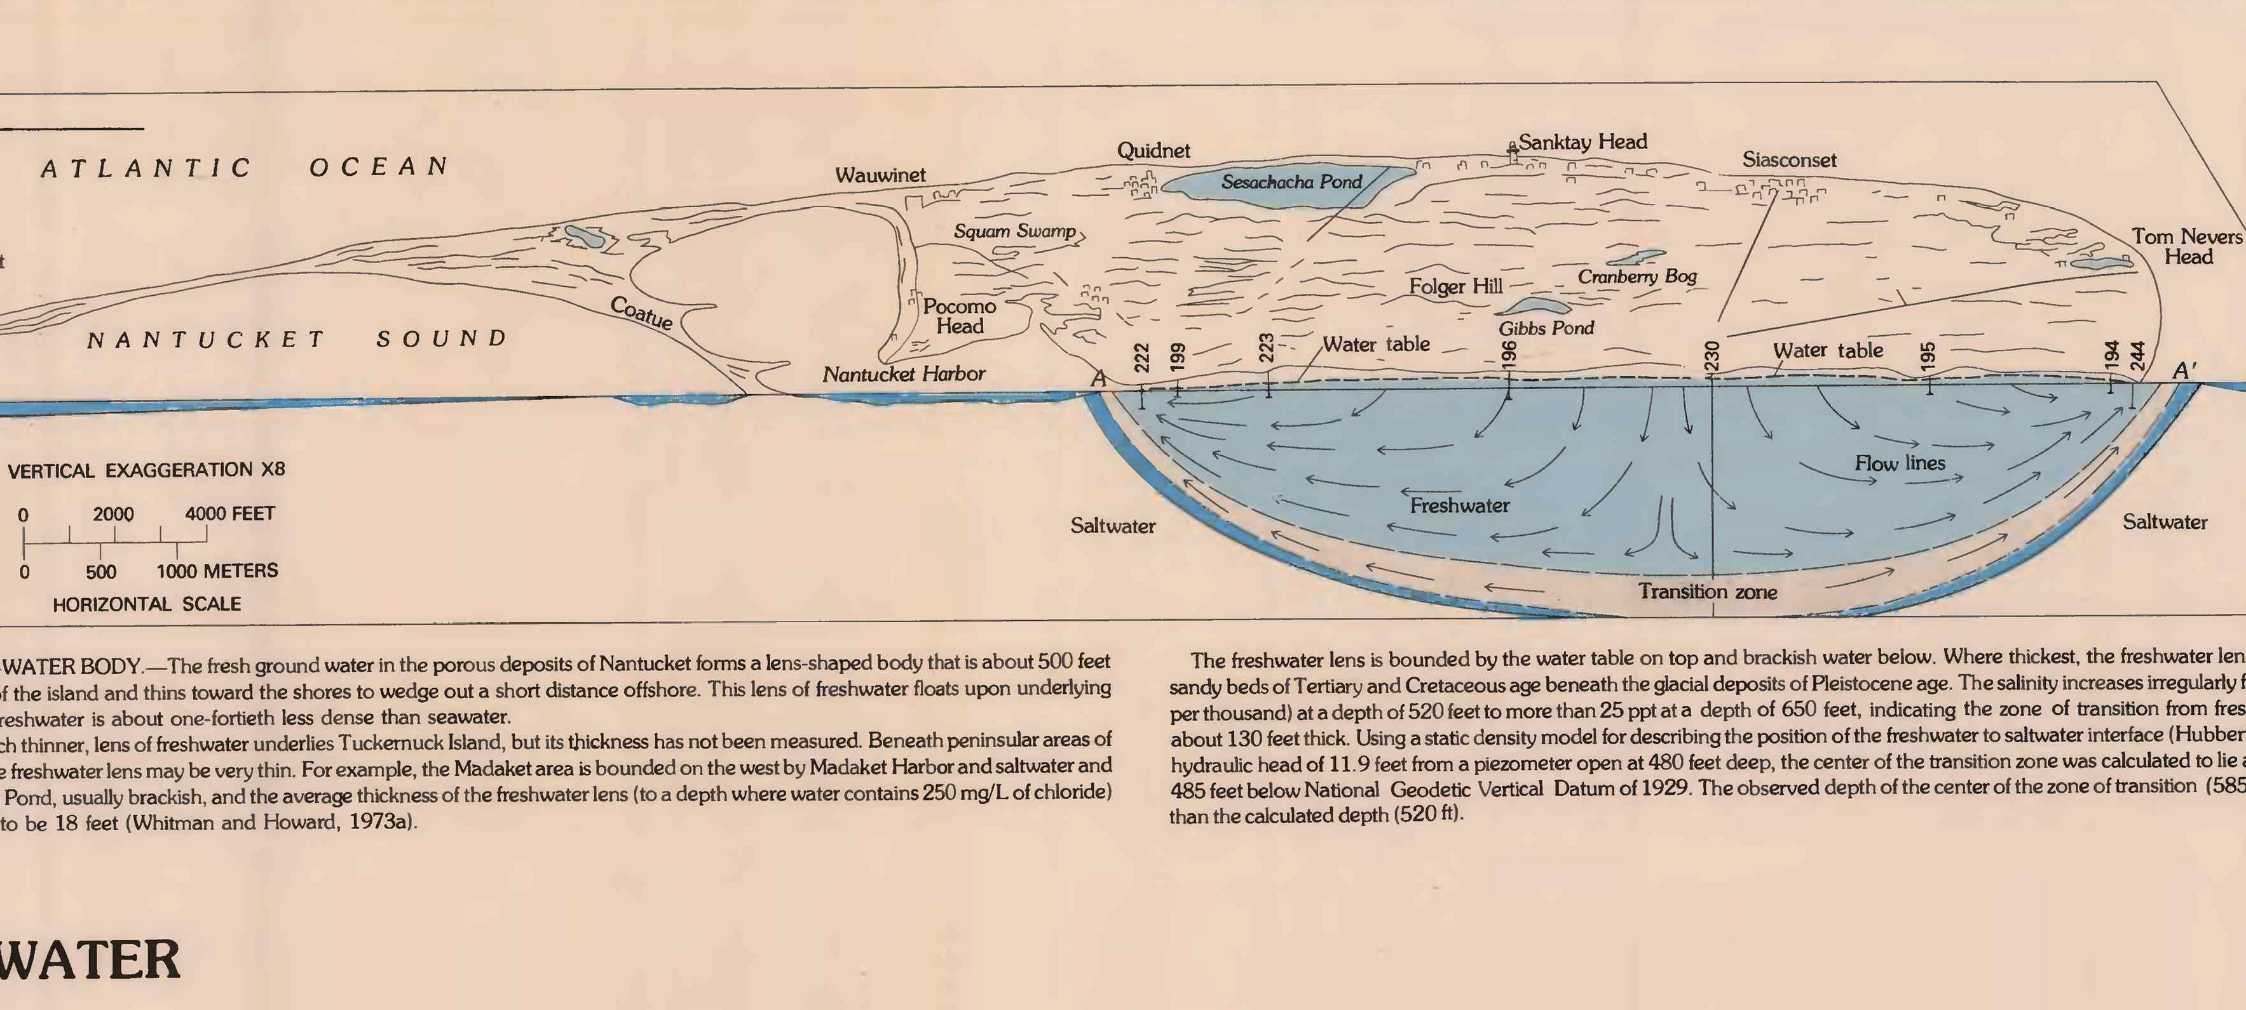
Groundwater?
Walker 1980

Slide 15
And it ought to be remembered that there is nothing more difficult to take in hand, more perilous to conduct, or more uncertain in its success, than to take the lead in the introduction of a new order of things. Because the innovator has for enemies all those who have done well under the old conditions, and lukewarm defenders in those
who may do well under the new. This coolness arises partly from fear of the opponents, who have the laws on their side, and partly from the incredulity of men, who do not readily believe in new things until they have had a long experience of them.
Nicolo Machiavelli, The Prince, Chap. VI , 1499

