Slide 1



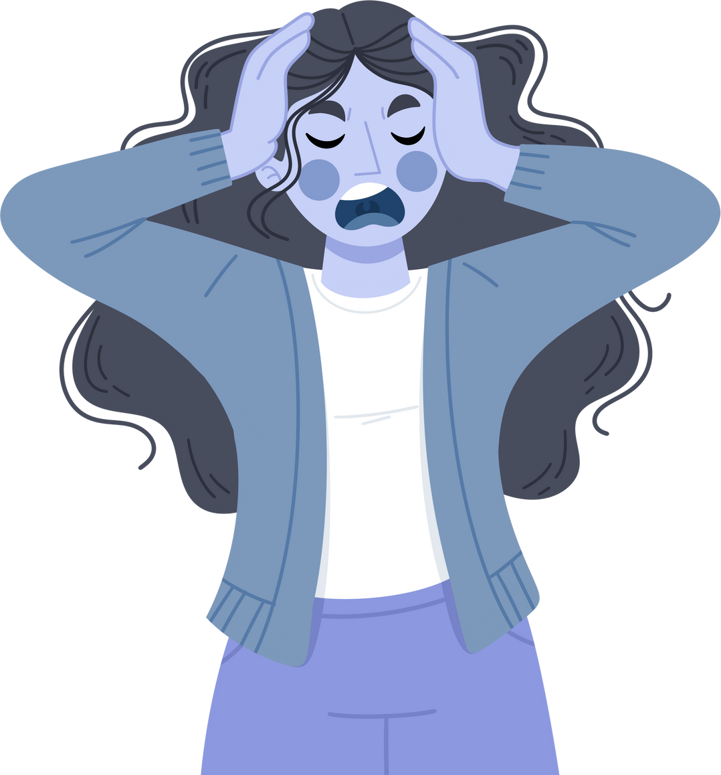

STRESS MANAGEMENT TECHNIQUES
Proven Strategies
to Reduce Stress and Improve Wellbeing

Slide 2



1
Understanding Stress
WHAT’S INSIDE?
2
The Long-Term Impact of Stress
3
Benefits of Stress Management
4
Simple Ways to Calm the Mind
5
Move Your Body to Manage Stress
6
Healthy Lifestyle Choices
7
Taking Control of Your Schedule
8
Building a Support System

Slide 3



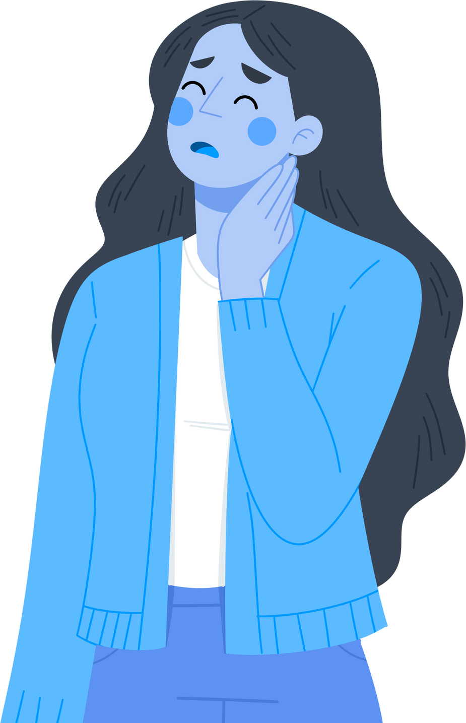



UNDERSTANDING STRESS
Stress is the body’s natural response to challenges or demands. It can be triggered by both external and internal factors, including daily responsibilities or personal thoughts. While short-term stress can sometimes
motivate us to perform better,
prolonged stress can harm our wellbeing. Recognising its causes and
symptoms is the first step to
addressing it effectively.
Physical and Emotional Impact
Common Causes

Slide 4
UNDERSTANDING STRESS
Common Causes
4. Lack of Support & Resources
Insufficient support from school leadership, parents, or access to teaching resources makes it harder to do the job effectively.
5. Emotional Demands
Teachers often support students through personal or emotional challenges, which can be mentally draining over time.
Common Causes

Slide 5
UNDERSTANDING STRESS
Common Causes
1. Heavy Workload & Time Pressure
Teachers often juggle lesson planning, grading, meetings, and admin tasks, with not enough time during the school day—leading to long hours and poor work-life balance.
2. Classroom Management
Managing disruptive or unmotivated students can be exhausting, especially without adequate support or training.
3. High Expectations & Accountability
Pressure to meet performance targets, ensure student success, and deliver results (often measured by tests) creates constant stress.
Common Causes

Slide 6

THE LONG-TERM IMPACT OF STRESS
Chronic stress can harm physical and mental health if left unmanaged. Its effects can accumulate over time, affecting both personal and professional life. Prolonged exposure to stress can weaken the immune system, making individuals more susceptible to illnesses.
Physical Health Issues
Mental Health Challenges
Behavioural Changes
Prolonged stress can cause heart disease, high blood pressure, and weakened immunity.
It may lead to depression, anxiety, and difficulty concentrating. It may lead to depression, anxiety, and difficulty concentrating.
Stress often results in unhealthy coping mechanisms, such as overeating or substance use.

Slide 7

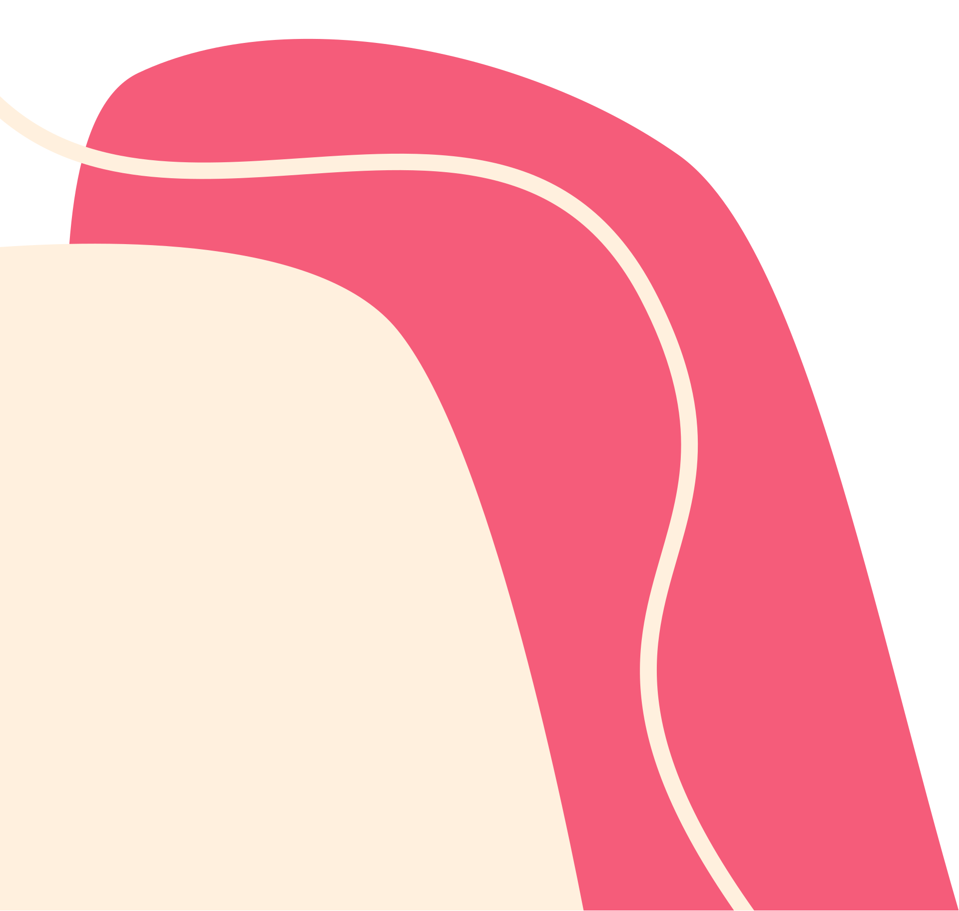



BENEFITS OF STRESS MANAGEMENT
Managing stress effectively improves both physical and mental wellbeing. It enhances focus, relationships, and overall quality of life. Taking steps to reduce stress allows individuals to enjoy greater emotional stability and resilience. Furthermore, adopting stress management techniques fosters healthier habits, better decision-making, and a more positive outlook on life. Investing in stress management can create a lasting impact on personal and professional success.
Improved Productivity
Lower stress levels lead to better performance and decision-making.
Better Emotional Health
Stress management fosters resilience and emotional stability.
Enhanced Relationships
Reducing stress can improve interactions and strengthen bonds with others.

Slide 8
RELAXATION TECHNIQUES
Relaxation techniques are vital tools for stress management. They are easy to practice and can be integrated into daily routines. Learning these techniques helps in reducing immediate stress and prevents long-term build-up.
1
Deep Breathing Exercises
2
Meditation and Mindfulness
3
Progressive Muscle Relaxation
Inhale deeply through the nose and exhale slowly to reduce tension. Controlled breathing helps lower blood pressure and calm the nervous system.
Focus on the present moment to clear your mind and lower stress levels. This practice promotes emotional stability and a heightened sense of awareness.
Tense and then release different muscle groups in your body. This technique helps alleviate physical tension and fosters a sense of relaxation.

Slide 9

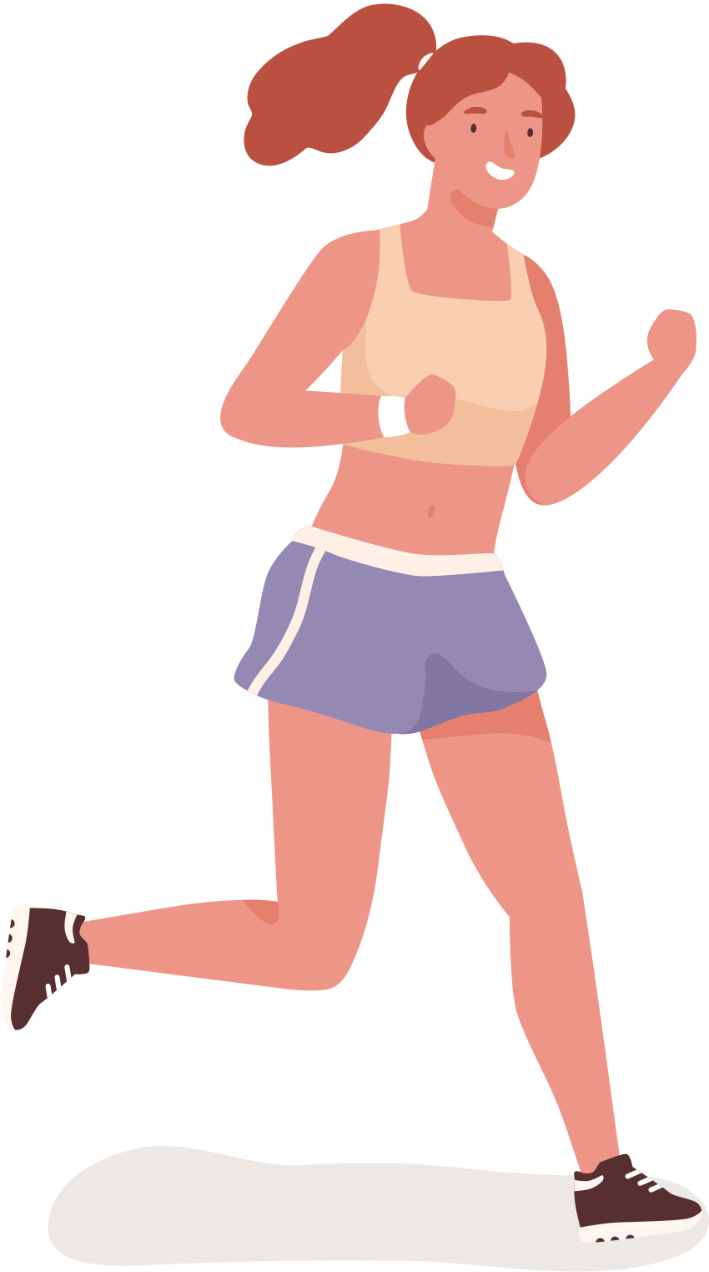
PHYSICAL ACTIVITIES
Physical activities release endorphins, which act as natural stress relievers. Even light exercise can improve your mood and overall health. Incorporating physical activities into daily life helps reduce stress hormones and boosts energy levels. Exercise not only improves physical fitness but also creates a sense of accomplishment, further enhancing mental wellbeing. Consistent physical activity supports both body and mind. Example: Regular Workouts and Stretching and Walking

Slide 10






HEALTHY LIFESTYLE CHOICES
Healthy habits provide the foundation for long-term stress management. Small, consistent changes can make a significant difference. By prioritising healthy choices, individuals can create a balanced and fulfilling life.
Balanced Diet
Quality Sleep
Eating nutrient-rich foods helps regulate mood and energy.
Aim for 7–9 hours of sleep per night to recharge your mind and body.

Slide 11

BUILDING A SUPPORT SYSTEM
Having a reliable support system can ease stress significantly. Don’t hesitate to reach out to others when you need help. Support systems provide emotional relief and practical solutions during challenging times. A strong network of friends, family, or professionals creates a sense of belonging and security. Leaning on your support system can be a transformative step in stress management. Having a reliable support system can ease stress significantly.

Slide 12
THANK YOU
Take the First Step Towards a Healthier Life
Stress management is a journey. By adopting these techniques, you can lead a healthier and more balanced life. Remember, small changes can have a big impact!

