Slide 1
Pylon Upgrade

Slide 2
Pylon Upgrade Value add by offering placement at a monthly fee

Slide 3
Pylon Upgrade

Slide 4
Pylon Upgrade

Slide 5
Pylon Upgrade

Slide 6
Pylon Project

Slide 7
Façade Upgrade

Slide 8
Façade Upgrade

Slide 9
Façade Painting

Slide 10
Façade Painting

Slide 11
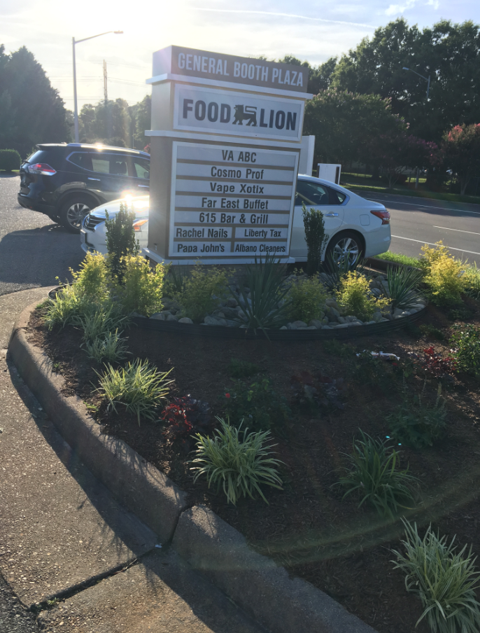
Landscaping Enhancements

Slide 12
Solar Projects

Slide 13
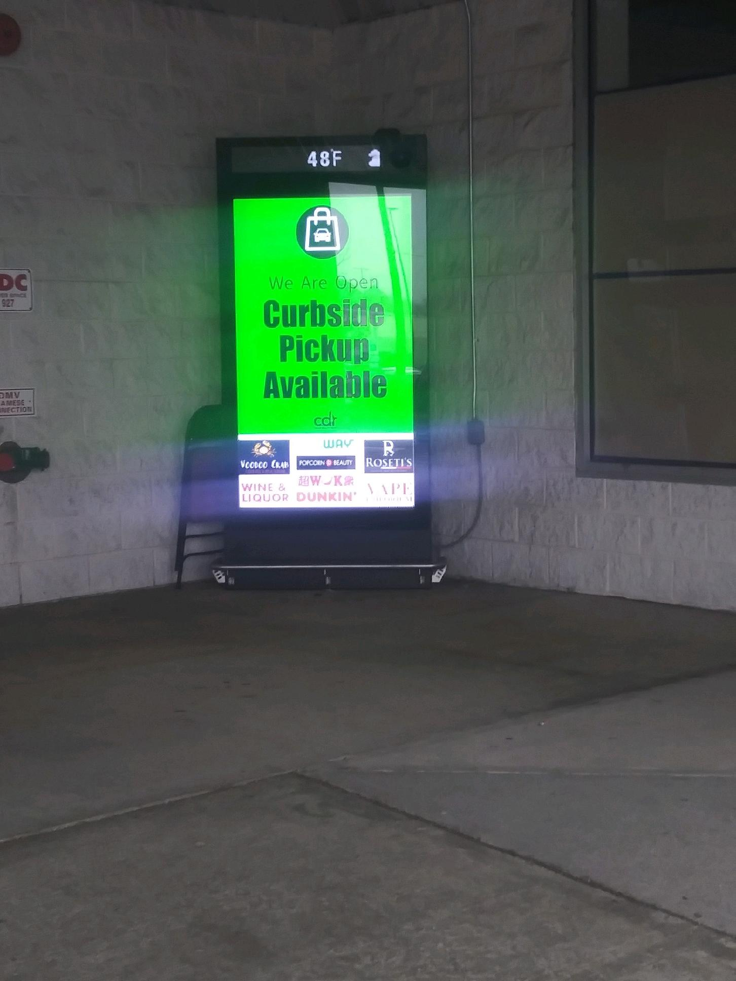
Digital Media Signs Free Marketing for Tenants of the Shopping Center

Slide 14
Charging Stations Amenities for Shopping Center Customers

Slide 15
Parking Lot Improvements

Slide 16
Parking Lot Improvements

Slide 17
Signage Projects

Slide 18
Signage Projects

Slide 19
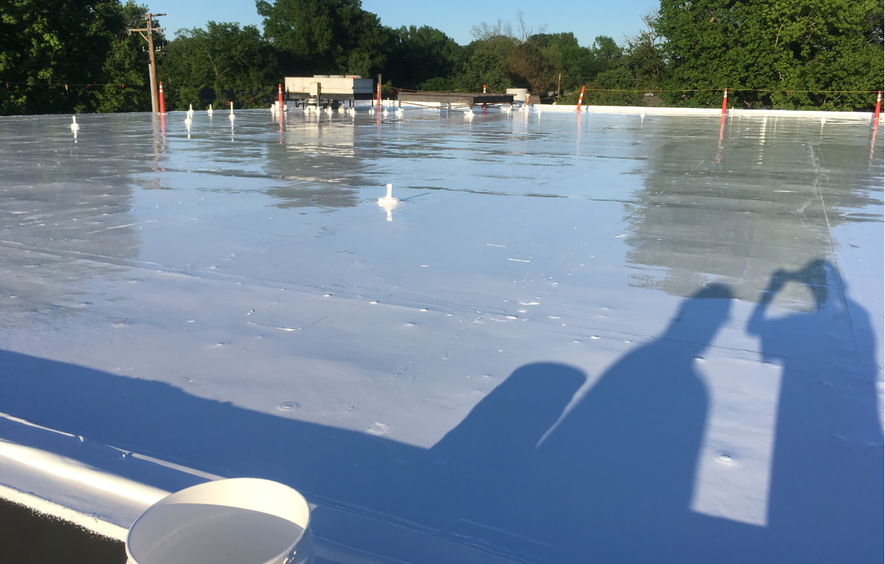
Roof Improvements

