Slide 1
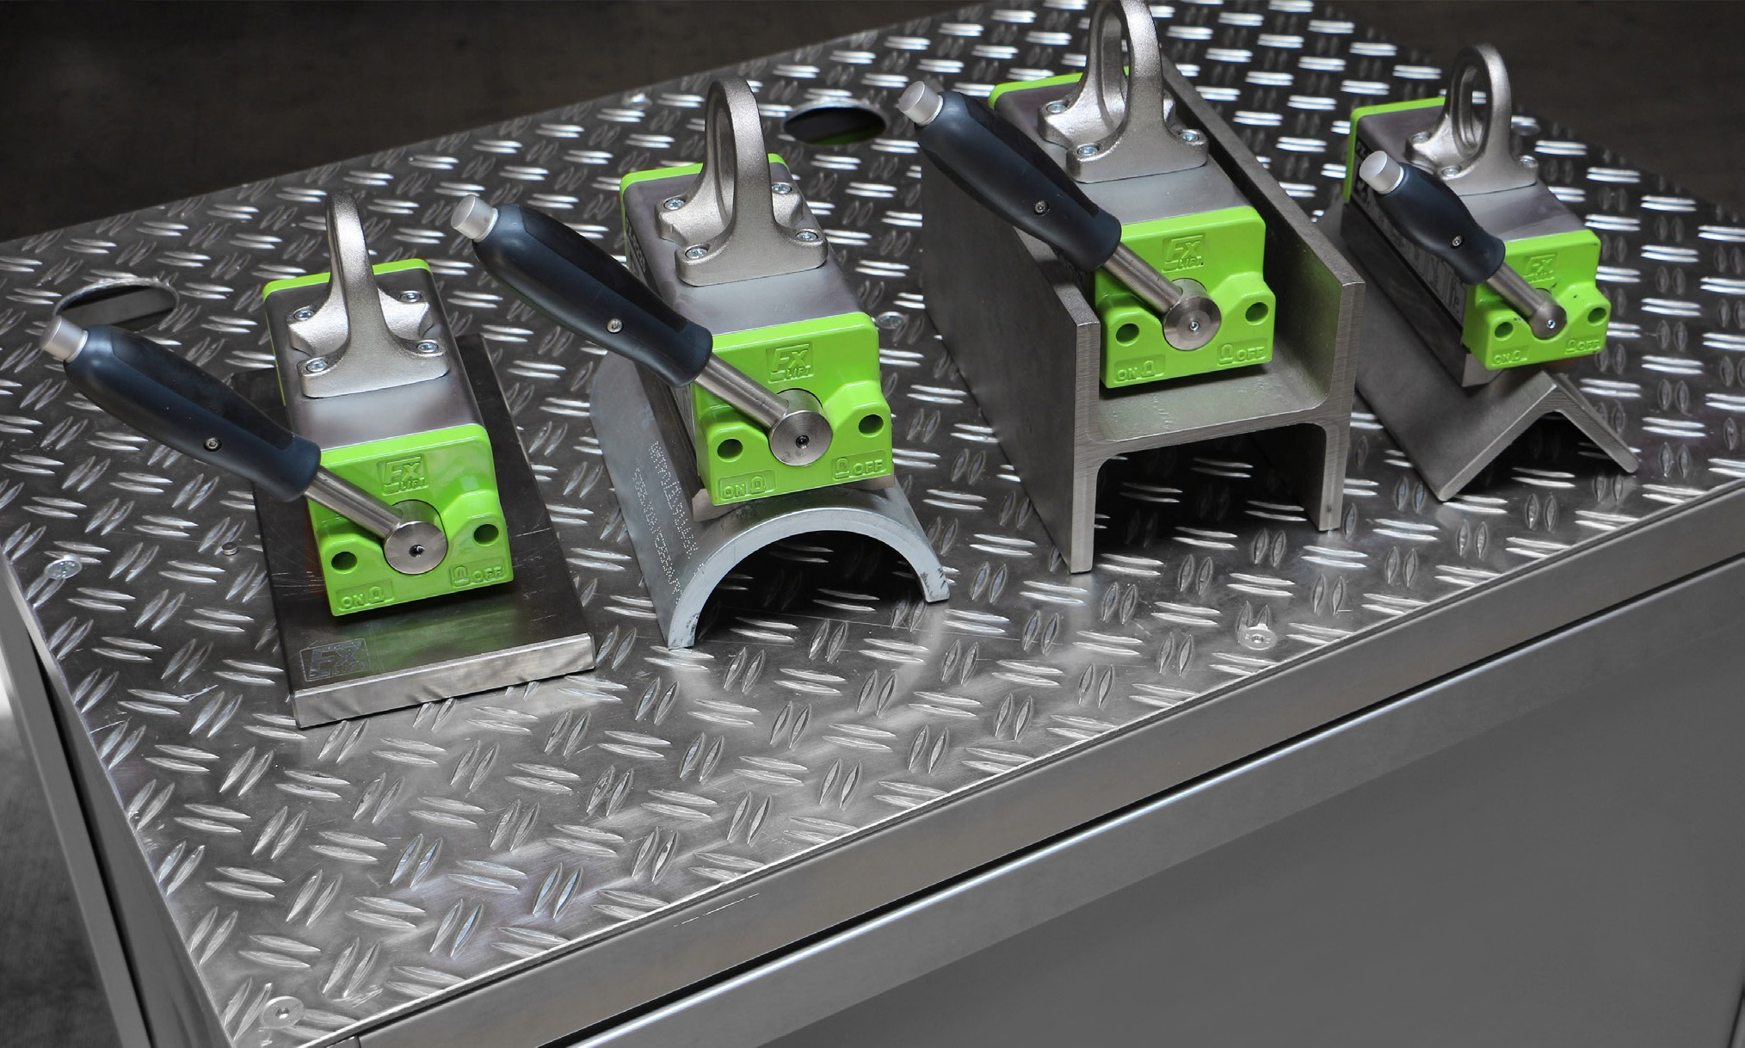
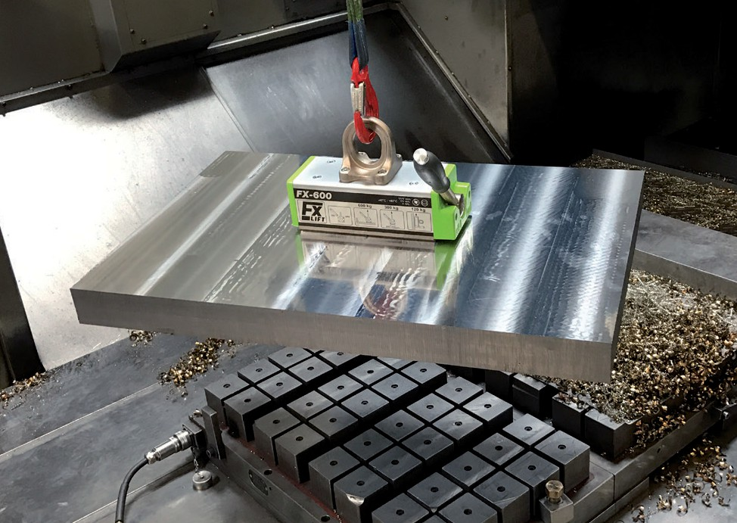
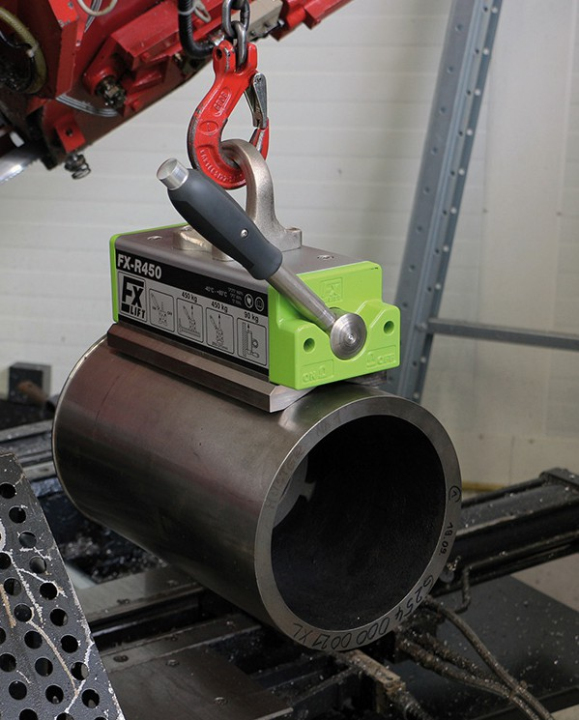
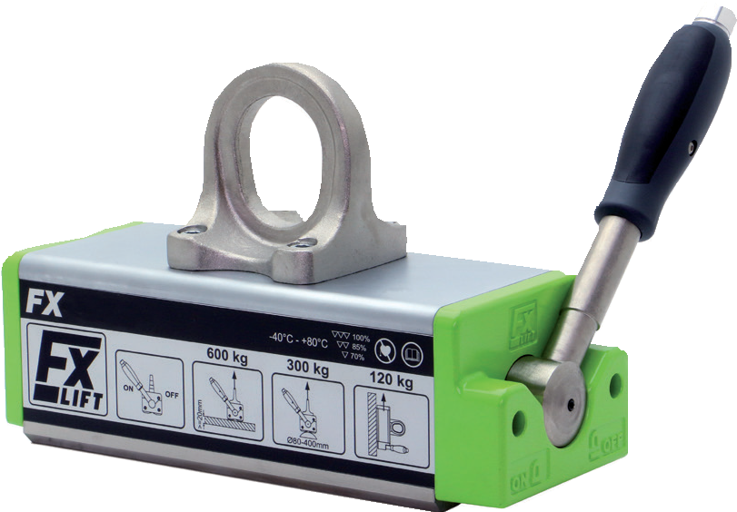
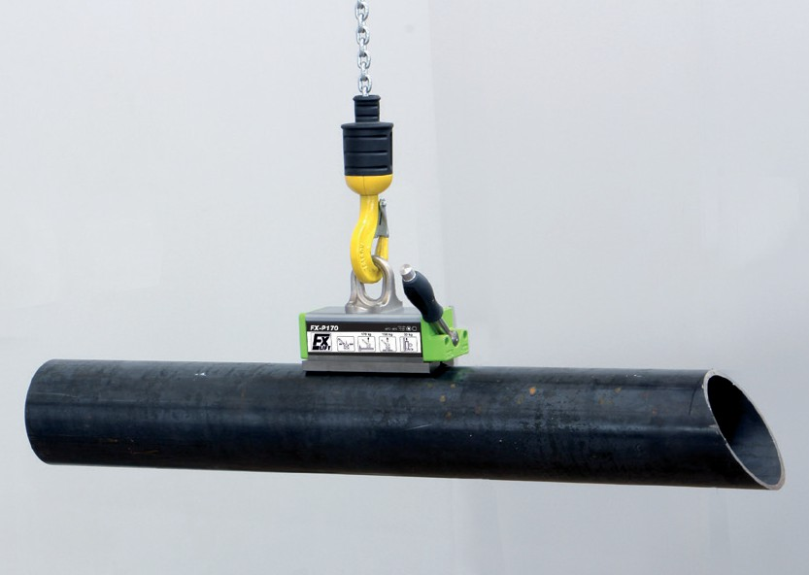
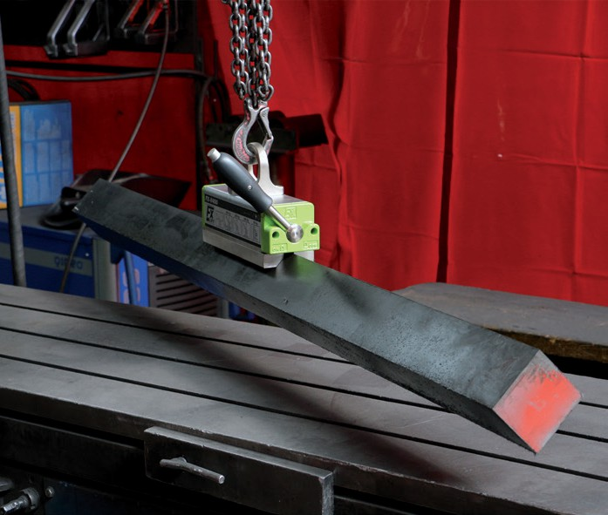
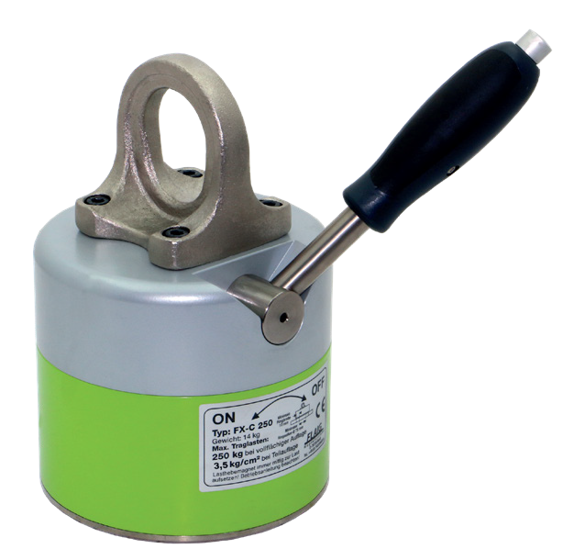
ON/OFF Permanent Lifting Magnets Designed for Your Lifting Application
FX Universal Flats & Rounds
FXR Mostly Rounds & Flats
FXP Thin Sheets & Pipe
FXV Beams, Angle Iron (90°) & Hot Parts
Keystone Assembly Solutions, LLC • www.keystoneassembly.com
401 West King Street, East Berlin, PA 17316 • Phone: 844-527-8665 • Email: solutions@keystoneassembly.com

Slide 2
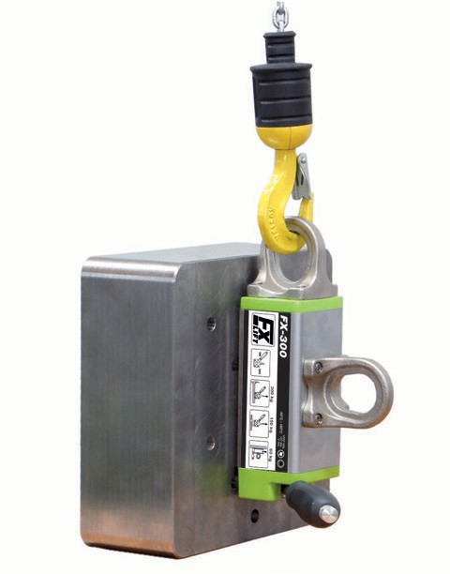
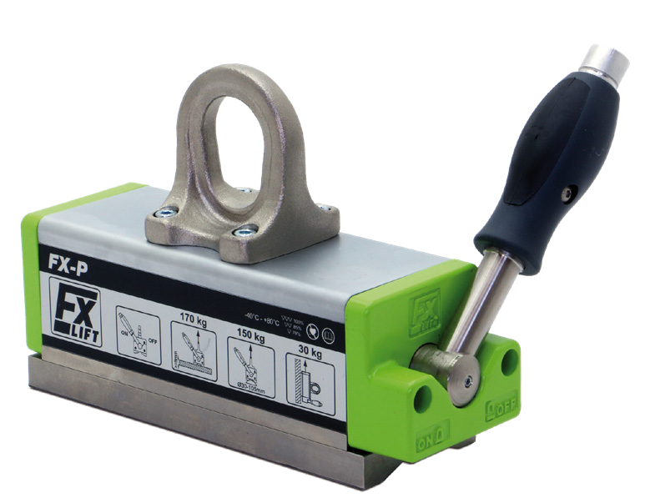
FX UNIVERSAL PERMANENT LIFTING MAGNETS for Flats and Round
The FX universal, On/Off permanent lift magnets are ideal for a variety of manufacturing applications where you’re mostly lifting flat material, but occasionally need to lift rounds.
Vertical Lift Lug
On/off, Rare-Earth Permanent Magnet
On/off handle only requires 90° rotation and locks at both on/off positions
Durable, recessed metal name plates, not stickers
Corrosion resistant, plated-magnet surface
Heat resistant up to 180°F (82°C)
3:1 Design Factor
2018 ASME B30.20 BTH-1 Design Category B, Service Class 3
Optional
WLL |  |  | Overall |  |  | Magnet |  | Handle |  | Bail
Model No. | LBS | KG | Height (in) | Length (in) | Height (in) | Width (in) | Length (in) | Length (in) | Thickness (in) | Height (in) | Width (in) | Weight (lbs)
FX0330 | 330 | 150 | 4.9 | 6.3 | 2.3 | 2.5 | 4.75 | 5.3 | 0.4 | 1.6 | 1 | 8
FX0660 | 660 | 300 | 6.2 | 8 | 3 | 3.4 | 6.2 | 7.5 | 0.5 | 2 | 1.6 | 19
FX1320 | 1320 | 600 | 7.4 | 11.3 | 3.7 | 4.4 | 9.4 | 9 | 0.6 | 2.4 | 2 | 42
FX2200 | 2200 | 1000 | 9.4 | 14.2 | 4.7 | 6 | 12 | 10.2 | 0.8 | 3 | 2.3 | 93
FX4400 | 4400 | 2000 | 12.3 | 18.5 | 6.6 | 9 | 15.7 | 16.1 | 1 | 3.5 | 2.6 | 254
FX6600 | 6600 | 3000 | 12.3 | 25.5 | 6.6 | 9 | 22.7 | 21 | 1 | 3.5 | 2.6 | 366
Working Load Limit (WLL) in lbs (kg) & *Max sheet Length Due To Sag For Material Thickness For Single Magnet Use |  |  |  |  |  |  |  | Round Lifting Applications |  |  | Vertical Part Flat
Model No. | 1/4 (6') | 3/8 (8') | 1/2 (8') | 3/4 (8') | 1 (10') | 2 (10') | 3 (10') | WLL RD | Min/Max Dia | Min Thk | WLL
FX0330 | 142 (65) | 330 (150) | 330 (150) | 330 (150) | 330 (150) | 330 (150) | 330 (150) | 165 (75) | 2 - 8 | 5/16 | 66 (30)
FX0660 | 355 (152) | 507 (230) | 580 (263) | 660 (300) | 660 (300) | 660 (300) | 660 (300) | 330 (150) | 2 - 12 | 1/2 | 132 (60)
FX1320 | 331(150) | 661 (300) | 965 (438) | 1320 (599) | 1320 (599) | 1320 (599) | 1320 (599) | 660 (300) | 4 - 16 | 5/8 | 264 (120)
FX2200 | NA | 772 (350) | 1160 (526) | 1984 (900) | 2200 (998) | 2200 (998) | 2200 (998) | 1100 (500) | 4 - 18 | 3/4 | 440 (200)
FX4400 | NA | NA | 965 (438) | 2200 (998) | 2646 (1200) | 4400 (1996) | 4400 (1996) | 2200 (998) | 6 - 24 | 1-1/2 | NA
FX6600 | NA | NA | NA | 3850 (1746) | 3968 (1800) | 6600 (2994) | 6600 (2994) | 3300 (1497) | 6 - 24 | 1-1/2 | NA
FXP PERMANENT LIFTING MAGNETS for Thin Sheets and Pipe
Ideal for thin sheets or parts, tanks/containers and thin-walled pipe that normally can’t be lifted with a permanent, On/Off magnet. The magnetic field on the FXP is concentrated and shallow to drive the strength into thin material.
On/off Rare Earth Permanent Magnet
On/off handle only requires 90° rotation and locks at both on/off positions
Recessed metal name plates, not stickers
Corrosion resistant, plated-magnet surface
Heat resistant up to 180°F (82°C)
3:1 Design Factor
2018 ASME B30.20 BTH-1 Design Category B, Service Class 3
 | WLL |  | Overall |  |  | Magnet |  | Handle |  | Bail
Model No. | LBS | KG | Height (in) | Length (in) | Height (in) | Width (in) | Length (in) | Length (in) | Thickness (in) | Height (in) | Width (in) | Weight (lbs)
FXP0375 | 375 | 170 | 5.3 | 7.7 | 2.7 | 2.5 | 6.8 | 5.3 | 0.4 | 1.6 | 1 | 12
FXP0725 | 725 | 330 | 6.7 | 10.4 | 3.5 | 3.4 | 9.4 | 7.5 | 0.5 | 2 | 1.6 | 28
FXP1450 | 1450 | 650 | 8 | 13.8 | 4.2 | 4.4 | 12.6 | 9 | 0.6 | 2.4 | 2 | 58
Working Load Limit (WLL) in lbs (kg) & *Max sheet Length Due To Sag For Material Thickness For Single Magnet Use |  |  |  |  |  |  |  | Round Lifting Applications
Model No. | 9 ga (6') | 3/16 (6') | 1/4 (6') | 3/8 (8') | 1/2 (8') | 3/4 (8') | 1 (10') | WLL RD | Min/Max Dia | Min Thk
FXP0375 | 176 (80) | 200 (91) | 265 (120) | 375 (170) | 375 (170) | 375 (170) | 375 (170) | 330 (150) | 1 - 4 | 5/16
FXP0725 | 220 (100) | 275 (125) | 353 (160) | 725 (329) | 725 (329) | 725 (329) | 725 (329) | 660 (300) | 2 - 6.5 | 1/2
FXP1450 | 353 (160) | 375 (170) | 441 (200) | 1060 (481) | 1125 (510) | 1450 (658) | 1450 (658) | 1210 (550) | 3 - 9 | 5/8
Keystone Assembly Solutions, LLC • www.keystoneassembly.com
401 West King Street, East Berlin, PA 17316 • Phone: 844-527-8665 • Email: solutions@keystoneassembly.com

Slide 3
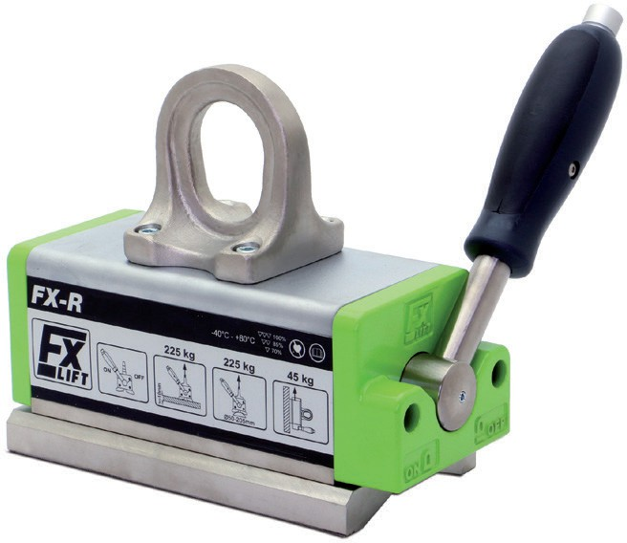
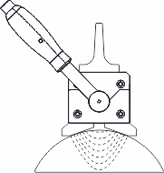
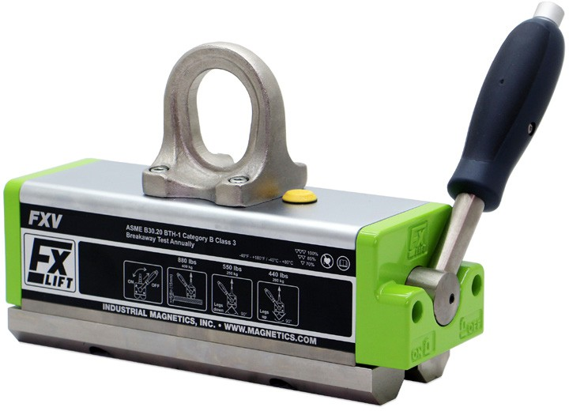
FXR PERMANENT LIFTING MAGNETS for Round Material
We recommend the FXR for when you’re mostly lifting round/curved surfaces such as shafts, thick walled pipe, or billet, but occasionally need to lift flat material. Specially designed pole shoes provide a deep penetrating magnetic field and part stability.
On/off, Rare-Earth Permanent Magnet
On/off handle only requires 90° rotation and locks at both on/off positions
Durable, recessed metal name plates, not stickers
Corrosion resistant, plated-magnet surface
Heat resistant up to 180°F (82°C)
3:1 Design Factor
2018 ASME B30.20 BTH-1 Design Category B, Service Class 3
WLL |  |  | Overall |  |  | Magnet |  | Handle |  | Bail
Model No. | LBS | KG | Height (in) | Length (in) | Height (in) | Width (in) | Length (in) | Length (in) | Thickness (in) | Height (in) | Width (in) | Weight (lbs)
FXR0220 | 220 | 100 | 5.2 | 6.3 | 2.7 | 2.7 | 5.4 | 5.3 | 0.4 | 1.6 | 1 | 9
FXR0500 | 500 | 225 | 6.7 | 8 | 3.5 | 3.8 | 7.2 | 7.5 | 0.5 | 2 | 1.6 | 21
FXR1000 | 1000 | 450 | 8.1 | 11.3 | 4.4 | 4.9 | 10.2 | 9 | 0.6 | 2.4 | 2 | 49
FXR1650 | 1650 | 750 | 10.3 | 14.2 | 5.6 | 6.7 | 13 | 10.2 | 0.8 | 3 | 2.3 | 108
FXR2650 | 2650 | 1200 | 13.1 | 18.5 | 7.5 | 9.7 | 18.2 | 16.1 | 1 | 3.5 | 2.6 | 280
FXR4000 | 4000 | 1800 | 13.1 | 25.5 | 7.5 | 9.7 | 24.1 | 21 | 1 | 3.5 | 2.6 | 402
Working Load Limit (WLL) in lbs (kg) & *Max sheet Length Due To Sag For Material Thickness For Single Magnet Use |  |  |  |  |  |  |  | Round Lifting Applications
Model No. | 1/4 (6') | 3/8 (8') | 1/2 (8') | 3/4 (8') | 1 (10') | 2 (10') | 3 (10') | WLL RD | Min/Max Dia | Min Thk
FXR0220 | 154 (70) | 220 (100) | 220 (100) | 220 (100) | 220 (100) | 220 (100) | 220 (100) | 220 (100) | 1 - 6 | 5/16
FXR0500 | 310 (141) | 500 (227) | 500 (227) | 500 (227) | 500 (227) | 500 (227) | 500 (227) | 500 (225) | 2 - 8 | 3/8
FXR1000 | 331 (150) | 661 (300) | 780 (354) | 1000 (454) | 1000 (454) | 1000 (454) | 1000 (454) | 1000 (450) | 2 - 11 | 3/4
FXR1650 | NA | 882 (400) | 1200 (544) | 1650 (748) | 1650 (748) | 1650 (748) | 1650 (748) | 1650 (750) | 3 - 15 | 3/4
FXR2650 | NA | 450 (204) | 900 (408) | 1764 (800) | 2205 (1000) | 2650 (1202) | 2650 (1202) | 2650 (1200) | 5 - 22 | 1-1/2
FXR4000 | NA | NA | 1250 (567) | 2646 (1200) | 3307 (1500) | 4000 (1814) | 4000 (1814) | 4000 (1800) | 5 - 22 | 1-1/2
FXV PERMANENT LIFTING MAGNETS for Beams, Angle Iron (90°) and Hot Parts
The FXV On/Off permanent lift magnets are ideal for handling 90° shapes like angle iron, square tubing, and hot parts. Also works extremely well for inside webbing of
I-beams where you need higher handle rotation. The on/off handle only requires 90° rotation and locks at both on/off positions. Durable construction with recessed metal name plates and corrosion-resistant plated magnet surface. Features a 3:1 design factor and meets 2018 ASME B30.20 BTH-1 Design Category B, Service Class 3.
Hot part Handling: contact time and cooling times
302°F (150°C) = 100%
392°F (200°C) = 50%, Max. 4 minutes contact, 4 minutes cooling time 482°F (250°C) = 33%, Max. 4 minutes contact, 8 minutes cooling time (Note: WLL reduces as temperature raises)
 | WLL |  | Overall |  |  | Magnet |  | Handle |  | Bail
Model No. | LBS | KG | Height (in) | Length (in) | Height (in) | Width (in) | Length (in) | Length (in) | Thickness (in) | Height (in) | Width (in) | Weight (lbs)
FXV0440 | 440 | 220 | 5.5 | 7.7 | 3 | 2.5 | 6.8 | 5.3 | 0.4 | 1.6 | 1 | 12
FXV0880 | 880 | 440 | 6.9 | 10.4 | 3.8 | 3.4 | 9.4 | 7.5 | 0.5 | 2 | 1.6 | 29
FXV1775 | 1775 | 800 | 8.3 | 13.5 | 4.5 | 4.4 | 12.6 | 9 | 0.6 | 2.4 | 2 | 62
FLAT SURFACES |  |  |  |  |  |  |  | ANGLE IRON LEGS DOWN (˄) ANGLE LEGS UP (˅)
Working Load Limit (WLL) in lbs (kg) & *Max sheet Length Due To Sag For Material Thickness For Single Magnet Use |  |  |  |  |  |  | ˄ | ˅ | ˄ | ˅ | ˄ | ˅ | ˄ | ˅ | ˄ | ˅
Model No. | 1/4 (6') | 3/8 (8') | 1/2 (8') | 3/4 (8') | 1 (10') | Model No. | 1/4 (6') | 1/4 (6') | 3/8 (8') | 3/8 (8') | 1/2 (8') | 1/2 (8') | 3/4 (8') | 3/4 (8') | 1 (14') | 1 (14')
FXV0440 | 270 (125) | 415 (190) | 440 (200) | 440 (200) | 440 (200) | FXV0440 | 260 (120) | 100 (50) | 260 (120) | 175 (80) | 260 (120) | 220 (100) | 260 (120) | 220 (100) | 260 (120) | 220 (100)
FXV0880 | 440 (200) | 695 (320) | 810 (370) | 880 (400) | 880 (400) | FXV0880 | 440 (200) | 270 (125) | 495 (225) | 275 (125) | 550 (250) | 385 (175) | 550 (250) | 440 (200) | 550 (250) | 440 (200)
FXV1775 | 440 (200) | 935 (450) | 1150 (550) | 1775 (800) | 1775 (800) | FXV1775 | 485 (220) | 300 (140) | 650 (300) | 325 (150) | 815 (375) | 500 (230) | 870 (400) | 650 (300) | 870 (400) | 650 (300)
Keystone Assembly Solutions, LLC • www.keystoneassembly.com
401 West King Street, East Berlin, PA 17316 • Phone: 844-527-8665 • Email: solutions@keystoneassembly.com

Slide 4
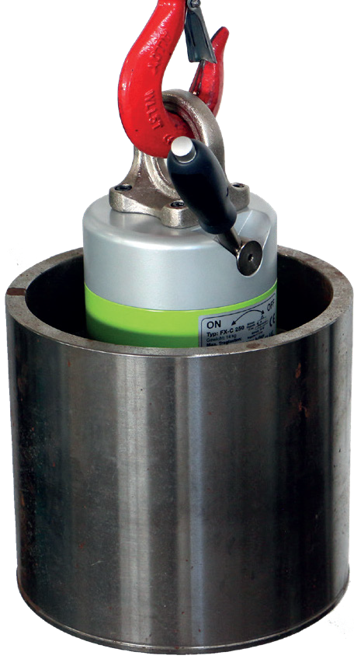
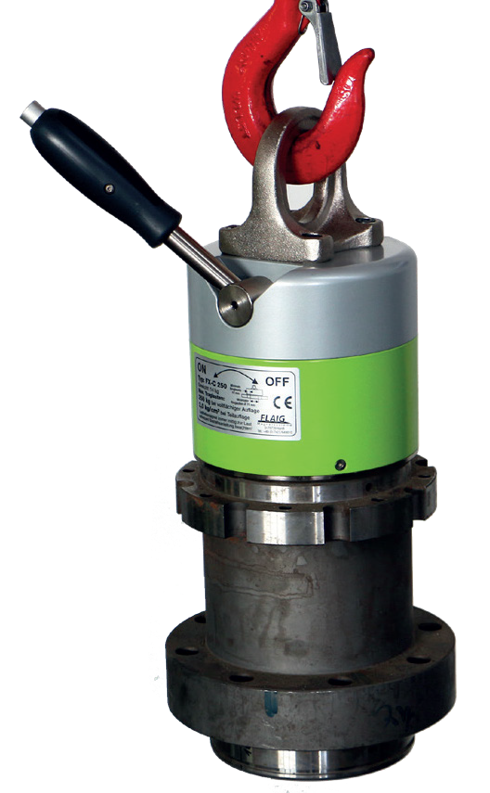
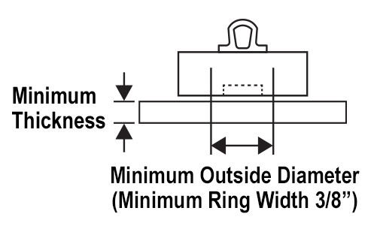
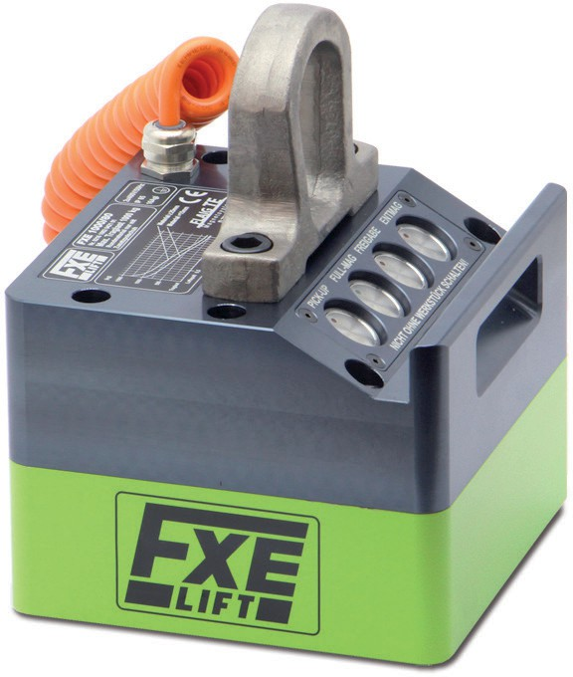
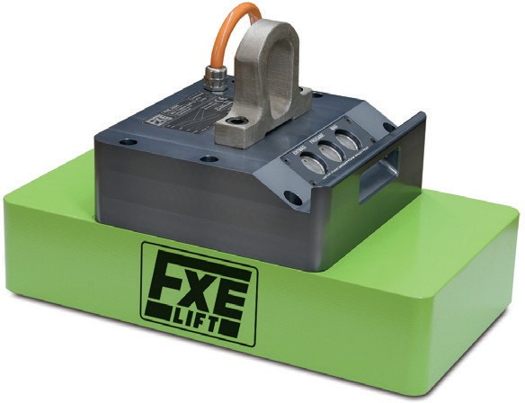
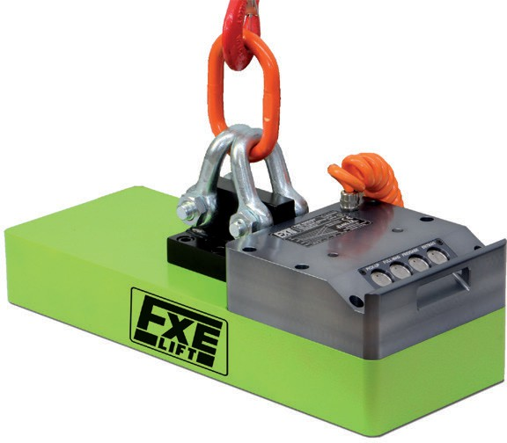
FXC PERMANENT LIFTING MAGNETS for Flat, Circular Parts
The FXC lift magnets have a round, multi-pole magnetic field designed for lifting flat, circular-shaped parts such as rings, sleeves, bearing housings, flange plates and end of billet/pipe/shaft pieces. The on/off handle only requires 90° rotation and locks at both on/off positions. Durable construction with metal name plates and corrosion-resistant plated magnet surface. Features a 3:1 design factor and meets 2018 ASME B30.20 BTH-1 Design Category B, Service Class 3.
Minimum Outside Diameter
(Minimum Ring Width 3/8”)
Bottom View of
N
Magnet
S
S
Depth
N
 | WLL | WLL | WLL | Overall |  | Depth | Magnet |  | Handle |  | Bail
Model No. | LBS KG | Min Thk (in) | Min Dia (in) | Height (in) | Diameter (in) | Height (in) | Height (in) | Diameter (in) | Length (in) | Thickness (in) | Height (in) | Width (in) | Weight (lbs)
FXC0385 | 385 175 | 0.39 | 2.4 | 8.3 | 4.7 | 5 | 5.1 | 4.5 | 7.5 | 0.5 | 2 | 1.6 | 17
FXC0550 | 550 250 | 0.47 | 3.3 | 9.5 | 6.3 | 5.8 | 5.7 | 6 | 7.5 | 0.6 | 2.4 | 2 | 33
FXC0990 | 990 450 | 0.59 | 4.7 | 11.2 | 9.4 | 6.5 | 6.1 | 9.3 | 9 | 0.8 | 3 | 2.3 | 77
FXE PERMANENT LIFTING MAGNETS Electronically Controlled
Smooth Surfaces, Cutting Tables
Flame Cut, Hot Rolled Ship Yards
Rough Surfaces, Casting, Forging, Slabs
Making Things Better ®
401 West King Street, East Berlin, PA 17316
www.keystoneassembly.com
Phone: 844-527-8665
Made in Germany
MGFXLift (01/25)

