Slide 1
Registering and filing IRS Form 990 e-Postcard
Note: This presentation was initially prepared in mid-August 2017. The IRS changes some of the screens every year.
I updated as much as I could on 9 Aug 21. Since I had already entered my information for the year, I could
only go as far as slide 41 (in Part 3). The remaining slides should be close enough for you to complete the process.
Please notify me if you find something substantially different, so I can update again.
PDG Rick Dodson
dodsonr23@gmail.com

Slide 2
Part 1.
Initial Registration for e-Postcard

Slide 3
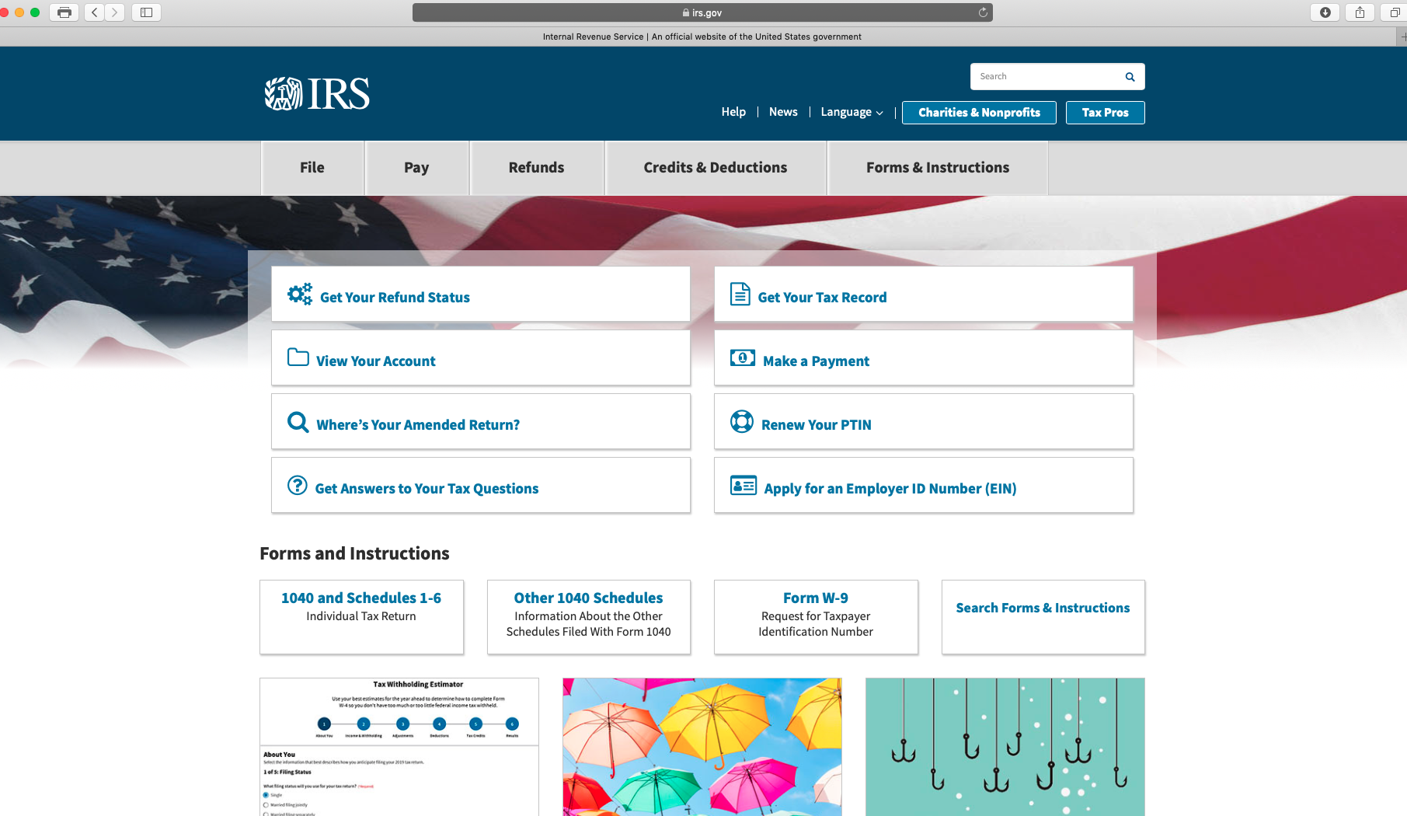
1. Go to “irs.gov”
2. Click

Slide 4
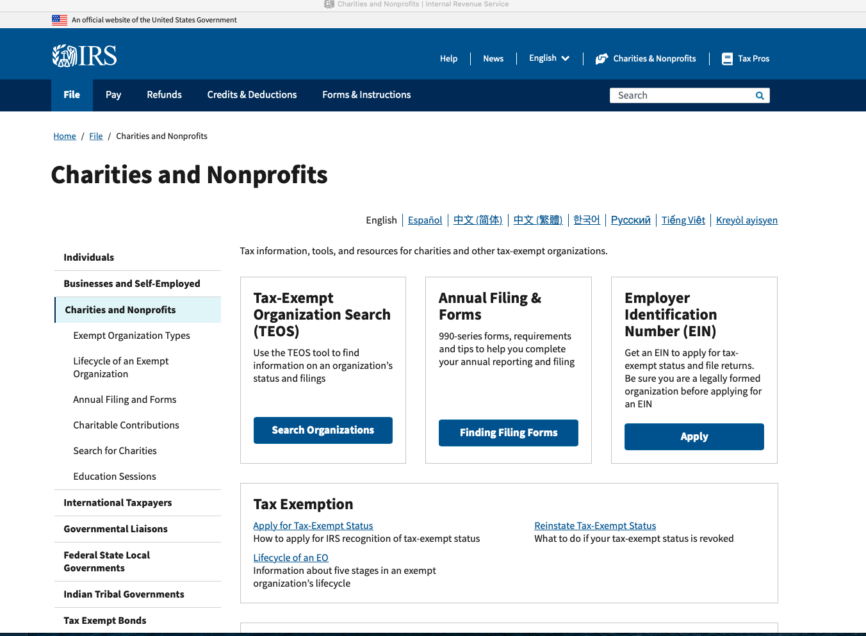
Click

Slide 5
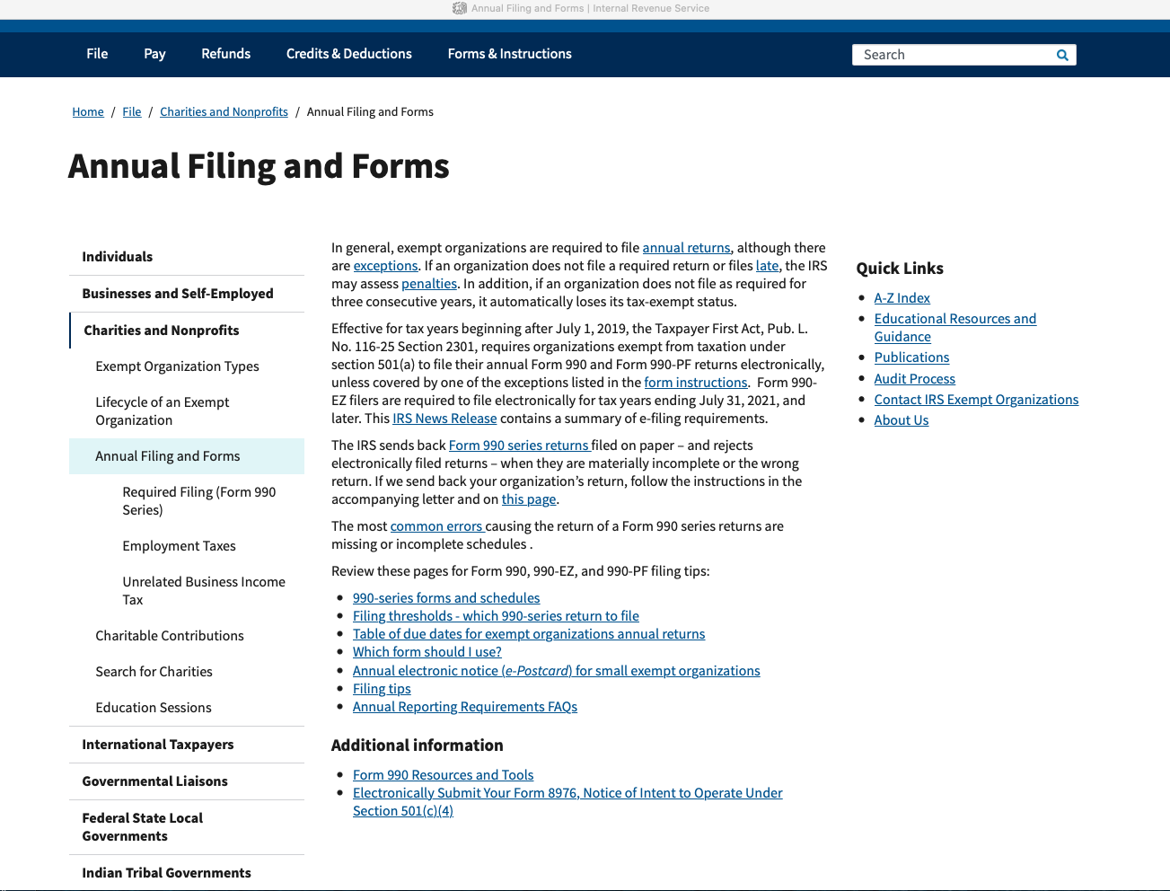
Click.
Important: Read about the penalties.
Then, click.

Slide 6
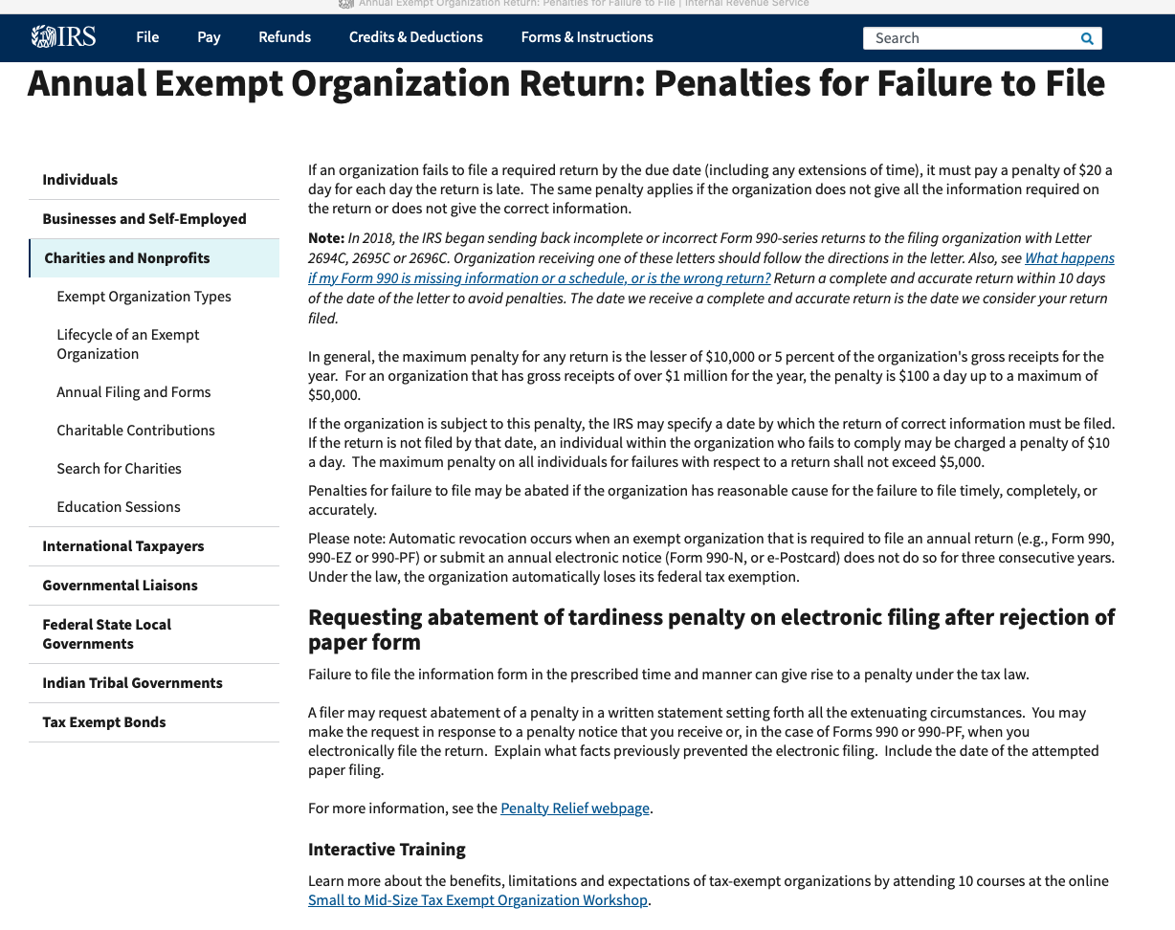
Read this, then return to previous screen.

Slide 7
Then, click.

Slide 8
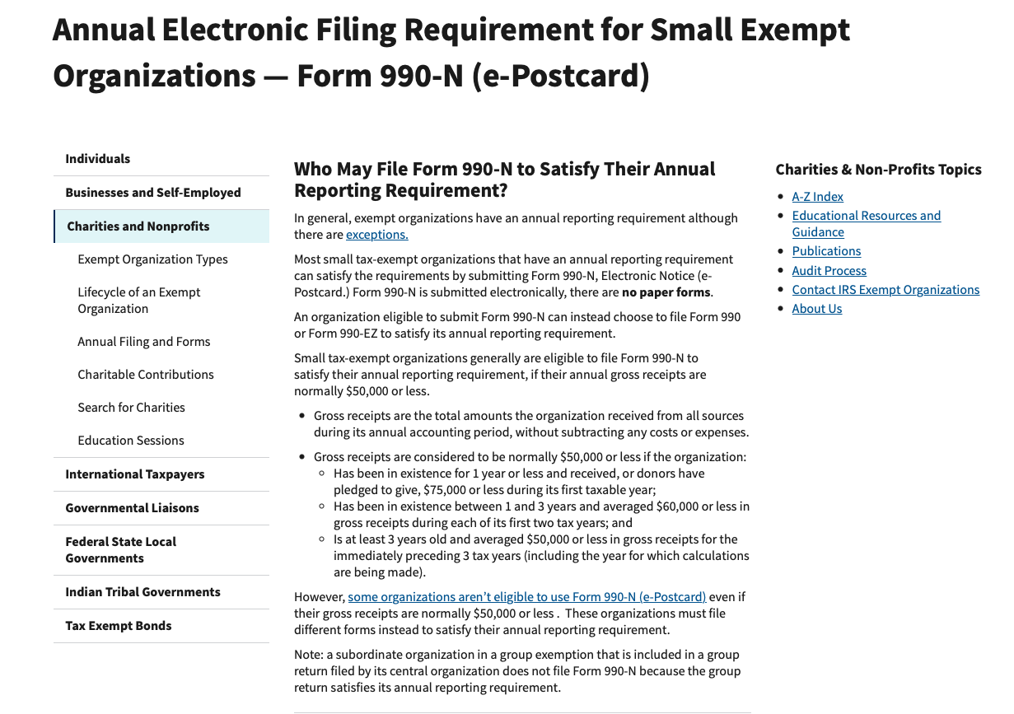
This slide and the next one are the same page on the screen. Split here for ease of reading.

Slide 9
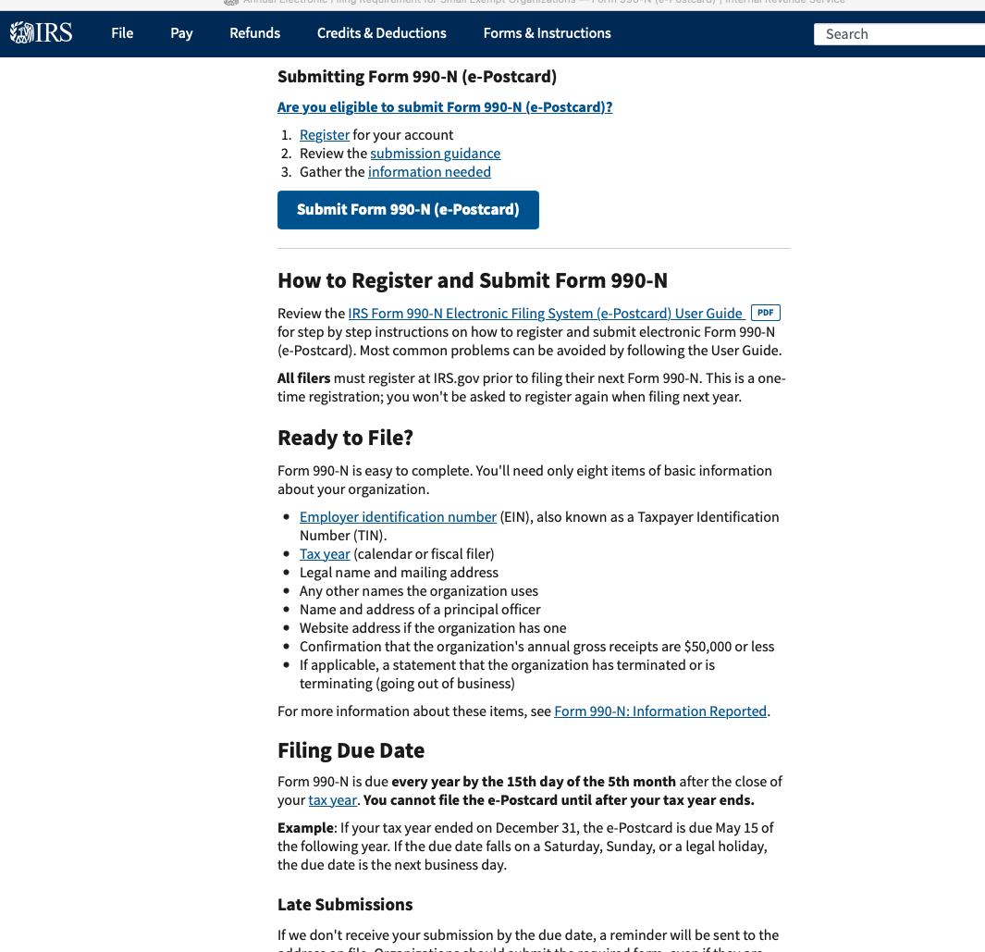
Click

Slide 10
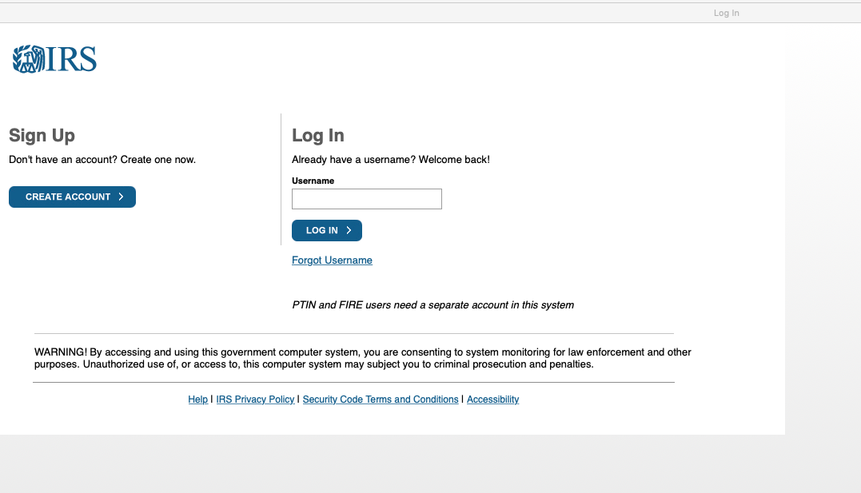
When initially registering and setting up your profile, click here.
In future years, when you get to this screen and you’ve already registered, enter your username and click here. Go to Part 3 of this slideshow for remaining instructions.

Slide 11
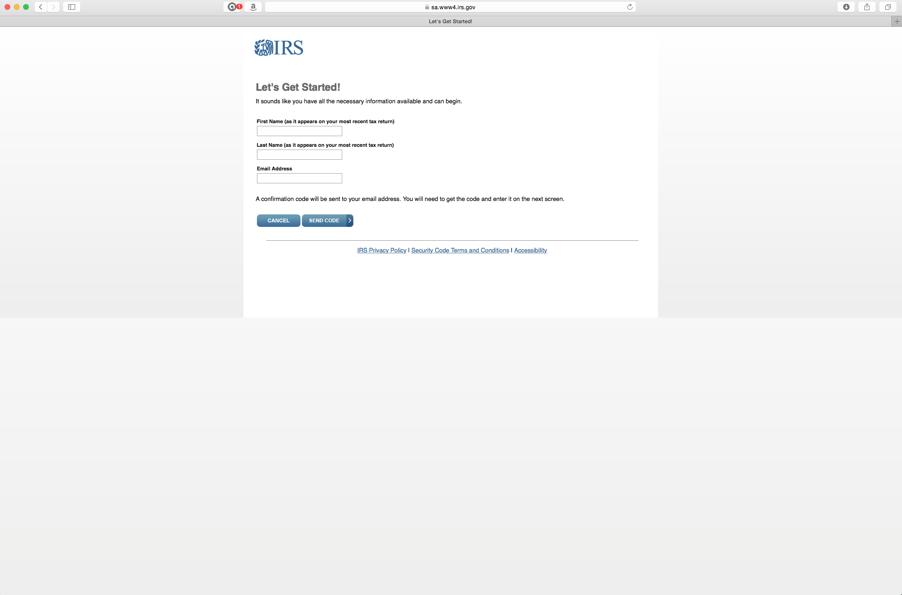
Put your first name, last name, email address.

Slide 12
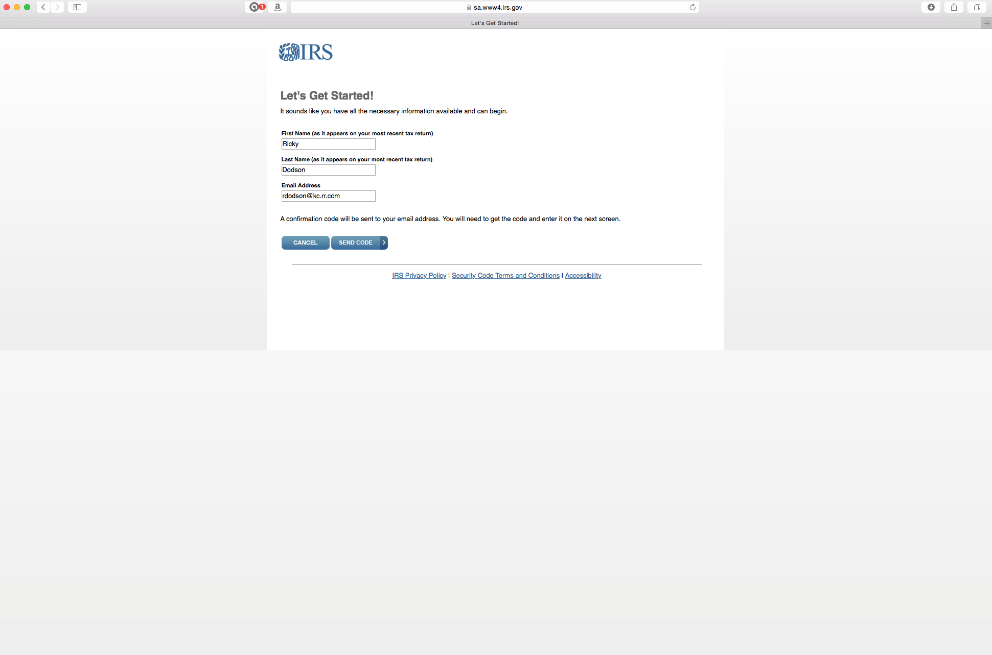
Then click “send code” to receive from IRS a code to continue the registration process. In the future, a new Secretary or Treasurer may have to change the profile to put in their name or keep using the name of the person who initially registered.
IMPORTANT: Make sure you write down and save the information to pass to the next Treasurer. That person can change it after they enter the first time.

Slide 13
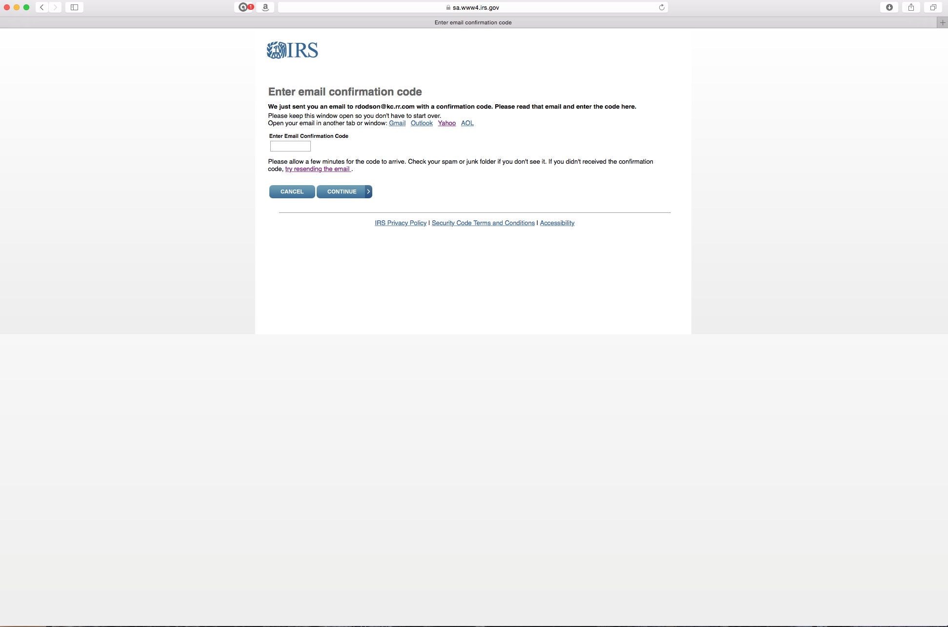
See the next slide for an example of the email from IRS with the code to put here.

Slide 14
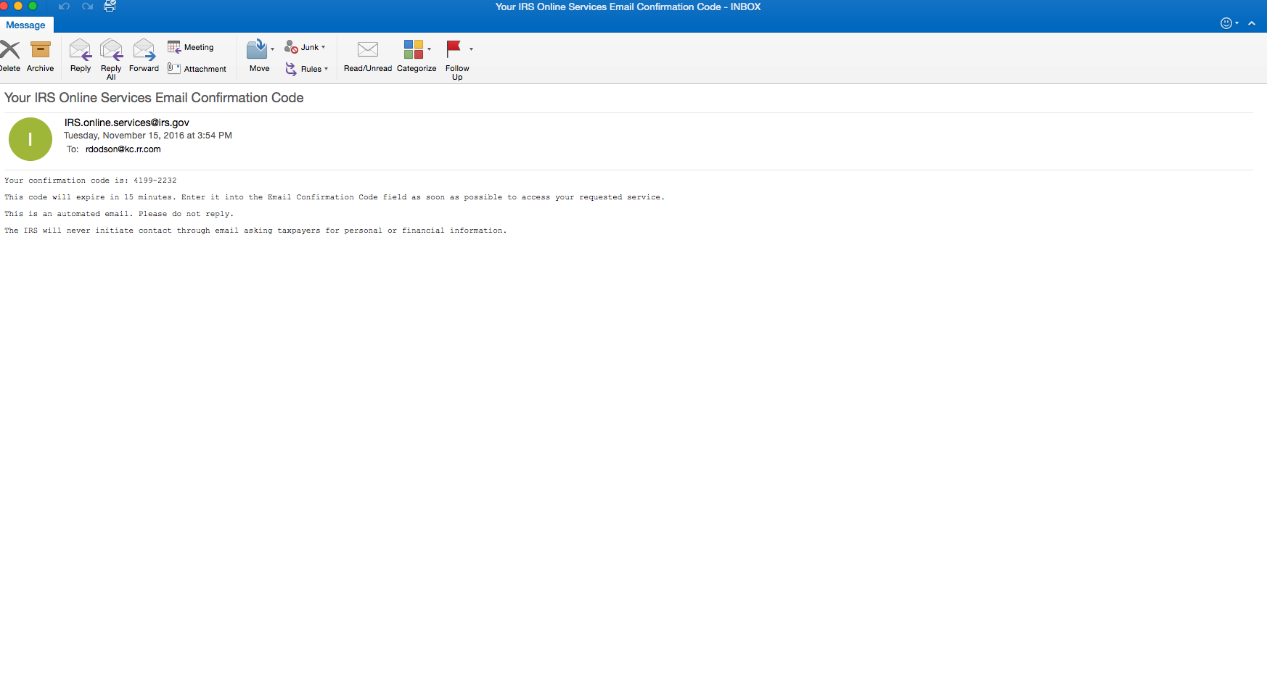
Note that the code is only good for 15 minutes. If you can’t complete the process, you may have to save and/or start over later.

Slide 15
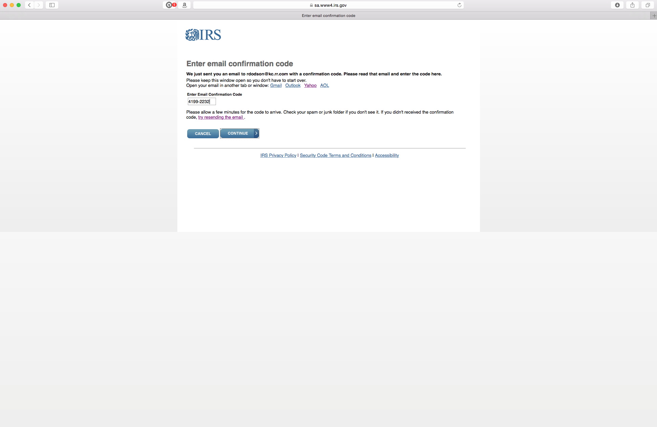
Click

Slide 16
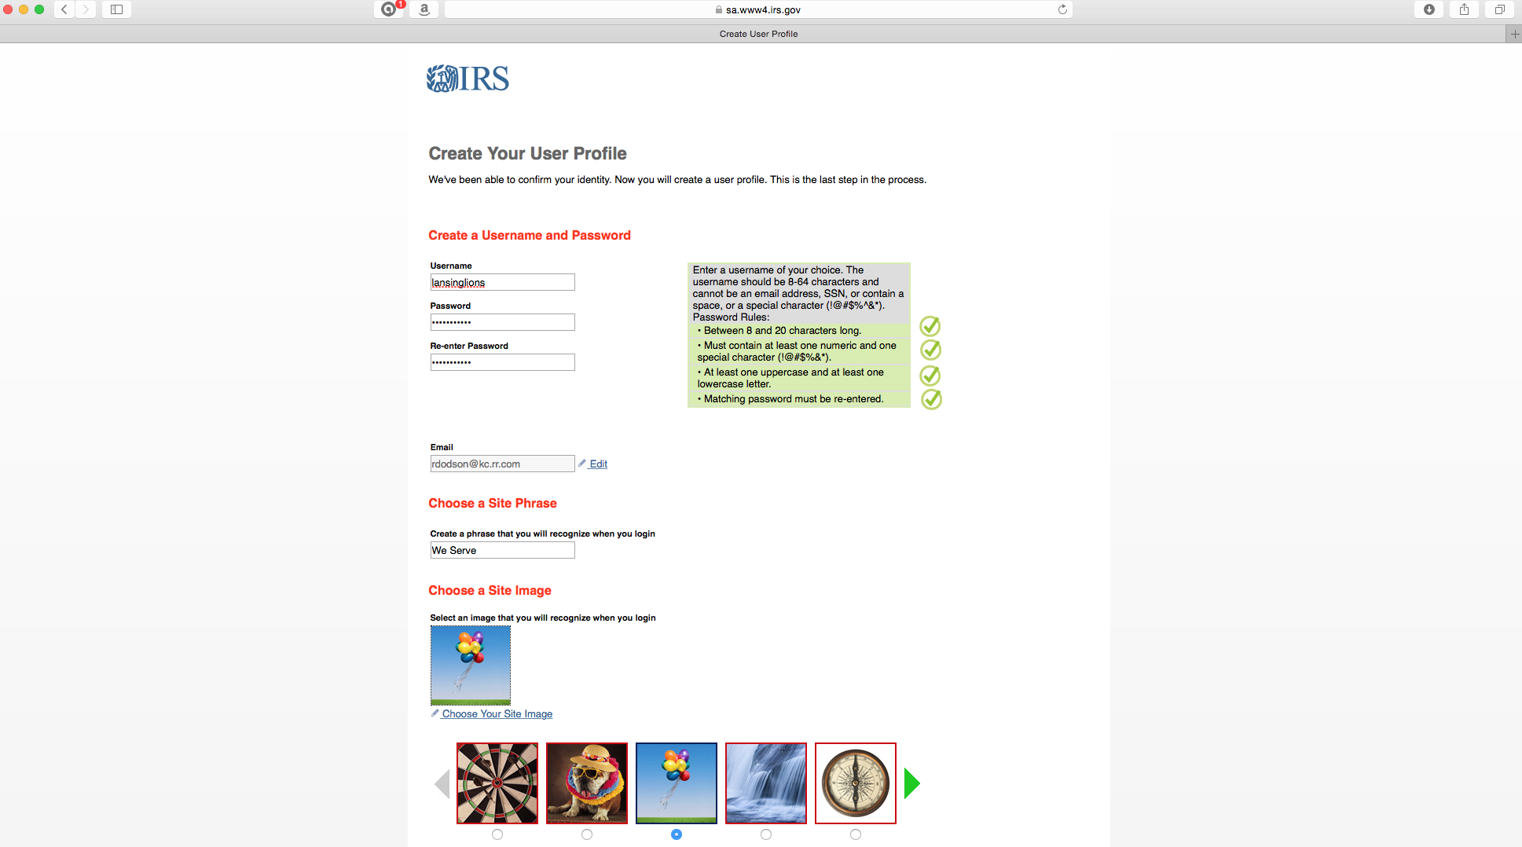
This is where you start creating your profile that will be used to permit you to sign in in the future and to establish some security measures. The following slide is the continuation of the page on the screen.
IMPORTANT: Make sure you write down and save all of these profile entries and pass them along to the future Secretary and/or Treasurer. If you lose/forget them, you won’t be able to sign in and complete the form in the future.

Slide 17
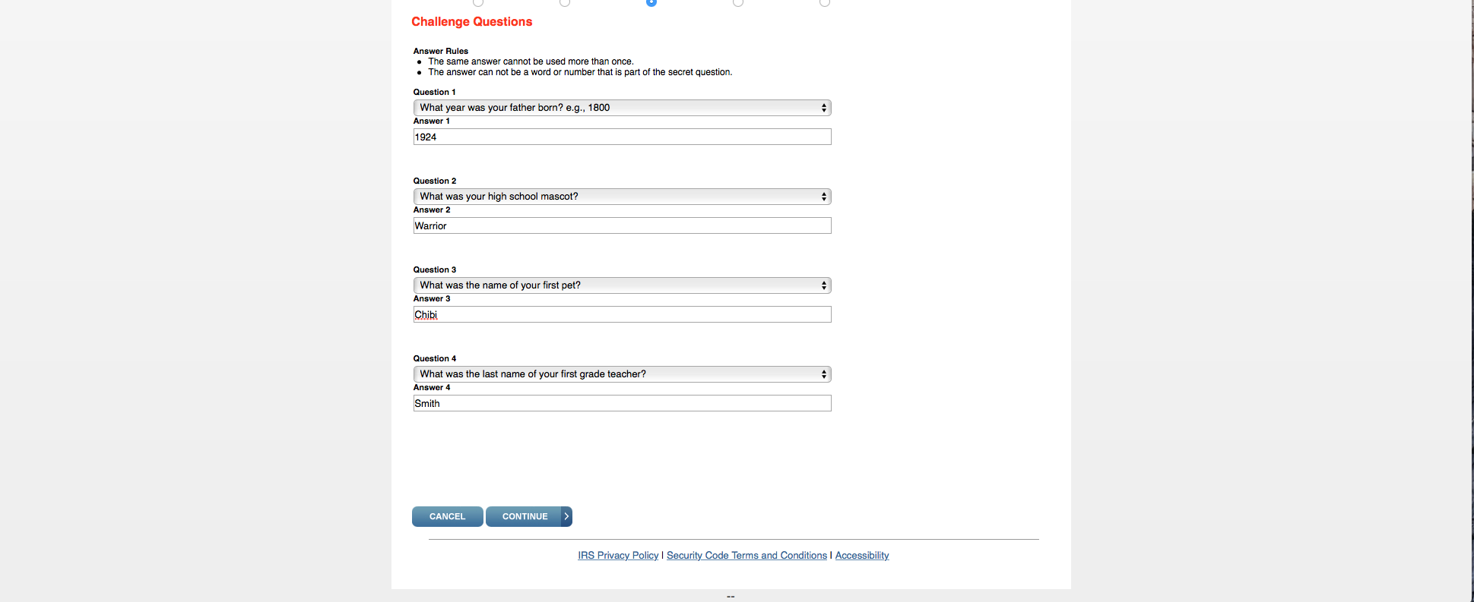
Click

Slide 18
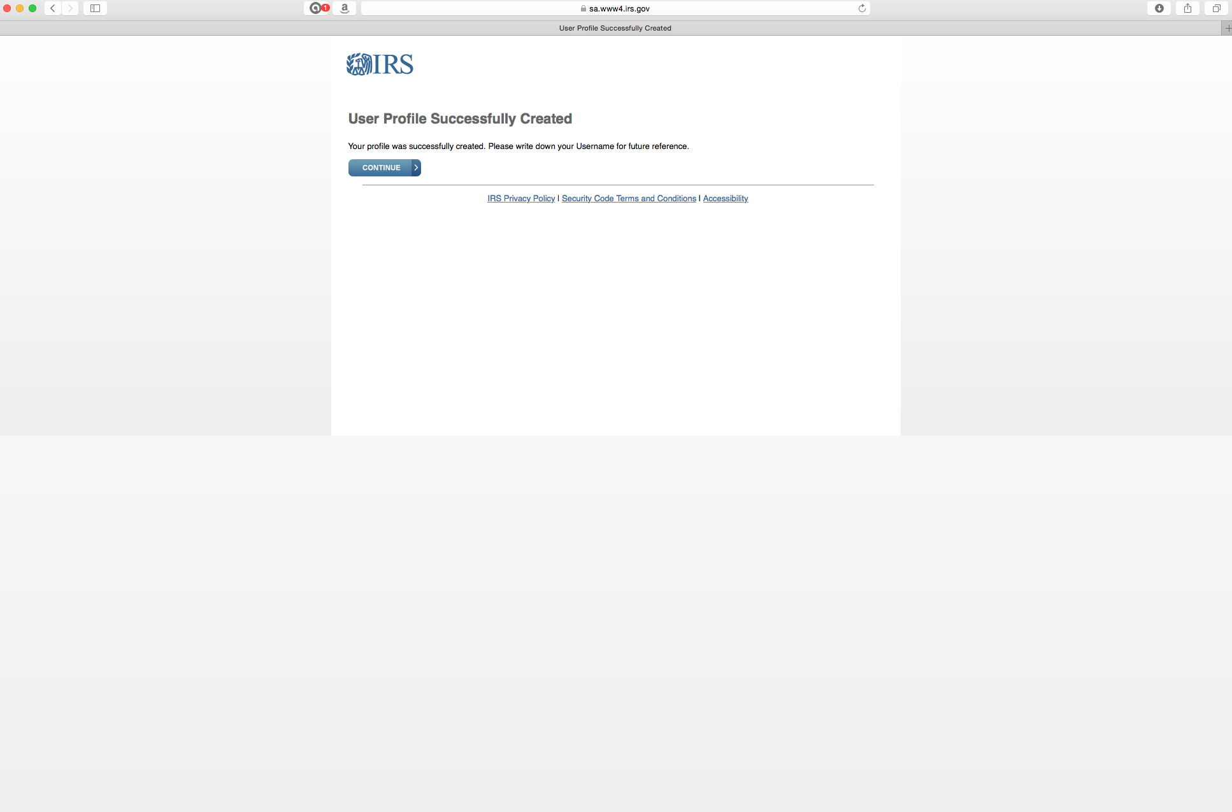
You’re done unless you want to go ahead and complete your current year’s submission.
If you want to do the first submission, the following slides show you how.
Click “continue” to create your first submission.

Slide 19
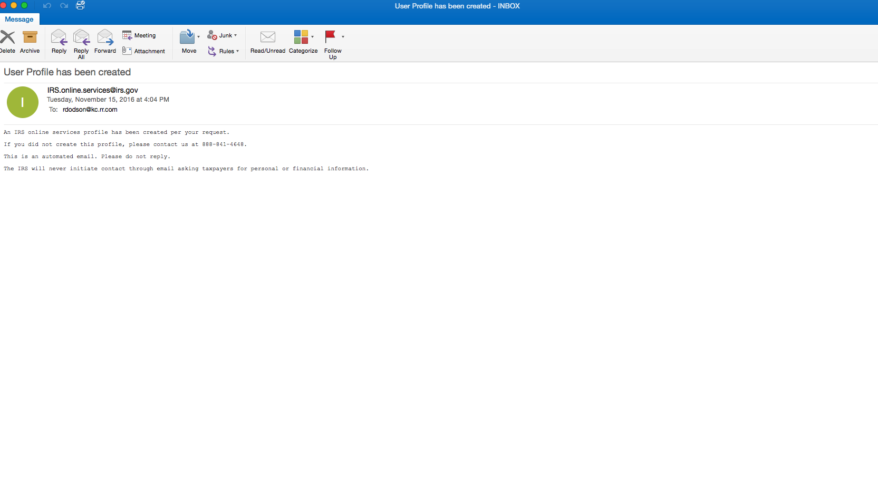
At some point after you complete the profile security questions and click “continue”,
you’ll get this email confirmation.

Slide 20
Part 2.
Submitting Your First Annual e-Postcard
When Initially Registering and
Creating Your Profile

Slide 21
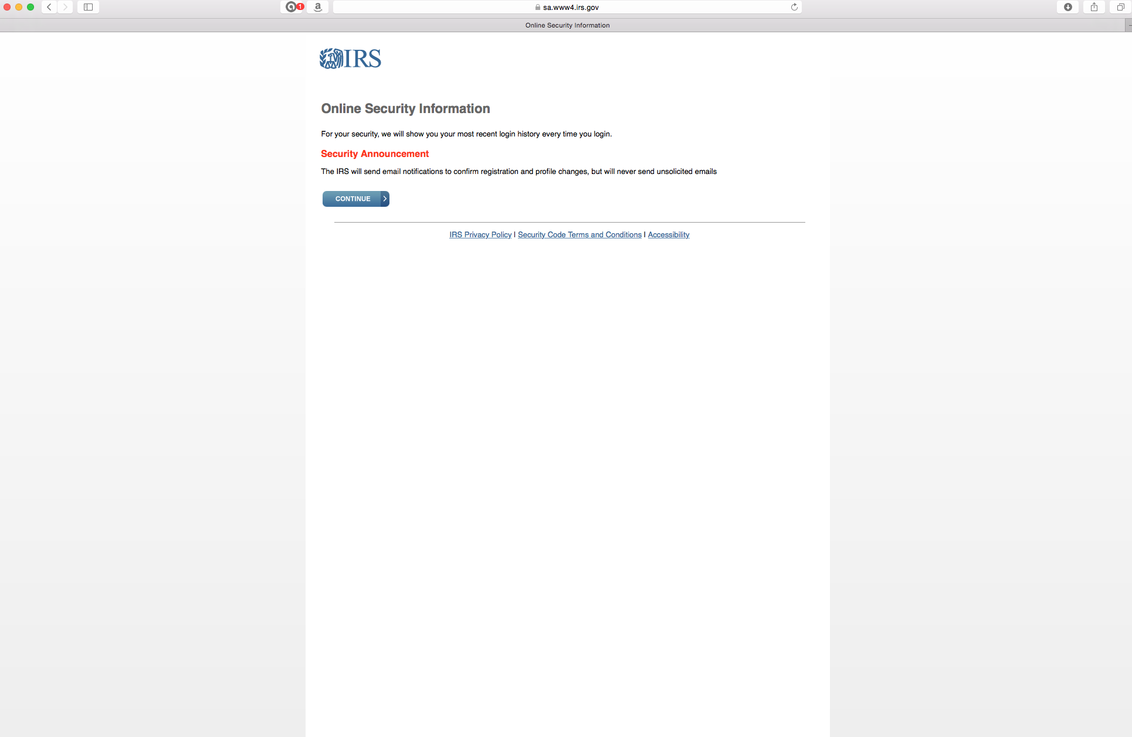
No input required here. Click “continue”.

Slide 22
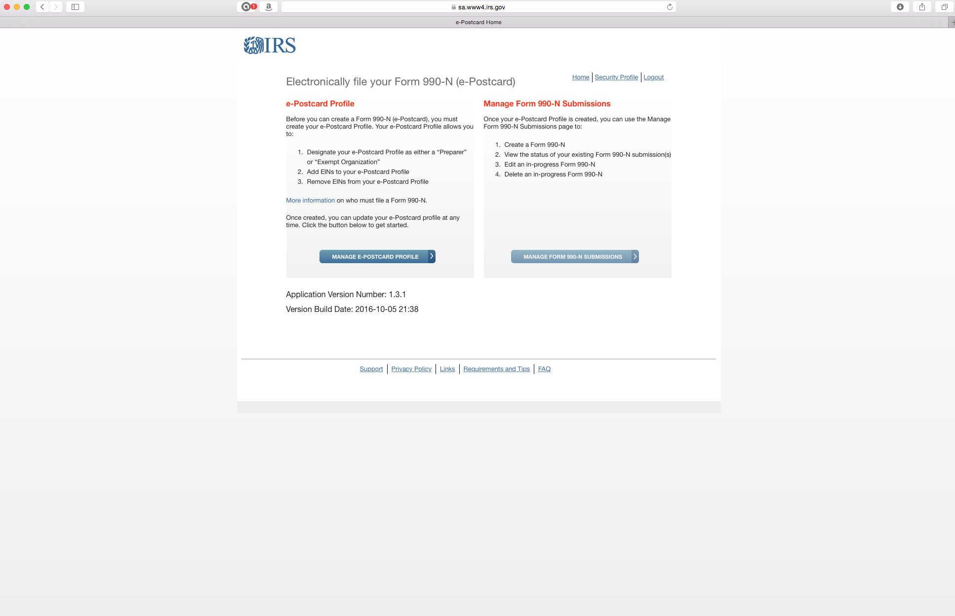
Click here to start your first submission.
In future years, you will not enter through this screen. Go back to slide 10 to see where you enter when you’ve already registered.

Slide 23
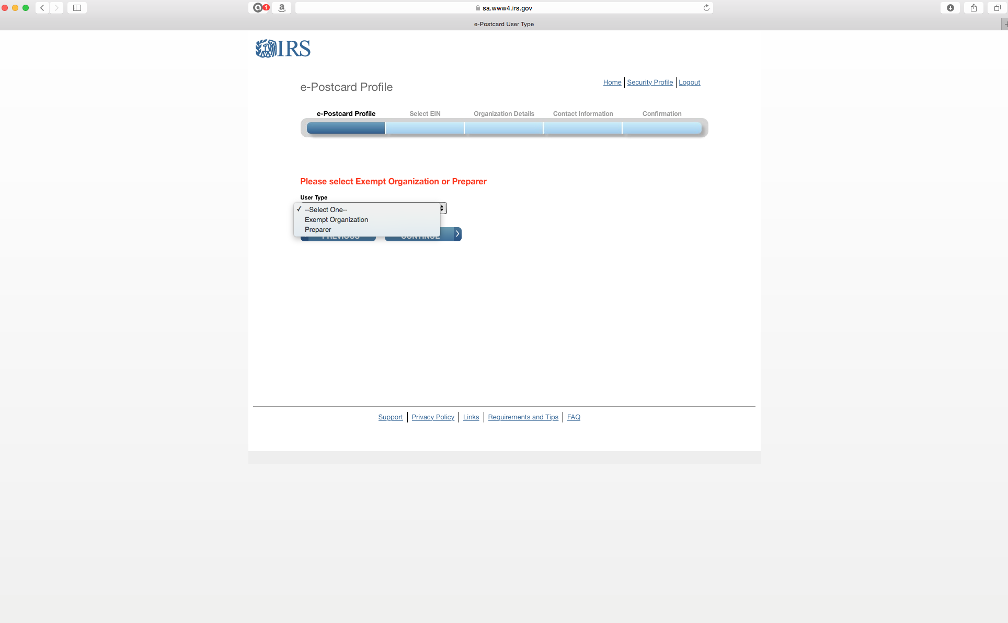
Click “Preparer”.

Slide 24
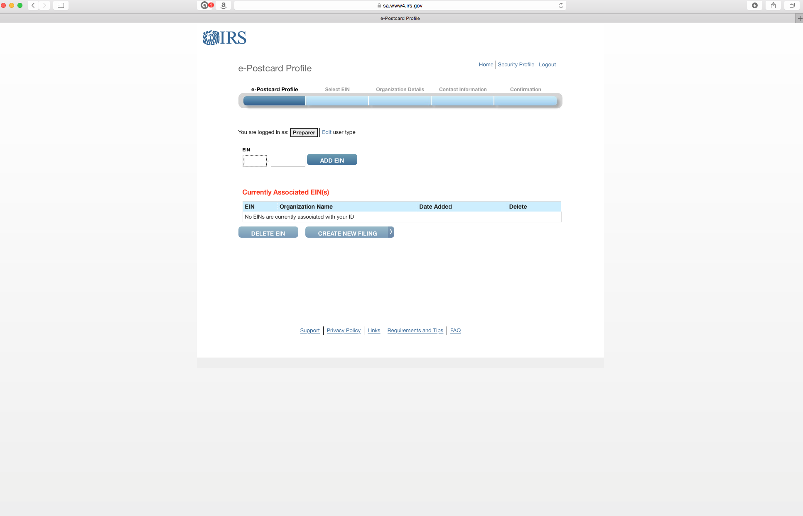
The first time you do this, enter your EIN and click “Add EIN”.

Slide 25
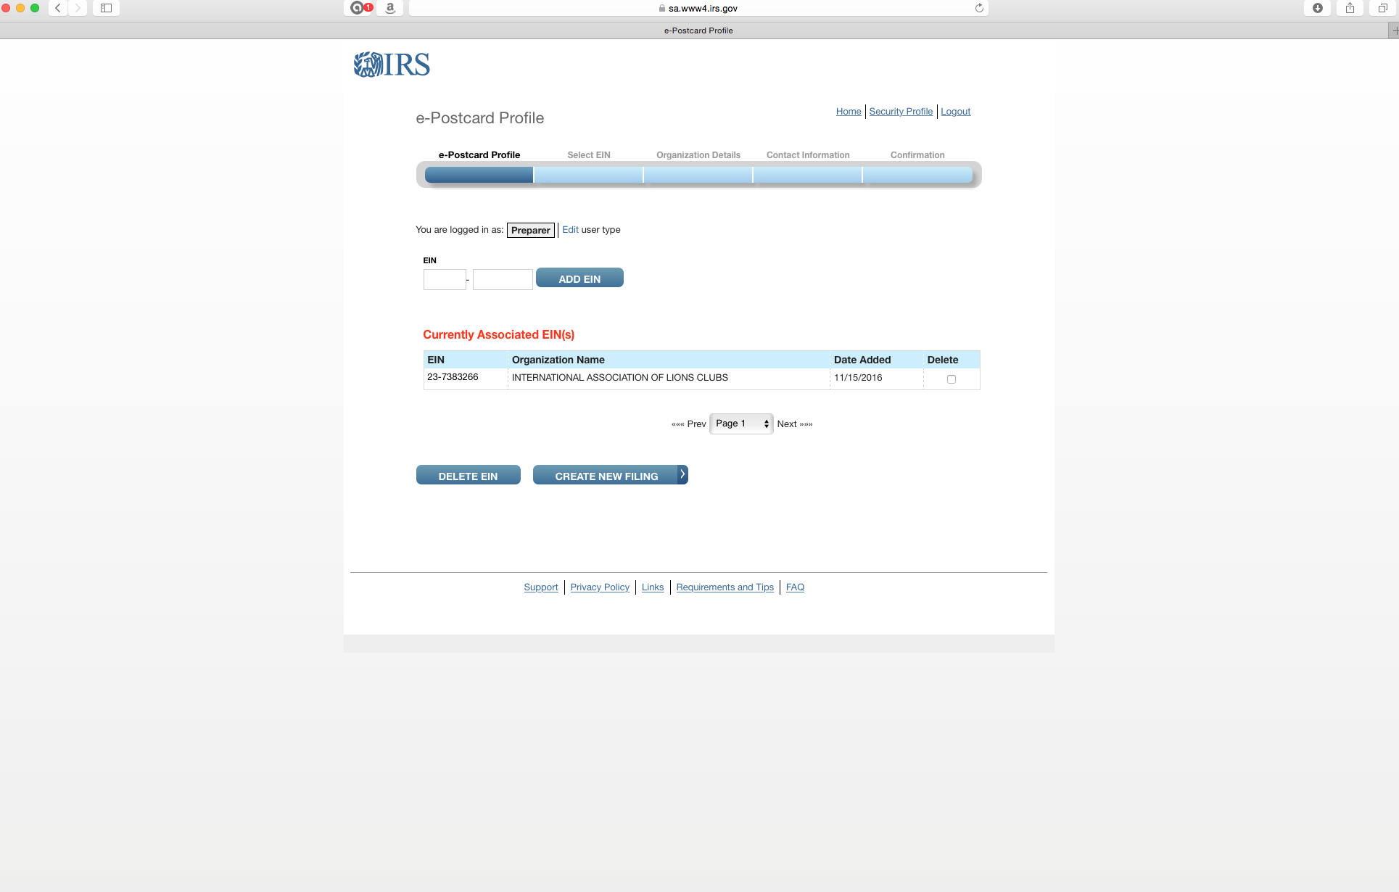
1. Now your EIN will be shown as associated with this profile. Note that all of our clubs’ EINs are shown with LCI’s name. You’ll be able to customize this in the profile later.
2. Click “Create New Filing”.

Slide 26
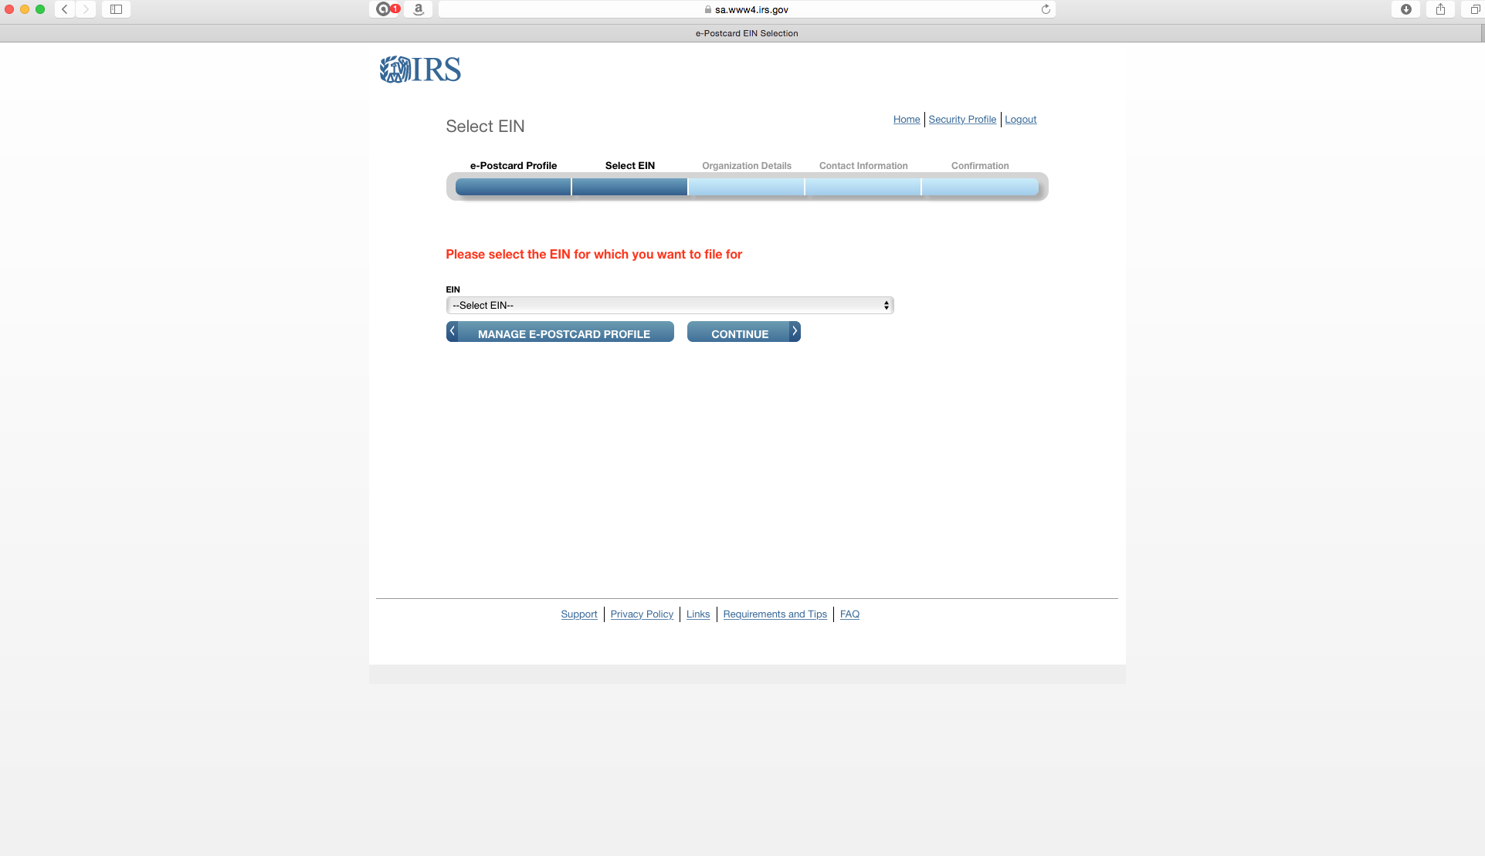
Click on the drop down menu.

Slide 27
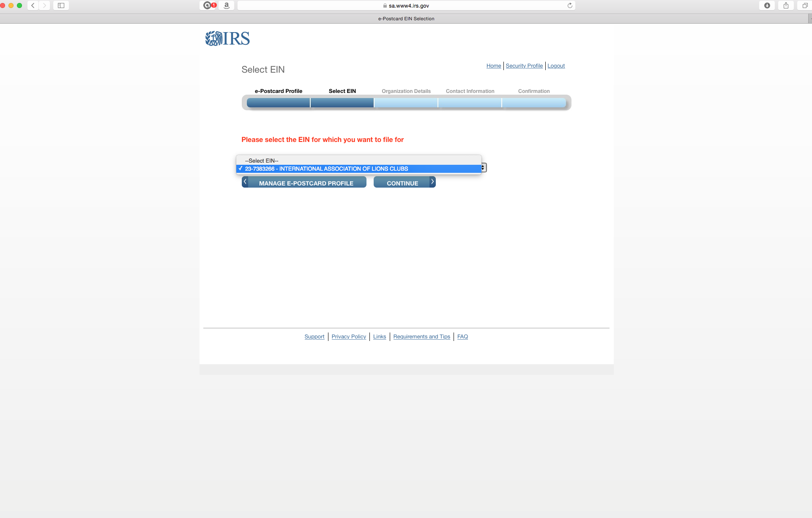
Your EIN should appear.

Slide 28
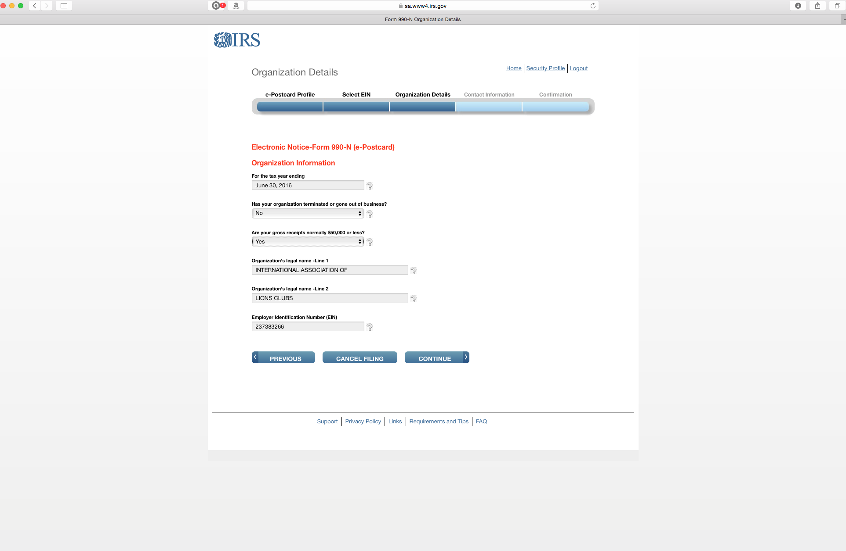
This is automatically filled out.
Answer these on the drop down menu.
Again, note that LCI’s name appears with your EIN.

Slide 29
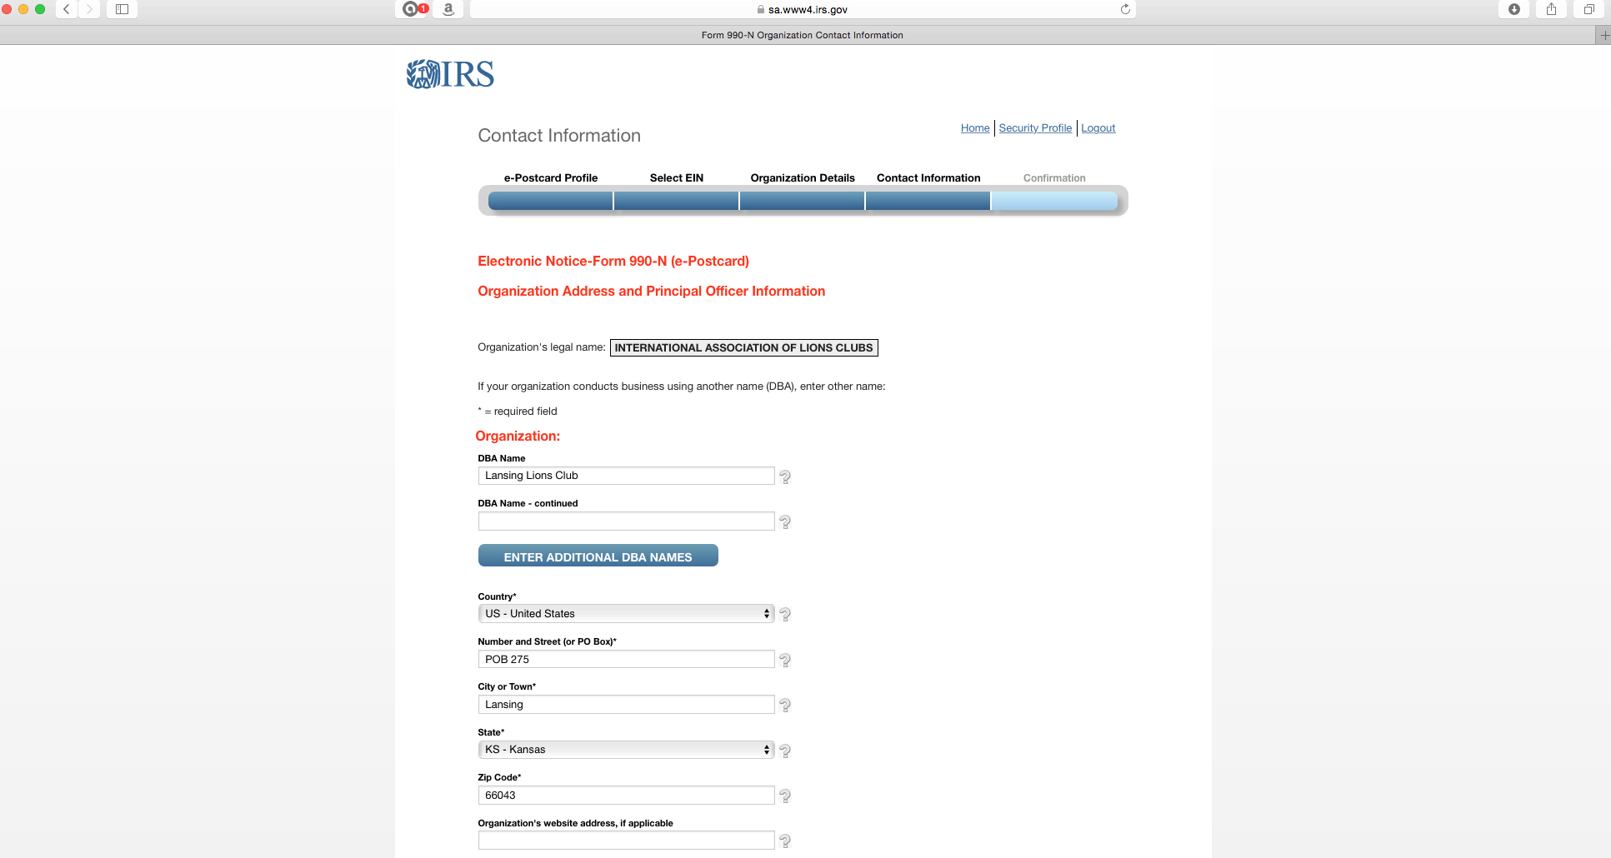
This is where you customize the profile to your club. DBA means “Doing Business As”. Put your club name and address info.

Slide 30
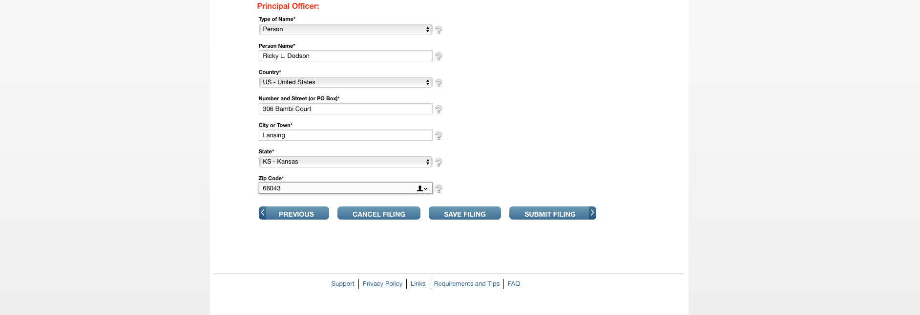
The drop down menu will give you a choice of “Person” or “Business” Select “Person” unless your club has established itself as a foundation, then you might select “Business”.
Probably not important who you enter here. If you put the president and that name changes each year, you’ll be constantly updating the profile.
Click here if you’re ready to submit.

Slide 31
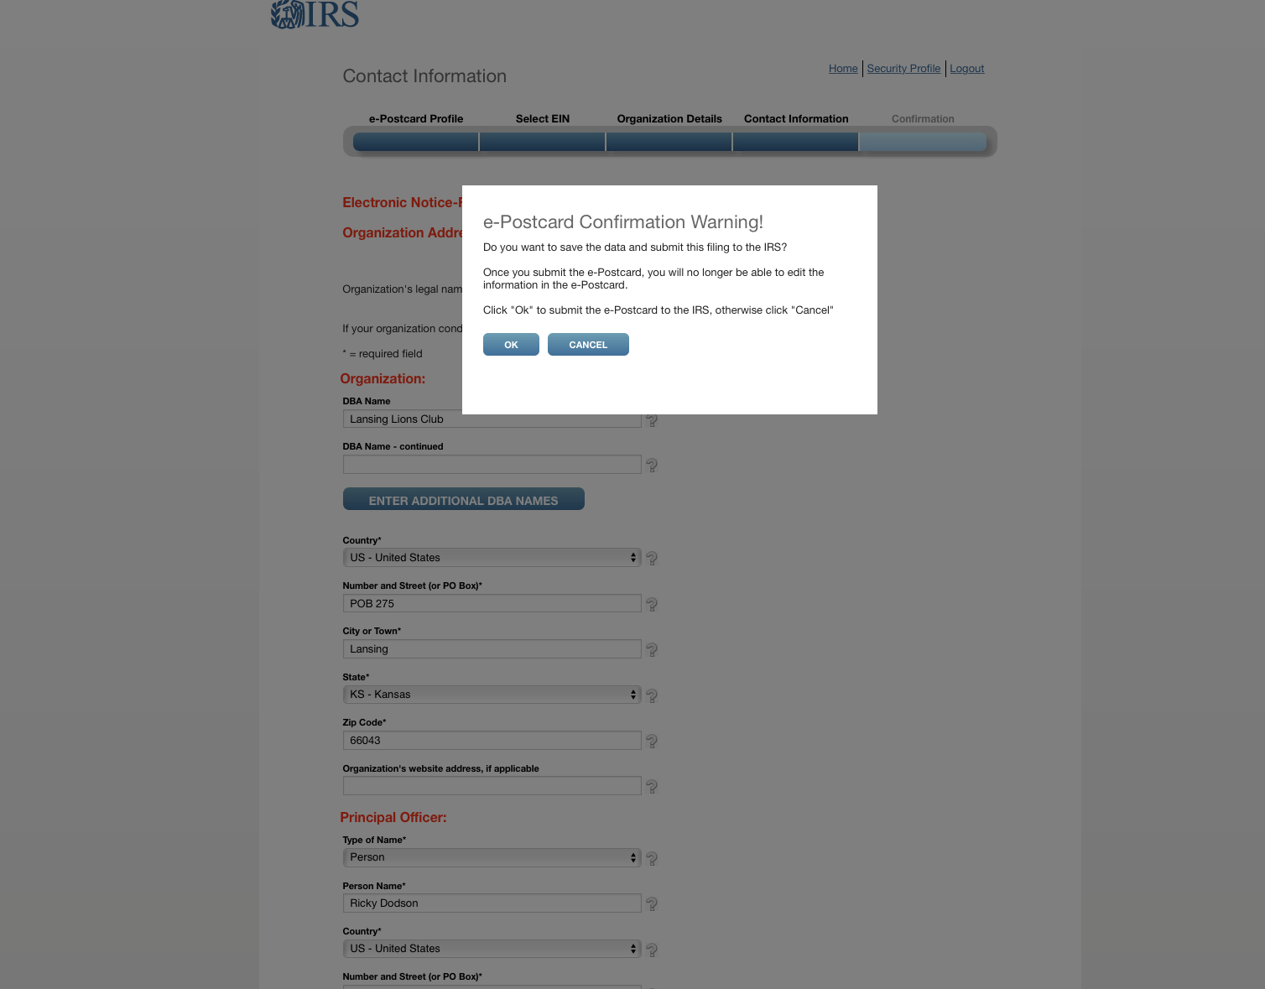
Click.

Slide 32
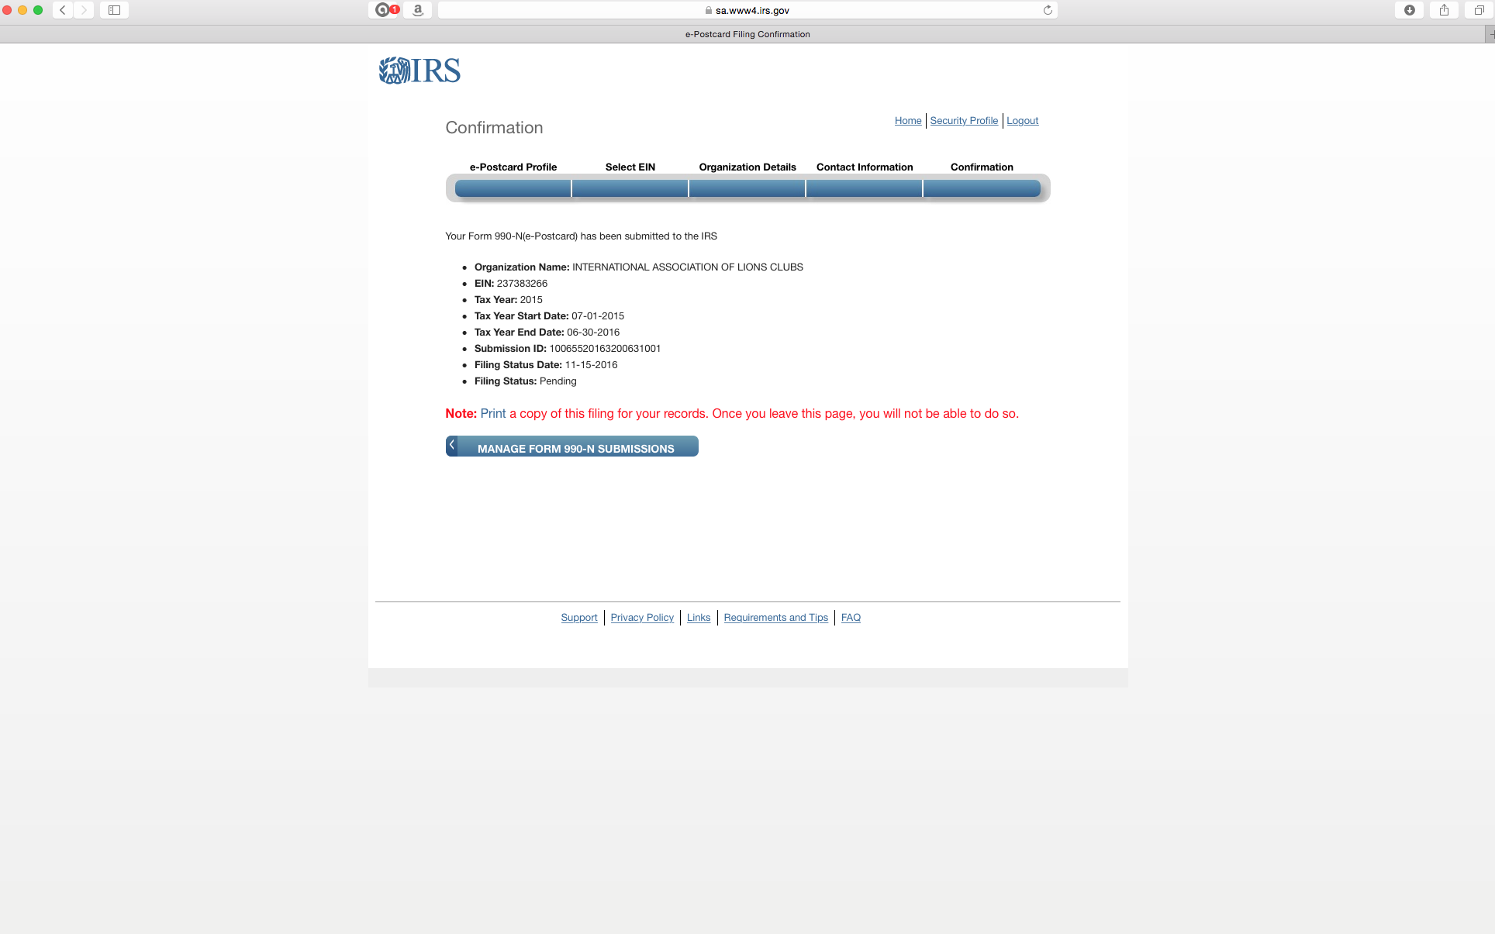
Don’t forget to print the screen.

Slide 33
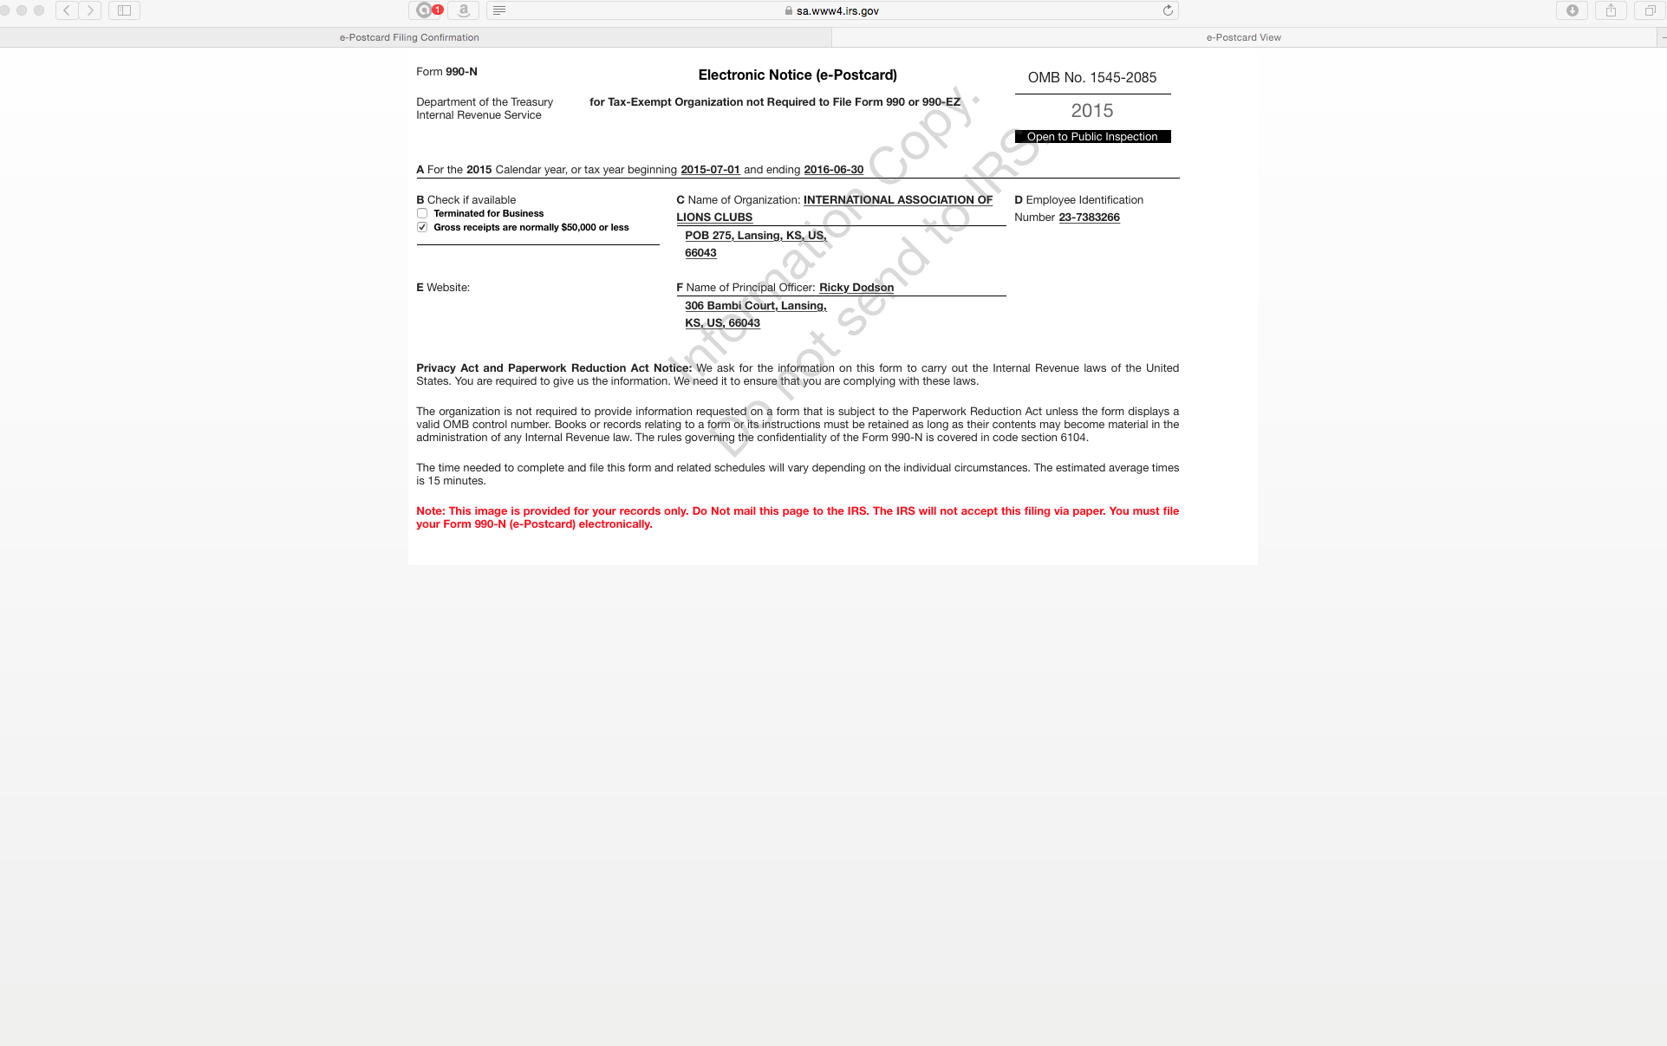

Slide 34
Part 3.
Submitting in future years with
registration already completed.

Slide 35
1. Go to “irs.gov”
2. Click

Slide 36
Click

Slide 37
Click.
Important: Read about the penalties.
Then, click.

Slide 38
Read this, then return to previous screen.

Slide 39
Then, click.

Slide 40
This slide and the next one are the same page on the screen. Split here for ease of reading.

Slide 41
Click

Slide 42
When you get to this screen and you’ve already registered, enter your username and click here.
The program is not very forgiving. If you wait too long to fill in blanks, it will tell you it has stopped you for security reasons and tells you to try again later. So, be prepared with all of your information.
You may have to start over several times to git’er done.

Slide 43
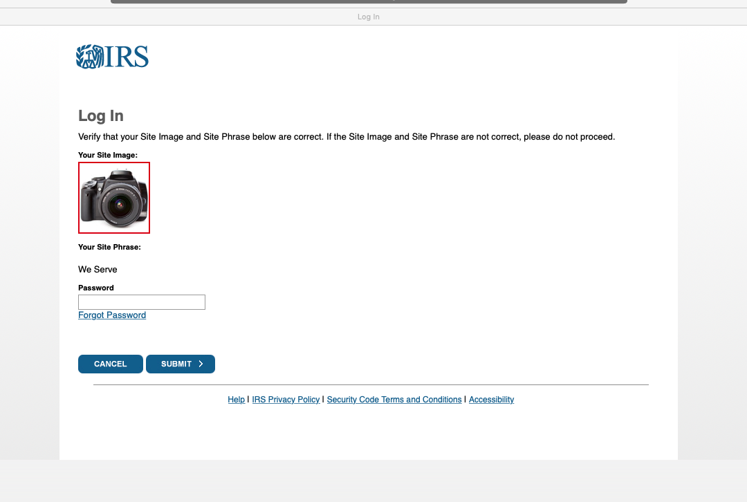
Enter your password and click “Submit”.

Slide 44
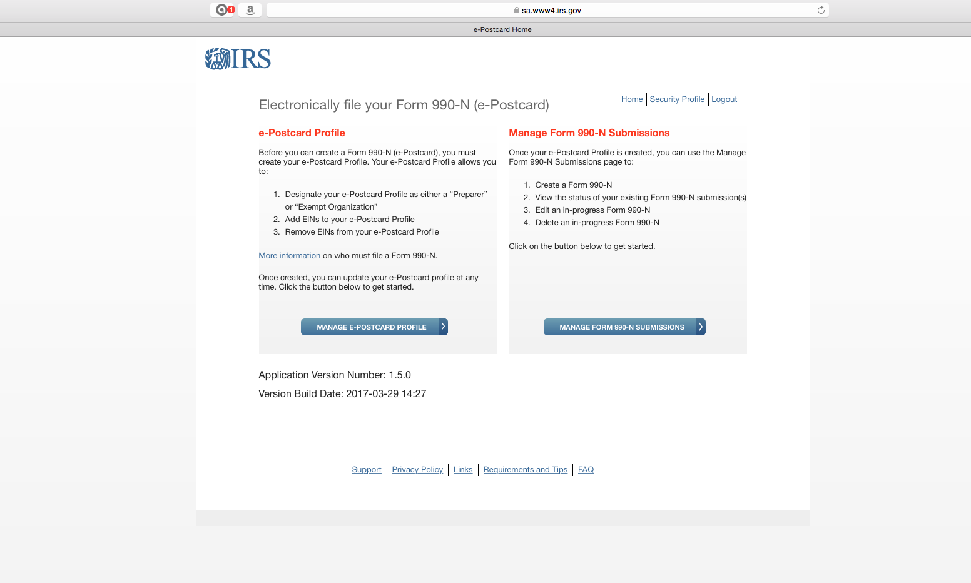
For annual updates,
Click here!!!!!

Slide 45
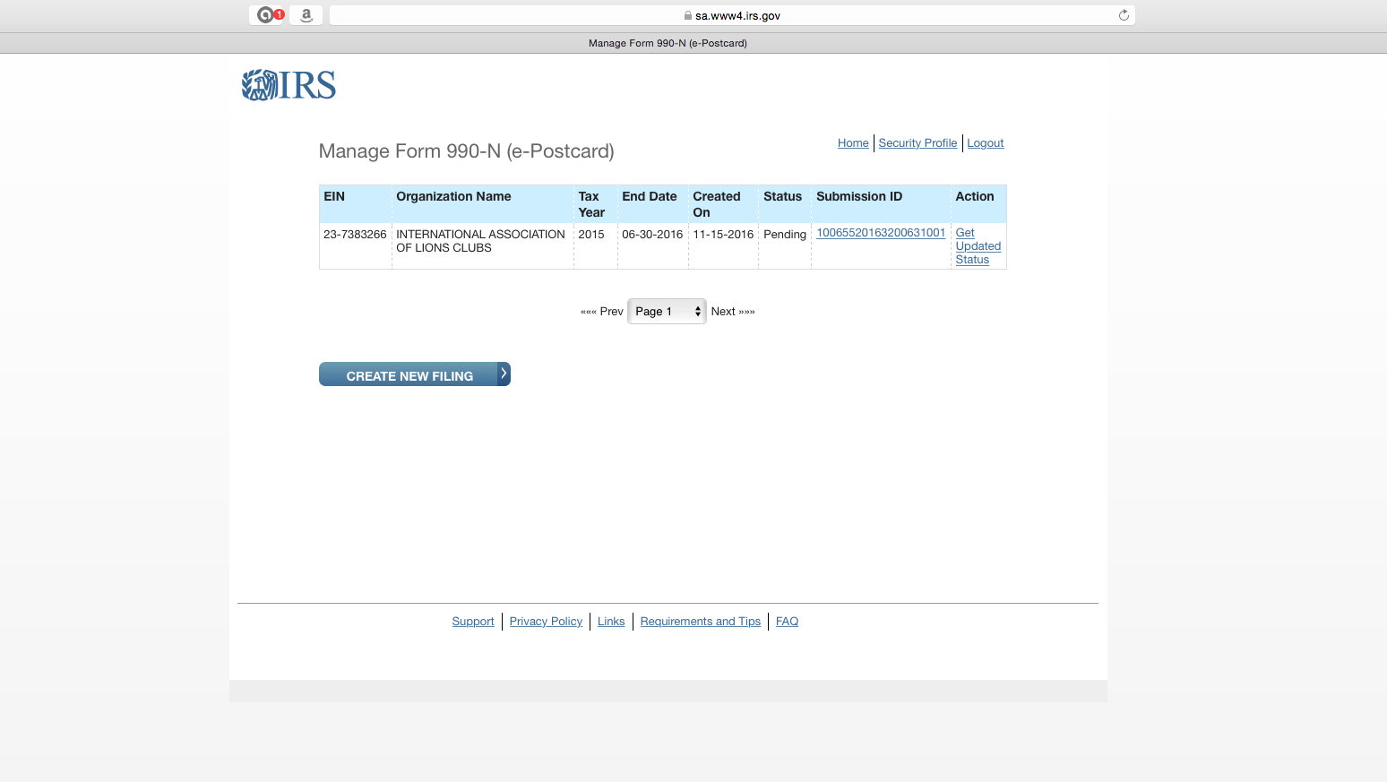
Click

Slide 46
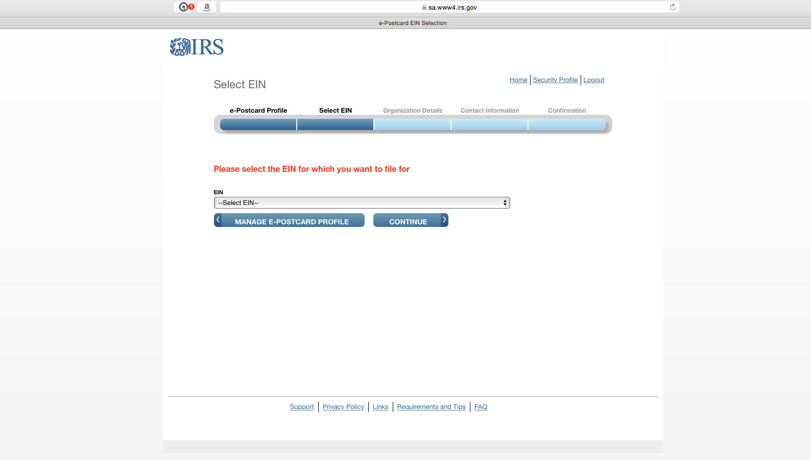
Click to get drop down menu.

Slide 47
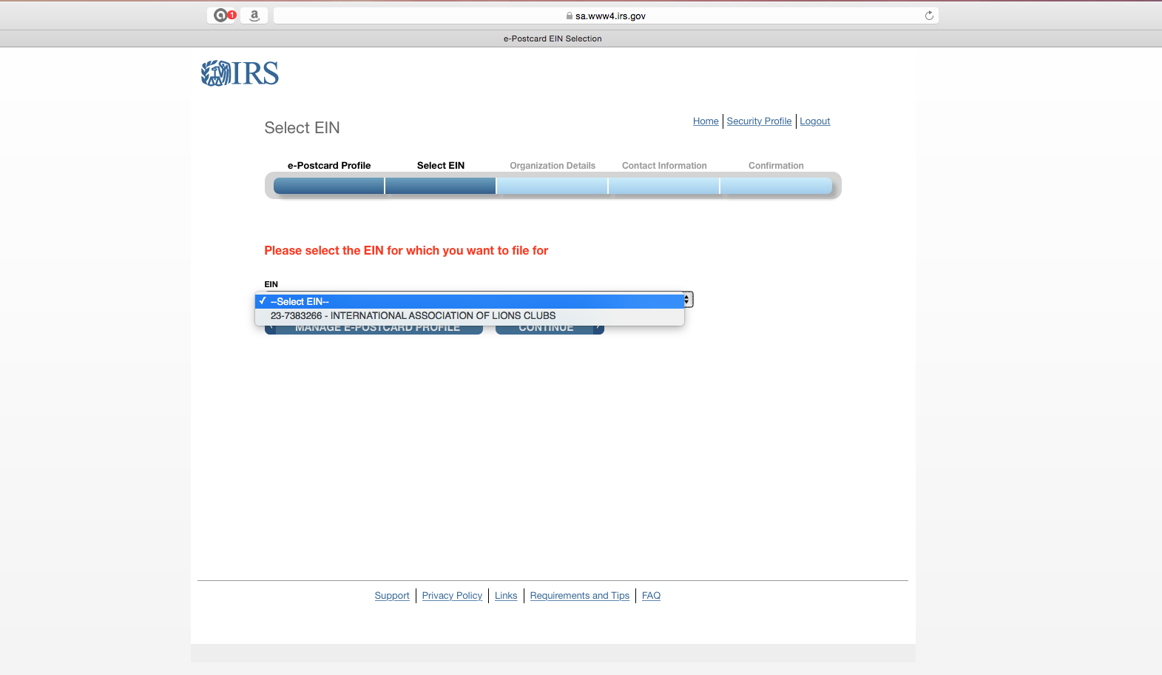
Click to select your EIN. You should get only one selection.
Then, continue.

Slide 48
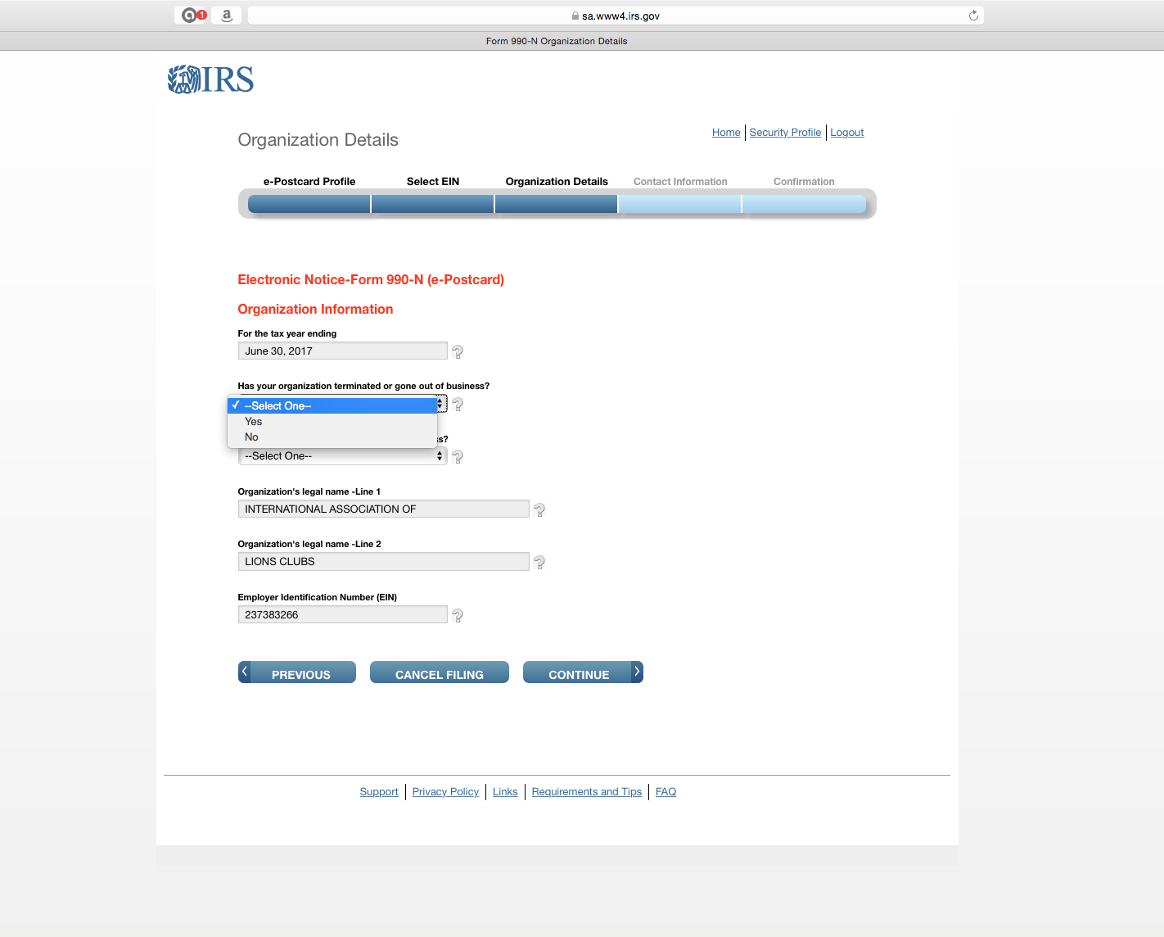
Select “No”.
Next menu should ask if you
made under $50,000. Select yes.
Then, continue.

Slide 49
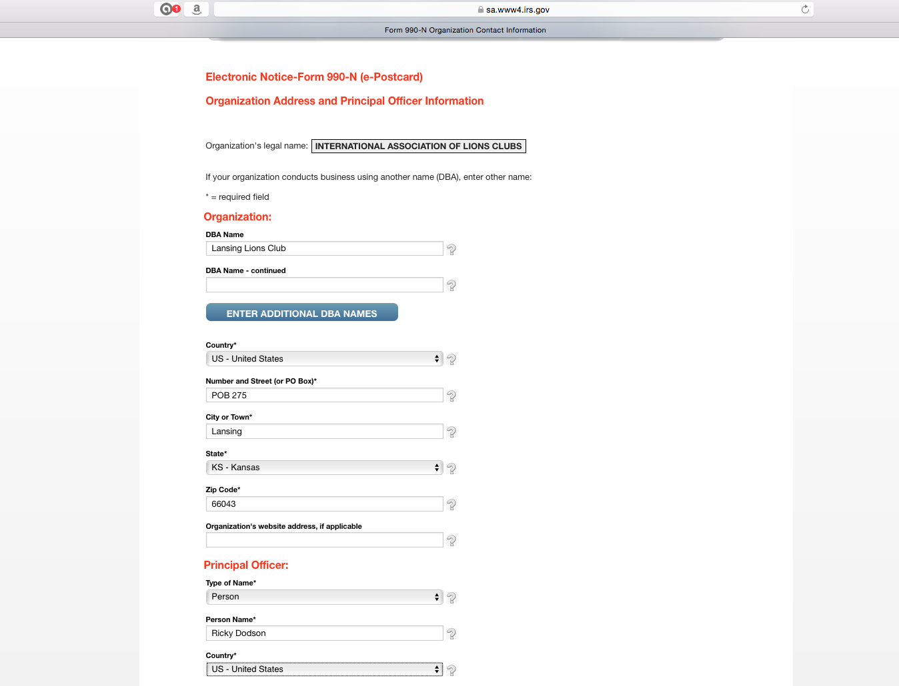
Enter your Lions Club name here.
Then enter other information below
Then, continue.

Slide 50
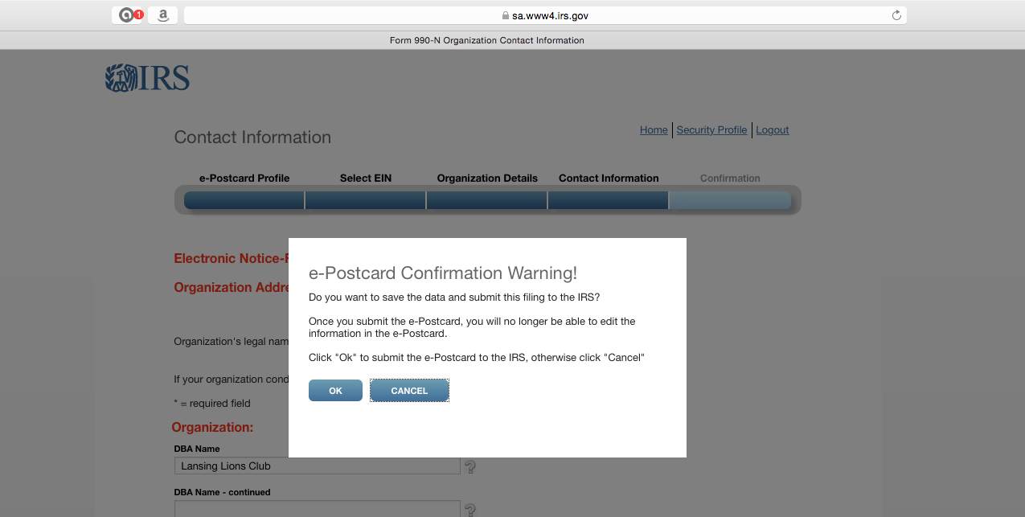
This is the confirmation screen.
Click “OK”.

Slide 51
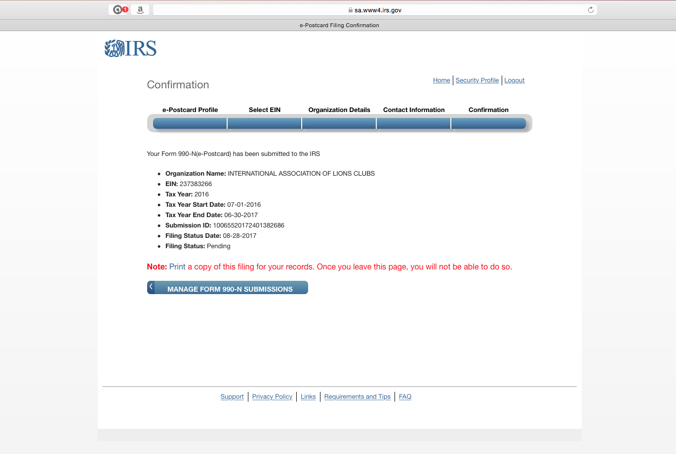
This is the final screen.
You will get an email confirmation,
but recommend you click here to print as well.
Then click on “Logout” on the top menu.
Do not click on the “Manage form 990-N submissions”.

Slide 52
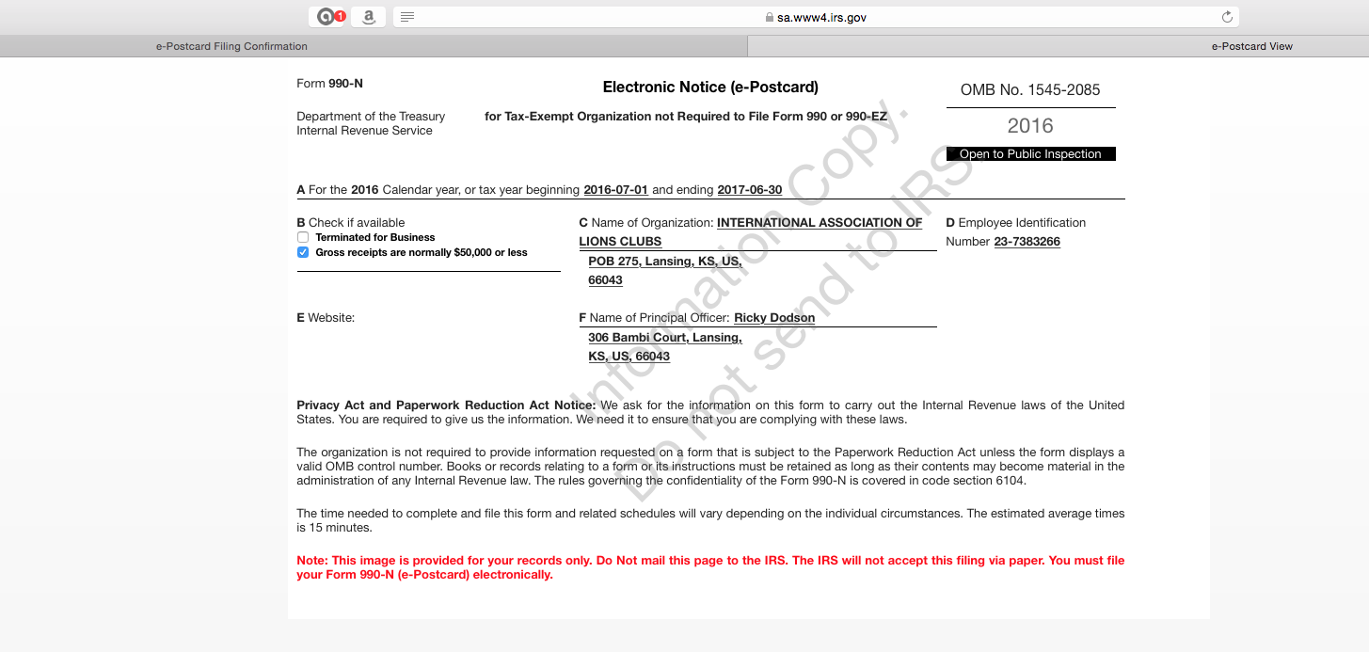
This is the printable confirmation. Save in your files.

Slide 53
Final notes:
These are some of the problems or situations I’ve experienced. You may find different problems. You may have to close and start over several times. If nothing works, call me and I’ll try to help. If all else fails, you’ll have to contact IRS.
  I have exited the program without finishing before. When I came back in, there were some different questions.
  If you answer something wrong, the program may kick you out. If it kicks you out, you may get a message saying you have to wait 24 hours to try again.
  If you have to start over, you may need to completely close down, then re-open, the browser.
  I’ve received a note before saying there was a technical problem, and I had to start over. No explanation of what the problem was so I could avoid it in the future.
PDG Rick Dodson, (913) 240-5302, dodsonr23@gmail.com

