Slide 1

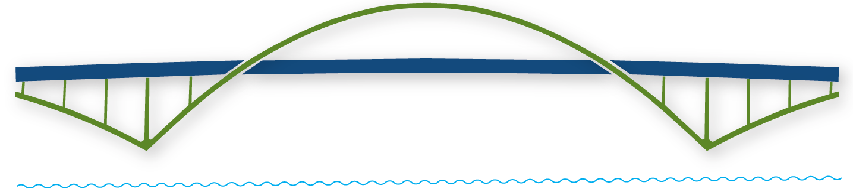
WELCOME
VIRTUAL LIONS TRAINING
Building a Bridge into the Future!

Slide 2

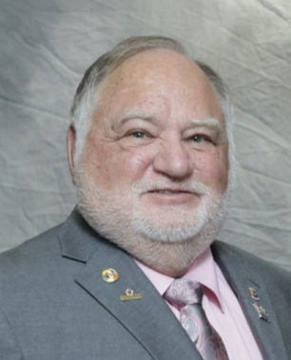
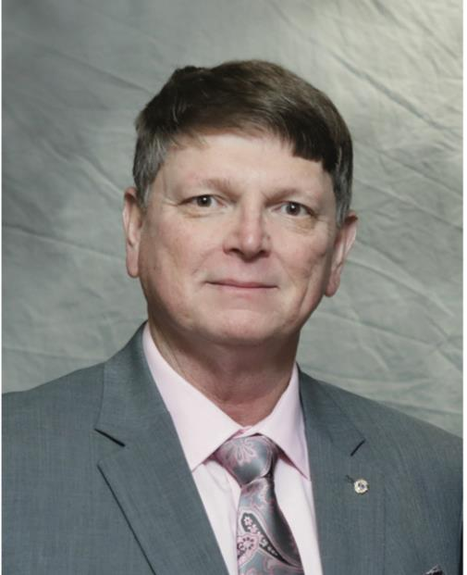
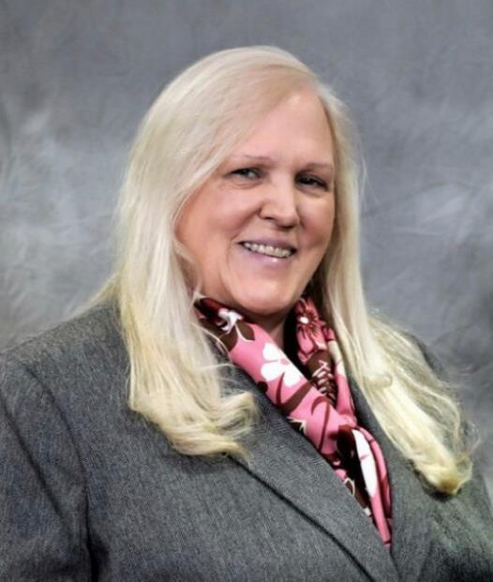
FACULTY
DG Rick Dodson District 17A
DG Chris Bauer District 17N
DG Diana Baumann District 17K

Slide 3

QUICK POLLS
.

Slide 4
“A leader is great not because of his or her power,
but because of his or her ability to empower others.”
― John Maxwell,
Building a Bridge into the Future!
Notes:
B

Slide 5
By the end of this session you will be able to:
Explain the role and responsibilities of the Club President.
Develop and put an annual club plan into action.
Plan and manage a meeting.
Access additional resources as needed.
Building a Bridge into the Future!

Slide 6
PRESIDENT’S ROLES & RESPONSILIITES
DG Rick Dodson
District 17A
Building a Bridge into the Future!

Slide 8
PRESIDENT’S ROLES & RESPONSIBILITIES
Attend officer training. Learn about MyLCI and MyLion.
Preside at all meetings of the board of directors and club.
Appoint the standing and special committees of the club.

Slide 9
PRESIDENT’S ROLE & RESPONSIBILITIES
(Continued)
Cooperate as an active member of the District Governor’s Advisory Committee.
Ensure that regular elections are duly called, noticed, and held.
Prepare your successor to facilitate continuity of operations.

Slide 10
SECRETARY
Maintain club records: minutes of club and board meetings, rosters, attendance, committee appointments, elections, member information, addresses and telephone numbers of members, member achievements, calendar of events, emails, etc.
Ensure club dues are invoiced, collected, and deposited. Inform Board of Directors (BOD) of delinquent dues.
Recommend appointment of a Club Administrator to back-up the Secretary and assist with administrative duties.
Along with President, serve as an active member of the District Governor’s Advisory Committee.

Slide 11
TREASURER
With BOD, prepare annual administrative and activity budgets.
Make financial reports to the board of directors as specified.
In cooperation with the Secretary: invoice, collect, and deposit dues.
Pay the club’s obligations as authorized by the board of directors.
Arrange for end of year audit.

Slide 12
OTHER CLUB OFFICERS
  Discussions on other club officers.
  In the President and Vice President e-Book.
  At the end of this module if time permits.
  In the District breakout module if time permits.
  In an optional Town Hall module at the end of the scheduled training session for those that wish to stay and participate.
  By sending a note to one of the DGs who will provide feedback.

Slide 13
CLUB PLAN
DG Chris Bauer
District 17N
Building a Bridge into the Future!

Slide 14

CLUB PLAN - 3 KEY ELEMENTS:
Developing the Plan
Executing the Plan
Monitoring implementation of the Plan

Slide 15
DEVELOPING A CLUB PLAN
Review president’s individual annual plan. See the Club President’s Monthly Planner.
Assess current club operations and needs of the community.
Set SMART goals. (Specific, Measurable, Actionable, Reasonable, Timebound) See goals sheet.
Develop club administrative and activity budgets.
Establish club calendar of events.

Slide 16
EXECUTING A CLUB PLAN
Conduct planning meetings or discussions during regular meetings.
Provide oversight at the President or Vice President level.
Make membership, marketing, and leadership a component of all activities.
Evaluate the plan on an ongoing basis during implementation.
Plan transitions to the next Lions year.

Slide 17
MONITORING A CLUB PLAN
Follow-up analysis of activities. Repeat? Change? Eliminate?
Arrange for publicity in various media outlets.
Follow up on potential recruits.

Slide 18
IDEAS FOR CONDUCTING EFFECTIVE &
ENGAGING MEETINGS
DG Diana Baumann
District 17K
Building a Bridge into the Future!

Slide 19
COMPONENTS OF EFFECTIVE MEETINGS
PREPARATION
FACILITATION
FOLLOW UP

Slide 20
MEETING PREPARATION
Determine tasks, actions, & outcomes
List agenda items & responsibilities
List participants, guests, & roles
Set time frame
Finalize logistics
Communicate
Set up
Prepare yourself

Slide 21
SAMPLE AGENDA
1. Call to Order by President
2. Introduction of Guests
3. Depending on Local Customs:
  Pledge of Allegiance, Prayer, & Song
4. Approval of Minutes from last meeting including Treasurer Report
5. Program
6. Unfinished Business
7. New Business
8. Recognition
9. Adjournment
Other activities unique to the club: Dinner, Entertainment,
Tail Twister time, Truth time, & Announcements.
Plan time for each activity and stick to the schedule!

Slide 22

COMPONENTS OF EFFECTIVE MEETING
INFORMATION
DISCUSSION
RECOGNITION

Slide 23

INFORMATION
  PROGRESS
IMPORTANT DATES
FACTS

Slide 24

DISCUSSION/DECISION
  STRATEGIES
IDEAS
PROJECT PLANNING
This Photo by Unknown Author is licensed under CC BY-NC-ND

Slide 25


RECOGNITION
  FORMAL
&
INFORMAL

Slide 26
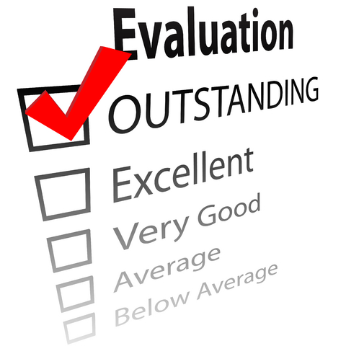

MEETING FOLLOW UP
  EVALUATE MEETING
ENSURE MINUTES ARE COMPLETED
CONTACT AND ACTION ITEMS

Slide 27
RESOURCES
DG Rick Dodson
District 17A
Building a Bridge into the Future!

Slide 28
  RESOURCES
  (See pages 12-15 of your Participant’s Manual)
President and Vice-President eBook – pre-assignment reading
Hyperlinks throughout the book on a variety of topics.
Blueprint for a Stronger Club
Club Standard Constitution and By-Laws
Lions Learning Center – found under your Lion Account “Learn” button
USA/CANADA Forum’s Lions University courses – please contact Zone Chairman & District Governor
Search for the President path.
YouTube videos
Club Quality Initiative

Slide 29
Did we meet our objectives?
Explain the role and responsibilities of the club president.
Develop and put an annual club plan into action.
Plan and manage a meeting.
Access additional resources as needed.
Building a Bridge into the Future!

Slide 30
QUICK POLLS

Slide 31
Questions and Comments
CC Diane Hentges

Slide 32
5 Minute Break

Slide 33
Breakout into separate District rooms
If you end up in the wrong District room, ”leave” to return to the Main room.
If you join late and everyone else is already in their District rooms,
wait and PDG Chris will move you to your District room.

Slide 34
WELCOME
VIRTUAL LIONS TRAINING
Building a Bridge into the Future!

Slide 35
QUICK POLLS

Slide 36
Closing Remarks
Thank you.
Writers, editors, and faculty.
  Writers: PDG Mel Barnett (17-K), PDG Randy St. Aubyn (17-K), PDG Dan Funke (17-N)
  Editors: PCC Beverly Nichols (17-A), PCC Fran Smith (17-K)
  CC Diane Hentges and PDG Marla Larison for helping us during this Module
  Faculty: DG Diana Baumann (17-K), DG Rick Dodson (17-A), DG Chris Bauer (17-N),
  PCC Deb and Ron Weaverling (17-A), PDG Neal Nichols (17-A), PDG Tom Baumann (17-K),
  PDG Randy St. Aubyn (17-K), and PDG Reland Cole (17-K)
Reminder of future training:
    Treasurer session on Saturday, August 22, at 10:00 a.m.
    Secretary session on Thursday, August 27, at 7: p.m.
Optional Town Hall Meeting following.

