Slide 1


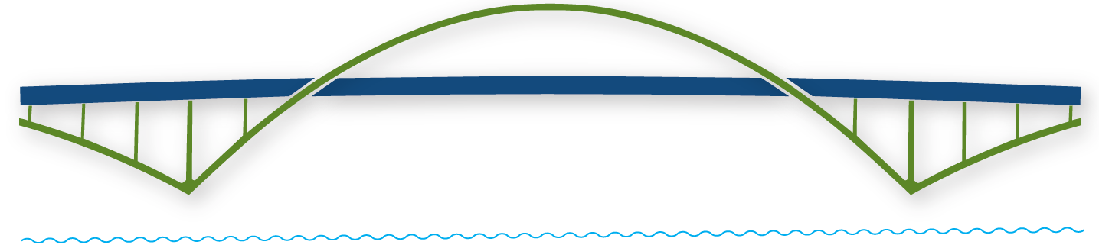
WELCOME
VIRTUAL LIONS TREASURER TRAINING
Building a Bridge into the Future!

Slide 2

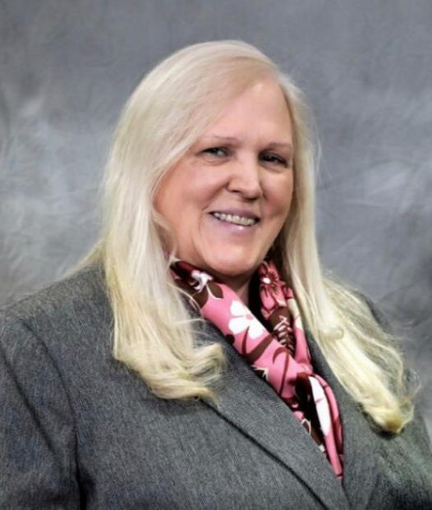
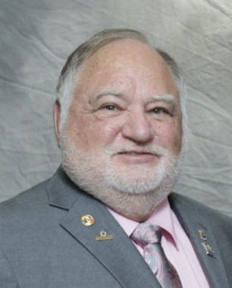
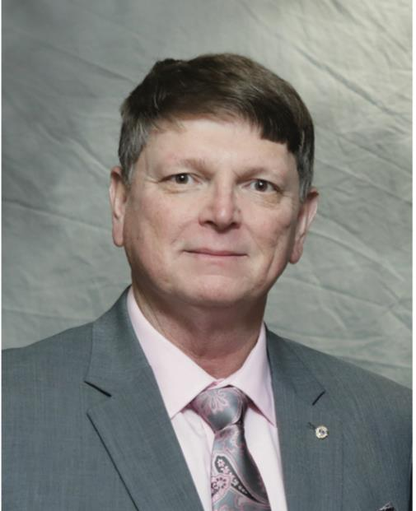
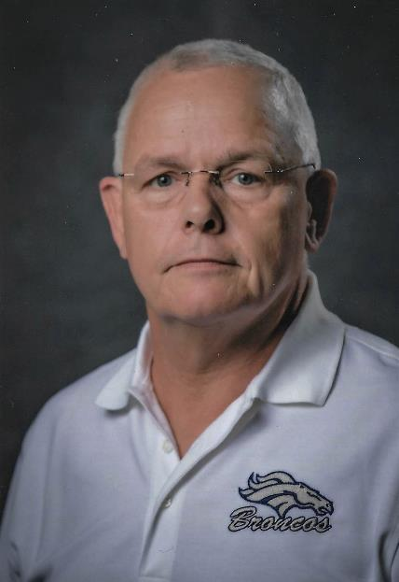

FACULTY
DG Diana Baumann District 17K
DG Rick Dodson District 17A
DG Chris Bauer District 17N
PCC Hans Neidhardt
State Treasurer

Slide 3

QUICK POLLS
Quick Poll – Please check if you are in attendance (Single Choice)
In attendance
◎ Yes
◎ Thank You
Submit
Quick Poll – Attendee’s Age
Please indicate your age:
◎ <30
◎ 31-45
◎ 46-60
◎ 61-75
◎ 75+
Submit

Slide 4
“Pleasure in the job puts perfection in the work.”
― Aristotle
Building a Bridge into the Future!

Slide 5
By the end of this session you will be able to:
Explain the role & responsibilities of the Club Treasurer
Correctly classify funds in accounts
Easily navigate through MyLCI and pay bills online
Complete tax forms for your club
Access additional resources as needed
Building a Bridge into the Future!

Slide 6
TREASURER’S ROLES & RESPONSIBILITES
DG Rick Dodson
District 17A
Building a Bridge into the Future!

Slide 8

JUST WHO IS THE TREASURER
The Financial Officer of the club who attends all meetings of the Board of Directors and the Club.
The Treasurer is under the direction of the President and the Board of Directors.
The Communicator of club finances to members and the Board of Directors. Reports are completed and presented monthly or quarterly.

Slide 9
Treasurer Poll
Is this your first year as a Lions Club Treasurer?
YES
NO

Slide 10
TREASURER’S ROLES & RESPONSIBILITIES
Attending at all meetings of the Board of Directors and Club.
Maintain accurate records and a complete audit trail at all times.
Pays out all monies only on the authority of the Board of Directors. There is no exception. However, the Board of Directors may annually pre-authorize the payment of fixed expenses.
Report reconciled balances with brief income and expense statements to members and the Board of Directors.
Receive and deposit money in approved bank accounts.

Slide 11
TREASURER’S ROLE & RESPONSIBILITIES
(Continued)
Prepare administrative and activities budgets.
Give bond for faithful discharge of your position.
Have records audited at the end of each fiscal year.
File the appropriate tax return after the end of the year.
Transfer financial records to the new treasurer after the end of the year (Budgets, Bank Statements, Audit
Reports, Tax Returns)
Banks statements, Audit reports and Tax Returns should be kept for a minimum of 7 years

Slide 12
SECRETARY’S ROLE & RESPONSIBILITIES
Maintain club records: minutes of club and board meetings, rosters, attendance, committee appointments, elections, member information, addresses and telephone numbers of members, member achievements, calendar of events, emails, etc.
Ensure club dues are invoiced, collected, and deposited. Inform Board of Directors (BOD) of delinquent dues.
  Most Club Treasurers do this, however, your Club Secretary may be involved in dues collection and a good source for help in collecting dues.

Slide 13
ACCURATE RECORDS
DG Diana Baumann
District 17K
Building a Bridge into the Future!

Slide 14

COMPONENTS OF ACCURATE RECORDS
ADMINISTRATIVE/PROJECT ACCOUNT
See Use of Funds Policy
FINANCIAL RECORDING
BONDING
AUDIT See SOP 3.02 Audit Procedure

Slide 15
ADMINISTRATIVE OR PROJECT ACCOUNT?
Funds raised from the public must be used to benefit the public.
Administrative Account
  Your club’s income and expense accounts for doing club business
Project Account
  Your club’s income and expense accounts for funds raised from the community
Correct accounting safeguards non-profit status
Creates trust from your community

Slide 16
FINANCIAL RECORDING & BONDING
Club Treasurer’s should utilize some form of accounting program/process
  Quickbooks, Quicken, Spreadsheet
  POLL
Communicate with previous Club Treasurer
Need help? Contact your District Governor
Club Treasurer should be bonded

Slide 17
AUDIT
Perform Club Audit at year end.
  Club Audit Committee
  Club member with accounting experience
  Outside source
Turn books over to auditor when all accounts
are balanced are reports ran for the year
Follow SOP 3.02 Audit Procedure
Report results back to Board

Slide 18
DUES COLLECTION AND PAYMENT
Building a Bridge into the Future!
PCC Hans Neidhardt
Kansas State Treasurer

Slide 19
DUES COLLECTION & PAYMENT
Lions Club International Dues - $43.00/year See Membership Dues & Fees Schedule
  Exceptions
  LCI Billing Statements
  LCI dues are based on membership
    June 30 and December 31
  Payment Options
District Dues
  Billing Statements
  Multiple District Dues - $17.00/year
  District Dues – Varies by District

Slide 20
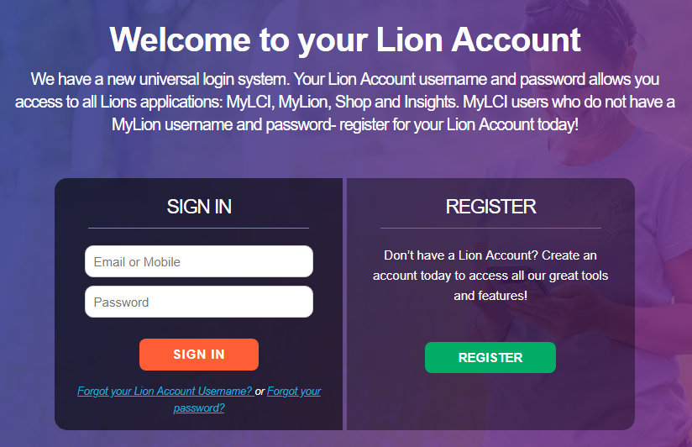
NAVIGATING THROUGH MyLCI
LOGIN
WHERE TO GO
PAY ONLINE
https://lionsclubs.org Click on Member Login

Slide 21
TAXES, NUMBERS & SPECIAL CONSIDERATION
Building a Bridge into the Future!
PCC Hans Neidhardt
Kansas State Treasurer

Slide 22
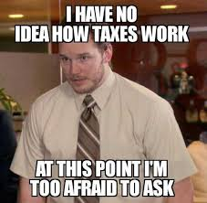
TAXES!
  IRS 990-N, IRS 990-EZ, or IRS 990
    Smaller nonprofits (Gross Receipts ≤ $50,000) file a 990-N
    (e-postcard).
    https://www.irs.gov/charities-non-profits/annual-electronic-filing-requirement-for-small-exempt-organizations-form-990-n-e-postcard
    Mid-size organizations (Gross Receipts < $200,000, and total assets < $500,000) file a 990 or 990-EZ.
    https://www.irs.gov/pub/irs-pdf/f990ez.pdf
    Larger organizations (Gross Receipts ≥ $200,000, or total assets ≥ $500,000) file a 990.
    https://www.irs.gov/pub/irs-pdf/f990.pdf
    Due by November 15th
    Penalties

Slide 23
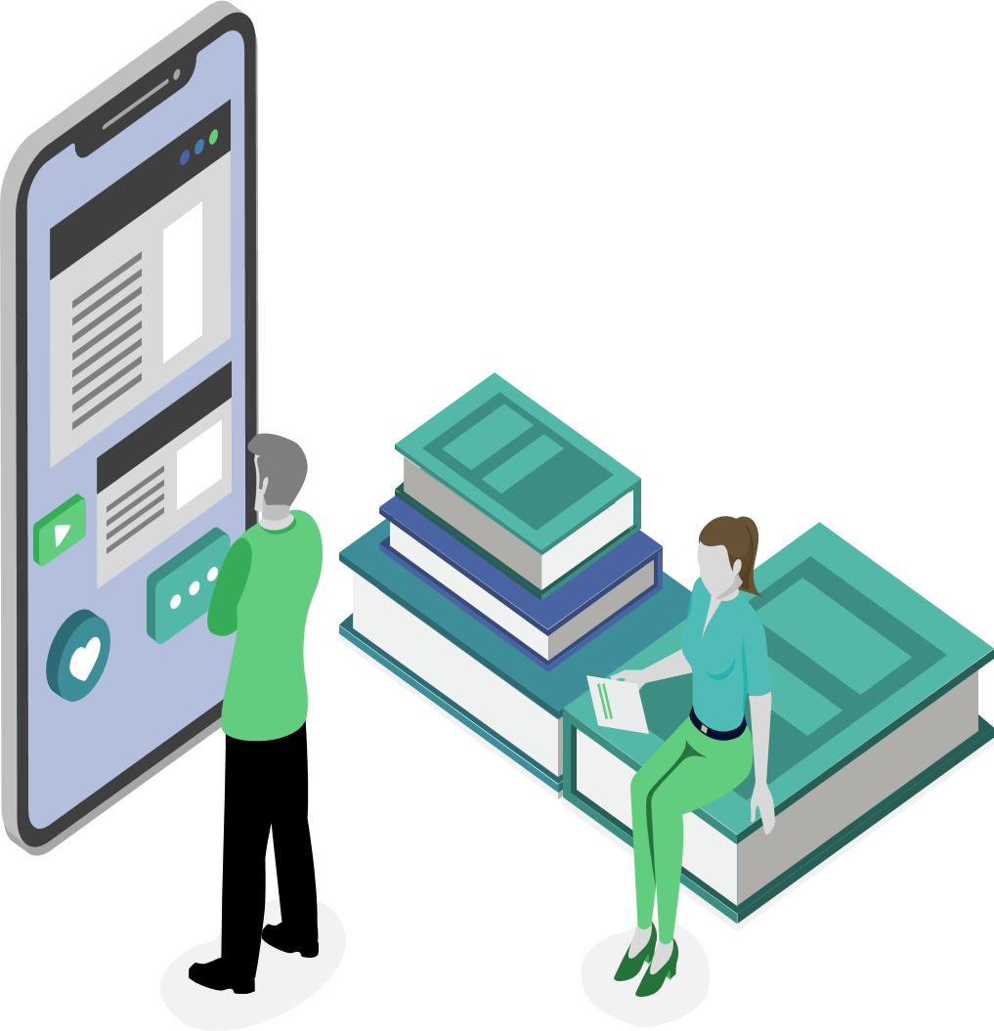

SPECIAL NUMBERS
  Federal EIN (Employer Identification Number)
    Unique federal number that identifies your club
    Apply online
    https://www.irs.gov/businesses/small-businesses-self-employed/apply-for-an-employer-identification-number-ein-online
    Kansas Sales Tax Exempt Number
    Club does not pay sales tax on purchases OR charge sales tax on sales
    Apply online
    https://www.ksrevenue.org

Slide 24
SALES TAX EXEMPTION
EXPIRES 10/1/2020
  Kansas Lions Clubs, District, State
    Sales Tax Exemption MUST be renewed
      BY OCTOBER 1, 2020
    To continue being sales tax exempt on sales and purchases, clubs have to renew
    Renew online
    https://www.kdor.ks.gov/Apps/KCSC/Secure/ExpCertListing.aspx

Slide 25
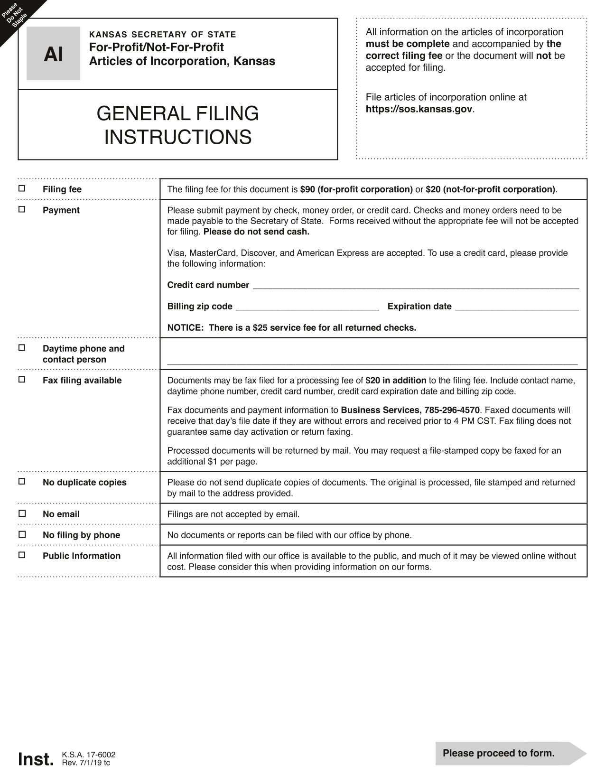
ARTICLES OF INCORPORATION
  Provides Liability Protection
    Apply online or by mail
      To apply online, go to https://kssos.org
        Search for Incorporation and follow instructions
      Mail to: Kansas Secretary of State, Memorial Hall, 1st Floor, 120 S.W. 10th Avenue, Topeka, Kansas 66612-1594
    Fees
      $20.00 Filing Fee
      $40.00 Annual Report Fee

Slide 26
IMPORTANT DATES
DG Rick Dodson
District 17- A
Building a Bridge into the Future!

Slide 27

IMPORTANT DATES
  JULY
    Bill members for dues
    Pay International dues
    Pay State & District dues
    Set up new signature cards at bank
    Have books of previous year audited
  NOVEMBER
    File 990 by the 15th (Can File any time after end of year and before Nov. 15th)
  DECEMBER
    File Annual Report by the 15th (Can File any time after end of year and before Dec. 15th)
  JANUARY
    Bill members for dues
    Pay International dues
    Pay State & District dues
  MAY/JUNE
    Prepare & approve budget
    Complete resolution for new signing officers

Slide 28
RESOURCES
DG Diana Baumann DG Rick Dodson DG Chris Bauer
District 17- K District 17-A District 17-N
Building a Bridge into the Future!

Slide 29


  RESOURCES
Kansas DONATION Point of Contacts
  Foundations
    Kansas Lions Sight Foundation
    Kansas Lions Band Foundation
    Kansas Lions Foundation
  Blind Services
    KSDS Assistance Dogs, Inc.
    Leader Dogs for the Blind
    Kansas School for the Blind
    Kansas Audio-Reader Network
    Diabetes
      Diabetes Camp

Slide 30
  RESOURCES, cont.
LCI Resource for Treasurers
  Club Treasurer eBook
  Standard Club Constitution & By-Laws
  Best Practice for Financial Transparency
  Lions Learning Center Link
    Login to MyLCI and click on Learn, click the GO button in online training, click Contact Library and search for Treasurer
USA/Canada Forum’s Lions University
  Bachelor’s Course 123, Club Finances
KS Incorporation Form and Instructions
KS Annual Report Form and Instructions
MyLCI Youtube.com
The Art of Recognition
State and District Websites

Slide 31

Did we meet our objectives?
Explain the role of the Club Treasurer
Correctly classify funds in accounts
Easily navigate through MyLCI and pay bills online
Complete tax forms for your club
Access additional resources as needed
Building a Bridge into the Future!

Slide 32
QUICK POLLS
Quick Poll – Faculty Evaluation
The faculty skillfully delivered the content and effectively facilitated the session.
◎ Strongly Agree
◎ Agree
◎ Disagree
◎ Strongly Disagree
Submit
Quick Poll – Course Evaluation
The session taught me something new or improved my skills.
◎ Strongly Agree
◎ Agree
◎ Disagree
◎ Strongly Disagree
Submit

Slide 33
5 MINUTE BREAK

Slide 34

USE OF FUNDS ???
PROJECT ACCOUNT???
ADMINISTRATIVE ACCOUNT???

Slide 35
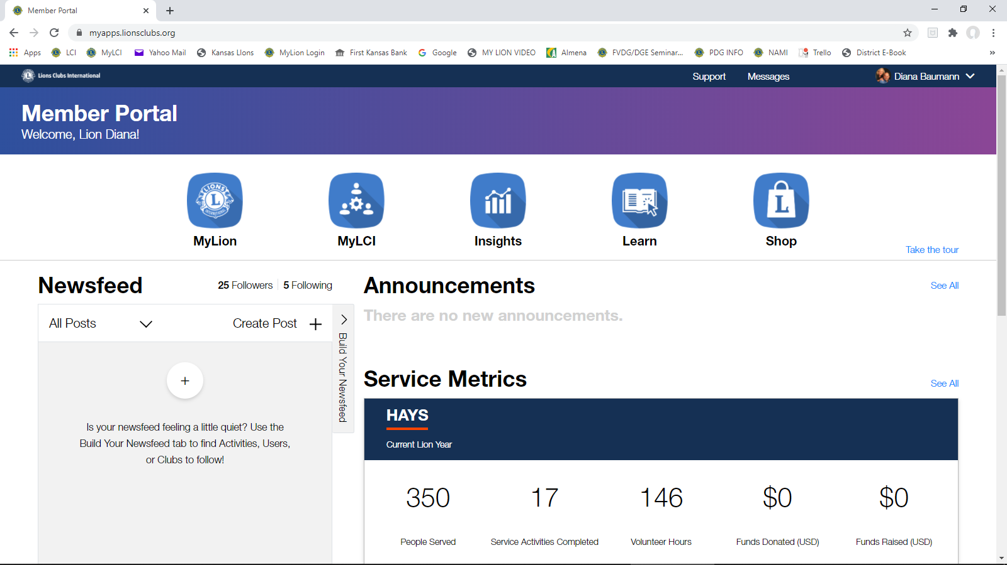
MyLCI

Slide 36

Dues Collection
Group Discussion
Do you have a hard time collecting from members?
How do you get Lions to pay timely?
How often do you drop Lions for nonpayment?
Do you offer discounts for 1st time Lions and their dues?
Has Covid-19 affected your ability to collect dues?

Slide 37
???
Ask the Team
???
??????????????
???
???

Slide 38
QUICK POLLS
Quick Poll – Faculty Evaluation
The faculty skillfully delivered the content and effectively facilitated the session.
◎ Strongly Disagree
◎ Disagree
◎ Agree
◎ Strongly Agree
Submit
Quick Poll – Course Evaluation
The activities and interactions during “Breakout Room” added to the value of this Club Officer President/Session.
◎ Strongly Agree
◎ Agree
◎ Disagree
◎ Strongly Disagree
Submit

Slide 39

THANK YOU!
WRITERS, EDITORS & FACULTY
  Writers: PCC Hans Neidhardt (17-N), PDG Don Keihl (17-K),
    John Scovill (17-N), PDG David Hentges (17-A),
    2VDG Tom Baumann (17-K), DG Diana Baumann (17-K)
  Editors: PCC Beverly Nichols (17-A), PCC Fran Smith (17-K)
  PDG Randy St. Aubyn and PDG Marla Larison for helping us during this Module
  Faculty: DG Diana Baumann (17-K), DG Rick Dodson (17-A),
  DG Chris Bauer (17-N), 2VDG Tom Baumann (17-K), 1VDG Randy
  St. Aubyn (17-K), PID Gene Vogal (17-A), PCC Hans Neidhardt (17-N)
  2VDG Richard Caldwell
Reminder of future training:
    Secretary Training on Thursday, August 27, at 7:00 p.m.
Optional Town Hall Meeting Following

Slide 40
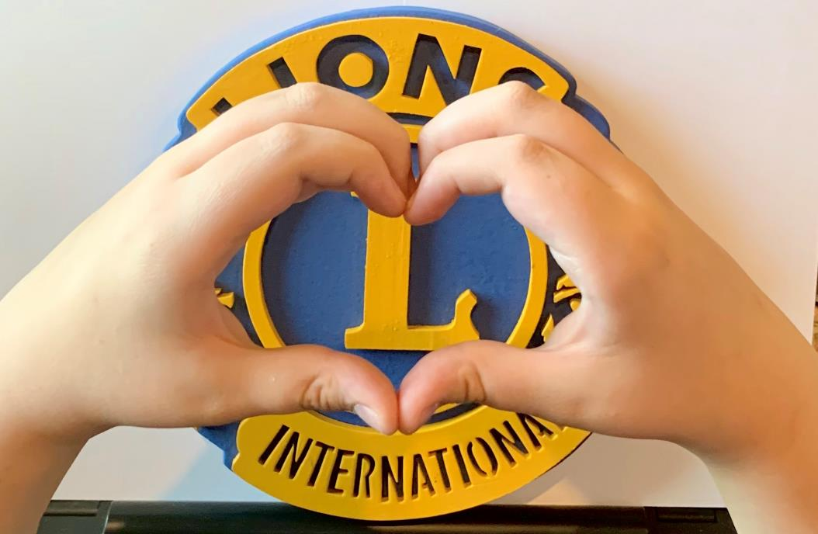
THANK YOU!
Everybody Can Be Great
Because Anybody Can Serve
Martin Luther King, Jr.

Slide 41
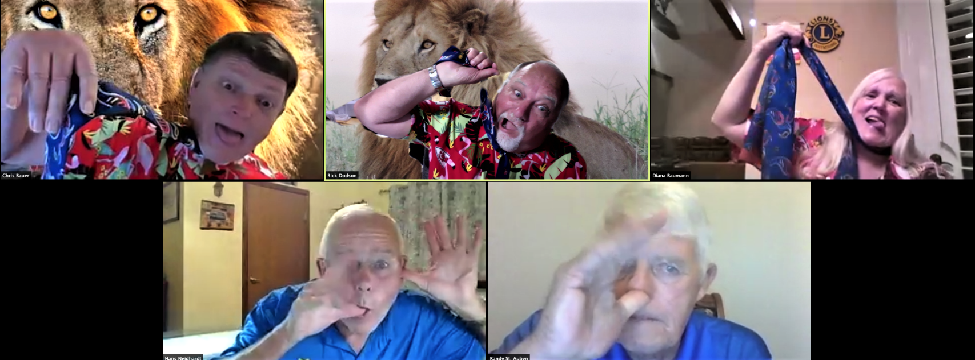
THANK YOU!
MOST IMPORTANTLY - HAVE FUN
ENJOY YOUR CLUB AND STATE LIONS
ENJOY YOUR SERVICE
ENJOY BEING A LION

