Slide 1


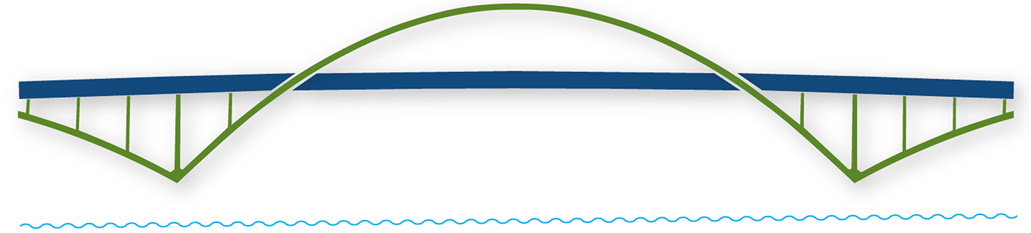
WELCOME
SECRETARY
VIRTUAL LIONS TRAINING
Building a Bridge into the Future!

Slide 2

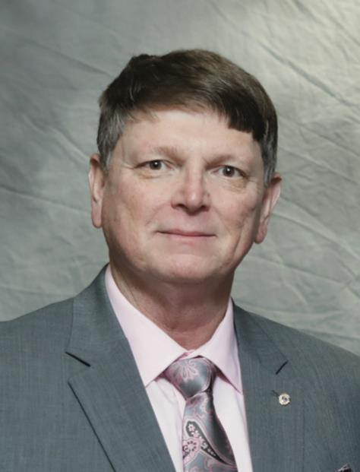
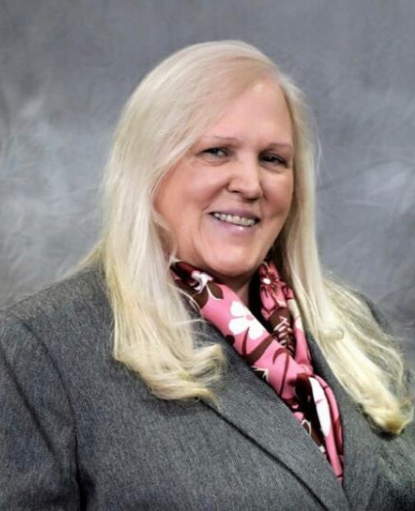
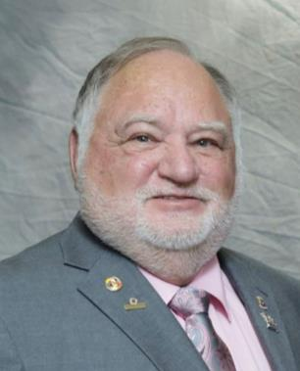
FACULTY
DG Chris Bauer District 17N
DG Diana Baumann District 17K
DG Rick Dodson District 17A

Slide 3
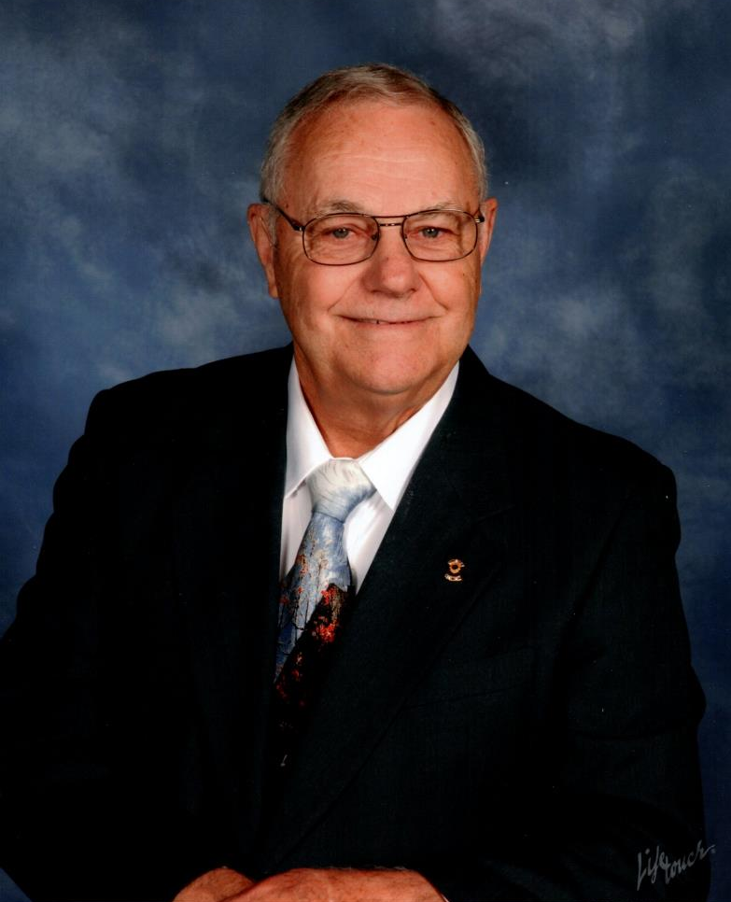
PID Gene Vogel

Slide 4

QUICK POLLS
Poll 1
Poll 2
Quick Poll – Please check if you are in attendance (Single Choice)
In attendance
◎ Yes
◎ Thank You
Submit
Quick Poll – Attendee’s Age
Please indicate your age:
◎ <30
◎ 31-45
◎ 46-60
◎ 61-75
◎ 75+
◎ Prefer not to answer Submit

Slide 5
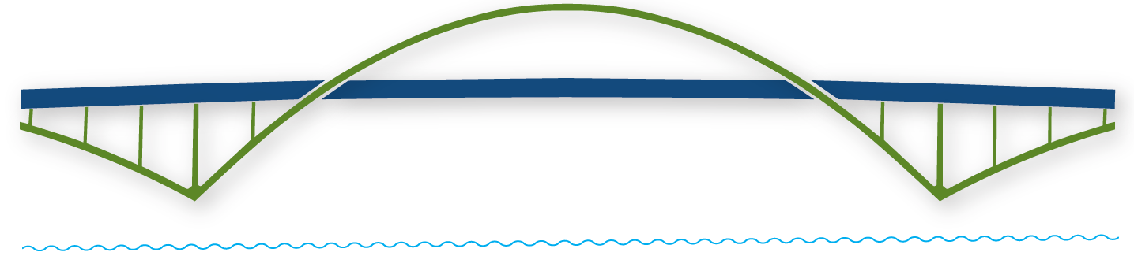
“Always be nice to Secretaries. They are
the real Gatekeepers in the World.”
- Anthony L. D’Angelo
Building a Bridge into the Future!

Slide 6
By the end of this session you will be able to:
    Summarize the responsibilities of the club secretary
    Explain the timelines for various responsibilities
    Access additional resources as needed
    Input data into MyLCI & MyLion (In Second Module)
Building a Bridge into the Future!

Slide 7
SECRETARY ROLES & RESPONSIBILITES
DG Rick Dodson
District 17A
Building a Bridge into the Future!

Slide 8
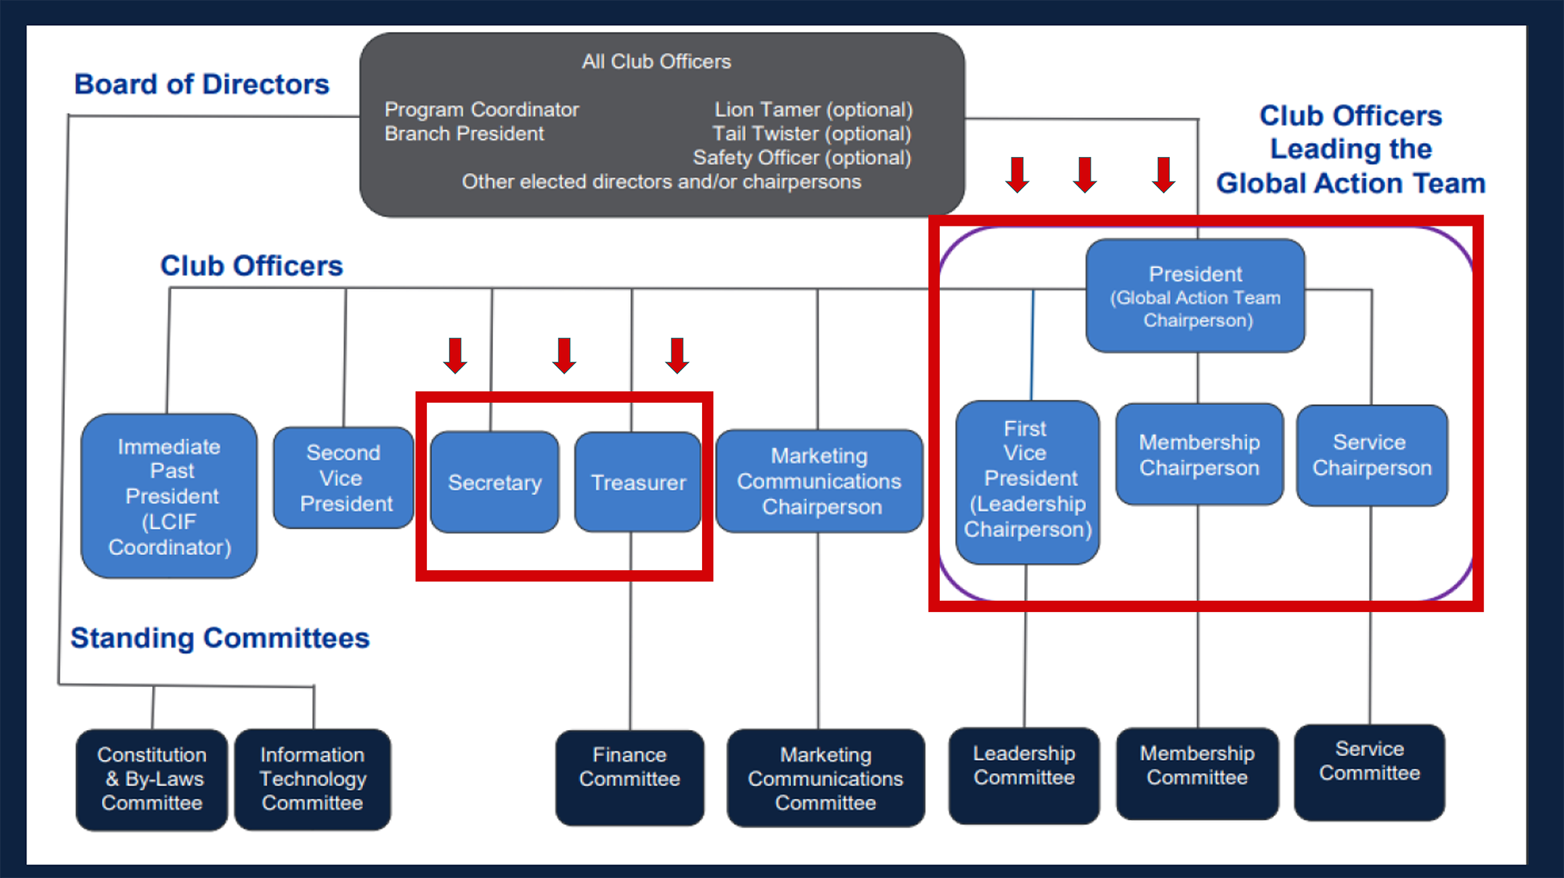

Slide 9

JUST WHO IS THE SECRETARY
The Secretary is the Recording Officer of the club who attends all meetings of the Board of Directors and the Club.
The Secretary is under the direction of the President and the Board of Directors.
The Secretary keeps the club running efficiently.

Slide 10

SECRETARY POLL
Poll 3
Quick Poll – Please respond to the question below.
Is this your first year as a Lions Club Secretary?
◎ Yes
◎ No
Submit

Slide 11
SECRETARY
Roles and Responsibilities
Keeps attendance and minutes of all meetings
Maintains records of the club and member’s records of service
Submits regular reports monthly and other reports as required.
Issues meeting notices
Is an active member of District Advisory Committee
Serves as Liaison between Club and District and International
Issues dues & obligation statements to members (This varies among clubs)

Slide 12

Remember that secretaries' responsibilities vary according to
regional practices and established club procedures.
Adapt the suggestions
in this module
to fit your club's needs

Slide 13

SECRETARY
On a Monthly basis, you will:
Attend club and board meetings
Submit Monthly Membership Reports using MyLCI
Submit Activities Report using MyLion
Keep member records up-to-date
Respond to or send out any letters or correspondence

Slide 14
SECRETARY
On a Quarterly basis, you will:
Attend zone meeting with the club president
Report to the president and board any delinquency issues and actions taken to collect funds due

Slide 15
SECRETARY
Twice yearly, you will:
Confirm that your list of members agrees with LCI’s records
Confirm members information on MyLCI is up to date. Including contact information. Provide e-mails if possible.
Work with club treasurer to issue semiannual dues statements to each member and reconcile other financial obligations owed to the club (your club may choose to do this quarterly or annually). This varies by club.

Slide 16
SECRETARY
Annually
Enter all Club Officers elected in MyLCI immediately following election
Attend your District Convention

Slide 17
MEETING DUTIES
DG Chris Bauer
District 17N
Building a Bridge into the Future!

Slide 18

BEFORE THE MEETING
Provide members with advance notice of meeting date, time, and location
In conjunction with the president, create a meeting agenda
Assemble any correspondence to give to appropriate member
Prepare awards or new member kits if necessary
Prepare club roster for taking attendance

Slide 19

DURING THE MEETING
Record attendance.
Record meeting minutes.
Document any non-Lion visitors and visiting Lions.
Gather activity information from committee chairpersons.

Slide 20

TAKING MINUTES
Minutes are meant to record what the club does and not what members say.
Therefore, debate is considered informal and not recorded.
Proper terminology is important and should be used.

Slide 21
TAKING MINUTES
Typically, minutes will include…
Type of meeting (Regular, Special, or Board)
Date and place of meeting
Name of person presiding over meeting
Whether previous meeting minutes were approved
All motions, their movers and whether the motions were sustained or lost
Time the meeting was called to order and adjourned

Slide 22

AFTER THE MEETING
Record awards presented.
Write up and distribute a copy of the meeting minutes.
Follow up on any outstanding issues from the meeting.

Slide 23

OTHER RESPONSIBILITIES
Building a Bridge into the Future!
DG Diana Baumann
District 17K

Slide 24

One of the most important responsibilities
of a club secretary
is keeping club records.

Slide 25

As the secretary,
keep the following club files
accurate and up to date:
The club history
The minutes of all club and board of directors' meetings
Annual reports of club officers and committees
Activity and service reports
Roster of club members

Slide 26

The District Governor's Advisory Committee
The district governor's advisory committee is comprised of:
The zone chairperson
The club presidents and first vice presidents within the zone
The club secretaries within the zone

Slide 27

The District Governor's Advisory Committee
What does the committee do?
This committee advises the zone chairperson about matters within the zone and makes recommendations on matters affecting all clubs in the district.
It allows you to exchange ideas regarding programs, projects, fundraising and membership issues.
It offers a forum for establishing cooperative relationships between clubs.
It gives you the opportunity to meet other Lions in your area.

Slide 28
RESOURCES
DG Diana Baumann DG Rick Dodson DG Chris Bauer
District 17- K District 17-A District 17-N
Building a Bridge into the Future!

Slide 29
Resources
LCI Resource for Secretaries
Club Secretary eBook
Standard Club Constitution & By-Laws
Your Club Your Way guide (DA-YCYW)
Model District Governor’s Advisory Committee Meeting guide (DA-ZMG)

Slide 30

Additional Training Courses for Secretaries
Lions Learning Center Link
USA/Canada Forum’s Lions University (Bachelor’s Course 122, Club Secretary)

Slide 31
Did we meet our objectives?
    Summarize the responsibilities of the club secretary
    Explain the timelines for various responsibilities
    Access additional resources as needed
    Input data into MyLCI & MyLion (After Second Module)
Building a Bridge into the Future!

Slide 32

QUICK POLLS
Poll 4
Poll 5
Quick Poll – Faculty Evaluation
The faculty skillfully delivered the content and effectively facilitated the session.
◎ Strongly Agree
◎ Agree
◎ Disagree
◎ Strongly Disagree
◎ Prefer not to answer
Submit
Quick Poll – Course Evaluation
The session taught me something new or improved my skills.
◎ Strongly Agree
◎ Agree
◎ Disagree
◎ Strongly Disagree
◎ Prefer not to answer
Submit

Slide 33


5 MINUTE BREAK

Slide 34
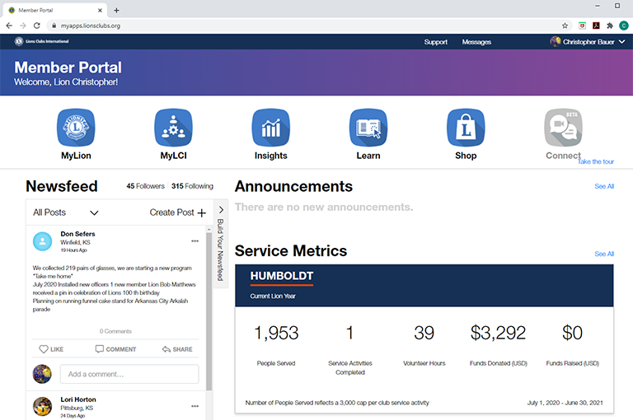
MyLCI and MyLION

Slide 35
MyLion Access
Any club member with a Lion Account can enter MyLion, view data, and create future activities.
Club President, Secretary, Administrator, and Service Chairperson can report a past activity.
Guiding Lion can input activities for a sponsored club.

Slide 36
Why Service Reporting Matters
Discover what can happen when clubs share their impact

Slide 37

Captivate & Connect
Local Cubs are making a difference in the world. Clear, relevant service data ensures people to know exactly where to go for help

Slide 38

Increase Global Awareness
Service data helps people understand the needs of communities around the world. Clubs identify opportunities and lead their local communities into action.

Slide 39

Paves the Way for Partnerships
Service reports provide tangible evidence to possible partners. These relationships strengthen the Club and yields benefits at the local level.

Slide 40

Uncover the next big project
One small service project can become the next signature initiative of the organization.

Slide 41
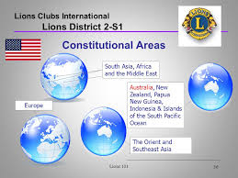
Enhance our Support
Service data enables Lions International to identify practices that can be shared globally

Slide 42

Build a Brighter Future
Measurement leads to sharpening focus which allows Clubs to set higher and reachable goals each year for the growth of the Club

Slide 43

Increase Membership
People want to participate in real, visible change. Reporting allows Clubs to continually engage their community, tell their story more effectively, and ultimately grow their membership.

Slide 44

Leverage our Foundation
Reporting shows how Clubs are using their funds from LCI Grants to serve their communities. This encourages Lions to think about their own projects and apply for theses grants

Slide 45

Recognize and Reward
When Service is reported Clubs become eligible for a number of Service Awards.

Slide 46
MyLCI Access
Access to MyLCI is limited. Must have a Lion Account and…
Club President, Secretary, and Administrator have view and edit capability.
Club Treasurer (and Secretary?) can view and ”Make a Payment”.
All other officers listed in MyLCI can view data.

Slide 47

Ask the Team

Slide 48

QUICK POLLS
Poll 6
Poll 7
Quick Poll – Faculty Evaluation
The faculty skillfully delivered the content and effectively facilitated the session.
◎ Strongly Disagree
◎ Disagree
◎ Agree
◎ Strongly Agree
◎ Prefer not to answer
Submit
Quick Poll – Course Evaluation
The demonstrations of MyLion and MyLCI added to the value of this Club Secretary Session.
◎ Strongly Agree
◎ Agree
◎ Disagree
◎ Strongly Disagree
◎ Prefer not to answer
Submit

Slide 49
THANK YOU!
WRITERS, EDITORS & FACULTY
  Writers: DG Diana Baumann (17-K), DG Rick Dodson (17-A), DG Chris Bauer (17-N), 1VDG Richard Caldwell (17-N), PCC Helen LeBlanc (17-N), PDG Denny Smith (17-K), Lion Kim Baker (17-A), Lion Louise Greenberg (17-K)
  Editors: PCC Beverly Nichols (17-A), PCC Fran Smith (17-K)
  Timekeeper: PDG Marla Larison for helping us during this Module
  Faculty: DG Diana Baumann (17-K), DG Rick Dodson (17-A),
  DG Chris Bauer (17-N), 1VDG Richard Caldwell (17-N)
  Optional Town Hall Meeting Following

Slide 50
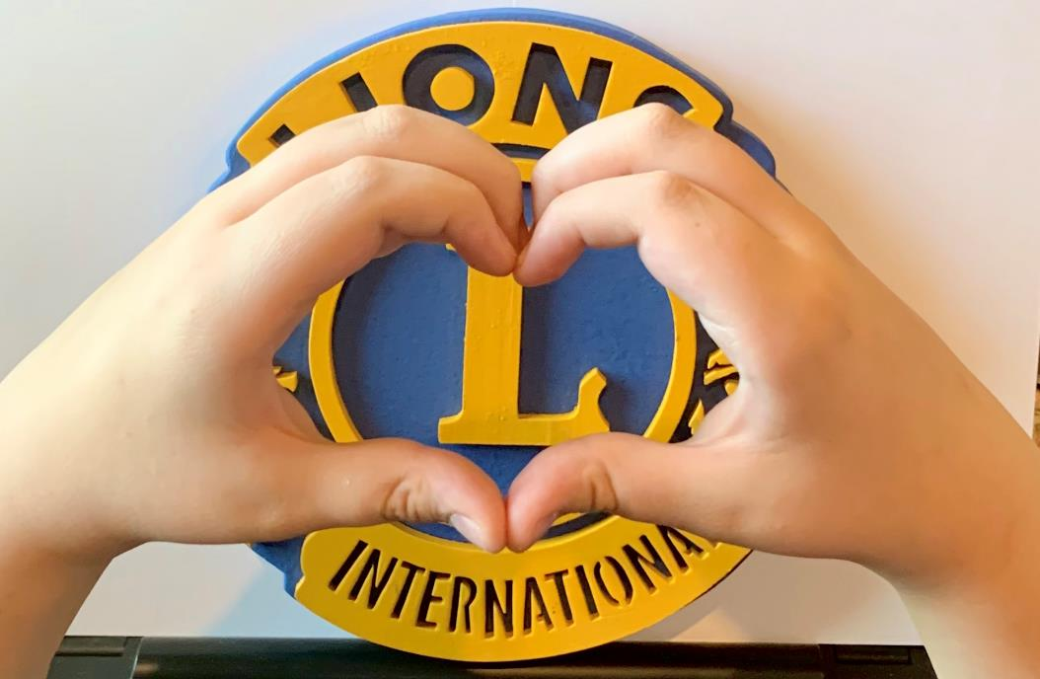
THANK YOU!
Everybody Can Be Great
Because Anybody Can Serve
Martin Luther King, Jr.

Slide 51
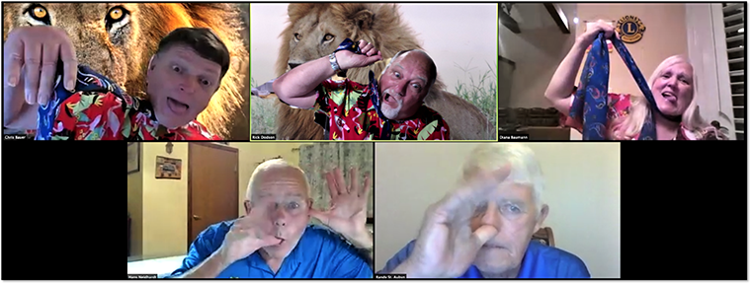
THANK YOU!
MOST IMPORTANTLY - HAVE FUN
ENJOY YOUR CLUB AND STATE LIONS
ENJOY YOUR SERVICE
ENJOY BEING A LION

