Slide 1
Registering and filing IRS Form 990 e-Postcard
Note: This presentation was initially prepared in mid-August 2017. The IRS changes some of the screens every year.
I updated as mush as I could on 5 Nov 19. Since I had already entered my information for the year, I could
only go as far as slide 41 (in Part 3). The remaining slides should be close enough for you to complete the process.
Please notify me if you find something substantially different, so I can update again.
Rick Dodson
rdodson@kc.rr.com

Slide 2
Part 1.
Initial Registration for e-Postcard

Slide 3
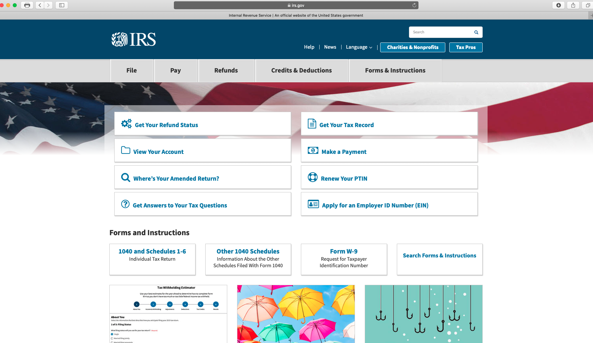
1. Go to “irs.gov”
2. Click

Slide 4
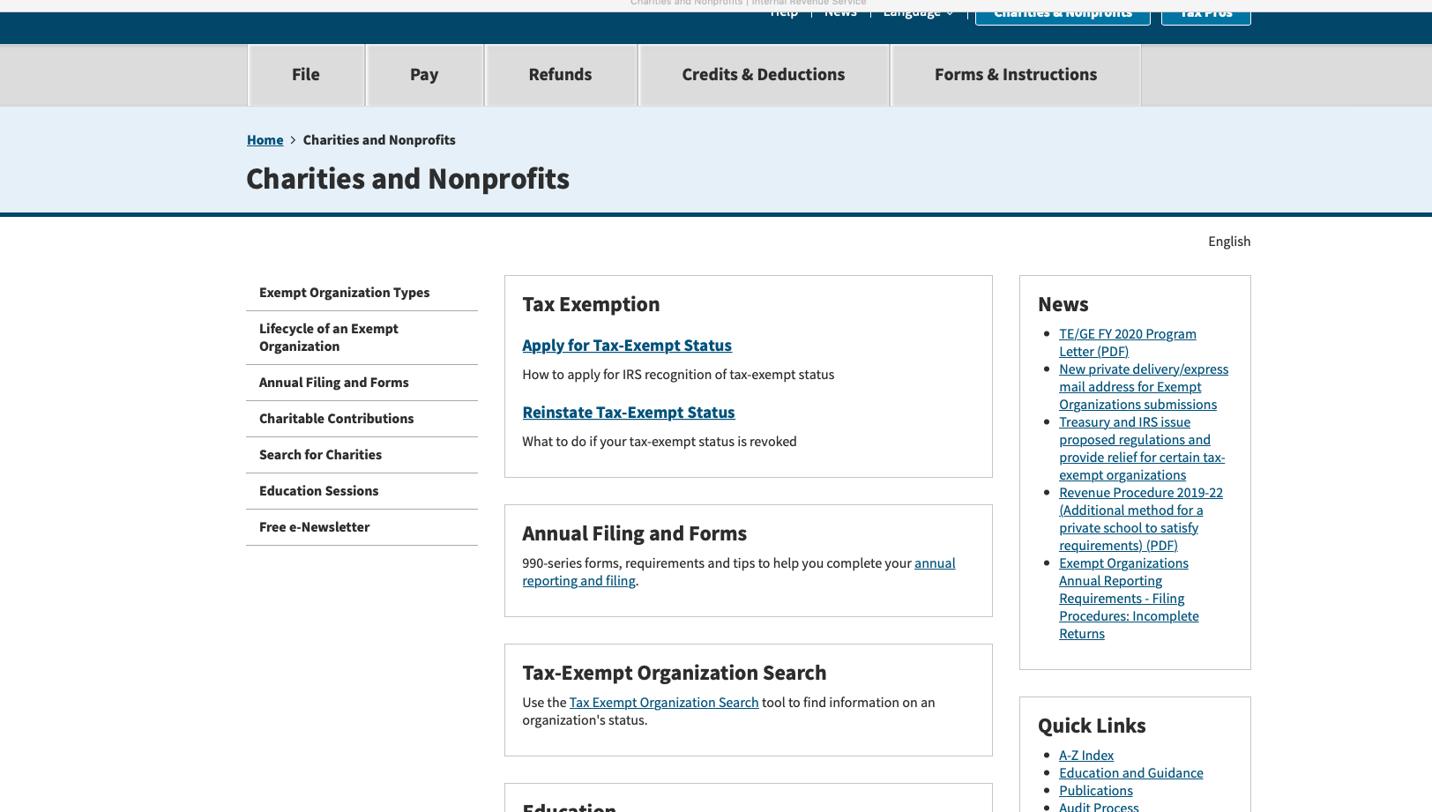
Click

Slide 5
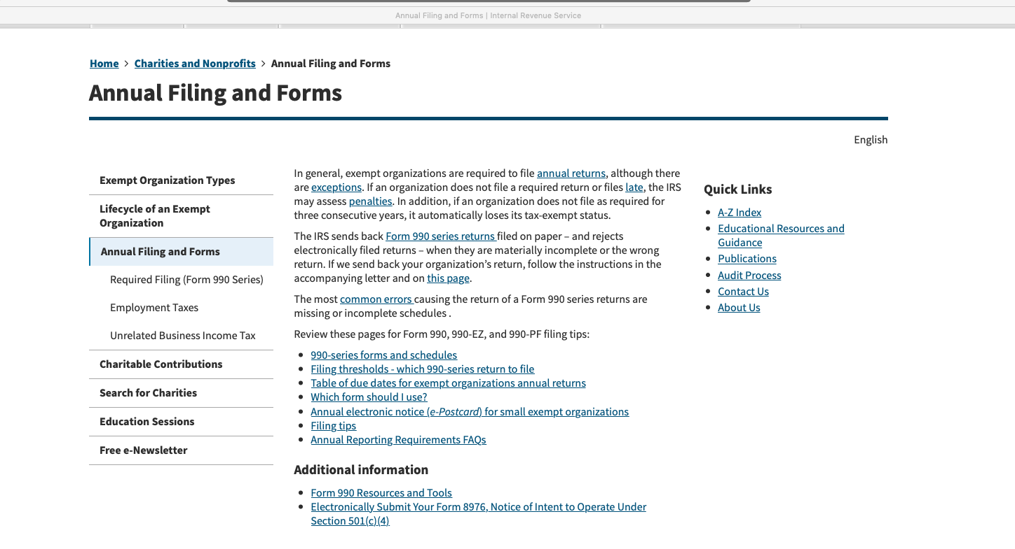
Click.
Important: Read about the penalties.
Then, click.

Slide 6
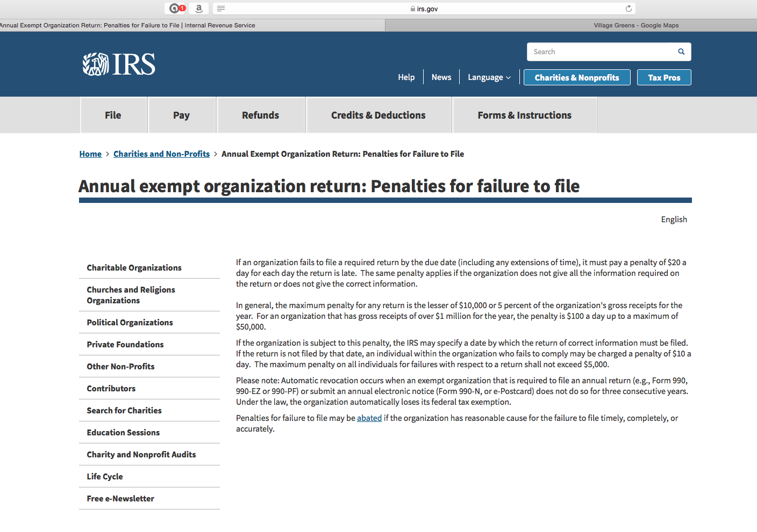
Read this, then return to previous screen.

Slide 7
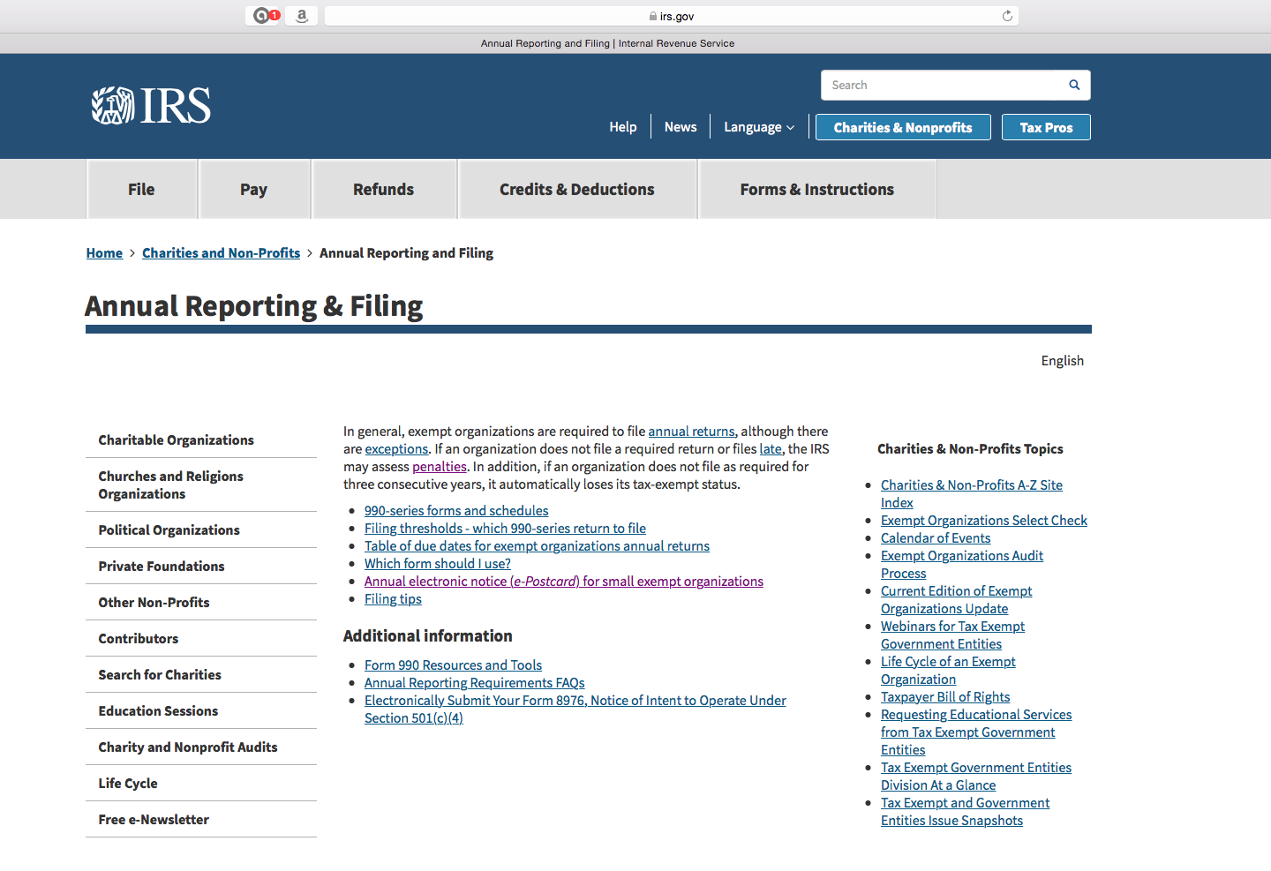
Recommend you click on the various links and read them.
When ready to proceed with registering, click here.

Slide 8
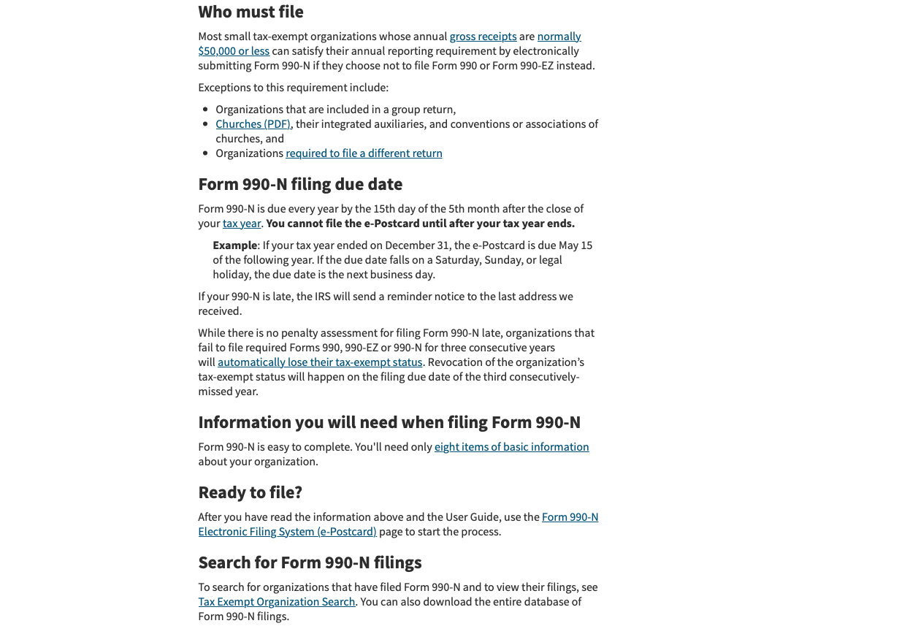
Click

Slide 9
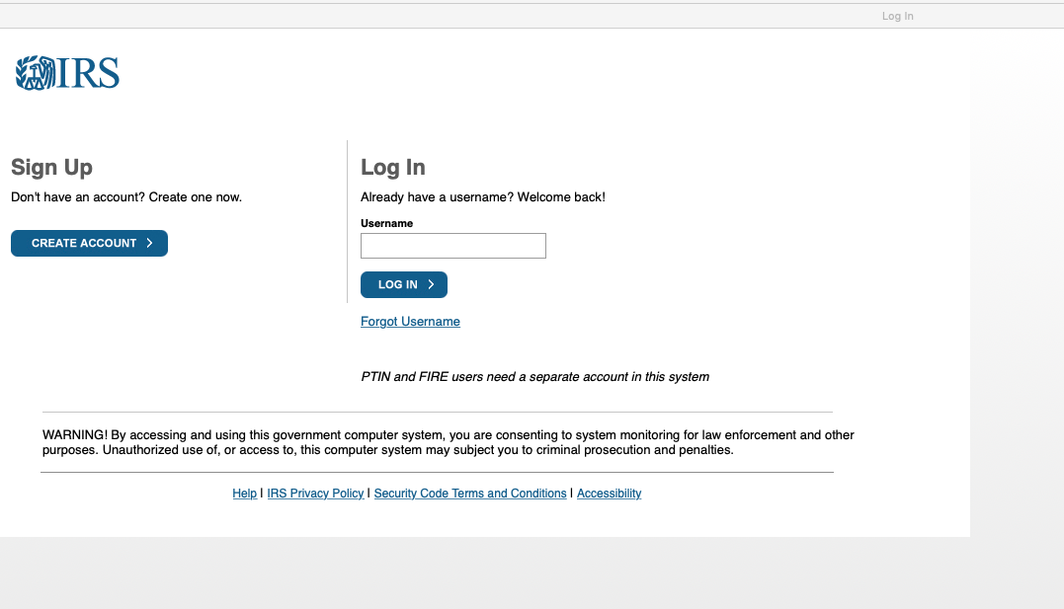
When initially registering and setting up your profile, click here.
In future years, when you get to this screen and you’ve already registered, enter your username and click here. Go to Part 3 of this slideshow for remaining instructions.

Slide 10
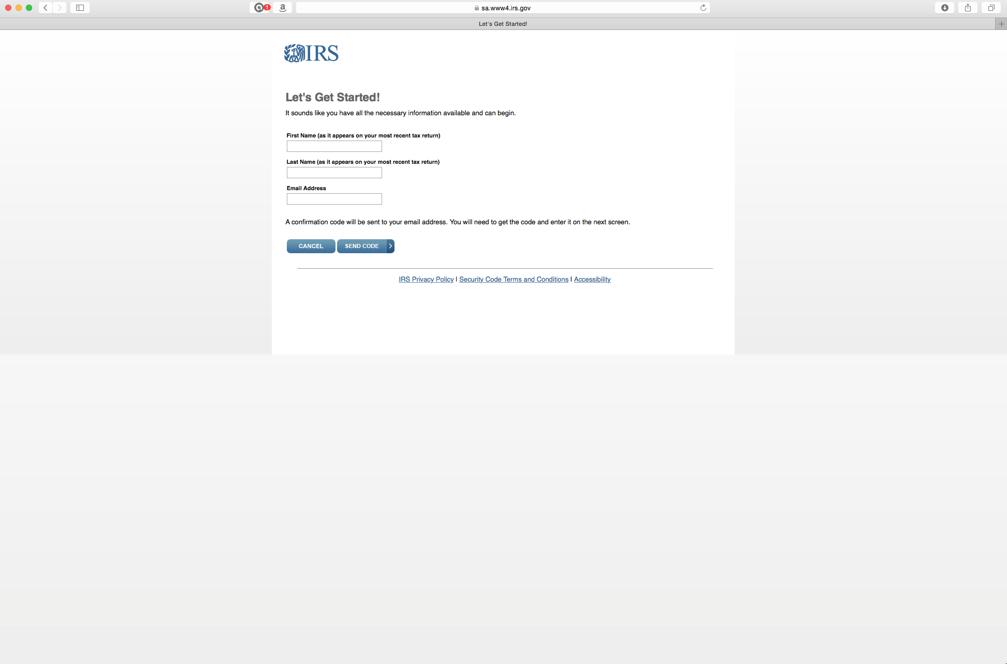
Put your first name, last name, email address.

Slide 11
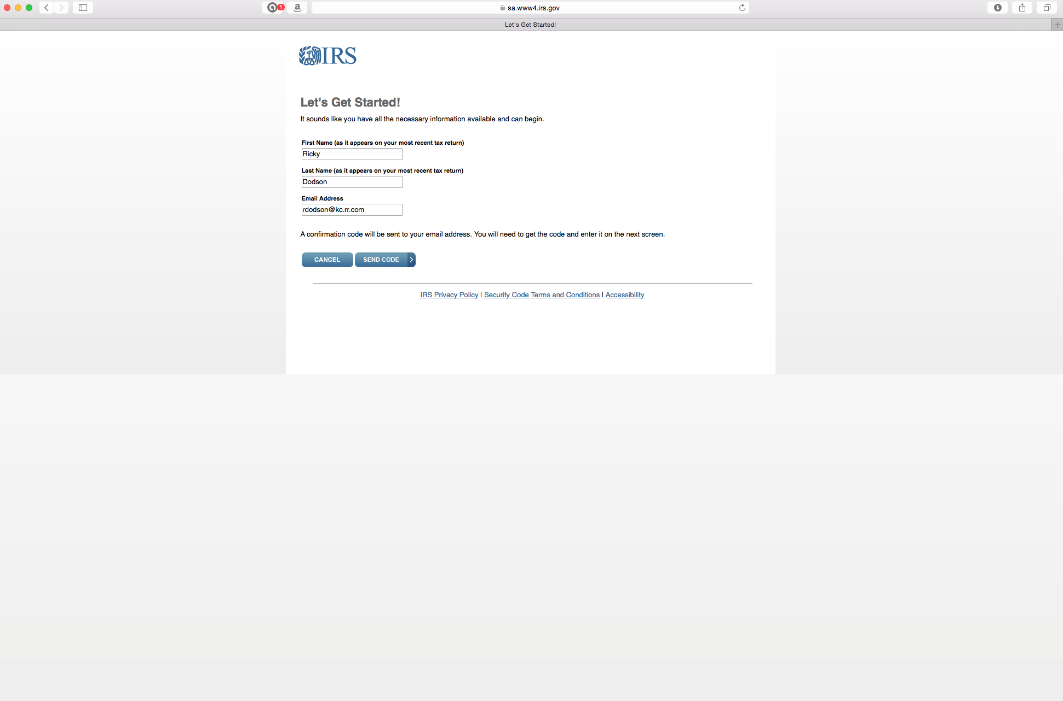
Then click “send code” to receive from IRS a code to continue the registration process. In the future, a new Secretary or Treasurer may have to change the profile to put in their name or keep using the name of the person who initially registered.
IMPORTANT: Make sure you write down and save the information to pass to the next Treasurer. That person can change it after they enter the first time.

Slide 12
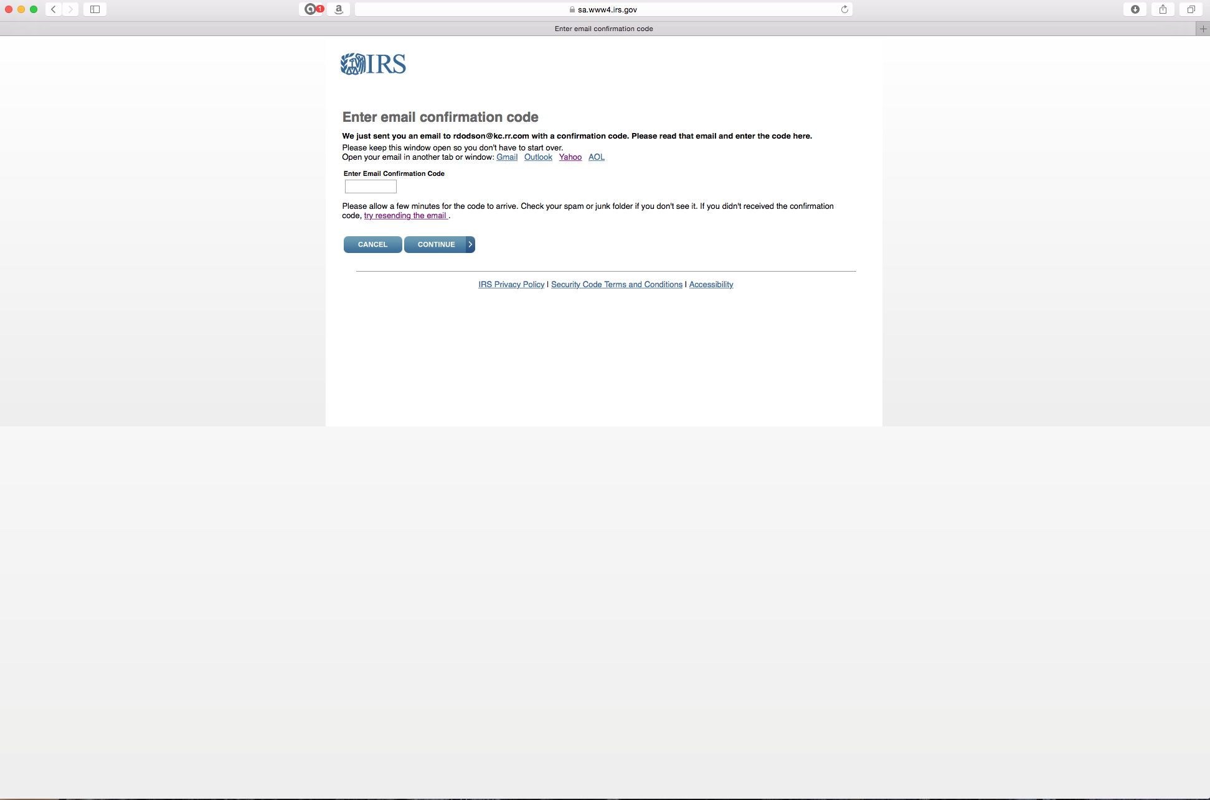
See the next slide for an example of the email from IRS with the code to put here.

Slide 13
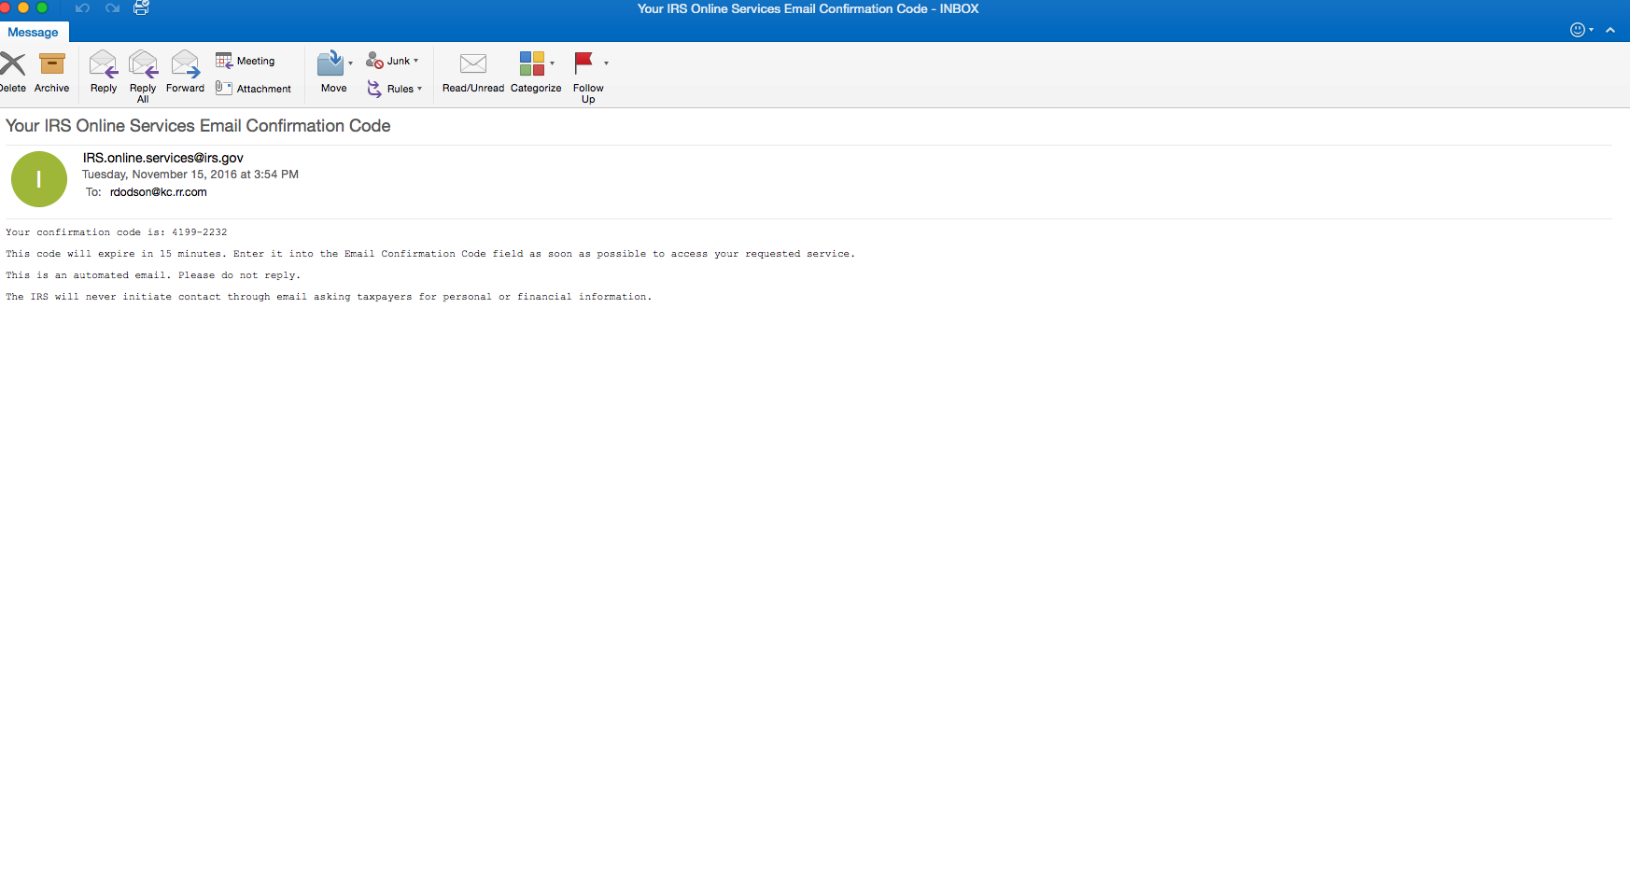
Note that the code is only good for 15 minutes. If you can’t complete the process, you may have to save and/or start over later.

Slide 14
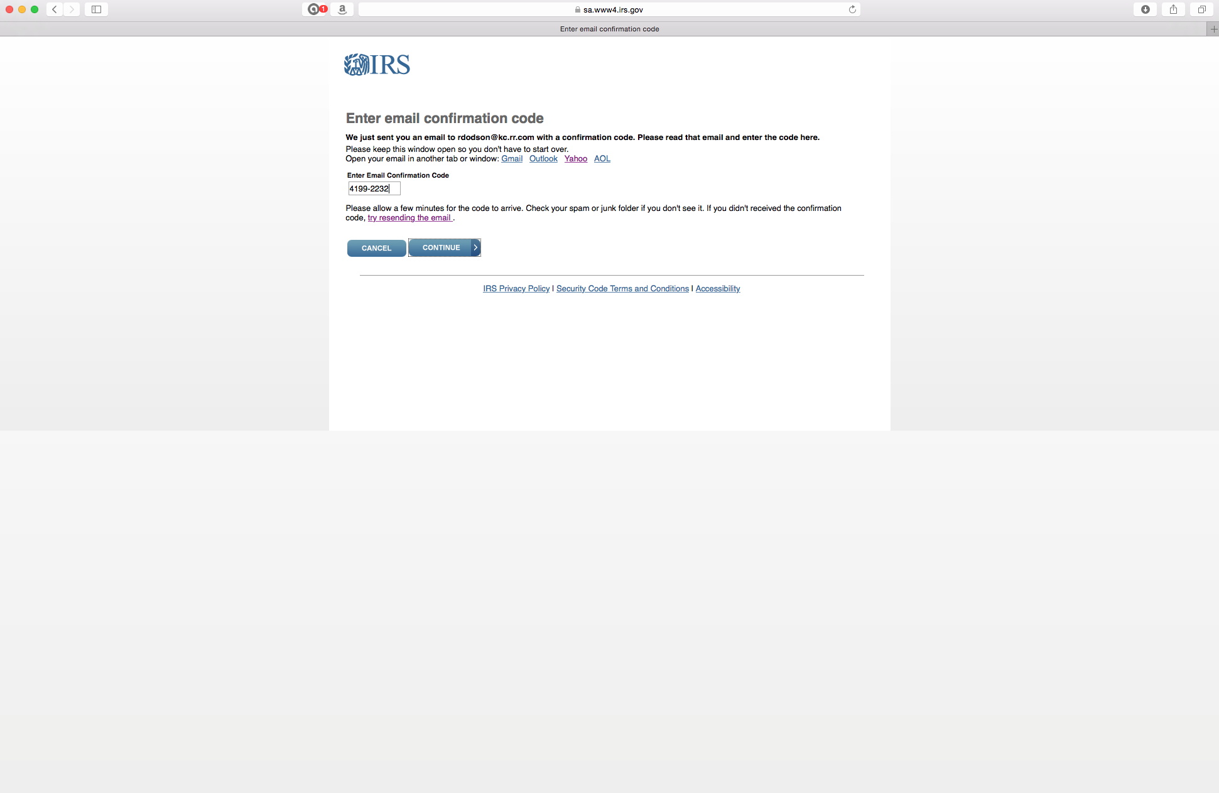
Click

Slide 15
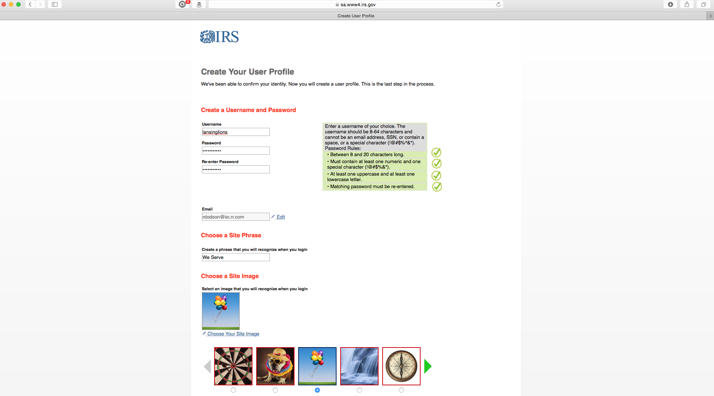
This is where you start creating your profile that will be used to permit you to sign in in the future and to establish some security measures. The following slide is the continuation of the page on the screen.
IMPORTANT: Make sure you write down and save all of these profile entries and pass them along to the future Secretary and/or Treasurer. If you lose/forget them, you won’t be able to sign in and complete the form in the future.

Slide 16
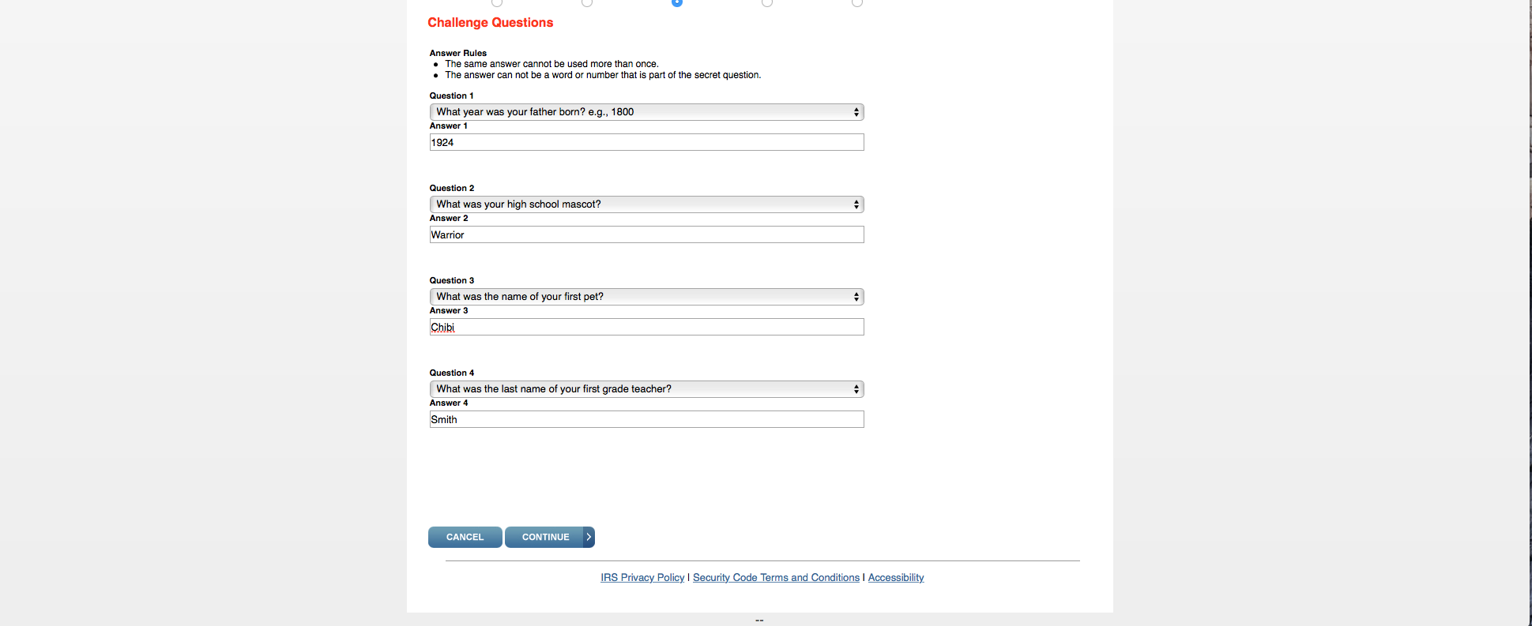
Click

Slide 17
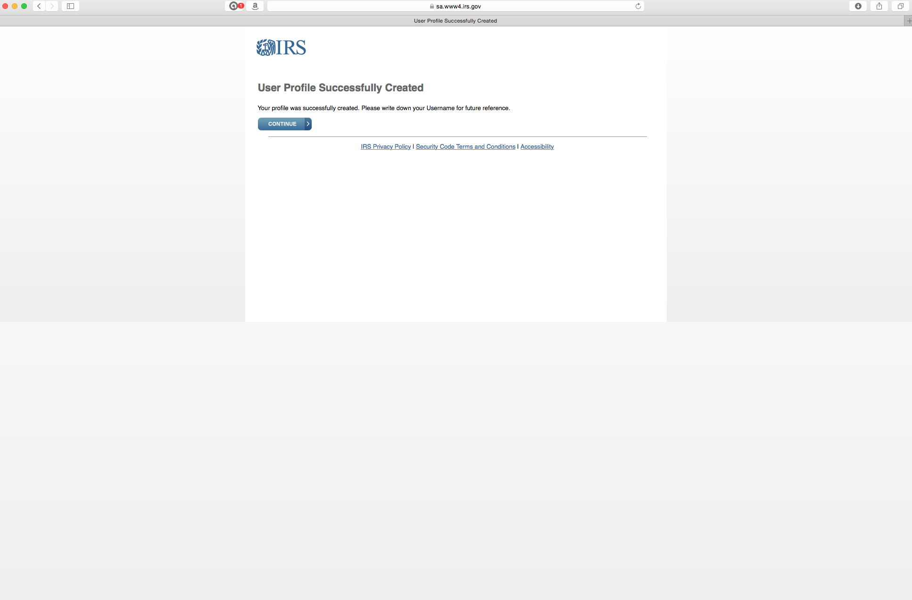
You’re done unless you want to go ahead and complete your current year’s submission.
If you want to do the first submission, the following slides show you how.
Click “continue” to create your first submission.

Slide 18
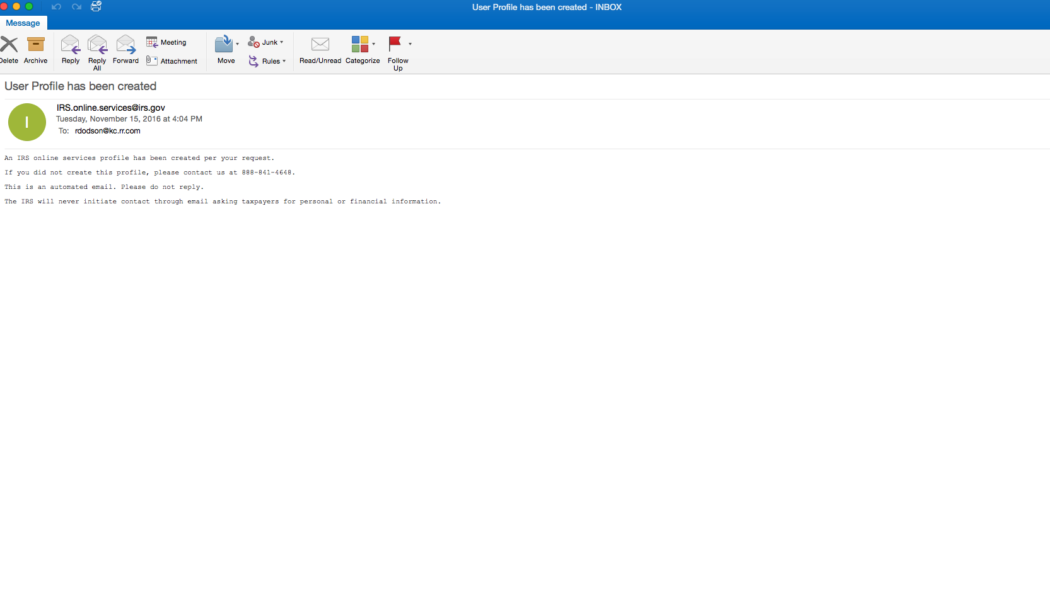
At some point after you complete the profile security questions and click “continue”,
you’ll get this email confirmation.

Slide 19
Part 2.
Submitting Your First Annual e-Postcard
When Initially Registering and
Creating Your Profile

Slide 20
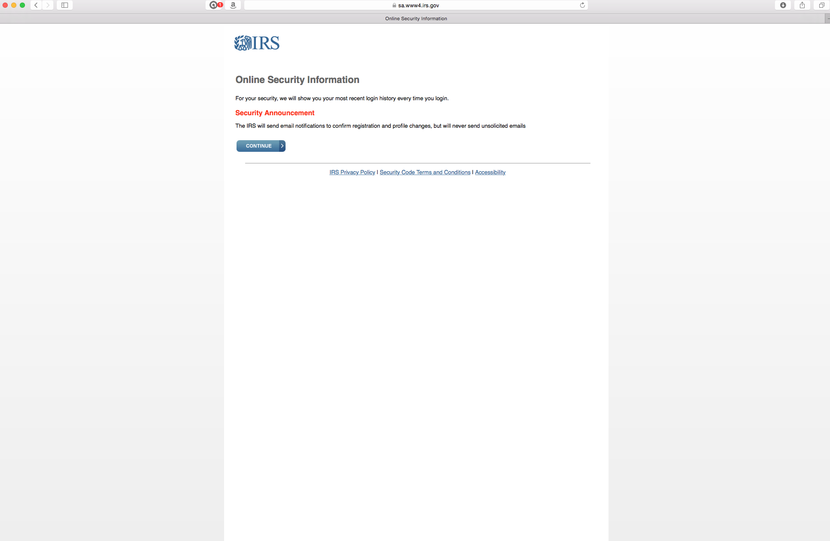
No input required here. Click “continue”.

Slide 21
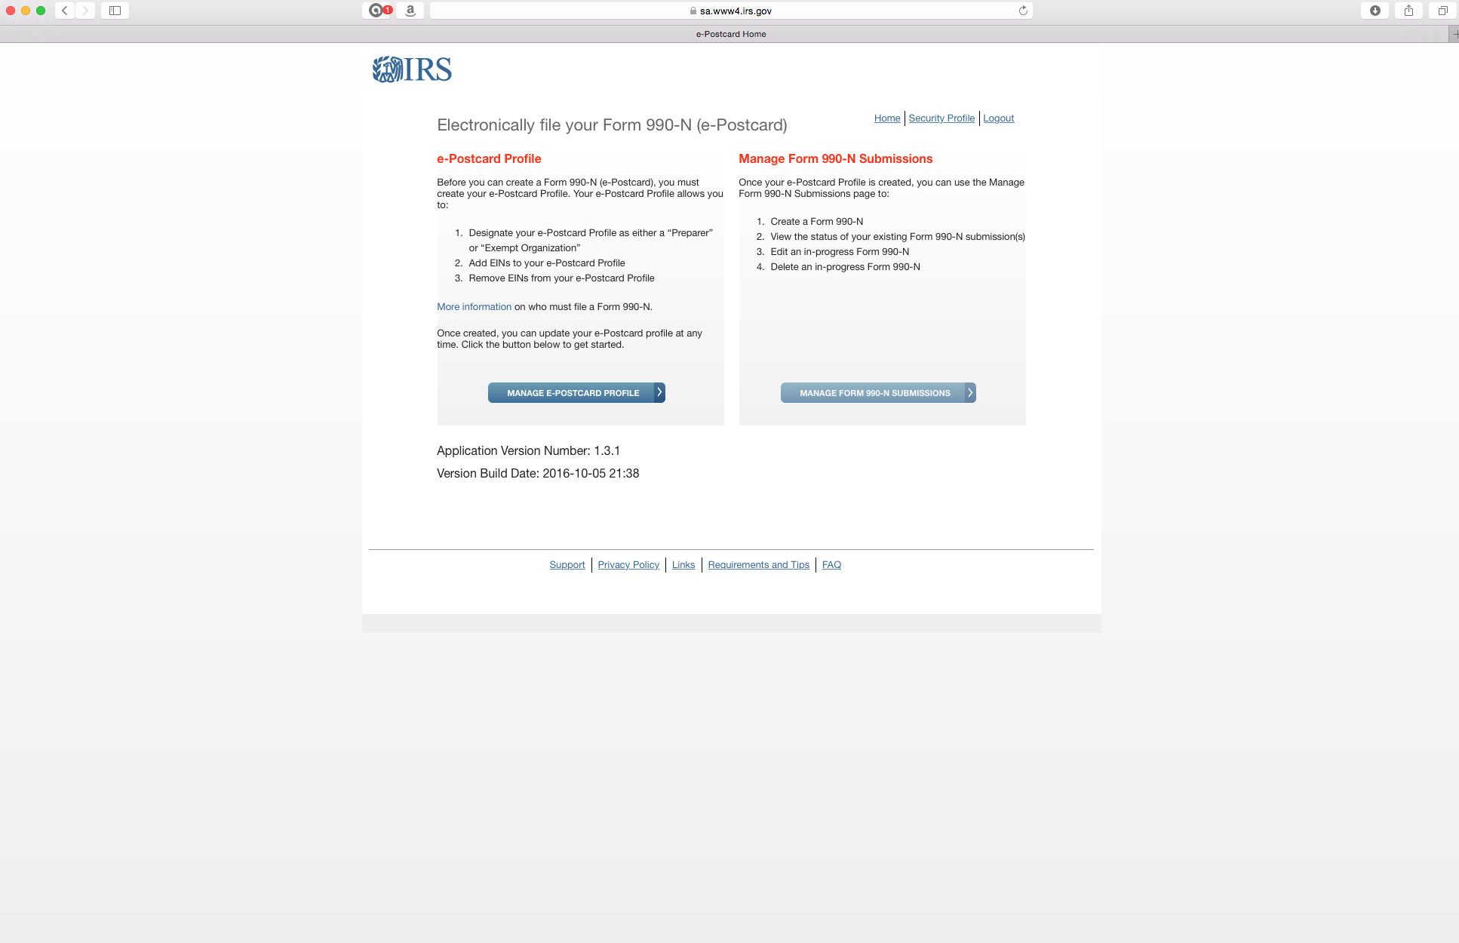
Click here to start your first submission.
In future years, you will not enter through this screen. Go back to slide 6 to see where you enter when you’ve already registered.

Slide 22
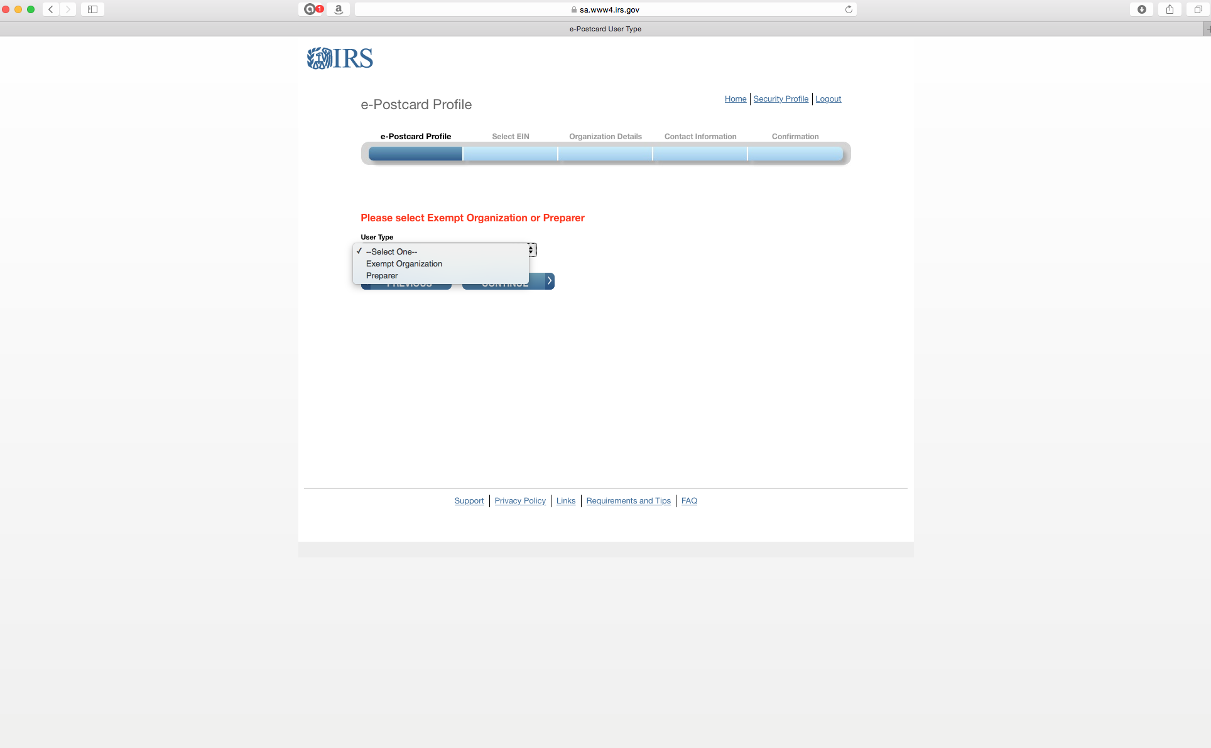
Click “Preparer”.

Slide 23
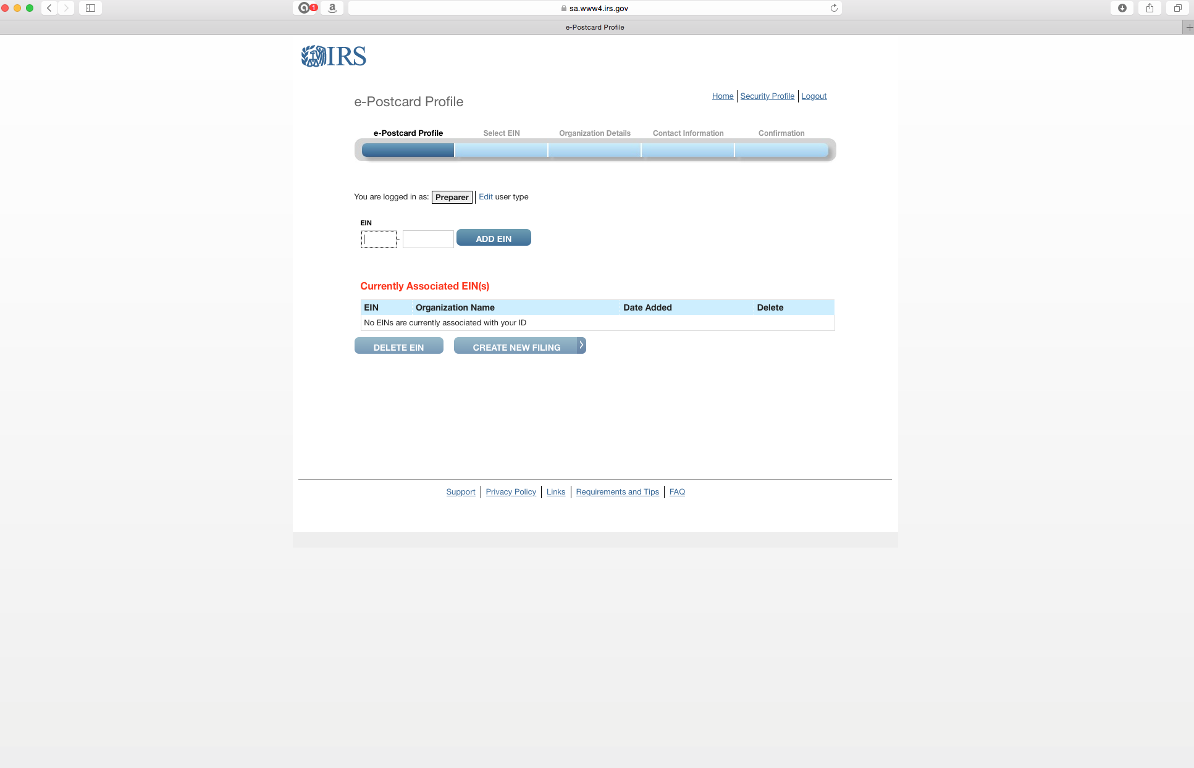
The first time you do this, enter your EIN and click “Add EIN”.

Slide 24
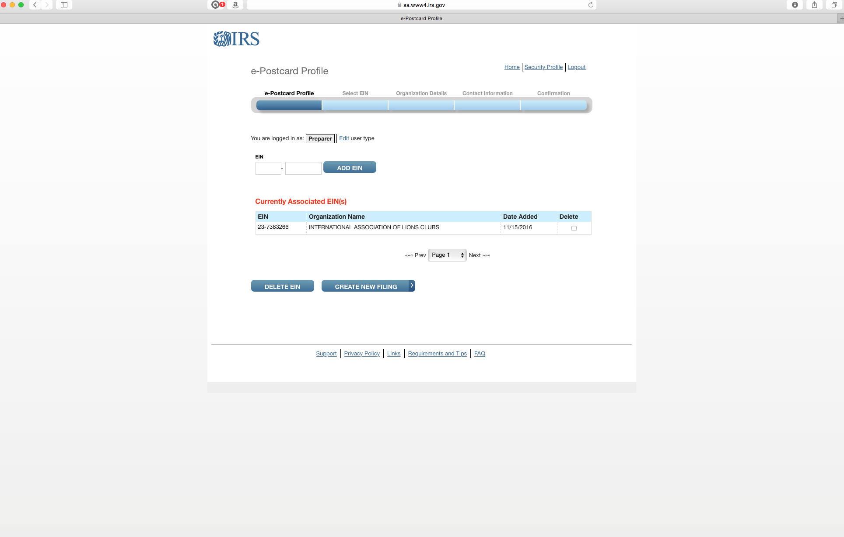
1. Now your EIN will be shown as associated with this profile. Note that all of our clubs’ EINs are shown with LCI’s name. You’ll be able to customize this in the profile later.
2. Click “Create New Filing”.

Slide 25
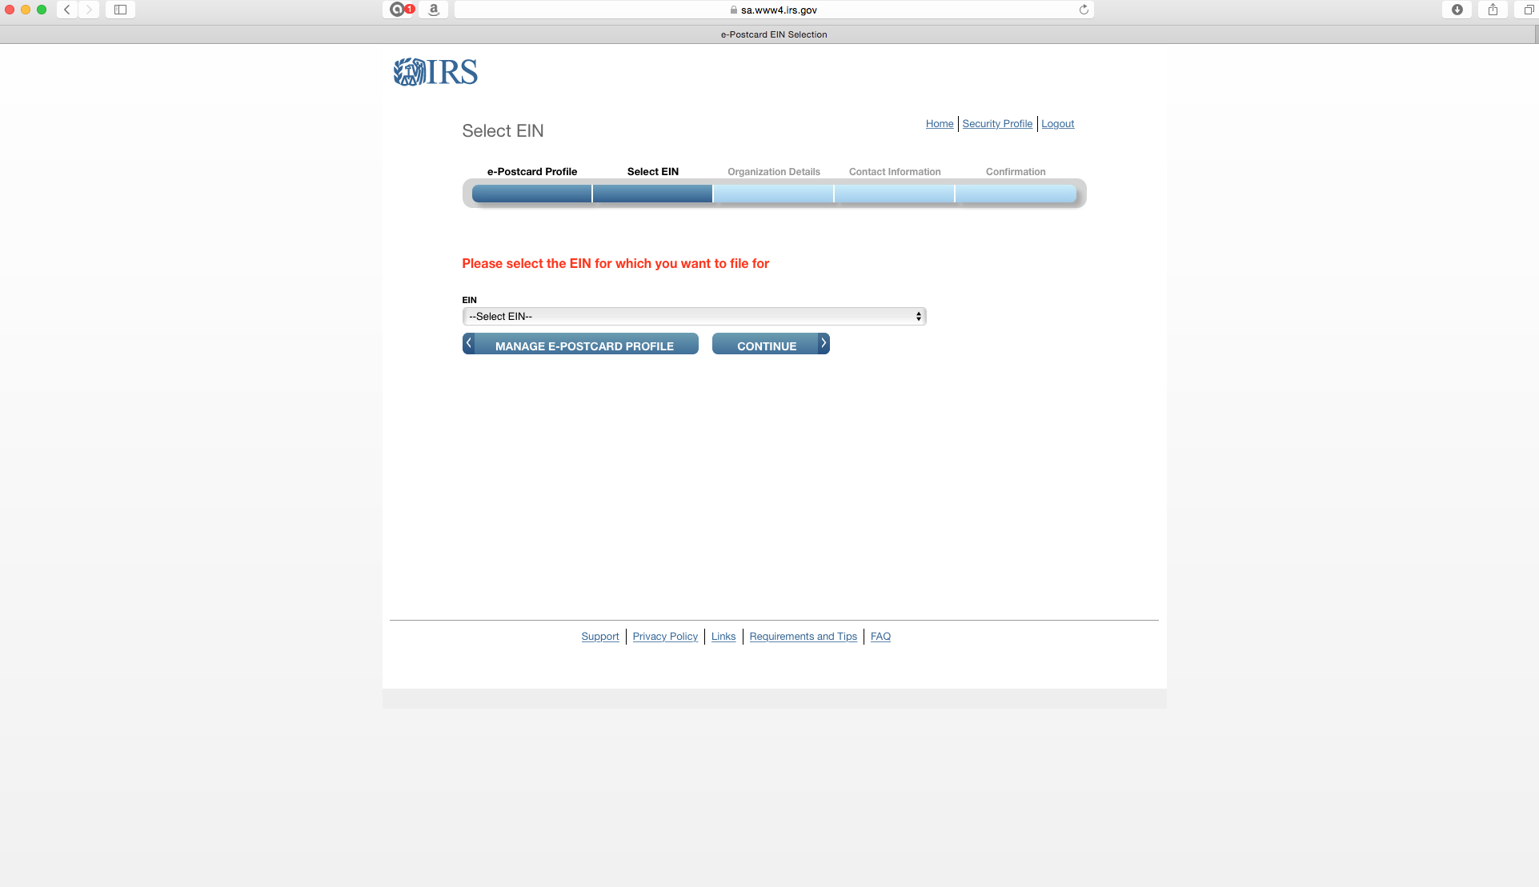
Click on the drop down menu.

Slide 26
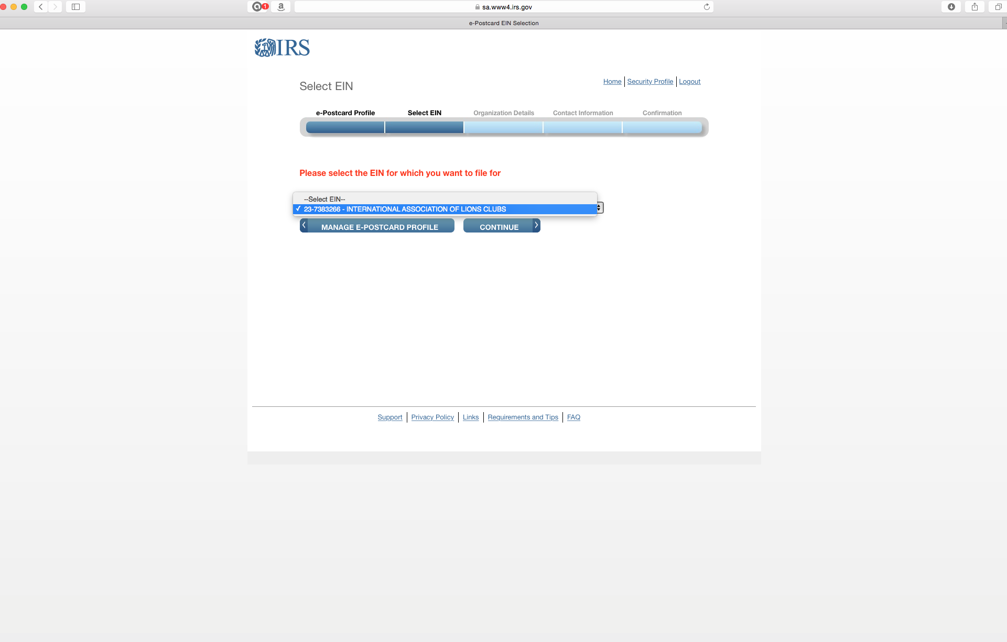
Your EIN should appear.

Slide 27
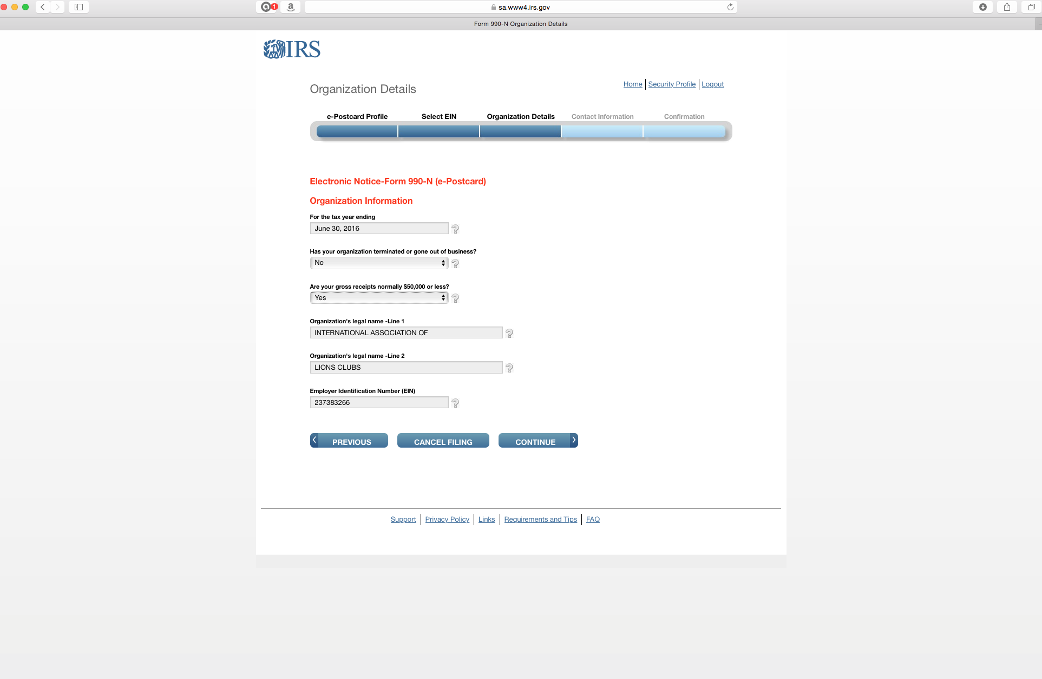
This is automatically filled out.
Answer these on the drop down menu.
Again, note that LCI’s name appears with your EIN.

Slide 28
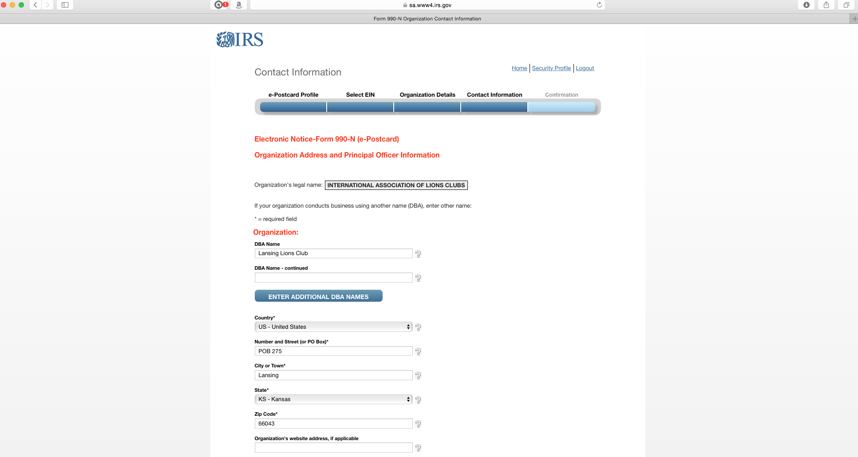
This is where you customize the profile to your club. DBA means “Doing Business As”. Put your club name and address info.

Slide 29
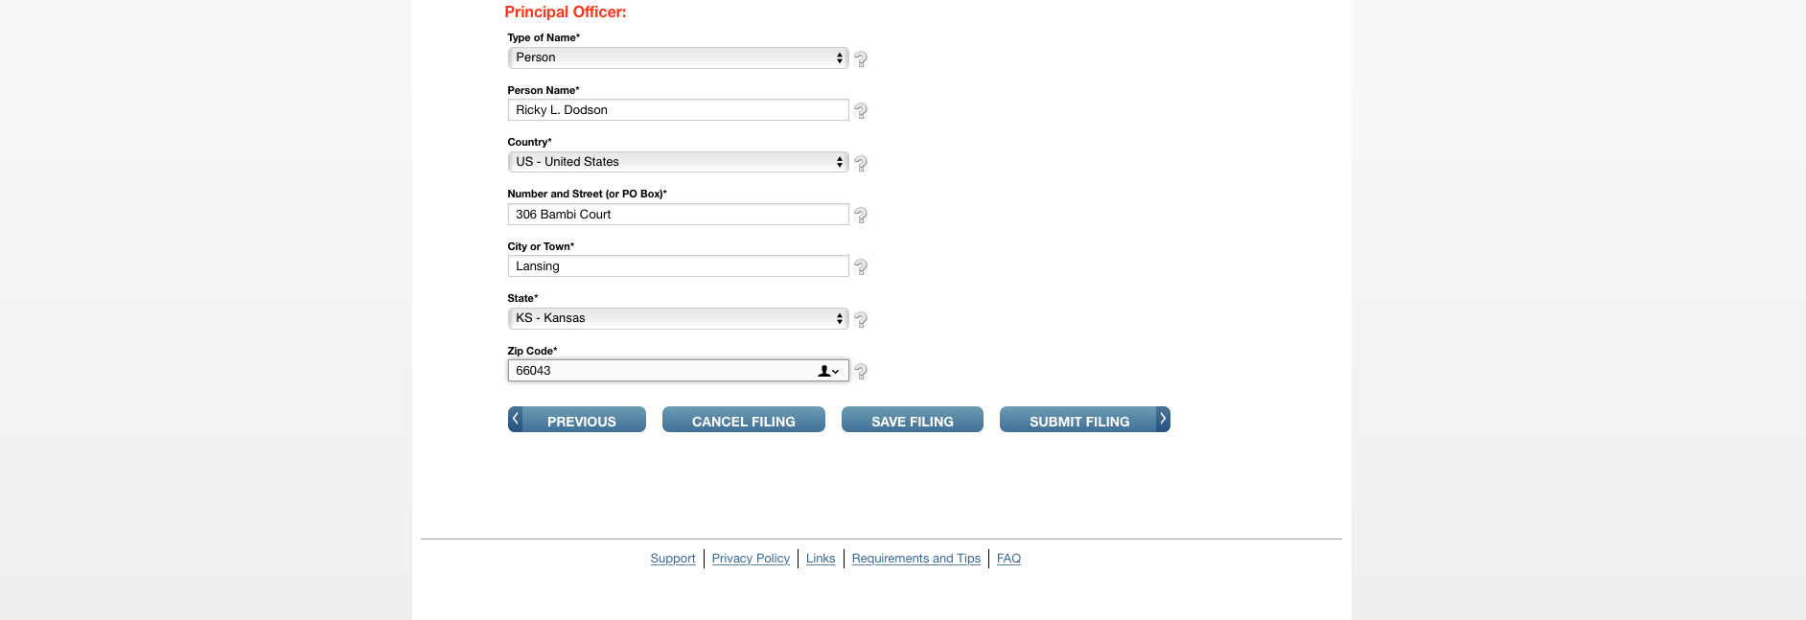
The drop down menu will give you a choice of “Person” or “Business” Select “Person” unless your club has established itself as a foundation, then you might select “Business”.
Probably not important who you enter here. If you put the president and that name changes each year, you’ll be constantly updating the profile.
Click here if you’re ready to submit.

Slide 30
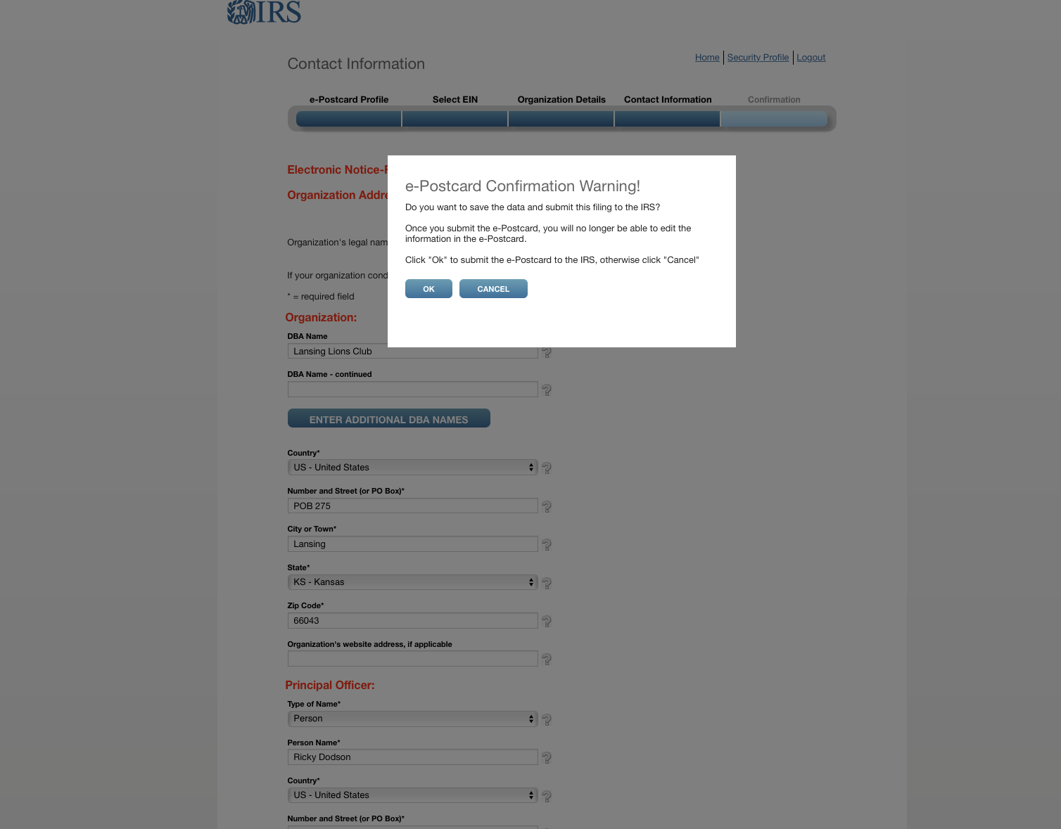
Click.

Slide 31
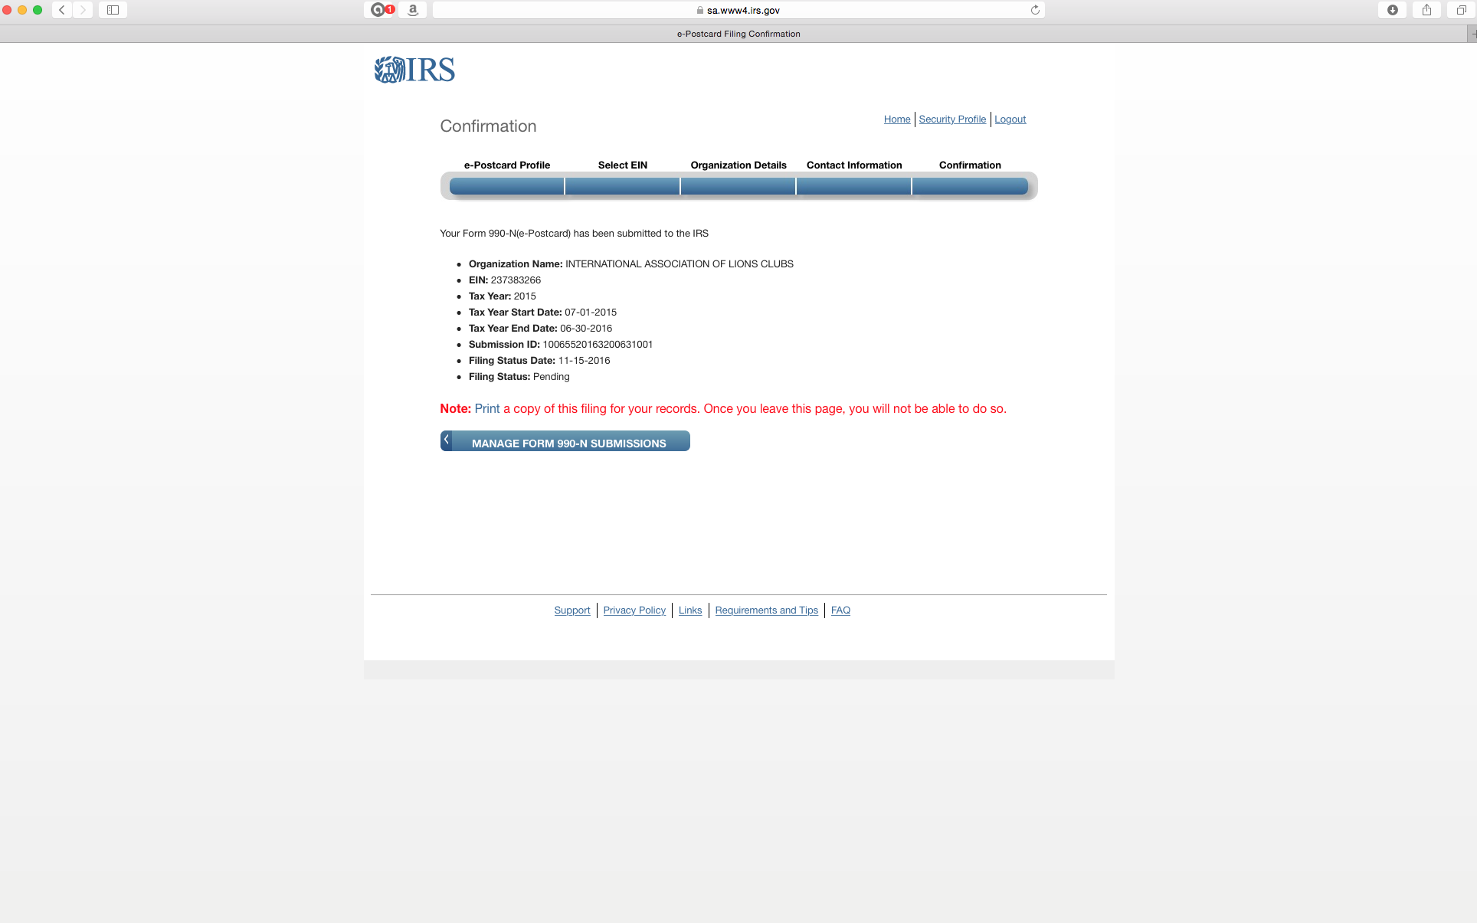
Don’t forget to print the screen.

Slide 32
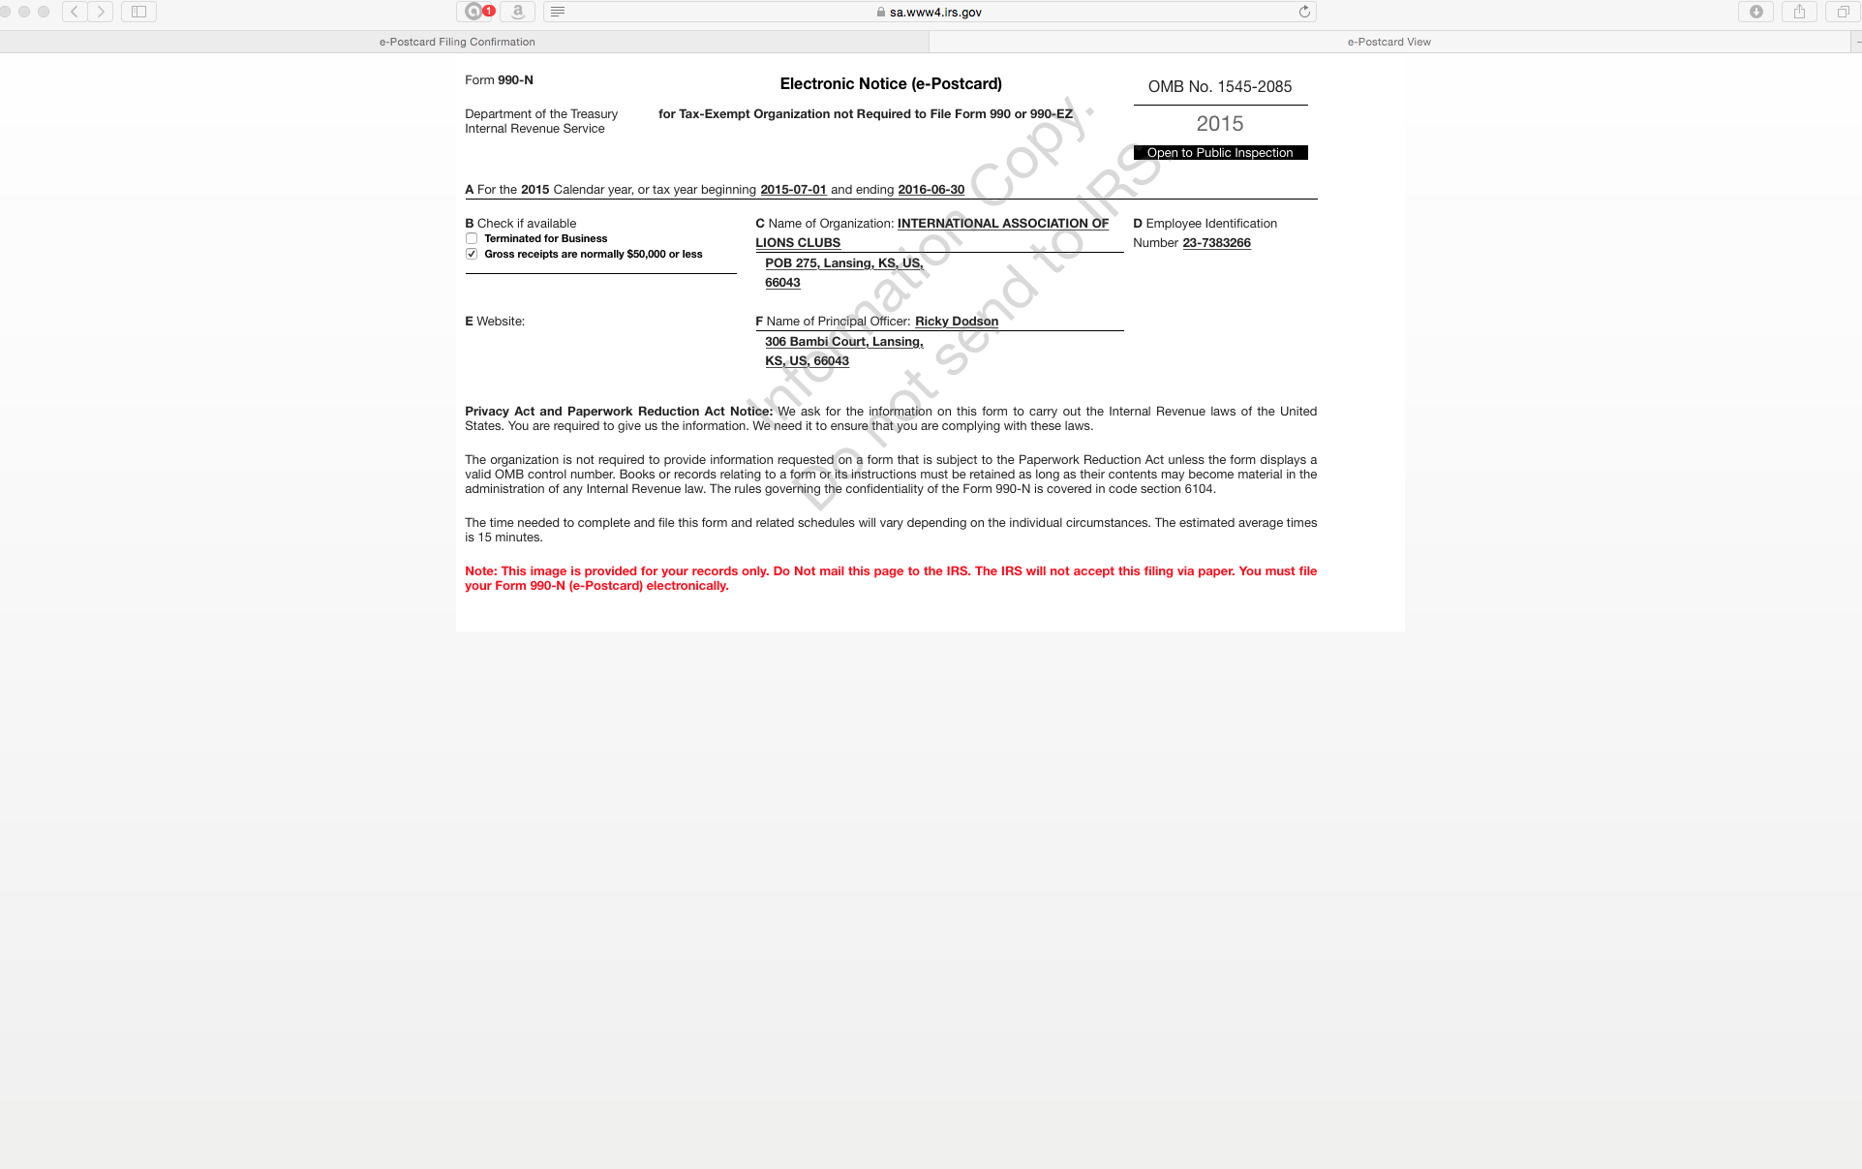

Slide 33
Part 3.
Submitting in future years with
registration already completed.

Slide 34
1. Go to “irs.gov”
2. Click

Slide 35
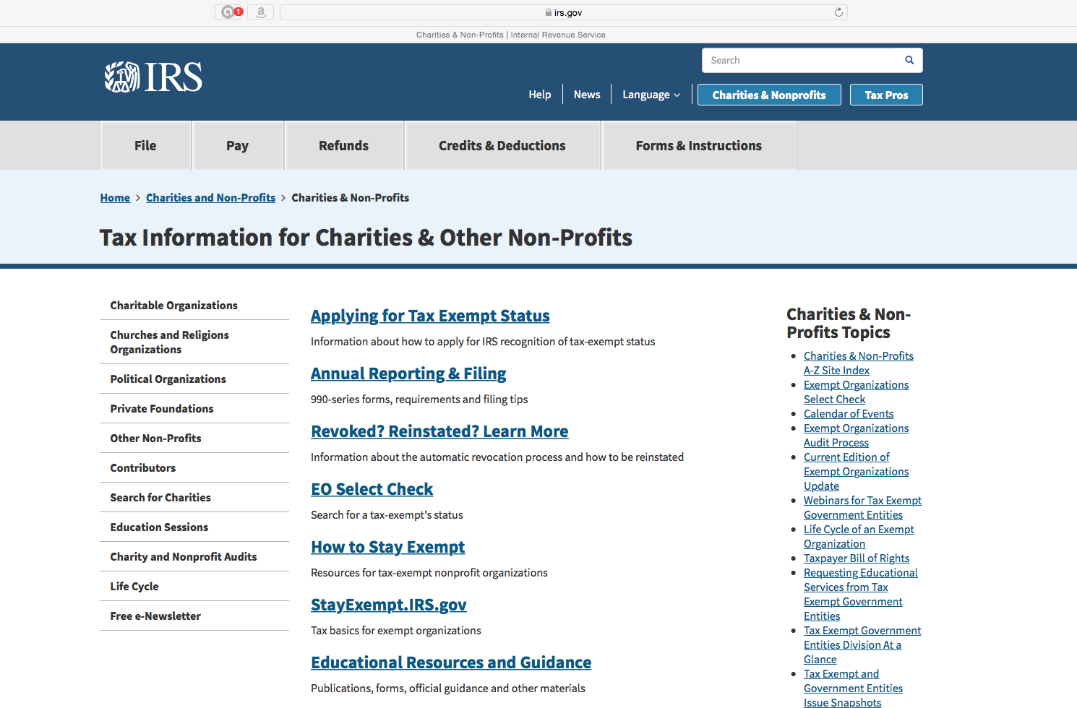
Click

Slide 36
Click.
Important: Read about the penalties.

Slide 37
Read this, then return to previous screen.

Slide 38
Recommend you click on the various links and read them.
When ready to proceed with registering, click here.

Slide 39
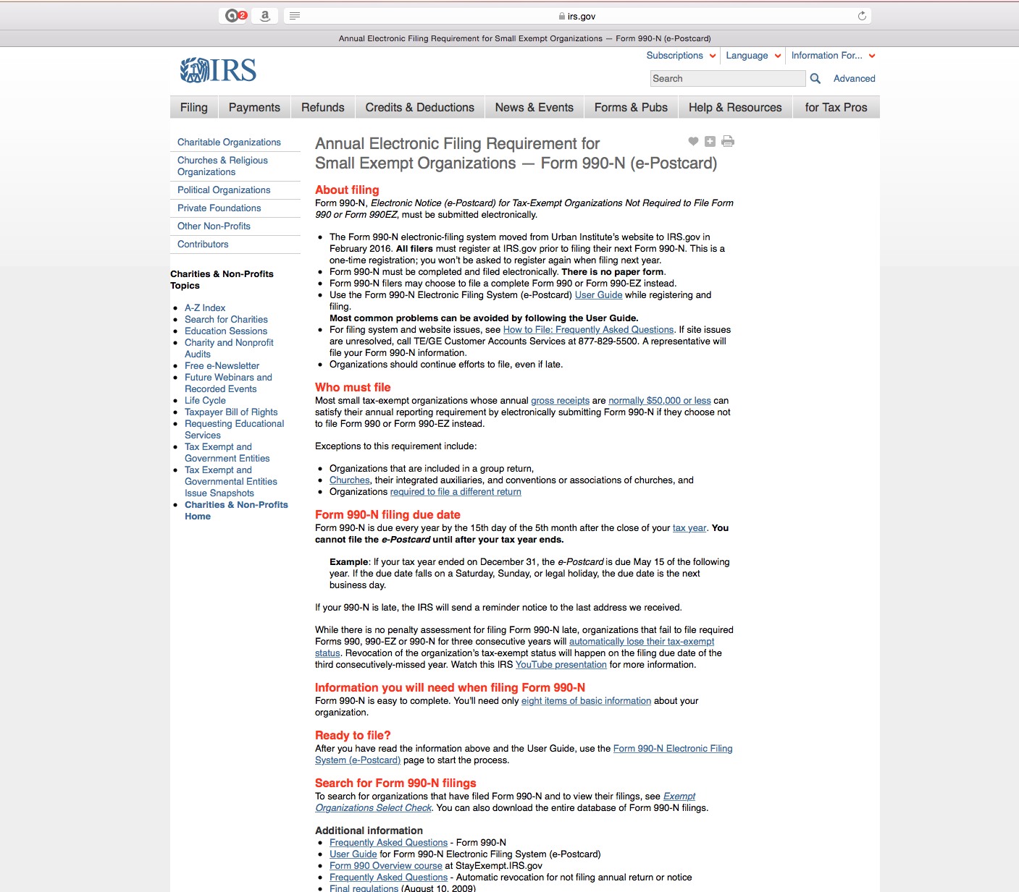
Click

Slide 40
When you get to this screen and you’ve already registered, enter your username and click here.
The program is not very forgiving. If you wait too long to fill in blanks, it will tell you it has stopped you for security reasons and tells you to try again later. So, be prepared with all of your information.
You may have to start over several times to git’er done.

Slide 41
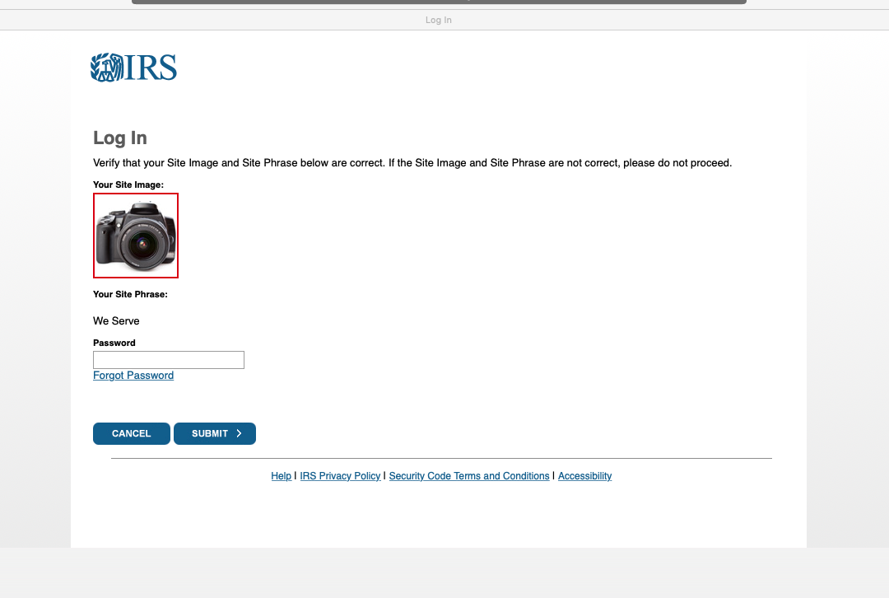
Enter your password and click “Submit”.

Slide 42
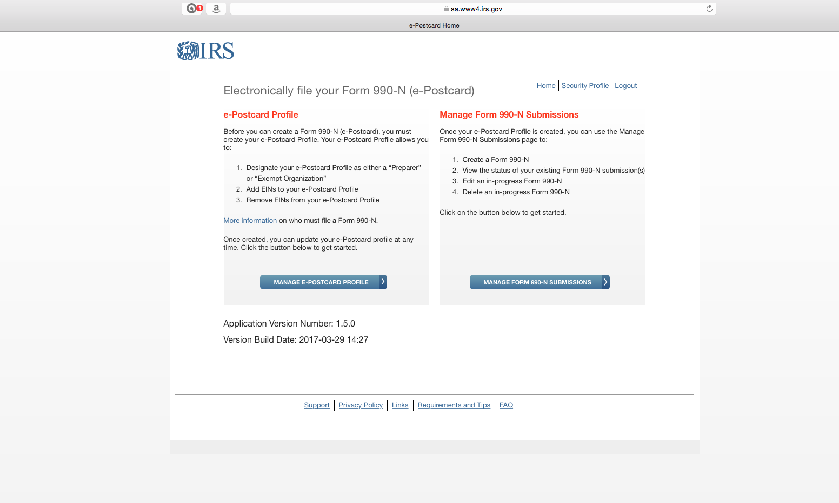
For annual updates,
Click here!!!!!

Slide 43
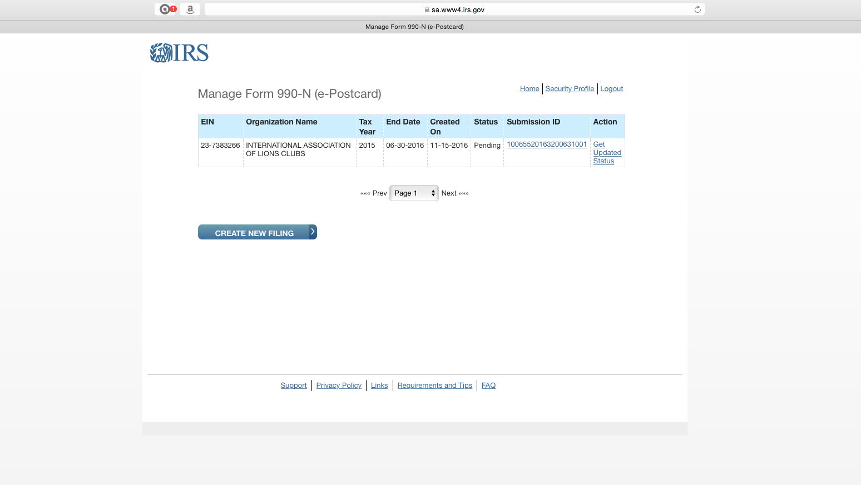
Click

Slide 44
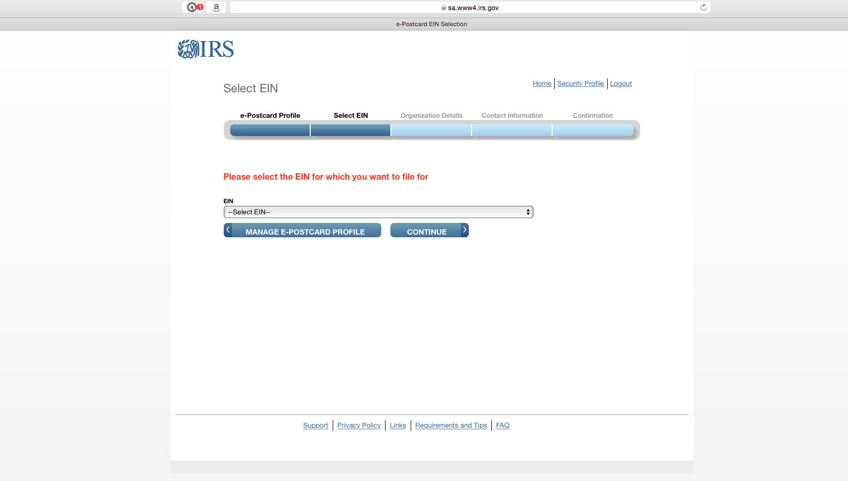
Click to get drop down menu.

Slide 45
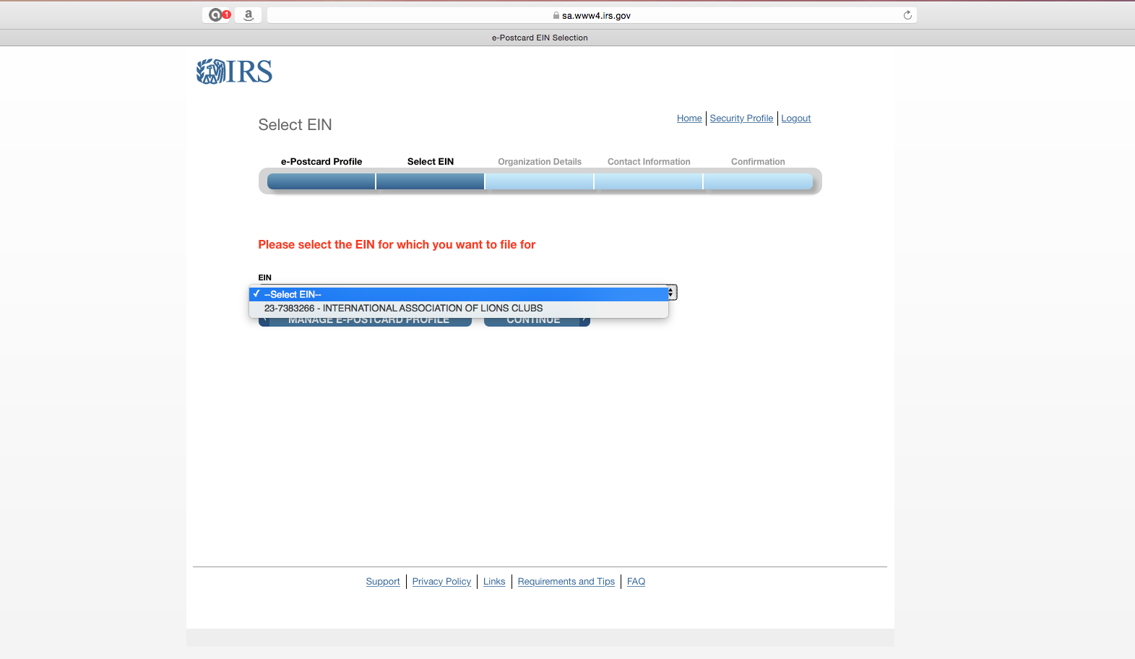
Click to select your EIN. You should get only one selection.
Then, continue.

Slide 46
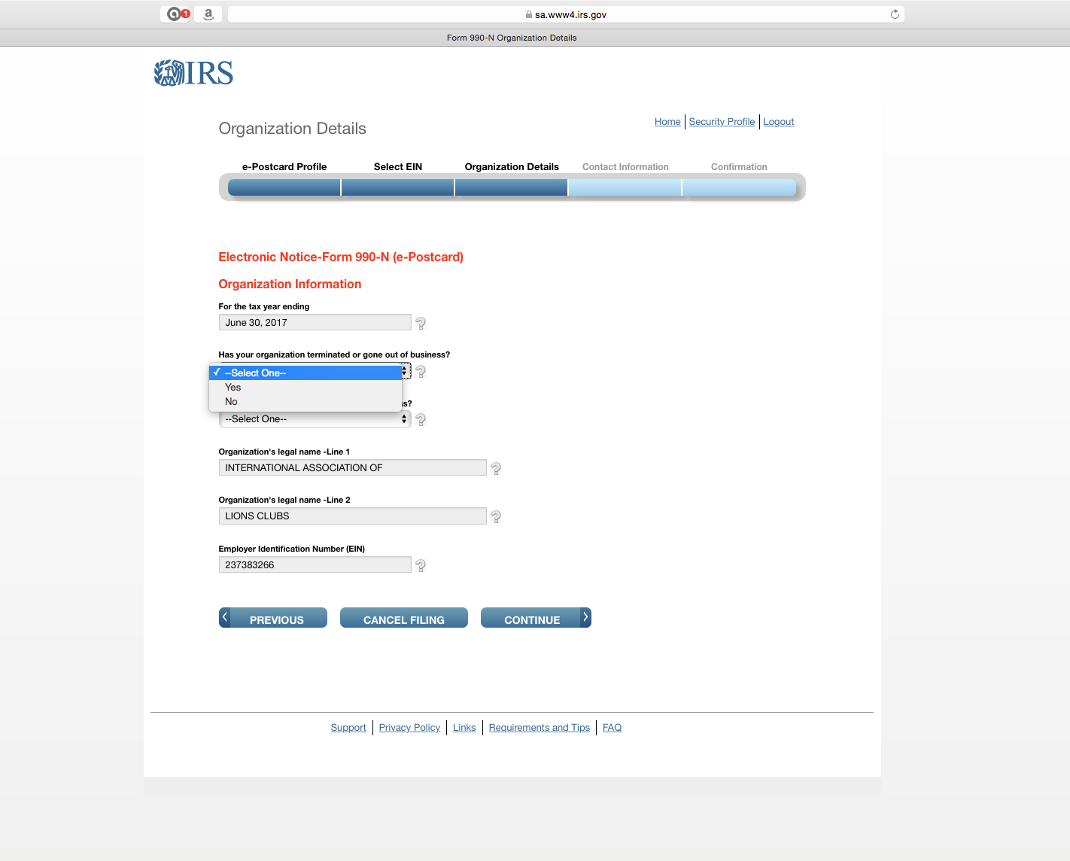
Select “No”.
Next menu should ask if you
made under $50,000. Select yes.
Then, continue.

Slide 47
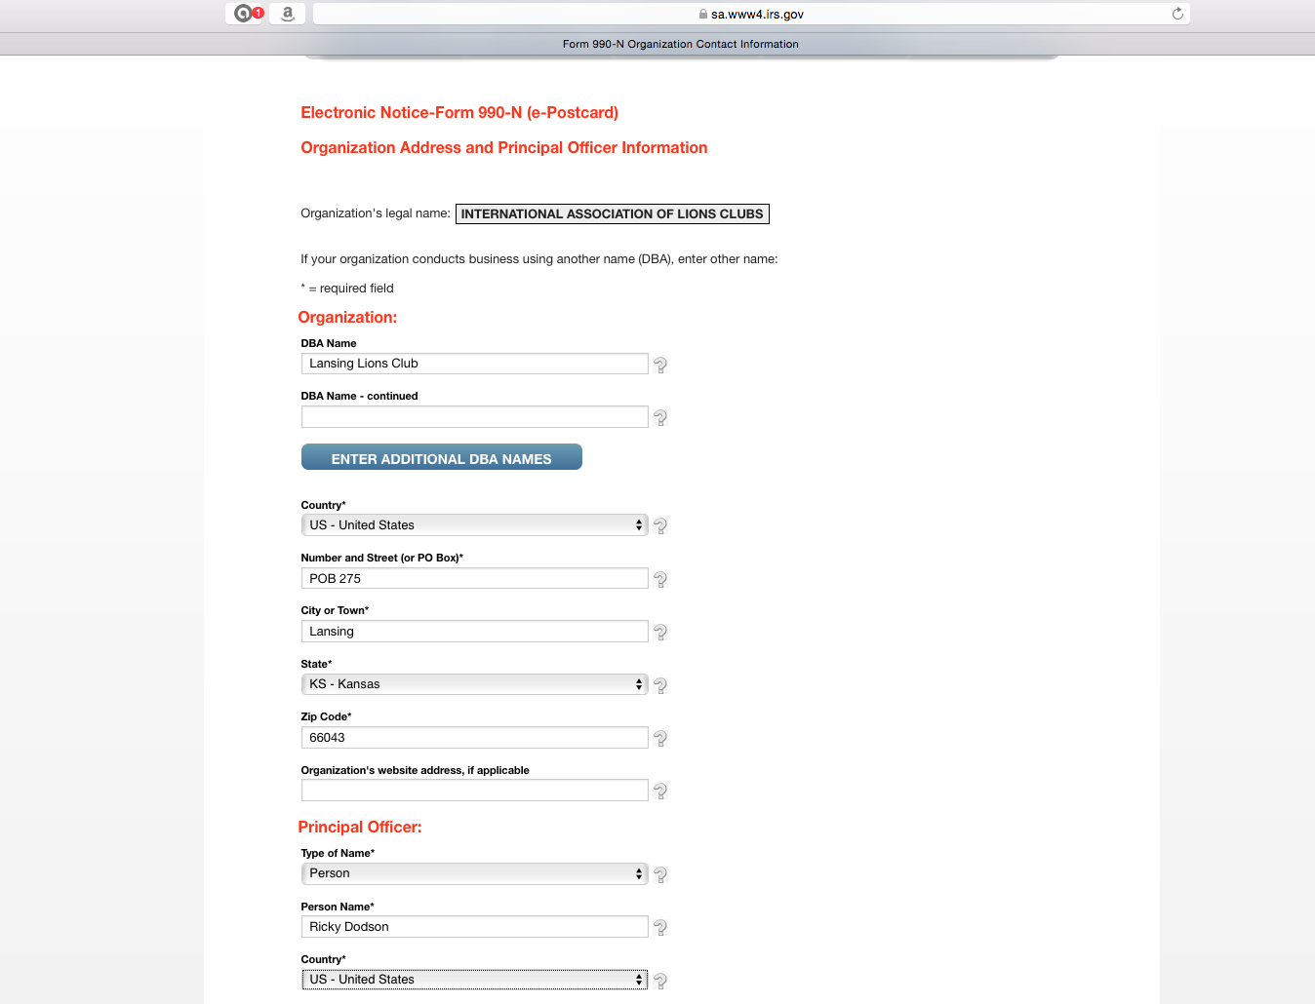
Enter your Lions Club name here.
Then enter other information below
Then, continue.

Slide 48
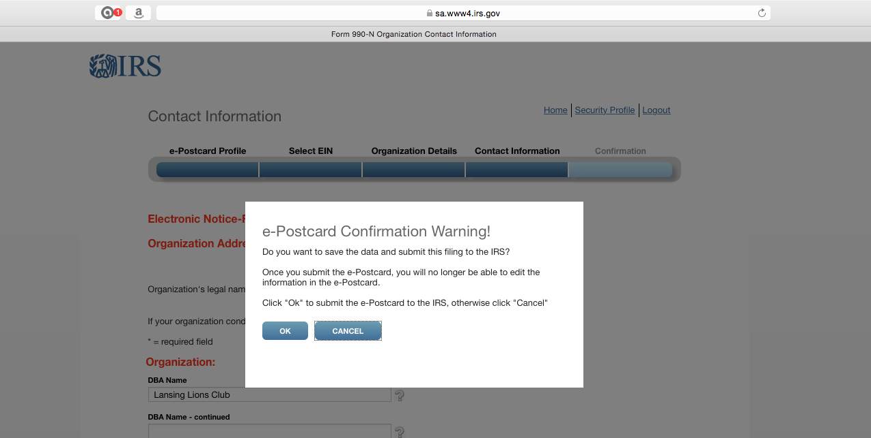
This is the confirmation screen.
Click “OK”.

Slide 49
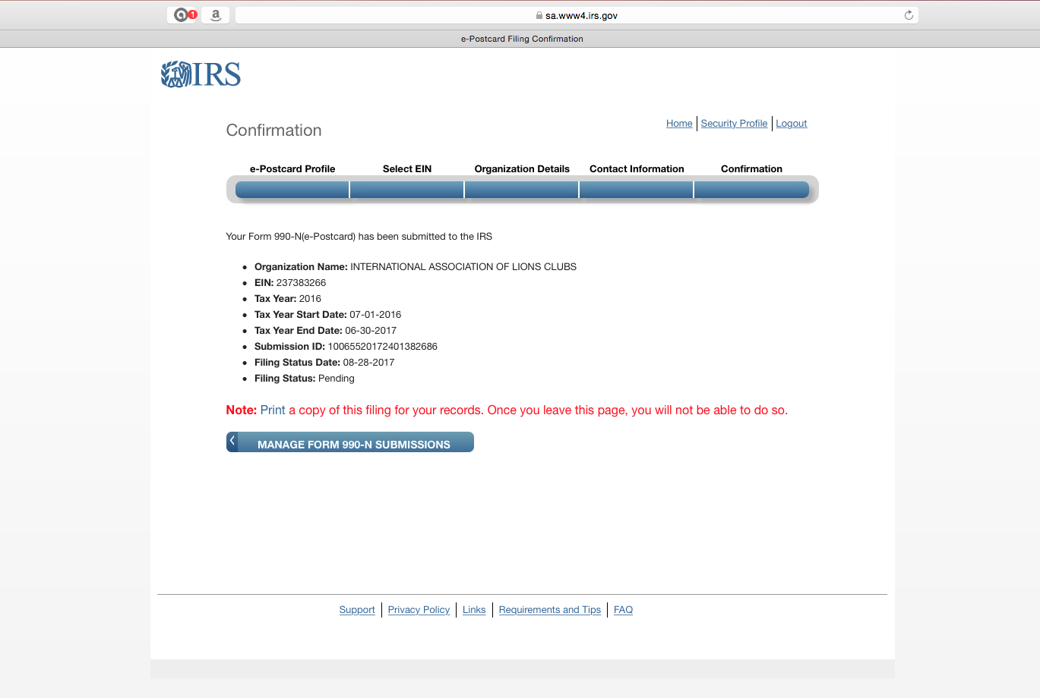
This is the final screen.
You will get an email confirmation,
but recommend you click here to print as well.
Then click on “Logout” on the top menu.
Do not click on the “Manage form 990-N submissions”.

Slide 50
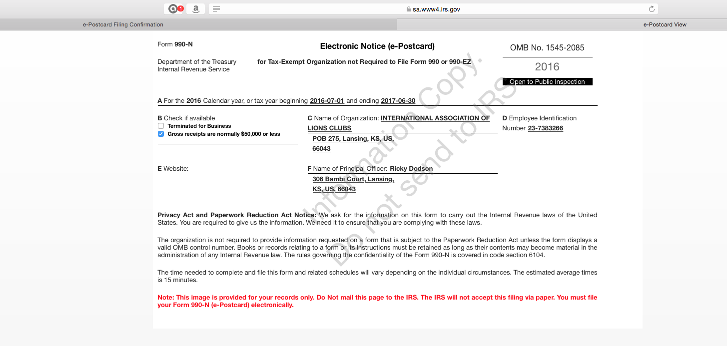
This is the printable confirmation. Save in your files.

