Slide 1


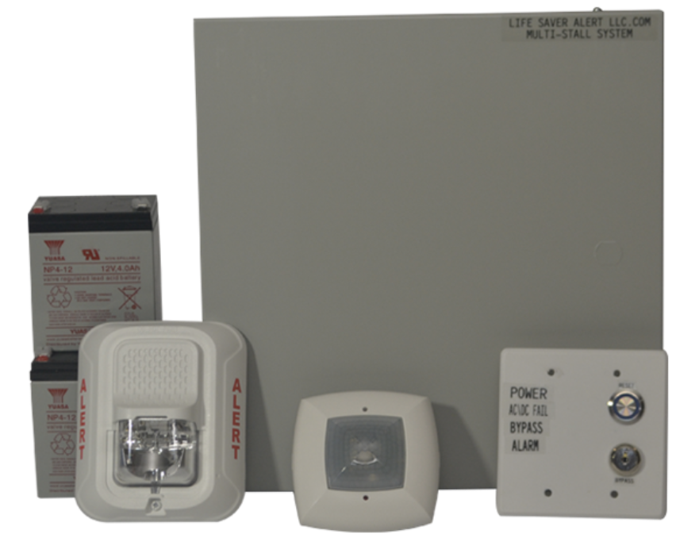
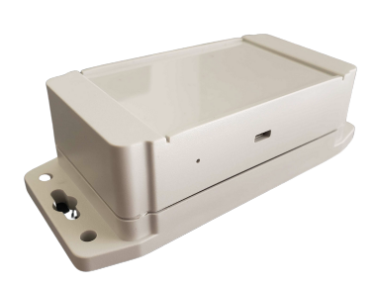
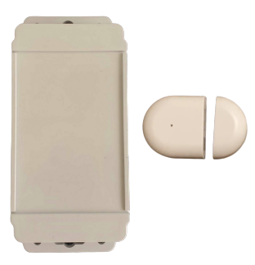
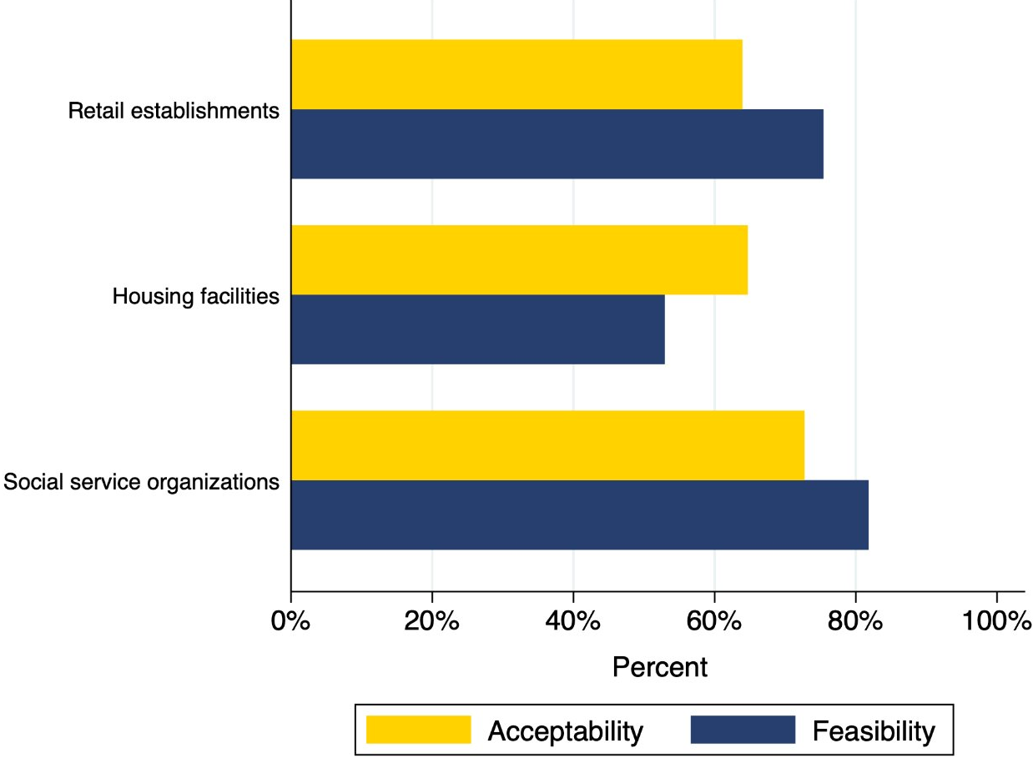
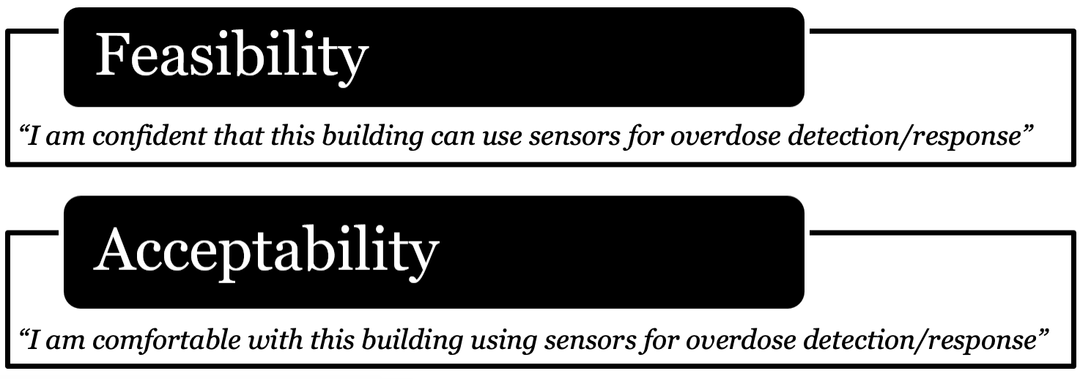
Restroom Motion Sensor Systems to Prevent Overdose: Pilot Findings from Rhode Island
Rehan Aslam ¹, Michelle McKenzie ², Joseph G. Rosen ^{1,3}, Autumn Froias ⁴, Gabrielle Riendeau ¹, Maxwell Krieger ⁵, Susan Ramsey ³, Ju Nyeong Park ^{1,3,5}
1. Harm Reduction Innovation Lab, Rhode Island Hospital, Providence, RI, 2. Preventing Overdose and Naloxone Intervention, Miriam Hospital, Providence, RI, 3. Division of General Internal Medicine, Rhode Island Hospital and Warren Alpert Medical School, Brown University, Providence, RI, 4. Simmons University, 5. Department of Epidemiology, School of Public Health, Brown University
Overview
Results
The primary objective of this study was to examine feasibility and acceptability of reverse motion sensors (RMS), and preliminary effectiveness of RMS implementation in preventing overdose deaths over 12 months. Secondary aims included identifying barriers and facilitators of implementation, and identifying factors that could impact reach of RMS.
Locations were coded and mapped as ‘housing’ (e.g., private homes, hotels/motels, nursing homes, residential facilities, assisted living, boarding/dormitories) or ‘other’ (e.g., businesses, food service, retail, hospitals, libraries, government buildings). Among locations coded as housing, we extracted the top 10th percentile resulting in 69 census block groups. Among all other indoor locations, we extracted the top 20th percentile, due to smaller numbers in these categories, which resulted in 38 census block groups. (Figure 1)
As of January 2025, Brave Sensors have been implemented in 13 restrooms across four sites. The sites include a research office, two drop-in centers, and a supportive housing program. As of January 2025, 10 sensors were still active, and 5 were uninstalled for a variety of reasons. No overdose deaths occurred during this time.
Preliminary interview findings suggest a variety of perceived barriers and facilitators to RMS implementation. Barriers included increased strain on site staff, and lack of confidence in RMS system due to false alerts. Facilitators included a perceived added layer of security, and increased awareness of bathroom utilization by clients. Some organizations reported positive experiences with the RMS systems and felt it to be a valuable tool. Some sites that installed RMS reported negative experiences, which were attributed to programmatic, technological, and policy constraints to their implementation and maintenance
Data collected from surveys indicates that RMS systems in restrooms are acceptable. Overall, 66% of surveyed sites reported that RMS would be effective at detecting overdoses in the building, and 73% of respondents reported that they would be comfortable having RMS installed (Figure 3). The research is ongoing.
Background
People who use drugs alone are at high risk for fatal overdose.
RMS systems (Figure 1) implemented in restrooms can detect a sudden loss of body movement (indicative of a potential overdose) and rapidly alert nearby responders who can administer naloxone and contact emergency medical services.
Figure 1: Brave Sensors & Lifesaver Alert System
Study Design
Figure 2: Census Block Groups
To determine optimal locations for pilot-testing the motion sensor system, we first mapped census block groups with the highest per capita non-fatal overdose rates by location type (e.g., housing, businesses, medical, drop-in centers), excluding outdoor settings, using EMS Attended Nonfatal Overdose Rates from 2020 to 2022.
We conducted surveys with 100 site within these census block groups.
In 2024, we began pilot testing the Brave Sensor system at four locations in Rhode Island. Surveys and in-depth interviews were conducted with staff from these four installation locations at 6- and 12-months post-installation, to examine the implementation processes and assess preliminary effectiveness outcomes.
Effectiveness outcomes were measured by the number of overdoses detected using RMS, and how many of these overdoses were successfully reversed. We examined reach by assessing the characteristics of those served by installation sites, as well as any barriers or facilitators to RMS implementation at these sites.
Figure 3: Acceptability & Feasibility
Conclusion
Our preliminary findings demonstrated that reverse-motion sensor systems implemented in restrooms are acceptable but there are several programmatic, technological, and policy constraints to their implementation and maintenance. Interventions are urgently needed in public and private restrooms where overdoses, when unnoticed, are likely to become fatal.
Research was supported by P20GM122507

