Slide 1
Phonics Foundations: A program for adult beginner readers
Copyright © Anna Fishley 2024
Adapted from:
https://jollyeducation.com.au
royalty free images - https://unsplash.com

Slide 2
Set 8 sounds
Set 1: s a t i p n
Set 2: ck e h r m d
Set 3: g o u l f b
Set 4: ai j oa ie ee or
Set 5: z w ng v oo oo
Set 6: y x ch sh th th
Set 7: qu ou oi ue er ar
Set 8: y /ee a-e /ai i-e /ie o-e/oa u-e /ue e /ee i /ie
Set 8 includes words with alternate spellings for the sounds ai, ee, ie, oa and ue
Set 8 sounds adapted from: SPELD SA Phonic Readers - New Series
© Anna Fishley 2024

Slide 3
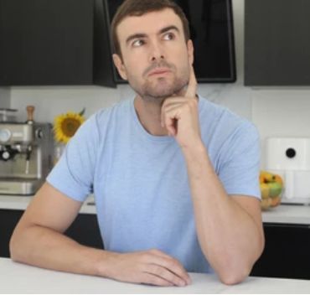
y / ee
Teacher: funny sunny tricky

Slide 4
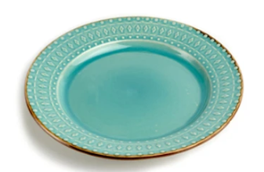
a-e / ai
Teacher: cake plate late

Slide 5
i-e / ie
Teacher: time ride like

Slide 6
o-e / oa
Teacher: stove home hose

Slide 7
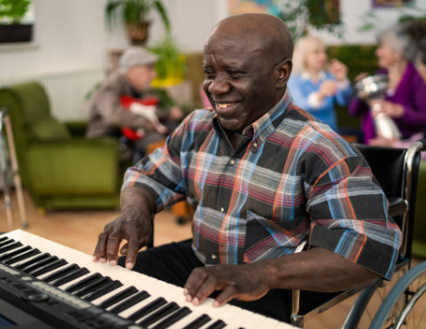
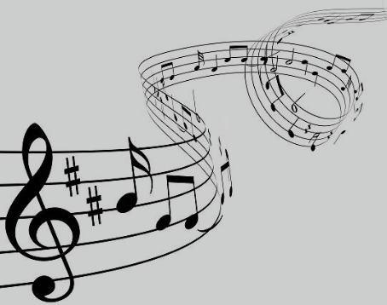
u-e / ue
Teacher: ute tune

Slide 8
e / ee
Teacher: remote me she

Slide 9
Reading rule
Remember
vowels: a e i o u
consonants: b c d f … y z

Slide 10
Reading rule:
vowel sounds
vowel names
a
e
i
o
u
A
E
I
O
U

Slide 11
Reading rule: letter pattern
vowel: consonant silent e
letter
name
e.g. c-a-k-e → cake
e.g. b-i-k-e → bike

Slide 12
Reading words (blending)
w…a…v…e→ wave
l…i…n…e → line
s…m…i…l…e → smile

Slide 13
Reading words (blending)
h…o…m…e → home
c…l…o…s…e → close
s…m…i…l…e → smile

Slide 14
Reading words (blending)
t…u…n…e → tune
m…e → me
sh…e → she
o…v…a…l → oval

Slide 15
Reading words (blending)
s…u…nn…y → sunny
s…t…or…y → story
s…a…f…e → safe

