Slide 1

Veterinary Training for the Salvo™ Ocular Microshunt
™
OneVet Medical, Inc.
6901 East Fish Lake Road, Suite 100
Maple Grove, MN 55369
www.onevetmedical.com

Slide 2
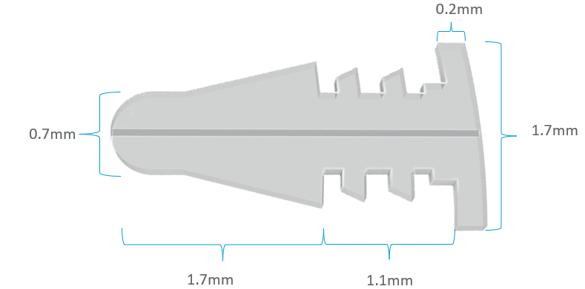
Salvo Ocular Microshunt
Central flow lumen
Product Indication¹:
The Salvo Ocular Microshunt is intented to be implanted adjunctively to a laser procedure to prevent short term IOP fluctuations in canines.
¹ - ACVO presentation 2024: Savannah, Ga.
PRELIMINARY FINDINGS OF CONCURRENT SALVO SHUNT PLACEMENT TO MINIMIZE THE INTRAOCULAR PRESSURE SPIKE ASSOCIATED WITH TRANSSCLERAL CYCLOPHOTOCOAGULATION: 9 CASES (8 DOGS) (JJ Gould, 1 JS Sapienza 1, MC Jimmerson 1) Long Island Veterinary Specialists, Plainview, NY

Slide 3
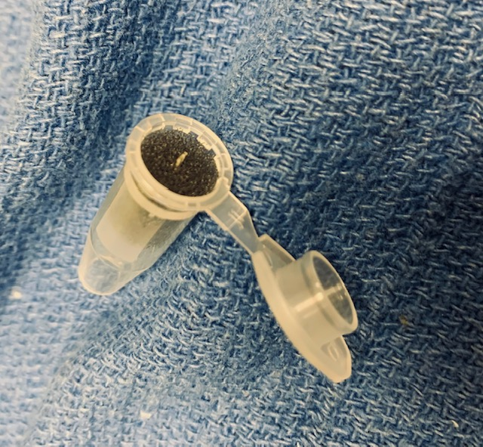
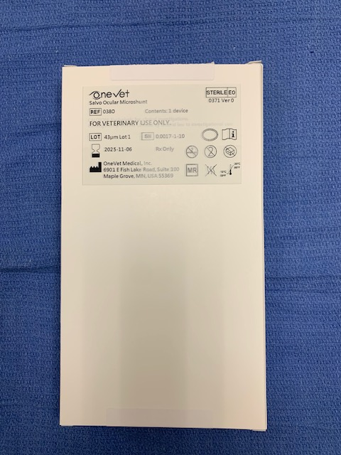
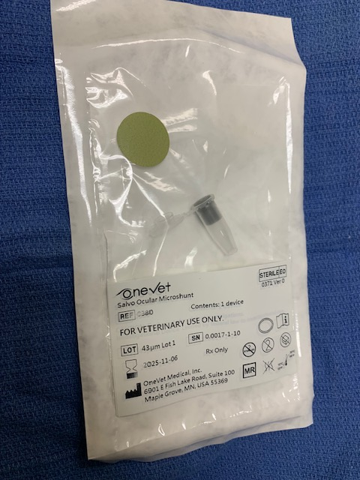
Salvo Packaging
One unit per box
ETO sterilized
Double sterile barrier, inner pouch placed in sterile field
Verify ‘Green’ color dot
Inspect package for any damage prior to use
Salvo implant centered in packaging tube
Remove directly with non-tooth forceps

Slide 4
I. Supplies and Medications

Slide 5
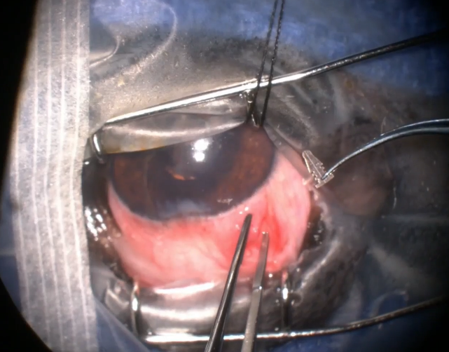
Supplies
Eyelid Speculum
Sterile Eye Drape
Fine Easer Tip Cautery
1.4mm Keratome or 19g MVR blade
Non-tooth Forceps
Salvo Ocular Microshunt
Dry Weck Spear
9-0 Vicryl
Supply List

Slide 6

Medications
Post-Operative
Prednisolone acetate (or dexamethasone) TID
Topical ofloxacin TID
Dorzolamide TID
Taper off latanprost therapy.
Oral NSAID's or prednisone as needed.
Medication List

Slide 7
II. PRE-OPERATIVE

Slide 8
Pre-Operative
It is recommended to complete the laser procedure prior to Salvo implantation for the following reasons:
  Less blood-ocular breakdown prior to laser therapy
  Pre-implant of the Salvo device will lower eye pressure potentially making the laser procedure more difficult for probe placement
In addition, the current experience with Salvo implantation, as referenced, has been performed in this sequence.

Slide 9
III. OPERATIVE – IMPLANT PROCEDURE

Slide 10
Operative – Implant Procedure
The patient is placed in dorsal recumbency and prepared for aseptic surgery
An eyelid speculum is placed as well as a sterile eye drape prior to creating incision
A 3-4mm peritomy is created in the dorsal quadrant of the eye down to bare sclera. Fine easer tip cautery is used to control hemostasis
The incision is made with a 1.4 mm slit blade, entering the anterior chamber immediately posterior (0.5 – 1mm) to the limbus. Incision should be made in a single, in-out, motion (no side-to-side motion)
Incision should be parallel to the iris so that the device is not vaulted anteriorly and touching the endothelium.
The Salvo shunt is gently grasped with non-tooth forceps and carefully inserted into the paracentesis. Flow from the Salvo shunt is confirmed with a dry Weck spear.
The conjunctiva is closed in a single layer with 9-0 vicryl in a simple continuous or simple interrupted fashion.

Slide 11
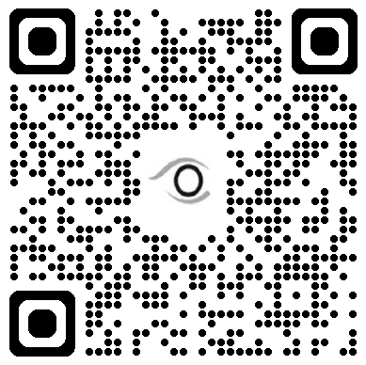
Operative – Implantation Video at www.onevetmedical.com

Slide 12
IV. POST-OPERATIVE

Slide 13
Post-Operative
Typical Post-Operative consultations:
24-hour postoperative examination
7-10 days
3 weeks
As needed afterwards

Slide 14
Potential Adverse Events & Considerations
Elevated IOP
Infection
Device Migration
Ocular Inflammation
Hypotony
Ocular Irritation
Foreign Body Sensation
Iris/Corneal Touch
Vision Changes
Corneal Changes

Slide 15
Veterinary Training for the Salvo™ Ocular Microshunt
™
OneVet Medical, Inc.
6901 East Fish Lake Road, Suite 100
Maple Grove, MN 55369
www.onevetmedical.com

