Slide 1

Veterinary Training for the Salvo™ Ocular Microshunt in the feline eye
™
OneVet Medical, Inc.
6901 East Fish Lake Road, Suite 100
Maple Grove, MN 55369
www.onevetmedical.com

Slide 2
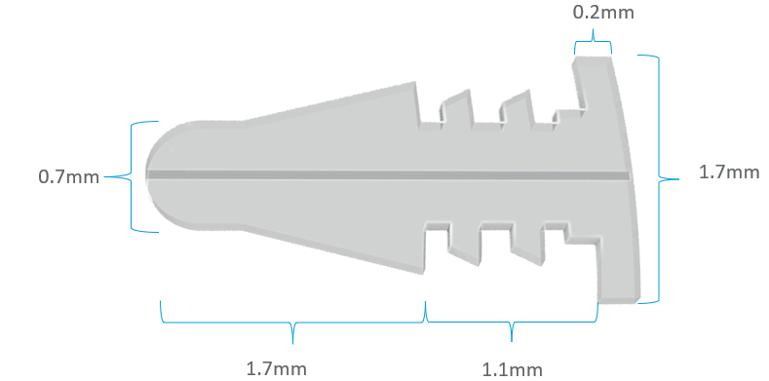
Salvo Ocular Microshunt
Central flow lumen
Product Indication:
The Salvo Ocular Microshunt is an implantable, minimally invasive device that shunts aqueous humor to the surface of the eye, effectively lowering IOP in felines with primary or secondary glaucoma.

Slide 3
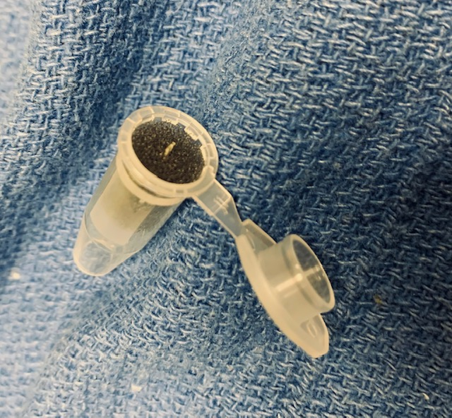
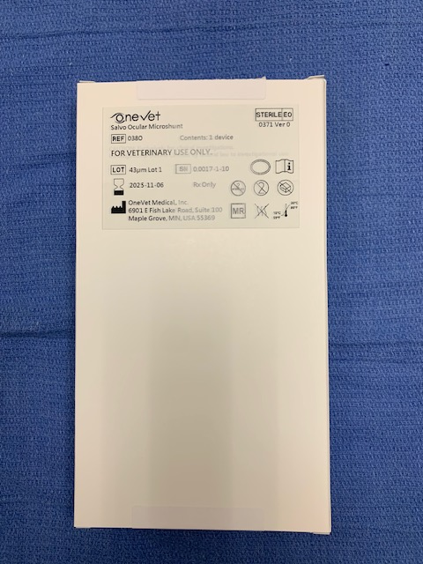
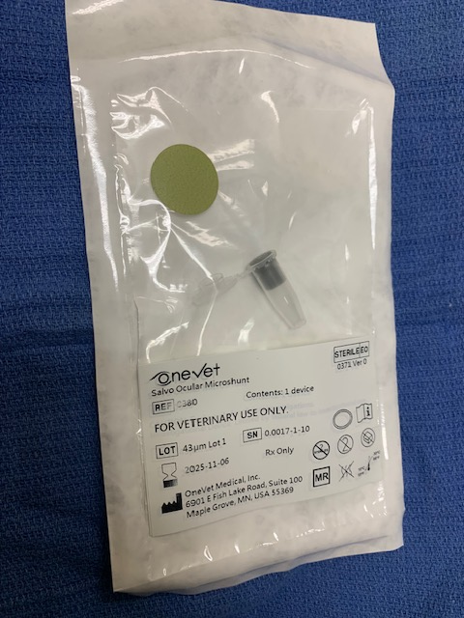
Salvo Packaging
One unit per box
ETO sterilized
Double sterile barrier, inner pouch placed in sterile field
Verify ‘Green’ color dot
Inspect package for any damage prior to use
Salvo implant centered in packaging tube
Remove directly with non-tooth forceps

Slide 4
I. Supplies and Medications

Slide 5
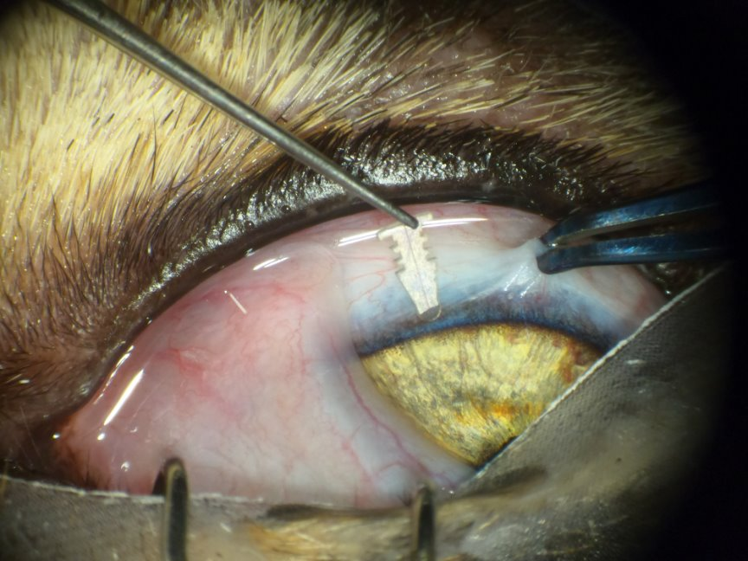
Supplies
Eyelid Speculum
Sterile Eye Drape
1.4mm Keratome or 19g MVR blade
Colibri forcept to position globe
Supply List
Non-tooth Forceps to handle shunt
Salvo Ocular Microshunt
Dry Weck Spear
Sterile marking pen

Slide 6

Medications
Postoperative
Prednisolone acetate (or dexamethasone) TID
Topical ofloxacin TID
Dorzolamide TID
Systemic AB (clavamox for 1 week)
E-collar to prevent rubbing for at least 1 week
Medication List

Slide 7
II. PRE-OPERATIVE

Slide 8
Pre-Operative
Complete ophthalmic exam
Schirmer tear test
Fluorescein stain
Tonometry
Perform complete sterile prep of the eye as for intraocular surgery.
Do not recommend implanting if has concurrent uveitis.

Slide 9
III. OPERATIVE – IMPLANT PROCEDURE

Slide 10
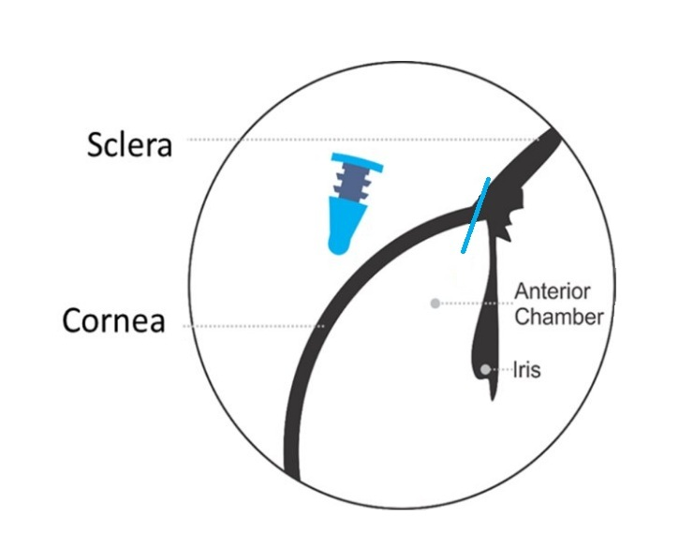
Operative – Implant Procedure
Implant Procedure
A scleral fixation ring is placed to stabilize the eye prior to creating incision. (delete this)
Using a surgical caliper, mark the implant site with a surgical marker, 0.5 to 1.0 mm posterior to the limbus on the sclera between the superior 10:00 and 2:00 position. This indicates the device entry point.
The incision is made in a single stabbing motion (do NOT rock blade back and forth) with a 1.4 mm slit blade with an entry point at the previous mark and in the iris plane. Prior to the incision, a fluorescein strip can be wiped on the blade to aid in visualizing the incision site.
Incision should be parallel to the iris so that the device is not vaulted anteriorly and touching the endothelium or posteriorly to touch the iris.
If bleeding occurs, use a surgical spear and surgical flush to clear all blood from the incision site.
The device is then removed from its sterile pouch and shipping tube. It can be grasped with an ophthalmic forceps (non-toothed) and should be inspected to be free from debris or damage.

Slide 11
Operative – Implant Procedure
Implant Procedure, con't...
The device is then gently inserted through the incision into the anterior chamber in a single motion.
The device should be fully inserted, optimally with the distal 1.5 mm of the device locking tab placed within the anterior chamber. The device should not touch the iris or cornea.
The final implant position of the Vizio device should be visualized microscopically. The angle of insertion is recorded on the implantation CRF. Photographs of the implant will be taken to document positioning and location.
The device should be checked for patency with a fluorescein strip after implant.

Slide 12
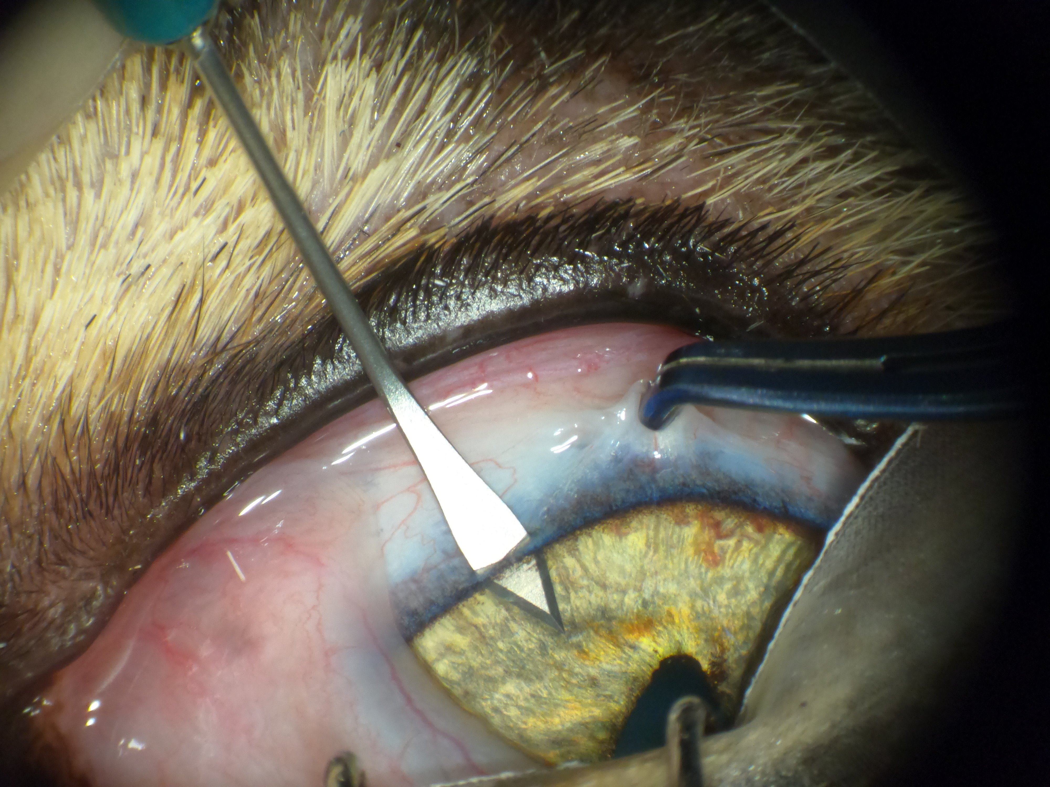

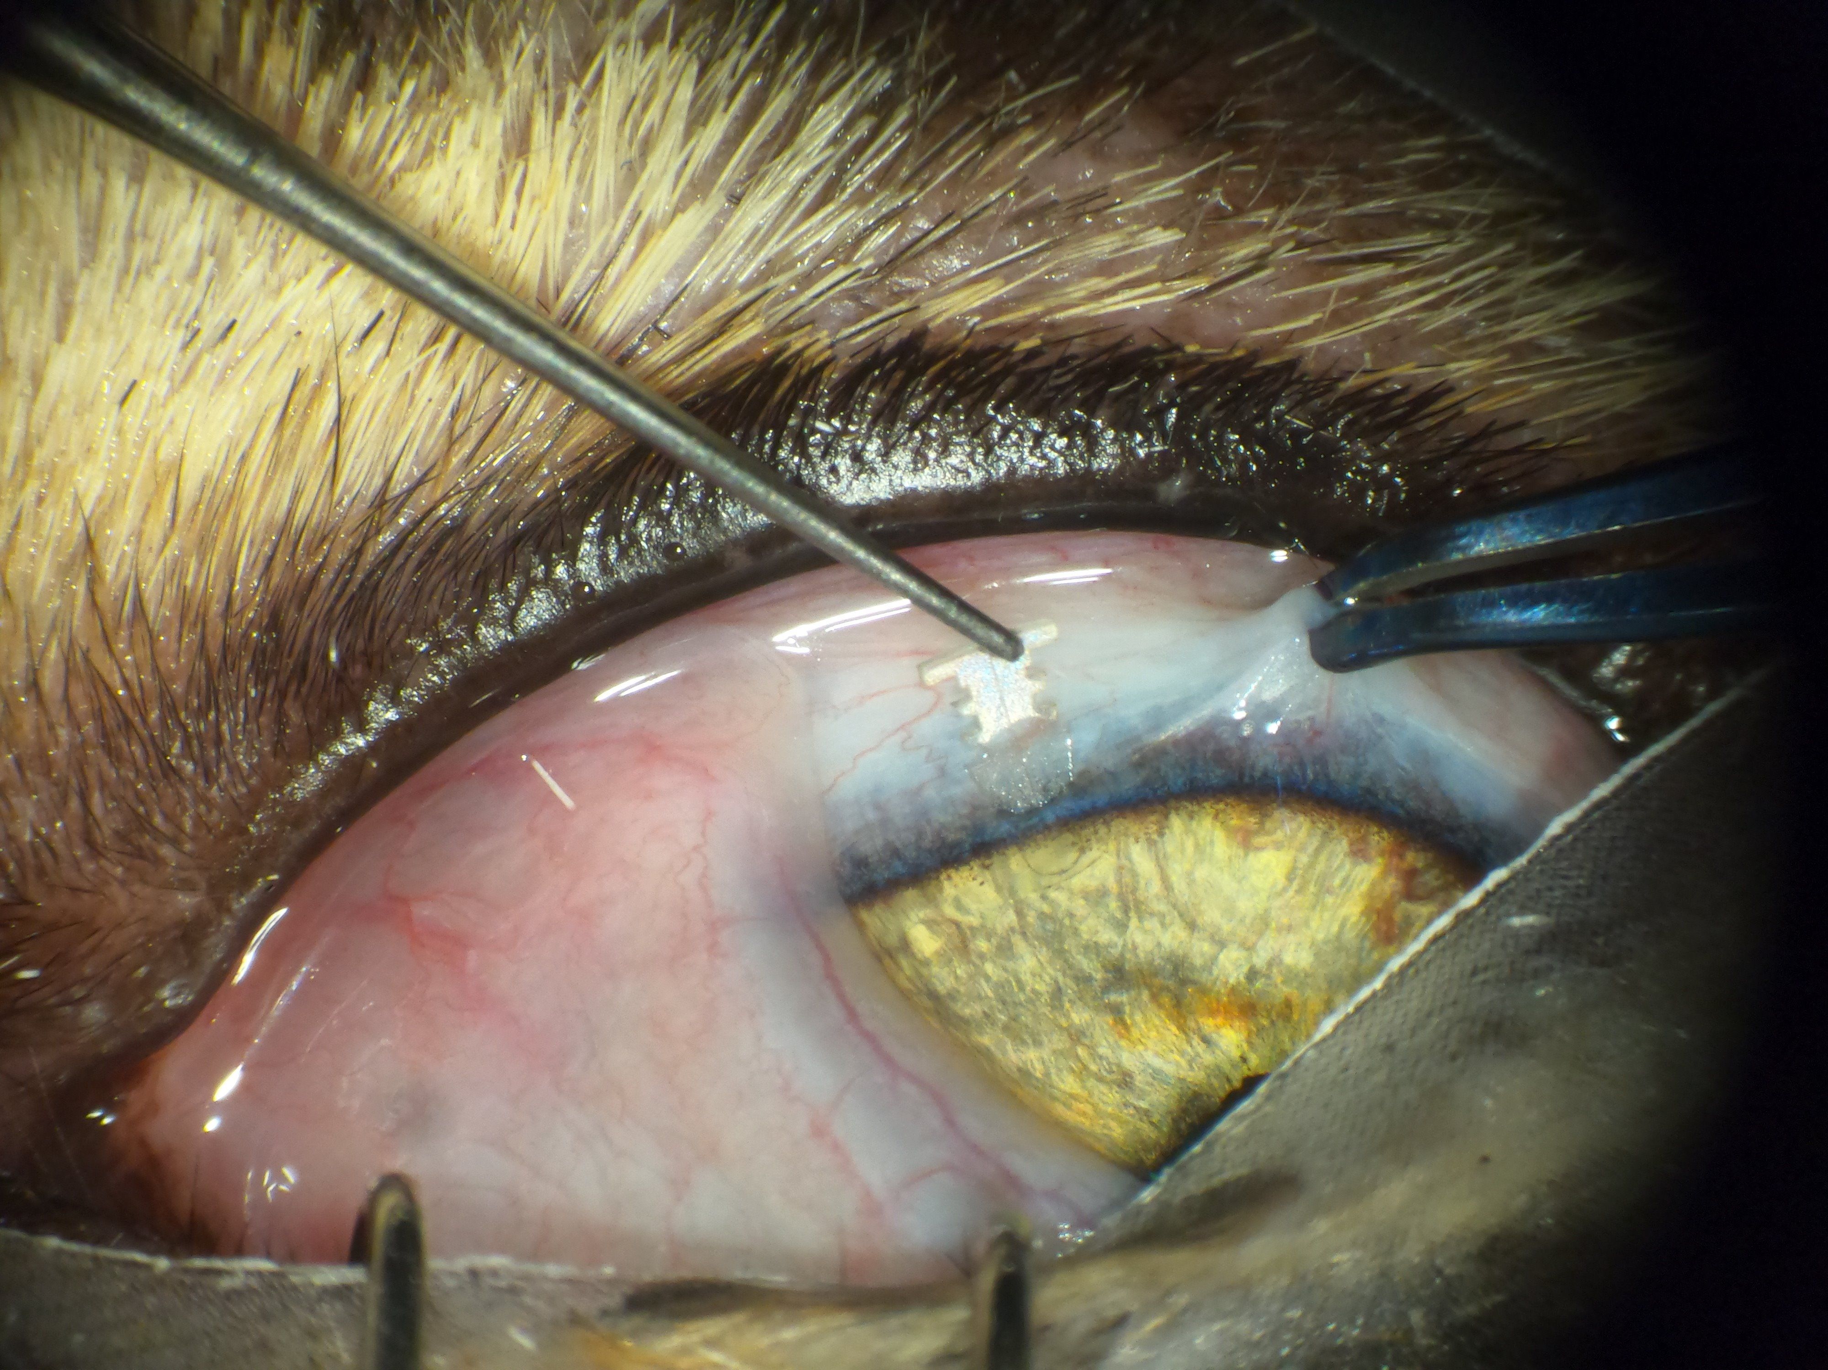
Operative – Implantation Photos

Slide 13
Operative – Key Points of Emphasis
The incision must be made in a single, stabbing motion. Do not rock the blade back and forth, particularly to get the incision started, as this can widen the incision and affect the fit of the device in the incisional tract.
If an incision or device placement is not optimal/adequate:
  Remove, discard, and replace any device that has been inserted into the incision or touched the surface of the eye.
  Abandon that incision site. Closing the incision by suture.
  Move at least one limbal clock hour and make a new incision
  Insert new device - Never reuse an inserted device or incision site
Post implantation reduced or minimal flow can be expected if incisional aqueous loss creates intraocular pressures < 15mmHg.
Peripheral flow of aqueous around the device may occur for up to 24 hours after device implantation.

Slide 14
IV. POST-OPERATIVE

Slide 15
Post-Operative
Typical Post-Operative consultations:
24-hour postoperative examination
7-10 days
3 weeks
As needed afterwards

Slide 16
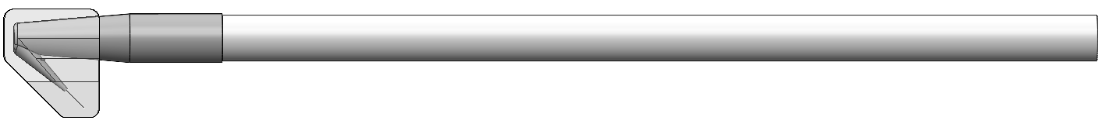
Post-Operative Potential Additional Procedures
Recanalization – In the event of elevated IOP with decreased or no flow through the shunt. Prior to recanalization, the eye should be sterily prepped
Recanalization Tool
Protective cover to be removed prior to use
Recanalization Wire
30 µm, Nitinol recanalization wire inserted back and forth through channel to remove any blockage and re-establish flow.

Slide 17
Potential Adverse Events & Considerations
Elevated IOP
Infection
Device Migration/Extruison
Uveitis
Corneal ulceration
Ocular Irritation
Foreign Body Sensation
Iris/Corneal Touch
Vision Changes
Corneal Changes

Slide 18
Veterinary Training for the Salvo™ Ocular Microshunt in the feline eye
™
OneVet Medical, Inc.
6901 East Fish Lake Road, Suite 100
Maple Grove, MN 55369
www.onevetmedical.com

