Slide 1

Psychology
Fifth Edition, Global Edition
Saundra K. Ciccarelli
J. Noland White
Saundra K. Ciccarelli
J. Noland White
Copyright © 2018 Pearson Education, Ltd. All Rights Reserved

Slide 2

Psychology
Fifth Edition, Global Edition
Chapter 1
1
The Science of Psychology

Slide 3
Learning Objectives 1 of 2
1.1 Describe the contributions of some of the early pioneers in psychology.
1.2 Summarize the basic ideas and the important people behind the early approaches known as Gestalt, psychoanalysis, and behaviorism.
1.3 Summarize the basic ideas behind the seven modern perspectives in psychology.
1.4 Differentiate between the various types of professionals within the field of psychology.
1.5 Recall the five steps of the scientific approach.
1.6 Compare and contrast some of the methods used to describe behavior.

Slide 4
Learning Objectives 2 of 2
1.7 Explain how researchers use the correlational technique to study relationships between two or more variables.
1.8 Identify the steps involved in designing an experiment.
1.9 Recall two common sources of problems in an experiment and some ways to control for these effects.
1.10 Identify some of the common ethical guidelines for doing research with people.
1.11 Explain why psychologists sometimes use animals in their research.
1.12 Recall the basic criteria for critical thinking that people can use in their everyday lives.

Slide 5
The History of Psychology
Psychology: the scientific study of behavior and mental processes
  Behavior: outward or overt actions and reactions
  Mental processes: internal, covert activity of our minds

Slide 6
In the Beginning: Wundt, Titchener, and James 1 of 3
Learning Objective 1.1 Describe the contributions of some of the early pioneers in psychology.
Wilhelm Wundt’s psychology laboratory
  Germany in 1879
  Developed the technique of objective introspection: the process of objectively examining and measuring one’s thoughts and mental activities

Slide 7
In the Beginning: Wundt, Titchener, and James 2 of 3
Titchener and Structuralism
  Edward Titchener
    Wundt’s student; brought structuralism to America
  Margaret Washburn
    Titchener’s student; first woman to earn a Ph.D. in psychology
  Structuralism died out in the early 1900s

Slide 8
In the Beginning: Wundt, Titchener, and James 3 of 3
William James and Functionalism
  How the mind allows people to adapt, live, work,
  and play
  James and Principles of Psychology
  Mary Whiton Calkins
    Denied Ph.D. because she was a woman
  African Americans and early psychology
  Influenced modern fields of educational, industrial, and organizational psychology

Slide 9
Three Influential Approaches: Gestalt, Psychoanalysis, and Behaviorism 1 of 3
Learning Objective 1.2 Summarize the basic ideas and the important people behind the early approaches known as Gestalt, psychoanalysis, and behaviorism.
Gestalt
  An organized whole
  Started with Wertheimer, who studied sensation and perception
  Gestalt ideas now part of study of cognitive psychology
Cognitive psychology: field focusing not only on perception but also on learning, memory, thought processes, and problem solving

Slide 10

Figure 1.2 A Gestalt Perception
The eye tends to “fill in” the blanks here and sees both of these figures as circles rather than as a series of dots or a broken line.
Notes:
10

Slide 11
Three Influential Approaches: Gestalt, Psychoanalysis, and Behaviorism 2 of 3
Psychoanalysis: theory and therapy based on the work of Sigmund Freud
Freud’s patients suffered from nervous disorders with no apparent physical cause.
  Proposed the existence of an unconscious (unaware) mind into which we push—or repress—our threatening urges and desires
  Believed that these repressed urges, in trying to surface, created nervous disorders
  Stressed the importance of early childhood experiences

Slide 12
Three Influential Approaches: Gestalt, Psychoanalysis, and Behaviorism 3 of 3
Behaviorism
  Focuses on observable behavior only
  Must be directly seen and measured
Proposed by John B. Watson
  Based on Pavlov’s work, who demonstrated that a reflex could be conditioned or learned
  Watson believed that phobias were learned
    Case of “Little Albert”: baby taught to fear a white rat
Mary Cover Jones: Early pioneer in behavior therapy

Slide 13
Modern Perspectives 1 of 5
Learning Objective 1.3 Summarize the basic ideas behind the seven modern perspectives in psychology. Objective 1.4 Modern Perspectives: Skinner, Maslow, and Rogers
Psychodynamic Perspective
  Modern version of psychoanalysis
  More focused on development of a sense of self and discovery of motivations behind a person’s behavior other than sexual motivations

Slide 14
Modern Perspectives 2 of 5
Behavioral Perspective
  B. F. Skinner studied operant conditioning of voluntary behavior
  Behaviorism became a major force in the twentieth century
  Skinner introduced the concept of reinforcement to behaviorism

Slide 15
Modern Perspectives 3 of 5
Humanistic Perspective
  Owes far more to the early roots of psychology in the field of philosophy
  People have free will: the freedom to choose their own destiny
    Self-actualization: achieving one’s full potential or actual self
  Early founders:
    Abraham Maslow
    Carl Rogers

Slide 16
Modern Perspectives 4 of 5
Cognitive Perspective
  Focuses on memory, intelligence, perception, problem solving, and learning
Sociocultural Perspective
  Focuses on relationship between social behavior and culture

Slide 17
Modern Perspectives 5 of 5
Biopsychological Perspective
  Attributes human and animal behavior to biological events occurring in the body, such as genetic influences, hormones, and activity of nervous system
Evolutionary Perspective
  Focuses on the biological bases of universal mental characteristics that all humans share
  Looks at how mind works and why it works as it does
  Behavior seen as having an adaptive or survival value

Slide 18
Psychological Professionals and Areas of Specialization 1 of 2
Learning Objective 1.4 Differentiate between the various types of professionals within the field of psychology.
Psychologist
  Professional with an academic degree and specialized training in one or more areas of psychology
  May specialize in any one of a large number of areas
    Clinical, counseling, developmental, social, and personality, among others
  Basic research and applied research

Slide 19
Psychological Professionals and Areas of Specialization 2 of 2
Psychiatrist
  Medical doctor who has specialized in the diagnosis and treatment of psychological disorders
Psychiatric social worker
  Social worker with some training in therapy methods who focuses on environmental conditions that can have an impact on mental disorders, such as poverty, overcrowding, stress, and drug abuse

Slide 20
Work Settings of Psychology
Where Psychologists Work | Percentage of Total
University and four-year colleges | 35%
Self-employed | 21%
Private for profit | 18%
Private not for profit | 9%
Schools and other educational settings | 7%
State and local government | 6%
Federal government | 4%
Notes:
20

Slide 21
Subfields of Psychology
Subfields of Psychology | Percentage of Total
Clinical | 34%
Counseling | 13%
Developmental | 12%
Experimental and other research areas | 8%
Cognitive | 6%
General | 6%
Social and personality | 6%
Industrial/organizational | 5%
School | 4%
Other | 4%
Educational | 2%

Slide 22
The Scientific Approach 1 of 2
Learning Objective 1.5 Recall the five steps of the scientific approach.
Scientific approach: system of gathering data so that bias and error in measurement are reduced
Psychology’s goals:
  Description: What is happening?
  Explanation: Why is it happening?
  Prediction: When will it happen again?
  Control: How can it be changed?

Slide 23
The Scientific Approach 2 of 2
Learning Objective 1.6 Psychology Is a Science; Steps in the Scientific Method
Steps in the scientific approach:
  Perceive the question
  Form a hypothesis
    Tentative explanation of a phenomenon based on observations
  Test the hypothesis
  Draw conclusions
  Report your results
    Others may replicate study or experiment to see whether same results will be obtained to demonstrate reliability of results

Slide 24
Descriptive Methods 1 of 4
Learning Objective 1.6 Compare and contrast some of the methods used to describe behavior.
Naturalistic Observation
  Watching animals or humans behave in their normal environment
  Major advantage: realistic picture of behavior
  Disadvantages
    Observer effect
    Observer bias
    Each naturalistic setting is unique, and observations may not hold

Slide 25
Descriptive Methods 2 of 4
Laboratory Observation
  Watching animals or humans behave in a laboratory setting
  Advantages
    Control over environment
    Allows use of specialized equipment
  Disadvantage
    Artificial situation may result in artificial behavior
Descriptive methods lead to formation of testable hypotheses

Slide 26
Descriptive Methods 3 of 4
Case Studies
  Study of one individual in great detail
  Advantage: tremendous amount of detail
  Disadvantage: cannot apply to others
  Famous case study: Phineas Gage
Phineas Gage survived a steel tamping rod going through his head after some explosive powder went off unexpectedly. The steel tamping rod entered above the left side of his mouth, passed through his left frontal lobe, and exited through the top of his skull.

Slide 27
Descriptive Methods 4 of 4
Surveys
  Researchers ask a series of questions about the topic under study
  Given to representative sample of population
  Population: entire group of people or animals in which researcher is interested
Advantages: data from large numbers of people; study covert behaviors
Disadvantages: must ensure representative sample or results not meaningful; courtesy bias

Slide 28
Correlations: Finding Relationships 1 of 3
Learning Objective 1.7 Explain how researchers use the correlational technique to study relationships between two or more variables..9 Correlational Technique
Correlation
  Measure of relationship between two variables
    Variable: anything that can change or vary
    Knowing value of one variable allows researchers to predict the value of other variable
  Measures of two variables go into a mathematical formula and produce a correlation coefficient (r), which represents two things:
    Direction of the relationship
    Strength of the relationship

Slide 29
Correlations: Finding Relationships 2 of 3
Correlation coefficient ranges from
-1.00 to +1.00
The closer to +1.00 or -1.00, the stronger the relationship between the variables
  No correlation = 0.0
  Perfect correlation = -1.00 or +1.00

Slide 30
Correlations: Finding Relationships 3 of 3
Positive correlation: variables are related in the same direction
  As one increases, the other increases
  As one decreases, the other decreases
Negative correlation: variables are related in opposite direction
  As one increases, the other decreases
Correlation does not prove causation!

Slide 31
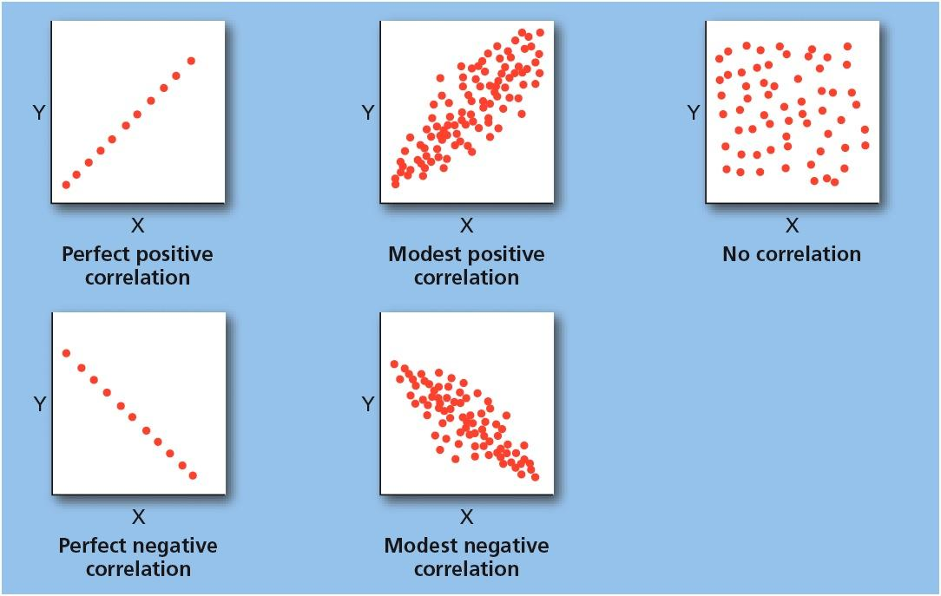
Figure 1.4 Five Scatterplots
These scatterplots show direction and strength of correlation. It should be noted that perfect correlations, whether positive or negative, rarely occur in the real world.
Notes:
31

Slide 32
The Experiment 1 of 4
Learning Objective 1.8 Identify the steps involved in designing an experiment.1.10 Experimental Approach and Terms
Experiment
  A deliberate manipulation of a variable to see whether corresponding changes in behavior result, allowing the determination of cause-and-effect relationships
Operationalization: specific definition of a variable of interest that allows it to be directly measured
  Example: definition of aggressive play

Slide 33
The Experiment 2 of 4
Independent variable (IV)
  Variable in an experiment that is manipulated by the experimenter
  Example of IV: violent TV
Dependent variable (DV)
  Variable in an experiment that represents the measurable response or behavior of subjects in the experiment
  Example of DV: aggressive play

Slide 34
The Experiment 3 of 4
Experimental group
  Subjects in an experiment who are subjected to the independent variable
  Experimental group: watch TV
Control group
  Subjects in an experiment who are not subjected to the independent variable and who may receive a placebo treatment (controls for confounding variables).
  Control group: no TV

Slide 35
The Experiment 4 of 4
Importance of Randomization
  Random assignment: process of assigning subjects to experimental or control groups randomly, so that each subject has an equal chance of being in either group
  Controls for confounding (extraneous, interfering) variables

Slide 36
Experimental Hazards and Controlling for Effects 1 of 2
1.9 Recall two common sources of problems in an experiment and some ways to
control for these effects.
Placebo effect
  Phenomenon in which the expectations of participants in a study can influence their behavior
Experimenter effect
  Tendency of experimenter’s expectations for a study to unintentionally influence results of the study

Slide 37
Experimental Hazards and Controlling for Effects 2 of 2
Single-blind study
  Subjects do not know whether they are in experimental or control group
  Reduces placebo effect
Double-blind study
  Neither the experimenter nor the subjects know which subjects are in the experimental or control group
  Reduces placebo effect and experimenter effect

Slide 38
A Sample Experiment 1 of 2
Hypothesis
  Knowing that other people might think one’s success in school is due to athletic ability rather than intelligence can make an athlete perform poorly on an academic test
Independent variable
  Timing of “high threat” question
Dependent variable
  Test scores

Slide 39
A Sample Experiment 2 of 2
Experimental group
  Answered “high threat” question before taking the test
Control group
  Answered “high threat” question after taking the test
Results-supported hypothesis
  Those asked the “high threat” question before the intellectual test scored significantly lower on that test

Slide 40
The Guidelines for Doing Research with People 1 of 2
1.10 Identify some of the common ethical guidelines for doing research with
people.
Institutional review boards
  Groups of psychologists or other professionals who look over each proposed research study and judge it according to its safety and consideration for the participants in the study

Slide 41
The Guidelines for Doing Research with People 2 of 2
Common Ethical Guidelines
  Rights and well-being of participants must be weighed against the study’s value to science.
  Participants must be allowed to make informed decision.
  Deception must be justified.
  Participants may withdraw from study at any time.
  Participants must be protected from risks or told explicitly of risks.
  Investigators must fully debrief participants.
  Data must remain confidential.
  If study results in undesirable consequences, researcher responsible for detecting/removing/correcting.

Slide 42
Animal Research
1.11 Explain why psychologists sometimes use animals in their research.
Animal research answers questions we could never investigate with human research.
The focus is on avoiding exposing animal subjects to unnecessary pain or suffering.
Animals are used in approximately 7 percent of psychological studies.

Slide 43
Thinking Critically About Critical Thinking 1 of 2
1.12 Recall the basic criteria for critical thinking that people can use in their everyday lives.1.14 Principles of Critical Thinking
Critical thinking
  Making reasoned judgments about claims

Slide 44
Thinking Critically About Critical Thinking 2 of 2
Four basic criteria:
  There are very few “truths” that do not need to be subjected to testing.
  All evidence is not equal in quality.
  Just because someone is considered to be an authority or to have a lot of expertise does not make everything that person claims automatically true.
  Critical thinking requires an open mind.

