Slide 1

Psychology
Fifth Edition, Global Edition
Saundra K. Ciccarelli
J. Noland White
Saundra K. Ciccarelli
J. Noland White
Copyright © 2018 Pearson Education, Ltd. All Rights Reserved

Slide 2

Psychology
Fifth Edition, Global Edition
Chapter 2
2
The Biological Perspective

Slide 3
Learning Objectives 1 of 2
2.1 Identify the parts of a neuron and the function of each.
2.2 Explain the action potential.
2.3 Describe how neurons use neurotransmitters to communicate with each other and with the body.
2.4 Describe how the brain and spinal cord interact and respond to external experiences.
2.5 Differentiate the roles of the somatic and autonomic nervous systems.
2.6 Explain why the pituitary gland is known as the “master gland.”
2.7 Recall the role of various endocrine glands.
2.8 Describe how lesioning studies and brain stimulation are used to study the brain.

Slide 4
Learning Objectives 2 of 2
2.9 Compare and contrast neuroimaging techniques for mapping the structure and function of the brain.
2.10 Identify the different structures of the hindbrain and the function of each.
2.11 Identify the structures of the brain that are involved in emotion, learning, memory, and motivation.
2.12 Identify the parts of the cortex that process the different senses and those that control movement of the body.
2.13 Name the parts of the cortex that are responsible for higher forms of thought, such as language.
2.14 Explain how some brain functions differ between the left and right hemispheres.
2.15 Identify some potential causes of attention-deficit/hyperactivity disorder.

Slide 5
Neurons and Nerves: Building the Network
Nervous system
  An extensive network of specialized cells that carry information to and from all parts of the body
Neuroscience
  Deals with the structure and function of neurons, nerves, and nervous tissue
  Relationship to behavior and learning

Slide 6
Structure of the Neuron: The Nervous System’s Building Block 1 of 3
Learning Objective 2.1 Identify the parts of a neuron and the function of each.
Neuron
  The basic cell that makes up the nervous system and receives and sends messages within that system

Slide 7
Structure of the Neuron: The Nervous System’s Building Block 2 of 3
Parts of a neuron
  Dendrites: branch-like structures that receive messages from other neurons
  Soma: the cell body of the neuron, responsible for maintaining the life of the cell
  Axon: long, tube-like structure that carries the neural message to other cells
  Axon terminals: rounded areas at the end of the branches at the end of the axon
    Responsible for communicating with other nerve cells

Slide 8
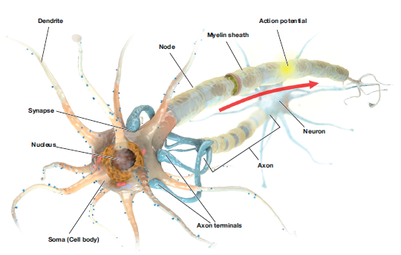
Figure 2.1
The Structure of the Neuron
Notes:
8

Slide 9
Structure of the Neuron: The Nervous System’s Building Block 3 of 3
Glial Cells
  Provide support for neurons to grow on and around
  Deliver nutrients to neurons
  Produce myelin to coat axons
Myelin: fatty substances produced by certain glial cells that coat the axons of neurons to insulate, protect, and speed up the neural impulse
  Clean up waste products and dead neurons

Slide 10
Generating the Message Within the Neuron: The Neural Impulse 1 of 2
Learning Objective 2.2 Explain the action potential.
Ions: charged particles
  Inside neuron: negatively charged
  Outside neuron: positively charged
Resting potential: the state of the neuron when not firing a neural impulse

Slide 11
Generating the Message Within the Neuron: The Neural Impulse 2 of 2
Action potential: the release of the neural impulse consisting of a reversal of the electrical charge within the axon
  Allows positive sodium ions to enter the cell
All-or-none: a neuron either fires completely or does not fire at all

Slide 12
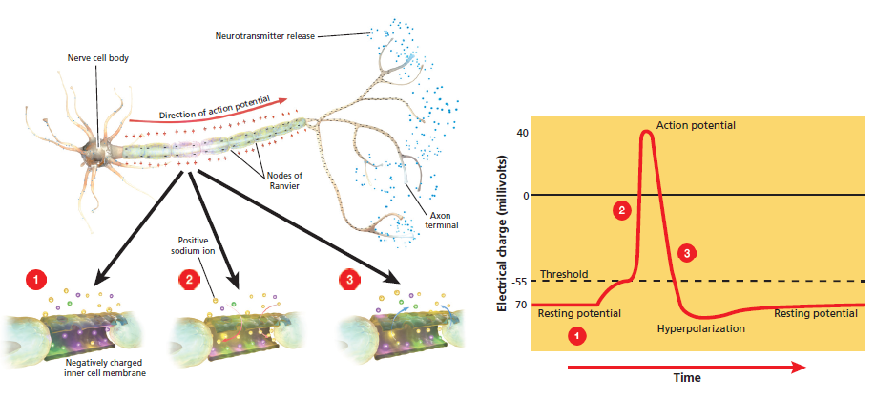
Figure 2.2
The Neural Impulse Action Potential
In the graph, voltage readings are shown at a given place on the neuron over a period of 20 or 30 milliseconds (thousandths of a second). At first the cell is resting; it then reaches threshold and an action potential is triggered. After a brief hyperpolarization period, the cell returns to its resting potential.
Notes:
12

Slide 13
Neurotransmission 1 of 5
Learning Objective 2.3 Describe how neurons use neurotransmitters to communicate with each other and with the body.
Sending The Message To Other Cells: The Synapse
  Synaptic vesicles: sack-like structures found inside the axon terminal containing chemicals
  Neurotransmitter: chemical found in synaptic vesicles which, when released, has an effect on the next cell

Slide 14
Neurotransmission 2 of 5
Synapse/Synaptic Gap
  Microscopic fluid-filled space between the rounded areas on the end of the axon terminals of one cell and the dendrites or surface of the next cell
Receptor Sites
  Holes in surface of dendrites or certain cells of the muscles and glands, which are shaped to fit only certain neurotransmitters

Slide 15
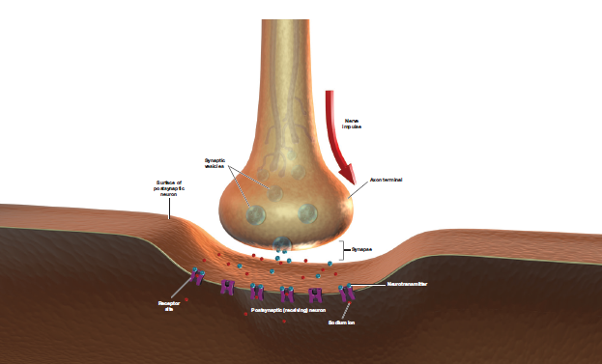
Figure 2.3 The Synapse
The nerve impulse reaches the axon terminal, triggering the release of neurotransmitters from the synaptic vesicles. The molecules of neurotransmitter cross the synaptic gap to fit into the receptor sites that fit the shape of the molecule, opening the ion channel and allowing sodium ions to rush in.

Slide 16
Neurotransmission 3 of 5
Neurons must be turned ON and OFF
  Excitatory neurotransmitter: neurotransmitter that causes the receiving cell to fire
  Inhibitory neurotransmitter: neurotransmitter that causes the receiving cell to stop firing

Slide 17
Neurotransmission 4 of 5
Neurotransmitters: Messengers of the Network
  Agonists: mimic or enhance the effects of a neurotransmitter on the receptor sites of the next cell, increasing or decreasing the activity of that cell
  Antagonists: block or reduce a cell’s response to the action of other chemicals or neurotransmitters

Slide 18
Table 2.1 Some Neurotransmitters and Their Functions
Neurotransmitters | Functions
Acetylcholine (ACh) | Excitatory or inhibitory; involved in arousal, attention, memory, and controls muscle contractions
Norepinephrine (NE) | Mainly excitatory; involved in arousal and mood
Dopamine (DA) | Excitatory or inhibitory; involved in control of movement and sensations of pleasure
Serotonin (5-HT) | Excitatory or inhibitory; involved in sleep, mood, anxiety, and appetite
Gaba-aminobutyric acid (GABA) | Major inhibitory neurotransmitter; involved in sleep and inhibits movement
Glutamate | Major excitatory neurotransmitter; involved in learning, memory formation, nervous system development, and synaptic plasticity
Endorphins | Inhibitory neural regulators; involved in pain relief

Slide 19
Neurotransmission 5 of 5
Cleaning Up the Synapse: Reuptake and Enzymes
  Reuptake: process by which neurotransmitters are taken back into the synaptic vesicles
  Enzyme: complex protein that is manufactured by cells

Slide 20
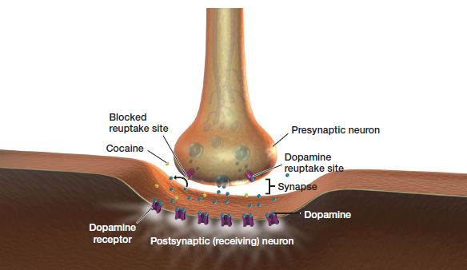
Figure 2.4 Neurotransmitters: Reuptake
Notes:
20

Slide 21
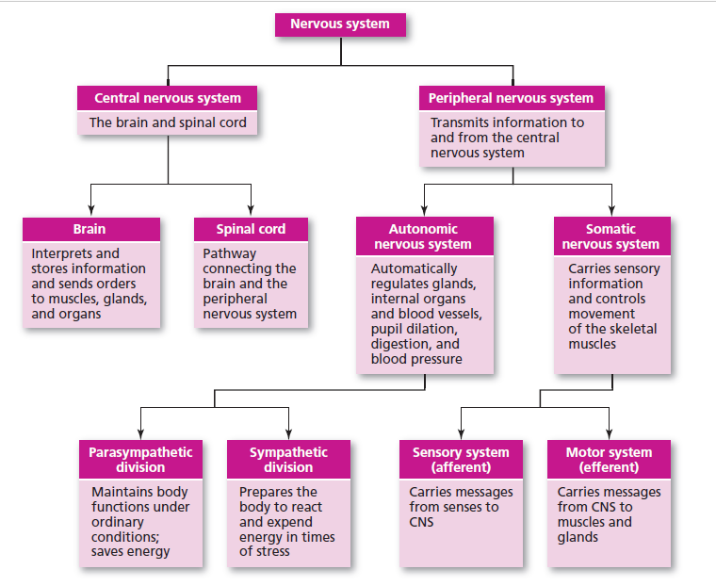
Figure 2.5
An Overview of the Nervous System

Slide 22
The Central Nervous System: The “Central Processing Unit” 1 of 4
Learning Objective 2.4 Describe how the brain and spinal cord interact and respond to external experiences.
Central nervous system (CNS): part of the nervous system consisting of the brain and spinal cord
  Spinal cord: a long bundle of neurons that carries messages to and from the body to the brain that is responsible for very fast, lifesaving reflexes

Slide 23
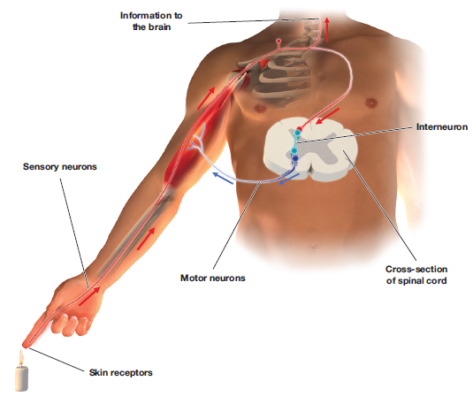
Figure 2.6
The Spinal Cord Reflex
The pain from the burning heat of the candle flame stimulates the afferent nerve fibers, which carry the message up to the interneurons in the middle of the spinal cord. The interneurons then send a message out by means of the efferent nerve fibers, causing the hand to jerk away from the flame.

Slide 24
The Central Nervous System: The “Central Processing Unit” 2 of 4
Sensory neuron: a neuron that carries information from the senses to the central nervous system
  Also called an afferent neuron
Motor neuron: a neuron that carries messages from central nervous system to muscles of body
  Also called an efferent neuron

Slide 25
The Central Nervous System: The “Central Processing Unit” 3 of 4
Interneuron: a neuron found in the center of the spinal cord that receives information from the sensory neurons and sends commands to the muscles through the motor neurons
  Interneurons also make up bulk of neurons in brain

Slide 26
The Central Nervous System: The “Central Processing Unit” 4 of 4
Damage to the Central Nervous System
  Damage once thought to be permanent
  Neuroplasticity: ability to constantly change both the structure and function of cells in response to experience or trauma
  Neurogenesis: formation of new neurons

Slide 27
The Peripheral Nervous System: Nerves on the Edge 1 of 3
Learning Objective 2.5 Differentiate the roles of the somatic and autonomic nervous systems.
Peripheral nervous system (PNS): all nerves and neurons that are not contained in the brain and spinal cord but that run through the body itself
  Somatic nervous system
  Autonomic nervous system

Slide 28
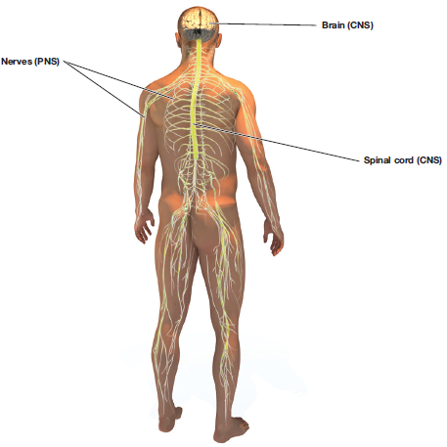
Figure 2.7
The Peripheral Nervous System

Slide 29
The Peripheral Nervous System: Nerves on the Edge 2 of 3
Somatic nervous system: division of the PNS consisting of nerves that carry information from the senses to the CNS and from the CNS to the voluntary muscles of the body
  Sensory pathway: nerves coming from the sensory organs to the CNS consisting of sensory neurons
  Motor pathway: nerves coming from the CNS to the voluntary muscles, consisting of motor neurons

Slide 30
The Peripheral Nervous System: Nerves on the Edge 3 of 3
Autonomic nervous system (ANS)
  Division of the PNS consisting of nerves that control all of the involuntary muscles, organs, and glands; sensory pathway nerves coming from the sensory organs to the CNS consisting of sensory neurons
  Sympathetic division (fight-or-flight system): part of the ANS that is responsible for reacting to stressful events and bodily arousal
  Parasympathetic division: part of the ANS that restores the body to normal functioning after arousal and is responsible for the day-to-day functioning of the organs and glands

Slide 31
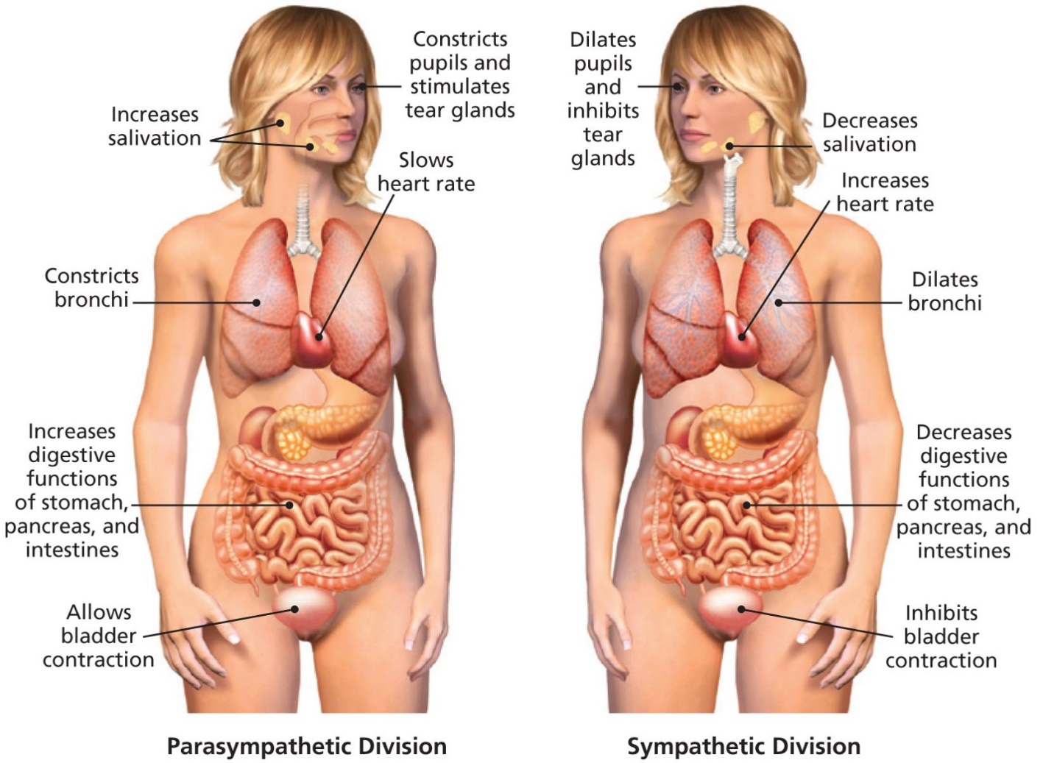
Figure 2.8 Functions of the Parasympathetic and Sympathetic Divisions of the Nervous System

Slide 32
Distant Connections: The Endocrine Glands
Endocrine glands: glands that secrete chemicals called hormones directly into the bloodstream
  Hormones: chemicals released into the bloodstream by endocrine glands

Slide 33
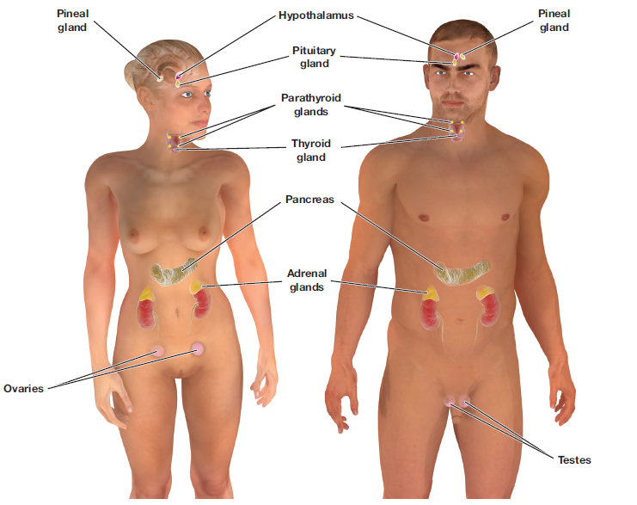
Figure 2.9 The Endocrine Glands
The endocrine glands secrete hormones directly into the bloodstream, which carries them to organs in the body, such as the heart, pancreas, and sex organs.

Slide 34
The Pituitary: Master of the Hormonal Universe
Learning Objective 2.6 Explain why the pituitary gland is known as the “master gland.”
Pituitary gland: gland located in the brain that secretes human growth hormone and influences all other hormone-secreting glands
  Also known as the master gland

Slide 35
Other Endocrine Glands 1 of 2
Learning Objective 2.7 Recall the role of various endocrine glands.
Pineal gland: endocrine gland located near the base of the cerebrum that secretes melatonin
Thyroid gland: endocrine gland found in the neck that regulates metabolism
Pancreas: endocrine gland that controls the levels of sugar in the blood

Slide 36
Other Endocrine Glands 2 of 2
Gonads: the sex glands; secrete hormones that regulate sexual development and behavior as well as reproduction
  Ovaries: the female gonads
  Testes: the male gonads
Adrenal glands: endocrine glands located on top of each kidney
  Secrete over thirty different hormones to deal with stress, regulate salt intake
  Provide a secondary source of sex hormones affecting the sexual changes that occur during adolescence

Slide 37
Methods for Studying Specific Regions of the Brain 1 of 2
Learning Objective 2.8 Describe how lesioning studies and brain stimulation are used to study the brain.
Lesioning Studies
  Insertion of a thin, insulated wire into the brain through which an electrical current is sent that destroys the brain cells at the tip of the wire
Brain Stimulation
  Electrical stimulation of the brain (ESB): milder electrical current that causes neurons to react as if they had received a message

Slide 38
Methods for Studying Specific Regions of the Brain 2 of 2
Invasive Techniques
  Deep brain stimulation (DBS), impulse generator implanted and sends impulses to implanted electrodes, stimulating brain areas of interest.
Noninvasive Techniques
  Transcranial magnetic stimulation (TMS), magnetic pulses are applied to the cortex using special copper wire coils that are positioned over the head
  Tepetitive TMS (rTMS)
  Transcranial direct current stimulation (tDCS)

Slide 39
Neuroimaging Techniques 1 of 3
Learning Objective 2.9 Compare and contrast neuroimaging techniques for mapping the structure and function of the brain. ng Objective 2.6 Study of the Brain and How It Works
Computed tomography (CT): brain-imaging method using computer-controlled X-rays of the brain
Magnetic resonance imaging (MRI): brain-imaging method using radio waves and magnetic fields of the body to produce detailed images of the brain

Slide 40
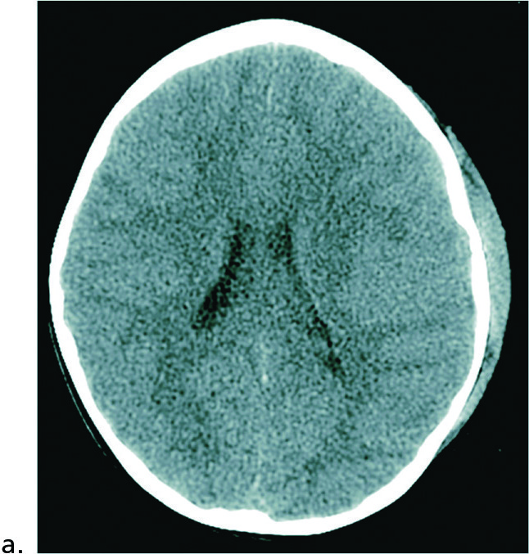
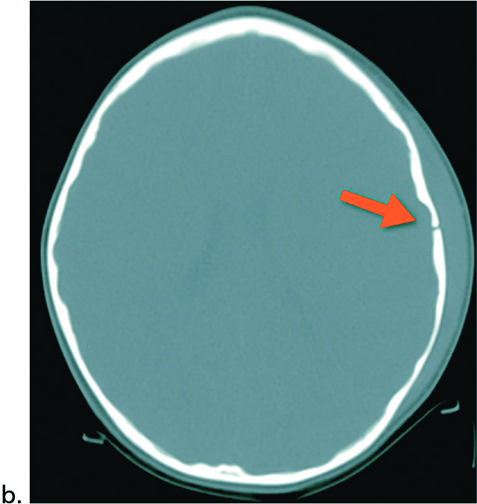
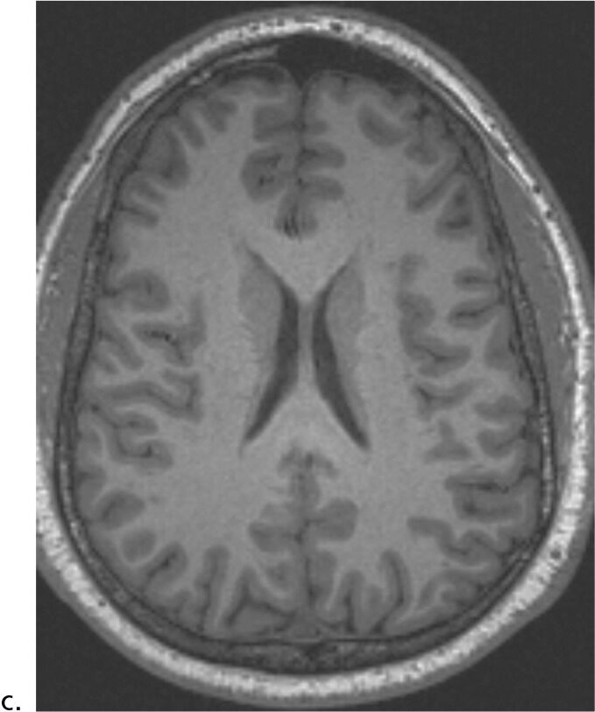
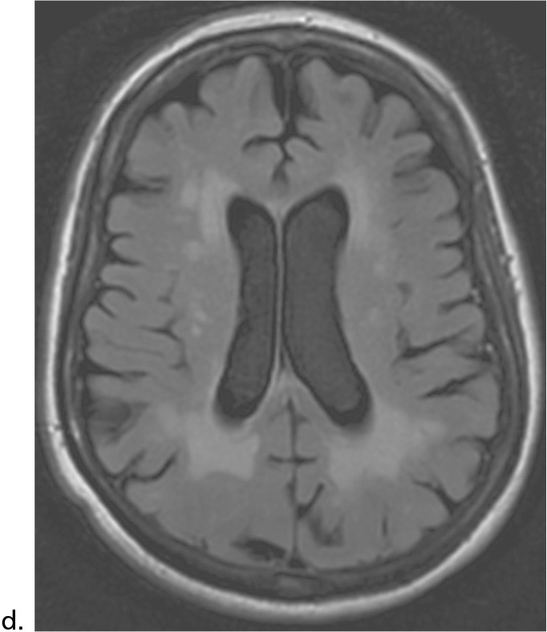
Figure 2.10 Mapping Brain Structure
Fig 2.10a: CT scan from a 5-year-old girl with a head injury and skull fracture, depicting the brain and swelling associated with the injury. Fig 2.10b: Same CT scan highlighting the skull fracture (indicated by the red arrow). Contrast the brain detail of Fig 2.10a with the MRI scan in Fig 2.10c (different, adult individual). Note the scans are in the horizontal plane, separating the brain into upper and lower portions. Fig 2.10d: Different type of MRI image from an older adult, with cortical cell loss (atrophy) and white matter changes. Notice the enlarged ventricles and widening of the grooves (sulci) in the outer cortex as compared to 2.10c. Figs 2.10a, b, c, and d images created with OsiriX software; CT and MRI data courtesy of N. White.

Slide 41
Neuroimaging Techniques 2 of 3
Mapping Function
  Electroencephalogram (EEG): records electric activity of the brain below specific areas of the skull
  Magnetoencephalography (MEG)
  Positron emission tomography (PET): radioactive sugar is injected into the subject and a computer compiles a color-coded image of brain activity of the brain; lighter colors indicate more activity

Slide 42
Neuroimaging Techniques 3 of 3
Mapping Function continued
  Single photon emission computed tomography (SPECT): similar to PET, but uses different radioactive tracers
  Functional MRI (fMRI): a computer makes a sort of “movie” of changes in the activity of the brain using images from different time periods

Slide 43
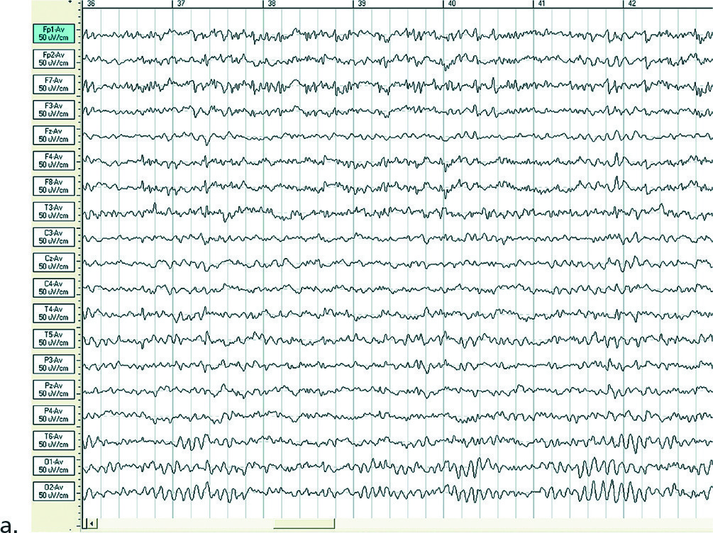
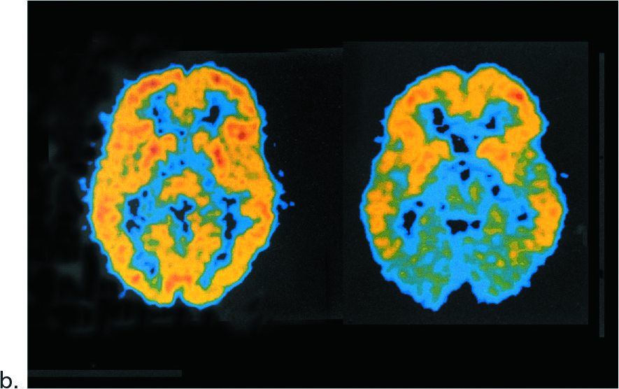
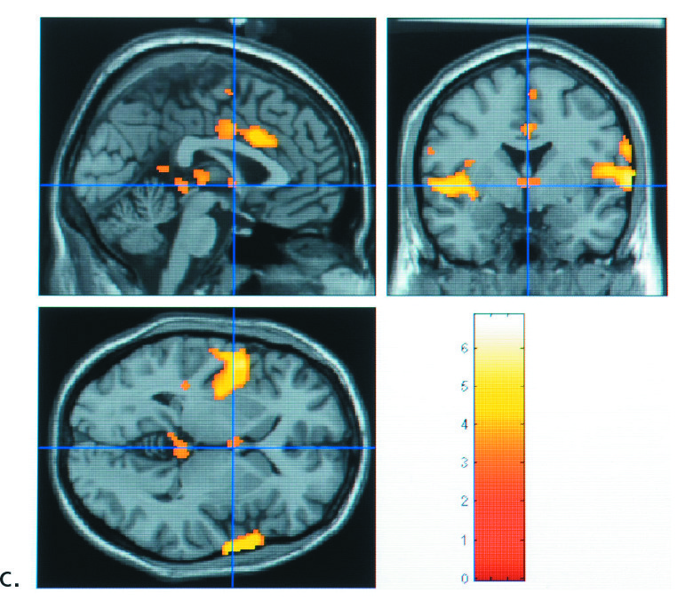
Figure 2.11 Mapping Brain Function
Various methods for mapping brain function. An EEG record is shown in 2.11a, a PET scan image in 2.11b, and an image from an fMRI study in 2.11c. Data and figure for 2.11a courtesy of N. White.

Slide 44
The Hindbrain 1 of 2
Learning Objective 2.10 Identify the different structures of the hindbrain and the function of each.
The Hindbrain
  Medulla: first large swelling at the top of the spinal cord, forming the lowest part of the brain
    Responsible for life-sustaining functions such as breathing, swallowing, and heart rate
  Pons: larger swelling above the medulla that connects the top of the brain to the bottom
    Plays a part in sleep, dreaming, left–right body coordination, and arousal

Slide 45
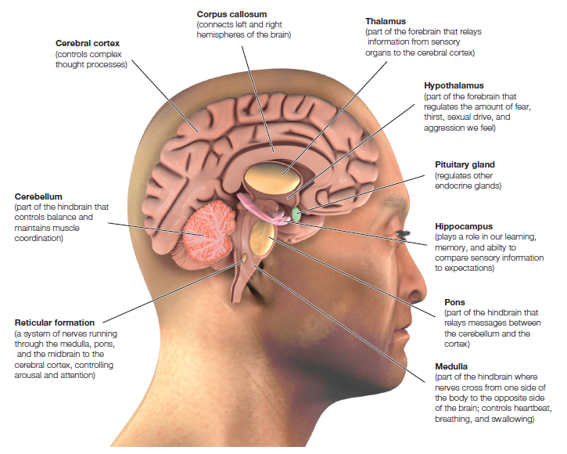
Figure 2.12 Major Structures of the Human Brain

Slide 46
The Hindbrain 2 of 2
Reticular formation (RF): area of neurons running through the middle of the medulla and the pons and slightly beyond
  Responsible for selective attention
Cerebellum: part of the lower brain located behind the pons
  Controls and coordinates involuntary, rapid, fine motor movement

Slide 47
Structures Under the Cortex: The Limbic System 1 of 3
Learning Objective 2.11 Identify the structures of the brain that are involved in emotion, learning, memory, and motivation.
A group of several brain structures located under the cortex and involved in learning, emotion, memory, and motivation
  Thalamus: part of the limbic system located in the center of the brain
    Relays sensory information from the lower part of the brain to the proper areas of the cortex
    Processes some sensory information before sending it to its proper area

Slide 48
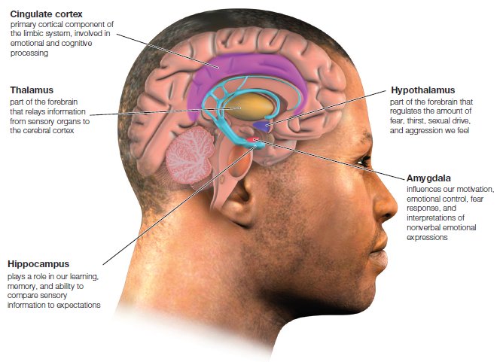
Figure 2.13 The Limbic System

Slide 49
Structures Under the Cortex: The Limbic System 2 of 3
Hypothalamus: small structure in the brain located below the thalamus and directly above the pituitary gland
  Responsible for motivational behavior such as sleep, hunger, thirst, and sex
Hippocampus: curved structure located within each temporal lobe
  Responsible for the formation of long-term memories and the storage of memory for location of objects

Slide 50
Structures Under the Cortex: The Limbic System 3 of 3
Amygdala: brain structure located near the hippocampus
  Responsible for fear responses and the memory of fear
Cingulate cortex: the limbic structure actually found in the cortex
  Plays important roles in cognitive and emotional processing

Slide 51
The Cortex 1 of 6
Learning Objective 2.12 Identify the parts of the cortex that process the different senses and those that control movement of the body.
Cortex: outermost covering of the brain consisting of densely packed neurons
  Responsible for higher thought processes and interpretation of sensory input
  Corticalization: wrinkling of the cortex
    Allows a much larger area of cortical cells to exist in the small space inside the skull

Slide 52
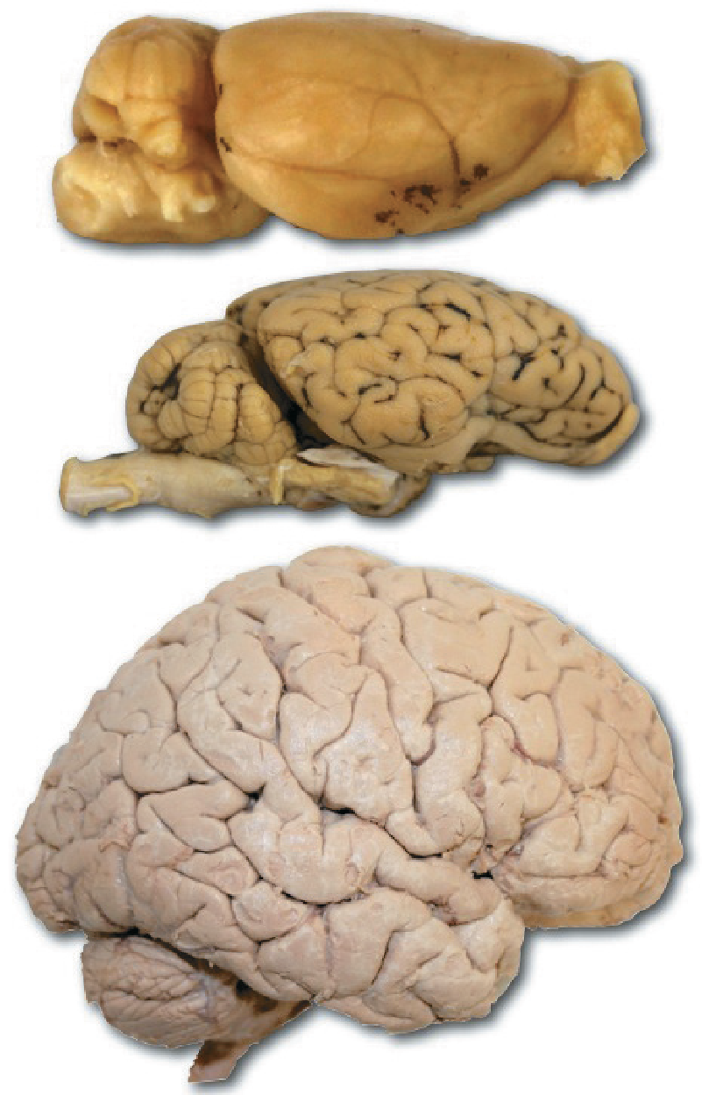
The Cortex 2 of 6
Cerebral hemispheres: the two sections of the cortex on the left and right sides of the brain
Corpus callosum: thick band of neurons that connects the right and left cerebral hemispheres
From top to bottom, a rat brain, sheep brain,
and human brain (not to scale!). Note the
differences in the amount of corticalization,
or wrinkling, of the cortex between these three brains. Greater amounts of corticalization are associated with increases in size and complexity.

Slide 53
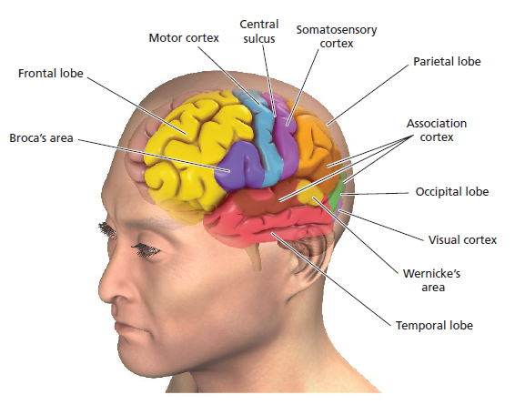
Figure 2.14 The Lobes of the Brain

Slide 54
The Cortex 3 of 6
Occipital lobe: section of the brain located at the rear and bottom of each cerebral hemisphere containing the visual centers of the brain
  Primary visual cortex: processes visual information from the eyes
  Visual association cortex: identifies and makes sense of visual information

Slide 55
The Cortex 4 of 6
Parietal lobes
  Sections of the brain located at the top and back of each cerebral hemisphere containing the centers for touch, taste, and temperature sensations
  Somatosensory cortex: area of neurons running down the front of the parietal lobes
    Responsible for processing information from the skin and internal body receptors for touch, temperature, body position, and possibly taste

Slide 56
The Cortex 5 of 6
Temporal lobes: areas of the cortex located just behind the temples containing the neurons responsible for the sense of hearing and meaningful speech
  Primary auditory cortex: processes auditory information from the ears
  Auditory association cortex: identifies and makes sense of auditory information

Slide 57
The Cortex 6 of 6
Frontal lobes: areas of the cortex located in the front and top of the brain; responsible for higher mental processes and decision making as well as the production of fluent speech
  Motor cortex: section of the frontal lobe located at the back; responsible for sending motor commands to the muscles of the somatic nervous system

Slide 58
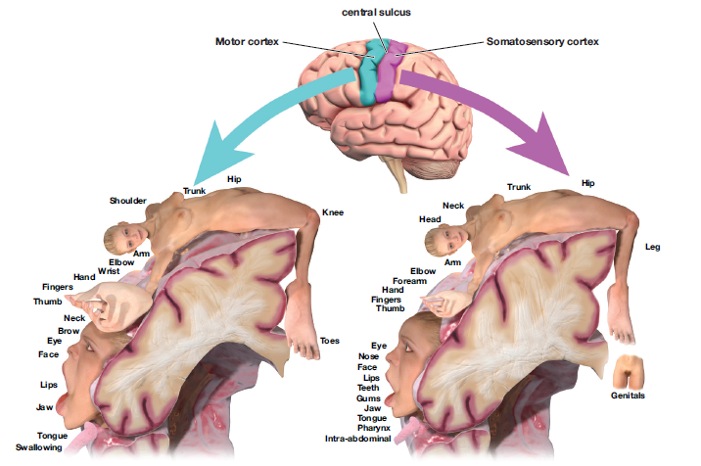
Figure 2.15 The Motor and Somatosensory Cortex
The motor cortex in the frontal lobe controls the voluntary muscles of the body. Cells at the top of the motor cortex control muscles at the bottom of the body, whereas cells at the bottom of the motor cortex control muscles at the top of the body. Body parts are drawn larger or smaller according to the number of cortical cells devoted to that body part. For example, the hand has many small muscles and requires a larger area of cortical cells to control it. The somatosensory cortex, located in the parietal lobe just behind the motor cortex, is organized in much the same manner and receives information about the sense of touch and body position.

Slide 59
The Association Areas of the Cortex 1 of 2
Learning Objective 2.13 Name the parts of the cortex that are responsible for higher forms of thought, such as language.
Association areas: areas within each lobe of the cortex responsible for the coordination and interpretation of information, as well as higher mental processing
Broca’s aphasia: condition resulting from damage to Broca’s area (usually in left frontal lobe)
  Causes the affected person to be unable to speak fluently, to mispronounce words, and to speak haltingly

Slide 60
The Association Areas of the Cortex 2 of 2
Wernicke’s aphasia: condition resulting from damage to Wernicke’s area (usually in left temporal lobe)
  Causes the affected person to be unable to understand or produce meaningful language
Spatial neglect: condition produced by damage to the association areas of the right hemisphere
  Results in an inability to recognize objects or body parts in the left visual field

Slide 61
The Cerebral Hemispheres: Are You in Your Right Mind? 1 of 3
Learning Objective 2.14 Explain how some brain functions differ between the left and right hemispheres.
Cerebrum: the upper part of the brain consisting of the two hemispheres and the structures that connect them

Slide 62
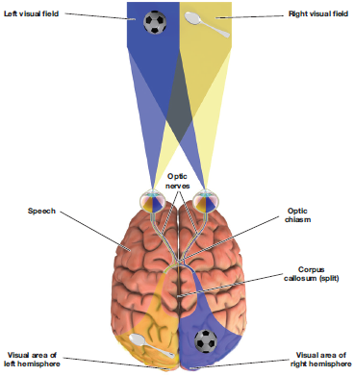
The Cerebral Hemispheres: Are You in Your Right Mind? 2 of 3
Split-Brain Research
  Study of patients with severed corpus callosum
  Involves sending messages to only one side of the brain
  Demonstrates right and left brain specialization
Figure 2.16
The Split-Brain Experiment
Roger Sperry created this experiment to demonstrate the specialization of the left and right hemispheres of the brain.

Slide 63
The Cerebral Hemispheres: Are You in Your Right Mind? 3 of 3
Left side of the brain
  Seems to control language, writing, logical thought, analysis, and mathematical abilities
  Processes information sequentially, and enables one to speak
Right side of the brain
  Controls emotional expression, spatial perception, recognition of faces, patterns, melodies, and emotions
  It processes information globally and cannot influence speech

Slide 64
Table 2.2
Specialization of the Two Hemispheres
Left Hemisphere | Right Hemisphere
Controls the right hand | Controls the left hand
Spoken language | Nonverbal
Written language | Visual-spatial perception
Mathematical calculations | Music and artistic processing
Logical thought processes | Emotional thought and recognition
Analysis of detail | Processes the whole
Reading | Pattern recognition
Blank cell | Facial recognition

Slide 65
Paying Attention to Attention-Deficit / Hyperactivity Disorder
Learning Objective 2.15 Identify some potential causes of attention-deficit/ hyperactivity disorder.
Likelihood of more than one cause and more than one brain route to ADHD
Current research looking at a variety of areas
  Environmental factors such as low-level lead exposure
  Genetic influences
  Role of heredity and familial factors
  Personality factors

