Slide 1
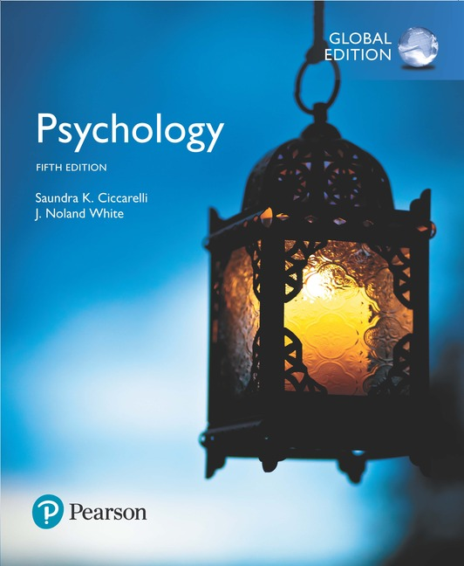
Psychology
Fifth Edition, Global Edition
Saundra K. Ciccarelli
J. Noland White
Saundra K. Ciccarelli
J. Noland White
Copyright © 2018 Pearson Education, Ltd. All Rights Reserved

Slide 2

Psychology
Fifth Edition, Global Edition
Chapter 3
3
Sensation and Perception

Slide 3
Learning Objectives 1 of 2
3.1 Describe how we get information from the outside world into our brains.
3.2 Describe the difference and absolute thresholds.
3.3 Explain why some sensory information is ignored.
3.4 Describe how light travels through the various parts of the eye.
3.5 Explain how light information reaches the visual cortex.
3.6 Compare and contrast two major theories of color vision, and explain how color-deficient vision occurs.
3.7 Explain the nature of sound, and describe how it travels through the various parts of the ear.
3.8 Summarize three theories of how the brain processes information about pitch.
3.9 Identify types of hearing impairment and treatment options for each.

Slide 4
Learning Objectives 2 of 2
3.10 Explain how the sense of taste works.
3.11 Explain how the sense of smell works.
3.12 Describe how we experience the sensations of touch, pressure, temperature, and pain.
3.13 Describe the systems that tell us about balance and position and movement of our bodies.
3.14 Describe how perceptual constancies and the Gestalt principles account for common perceptual experiences.
3.15 Explain how we perceive depth using both monocular and binocular cues.
3.16 Identify some common visual illusions and the factors that influence our perception of them.
3.17 Describe how the neuroscientific study of magic can help to explain visual and cognitive illusions.

Slide 5
Transduction 1 of 2
Learning Objective 3.1 Describe how we get information from the outside world into our brains.
Sensation: activation of receptors in the various sense organs
Sensory receptors: specialized forms of neurons
  Stimulated by different kinds of energy rather than by neurotransmitters

Slide 6
Transduction 2 of 2
Sense organs:
  Eyes
  Ears
  Nose
  Skin
  Taste buds
Transduction: turning outside stimuli into neural activity

Slide 7
Sensory Thresholds 1 of 3
Learning Objective 3.2 Describe the difference and absolute thresholds.
Just noticeable difference (jnd or the difference threshold): the smallest difference between two stimuli that is detectable 50 percent of the time
Absolute threshold: the smallest amount of energy needed for a person to consciously detect a stimulus 50 percent of the time it is present

Slide 8
Table 3.1 Examples of Absolute Thresholds
Sense | Threshold
Sight | A candle flame at 30 miles on a clear, dark night
Hearing | The tick of a watch 20 feet away in a quiet room
Smell | One drop of perfume diffused throughout a three-room apartment
Taste | 1 teaspoon of sugar in 2 gallons of water
Touch | A bee’s wing falling on the cheek from 1 centimeter above

Slide 9
Sensory Thresholds 2 of 3
Subliminal stimuli: stimuli that are below the level of conscious awareness
  Just strong enough to activate sensory receptors, but not strong enough for consciously awareness
  Limin: “threshold”
  Sublimin: “below the threshold”

Slide 10
Sensory Thresholds 3 of 3
Subliminal perception: the process by which subliminal stimuli act upon the unconscious mind, influencing behavior
Signal detection theory

Slide 11
Habituation and Sensory Adaptation
Learning Objective 3.3 Explain why some sensory information is ignored.
Habituation: the tendency of the brain to stop attending to constant, unchanging information
Sensory adaptation: the tendency of sensory receptor cells to become less responsive to a stimulus that is unchanging
  Microsaccades

Slide 12
Light and the Eye 1 of 10
Learning Objective 3.4 Describe how light travels through the various parts of the eye.
Brightness: determined by the amplitude of wave—how high or how low the wave actually is
  Higher the wave, the brighter the light will be
  Low waves are dimmer

Slide 13
Light and the Eye 2 of 10
Color: determined by length of the wave
  Long wavelengths are found at red end of visible spectrum
  Shorter wavelengths are found at blue end
Saturation: the purity of the color people see
  Mixing in black or gray lessens the saturation

Slide 14
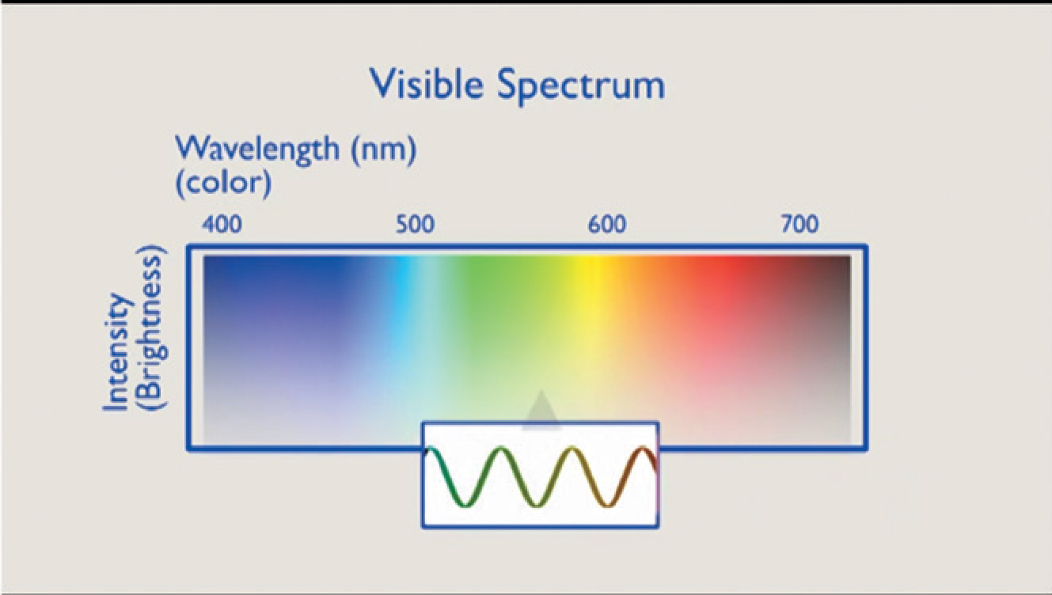
Figure 3.1 The Visible Spectrum

Slide 15
Figure 3.2 Structure of the Eye
Light enters the eye through the cornea and pupil. The iris controls the size of the pupil. From the pupil, light passes through the lens to the retina, where it is transformed into nerve impulses. The nerve impulses travel to the brain along the optic nerve.
Notes:
15

Slide 16
Light and the Eye 3 of 10
Cornea: clear membrane that covers the surface of the eye
  Protects the eye
  Focuses most of the light coming into the eye
  Fixed curvature

Slide 17
Light and the Eye 4 of 10
Aqueous humor: visual layer below cornea
  Clear, watery fluid that is continually replenished
  Supplies nourishment to the eye
Pupil: hole through which light from the visual image enters the interior of the eye

Slide 18
Light and the Eye 5 of 10
Iris: round muscle (the colored part of the eye) in which the pupil is located
  Can change size of the pupil, letting more or less light into the eye
  Helps focus the image
Lens: another clear structure behind the iris, suspended by muscles
  Finishes the focusing process begun by the cornea

Slide 19
Light and the Eye 6 of 10
Visual accommodation: the change in the thickness of the lens as the eye focuses on objects that are far away or close
Vitreous humor: jelly-like fluid that also nourishes the eye and gives it shape

Slide 20
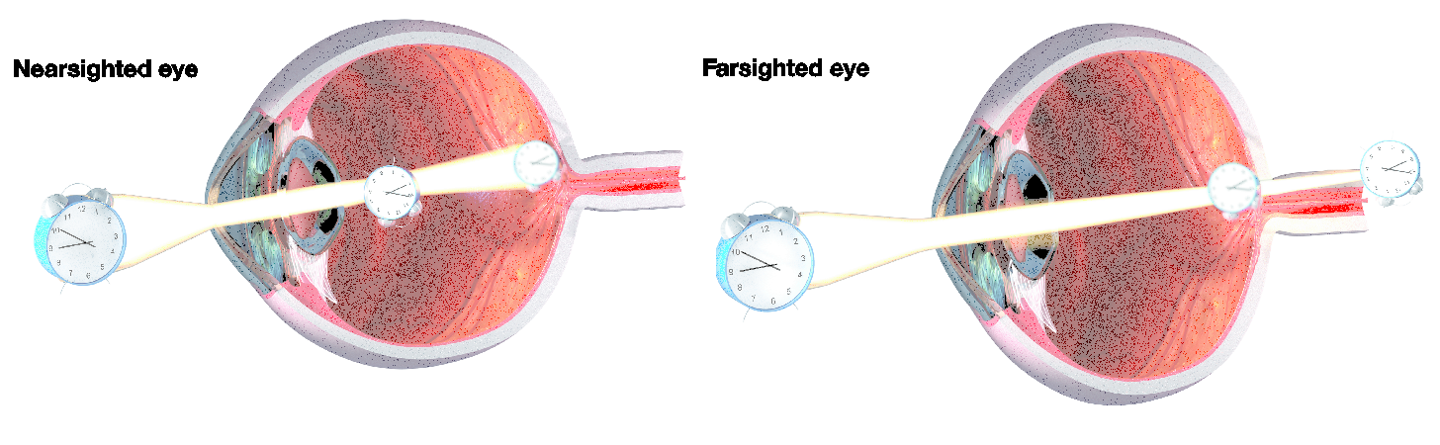
Light and the Eye 7 of 10
Nearsightedness, or myopia
  Shape of eye causes focal point to fall short of the retina
Farsightedness, or hyperopia
  Focus point is behind the retina
Figure 3.3 Nearsightedness and Farsightedness

Slide 21
Light and the Eye 8 of 10
Retina: final stop for light in the eye
  Contains three layers:
    Ganglion cells
    Bipolar cells
    Photoreceptors that respond to various light waves

Slide 22
Light and the Eye 9 of 10
Rods: visual sensory receptors found at the back of the retina
  Responsible for non-color sensitivity to low levels of light
Cones: visual sensory receptors found at the back of the retina
  Responsible for color vision and sharpness of vision

Slide 23
Light and the Eye 10 of 10
Blind spot: area in the retina where the axons of the three layers of retinal cells exit the eye to form the optic nerve; insensitive to light

Slide 24
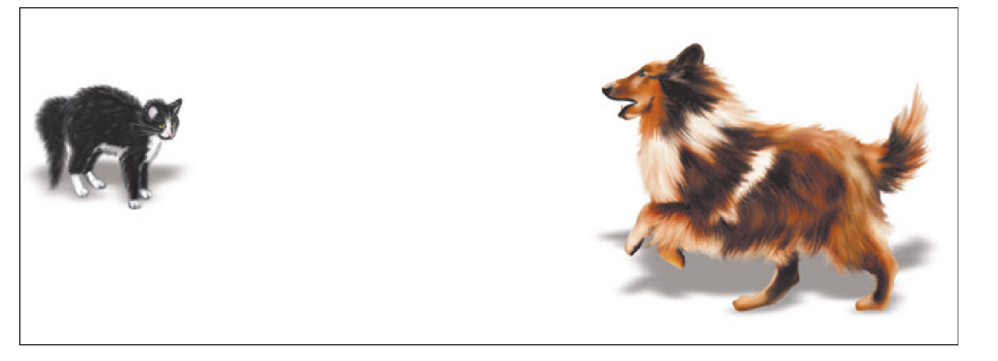
Figure 3.4 The Blind Spot
Hold the book in front of you. Close your right eye and stare at the picture of the dog with your left eye. Slowly bring the book closer to your face. The picture of the cat will disappear at some point because the light from the picture of the cat is falling on your blind spot. If you cannot seem to find your blind spot, trying moving the book more slowly.

Slide 25
The Visual Pathway
Learning Objective 3.5 Explain how light information reaches the visual cortex.
Dark adaptation: recovery of the eye’s sensitivity to visual stimuli in darkness after exposure to bright lights
  Night blindness
Light adaptation: recovery of the eye’s sensitivity to visual stimuli in light after exposure to darkness

Slide 26
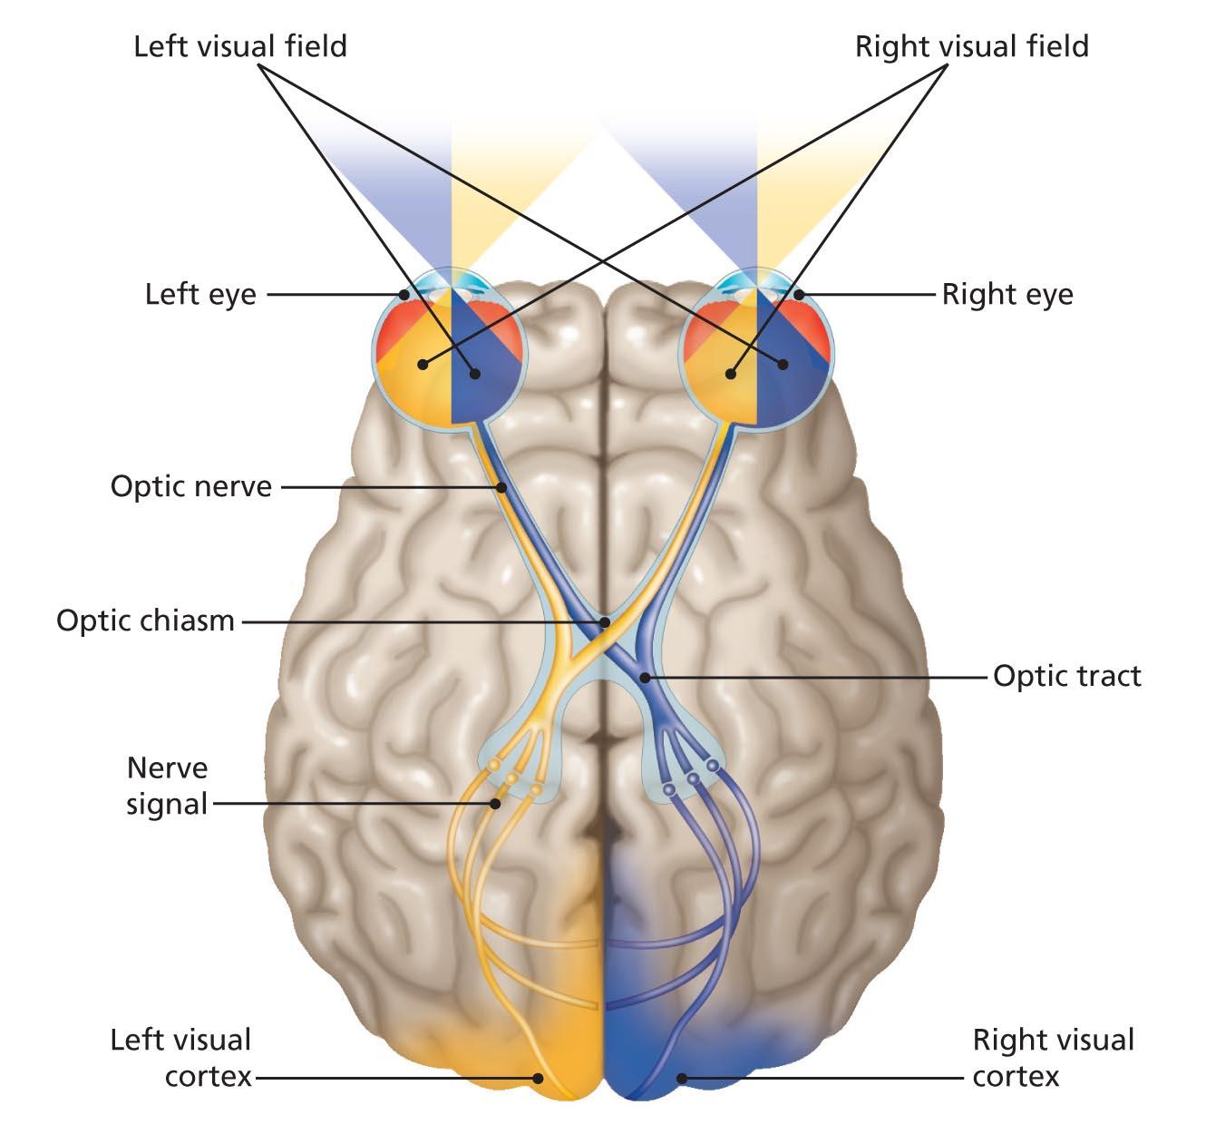
Figure 3.5 Crossing of the Optic Nerve
Light falling on the left side of each eye’s retina (from the right visual field, shown in yellow) will stimulate a neural message that will travel along the optic nerve to the thalamus, and then on to the visual cortex in the occipital lobe of the left hemisphere. Notice that the message from the temporal half of the left retina goes to the left occipital lobe, while the message from the nasal half of the right retina crosses over to the left hemisphere (the optic chiasm is the point of crossover). The optic nerve tissue from both eyes joins together to form the left optic tract before going on to the thalamus and the left occipital lobe. For the left visual field (shown in blue), the messages from both right sides of the retinas will travel along the right optic tract to the right visual cortex in the same manner.

Slide 27
Perception of Color 1 of 2
Learning Objective 3.6 Compare and contrast two major theories of color vision, and explain how color-deficient vision occurs.
Trichromatic theory: theory of color vision that proposes three types of cones: red, blue, and green
Opponent-process theory: theory of color vision that proposes four primary colors with cones arranged in pairs: red and green, blue and yellow
  Afterimages: images that occur when a visual sensation persists for a brief time even after the original stimulus is removed
  Lateral geniculate nucleus (LGN) of thalamus

Slide 28
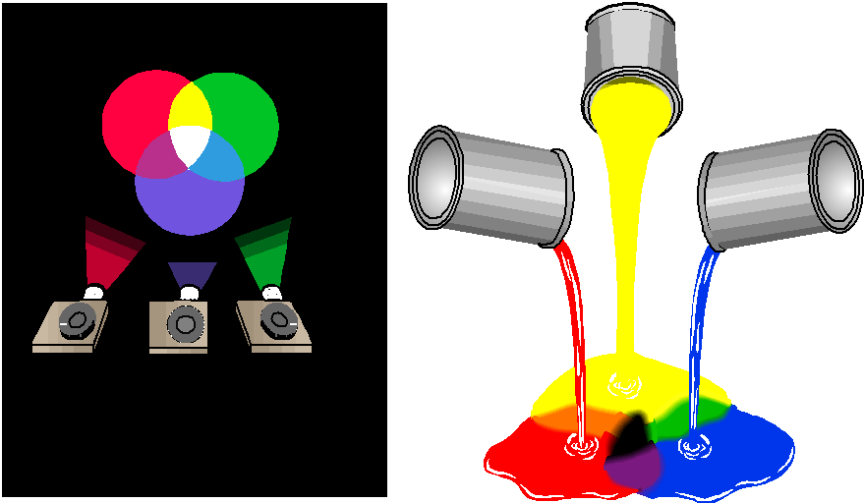
Figure 3.6 Trichromatic Theory
In trichromatic theory, the three types of cones combine to form different colors much as these three colored lights combine.

Slide 29
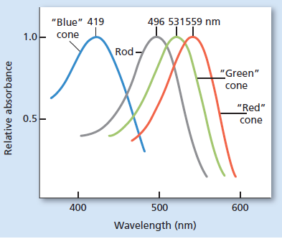
Figure 3.7 Absorbance of Light from Rods and Three Types of Cones

Slide 30
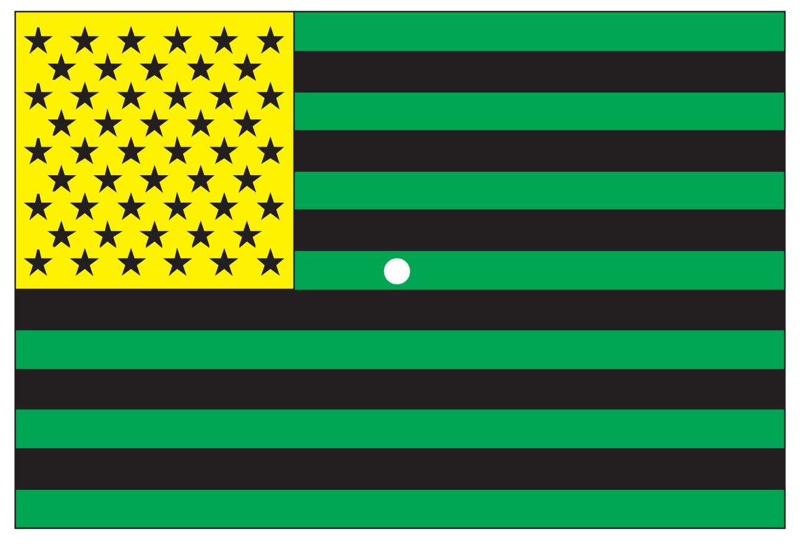
Figure 3.8 Color Afterimage
Stare at the white dot in the center of this oddly colored flag for about 30 seconds. Now look at a white piece of paper or a white wall. Notice that the colors are now the normal, expected colors of the American flag. They are also the primary colors that are opposites of the colors in the picture and provide evidence for the opponent-process theory of color vision.

Slide 31
Perception of Color 2 of 2
Monochrome colorblindness: a condition in which a person’s eyes either have no cones or have cones that are not working at all
Red-green colorblindness: either the red or the green cones are not working
Sex-linked inheritance
  Gene for color-deficient vision is recessive

Slide 32
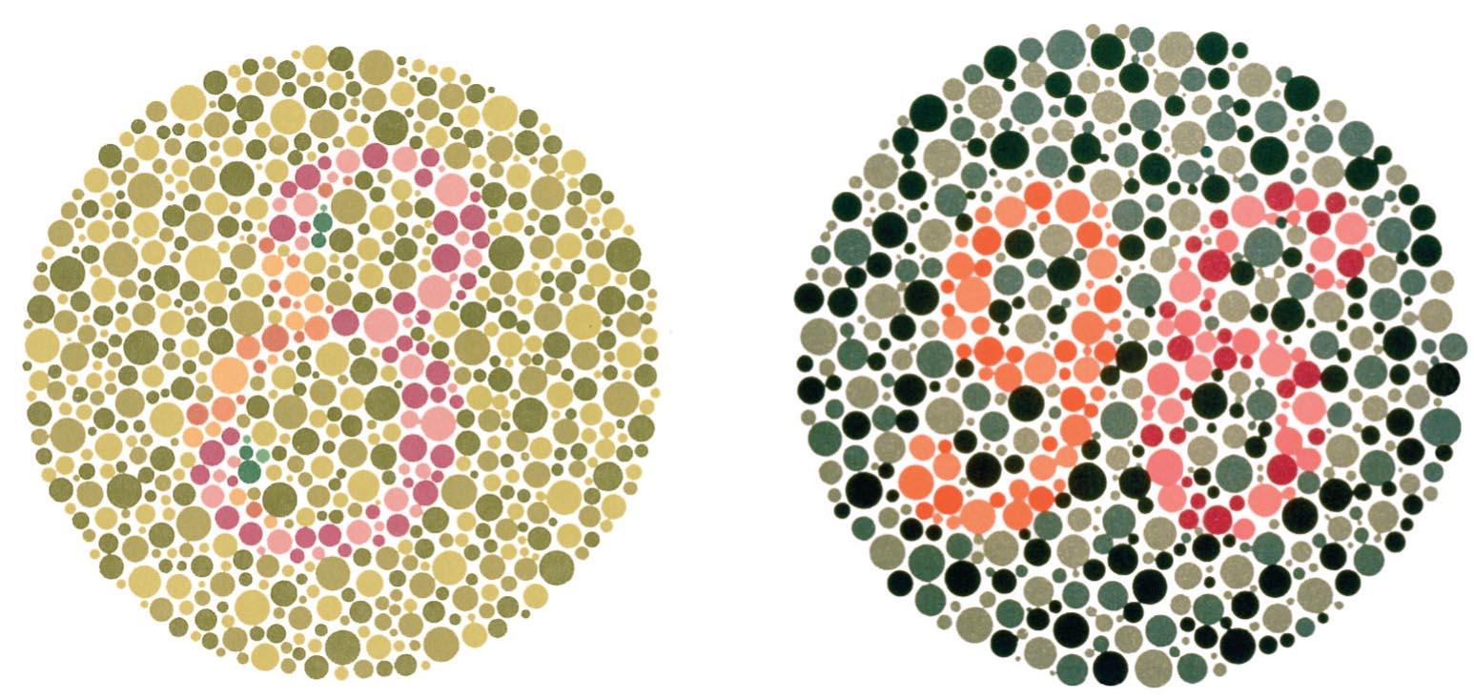
Figure 3.9 The Ishihara Color Test
In the circle on the left, the number 8 is visible only to those with normal color vision. In the circle on the right, people with normal vision will see the number 96, while those with red-green color blindness will see nothing but a circles of dots.

Slide 33
Sound Waves and the Ear 1 of 3
Learning Objective 3.7 Explain the nature of sound, and describe how it travels through the various parts of the ear.
Wavelength: interpreted as frequency or pitch (high, medium, or low)
Amplitude: interpreted as volume (how soft or loud a sound is)
Purity: interpreted as timbre (a richness in the tone of the sound)
Hertz (Hz): cycles or waves per second, a measurement of frequency

Slide 34
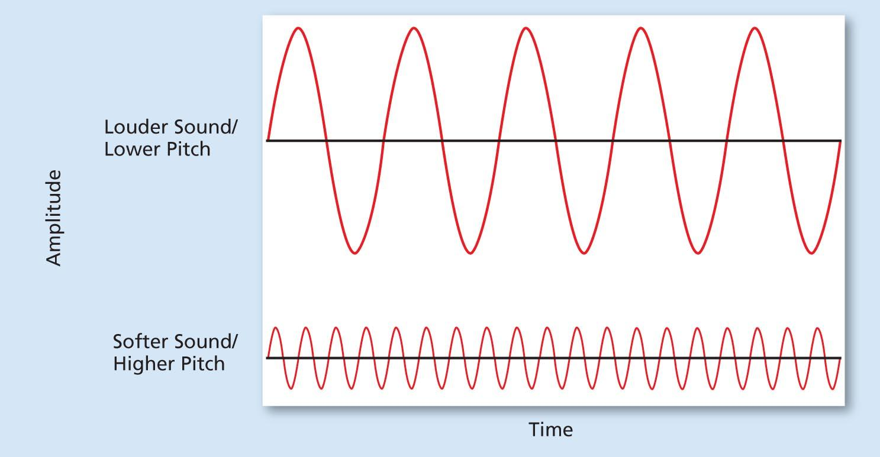
Figure 3.10a Sound Waves
Two sound waves. The higher the wave, the louder the sound; the lower the wave, the softer the sound. If the waves are close together in time (high frequency), the pitch will be perceived as a high pitch. Waves that are farther apart (low frequency) will be perceived as having a lower pitch.

Slide 35
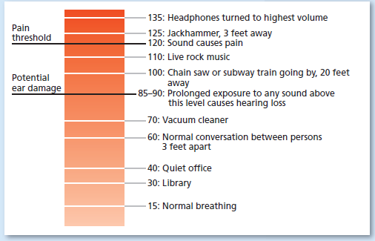
Figure 3.10b Sound Waves
Decibels of various stimuli. A decibel is a unit of measure for loudness. Psychologists study the effects that noise has on stress, learning, performance, aggression, and psychological and physical well-being.

Slide 36
Sound Waves and the Ear 2 of 3
Auditory canal: short tunnel that runs from the pinna to the eardrum (tympanic membrane)
Eardrum: thin section of skin that tightly covers the opening into the middle part of the ear
  When sound waves hit the eardrum, it vibrates and causes three tiny bones in the middle ear to vibrate
    Hammer
    Anvil
    Stirrup

Slide 37
Sound Waves and the Ear 3 of 3
Cochlea: snail-shaped structure of the inner ear that is filled with fluid
Organ of Corti: rests in the basilar membrane
  Contains receptor cells for sense of hearing
Auditory nerve: bundle of axons from the hair cells in the inner ear
  Receives neural message from the organ of Corti

Slide 38
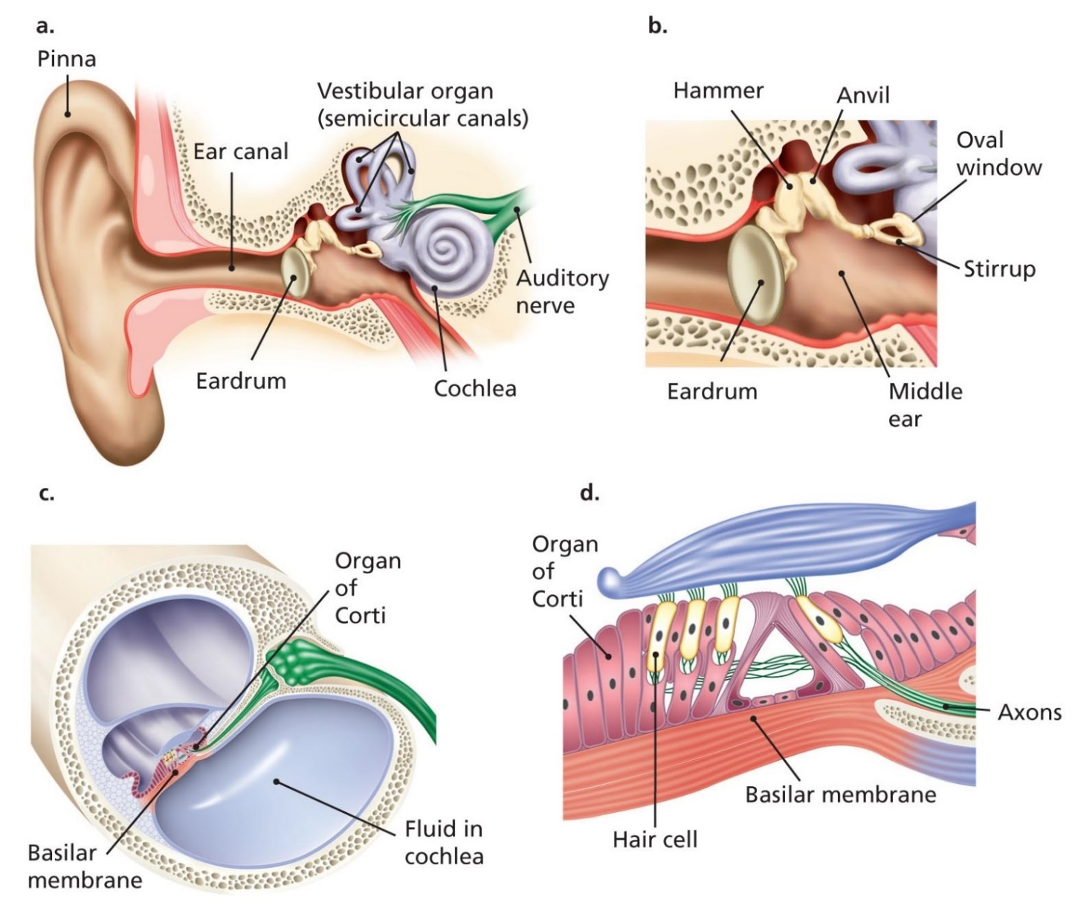
Figure 3.9 The Structure of the Ear
(a) This drawing shows the entire ear, beginning with the outer ear (pinna, ear canal, and eardrum). The vestibular organ includes the semicircular canals and the otolith organs (inside the round structures just above the cochlea). (b) The middle ear. Sound waves entering through the ear canal cause the eardrum to vibrate, which causes each of the three bones of the middle ear to vibrate, amplifying the sound. The stirrup rests on the oval window, which transmits its vibration to the fluid in the inner ear. (c) The inner ear. Large spaces are filled with fluid (shown in purple) that vibrates as the oval window vibrates. A thin membrane suspended in this fluid is called the basilar membrane, which contains the organ of Corti, the structure composed of the hairlike cells that send signals via the auditory nerve to the thalamus, which then relays information to the auditory cortex. (d) A close-up view of the basilar membrane (in dark pink) with the hair cells of the organ of Corti (in lighter pink). Notice the axons (small green lines) leaving the hair cells to form the auditory nerve.

Slide 39
Perceiving Pitch 1 of 2
Learning Objective 3.8 Summarize three theories of how the brain processes information about pitch.
Pitch: psychological experience of sound that corresponds to the frequency of the sound waves
  Higher frequencies are perceived as higher pitches
Place theory: theory of pitch that states that different pitches are experienced by stimulation of hair cells in different locations on organ of Corti

Slide 40
Perceiving Pitch 2 of 2
Frequency theory: theory of pitch that states that pitch is related to the speed of vibrations in the basilar membrane
Volley principle: theory of pitch that states that frequencies from about 400 Hz up to about 4000 Hz cause the hair cells (auditory neurons) to fire in a volley pattern, or take turns in firing

Slide 41
Types of Hearing Impairments 1 of 2
Learning Objective 3.9 Identify types of hearing impairment and treatment options for each.
Conduction hearing impairment can result from:
  Damaged eardrum: would prevent sound waves from being carried into the middle ear properly
  Damage to bones of middle ear: sounds cannot be conducted from the eardrum to the cochlea
Nerve hearing impairment can result from:
  Damage in inner ear
  Damage in auditory pathways and cortical areas of the brain

Slide 42
Types of Hearing Impairments 2 of 2
Cochlear implant: a microphone implanted just behind the ear that picks up sound from the surrounding environment
  Speech processor selects and arranges the sound picked up by the microphone
  Implant is a transmitter and receiver, converting signals into electrical impulses
  Collected by electrode array in cochlea, sent to the brain

Slide 43
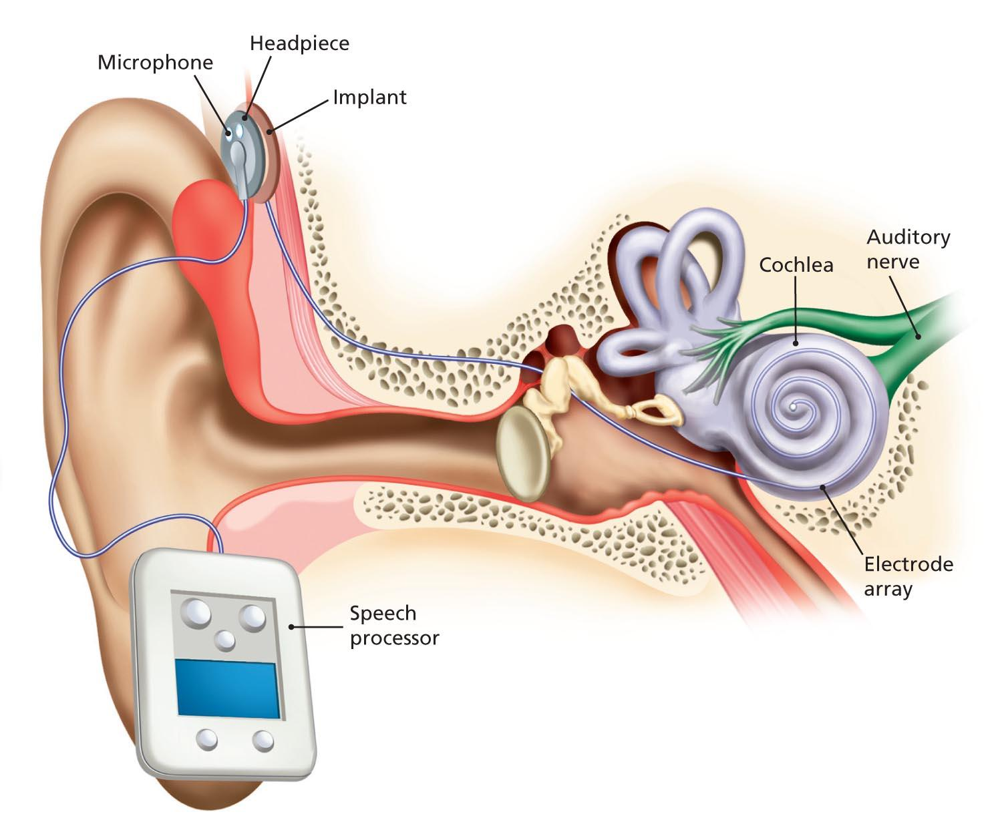
Figure 3.12 Cochlear Implant
In a cochlear implant, a microphone implanted just behind the ear picks up sound from the surrounding environment.
A speech processor, attached to the implant and worn outside the body, selects and arranges the sound picked up by the microphone. The implant itself is a transmitter and receiver, converting the signals from the speech processor into electrical
impulses that are collected by the electrode array in the cochlea and then sent to the brain.

Slide 44
Gustation: How We Taste the World
Learning Objective 3.10 Explain how the sense of taste works.
Taste buds
  Taste receptor cells in mouth; responsible for sense of taste
Gustation
  The sensation of a taste
Five basic tastes
  Sweet
  Sour
  Salty
  Bitter
  “Brothy,” or umami

Slide 45
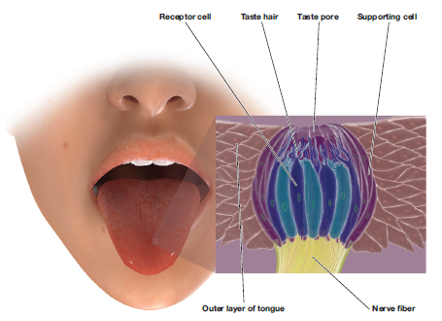
Figure 3.13 The Tongue and Taste Buds
(a) The right side of this drawing shows the nerves in the tongue's deep tissue. (b) The taste bud is located inside the papillae and is composed of small cells that send signals to the brain when stimulated by molecules of food. (c) Microphotograph of the surface of the tongue, showing two different sizes of papillae. The taste buds are located under the surface of the larger red papillae, whereas the smaller and more numerous papillae form a touch-sensitive rough surface that helps in chewing and moving food around the mouth.

Slide 46
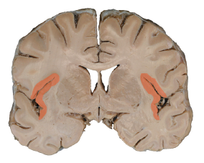
Figure 3.14 The Gustatory Cortex
The gustatory cortex is found in the anterior insula and frontal operculum. The insula is
an area of cortex covered by folds of overlying cortex, and each fold is an operculum. In
the coronal section of a human brain above, the gustatory cortex is found in the regions
colored a light red.

Slide 47
The Sense of Scents: Olfaction
Learning Objective 3.11 Explain how the sense of smell works.
Olfaction (olfactory sense)
  Sense of smell
Olfactory bulbs
  Areas of brain located just above sinus cavity and just below frontal lobes that receive information from the olfactory receptor cells
  At least 1,000 olfactory receptors

Slide 48
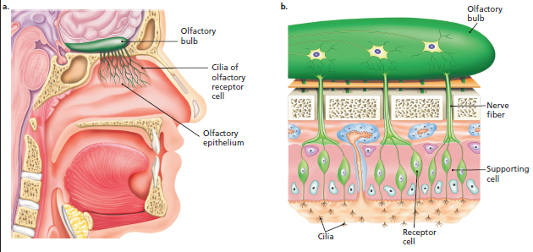
Figure 3.15 The Olfactory Receptors
(a) A cross-section of the nose and mouth. This drawing shows the nerve fibers inside the nasal cavity that carry information about smell directly to the olfactory bulb just under the frontal lobe of the brain (shown in green). (b) A diagram of the cells in the nose that process smell. The olfactory bulb is on top. Notice the cilia, tiny hairlike cells that project into the nasal cavity. These are the receptors for the sense of smell.

Slide 49
Somesthetic Senses 1 of 2
Learning Objective 3.12 Describe how we experience the sensations of touch, pressure, temperature, and pain.
Somesthetic senses: the body senses consisting of the skin senses, the kinesthetic sense, and the vestibular senses
  “Soma”: body
  “Esthetic”: feeling

Slide 50
Somesthetic Senses 2 of 2
Skin senses: the sensations of touch, pressure, temperature, and pain
  Sensory receptors in the skin
  Gate-control theory: pain signals must pass through a “gate” located in the spinal cord

Slide 51
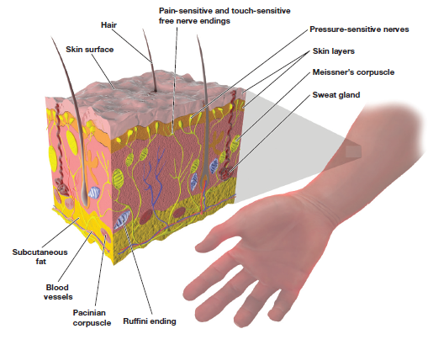
Figure 3.16 Cross-Section of the Skin and Its Receptors
The skin is composed of several types of cells that process pain, pressure, and temperature. Some of these cells are wrapped around the ends of the hairs on the skin and are sensitive to touch on the hair itself, whereas others are located near the surface and still others just under the top layer of tissue.

Slide 52
Body Movement and Position 1 of 2
Learning Objective 3.13 Describe the systems that tell us about balance and position and movement of our bodies.
Kinesthetic sense: sense of the location of body parts in relation to the ground and each other
  Proprioception

Slide 53
Body Movement and Position 2 of 2
Vestibular senses: the sensations of movement, balance, and body position
Sensory conflict theory: an explanation of motion sickness in which the information from the eyes conflicts with the information from the vestibular senses
  Results in dizziness, nausea, and other physical discomforts

Slide 54
How We Organize Our Perceptions 1 of 4
Learning Objective 3.14 Describe how perceptual constancies and the Gestalt principles account for common perceptual experiences.
Perception
  The method by which the sensations experienced at any given moment are interpreted and organized in some meaningful fashion
Size constancy
Shape constancy
Brightness constancy

Slide 55
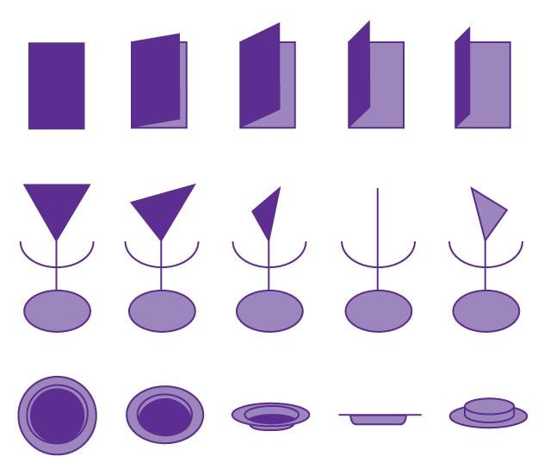
Figure 3.17 Shape Constancy
Three examples of shape constancy are shown here. The opening door is actually many different shapes, yet we still see it as basically a rectangular door. We do the same thing with a triangle and a circle—and, although when we look at them from different angles they cast differently shaped images on our retina, we experience them as a triangle and a circle because of shape constancy.

Slide 56
How We Organize Our Perceptions 2 of 4
Figure-Ground
  The tendency to perceive objects, or figures, as existing on a background
Reversible figures
  Visual illusions in which the figure and ground can be reversed

Slide 57
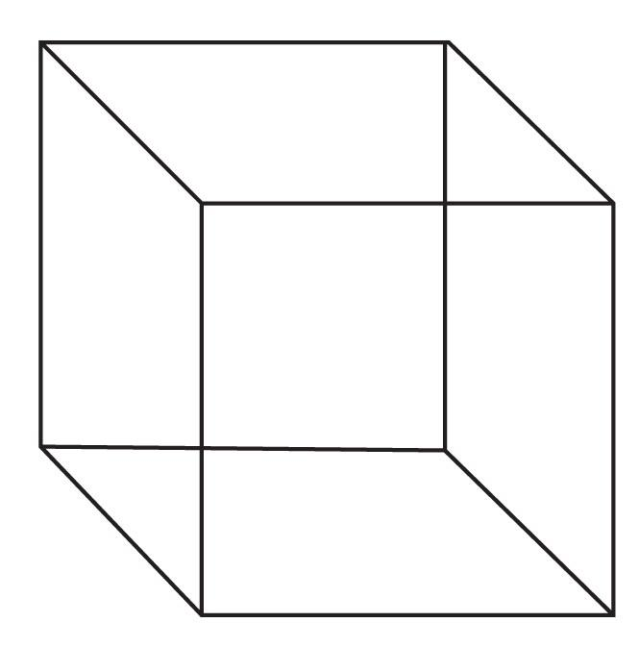
Figure 3.18 The Necker Cube
This is an example of a reversible figure. It can also be described as an ambiguous figure, since it is not clear which pattern should predominate.

Slide 58

Figure 3.19 Figure-Ground Illusion
What do you see when you look at this picture? Is it a wine goblet? Or two faces looking at each other?
This is an example
in which the figure and the ground seem to “switch” each time you look at the picture.

Slide 59
How We Organize Our Perceptions 3 of 4
Proximity
  Tendency to perceive objects that are close to each other as part of the same grouping
Similarity
  Tendency to perceive things that look similar to each other as being part of the same group
Closure
  Tendency to complete figures that are incomplete

Slide 60
How We Organize Our Perceptions 4 of 4
Closure
  Tendency to complete figures that are incomplete
Continuity
  Tendency to perceive things as simply as possible with a continuous pattern rather than with a complex, broken-up pattern

Slide 61
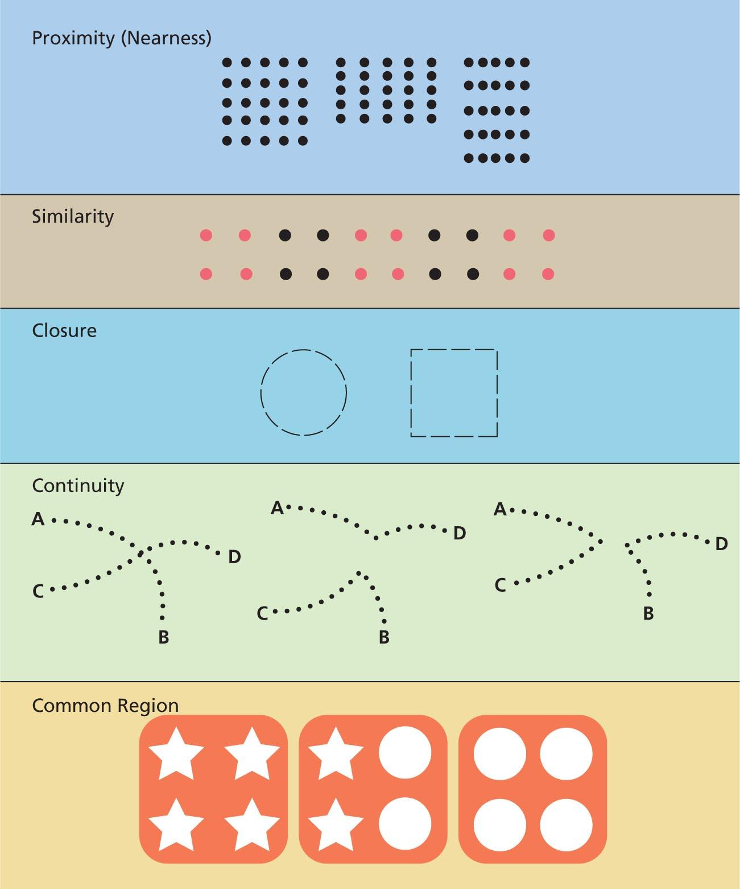
Figure 3.20 Gestalt Principles of Grouping
The Gestalt principles of grouping are shown here. These are the human tendency to organize isolated stimuli into groups on the basis of five characteristics: proximity, similarity, closure, continuity, and common region.
Proximity: The dots on the left can be seen as horizontal or vertical rows—neither organization dominates. But just by changing the proximity of certain dots, as in the other two examples, we experience the dots as vertical columns (middle) or horizontal rows (right).
Similarity: The similarity of color here makes you perceive these dots as forming black squares and color squares rather than two rows of black and colored dots. Closure: Even though the lines are broken, we still see these figures as a circle and a square—an example of how we tend to “close” or “fill in” missing parts from what we know of the whole.
Continuity: Because of continuity, we are much more likely to see the figure on the left as being made up of two lines, A to B and C to D, than we are to see it as a figure made up of lines A to D and C to B or A to C and B to D.
Common Region: Similarity would suggest that people see two groups, stars and circles. But the colored backgrounds define a visible common region, and the tendency is to perceive three different groups.

Slide 62
Depth Perception 1 of 2
Learning Objective 3.15 Explain how we perceive depth using both monocular and binocular cues.
Depth perception: the ability to perceive the world in three dimensions
Monocular cues (pictorial depth cues): cues for perceiving depth based on one eye only
  Linear perspective
  Relative size
  Overlap
  Aerial perspective
  Texture gradient
  Motion parallax
  Accomodation

Slide 63

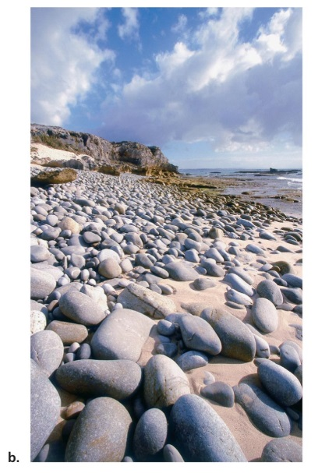
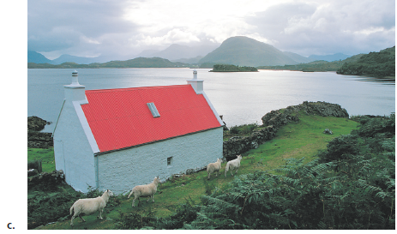
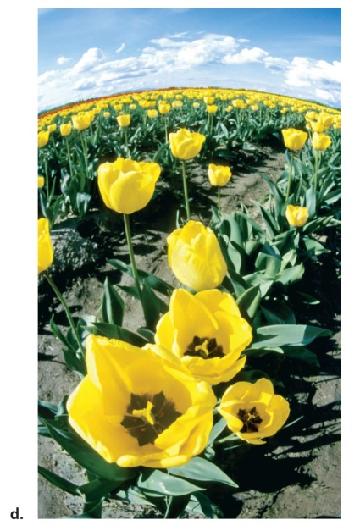
Figure 3.21 Examples of Pictorial Depth Cues
Both the lines of the trees and the sides of the road appear to come together or converge in the distance. This is an example of linear perspective.
Notice how the larger pebbles in the foreground seem to give way to smaller and smaller pebbles near the middle of the picture. Texture gradient causes the viewer to assume that as the texture of the pebbles gets finer, the pebbles are getting farther away.
(c) In aerial or atmospheric perspective, the farther away something is the hazier it appears because of fine particles in the air between the viewer and the object. Notice that the road and farmhouse in the foreground are in sharp focus while the mountain ranges are hazy and indistinct.
(d) The depth cue of relative size appears in this photograph. Notice that the flowers in the distance appear much smaller than those in the foreground. Relative size causes smaller objects to be perceived as farther away from the viewer.
Notes:
Image credits:
Tree-lined road: Grant Faint/The Image Bank/Getty Images
Rocky beach: Shaen Adey/Dorling Kindersley
Farmhouses: Robin Smith/Photolibrary/Getty Images
Tulips: Creative Eye/MIRA.com

Slide 64
Depth Perception 2 of 2
Binocular cues: cues for perceiving depth based on both eyes
  Convergence
  Binocular disparity

Slide 65
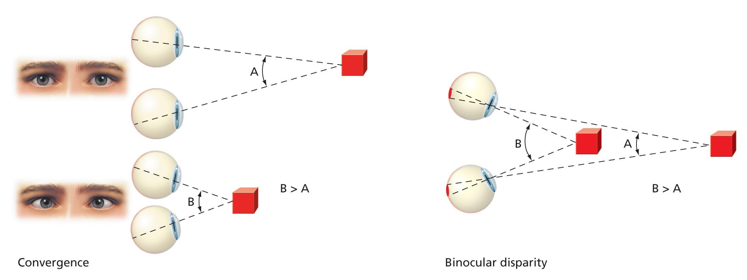
Figure 3.22
Binocular Cues to Depth Perception
(left) Convergence is a depth cue that involves the muscles of the eyes. When objects are far away, the eye muscles are more relaxed; when objects are close, the eye muscles move together, or converge. (right) Binocular disparity. Because your eyes are separated by several centimeters, each eye sees a slightly different image of the object in front of you. In A, the object is far enough away that the difference is small. In B, while the object is closer, there is a greater difference between what each eye sees. The brain interprets this difference as the distance of the object.

Slide 66
Perceptual Illusions 1 of 5
Learning Objective 3.16 Identify some common visual illusions and the factors that influence our perception of them.
Hermann grid: possibly due to the response of the primary visual cortex
Müller-Lyer illusion: illusion of line length that is distorted by inward-turning or outward-turning corners on the ends of the lines, causing lines of equal length to appear to be different

Slide 67

Figure 3.23 The Hermann Grid
Look at this matrix of squares. Do you notice anything interesting at the white intersections? What happens if you focus your vision directly on one of the intersections?

Slide 68
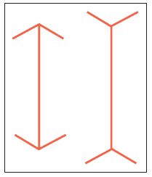
The Müller-Lyer illusion
The Müller-Lyer optical illusion features a red line that appears to be longer than a blue line. In reality, both lines are equal in length. As can be seen in the bottom two lines, outward facing fins create a visual perception of greater length than do inward facing fins. In this experiment, we’ll look at why this effect occurs, and determine if you are susceptible to the Müller-Lyer illusion.

Slide 69

Perceptual Illusions 2 of 5
Moon illusion: the moon on the horizon appears to be larger than the moon in the sky
  Apparent distance hypothesis
Notes:
Image credit: Larry Landolfi / Photo Researchers, Inc.

Slide 70
Perceptual Illusions 3 of 5
Illusions of motion
  Autokinetic effect: a small, stationary light in a darkened room will appear to move or drift because there are no surrounding cues to indicate that the light is not moving
  Stroboscopic motion: seen in motion pictures, in which a rapid series of still pictures will appear to be in motion
  Phi phenomenon: lights turned on in a sequence appear to move
  Rotating snakes: due in part to eye movements
  The Enigma: due in part to microsaccades

Slide 71
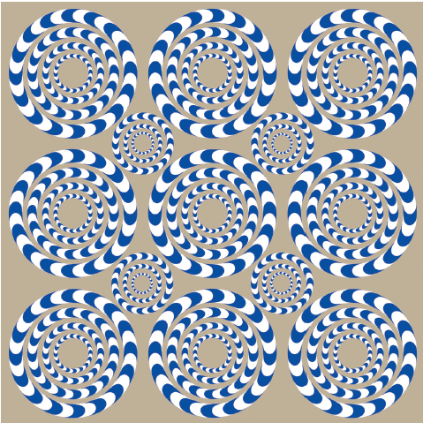
Figure 3.24 “Rotating Snakes”
Notice anything as you move your eyes over this image? The image is not moving; seeing the “snakes” rotate is due at least in part to movements of your eyes.
Created by and courtesy of Dr. Akiyoshi Kitaoka, Ritsumeikan University.

Slide 72
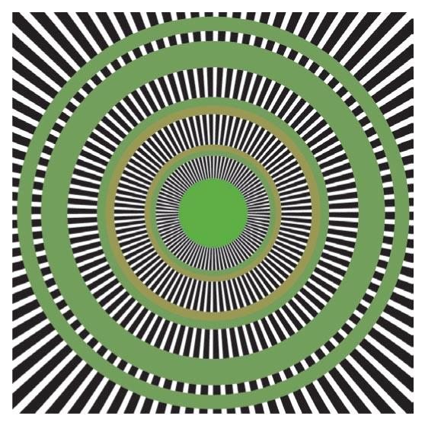
Figure 3.25 “Reinterpretation of Enigma”
As in Figure 3.24, the motion you see in this static image is because of movements of your eyes, this time due more to tiny movements called microsaccades.
Created by and courtesy of Jorge Otero-Millan,
Martinez-Conde Laboratory, Barrow Neurological
Institute.

Slide 73
Perceptual Illusions 4 of 5
Perceptual set (perceptual expectancy): the tendency to perceive things a certain way because previous experiences or expectations influence those perceptions
Top-down processing: the use of preexisting knowledge to organize individual features into a unified whole

Slide 74
Perceptual Illusions 5 of 5
Bottom-up processing: the analysis of the smaller features to build up to a complete perception

Slide 75

Figure 3.26 The Devil’s Trident
At first glance, this seems to be an ordinary three-pronged figure. But a closer look reveals that the three prongs cannot be real as drawn. Follow the lines of the top prong to see what goes wrong.

