Slide 1

Psychology
Fifth Edition, Global Edition
Saundra K. Ciccarelli
J. Noland White
Saundra K. Ciccarelli
J. Noland White
Copyright © 2018 Pearson Education, Ltd. All Rights Reserved

Slide 2

Psychology
Fifth Edition, Global Edition
Chapter 4
4
Consciousness

Slide 3
Learning Objectives 1 of 2
4.1 Define what it means to be conscious.
4.2 Differentiate between the different levels of consciousness.
4.3 Describe the biological process of the sleep–wake cycle.
4.4 Explain why we sleep.
4.5 Identify the different stages of sleep.
4.6 Differentiate among the various sleep disorders.
4.7 Compare and contrast two explanations of why people dream.
4.8 Identify commonalities and differences in the content of people’s dreams.

Slide 4
Learning Objectives 2 of 2
4.9 Explain how hypnosis affects consciousness.
4.10 Compare and contrast two views of why hypnosis works.
4.11 Distinguish between physical dependence and psychological dependence upon drugs.
4.12 Identify the effects and dangers of using stimulants.
4.13 Identify the effects and dangers of using depressants.
4.14 Identify the effects and dangers of using hallucinogens.
4.15 Describe how the workings of our consciousness can explain “supernatural” visitations.

Slide 5
Definition of Consciousness
Learning Objective 4.1 Define what it means to be conscious.
Consciousness
  A person’s awareness of everything that is going on around him or her at any given moment
  Generated by set of action potentials in communication among neurons

Slide 6
Altered States of Consciousness
Learning Objective 4.2 Differentiate between the different levels of consciousness.
Waking consciousness
  State in which thoughts, feelings, and sensations are clear and organized, and the person feels alert
Altered state of consciousness
  State in which there is a shift in the quality or pattern of mental activity as compared to waking consciousness

Slide 7
The Biology of Sleep 1 of 2
Learning Objective 4.3 Describe the biological process of the sleep–wake cycle.
Circadian rhythm: a cycle of bodily rhythm that occurs over a twenty-four-hour period

Slide 8
The Biology of Sleep 2 of 2
Hypothalamus: tiny section of the brain that influences the glandular system
  Suprachiasmatic nucleus
    Deep within the hypothalamus
    Internal clock that tells people when to wake up and when to fall asleep
Hypothalamus tells pineal gland to secrete melatonin
  Melatonin makes a person feel sleepy

Slide 9
Why We Sleep 1 of 2
Learning Objective 4.4 Explain why we sleep.
Amount of needed sleep varies
Microsleeps: brief sidesteps into sleep lasting only a few seconds
Sleep deprivation: any significant loss of sleep
  Results in irritability and problems with concentration

Slide 10
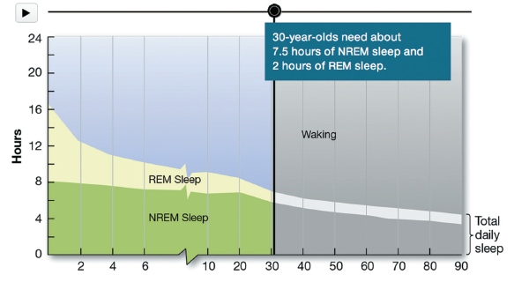
Figure 4.1
Sleep Patterns of Infants and Adults
Infants need far more sleep than older children and adults. Both REM sleep and NREM sleep decrease dramatically in the first 10 years of life, with the greatest decrease in REM sleep. Nearly 50 percent of an infant’s sleep is REM, compared to only about 20 percent for a normal, healthy adult (Roffwarg, 1966).

Slide 11
Why We Sleep 2 of 2
Adaptive theory: theory of sleep proposing that animals and humans evolved sleep patterns to avoid predators by sleeping when predators are most active
Restorative theory: theory of sleep proposing that sleep is necessary to the physical health of the body and serves to replenish chemicals and repair cellular damage

Slide 12
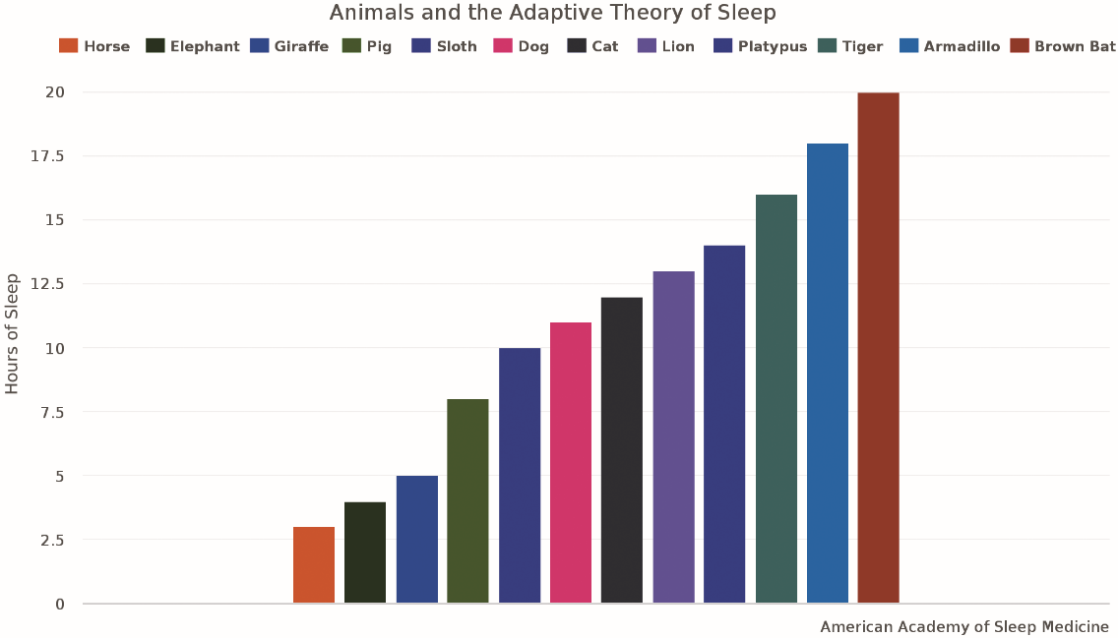
Figure 4.2 Animals and the Adaptive Theory of Sleep

Slide 13
The Stages of Sleep 1 of 5
Learning Objective 4.5 Identify the different stages of sleep.
Rapid eye movement (REM): stage of sleep in which the eyes move rapidly under the eyelids and the person is typically experiencing a dream
NREM (non-REM) sleep: any of the stages of sleep that do not include REM

Slide 14
The Stages of Sleep 2 of 5
Electroencephalograph (EEG)
  Allows scientists to see the brain wave activity as a person passes through the various stages of sleep and to determine what type of sleep the person has entered
Alpha waves: brain waves that indicate a state of relaxation or light sleep
Theta waves: brain waves indicating the early stages of sleep
Delta waves: long, slow waves that indicate the deepest stage of sleep

Slide 15
The Stages of Sleep 3 of 5
N1: Light Sleep
  May experience:
    Hypnagogic images: hallucinations or vivid visual events
    Hypnic jerk: knees, legs, or whole body jerks
N2: Sleep Spindles
  Brief bursts of activity only lasting a second or two

Slide 16
The Stages of Sleep 4 of 5
N3: Delta Waves
  Deepest stage of sleep: 50 percent or more of waves are delta waves
  Body at lowest level of functioning
  Time at which growth occurs

Slide 17
The Stages of Sleep 5 of 5
R: Rapid Eye Movement
  REM sleep is paradoxical sleep (high level of brain activity)
  Vivid, more detailed and longer dreams
  REM rebound: increased amounts of REM sleep after being deprived of REM sleep on earlier nights

Slide 18
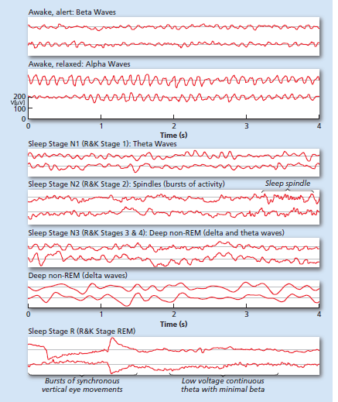
Figure 4.3
Brain Activity During Sleep
The EEG reflects brain activity during both waking and sleep. This activity varies according to level of alertness while awake (top two segments) and the stage of sleep. Stage N3 of sleep is characterized by the presence of delta activity, which is much slower and accounts for the larger, slower waves on these graphs. R sleep has activity that resembles alert wakefulness but has relatively no muscle activity except rapid eye movement. The graph shows the typical progression through the night of Stages N1–N3 and R. The R sleep periods occur about every 90 minutes throughout the night (based on Dement, 1974).
Notes:
EEG data and images in this figure are courtesy of Dr. Leslie Sherlin.

Slide 19
Sleep Disorders 1 of 4
Learning Objective 4.6 Differentiate among the various sleep disorders.
Nightmares
  Bad dreams occurring during REM sleep
  More common in children
REM behavior disorder
  Mechanism that blocks movement of the voluntary muscles fails
  Allows person to thrash around, or even get up and act out nightmares

Slide 20
Sleep Disorders 2 of 4
Night terrors
  Person experiences extreme fear and screams or runs around during deep sleep
  Doesn’t wake fully
  Occurs in up to 56 percent of young children, decreases with age

Slide 21
Sleep Disorders 3 of 4
Sleepwalking (somnambulism)
  Episode of moving around or walking around in one’s sleep
  Occurs during deep sleep
  More common among children than adults
  Sleepwalking can be a defense against criminal charges

Slide 22
Sleep Disorders 4 of 4
Insomnia: the inability to get to sleep, stay asleep, or get a good quality of sleep
Sleep apnea: disorder in which the person stops breathing for nearly half a minute or more
  Continuous positive airway pressure device (CPAP)
Narcolepsy: sleep disorder in which a person falls immediately into REM sleep during the day without warning
  Cataplexy: sudden loss of muscle tone

Slide 23
Table 4.1
Sleep Disorders
Name of Disorder | Primary Symptoms
Somnambulism | Sitting, walking, or performing complex behavior while asleep
Night terrors | Extreme fear, agitation, screaming while asleep
Restless leg syndrome | Uncomfortable sensations in legs causing movement and loss of sleep
Nocturnal leg cramps | Painful cramps in calf or foot muscles
Hypersomnia | Excessive daytime sleepiness
Circadian rhythm disorders | Disturbances of the sleep-wake cycle such as jet lag and shift work
Enuresis | Urinating while asleep in bed

Slide 24
Why Do We Dream? 1 of 2
Learning Objective 4.7 Compare and contrast two explanations of why people dream.
Freud: dreams as wish fulfillment
  Manifest content: the dream itself
  Latent content: the true, hidden meaning of a dream
Activation-synthesis hypothesis: dreams are created by higher centers of cortex to explain the brain stem’s activation of cortical cells during REM sleep periods

Slide 25
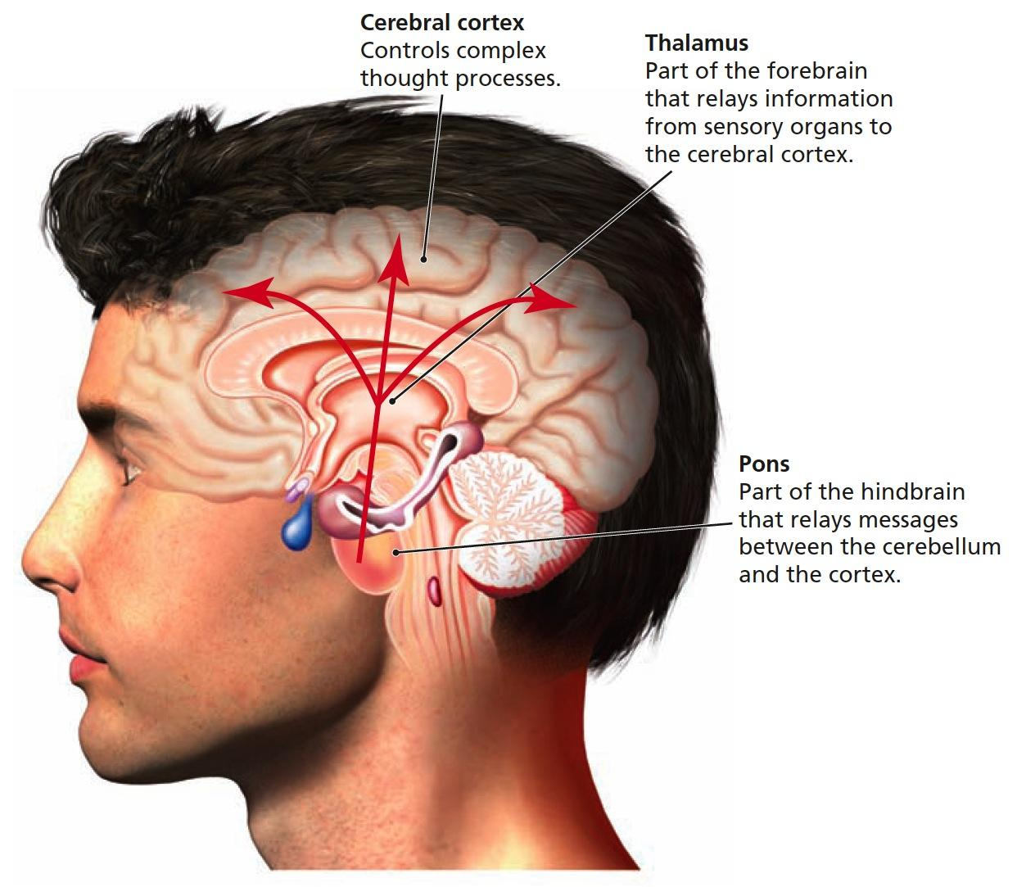
Figure 4.4 The Brain and Activation-Synthesis Theory
According to the activation-synthesis theory of dreaming, the pons in the brainstem sends random signals to the upper part of the brain during REM sleep. These random signals pass through the thalamus, which sends the signals to the proper sensory areas of the cortex. Once in the cortex, the association areas of the cortex respond to the random activation of these cortical cells by synthesizing (making up) a story, or dream, using bits and pieces of life experiences and memories

Slide 26
Why Do We Dream? 2 of 2
Activation-information-mode model (AIM)
  Revised version of activation-synthesis explanation of dreams
  Information that is accessed during waking hours can have an influence on the synthesis of dreams

Slide 27
What Do People Dream About?
Learning Objective 4.8 Identify commonalities and differences in the content of people’s dreams.
Typically about events that occur in everyday life
Most dream in color
Gender differences:
  Girls and women dream about people they know, personal appearance concerns, issues related to family and home
  Boys and men dream about outdoor or unfamiliar settings; may involve weapons, tools, cars, or sexual dreams with unknown partners

Slide 28
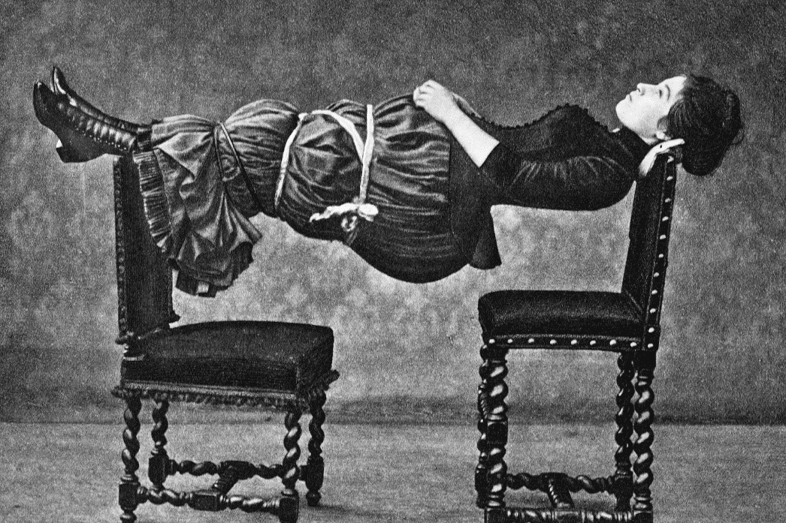
How Hypnosis Works 1 of 2
Learning Objective 4.9 Explain how hypnosis affects consciousness.
Hypnosis: state of consciousness in which the person is especially susceptible to suggestion
Stage hypnotists often make use of people’s willingness to believe that something ordinary is extraordinary. This woman was hypnotized and suspended between two chairs after the person supporting her middle stepped away. The hypnotist led the audience to believe that she could not do this unless hypnotized, but in reality anyone can do this while fully conscious.

Slide 29
How Hypnosis Works 2 of 2
Four elements of hypnosis:
  Hypnotist tells the person to focus on what is being said
  Person is told to relax and feel tired
  Hypnotist tells the person to “let go” and accept suggestions easily
  Person is told to use vivid imagination
Hypnotic susceptibility: degree to which a person is a good hypnotic subject

Slide 30
Theories of Hypnosis
Learning Objective 4.10 Compare and contrast two views of why hypnosis works.
Hypnosis as dissociation: hypnosis works only in a person’s immediate consciousness, while a hidden “observer” remained aware of all that was going on
Social-cognitive theory of hypnosis: people who are hypnotized not in an altered state, but merely playing role expected of them in the situation

Slide 31
Table 4.2 Examples of Items that Would Appear on a Hypnotic Susceptibility Scale
Examples of Items That Would Appear on a Hypnotic Susceptibility Scale
1. Movement of the body back and forth
2. Closing eyes and unable to open them
3. Fingers locked together
4. One arm locked into position
5. Responding to posthypnotic suggestion
6. Loss of memory for events during the session
7. Unable to state one’s own name
8. Seeing or hearing nonexistent stimuli

Slide 32
Table 4.3 Facts About Hypnosis
Hypnosis Can: | Hypnosis Cannot:
Create amnesia for whatever happens during the hypnotic session, at least for a brief time (Bowers & Woody, 1996). | Give people superhuman strength. (People may use their full strength under hypnosis, but it is no more than they had before hypnosis.)
Relieve pain by allowing a person to remove conscious attention from the pain (Holroyd, 1996). | Reliably enhance memory. (There’s an increased risk of false-memory retrieval because of the suggestible state hypnosis creates.)
Alter sensory perceptions. (Smell, hearing, vision, time sense, and the ability to see visual illusions can all be affected by hypnosis.) | Regress people back to childhood. (Although people may act like children, they do and say things children would not.)
Help people relax in situations that normally would cause them stress, such as flying on an airplane (Muhlberger et al., 2001). | Regress people to some “past life.” There is no scientific evidence for past-life regression (Lilienfeld et al., 2004).

Slide 33
Dependence 1 of 3
Learning Objective 4.11 Distinguish between physical dependence and psychological dependence upon drugs.
Psychoactive drugs: drugs that alter thinking, perception, and memory
Physical dependence
  Tolerance: more and more of the drug is needed to achieve the same effect
  Withdrawal: physical symptoms resulting from a lack of an addictive drug in the body systems
    Nausea, pain, tremors, crankiness, and high blood pressure

Slide 34
Dependence 2 of 3
Brain plays important role in dependency
  Drugs enter brain’s reward pathway, causing release of dopamine and intense pleasure
  Brain tries to adapt by decreasing synaptic receptors for dopamine
  More drugs now needed to achieve same pleasure response → drug tolerance

Slide 35
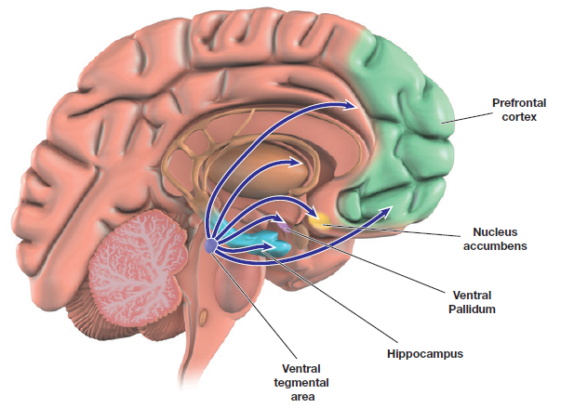
Figure 4.5 The Brain’s Reward Pathway
A pleasure center has been discovered in the mesotelencephalic dopamine pathway. The cells in this pathway communicate via the neurotransmitter dopamine. The pathway between the ventral tegmental area and the nucleus accumbens is most likely the site for the rewarding effects of natural rewards (e.g. eating, drinking, sex) and drug effects (e.g. euphoria, pleasure).

Slide 36
Dependence 3 of 3
Psychological dependence: feeling that a drug is needed to continue a feeling of emotional or psychological well-being
  Any drug can cause psychological dependence

Slide 37
Stimulants: Up, Up and Away
Learning Objective 4.12 Identify the effects and dangers of using stimulants.
Stimulants: drugs that increase the functioning of the nervous system
  Amphetamines: drugs that are synthesized (made in labs) rather than found in nature
  Cocaine: natural drug; produces euphoria, energy, power, and pleasure
  Nicotine: active ingredient in tobacco
  Caffeine: stimulant found in coffee, tea, most sodas, chocolate, and even many over-the-counter drugs

Slide 38
Down in the Valley: Depressants 1 of 3
Learning Objective 4.13 Identify the effects and dangers of using depressants.
Depressants: drugs that decrease the functioning of the nervous system
  Barbiturates: depressant drugs with sedative effect
  Benzodiazepines: drugs that lower anxiety and reduce stress
  Rohypnol: the “date rape” drug

Slide 39
Down in the Valley: Depressants 2 of 3
Alcohol: the chemical resulting from fermentation or distillation of various kinds of vegetable matter
  Often mistaken for a stimulant, alcohol is actually a CNS depressant
  Most commonly used and abused depressant

Slide 40
Table 4.4 Blood Alcohol Level and Behavior Associated With Amounts of Alcohol 1 of 2
A drink is a drink. Each contains half an ounce of alcohol.
So a drink is…
  1 can of beer (12 oz.; 4-5% alcohol)
  1 glass of wine (4 oz.; 12% alcohol)
  1 shot of most liquors (1 oz.; 40-50% alcohol)
  At times “a drink” is really the equivalent of more than just one drink, like when you order a drink with more than one shot of alcohol in it, or you do a shot followed by a beer.
Average Number of Drinks | Blood Alcohol Level | Behavior
1-2 drinks | 0.05% | Feeling of well-being Uninhibited Poor judgment Coordination and alertness Impaired driving
3-5 drinks | 0.10% | Slow reaction time Muscle control Vision Speech impaired Crash risk greatly increased

Slide 41
Table 4.4 Blood Alcohol Level and Behavior Associated With Amounts of Alcohol 2 of 2
Average Number of Drinks | Blood Alcohol Level | Behavior
6-7 drinks | 0.15% | Major increases in reaction time
8-10 drinks | 0.20% | Loss of balance Fine motor skills Legally blind Unable to drive for up to 10 hours
10-14 drinks | 0.20% and 0.25% | Staggering and severe motor disturbances
10-14 drinks | 0.30% | Not aware of surroundings
10-14 drinks | 0.35% | Surgical anesthesia Lethal dosage for a small percentage of people
14-20 drinks | 0.40% | Lethal dosage for about 50% of people Severe circulatory/respiratory depression Alcohol poisoning/overdose
Source: Adapted from the Moderate Drinking Skills Study Guide. (2004). Eau-Claire, WI: University of Wisconsin.

Slide 42
Down in the Valley: Depressants 3 of 3
Opiates: suppress sensation of pain by binding to and stimulating the nervous system’s natural receptor sites for endorphins.
  Opium: substance made from the opium poppy and from which all narcotic drugs are derived
  Morphine: narcotic drug derived from opium; used to treat severe pain
  Heroin: narcotic drug derived from opium that is extremely addictive

Slide 43
Hallucinogens: Higher and Higher 1 of 2
Learning Objective 4.14 Identify the effects and dangers of using hallucinogens.
Manufactured Highs: developed in lab
  Hallucinogens: drugs that cause false sensory messages, altering the perception of reality
  LSD (lysergic acid diethylamide): powerful synthetic hallucinogen
  PCP: synthesized drug now used as an animal tranquilizer that can cause stimulant, depressant, narcotic, or hallucinogenic effects
  MDMA (Ecstasy or X): designer drug that can have both stimulant and hallucinatory effects
  Stimulatory hallucinogenics: drugs producing mixture of psychomotor stimulant and hallucinogenic effects

Slide 44
Hallucinogens: Higher and Higher 3 of 3
Nonmanufactured High: naturally occurring
Marijuana: mild hallucinogen derived from the leaves and flowers of type of hemp plant
  Produces a feeling of well-being, mild intoxication, mild sensory distortions or hallucinations
  Affects reaction time and perception of surroundings
  Psychologically addicting

Slide 45
Table 4.5
How Drugs Affect Consciousness
Drug Classification | Common Name | Main Effect | Adverse Effects
Stimulants | Blank cell |  | Blank cell
Amphetamines | Methamphetamine, speed, Ritalin, Dexedrine | Blank cell | Risk of addiction, stroke, fatal heart problems, psychosis
Cocaine | Cocaine, crack | Blank cell | Risk of addiction, stroke, fatal heart problems psychosis
Nicotine | Tobacco | Blank cell | Addiction, cancer
Caffeine | Coffee, tea, energy drinks | Blank cell | Addiction, high blood pressure
Depressants | Blank cell |  | Blank cell
Barbiturates (major tranquilizers) | Nembutal, Seconal | Blank cell | Addiction, brain damage, death
Benzodiazepines (minor tranquilizers) | Valium, Xanax, Halcion, Ativan, Rohypnol | Blank cell | Lower risk of overdose and addiction when taken alone
Alcohol | Beer, wine, spirits | Blank cell | Alcoholism, health problems, depression, increased risk of accidents, death
Narcotics | Opium, Morphine, heroin | Euphoria | Addiction, death
Hallucinogens | LSD, PCP, MDMA (Ecstasy), marijuana | Distorted consciousness, altered perception | Possible permanent memory problems, bad “trips,” suicide, overdose, and death

Slide 46
Thinking Critically About Ghosts, Aliens, and Other Things That Go Bump in the Night
Learning Objective 4.15 Describe how the workings of our consciousness can explain “supernatural” visitations.
Hypnogogic hallucination: hallucination that can occur just as a person is entering N1 sleep
Hypnopompic hallucination: hallucination that happens just as a person is in the between-state of being in REM sleep (in which the voluntary muscles are paralyzed) and not yet fully awake

