Slide 1

Psychology
Fifth Edition, Global Edition
Saundra K. Ciccarelli
J. Noland White
Saundra K. Ciccarelli
J. Noland White
Copyright © 2018 Pearson Education, Ltd. All Rights Reserved

Slide 2

Psychology
Fifth Edition, Global Edition
Chapter 6
6
Memory

Slide 3
Learning Objectives 1 of 2
6.1 Identify the three processes of memory.
6.2 Explain how the different models of memory work.
6.3 Describe the process of sensory memory.
6.4 Describe short-term memory, and differentiate it from working memory.
6.5 Explain the process of long-term memory, including nondeclarative and declarative forms.
6.6 Identify the effects of cues on memory retrieval.
6.7 Differentiate the retrieval processes of recall and recognition.

Slide 4
Learning Objectives 2 of 2
6.8 Describe how some memories are automatically encoded into long-term memory.
6.9 Explain how the constructive processing view of memory retrieval accounts for forgetting and inaccuracies in memory.
6.10 Describe the "curve of forgetting.“
6.11 Identify some common reasons people forget things.
6.12 Explain the biological bases of memory in the brain.
6.13 Identify the biological causes of amnesia.
6.14 Explain how sleep, exercise, and diet affect memory.

Slide 5
What Is Memory?
Memory: an active system that receives information from the senses, organizes and alters that information as it stores it away, and then retrieves the information from storage

Slide 6
Three Processes of Memory
Learning Objective 6.1 Identify the three processes of memory.
Processes of Memory
  Encoding: set of mental operations that people perform on sensory information to convert that information into a form usable in the brain’s storage systems
  Storage: holding onto information for period of time
  Retrieval: getting information in storage into a form that can be used

Slide 7
Models of Memory 1 of 2
Learning Objective 6.2 Explain how the different models of memory work.
Information-processing model: assumes that the processing of information for memory storage is similar to the way a computer processes memory—in a series of three stages
Parallel distributed processing (PDP) model: memory processes are proposed to take place at the same time over a large network of neural connections

Slide 8
Models of Memory 2 of 2
Levels-of-processing model: assumes that information that is more “deeply processed”—or processed according to its meaning, rather than just the sound or physical characteristics of the word or words—will be remembered more efficiently and for a longer period of time

Slide 9
Sensory Memory: Why Do People Do Double Takes? 1 of 3
Learning Objective 6.3 Describe the process of sensory memory.
Sensory memory: the very first stage of memory
  Point at which information enters the nervous system through the sensory systems
  Raw information from the senses is held for a very brief period of time

Slide 10
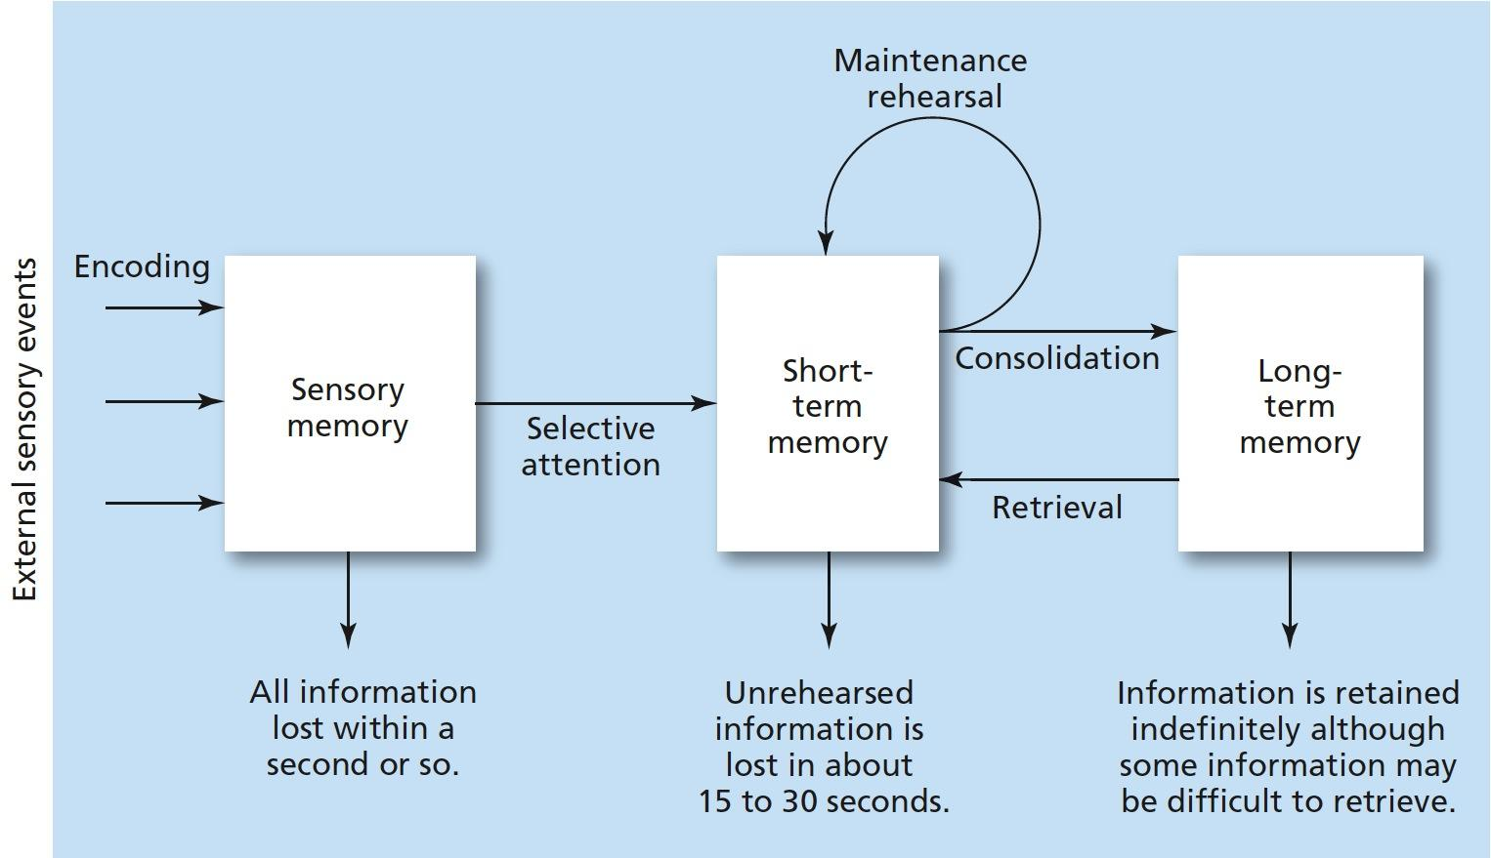
Figure 6.1
Three-Stage Process of Memory
Information enters through the sensory system, briefly registering in sensory memory. Selective attention filters the information into short-term memory, where it is held while attention (rehearsal) continues. If the information receives enough rehearsal (maintenance or elaborative), it will enter and be stored in long-term memory.

Slide 11
Sensory Memory: Why Do People Do Double Takes? 2 of 3
Iconic memory: visual sensory memory, lasting only a fraction of a second
  Capacity: everything that can be seen at one time
  Duration: information that has just entered iconic memory will be pushed out very quickly by new information, a process called masking
Eidetic imagery: the (rare) ability to access a visual memory for thirty seconds or more

Slide 12
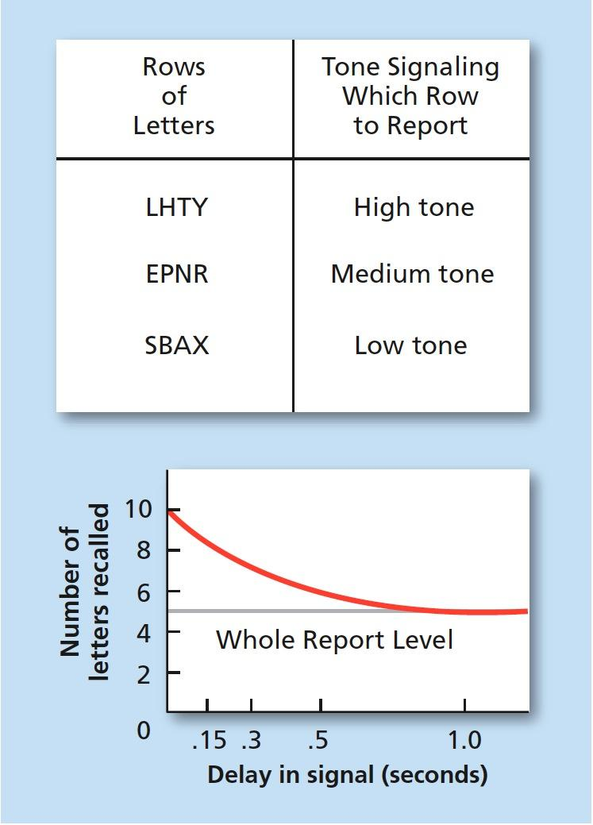
Figure 6.2
Iconic Memory Test
Sample grid of letters for Sperling’s test of iconic memory. To determine if the entire grid existed in iconic memory, Sperling sounded a tone associated with each row after the grid’s presentation. Participants were able to recall the letters in the row for which they heard the tone. The graph shows the decrease in the number of letters recalled as the delay in presenting the tone increased.

Slide 13
Sensory Memory: Why Do People Do Double Takes? 3 of 3
Echoic memory: the brief memory of something a person has just heard
  Capacity: limited to what can be heard at any one moment; smaller than the capacity of iconic memory
  Duration: lasts longer than iconic; about two to four seconds

Slide 14
Short-Term Memory 1 of 4
Learning Objective 6.4 Describe short-term memory, and differentiate it from working memory.
Short-term memory (STM; working memory): the memory system in which information is held for brief periods of time while being used
  Selective attention: ability to focus on only one stimulus from among all sensory input

Slide 15
Short-Term Memory 2 of 4
Digit-span test: a series of numbers is read to subjects who are then asked to recall the numbers in order
  Conclusion: capacity of STM is about seven items or pieces of information, plus or minus two items—or from five to nine bits of information.
  Magical number = 7

Slide 16
Short-Term Memory 3 of 4
STM lasts from about twelve to thirty seconds without rehearsal
STM is susceptible to interference
  e.g., if counting is interrupted, one will have to start over

Slide 17
Short-Term Memory 4 of 4
Chunking: bits of information are combined into meaningful units, or chunks, so that more information can be held in STM
Maintenance rehearsal: saying bits of information to be remembered over and over in one’s head in order to maintain it in short-term memory
  STMs tend to be encoded in auditory form

Slide 18
Long-Term Memory 1 of 7
Learning Objective 6.5 Explain the process of long-term memory, including nondeclarative and declarative forms.
Long-term memory (LTM): the memory system into which all the information is placed to be kept more or less permanently
  Duration
Elaborative rehearsal: a method of transferring information from STM into LTM by making that information meaningful in some way

Slide 19
Long-Term Memory 2 of 7
Nondeclarative (implicit) memory: type of long-term memory including memory for skills, procedures, habits, and conditioned responses
  These memories are not conscious, but their existence is implied because they affect conscious behavior
  Includes emotional associations, habits, and simple conditioned reflexes

Slide 20
Long-Term Memory 3 of 7
Implicit memory: memory that is not easily brought into conscious awareness
Anterograde amnesia: loss of memory from the point of injury or trauma forward, or the inability to form new long-term memories
  Usually does NOT affect procedural LTM

Slide 21
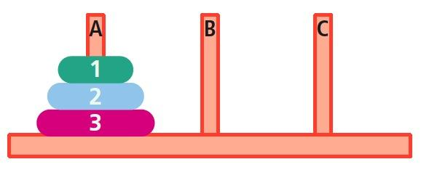
Figure 6.3 Tower of Hanoi
The Tower of Hanoi is a puzzle that is solved in a series of steps by moving one disk at a time. The goal is to move all of the disks from peg A to peg C; the rules are that a larger disk can not be moved on top of a smaller one and a disk can not be moved if there are other disks on top of it. Amnesia patients were able to learn the procedure for solving the puzzle but could not remember that they knew how to solve it.

Slide 22
Long-Term Memory 4 of 7
Declarative (explicit) memory: type of long-term memory containing information that is conscious and known
  Memory for facts

Slide 23
Long-Term Memory 5 of 7
Types of Declarative Memory
  Semantic memory: declarative memory containing general knowledge
    Knowledge of language, information learned in formal education
  Episodic memory: declarative memory containing personal information not readily available to others
    Daily activities and events

Slide 24
Long-Term Memory 6 of 7
Semantic and episodic memories are forms of explicit memory—memory that is consciously known.

Slide 25
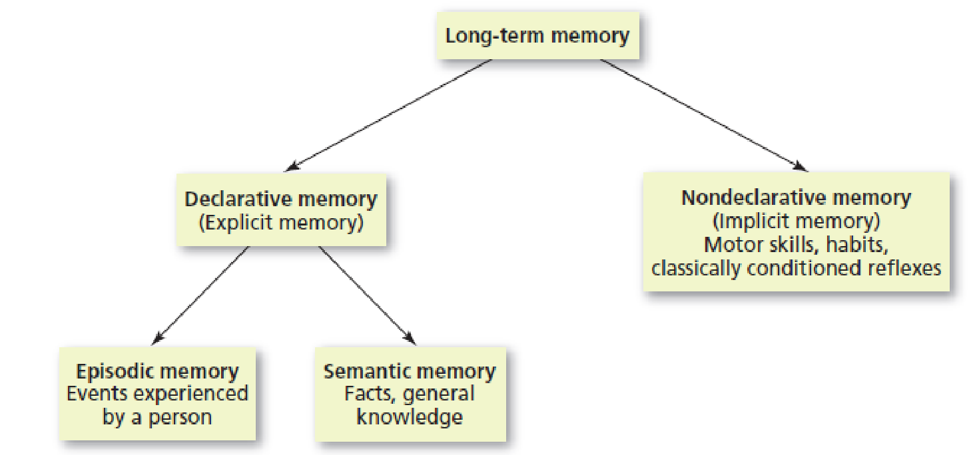
Figure 6.4 Types of Long-Term Memories
Long-term memory can be divided into declarative memories, which are factual and typically conscious (explicit) memories, and nondeclarative memories, which are skills, habits, and conditioned responses that are typically unconscious (implicit). Declarative memories are further divided into episodic memories (personal experiences) and semantic memories (general knowledge).

Slide 26
Long-Term Memory 7 of 7
LTM is organized in terms of related meanings and concepts
Semantic network model: assumes that information is stored in the brain in a connected fashion
  Concepts that are related stored physically closer to each other than to unrelated concepts

Slide 27
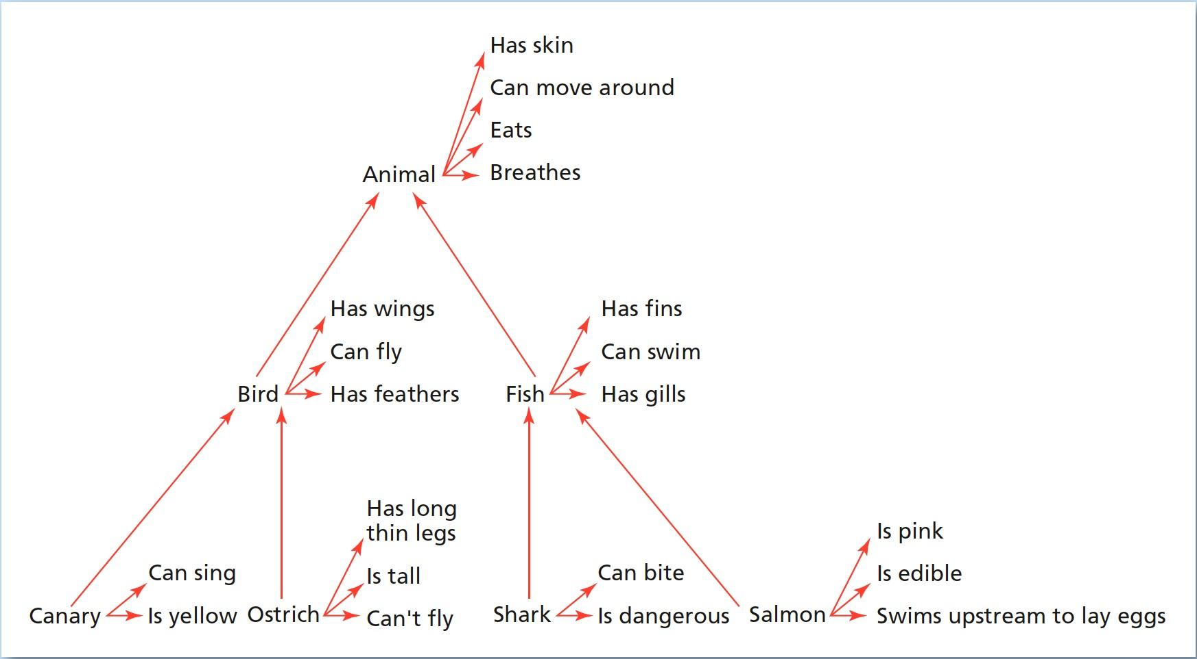
Figure 6.5
An Example of a Semantic Network
In the semantic network model of memory, concepts that are related in meaning are thought to be stored physically near each other in the brain. In this example, canary and ostrich are stored near the concept node for “bird,” whereas shark and salmon are stored near “fish.” But the fact that a canary is yellow is stored directly with that concept.

Slide 28
Retrieval Cues 1 of 2
Learning Objective 6.6 Identify the effects of cues on memory retrieval.
Retrieval cue: stimulus for remembering
Priming can occur where experience with information or concepts can improve later performance

Slide 29
Retrieval Cues 2 of 2
Encoding specificity: tendency for memory of information to be improved if related information (e.g., surroundings or physiological state) available when memory was first formed is also available when memory is retrieved
  State-dependent learning: memories formed during a particular physiological or psychological state will be easier to recall while in a similar state

Slide 30
Recall and Recognition 1 of 4
Learning Objective 6.7 Differentiate the retrieval processes of recall and recognition.
Recall: memory retrieval in which the information to be retrieved must be “pulled” from memory with very few external cues
Retrieval failure: recall has failed (at least temporarily)
  Tip of the tongue (TOT) phenomenon

Slide 31
Recall and Recognition 2 of 4
Serial position effect: information at beginning and end of a body of information more accurately remembered than information in middle
  Primacy effect: tendency to remember information at beginning of a body of information better than what follows
  Recency effect: tendency to remember information at end of a body of information better than the information ahead of it

Slide 32
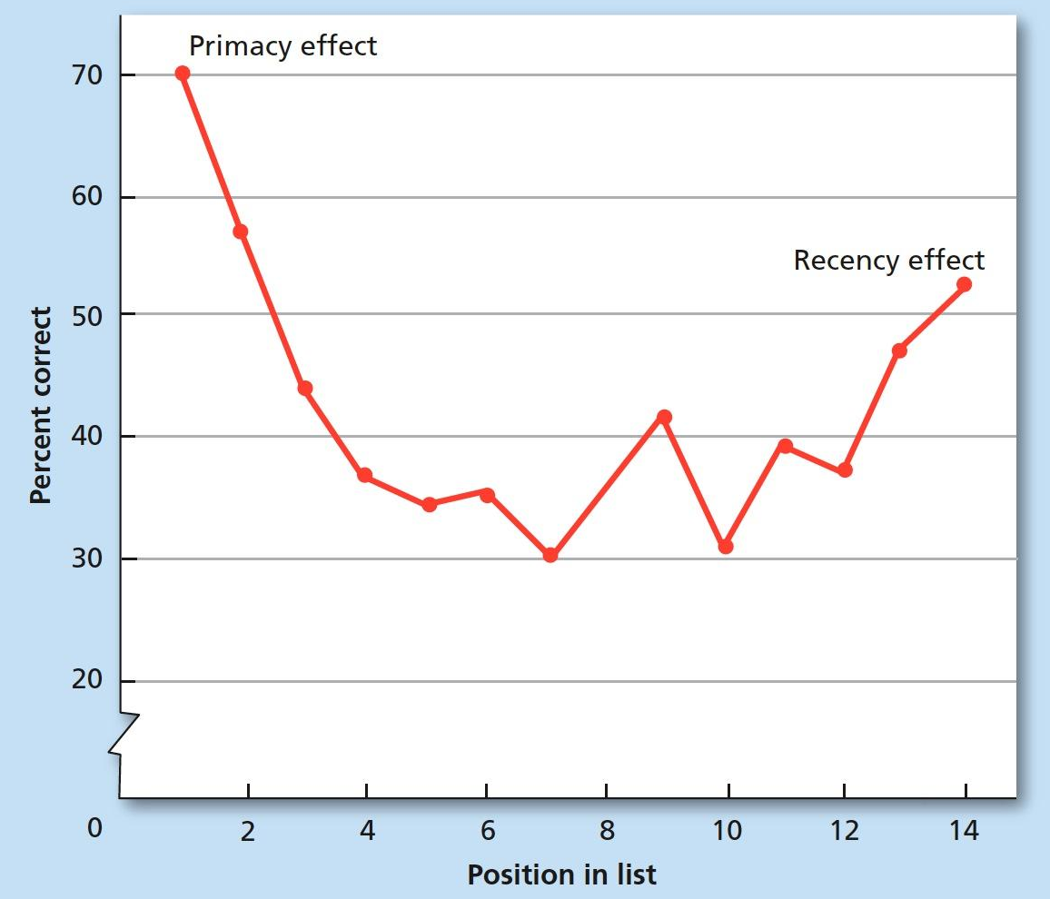
Figure 6.6 Serial Position Effect
In the serial position effect, information at the beginning of a list will be recalled at a higher rate than information in the middle of the list (primacy effect), because the beginning information receives more rehearsal and may enter LTM. Information at the end of a list is also retrieved at a higher rate (recency effect), because the end of the list is still in STM, with no information coming after it to interfere with retrieval.

Slide 33
Recall and Recognition 3 of 4
Recognition: ability to match a piece of information or a stimulus to a stored image or fact
False positive: error of recognition in which people think that they recognize a stimulus that is not actually in memory
  Case of Father Bernard Pagano

Slide 34
Recall and Recognition 4 of 4
Elizabeth Loftus and Eyewitnesses
  Showed that what people see and hear about an event afterwards can affect accuracy of their memories
  Demonstrated that eyewitness testimony is not always reliable

Slide 35
Automatic Encoding: Flashbulb Memories
Learning Objective 6.8 Describe how some memories are automatically encoded into long-term memory.
Automatic encoding: tendency of certain kinds of information to enter long-term memory with little or no effortful encoding
Flashbulb memories: automatic encoding that occurs because an unexpected event has strong emotional associations for person remembering it

Slide 36
The Reconstructive Nature of Long-Term Memory Retrieval: How Reliable Are Memories? 1 of 4
Learning Objective 6.9 Explain how the constructive processing view of memory retrieval accounts for forgetting and inaccuracies in memory.
Constructive processing: memory retrieval process in which memories are “built,” or reconstructed, from information stored during encoding
  With each retrieval, memories may be altered, revised, or influenced by newer information

Slide 37
The Reconstructive Nature of Long-Term Memory Retrieval: How Reliable Are Memories? 2 of 4
Hindsight bias: the tendency to falsely believe, through revision of older memories to include newer information, that one could have correctly predicted the outcome of an event
  “Monday morning quarterbacking”

Slide 38
The Reconstructive Nature of Long-Term Memory Retrieval: How Reliable Are Memories? 3 of 4
Misinformation effect: tendency of misleading information presented after an event to alter the memories of the event itself

Slide 39
The Reconstructive Nature of Long-Term Memory Retrieval: How Reliable Are Memories? 4 of 4
False memory syndrome: creation of inaccurate or false memories through the suggestion of others, often while the person is under hypnosis
Evidence suggests that false memories cannot be created for just any kind of memory
  Memories must at least be plausible

Slide 40
Ebbinghaus and the Forgetting Curve
Learning Objective 6.10 Describe the "curve of forgetting."
Curve of forgetting: a graph showing a distinct pattern in which forgetting is very fast within first hour after learning a list and then tapers off gradually
  Distributed practice: spacing one’s study sessions
    Produces better retrieval
  Massed practice: studying a complete body of information all at once

Slide 41
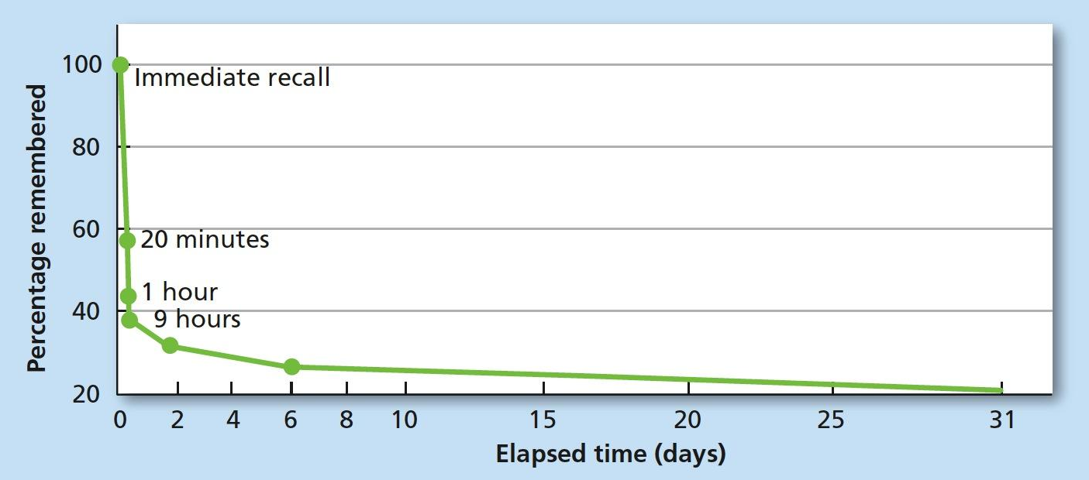
Figure 6.7 Curve of Forgetting
Ebbinghaus found that his recall of words from his memorized word lists was greatest immediately after learning the list but rapidly decreased within the first hour. After the first hour, forgetting leveled off.

Slide 42
Reasons We Forget 1 of 3
Learning Objective 6.11 Identify some common reasons people forget things.
Encoding failure: failure to process information into memory

Slide 43

Figure 6.8 Stop!
Many people look at stop signs multiple times a day. Which of these stop signs is closest to an actual stop sign? (The answer can be found in the notes section of this slide.)
Notes:
The answer to Figure 6.9 is the middle right image.

Slide 44
Reasons We Forget 2 of 3
Memory trace: physical change in the brain that occurs when a memory is formed
  Decay: loss of memory due to the passage of time, during which the memory trace is not used
  Disuse: another name for decay, assuming that memories that are not used will eventually decay and disappear
  Memories recalled after many years are not explained by memory trace theory

Slide 45
Reasons We Forget 3 of 3
Proactive interference: memory retrieval problem that occurs when older information prevents or interferes with the retrieval of newer information
Retroactive interference: memory retrieval problem that occurs when newer information prevents or interferes with the retrieval of older information

Slide 46
Table 6.1
Reasons for Forgetting
Reason | Description
Encoding Failure | The information is not attended to and fails to be encoded.
Decay or Disuse | Information that is not accessed decays from the storage system over time.
Proactive Interference | Older information already in memory interferes with the learning of newer information.
Retroactive Interference | Newer information interferes with the retrieval of older information.

Slide 47
The Biological Bases of Memory
Learning Objective 6.12 Explain the biological bases of memory in the brain.
Consolidation: changes that take place in the structure and functioning of neurons when a memory is formed
  Long-term potentiation: changes in number and sensitivity of receptor sites/synapses through repeated stimulation
Hippocampus: area of brain responsible for the formation of ltms
  Case of H.M.

Slide 48
When Memory Fails: Organic Amnesia 1 of 3
Learning Objective 6.13 Identify the biological causes of amnesia.
Retrograde amnesia: loss of memory from the point of some injury or trauma backwards, or loss of memory for the past
Anterograde amnesia: loss of memory from the point of injury or trauma forward, or the inability to form new long-term memories
  Senile dementia
  Case of H.M.

Slide 49
When Memory Fails: Organic Amnesia 2 of 3
Alzheimer’s Disease
  5.3 million cases in U.S.
  Most common type of dementia in adults and elderly
  Primarily anterograde amnesia
  Various drugs to slow or stop progression, but no cure
Risk factors
  High cholesterol
  High blood pressure
  Smoking
  Obesity
  Type II diabetes
  Lack of exercise

Slide 50
When Memory Fails: Organic Amnesia 3 of 3
Infantile amnesia: the inability to retrieve memories from much before age three
Autobiographical memory: the memory for events and facts related to one’s personal life story (usually after age three)

Slide 51
Health and Memory
Learning Objective 6.14 Explain how sleep, exercise, and diet affect memory.
Sleep important in forming memories
  Memory consolidation
Sleep deprivation interferes with hippocampal functioning
Even brief exercise good for memory
Fish is brain food?
  Omega-3 fatty acid called dha helps memory cells communicate

