Slide 1

Psychology
Fifth Edition, Global Edition
Saundra K. Ciccarelli
J. Noland White
Saundra K. Ciccarelli
J. Noland White
Copyright © 2018 Pearson Education, Ltd. All Rights Reserved

Slide 2

Psychology
Fifth Edition, Global Edition
Chapter 8
8
Development Across
the Life Span

Slide 3
Learning Objectives 1 of 2
8.1 Compare and contrast the special research methods used to study development.
8.2 Explain the relationship between heredity and environmental factors in determining development.
8.3 Summarize the role of chromosomes and genes in determining the transmission of traits and the inheritance of disorders.
8.4 Explain the process of fertilization, including the twinning process.
8.5 Describe the three stages of prenatal development.
8.6 Describe the physical and sensory changes that take place in infancy and childhood.
8.7 Compare and contrast two theories of cognitive development, and define autism spectrum disorder.
8.8 Identify the development of personality, relationships, and self-concept in infancy and childhood.

Slide 4
Learning Objectives 2 of 2
8.9 Describe the physical changes of puberty.
8.10 Identify the cognitive and moral advances that occur in adolescence.
8.11 Describe how the adolescent search for personal identity influences relationships with others.
8.12 Identify the physical changes and health issues associated with adulthood.
8.13 Describe how memory abilities change during adulthood.
8.14 Apply Erikson’s theory to some common psychosocial concerns of adulthood.
8.15 Compare and contrast four theories of why aging occurs.
8.16 Describe Kübler-Ross’s theory of death and dying, and identify some criticisms of this theory.
8.17 Compare and contrast some cross-cultural differences in views of death and dying.

Slide 5
Research Designs 1 of 2
Learning Objective 8.1 Compare and contrast the special research methods used to study development.
Human development: the scientific study of changes that occur in people as they age from conception until death
Longitudinal design: research design in which one participant or group of participants is studied over a long period of time
  Cohort effect: impact on development when a group of people share common time period or life experience

Slide 6
Research Designs 2 of 2
Cross-sectional design: research design in which several different age groups of participants are studied at one particular point in time
Cross-sequential design: research design in which participants are first studied by means of a cross-sectional design but also followed and assessed for a period of no more than six years

Slide 7
Nature and Nurture
Learning Objective 8.2 Explain the relationship between heredity and environmental factors in determining development.
Nature: the influence of our inherited characteristics on our personality, physical growth, intellectual growth, and social interactions
Nurture: the influence of the environment on personality, physical growth, intellectual growth, and social interactions
Behavioral genetics: focuses on nature vs. nurture

Slide 8
Table 8.1 A Comparison of Three Developmental Research Designs
Research Designs | Objective | Description
Cross-Sectional Design | Different participants of various ages are compared at one point in time to determine age-related differences. | Group One: 20-year-old participants Group Two: 40-year-old participants Group Three: 60-year-old participants (research done in 2014)
Longitudinal Design | The same participants are studied at various ages to determine age-related changes. | Study One: 20-year-old participants (1974) Study Two: Same participants at 40 years old (1994) Study Three: Same participants are now 60 years old (2014)
Cross-Sequential Design | Different participants of various ages are compared at several points in time to determine both age-related differences and age-related changes. | Study One: Group One: 20-year-old participants Group Two: 40-year-old participants (2014) Study Two: Group One: Participants will be 25 years old; Group Two: Participants will be 45 years old (to be done in 2019)

Slide 9
The Basic Building Blocks of Development 1 of 3
Learning Objective 8.3 Summarize the role of chromosomes and genes in determining the transmission of traits and the inheritance of disorders.
Genetics: the science of inherited traits
  Behavioral genetics
DNA (deoxyribonucleic acid): special molecule that contains the genetic material of the organism

Slide 10
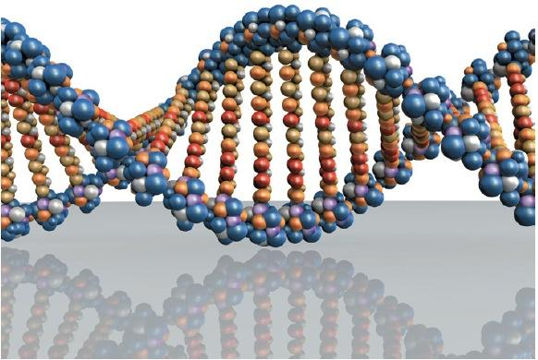
Figure 8.1 DNA Molecule
In this model of a DNA molecule, the two strands making up the sides of the “twisted ladder” are composed of sugars and phosphates. The “rungs” of the ladder that link the two strands are amines. Amines contain the genetic codes for building the proteins that make up organic life.

Slide 11
The Basic Building Blocks of Development 2 of 3
Gene: section of DNA having a certain pattern of chemical elements
  Dominant: a gene that actively controls the expression of a trait
  Recessive: a gene that only influences the expression of a trait when paired with an identical gene

Slide 12
The Basic Building Blocks of Development 3 of 3
Chromosome: tightly wound strand of genetic material or DNA
Chromosome disorders include Down syndrome, Klinefelter’s syndrome, and Turner’s syndrome
Genetic disorders include PKU, cystic fibrosis, sickle cell anemia, and Tay-Sachs disease

Slide 13
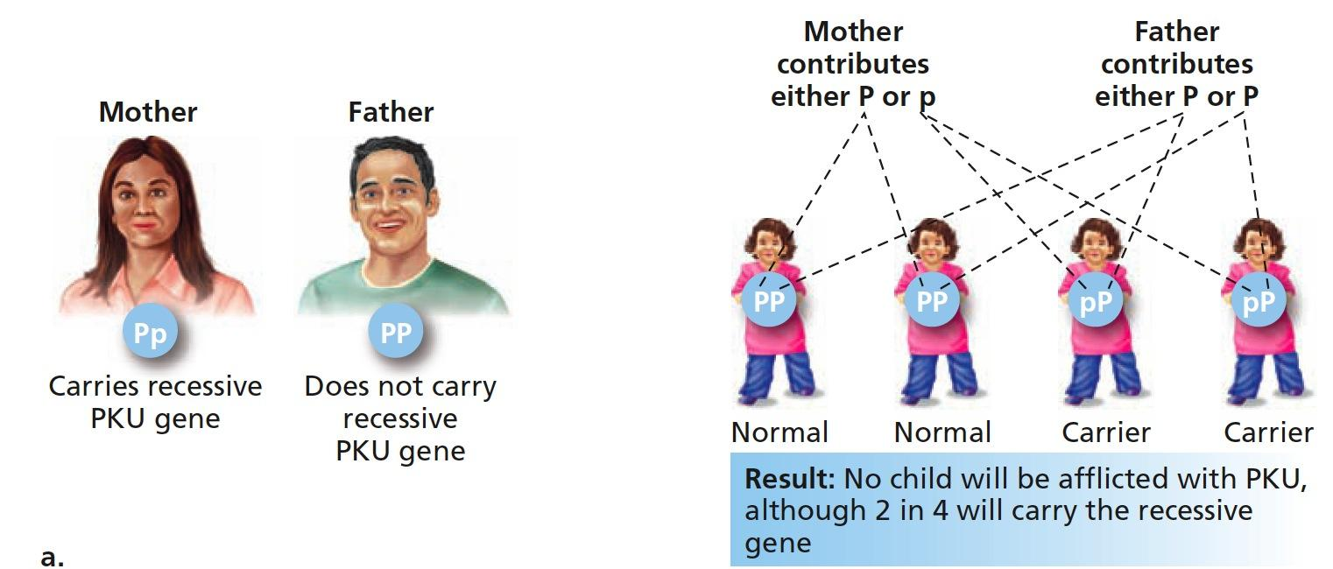
Figure 8.2 Dominant and Recessive Genes and PKU 1 of 2
This figure shows the variation of parents carrying one or two recessive genes and the result of this in their offspring. (a) If only one parent carries the PKU gene, their children might be carriers, but will not have PKU.

Slide 14
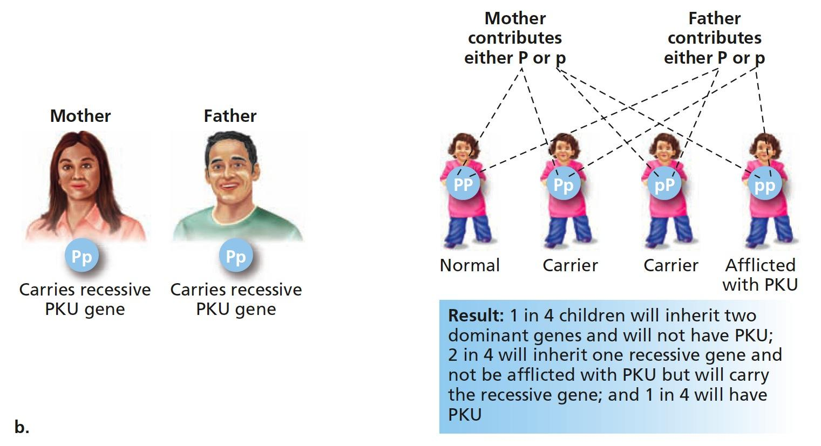
Figure 8.2 Dominant and Recessive Genes and PKU 2 of 2
This figure shows the variation of parents carrying one or two recessive genes and the result of this in their offspring. (b) Only if both parents are carriers of PKU will a child have the 1 in 4 possibility of having PKU.

Slide 15
Prenatal Development: Fertilization 1 of 2
Learning Objective 8.4 Explain the process of fertilization, including the twinning process.
Conception: the moment at which a female becomes pregnant
Ovum: the female sex cell, or egg
Fertilization: the union of the ovum and sperm
Zygote: cell resulting from the uniting of the ovum and sperm; divides into many cells, eventually forming the baby

Slide 16
Prenatal Development: Fertilization 2 of 2
Monozygotic twins: identical twins
  Formed when one zygote splits into two separate masses of cells, each of which develops into a separate embryo
Dizygotic twins: often called fraternal twins
  Occur when two eggs get fertilized by two different sperm, resulting in the development of two zygotes in the uterus at the same time

Slide 17
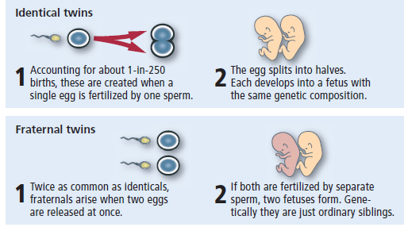
Figure 8.3
Monozygotic and Dizygotic Twins
Because identical twins come from one fertilized egg (zygote), they are called monozygotic. Fraternal twins, who come from two different fertilized eggs, are called dizygotic.

Slide 18
Prenatal Development: Three Stages of Development 1 of 3
Learning Objective 8.5 Describe the three stages of prenatal development.
Germinal period: first two weeks after fertilization, during which the zygote moves down to the uterus and begins to implant in the lining
  Embryo is name for the developing organism from two weeks to eight weeks after fertilization

Slide 19
Prenatal Development: Three Stages of Development 2 of 3
Embryonic period: the period from two to eight weeks after fertilization, during which major organs and structures of the organism develop
  Critical periods: times during which certain environmental influences can have an impact on the development of the infant
  Teratogen: any factor that can cause a birth defect

Slide 20
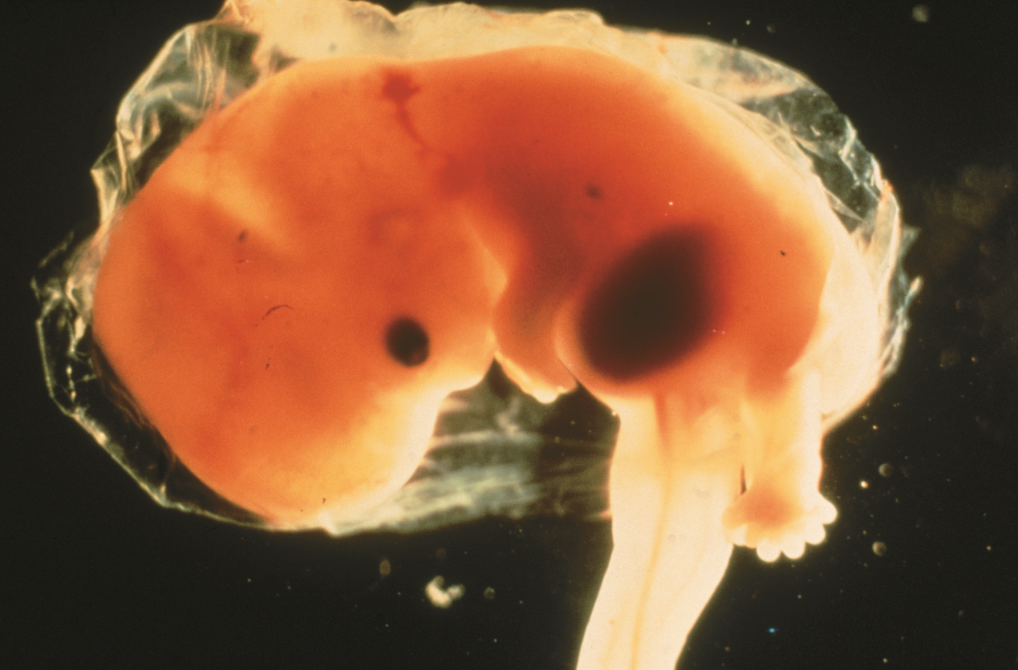
Embryonic Period
The embryonic period lasts from about 2 weeks to 8 weeks.

Slide 21
Table 8.2 Common Teratogens
Teratogenic Agent | Effect on Development
Measles, Mumps, Rubella | Blindness, deafness, heart defects, brain damage
Marijuana | Irritability, nervousness, tremors; infant is easily disturbed, startled
Cocaine | Decreased height, low birth weight, respiratory problems, seizures, learning difficulties; infant is difficult to soothe
Alcohol | Fetal alcohol syndrome (intellectual disability, delayed growth, facial malformation), learning difficulties, smaller than normal head
Nicotine | Miscarriage, low birth weight, stillbirth, short stature, intellectual disability, learning disabilities
Mercury | Intellectual disability, blindness
Vitamin A (high doses) | Facial, ear, central nervous system, and heart defects
Caffeine | Miscarriage, low birth weight
Toxoplasmosis | Brain swelling, spinal abnormalities, deafness, blindness, intellectual disability
High Water Temperatures | Increased chance of neural tube defects
SOURCES: March of Dimes Foundation (2009); Organization of Teratology Information Specialists (2011); Shepard, T. H. (2001).

Slide 22
Prenatal Development: Three Stages of Development 3 of 3
Fetal period: the time from about eight weeks after conception until the birth of the child
  Fetus: name for the developing organism from eight weeks after fertilization to the birth of the baby
  Viability: the point at which it is possible for an infant to survive outside the womb, usually about 22 - 26 weeks

Slide 23
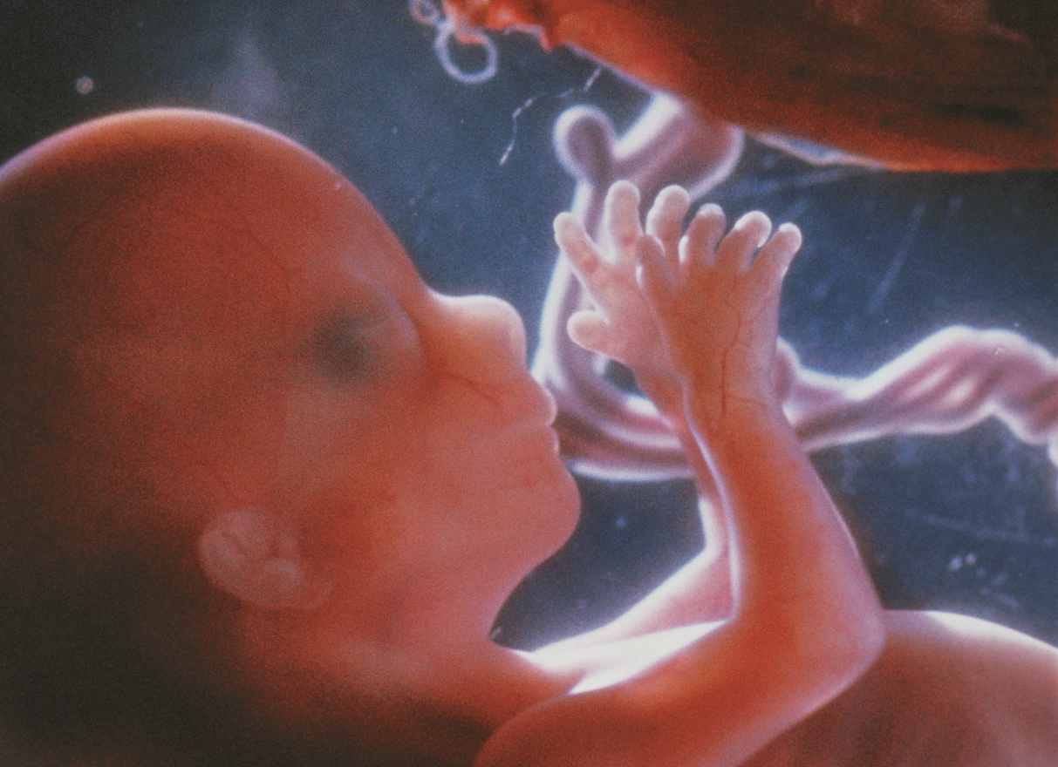
Fetal Period
The fetal period lasts from 8 weeks until the end of the pregnancy.

Slide 24
Infancy and Childhood Development: Physical Development 1 of 2
Learning Objective 8.6 Describe the physical and sensory changes that take place in infancy and childhood.
Infants are born with reflexes that help them survive
  Grasping
  Moro (startle)
  Rooting
  Stepping
  Sucking

Slide 25
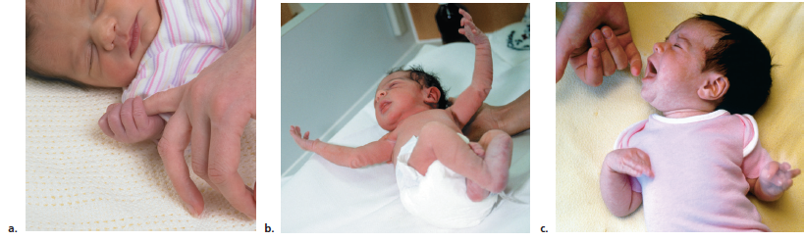
Figure 8.4 Five Infant Reflexes 1 of 2
Shown here are (a) grasping reflex; (b) startle reflex (also known as the Moro reflex); (c) rooting reflex (when you touch a baby's cheek it will turn toward your hand, open its mouth, and search for the nipple).

Slide 26
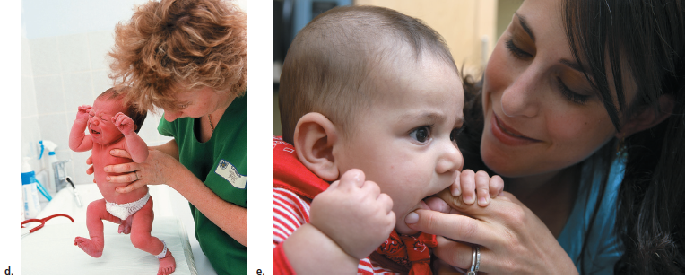
Figure 8.4 Five Infant Reflexes 2 of 2
Shown here are (d) stepping reflex; and (e) sucking reflex. These infant reflexes can be used to check the health of an infant’s nervous system. If a reflex is absent or abnormal, it may indicate brain damage or some other neurological problem.

Slide 27
Infancy and Childhood Development: Physical Development 2 of 2
Motor development
  Tremendous motor development from birth to age 2
Brain development
  Infant brain consists of 100 billion neurons
  Synaptic pruning: unused synaptic connections and nerve cells cleared away to make way for functioning connections and cells
Senses
  Except for vision, senses fairly well developed at birth

Slide 28
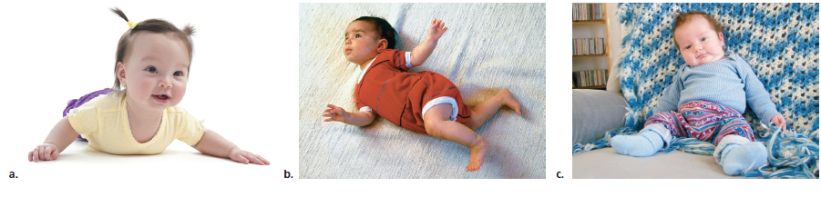
Figure 8.5 Six Motor Milestones 1 of 2
Shown here are (a) raising head and chest—2 to 4 months, (b) rolling over—2 to 5 months, (c) sitting up with support—4 to 6 months.

Slide 29
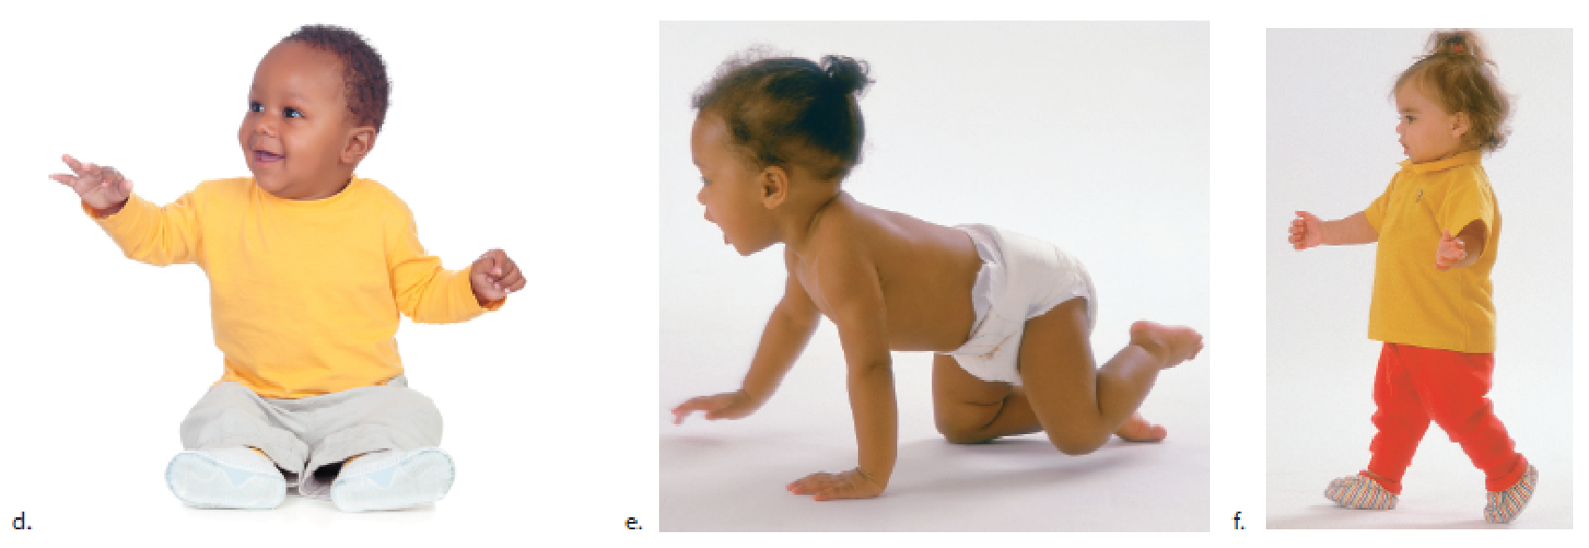
Figure 8.5 Six Motor Milestones 2 of 2
(d) sitting up without support—6 to 7 months, (e) crawling—7 to 8 months, and (f) walking—8 to 18 months. The motor milestones develop as the infant gains greater voluntary control over the muscles in its body, typically from the top of the body downward. This pattern is seen in the early control of the neck muscles and the much later development of control of the legs and feet.

Slide 30
Infancy and Childhood Development: Cognitive Development 1 of 8
Learning Objective 8.7 Compare and contrast two theories of cognitive development, and define autism spectrum disorder.
Cognitive development: the development of thinking, problem solving, and memory
Jean Piaget: developed a four-stage theory of cognitive development based on observation of infants and children
  Schemes: mental concepts formed by children as they experience new situations and events

Slide 31
Infancy and Childhood Development: Cognitive Development 2 of 8
Sensorimotor stage: Piaget’s first stage of cognitive development, in which the infant uses its senses and motor abilities to interact with objects in the environment
  Object permanence: the knowledge that an object exists even when it is not in sight
  Symbolic thought begins

Slide 32
Infancy and Childhood Development: Cognitive Development 3 of 8
Preoperational stage: Piaget’s second stage of cognitive development, in which the preschool child learns to use language as a means of exploring the world
  Egocentrism
  Centration
  Conservation
  Irreversibility

Slide 33
Table 8.3 Piaget’s Stages of Cognitive Development
Stage | Age Range | Cognitive Development
Sensorimotor | Birth to 2 years old | Children explore the world using senses and ability to move. They develop object permanence and the understanding that concepts and mental images represent objects, people, and events.
Preoperational | 2 to 7 years old | Young children can mentally represent and refer to objects and events with words or pictures and they can pretend. However, they can’t conserve, logically reason, or simultaneously consider many characteristics of an object.
Concrete Operations | 7 to 12 years old | Children at this stage are able to conserve, reverse their thinking, and classify objects in terms of their many characteristics. They can also think logically and understand analogies but only about concrete events.
Formal Operations | 12 years to adulthood | People at this stage can use abstract reasoning about hypothetical events or situations, think about logical possibilities, use abstract analogies, and systematically examine and test hypotheses. Not everyone can eventually reason in all these ways.

Slide 34
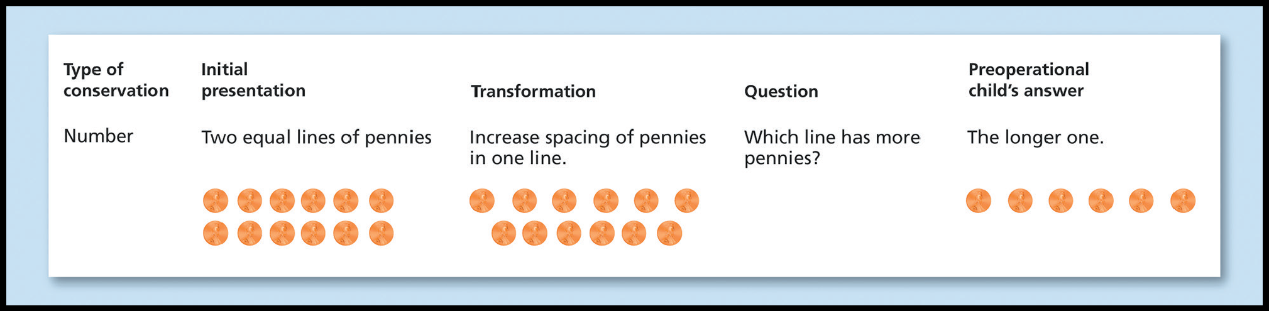
Figure 8.7 Conservation Experiment
In this conservation task, pennies are laid out in two equal lines. When the pennies in the top line are spaced out, the child who cannot yet conserve will centrate on the top line and assume that there are actually more pennies in that line.

Slide 35
Infancy and Childhood Development: Cognitive Development 4 of 8
Concrete operations stage: third stage of cognitive development, in which the school-aged child becomes capable of logical thought processes but is not yet capable of abstract thinking
  Concrete concepts

Slide 36
Infancy and Childhood Development: Cognitive Development 5 of 8
Formal operations: Piaget’s last stage of cognitive development, in which the adolescent becomes capable of abstract thinking
  Not everyone reaches this stage
  Relativistic thinking extends beyond formal operations

Slide 37
Infancy and Childhood Development: Cognitive Development 6 of 8
Vygotsky’s Theory: emphasized the role of others and interaction in cognitive development
Scaffolding: process in which a more skilled learner gives help to a less skilled learner, then reduces the amount of help as the less skilled learner becomes more capable

Slide 38
Infancy and Childhood Development: Cognitive Development 7 of 8
Zone of proximal development (ZPD): the difference between what a child can do alone and what that child can do with the help of a teacher
  Private speech: Vygotsky viewed this as a way for a child to “think out loud” and advance cognitively

Slide 39
Infancy and Childhood Development: Cognitive Development 8 of 8
Autism spectrum disorder: developmental disorder encompassing a range of problems in thinking, feeling, language, and social skills
  Theory of mind
  Myths relating ASD and vaccines have been debunked

Slide 40
Infancy and Childhood Development: Psychosocial Development 1 of 5
Learning Objective 8.8 Identify the development of personality, relationships, and self-concept in infancy and childhood.
Temperament: behavioral characteristics that are fairly well established at birth
  Easy: regular, adaptable, and happy
  Difficult: irregular, nonadaptable, and irritable
  Slow to warm up: need to adjust gradually to change

Slide 41
Infancy and Childhood Development: Psychosocial Development 2 of 5
Attachment: the emotional bond between an infant and the primary caregiver
  Secure: willing to explore; upset when mother departs, but easily soothed upon her return
  Avoidant: unattached; explores without “touching base”
  Ambivalent: insecurely attached; upset when mother leaves and then angry with mother upon her return
  Disorganized-disoriented: insecurely attached and sometimes abused or neglected; child seems fearful, dazed, and depressed

Slide 42
Infancy and Childhood Development: Psychosocial Development 3 of 5
Harlow monkey experiment
  Wire surrogate “mother” provides food for infant rhesus monkey; but infant spends all its time with soft, cloth-covered surrogate
  According to Harlow, demonstrates the importance of contact comfort in attachment

Slide 43
Infancy and Childhood Development: Psychosocial Development 4 of 5
Development of Self-Concept
  Self-concept is the image you have of yourself
  Based on your interactions with important people in your life
  Infants learn to separate “me” from both physical surrounding and other people

Slide 44
Infancy and Childhood Development: Psychosocial Development 5 of 5
Erikson’s Theory: first four stages of development occur in infancy and childhood; social interactions most important factor
  Trust versus mistrust: first stage
  Autonomy versus shame and doubt: second stage
  Initiative versus guilt: third stage
  Industry versus inferiority: fourth stage

Slide 45
Table 8.4 Erikson’s Psychosocial Stages of Development Stages 1-4
Stage | Developmental Crisis | Successful Dealing with Crisis | Unsuccessful Dealing with Crisis
1. Infant Birth to 1 year old | Trust Verses Mistrust Infants learn a basic sense of trust dependent upon how their needs are met. | If a babies’ needs for food, comfort, and affection are met, they develop a sense of trust in people and expect those needs to be met in the future. | If babies needs for food, comfort, and affection are not met, they develop a sense of mistrust and do not expect their needs to be met in the future.
2. Toddler 1 to 3 years old | Autonomy Verses Shame and Doubt Toddlers begin to understand that they can control their own actions. | Toddlers who are successful in controlling their own actions develop independence. | Toddlers whose attempts at being independent are blocked develop a sense of self-doubt and shame for failing.
3. Preschool Age 3 to 5 years old | Initiative Verses Guilt Preschool children learn to take responsibility for their own behavior as they develop self-control. | If preschoolers succeed in controlling their reactions and behavior, they feel capable and develop a sense of initiative. | If preschoolers fail in controlling their reactions and behavior, they feel irresponsible, anxious, and develop a sense of guilt.
4. Elementary School Age 5 to 12 years old | Industry Verses Inferiority The school-aged child must learn new skills in both the academic world and the social world. They compare themselves to others to measure their success of failure. | When children feel they have succeeded at learning these skills, they develop a sense of industry, making them feel competent and improving their self-esteem. | When children fail or feel that they have failed in learning these skills, they feel inferior when compared to others.
Notes:
Derived from Erikson, 1950

Slide 46
Adolescence: Physical Development
Learning Objective 8.9 Describe the physical changes of puberty.
Adolescence - the period of life from about age 13 to the early 20s, during which a young person is no longer physically a child but is not yet an independent, self-supporting adult.
Puberty - the physical changes that occur in the body as sexual development reaches its peak.

Slide 47
Adolescence: Cognitive Development 1 of 2
Learning Objective 8.10 Identify the cognitive and moral advances that occur in adolescence.
Piaget’s Formal Operations Revisited
  Abstract thinking becomes possible, although some egocentric thought remains
  Personal fable: young people believe themselves to be unique and protected from harm
  Imaginary audience: young people believe that other people are just as concerned about the adolescent’s thoughts and characteristics as they themselves are

Slide 48
Adolescence: Cognitive Development 2 of 2
Kohlberg’s Levels of Morality
  Preconventional morality: behavior is governed by the consequences of the behavior
  Conventional morality: behavior is governed by conforming to society’s norms of behavior
  Postconventional morality: behavior is governed by moral principles that have been decided on by the individual
    May conflict with accepted social norms

Slide 49
Table 8.5
Kohlberg’s Three Levels of Morality
Level of Morality | How Rules Are Understood | Example
Preconventional morality (very young children) | Morality of an action is based on the consequences; actions that get rewarded are right and those that earn punishment are wrong. | A child who takes money from a parent’s wallet and does not get caught does not see that action as wrong.
Conventional* morality (older children, adolescents, and most adults) | An action is morally right if it conforms to the rules of the society and wrong if it does not. | A child scolds a parent for littering because there is a sign saying not to do so.
Postconventional morality (about one fifth of the adult population) | Morality is now determined by the experiences and judgment of the person, even if that judgment disagrees with society’s rules. | A husband helps his dying wife commit suicide to end her pain, even though society considers that action to be murder.
*The term conventional refers to general standards or norms of behavior for a particular society, which will differ from one social group or culture to another.

Slide 50
Adolescence: Psychosocial Development
Learning Objective 8.11 Describe how the adolescent search for personal identity influences relationships with others.
Erikson’s identity versus role confusion: fifth stage of personality development
  The adolescent must find a consistent sense of self
Parent–teen conflict
  A certain amount of “rebellion” and conflict is a necessary step in breaking away from childhood dependence on parents and becoming a self-sufficient adult

Slide 51
Adulthood and Aging: Physical Development: Use It or Lose It 1 of 2
Learning Objective 8.12 Identify the physical changes and health issues associated with adulthood.
Adulthood begins in the early twenties and ends with old age and death
  Divided into young adulthood, middle adulthood, and late adulthood
  Emerging adulthood: time from late adolescence through the 20s

Slide 52
Adulthood and Aging: Physical Development: Use It or Lose It 2 of 2
Menopause
  Women experience a physical decline in the reproductive system called the climacteric
  Cessation of ovulation and menstrual cycles and the end of a woman’s reproductive capability
  Andropause: gradual changes in the sexual hormones and reproductive system of males

Slide 53
Adulthood and Aging: Cognitive Development
Learning Objective 8.13 Describe how memory abilities change during adulthood.
Challenges in memory most likely caused by stress and high volumes of information to maintain
Exercising mental abilities helps
  Work challenging crossword puzzles
  Reading
  Have active social life
  Stay physically active

Slide 54
Adulthood and Aging: Psychosocial Development 1 of 3
Learning Objective 8.14 Apply Erikson’s theory to some common psychosocial concerns of adulthood.
Erikson’s Intimacy Versus Isolation
  Emotional and psychological closeness that is based on the ability to trust, share, and care, while still maintaining a sense of self

Slide 55
Adulthood and Aging: Psychosocial Development 2 of 3
Erikson’s Generativity Versus Stagnation:
  Providing guidance to one’s children or the next generation, or contributing to the well-being of the next generation through career or volunteering
  Parenting styles
    Authoritarian
    Permissive
    Authoritative

Slide 56
Adulthood and Aging: Psychosocial Development 3 of 3
Erikson’s Ego Integrity Versus Despair:
  Sense of wholeness that comes from having lived a full life and the ability to let go of regrets; the final completion of the ego

Slide 57
Adulthood and Aging: Theories of Physical and Psychological Aging 1 of 2
Learning Objective 8.15 Compare and contrast four theories of why aging occurs.
Cellular clock theory: based on the idea that cells only have so many times that they can reproduce
Wear-and-tear theory: as time goes by, repeated use and abuse of the body’s tissues cause it to be unable to repair all the damage

Slide 58
Adulthood and Aging: Theories of Physical and Psychological Aging 2 of 2
Free radical theory: oxygen molecules with an unstable electron move around the cell, damaging cell structures as they go
Activity theory: theory of adjustment to aging that assumes older people are happier if they remain active in some way, such as volunteering or developing a hobby

Slide 59
Adulthood and Aging: Stages of Death and Dying
Learning Objective 8.16 Describe Kübler-Ross’s theory of death and dying, and identify some criticisms of this theory.
Kübler-Ross’s five stages of reaction when faced with death
  Denial
  Anger
  Bargaining
  Depression
  Acceptance

Slide 60
Cross-Cultural Views on Death
Learning Objective 8.17 Compare and contrast some cross-cultural differences in views of death and dying.
Westerners see a person as either dead or alive
Some cultures mourn individuals as already dead—as is the case in many Native American cultures
In wealthy Hindu cultures, death surrounded by visits and rituals; lengthy funeral period

