Slide 1

Psychology
Fifth Edition, Global Edition
Saundra K. Ciccarelli
J. Noland White
Saundra K. Ciccarelli
J. Noland White
Copyright © 2018 Pearson Education, Ltd. All Rights Reserved

Slide 2

Psychology
Fifth Edition, Global Edition
Chapter 9
9
Motivation and Emotion

Slide 3
Learning Objectives 1 of 2
9.1 Distinguish between intrinsic motivation and extrinsic motivation.
9.2 Identify the key elements of the early instinct and drive-reduction approaches to motivation.
9.3 Explain the characteristics of the three types of needs.
9.4 Identify the key elements of the arousal and incentive approaches to motivation.
9.5 Describe how Maslow’s hierarchy of needs and self-determination theories explain motivation.
9.6 Identify the physical and social factors that influence hunger.

Slide 4
Learning Objectives 2 of 2
9.7 Recognize some of the factors that contribute to obesity.
9.8 Describe the three elements of emotion.
9.9 Distinguish among the common-sense, James-Lange, Cannon-Bard, and facial feedback theories of emotion.
9.10 Identify the key elements in the cognitive arousal and cognitive-mediational theories of emotion.
9.11 Summarize the five steps of the GTD method.

Slide 5
Defining Motivation
Learning Objective 9.1 Distinguish between intrinsic motivation and extrinsic motivation.
Motivation: the process by which activities are started, directed, and continued so that physical or psychological needs or wants are met
  Extrinsic motivation: a person performs an action because it leads to an outcome that is separate from or external to the person
  Intrinsic motivation: a person performs an action because the act is fun, challenging, or satisfying in an internal manner

Slide 6
Early Approaches to Understanding Motivation 1 of 3
Learning Objective 9.2 Identify the key elements of the early instinct and drive-reduction approaches to motivation.
Instincts and the evolutionary approach: approach to motivation that assumes people are governed by instincts similar to those of animals
Instincts: the biologically determined and innate patterns of behavior that exist in both people and animals

Slide 7
Early Approaches to Understanding Motivation 2 of 3
Drive-Reduction Theory: assumes behavior arises from physiological needs that cause internal drives to push the organism to satisfy the need and reduce tension and arousal
Need: a requirement of some material essential for survival of the organism
Drive: psychological tension and physical arousal when there is need that motivates organism to act in order to fulfill need and reduce tension

Slide 8
Early Approaches to Understanding Motivation 3 of 3
Primary drives: involve needs of the body such as hunger and thirst
Acquired (secondary) drives: learned through experience or conditioning, such as the need for money or social approval
Homeostasis: the tendency of the body to maintain a steady state

Slide 9
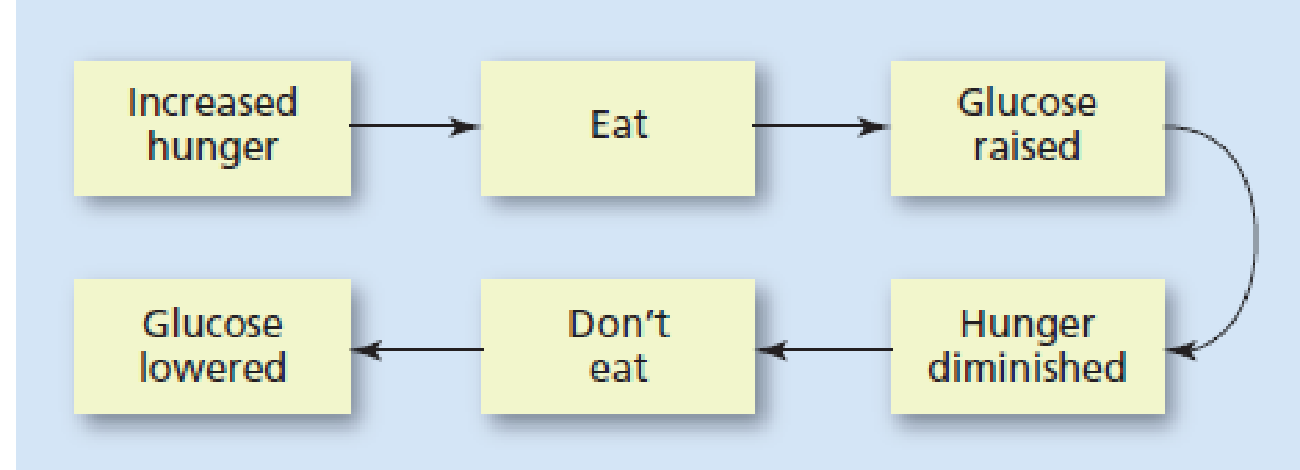
Figure 9.1 Homeostasis
In homeostasis, the body maintains balance in its physical states. For
example, this diagram shows how increased hunger (a state of imbalance) prompts a person to eat. Eating increases the level of glucose (blood sugar), causing the feelings of hunger to reduce. After a period without eating, the glucose levels become low enough to stimulate the hunger drive once again, and entire cycle is repeated.

Slide 10
Different Strokes for Different Folks: Psychological Needs 1 of 2
Learning Objective 9.3 Explain the characteristics of the three types of needs.
McClelland’s Theory
  Need for affiliation (nAff): the need for friendly social interactions and relationships with others
  Need for power (nPow): the need to have control or influence over others
  Need for achievement (nAch): involves a strong desire to succeed in attaining goals—not only realistic ones, but also challenging ones

Slide 11
Different Strokes for Different Folks: Psychological Needs 2 of 2
Personality and nAch: Carol Dweck’s Self-theory of Motivation
  Need for achievement closely linked to personality factors, including view of self
  Locus of control: internal or external?

Slide 12
Arousal and Incentive Approaches 1 of 4
Learning Objective 9.4 Identify the key elements of the arousal and incentive approaches to motivation.
Stimulus motive: a motive that appears to be unlearned but causes an increase in stimulation, such as curiosity
Arousal theory: theory of motivation in which people are said to have an optimal (best or ideal) level of tension that they seek to maintain by increasing or decreasing stimulation

Slide 13
Arousal and Incentive Approaches 2 of 4
Yerkes-Dodson law: law stating performance is related to arousal; moderate levels of arousal lead to better performance than do levels of arousal that are too low or too high
  Effect varies with the difficulty of the task
    Easy tasks require a high-moderate level
    More difficult tasks require a low-moderate level

Slide 14
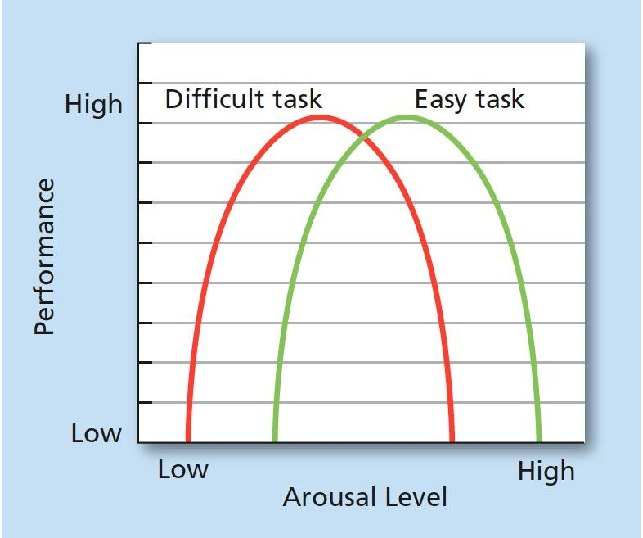
Figure 9.2 Arousal and Performance
The optimal level of arousal for task performance depends on the difficulty of the task. We generally perform easy tasks well if we are at a high–moderate level of arousal (green) and accomplish difficult tasks well if we are at a low–moderate level (red).

Slide 15

Arousal and Incentive Approaches 3 of 4
Sensation seeker: one who needs more arousal than the average person
Does this look fun? If so, you may score relatively higher in sensation seeking.

Slide 16
Table 9.1 Sample Items From the Zuckerman-Kuhlman Personality Questionnaire
Scale Item | Sensation Seeking
I sometimes do “crazy” things just for fun. | High
I prefer friends who are exciting and unpredictable. | High
I am an impulsive person. | High
Before I begin a complicated job, I make careful plans. | Low
I usually think about what I am going to do before doing it. | Low
Source: Adapted from Zuckerman, M. (2002). | Blank cell

Slide 17
Arousal and Incentive Approaches 4 of 4
Incentive approaches: theories of motivation in which behavior is explained as a response to the external stimulus and its rewarding properties
  Incentives: things that attract or lure people into action

Slide 18
Humanistic Approaches 1 of 2
Learning Objective 9.5 Describe how Maslow’s hierarchy of needs and self-determination theories explain motivation.
Maslow’s Hierarchy of Needs
  Several levels of need a person must strive for before reaching self-actualization
  Self-actualization: point at which people have sufficiently satisfied the lower needs and achieved their full human potential
  Peak experiences: times in a person’s life during which self-actualization is temporarily achieved

Slide 19
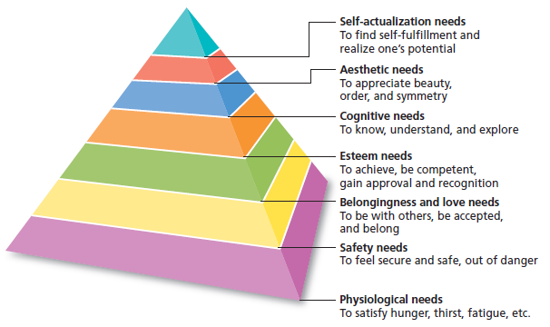
Figure 9.3 Maslow’s Hierarchy of Needs
Maslow proposed that human beings must fulfill the more basic needs, such as physical and security needs, before being able to fulfill the higher needs of self-actualization and transcendence.

Slide 20
Humanistic Approaches 2 of 2
Self-determination theory (SDT): the social context of an action has an effect on the type of motivation existing for the action
  Autonomy
  Competence
  Relatedness

Slide 21
Physiological and Social Components of Hunger 1 of 4
Learning Objective 9.6 Identify the physical and social factors that influence hunger.
Hormonal Influences
  Insulin and glucagon: hormones secreted by the pancreas to control levels of fats, proteins, and carbohydrates in the bloodstream
    Insulin reduces level of glucose in bloodstream
    Glucagon increases level of glucose in bloodstream
  Leptin: hormone that signals the hypothalamus that the body has had enough food and reduces the appetite while increasing the feeling of being full

Slide 22
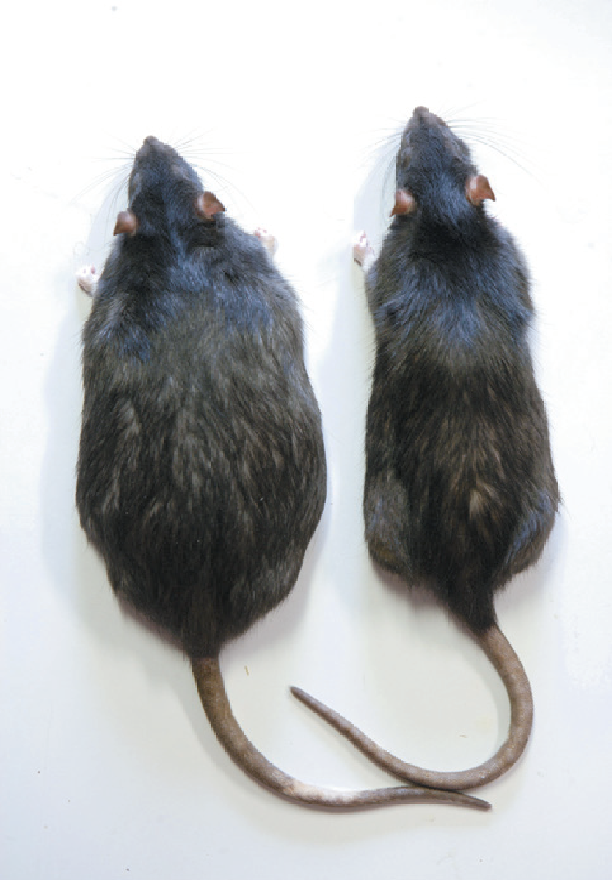
Physiological and Social Components of Hunger 2 of 4
Role of the Hypothalamus
  Responds to levels of glucose and insulin in the body
  Leptin: hormone that signals hypothalamus that body has had enough food, and reduces appetite while increasing feeling of being full
Figure 9.4
The rat on the left has reached a high level of obesity because its ventromedial hypothalamus has been deliberately damaged in the laboratory. The result is a rat that no longer receives signals of being satiated, and so the rat continues to eat and eat and eat.

Slide 23
Physiological and Social Components of Hunger 3 of 4
Weight set point: the particular level of weight that the body tries to maintain
Basal metabolic rate (BMR): the rate at which the body burns energy when the organism is resting

Slide 24
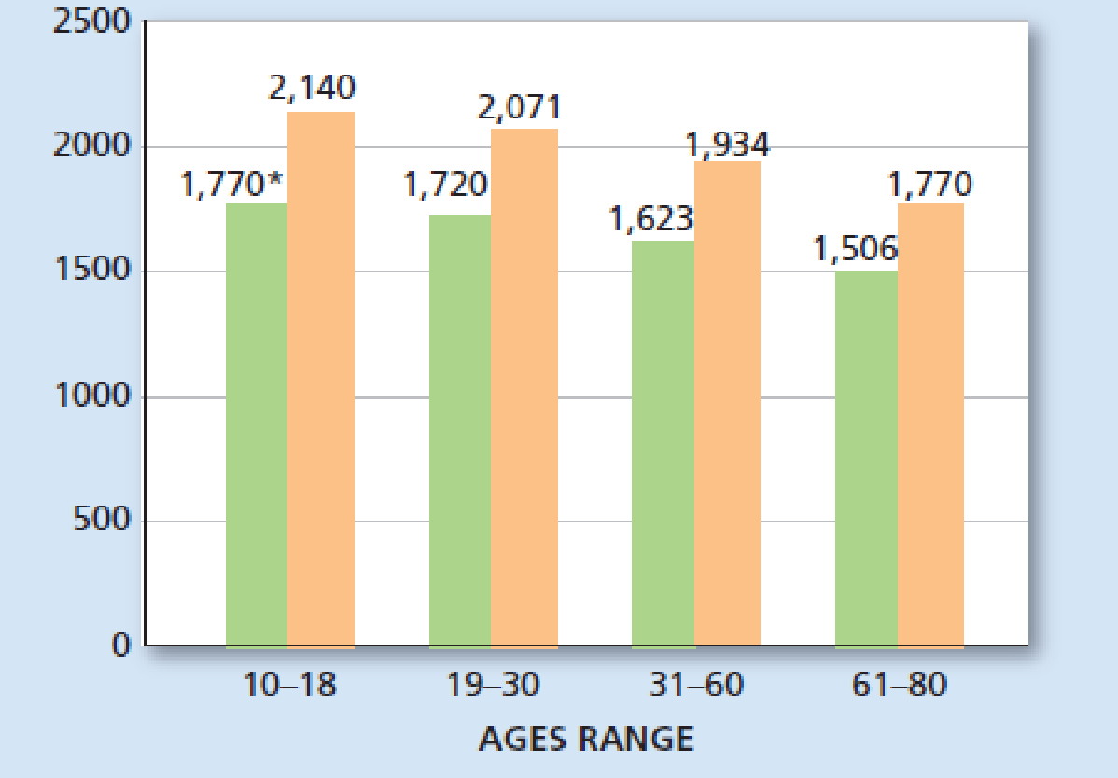
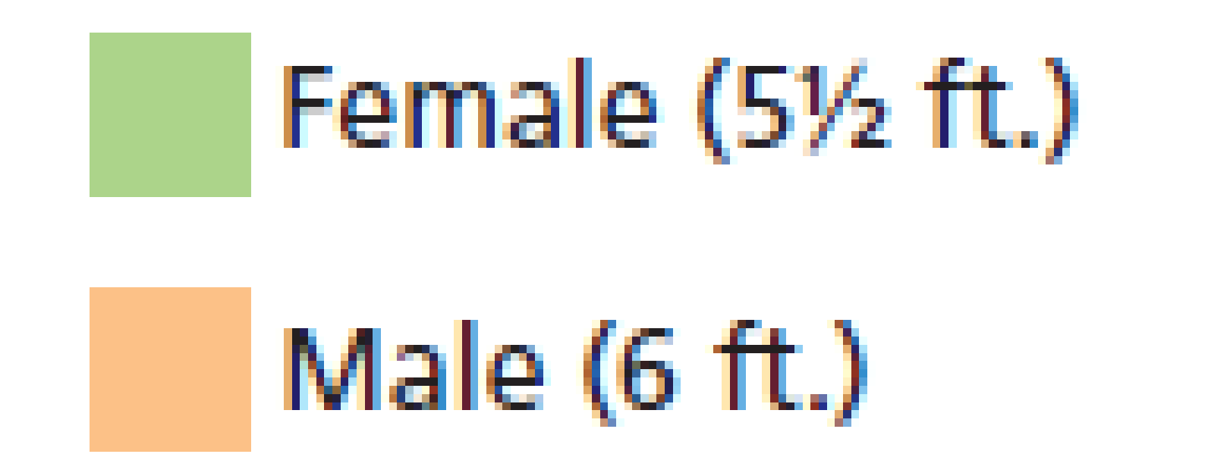
Figure 9.5
Average BMR for a Female and Male
*Numbers in the table represent the number of calories a person needs to consume each day to maintain body weight (without exercise)

Slide 25
Physiological and Social Components of Hunger 4 of 4
Social Components of Hunger
  Social cues
  Food preferences
  Cultural factors
  Gender
  Comfort device or escape from unpleasantness
    Some people may respond to anticipation of eating by producing an insulin response

Slide 26
Obesity
Learning Objective 9.7 Recognize some of the factors that contribute to obesity.
Obesity
  Body weight is 20 percent or more over the ideal body weight for that person’s height
  Biological causes include heredity, hormones, and slowing metabolism with age
  Overeating
  Stress

Slide 27
The Three Elements of Emotion 1 of 4
Learning Objective 9.8 Describe the three elements of emotion.
Emotion: the “feeling” aspect of consciousness characterized by:
  Certain physical arousal
  Certain behavior that reveals emotion to outside world
  Inner awareness of feelings

Slide 28
The Three Elements of Emotion 2 of 4
Which parts of the brain are involved in various aspects of emotion?
  Amygdala
    A complex structure with many different nuclei and subdivisions, whose roles have been investigated primarily through studies of fear conditioning
    Emotional stimuli travel to the amygdala by both a fast, crude “low road” (subcortical) and a slower but more involved cortical “high road”

Slide 29
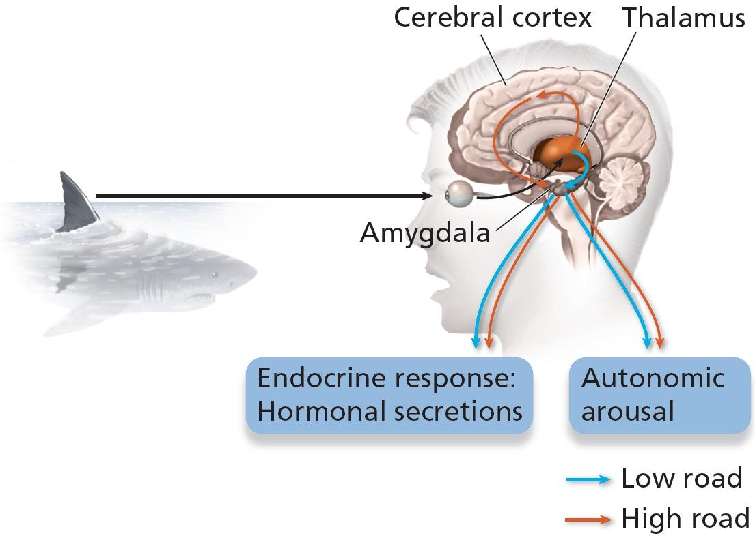
Figure 9.6
The “Low Road” and “High Road”
When we are exposed to an emotion-provoking stimulus (such as a shark), the neural signals travel by two pathways to the amygdala. The “low road” is the pathway underneath the cortex and is a faster, simpler path, allowing for quick responses to the stimulus, sometimes before we are consciously aware of the nature of the stimulus. The “high road” uses cortical pathways and is slower and more complex, but it allows us to recognize the threat and, when needed, take more conscious control of our emotional responses. In this particular example, the low road shouts, “Danger!” and we react before the high road says, “It’s a shark!”

Slide 30
The Three Elements of Emotion 3 of 4
Which parts of the brain are involved in various aspects of emotion?
  Other subcortical and cortical areas
    Hemisphere
    Frontal lobes
    Anterior cingulate cortex
    Lateral orbitofrontal cortex

Slide 31
The Three Elements of Emotion 4 of 4
Emotional Expression
  Facial expressions vary across different cultures
  Display rules
    Differ by gender
    Differ by culture
Labeling Emotion
    Interpreting subjective feelings by giving it a label
    Cognitive element

Slide 32
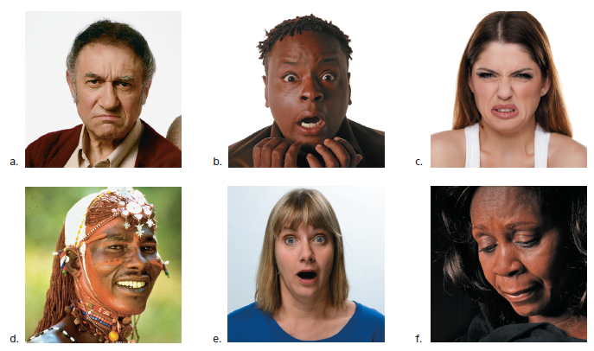
Figure 9.7 Facial Expressions of Emotion
Facial expressions appear to be universal. For example, these faces are consistently interpreted as showing (a) anger, (b) fear, (c) disgust, (d) happiness, (e) surprise, and (f) sadness by people of various cultures from all over the world. Although the situations that cause these emotions may differ from culture to culture, the expression of particular emotions remains strikingly the same.

Slide 33
Early Theories of Emotion 1 of 4
Learning Objective 9.9 Distinguish among the common-sense, James-Lange, Cannon-Bard, and facial feedback theories of emotion.
Common sense theory of emotion: a stimulus leads to an emotion, which then leads to bodily arousal

Slide 34
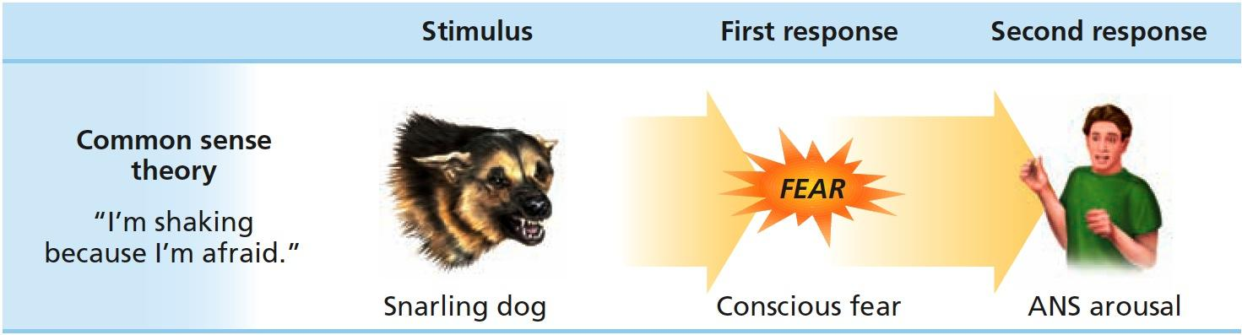
Figure 9.8
Common Sense Theory of Emotion
In the common-sense theory of emotion, a stimulus (snarling dog) leads to an emotion of fear, which then leads to bodily arousal (in this case, indicated by shaking) through the autonomic nervous system (ANS).

Slide 35
Early Theories of Emotion 2 of 4
James-Lange theory of emotion: a physiological reaction leads to the labeling of an emotion

Slide 36
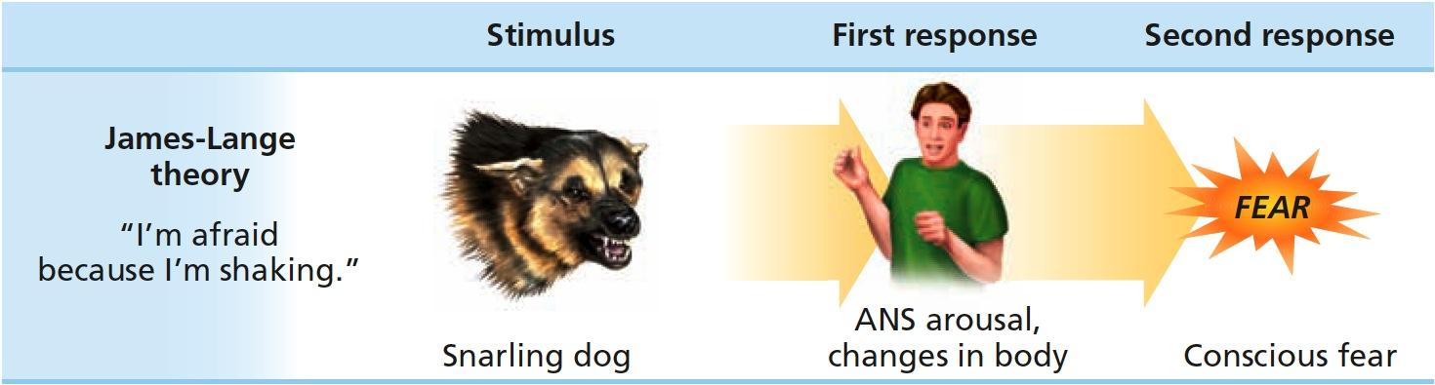
Figure 9.9
James-Lange Theory of Emotion
In the James-Lange theory of emotion, a stimulus leads to bodily arousal first, which is then interpreted as an emotion.

Slide 37
Early Theories of Emotion 3 of 4
Cannon-Bard theory of emotion: the physiological reaction and the emotion are assumed to occur at the same time

Slide 38
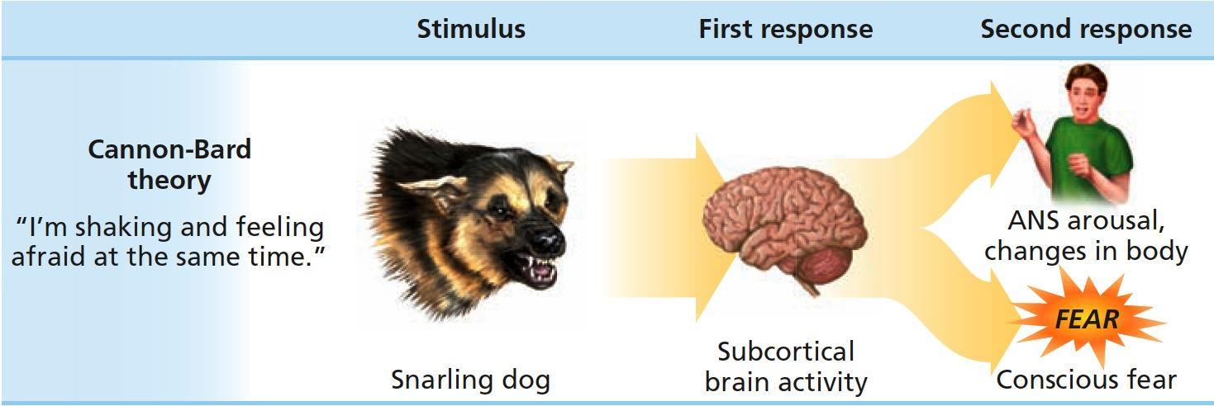
Figure 9.10
Cannon-Bard Theory of Emotion
In the Cannon-Bard theory of emotion, a stimulus leads to activity in the brain, which then sends signals to arouse the body and interpret the emotion at the same time.

Slide 39
Early Theories of Emotion 4 of 4
Facial feedback hypothesis: facial expressions provide feedback to the brain concerning the emotion being expressed, which in turn causes and intensifies the emotion

Slide 40
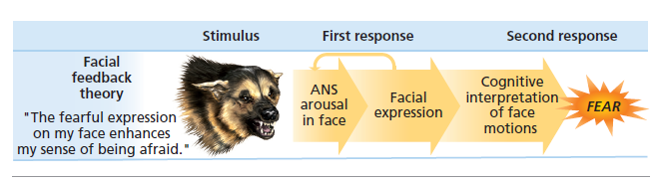
Figure 9.11
Facial Feedback Theory of Emotion
In the facial feedback theory of emotion, a stimulus such as this snarling dog causes arousal and a facial expression. The facial expression then provides feedback to the brain about the emotion. The brain then interprets the emotion and may also intensify it.

Slide 41
Cognitive Theories of Emotion 1 of 2
Learning Objective 9.10 Identify the key elements in the cognitive arousal and cognitive-mediational theories of emotion.
Cognitive arousal theory: both the physical arousal and labeling of that arousal based on cues from the environment must occur before the emotion is experienced

Slide 42
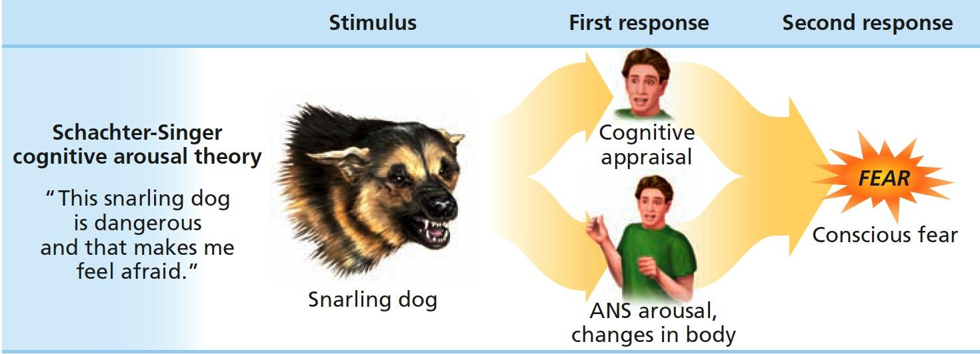
Figure 9.12
Schachter-Singer Cognitive Arousal Theory of Emotion
Schachter and Singer’s cognitive arousal theory is similar to the James-Lange theory but adds the element of cognitive labeling of the arousal. In this theory, a stimulus leads to both bodily arousal and the labeling of that arousal (based on the surrounding context), which leads to the experience and labeling of the emotional reaction.

Slide 43
Cognitive Theories of Emotion 2 of 2
Cognitive-mediational theory: a stimulus must be interpreted (appraised) by a person in order to result in a physical response and an emotional reaction

Slide 44
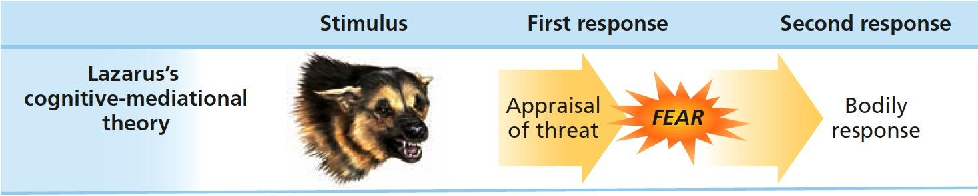
Figure 9.13
Lazarus’s Cognitive-Mediational Theory of Emotion
In Lazarus’s cognitive-mediational theory of emotion, a stimulus causes an immediate appraisal (e.g., “The dog is snarling and not behind a fence, so this is dangerous”). The cognitive appraisal results in an emotional response, which is then followed by the appropriate bodily response.

Slide 45
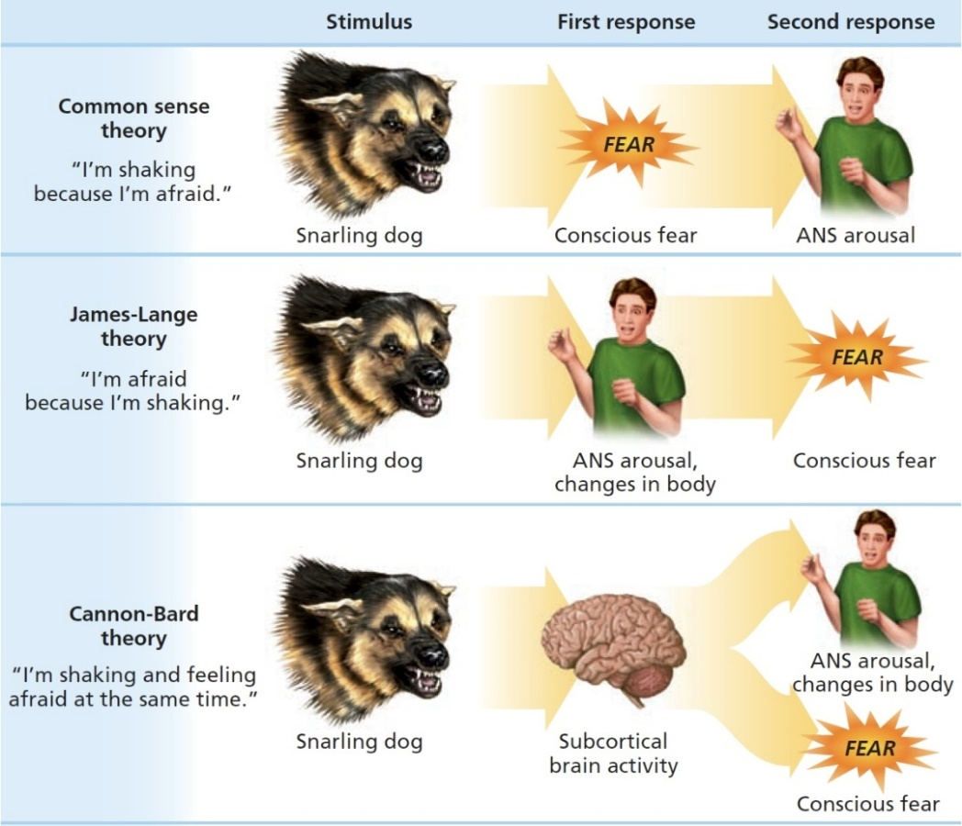
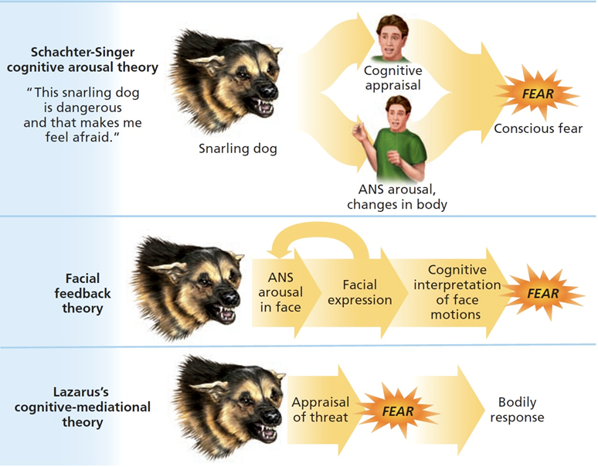
Figure 9.14
Comparison of Theories of Emotion
These figures represent the six different theories of emotion as discussed.

Slide 46
When Motivation Is Not Enough
Learning Objective 9.11 Summarize the five steps of the GTD method.
Getting Things Done methodology
  Capture anything that has your attention in one place.
  Process and define what you can take action on and identify the next steps.
  Organize information and reminders into categories based on how and when you need them.
  Complete weekly reviews of your projects, next actions, and new items.
  Do your next actions in the appropriate context or time frame for doing so.

