Slide 1
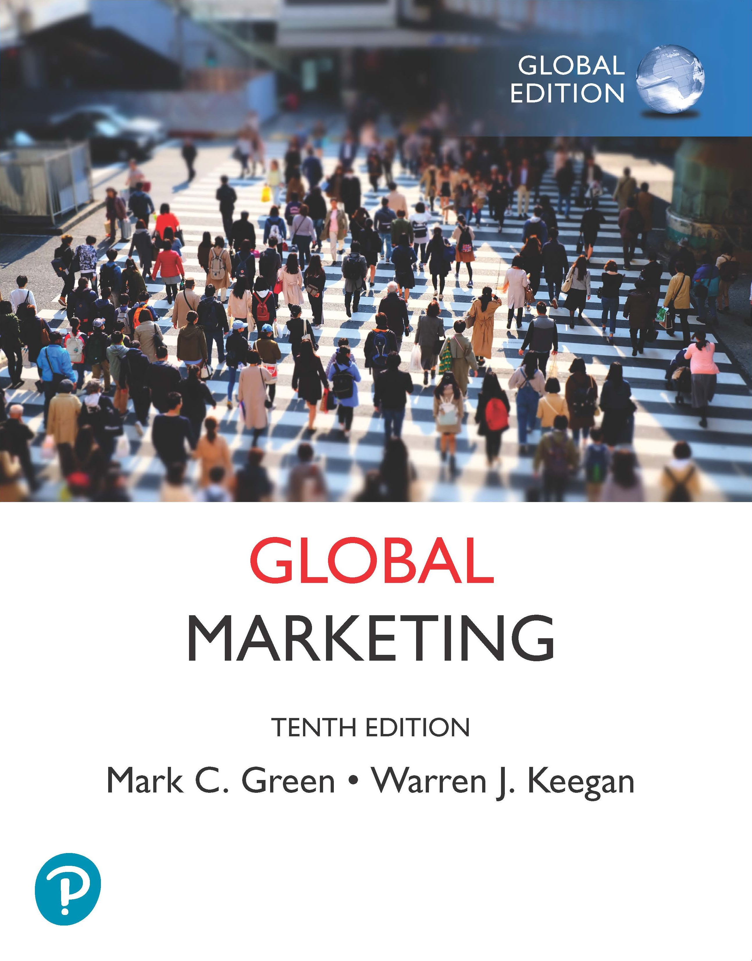
Global Marketing
Tenth Edition, Global Edition
Chapter 1
Introduction to Global Marketing
Copyright © 2020 Pearson Education Ltd. All Rights Reserved.
Notes:
If this PowerPoint presentation contains mathematical equations, you may need to check that your computer has the following installed:
1) MathType Plugin
2) Math Player (free versions available)
3) NVDA Reader (free versions available)

Slide 2
Learning Objectives
1.1 Use the product/market growth matrix to explain the various ways a company can expand globally.
1.2 Describe how companies in global industries pursue competitive advantage.
1.3 Compare and contrast a single-country marketing strategy with a global marketing strategy (G M S).
1.4 Identify the companies at the top of the Global 500 rankings.
1.5 Explain the stages a company goes through as its management orientation evolves from domestic and ethnocentric to global and geocentric.
1.6 Discuss the driving and restraining forces affecting global integration today.

Slide 3
Overview
International trade flourished from mid-1800s until 1920s. Great Britain dominated the world economy but that ended
the Great Depression and the Bolshevik
Revolution.
The post
era brought unparalleled expansion by
companies going outside their home markets.
Four decades ago the phrase global marketing did not exist.
Today companies go global to survive as competitors will enter the home market with lower costs, more experience and better products.

Slide 4
Marketing & Global Marketing Defined
Marketing: “the activity, set of institutions, and processes for creating, communicating, delivering, and exchanging offerings that have value for customers, clients, partners, and society at large”
Marketing Mix: The 4 Ps
Global Marketing: The scope of activities outside the home market

Slide 5
What is Global Marketing?
Global versus “Regular” Marketing
  Scope of activities are outside the home-country market
Table 1-1 Product/Market Growth Matrix
Blank | Blank | Product Orientation Existing Products | Product Orientation New Products
Market Orientation | Existing markets | Market penetration Strategy | Product development strategy
Blank | New markets | Market development strategy | Diversification strategy
Notes:
The matrix shows that Market Penetration is defined as getting the existing customers to buy more of existing products. Starbucks is building on its loyalty card and rewards program in the United States with a smartphone app that enables customers to pay for purchases electronically.
Market Development is defined as taking existing products into new markets. Starbucks’s expansion into Italy in 2018 with a 25,000 sq. ft. Reserve Roastery in Milan. It will offer pastries from a local bakery and aperitivo beverages popular in Italy.
Product development is developing new products and placing them in existing markets. Starbucks created a brand of instant coffee, Via, to enable its customers to enjoy coffee at the office and other locations where brewed coffee is not available. After a successful launch in the US, Starbucks rolled out Via in Great Britain, Japan, South Korea and several other Asian countries.
Diversification is developing new products for new markets. Starbucks dropped the word “Coffee” its logo. It recently acquired a juice maker, Evolution Fresh; the Bay Bread bakery, and tea retailer Teavana Holdings. Next up: Revamping stores so they can serve as wine bars and attract new customers in the evening.

Slide 6
Challenges for Marketers
Marketers encounter unique or unfamiliar features in countries or regions
  counterfeiting and piracy in China
  Bribery and corruption
Managers at global companies understand the importance of local excellence.
“The best global brands are also the best local brands.”
John Quelch & Katherine Jocz

Slide 7
Customer Perceived Value
The Value Chain is composed of marketing, product design, manufacturing, and transportation logistics.
The essence of marketing is to provide a superior value proposition to surpass the competition.
Create value for customers by improving benefits or reducing price
  Improve the product
  Find new distribution channels
  Create better communications
  Cut monetary and non-monetary costs and prices
Notes:
Companies that use price as a competitive weapon may use global sourcing to access cheap raw materials or low-wage labor. Companies can seek to improve process efficiencies or gain economies of scale with high production volumes.
Marketers may be able to reduce non-monetary costs by decreasing the time and effort customers expend to learn about or seek out the product.
A market is defined as people and organizations that are both able and willing to buy. A successful product or brand must be of acceptable quality and consistent with buyer behavior, expectations, and preferences. If a company is able to offer a combination of superior product, distribution or promotion benefits, and lower price than competitors, it should enjoy a competitive advantage. Japanese auto makers made significant gains in the American market in the 1980s by creating a superior value proposition. They offered cars with higher quality and lower prices than those made by American car companies. . Today, the auto industry is shifting its attention to emerging markets such as India and Africa. Renault and its rivals are racing to offer middle-class consumers a new value proposition: high-quality vehicles that sell for the equivalent of $10,000 or less. On the heels of Renault’s success with the Dacia Logan come the $2,500 Nano from India’s Tata Motors and a $3,000 Datsun from Nissan.

Slide 8
Markets & Value Proposition
Market
  People or organizations that are both able and willing to buy
Value Proposition
  Perceived value to the customer
  The firm’s promise to the customer
Japanese auto makers gained U.S. market share in the 1980s by creating a superior value proposition: Cars with higher quality, better mileage, and lower prices that those of U.S. makers.
Today’s new value proposition: high quality vehicles for less than $10K or less for Indian and African markets.
Notes:
To achieve market success, a product or brand must measure up to a threshold of acceptable quality and be consistent with buyer behavior, expectations, and preferences. If a company is able to offer a combination of superior product, distribution, or promotion benefits and lower prices than the competition does, it should enjoy an extremely advantageous position.
Achieving success in global marketing often requires persistence and patience. Following World War II, some of Japan’s initial auto exports were market failures. In the late 1960s, for example, Subaru of America began importing the Subaru 360 automobile and selling it for $1,297. After Consumer Reports judged the 360 to be unacceptable, sales ground to a halt. Similarly, the Yugo automobile achieved a modest level of U.S. sales in the 1980s (despite a “don’t buy” rating from a consumer magazine) because its sticker price of $3,999 made it the cheapest new car available. Low quality was the primary reason for the market failure of both the Subaru 360 and the Yugo. The Subaru story does have a happy ending, however, due in no small measure to the company’s decades-long efforts to improve its vehicles. In fact, each year, Consumer Reports puts Subaru near the top of its quality rankings, in the same league with Lexus, Mazda, Toyota, and Audi. History has not been so kind to the Yugo: It ended up on Time magazine’s list of the “50 Worst Cars of All Time.”

Slide 9
Competitive Advantage
When a company succeeds in creating more value for customers than its competitors do it creates Competitive Advantage.
Measured relative to industry rivals
“Created when a firm has value-creating strategy not simultaneously being implemented by any current or potential competitors.” ~ Jay Barney
Notes:
Competitive advantage is measured relative to rivals in a specific industry sectors. For example, your local laundromat is in a local industry; its competitors are local. In a national industry, competitors are national. In a global industry—consumer electronics, apparel, automobiles, steel, pharmaceuticals, furniture, and dozens of other sectors—the competition is, likewise, global (and, in many industries, local as well). Global marketing is essential if a company competes in a global industry or one that is globalizing.

Slide 10
Globalization
“Economic globalization constitutes integration of national economies into the international economy through trade, direct foreign investment (by corporations and multinationals), short-term capital flows, international flows of workers and humanity generally, and flows of technology.”
~Jagdish Bhagwati~
Notes:
From a marketing point of view, globalization presents companies with tantalizing opportunities—and challenges—as executives decide whether to offer their products and services everywhere. At the same time, globalization presents companies with unprecedented opportunities to reconfigure themselves. As John Micklethwait and Adrian Wooldridge put it, the same global bazaar that allows consumers to buy the best that the world can offer also enables producers to find the best partners.

Slide 11
Global Industries
An industry is global to the extent that a company’s industry position in one country is interdependent with its industry position in another country
Indicators of globalization:
Ratio of cross-border investment to total capital investment
Proportion of industry revenue generated by all companies that compete in key world regions
Ratio of cross-border trade to worldwide production
Notes:
80% of Coca-Cola’s case sales come from outside the US. Brazil, Mexico, China and Japan account for 31% of case sales (Annual Report, 2011)

Slide 12
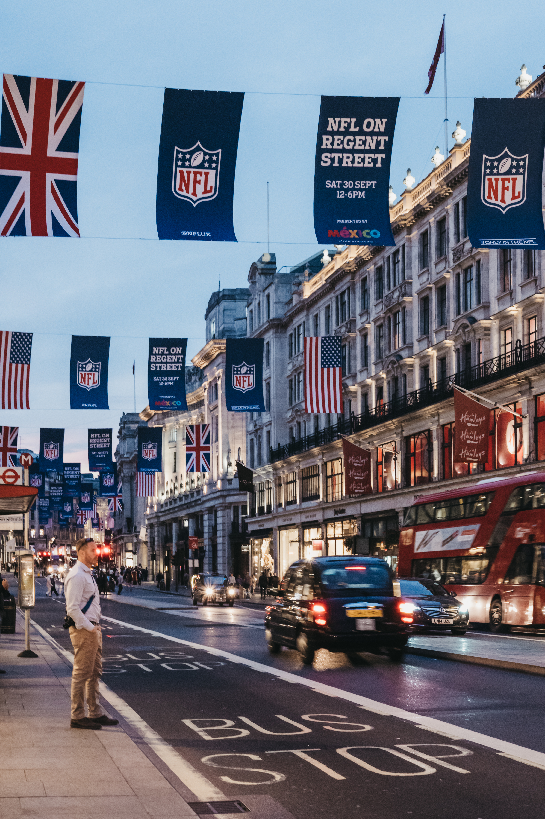
Globalization of Pro Sports
Major league sports like the N B A, N F L, and M L S are finding new fans abroad.
Soccer is a global sport.
The National Football League is focusing on Canada, China, Germany, Japan, Mexico, and the U K.
Exhibit 1-2 The National Football League (N F L) promotes American football globally. The N F L is focusing on a handful of key markets, including Canada, China, Germany, Japan, Mexico, and the United Kingdom. Every fall, banners are draped over London’s Regent Street to create awareness of the International Series games played before sellout crowds at Wembley Stadium and Twickenham.

Slide 13
Competitive Advantage, Globalization & Global Industries
Focus
  Concentration and attention on core business and competence
  “Nestle is focused: We are food and beverages. We are not running bicycle shops. Even in food we are not in all fields. There are certain areas we do not touch…We have no soft drinks because I have said we will either buy Coca-Cola or we leave it alone. This is focus.”
  ~Helmut Maucher, former chairman of Nestlé S A~
Notes:
When a company succeeds in creating more value for customers than its competitors, that company is said to enjoy competitive advantage. CA is measured relative to rivals in an industry. A local laundromat is in a local industry and competes locally. A national company competes within its country’s borders. Global industries compete globally—consumer electronics, apparel, automobiles, steel, pharmaceuticals, furniture, etc.
In recent years, Bertelsmann, Colgate, Danone, Electrolux, Fiat, Ford, Fortune Brands, General Motors, Harley-Davidson, Henkel, LEGO, McDonald’s, Royal Philips Electronics, Toshiba, and many other companies have stepped up efforts to sharpen their strategic focus on core businesses and brands.

Slide 14
Value, Competitive Advantage, & Focus
Value, Competitive Advantage, and Focus are universal in their relevance and guide marketing in any part of the world.
Companies that understand and engage in global marketing can offer more value to customers that those who do not.
  “Globalization is no longer an abstraction but a stark reality…Choosing not to participate in global markets is no longer an option. All firms, regardless of their size, have to craft strategies in the broader context of world markets to anticipate, respond, and adapt to the changing configuration of these markets.
  C. Samuel Craig and Susan P. Douglas
Notes:
C. Samuel Craig and Susan P. Douglas, “Responding to the Challenges of Global Markets: Change, Complexity, Competition, and Conscience,” Columbia Journal of World Business 31, no. 4 (Winter 1996), pp. 6–18

Slide 15
Table 1-2 Strategic Focus
Company/Headquarters | Divestiture/Buyer
General Electric (United States) | Appliance division, sold to Haier (China) for $5.4 billion (2016); N B C Universal, sold to Comcast for $30 billion (2009).
Vivendi (France) | Activision Blizzard videogame unit, management buyout for $8.2 billion (2013).
Unilever (United Kingdom/Netherlands) | American pasta sauce business, sold to Mizkan Group (Japan) for $2.15 billion (2014).
I B M (United States) | Microelectronics division, sold to Global Foundries for $1.5 billion (2014).

Slide 16
Pros and Cons of Globalization
Hundreds of million of people have been lifted from poverty and joined the middle class
Where globalization has raised wages, living standards have improved
Not all gains from globalization have been evenly distributed
U.S. President Trump’s “America First” agenda is one example of nations retreating into protectionism and isolation
“Globalization in reverse”

Slide 17
Standardization versus Adaptation
Globalization (Standardization)
  Developing standardized products marketed worldwide with a standardized marketing mix
  Essence of mass marketing
Global localization (Adaptation)
  Mixing standardization and customization in a way that minimizes costs while maximizing satisfaction
  Essence of segmentation
  Think globally, act locally
Notes:
Global marketing may include a combination of standard (e.g., the actual product itself) and nonstandard (e.g., distribution or packaging) approaches.
Many companies are learning that it is equally important to think locally and act globally. In practice, this means that companies are discovering the value of leveraging innovations that occur far from headquarters and transporting them back home. For example, McDonald’s restaurants in France don’t look like McDonald’s restaurants elsewhere. Décor colors are muted, and the golden arches are displayed more subtly. After seeing the sales increases posted in France, some American franchisees began undertaking similar renovations.

Slide 18
Global Marketing: What It Is & What It Isn’t
Single-Country Marketing Strategy | Global Marketing Strategy
Target Market Strategy Marketing Mix Product Price Promotion Place | Global Market Participation Marketing Mix Development 4 P’ s: Adapt or Standardize? Concentration of Marketing Activities Coordination of Marketing Activities Integration of Competitive Moves
Notes:
Since countries and people are different, marketing practices that work in one country will not necessarily work in another. Customer preferences, competitors, channels of distribution, and communication may differ. Global marketers must realize the extent to which plans and programs may be extended or need adaptation. The way a company addresses this task is a reflection of its global marketing strategy (GMS). Standardization versus adaptation is the extent to which each marketing mix element can be executed in the same or different ways in various country markets.
Concentration of marketing activities is the extent to which marketing mix activities are performed in one or a few country locations.
Coordination of marketing activities refers to the extent to which marketing mix activities are planned and executed interdependently around the globe.
Integration of competitive moves is the extent to which a firm’s competitive marketing tactics are interdependent in different parts of the world.

Slide 19
Additional Dimensions
Concentration of Marketing Activities
  the extent to which activities related to the marketing mix (e.g., promotional campaigns or pricing decisions) are performed in one or a few country locations
Coordination of Marketing Activities
  the extent to which marketing activities related to the marketing mix are planned and executed interdependently around the globe
Integration of Competitive Moves
  the extent to which a firm’s competitive marketing tactics in different parts of the world are interdependent

Slide 20
Markets with Great Potential
B R I C S are long recognized as offering significant growth opportunities
  Brazil
  Russia
  India
  China
  South Africa
M I N Ts are a new group with great potential
  Mexico
  Indonesia
  Nigeria
  Turkey
Notes:
The decision to enter one or more particular markets outside the home country depends on a company’s resources, its managerial mind-set, and the nature of opportunities and threats. Today, most observers agree that Brazil, Russia, India, China, and South Africa—five emerging markets known collectively as BRICS—represent significant growth opportunities. Mexico, Indonesia, Nigeria, and Turkey—the so-called MINTs—also hold great potential. Throughout this text,
marketing issues in these countries are highlighted in “Emerging Markets Briefing Book” boxes.

Slide 21
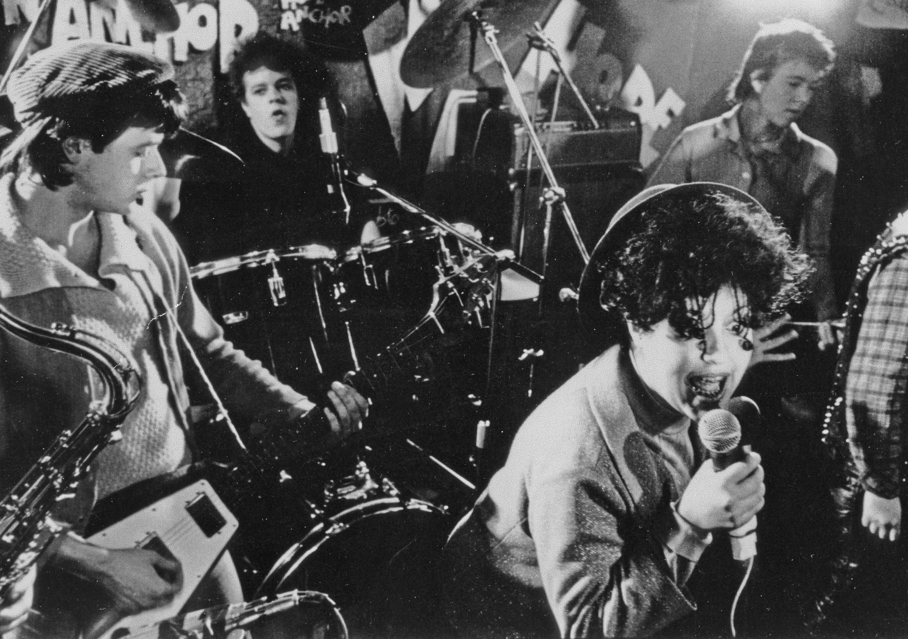
40 Years of Punk Rock, 1976-2016
1976 Punk rock emerged to challenge prevailing music styles set by Genesis, Pink Floyd, the Eagles, Linda Ronstadt, et al.
Punk offered a voice for disenfranchised youth to rebel.
Easy to play with only 2-3 chords.
The Ramones, Blondie, Talking Heads, X, Black Flag in the U.S.
U.K. had the Sex Pistols, Clash,X-Ray Spex.
“Rock and Roll needed to be hit upside the head”
Exhibit 1-4 Among punk’s positive social effects was the empowerment of women. For example, Exene Cervenka fronted L.A. punk band X, and Poly Styrene (shown here) was the singer for London’s X-Ray Spex.
Notes:
Decades before the term “brand tribes” entered the marketing vocabulary, the Dead attracted a self-identified community known as Deadheads. For these loyal fans, being a Deadhead was badge of identity. Deadheads typically attended multiple concerts, moving from city to city in sync with the band. Part of the Dead’s legacy was creating customer value with marathon live concerts that lasted three hours or more—a template for contemporary jam bands such as Phish.
A direct-to-fan ticketing approach brought the Grateful Dead closer to their fans. Thanks to its direct approach, the band accumulated an extensive database that kept it in close communication with fans—via mail and telephone—and facilitated merchandise marketing. The Dead’s social network innovation happened in the pre‒Internet/social media era. However, the direct-to-fan model has been adopted in the present day by artists working in the EDM scene and other genres that operate somewhat out of the industry mainstream.
Sonic perfectionists, the Dead toured with a custom-built sound system that produced a “wall of sound” renowned for its clarity and volume. While music piracy is an industry hot-button issue in the twenty-first century, the Dead actually encouraged their fans to record their live concerts. The fans then traded the tapes amongst themselves, creating a sense of connection and community. As John Perry Barlow, a lyricist and member of the Dead’s extended family, noted succinctly, “We invented file sharing!” Allowing fans to tape their concerts and take the experience home with them created brand equity, and the Dead redefined the relationship between artists and their fans.

Slide 22
Burberry’s G M S
Expand in B R I C S, U S
Marketing Mix
  Product: emphasize handbags, belts, accessories
  Price: Affordable luxury
  Place: Independent stores in major cities like Hong Kong, Los Angeles, San Francisco, N Y C
  Promotion: Encourage advocacy and sharing via social media, Burberry Acoustic for emerging musicians
  Burberry celebrated its 160th anniversary in 2016; trademark registered in more than 90 countries
Notes:
At Burberry, haphazard growth had led to a federation of individual operations. Company units in some parts of the world didn’t talk to each other. In some cases they competed against each other, and sometimes designed their own products for their own markets and wouldn’t share ideas with other parts of the business. To address this issue, former CEO Angela Ahrendts was very clear that she wanted to leverage the Burberry franchise. Her mantra was: One company, one brand.”
In 2014 new CEO Christopher Bailey is refining and updating Ahrendts’ strategies with an approach he calls “Inspire with the Brand.” Using data analytics, Bailey intends to leverage consumer insights gleaned from Burberry’s strong digital presence and its worldwide network of brick-and-mortar stores to project a consistent brand voice. Collaborations with musicians also became integral to Bailey’s strategy; he even designed the sequined gown global superstar Adele wore on her 2016 world tour! Bailey also embraced multichannel marketing, adding more mobile marketing to the existing mix of retail and wholesale channels.
An Italian businessman, Marco Gobetti, took over as Burberry’s CEO in 2017. He faces a number of new challenges to the company’s global marketing strategy, including the declining popularity of department store shopping in the United States and slowing sales of luxury goods in China

Slide 23
Global Localization
“Think globally, act locally”
May be a combination of standard (product) and nonstandard approaches (distribution or packaging)
McDonald’s in France have muted colors and golden arches are more subtle. American franchisees saw the success in France and implemented similar renovations.
C P G companies find that products created for emerging markets with low cost and less packaging appeal to budget consumers in countries like Spain and Greece.
Notes:
Many companies are learning that it is equally important to think locally and act globally. In practice, this means that companies are discovering the value of leveraging innovations that occur far from headquarters and transporting them back home. For example, McDonald’s restaurants in France don’t look like McDonald’s restaurants elsewhere. Décor colors are muted, and the golden arches are displayed more subtly. After seeing the sales increases posted in France, some American franchisees began undertaking similar renovations.
The Coca-Cola Company supports its Coke, Fanta, and Powerade brands with marketing mix elements that are both global and local. Dozens of other companies also have successfully pursued global marketing by creating strong global brands, in various ways. In consumer electronics, Apple is synonymous with hardware and software integration, ease of use, cutting-edge innovation, and high-tech design. In appliances, Germany’s reputation for engineering and manufacturing excellence is a source of competitive advantage for Bosch (see Exhibit 1-7). Italy’s Benetton utilizes a sophisticated distribution system to quickly deliver the latest fashions to its worldwide network of stores. The backbone of Caterpillar’s global success is a network of dealers who support the company’s promise of “24-hour parts and service” anywhere in the world. As these examples indicate, there are many different paths to success in global markets. In this book, we do not propose that global marketing is a knee-jerk attempt to impose a totally standardized approach on marketing around the world. Instead, a central issue in global marketing is how to tailor the global marketing concept to fit particular products, businesses, and markets

Slide 24
Table 1-5 Examples of Effective Global Marketing: McDonald’s
Marketing Mix Element | Standardized | Localized
Product | Big Mac | McAloo Tikka potato burger, Chicken Maharaja Mac (India); Rye McFeast (Finland); Adagio (Italy)
Promotion | Brand name Advertising slogan “i’m lovin’ it” | Slang nicknames-for example, Mickey D’s (United States, Canada), Macky D’s (United Kingdom, Ireland), Macca’s (Australia), Mäkkäri (Finland), MakDo (Philippines), McDo (France) “Venez comme vous êtes” (“Come as you are”) television ad campaign in France. Various executions show individuals expressing different aspects of their respective personalities. One features a young man dining with his father. The ad’s creative strategy centers on sexual freedom and rebellion: The father does not realize that his son is gay.
Place | Freestanding restaurants in high-traffic public areas | McDonald’s Switzerland operates themed dining cars on the Swiss national rail system; McDonald’s is served on the Stena Line ferry from Helsinki to Oslo; home delivery (India)
Price | Average price of Big Mac is $4.20 (United States) | $6.79 (Norway); $2.44 (China)

Slide 25
The Importance of Global Marketing
For U.S. companies, 75% of total world market for goods and services is outside the country
  Coca-Cola earns 75% of operating income and 2/3
  of profit outside of North America
For Japanese companies, 90% of world market is outside the country
94% of market potential is outside of Germany for its companies even though it is the largest E U market
Notes:
Industries that were essentially national in scope only a few years ago are dominated today by a handful of global companies. In most industries, the companies that will survive and prosper in the twenty-first century will be global enterprises. Some companies that fail to formulate adequate responses to the challenges and opportunities of globalization will be absorbed by more dynamic, visionary enterprises. Others will undergo wrenching transformations and, if their efforts succeed, will emerge from the process greatly transformed. Some companies will simply disappear.

Slide 26
Management Orientations (1 of 4)
Ethnocentric Orientation
  Home country is superior to others
  Sees only similarities in other countries
  Assumes products and practices that succeed at home will be successful everywhere
  Leads to a standardized or extension approach
Notes:
Ethnocentric orientation leads to a standardized or extension approach. Foreign operations are typically viewed as being secondary or subordinate to the country in which the company is headquartered. Sometimes valuable managerial knowledge and experience in local markets may go unnoticed. Ethnocentric companies that conduct business outside the home country can be described as international companies; they adhere to the notion that the products that succeed in the home country are superior.
Manufacturing firms may view foreign markets as dumping grounds with little or no marketing research conducted, manufacturing modifications made or attention paid to customer needs and wants.
In Nissan’s early days of exporting to the U.S., the company shipped cars for the mild Japanese winters. Executives assumed that when the weather turned cold, Americans would put a blanket over their cars just like Japanese did. Nissan’s spokesperson said, “We tried for a long time to design cars in Japan and shove them down the American consumer’s throat. That didn’t work very well.”
Michael Mondavi, former CEO of the wine company said, “Robert Mondavi was a local winery that thought locally, grew locally, produced locally, and sold globally…To be a truly global company, I believe it’s imperative to grow and produce great wines in the world in the best wine-growing regions, regardless of the country or the borders.”
Japanese cell phone manufacturers concentrated on their home market. When it reached saturation, they looked outside their borders only to discover Nokia, Samsung, and Motorola dominated the global market.

Slide 27
Management Orientations (2 of 4)
Polycentric Orientation
  Each country is unique
  Each subsidiary develops its own unique business and marketing strategies
  Often referred to as multinational
  Leads to a localized or adaptation approach that assumes products must be adapted to local market conditions
Notes:
At Procter & Gamble, one of Pampers’ many problems in the 1990s was that various regional groups and 80-plus country teams were all acting independently. P&G executives knew they had to address the issue in Pampers’ two biggest organizations, Pampers Europe (run by an Austrian), and Pampers North America (run by an American). The two executives were not collaborating, thereby stifling any potential for their organizations to cooperate in solving the global challenges Pampers faced in research and development, design, manufacturing, and marketing.
Unilever, the Anglo-Dutch consumer products company, once exhibited a polycentric orientation. For example, its Rexona deodorant brand had 30 different package designs and 48 different formulations. Advertising was also executed on a local basis. Top management has spent the last decade changing Unilever’s strategic orientation by implementing a reorganization plan that centralizes authority and reduces the power of local country managers.

Slide 28
Management Orientations (3 of 4)
Regiocentric Orientation
  A region is the relevant geographic unit
    Ex: The N A F T A or European Union market
  Some companies serve markets throughout the world but on a regional basis
    Ex: General Motors had four regions for decades
Notes:
At GM, executives were given considerable autonomy in designing autos for their regions. One result was the use of 270 different radios being installed around the world. As GM Vice Chairman Robert Lutz told an interviewer in 2004, “GM’s global product plan used to be four regional plans stapled together.”

Slide 29
Management Orientations (4 of 4)
Geocentric Orientation
  Entire world is a potential market
  Strives for integrated global strategies
  Also known as a global or transnational company
  Retains an association with the headquarters country
  Pursues serving world markets from a single country or sources globally to focus on select country markets
  Leads to a combination of extension and adaptation elements
Notes:
Ex: GM now assigns engineering jobs worldwide. GM’s new policy calls for engineering jobs to be assigned on a worldwide basis, with a global council based in Detroit determining the allocation of the company’s $7 billion annual product development budget. One goal of the geocentric approach: Save 40 percent in radio costs by using a total of 50 different radios.
Transnational companies serve global markets and use global supply chains, which often results in a blurring of national identity. A true transnational would be characterized as “stateless.” Toyota and Honda are two examples of companies that exhibit key characteristics of transnationality. At global and transnational companies, management uses a combination of standardized (extension) and localized (adaptation) elements in the marketing program. A key factor that distinguishes global and transnational companies from international or multinational companies is mind-set: At global and transnational companies, decisions regarding extension and adaptation are not based on assumptions. Rather, such decisions are made on the basis of ongoing research into market needs and wants.
Other examples: Harley-Davidson (U.S.), Waterford (Ireland), Gap (U.S.)

Slide 30
Forces Affecting Global Integration & Global Marketing
Multilateral trade agreements
Converging market needs and wants and the information revolution
Transportation and communication improvements
Product development costs
Quality
Notes:
DRIVING FORCES
Regional agreements: NAFTA, EU expansion and single currency. WTO (1994)
Converging Market needs and Wants and IT: There are cultural universals as well as differences. Common elements in human nature provide the opportunity to create and serve global markets, i.e. soft drinks. Companies must recognize that product adaptation is not always necessary and that competitors may be serving global customers. The information revolution which some call the democratization of information is one reason for the trend to convergence. The revolution is fueled by a variety of technologies, products, and services, including satellite dishes; globe-spanning TV networks such as CNN and MTV; widespread access to broadband Internet; and Facebook, Twitter, YouTube, and other social media allow people in remote areas to compare their lifestyles to others. Advertising overlapping national boundaries like in Asia or Europe and the mobility of consumers in these markets has allowed for pan-regional positioning. The Internet is perhaps the strongest force that allows people everywhere to buy and sell.
Transportation and communication: Jets allow around the world travel in less than 48 hours. 1970: 75 million international passengers. 2011: 980 million. Airlines sell each other’s seats thanks to modern technology. the cost of international data, voice, and video communication has fallen dramatically over the past several decades. Today, Skype, Google+, and Cisco Telepresence are powerful new communication channels. International phone calls are inexpensive and there are many other ways to communicate like fax, e-mail, video conferencing, Wi-Fi and broadband internet. Transportation costs have fallen. Due to specially designed ships, the cost of shipping autos from Japan to the U.S. is less than the cost to ship from Detroit to either U.S. coast. Intermodal transportation uses 20 to 40 foot containers that may be transferred from trucks to railroad cars to ships.
Product Development Costs: New pharmaceutical cost in 1976 = $54 million; today = $400 million and up to 14 years to get a drug approved. Pharmaceutical companies go global to spread the costs. However, only seven countries account for 75% of sales.
QUALITY: Global marketing strategies can generate more revenues and higher operating margins that, in turn, support design and manufacturing quality. For example, a global company and a domestic company may each spend 5 percent of their sales on R&D, but the global company may have many times the total revenue of the domestic company because it serves the world market

Slide 31
Driving Forces Affecting Global Integration and Global Marketing
World Economic Trends
  Prior to the global economic crisis in 2008, economic growth has been driven by:
    Economic growth in key developing countries provided incentive for investment. (Growing middle class in India, China have money to spend)
    Economic growth led policymakers to favor outsiders. (China saw that foreign firms would not threaten domestic firms.)
    The worldwide movement toward free markets, deregulation, and privatization
Leverage
  Experience transfers
  Scale economies
  Resource utilization
  Global strategy
Notes:
World Economic Trends Prior to the global economic crisis that began in 2008, economic growth had been a driving force in the expansion of the international economy and in the growth of global marketing for three reasons. First, economic growth in key developing countries creates market opportunities that provide a major incentive for companies to expand globally. Thanks to rising per capita incomes in India, China, and elsewhere, the growing ranks of middle-class consumers have more money to spend than in the past. At the same time, slow growth in industrialized countries has compelled management to look abroad for opportunities in nations or regions with high rates of growth. Second, economic growth has reduced resistance that might otherwise have developed in response to the entry of foreign firms into domestic economies. When a country such as China is experiencing rapid economic growth, policymakers are likely to look more favorably on outsiders. A growing country means growing markets; there is often plenty of opportunity for everyone. As a consequence, it is possible for a “foreign” company to enter a domestic economy and establish itself without threatening the existence of local firms. The latter can ultimately be strengthened by the new competitive environment. Without economic growth, however, global enterprises may take business away from domestic ones. In this kind of environment, domestic businesses are more likely to seek governmental intervention to protect their local positions. Predictably, the most recent economic crisis has created new pressure on policymakers in emerging markets to protect domestic markets. The worldwide movement toward free markets, deregulation, and privatization is a third driving force. The trend toward privatization is opening up formerly closed markets; tremendous opportunities are being created as a result.
Leverage means some type of advantage that a company enjoys by virtue of the fact that it has experience in more than one country. Leverage allows a company to conserve resources when pursuing opportunities in new geographical markets. In other words, leverage enables a company to expend less time, less effort, and/or less money.
Experience transfers: Whirlpool’s experience with major retailers n the US (Sears., Best Buy) positions it to be ready for the development of power retailers in the EU. Chervon has drilled in every kind of rock there is. What it has learned in one geographic area can be transferred to another.
Scale economies: Japan's Matsushita built manufacturing plants to export to the world market. Flexible manufacturing methods has made this less important. Other companies eliminate duplicate staffing positions worldwide by centralizing functional activities.
Resource utilization: A major strength of the global company is its ability to scan the entire world to identify people, money, and raw materials that will enable it to compete most effectively in world markets. For a global company, it is not problematic if the value of the “home” currency rises or falls dramatically, because there really is no such thing as a home currency. The world is full of currencies, and a global company seeks financial resources on the best available terms.
Global strategy: The global strategy is a design to create a winning offering on a global scale. French automaker Renault operated as a regional company for years but as the industry began to be dominated by global companies like Toyota, it had to develop a global strategy. It acquired a majority stake in Nissan and the Romanian Dacia, invested $1 billion in a plant in Brazil and spending billions in Korea.

Slide 32
Restraining Forces Affecting Global Integration and Global Marketing
Management myopia
Organizational culture
National controls
Opposition to globalization
Notes:
Management Myopia and Organizational Culture: Ethnocentric companies will not expand geographically. Managers tend to dictate when they should create strong local teams that they can rely upon for market information. Know-it-all local teams won’t listen to management and all-knowing managers won’t listen to local experts. Successful global companies have learned to integrate global vision and perspective with local market initiative and input.
National controls: Every country tries to protect its home industries and services through tariff and non-tariff controls. Thanks to organizations like GATT, WTO, NAFTA, EU, and other economic agreements, tariffs have been largely removed in high-income countries. Non-tariff barriers to trade include “Buy Local” campaigns, food safety rules and other bureaucratic obstacles.
Opposition to Globalization: Globophobia is the term used to describe an attitude of hostility toward trade agreements, global brands, or company policies that appear to result in hardship for some individuals or countries while benefiting others. Opponents to globalization include college or university students, NGOs and labor unions. Some Americans believe that globalization has sent American jobs—both blue-and white-collar—overseas and also depressed wages at home. In developing countries, many believe that free trade agreements benefit the world’s most advanced countries. An unemployed miner in Bolivia said, “Globalization is just another name for submission and domination. We’ve had to live with that here for 500 years and now we want to be our own masters.”
Two prominent examples of this restraining force are the election of Donald Trump in the United States and the Brexit vote in the United Kingdom. Shortly after being sworn in as the 45th U.S. president, Trump pulled the United States out of the Transatlantic Trade and Investment Partnership (TTIP) as well as the Trans-Pacific Partnership (TPP). He also campaigned on a pledge to revise or withdraw from NAFTA. Meanwhile, U.K. Prime Minister Theresa May was working to finalize “divorce” arrangements for the United Kingdom’s withdrawal from the European Union.

Slide 33
Book Overview
Part
Overview of Global Marketing
Part
Environments of Global Marketing
Part
Global Strategy
Part
Global Considerations of the Marketing Mix
Part
Integrating the Dimensions of Global Marketing

