Slide 1
Global Marketing
Tenth Edition, Global Edition
Chapter 6
Global Information Systems and Market Research
Copyright © 2020 Pearson Education Ltd. All Rights Reserved.
Notes:
If this PowerPoint presentation contains mathematical equations, you may need to check that your computer has the following installed:
1) MathType Plugin
2) Math Player (free versions available)
3) NVDA Reader (free versions available)

Slide 2
Learning Objectives
6.1 Discuss the roles of I T, M I S, and big data in a global company’s decision-making processes.
6.2 Describe the various sources of market information, including direct perception.
6.3 Identify the individual steps in the traditional market research process and explain some of the ways global marketers adapt them.
6.4 Compare the way a multinational firm organizes the marketing research effort with the way a global or transnational firm approaches the organizing issue.
6.5 Explain how information’s role as a strategic asset affects the structure of global corporations.

Slide 3
Information Technology, Management Information System & Big Data
I T: An organization’s processes for creating, storing, exchanging, using, and managing information.
M I S: A means for gathering, analyzing and reporting relevant data to provide managers and other decision makers with a continuous flow of information about markets, customers, competitors, and company operations.
Big Data: Extremely large data sets that can be subjected to computational analysis to reveal patterns and trends.
Notes:
Big data and big data analytics have long been the province of astronomers, meteorologists, and other members of the scientific community. It is only recently that big data collection and analysis have been used in business situations. In particular, the exploding popularity of Facebook and other social media platforms has resulted in a wealth of big data. However, much of that data may be redundant or irrelevant, for a simple reason: The cost of data collection has dropped so dramatically that a company can amass data irrespective of a particular question, problem, or purpose that its marketers might have.
A case in point is video-streaming pioneer Netflix, which has collected more than 10 billion movie ratings from subscribers. Netflix also gathers demographic data about all its subscribers, including age, gender, and place of residence. Netflix knows, for example, that some 20-something males have viewing habits that many people would associate with 70-year-old females, and vice versa. Netflix managers must determine how to use the ratings in conjunction with demographic information and viewership data so that new subscribers enjoy a better content-discovery experience.

Slide 4
Business Intelligence Network
A component of M I S
Major Objective of B I:
To enable interactive access to data, enable manipulation of these data, and to provide managers and analysts with the ability to conduct appropriate analysis. By analyzing historical and current data, situations, and performances, decision makers get valuable insights upon which they can base more informed and better decisions.
Notes:
Many companies with global operations have made significant investments in IT infrastructure in recent years. Such investment is typically directed at upgrading a company’s legacy computer hardware and software. Microsoft, SAP, Oracle, and IBM are some of the beneficiaries of this trend. All are global enterprises, and many of their customers are global as well. Vendors of complex software systems can find it difficult to achieve 100 percent customer satisfaction.

Slide 5
I T Infrastructure (1 of 3)
Intranet: A private network that allows insiders or outsiders to share information securely and without paper
R T E: Real Time Enterprises are companies like Google, Amazon, FedEx that leverage big data
E D I: Electronic Data Interchange systems allow computer systems to speak the same language
Notes:
An EDI system allows a company’s business units to submit orders, issue invoices, and conduct business electronically with other company units as well as with outside companies. One of the key features of EDI is that its transaction formats are universal. This enables computer systems at different companies to speak the same language. Walmart is legendary for its sophisticated EDI system; for years, vendors had received orders from the retailer on personal computers using dial-up modems connected to third-party transmission networks. In 2002, Walmart informed vendors that it was switching to an Internet-based EDI system. The switch has saved both time and money; the modem-based system was susceptible to transmission interruptions, and the cost was between $0.10 and $0.20 per thousand characters transmitted. Any vendor that now wishes to do business with Walmart must purchase and install the necessary computer software.

Slide 6
I T Infrastructure (2 of 3)
E C R: Efficient Consumer Response is a joint initiative of supply chain members to optimize the supply chain to benefit customers.
E P O S: Electronic Point of Sale data read on checkout scanners help firms identify sales patterns & geographical consumer preferences.
Notes:
In addition to EDI, retailers are increasingly using a technique known as efficient consumer response (ECR) in an effort to work more closely with vendors on stock replenishment. ECR can be defined as a joint initiative of members of a supply chain working together to improve and optimize aspects of the supply chain to benefit customers. ECR systems utilize electronic point of sale (EPOS) data gathered by checkout scanners to help retailers identify product sales patterns and determine how consumer preferences vary with geography. Although currently more popular in the United States, the ECR system is gaining traction in Europe. Companies such as Carrefour, Metro, Coca-Cola, and Henkel have all embraced ECR. Supply-chain innovations such as radio frequency identification tags (RFID) are likely to provide increased momentum for the use of ECR.

Slide 7
I T Infrastructure (3 of 3)
C R M: Customer Relationship Management is a philosophy that values two-way communication between the company & the customer.
Touchpoints are any point of contact between the two.
360-degree view of the customer
S F A: Sales Force Automation software automates routine sales & marketing functions
Data warehouses
Notes:
A company’s use of CRM can manifest itself in various ways. In the hotel industry, for example, CRM can take the form of front-desk staff who monitor, respond to, and anticipate the needs of repeat customers. A visitor to Amazon.com who buys the latest Taylor Swift CD encounters CRM when he or she gets the message “Frequently Bought with the Item You Added: Ed Sheeran’s X and Sam Smith’s In the Lonely Hour.” CRM can also be based on the click path that a Web site visitor follows. In this case, however, Internet users may be unaware that a company is tracking their behaviors and interests.
One challenge of using CRM is integrating data into a complete picture of the customer and his or her relationship to the company and its products or services—a perspective sometimes referred to as a “360-degree view of the customer.” This challenge is compounded for global marketers. Their subsidiaries in different parts of the world may use different customer data formats, and commercial CRM products may not support all the target languages. In view of such issues, industry experts recommend implementing global CRM programs in phases.
The first phase could focus on a specific task such as sales force automation (SFA); this term refers to a software system that automates routine aspects of sales and marketing functions such as lead assignment, contact follow-up, and opportunity reporting. While Salesforce.com is a key player in this space, Microsoft Dynamics CRM and Oracle Siebel CRM on Demand are among the other vendors offering SFA. An SFA system can also analyze the cost of sales and the effectiveness of marketing campaigns. Some SFA software can assist with quote preparation and management of other aspects of a sales campaign, such as mass mailings and conference or convention attendee follow-up.
Databases called data warehouses are frequently an integral part of a company’s CRM system. Data warehouses can serve other purposes as well. For example, they can help retailers with multiple store locations fine-tune their product assortments at specific venues. Company personnel, including persons who are not computer specialists, can access data warehouses via standard Web browsers. Teradata, Oracle, IBM, and SAP are among the leading data warehouse vendors.

Slide 8
Sources of Market Information
Personal Sources
As much as 2/3 of corporate information
Executives based abroad, company subsidiaries, affiliates, and branches communicate with distributors, consumers, customers, suppliers, and government officials
Domestic companies often don’t look outside their home countries so may miss new opportunities and trends.

Slide 9
Direct Sensory Perception
Seeing, feeling, hearing, smelling, or tasting firsthand to find out what is going on in a country
“We often find consumers can’t articulate it. That’s why we need to have a culture where we are understanding. There can’t be detachment. You can’t just live away from the consumer and the brand and hope to gain your insights from data or reading or talking to academics. You have to be experiential. And some of our best ideas are coming from people getting out there and experiencing and listening.”
Jim Stengel, C M O Procter & Gamble
Notes:
Some information is easily available from other sources, but sensory experience of it is needed for it to sink in. Often, the background information or context one gets from observing a situation can help fill in the big picture. For example, Walmart’s first stores in China stocked a number of products—extension ladders and giant bottles of soy sauce, for example—that were inappropriate for local customers. Joe Hatfield, Walmart’s top executive for Asia, began roaming the streets of Shenzhen in search of ideas. His observations paid off; when Walmart’s giant store in Dalian opened in April 2000, a million shoppers passed through its doors in the first week. They snapped up products ranging from lunch boxes to pizza topped with corn and pineapple.

Slide 10
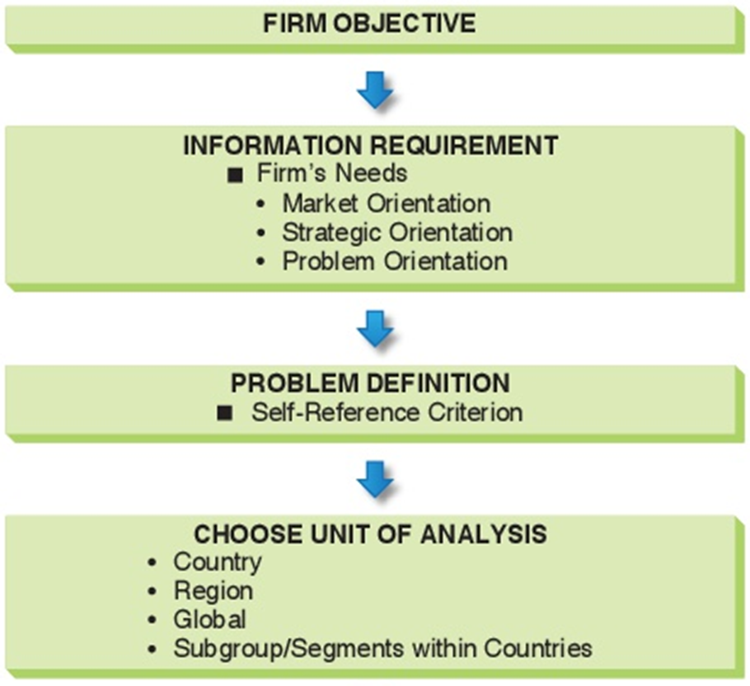
Formal Marketing Research (1 of 3)

Slide 11
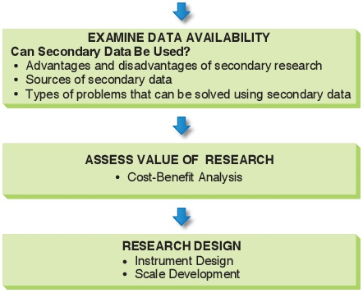
Formal Marketing Research (2 of 3)

Slide 12
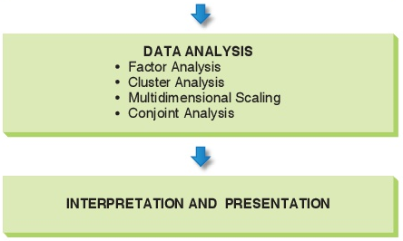
Formal Marketing Research (3 of 3)
Figure 6-2 Market Research Process

Slide 13
Step 1: Information Requirement
Table 6 - 1 Subject Agenda Categories for a Global Marketing Information System
Category | Coverage
Market potential | Demand estimates, consumer behavior, review of products, channels, communication media
Competitor information | Corporate, business, and functional strategies; resources and intentions; capabilities
Foreign exchange | Balance of payments, interest rates, attractiveness of country currency, expectations of analysts
Prescriptive information | Laws, regulations, rulings concerning taxes, earnings, dividends in both host and home countries
Resource information | Availability of human, financial, physical, and information resources
General conditions | Overall review of sociocultural, political, and technological environments

Slide 14
Step 2: Problem Definition
Be aware! The Self-Reference Criterion is at work when a person’s home-country values and beliefs influence the assessment of another country.
Mattel execs thought Japanese girls would like Barbie just like American girls. They didn’t.
Disney’s detailed code about personal appearance was an insult to French culture, individualism, and privacy when Disneyland Paris opened.
Notes:
As these examples show, managers sometimes make decisions based on home-country marketing success that can turn out to be wrong when applied globally. Marketers might also assume that a marketing program that is successful in one country market can be applied to other country markets in the region. Consider again the case of Disney’s theme park business. Although Disneyland Japan was a huge success from opening day, the $3.2 billion Hong Kong Disneyland that opened in 2005 was less successful. This was due, in part, to the fact that visitors from mainland China had limited familiarity with traditional Disney “face characters” such as Snow White. As Jay Rasulo, president of Disney’s park and resort division, noted, “People from the mainland don’t show up with the embedded ‘Disney software’ like at other parks.”
When approaching global markets, it is best to have “eyes wide open.” In other words, marketers must be aware of the impact that SRC and other cross-cultural assumptions can have. Such awareness can have several positive effects. First, it can enhance management’s willingness to conduct market research in the first place. Second, an awareness of SRC can help ensure that the research effort is designed with minimal home-country or second-country bias. Third, it can enhance management’s receptiveness to research findings—even if they contradict “tried-and-true” marketing experience in other markets.

Slide 15
Step 3: Choose a Unit of Analysis
Single country
Region
Global
City, state, or province
Notes:
In some instances, the marketer is interested in a segment that is global. Countrywide data are not required for all market-entry decisions; in some cases, a specific city, state, or province may be the relevant unit of analysis. For example, a company that is considering entering China may focus initially on Shanghai. Located in the Jiangsu province, Shanghai is China’s largest city and main seaport. Because Shanghai is a manufacturing center, has a well-developed infrastructure, and is home to a population with a relatively high per capita income, it would be the logical focus of a market research effort.

Slide 16
Step 4: Examine Data Availability (1 of 2)
Can secondary data be used?
When does management need the information in order to make a decision?
Secondary data are less expensive than a formal market study that may take months and be very expensive.
U.S. Government Resources
Statistical Abstract of the United States
National Trade Data Base (Dept. of Commerce)
Bureau of Economic Analysis
Census Bureau

Slide 17
Step 4: Examine Data Availability (2 of 2)
Eurostat
Canadian Trade Commissioner Service
Statistical Yearbook of the United Nations
C I A World Factbook
The Economist & Financial Times
Market Research.com
Notes:
A word of caution is in order at this point: Remember that data are compiled from various sources, some of which may not be reputable. Even when the sources are reputable, there is likely to be some variability from source to source. Anyone using data should be clear on exactly what the data are measuring. For example, studying income data requires understanding whether one is working with GNP or GDP figures. Also, anyone using the Internet as an information source should evaluate the credibility of the person(s) responsible for the Web site.
Syndicated studies published by private research companies are another source of secondary data and information (the word syndicated comes from the newspaper and television industries and refers to the practice of selling articles, cartoons, or guest columns, or programming to a number of different organizations). For example, MarketResearch.com (www.marketresearch. com) sells reports on a wide range of global business sectors, including consumer goods, food and beverages, and life sciences. The company partners with hundreds of research firms to offer a comprehensive set of reports. Although a single report can cost thousands of dollars, a company may be able to get the market information it needs without incurring the greater costs associated with conducting primary research.

Slide 18
Step 5: Assess Value of Research
If secondary data are not available, managers may conduct further studies of the area
Assess the cost of research vs. what the information is worth
Would the company enter the market without spending big money on research?
Small markets may merit only modest research expense
Notes:
When data are not available through published statistics or studies, management may wish to conduct further study of the individual country market, region, or global segment. However, collecting information costs money. Thus, the marketing research plan should also spell out what this information is worth to the company in dollars (or euros, or yen, etc.) compared with what it would cost to collect it. What will the company gain by collecting these data? What would be the cost of not getting the data that could be converted into useful information? Research requires an investment of both money and managerial time, and it is necessary to perform a cost-benefit analysis before proceeding further. In some instances, a company will pursue the same course of action no matter what the research reveals. Even when more information is needed to ensure a high-quality decision, a realistic cost estimate of a formal study may reveal that the cost to perform research is simply too high.
The small markets around the world pose a special problem for the researcher. The relatively low profit potential in smaller markets justifies only modest expenditures for marketing research. Therefore, the global researcher must devise techniques and methods that keep expenditures in line with the market’s profit potential. The researcher is often pressured to discover economic and demographic relationships that can lead to estimates of demand based on a minimum of information. It may also be necessary to use inexpensive survey research that sacrifices some elegance or statistical rigor to achieve results within the constraints of the smaller market research budget.

Slide 19
Step 6: Research Design (1 of 2)
Primary Data
when secondary data not available
provides accurate data which give exact answers to a given research problem
Possible problems
difficulties in gaining the data
cost
more time is necessary to gather the data

Slide 20
Step 6: Research Design (2 of 2)
Use multiple indicators rather than a single measure
Individual companies should develop customized indicators specific to the industry, product market, or business model
Always conduct comparative assessments in multiple markets
Observations of purchasing patterns, other behavior should weigh more heavily than reports or opinions about purchase intention or price sensitivity
Notes:
Use multiple indicators rather than a single measure. This approach will decrease the level of uncertainty for decision makers. As the saying goes, “There are three sides to every story: your side, my side, and the truth.” A land surveyor can pinpoint the location of a third object given the known location of two objects. This technique, known as triangulation, is equally useful in global market research.
Individual companies should develop customized indicators specific to the industry, product market, or business model. Such indicators should leverage a company’s previous experience in global markets. For example, in some developing markets Mary Kay Cosmetics uses the average wage of a female secretary as a basis for estimating income potential for its beauty consultants.
Always conduct comparative assessments in multiple markets. Do not assess a particular market in isolation. Comparative assessment enables management to develop a “portfolio” approach in which alternative priorities and scenarios can be developed. For example, to better understand Czech consumers in general, a company might also conduct research in nearby Poland and Hungary. By contrast, if a brewing company wished to learn more about beer consumption patterns in the Czech Republic, it might also conduct research in Ireland and Germany, where per capita beer consumption is high.
Observations of purchasing patterns and other behavior should be weighted more heavily than reports or opinions regarding purchase intention or price sensitivity. Particularly in developing markets, it is difficult to accurately survey consumer perceptions.

Slide 21
Qualitative Research Use
To provide consumer understanding; to “get close” to the consumer
To describe the social and cultural contexts of consumer behavior, including cultural, religious, and political factors that impact decision making
To identify core-brand equity and “get under the skin” of brands
To “mine” the consumer and identify what people really feel

Slide 22
Issues in Data Collection
Standardization vs. Extension of Marketing Mix?
Demand & profit potential may depend on whether the market is existing or potential
Existing Markets are being served by one or more companies
Potential Markets
Latent: An undiscovered segment
Incipient: A market will emerge if an economic, demographic, political, or sociocultural trend continues
Notes:
A latent market is, in essence, an undiscovered segment. It is a market in which demand would materialize if an appropriate product were made available. In a latent market, demand is zero before the product is introduced. In the case of existing markets such as the one for minivans previously described, the main research challenge is to understand the extent to which the competition fully meets customer needs. With latent markets, initial success is not based on a company’s competitiveness. Rather, it depends on the prime-mover advantage—a company’s ability to uncover the opportunity and launch a marketing program that taps the latent demand.
An incipient market is a market that will emerge if a particular economic, demographic, political, or sociocultural trend continues. A company is not likely to succeed if it offers a product in an incipient market before the trends have taken root. After the trends have had a chance to gain traction, the incipient market will become latent and, later, existing. The concept of incipient markets can also be illustrated by the impact of rising income on demand for automobiles and other expensive consumer durables. As per capita income rises in a country, the demand for automobiles will also rise. Therefore, if a company can predict a country’s future rate of income growth, it can also predict the growth rate of its automobile market.

Slide 23
Research Methodologies
Survey Research: Qualitative or Quantitative
May use Back or Parallel translation technique to ensure accuracy
Consumer Panel: Respondents’ behavior tracked over time; Nielsen Media tracks television audience measurement (T A M)
Observation: Trained observers or a mechanical device (video camera) watch & record actual or potential consumers
Focus Groups: Moderator leads 6-10 person discussion
Scale Development: Likert scale; be aware of bias
Sampling: Convenience or Quota samples
Notes:
Survey research utilizes questionnaires designed to elicit quantitative data (“How much would you buy?”), qualitative responses (“Why would you buy?”), or both. Survey research is often conducted by means of a questionnaire distributed through the mail, asked over the telephone, or asked in person. Many good marketing research textbooks provide details on questionnaire design and administration.
Recall that step 2 of the global market research process calls for identifying possible sources of SRC bias. This issue is especially important in survey research: SRC bias can originate from the cultural backgrounds of those designing the questionnaire. For example, a survey designed and administered in the United States may be inappropriate in non-Western cultures even if it is carefully translated. This is especially true if the person designing the questionnaire is not familiar with the SRC. A technique known as back-translation can help increase comprehension and validity; it requires that, after a questionnaire or survey instrument is translated into a particular target language, it is translated once again, this time into the original language by a different translator. For even greater accuracy, parallel translations—two versions by different translators—can be used as input to the back-translation. The same techniques can ensure that advertising copy is accurately translated into different languages.
In global market research, a number of survey design and administration issues may arise. When using the telephone as a research tool, it is important to remember that what is customary in one country may be impossible in others because of infrastructure differences, cultural barriers, or other reasons. For example, telephone directories or lists may not be available; also, important differences may exist between urban dwellers and people in rural areas. In China, for example, the Ministry of Information Industry reports that 77 percent of households in coastal areas have at least one fixed-line telephone; in rural areas, the number is only 40 percent.
At a deeper level, culture shapes attitudes and values in a way that directly affects people’s willingness to respond to interviewer questions. Open-ended questions may help the researcher identify a respondent’s frame of reference. In some cultures, respondents may be unwilling to answer certain questions or they may intentionally give inaccurate answers.
In focus group research, a trained moderator facilitates discussion of a product concept, a brand’s image and personality, an advertisement, a social trend, or another topic with a group of 6 to 10 people. Global marketers can use focus groups to arrive at important insights.
Even with standard data-gathering techniques, the application of a particular technique may differ from country to country. Matthew Draper, vice president at New Jersey–based Total Research Corporation, cites “scalar bias” as a major problem: “There are substantial differences in the way people use scales, and research data based on scales such as rating product usefulness on a scale of 1 to 10 is therefore frequently cluttered with biases disguising the truth.” For example, while the typical American scale would equate a high number such as 10 with “most” or “best” and 1 with “least,” Germans prefer scales in which 1 is “most/best.” Also, while American survey items pertaining to spending provide a range of figures, Germans prefer the opportunity to provide an exact answer
When collecting data, researchers generally cannot administer a survey to every possible person in the designated group. A sample is a selected subset of a population that is representative of the entire population. The two best-known types of samples are probability samples and nonprobability samples. A probability sample is generated by following statistical rules that ensure that each member of the population under study has an equal chance—or probability—of being included in the sample. The results of a probability sample can be projected to the entire population with statistical reliability reflecting sampling error, degree of confidence, and standard deviation. The results of a nonprobability sample cannot be projected with statistical reliability. One form of nonprobability sample is a convenience sample. As the name implies, researchers select people who are easy to reach.

Slide 24
Step 7: Data Analysis
Data must be cleaned & tabulated
Factor analysis
Cluster analysis
Multidimensional Scaling/Perceptual mapping
Conjoint analysis
Comparative analysis
Market estimation by analogy
Comparative analysis
Notes:
Factor analysis can be used to transform large amounts of data into manageable units; specialized computer programs perform data reduction by “distilling out” from a multitude of survey responses a few meaningful factors that underlie attitudes and perceptions. Factor analysis is useful in psychographic segmentation studies and can also be used to create perceptual maps.
Cluster analysis allows the researcher to group variables into clusters that maximize within-group similarities and between-group differences. This type of analysis shares some characteristics of factor analysis: It does not classify variables as dependent or independent, and it can be used in psychographic segmentation.
Multidimensional scaling (MDS) is another technique for creating perceptual maps. When the researcher is using MDS, the respondent is given the task of comparing products or brands, one pair at a time, and judging them in terms of similarity.
Conjoint analysis is a tool that researchers can use to gain insights into the combination of features that will be most attractive to consumers; it is assumed that features affect both perception and preferences.
COMPARATIVE ANALYSIS AND MARKET ESTIMATION BY ANALOGY One of the unique opportunities in global marketing analysis is to conduct comparisons of market potential and marketing performance in different country or regional markets at the same point in time. A common form of comparative analysis is the intra-company cross-national comparison. For example, general market conditions in two or more countries (as measured by income, stage of industrialization, or some other indicator) may be similar. If there is a significant discrepancy between per capita sales of a given product in the countries, the marketer might reasonably research that gap and determine which actions need to be taken.

Slide 25
Step 8: Interpretation & Presentation
The report should clearly link to the problem or opportunity identified in Step 1
Use language with which managers are comfortable
Simplify complex quantitative analysis
Notes:
The report based on the market research must be useful to managers as input to the decision-making process. Whether the report is presented in written form, orally, or electronically via video, it must relate clearly to the problem or opportunity identified in step 1. Generally, it is advisable for major findings to be summarized concisely in a memo that indicates the answer or answers to the problem first proposed in step 1. Many managers are uncomfortable with research jargon and complex quantitative analysis. To overcome their resistance, results should be clearly stated and provide a basis for managerial action. Otherwise, the report may end up on the shelf, where it will gather dust and serve as a reminder of wasted time and money.
As the data provided by the corporate information systems and market research become increasingly available on a worldwide basis, it becomes possible to analyze marketing expenditures’ effectiveness across national boundaries. Managers can then decide where they are achieving the greatest marginal effectiveness for their marketing expenditures and can adjust expenditures accordingly.

Slide 26
Current Issues in Global Marketing Research
Where to locate control of the firm’s research?
Comparability means that research can be used for valid comparisons between countries
Emic analysis studies a culture from within
Etic analysis is detached & used in multi-country studies
Notes:
An issue for the global company is where to locate control of the organization’s research capability. The difference between a multinational, polycentric company and a global, geocentric company on this issue is significant. In the multinational company, responsibility for research is delegated to the operating subsidiary. In contrast, the global company delegates responsibility for research to operating subsidiaries but retains overall responsibility and control of research as a headquarters’ function. A key difference between single-country market research and global market research is the importance of comparability. In practice, this means that the global company must ensure that research is designed and executed so as to yield comparable data.

