Slide 1
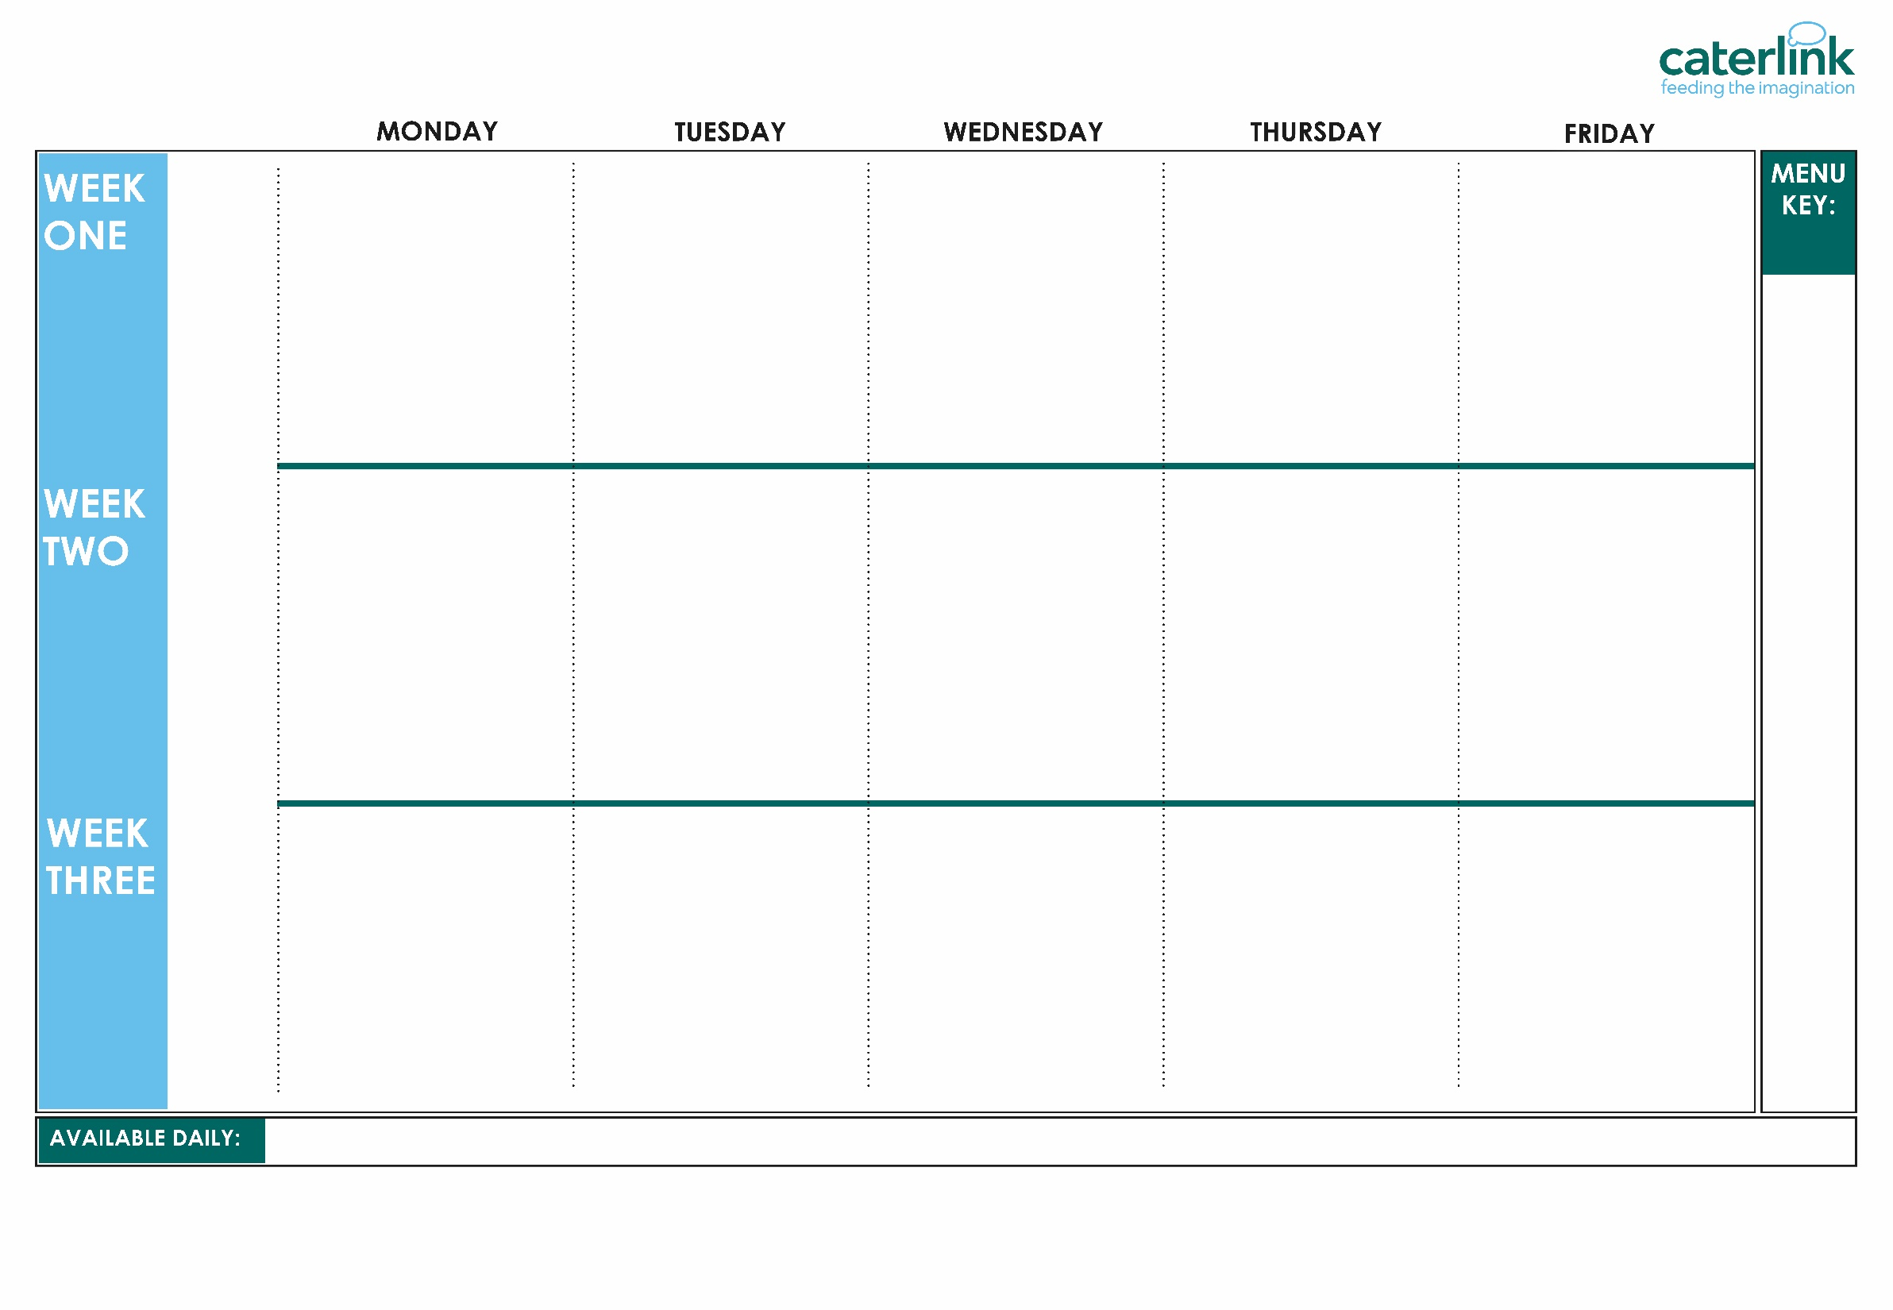

SPRING SUMMER MENU 2026
Macaroni Cheese | Phat Pasty Pork Sausage Roll with Potato Wedges | Roast Chicken, Stuffing, Roast Potatoes & Gravy | Spaghetti Bolognaise | Fishfingers or Salmon Fishfingers with Chips & Tomato Sauce
Chickpea Curry with Rice | Mild Mexican Chilli with Rice | Roasted Quorn, Roast Potatoes, & Gravy | Smokey Bean Burger with Wedges & Tomato Sauce | Cheese & Bean Pasty with Chips & Tomato Sauce
Vegetables of the Day | Vegetables of the Day | Vegetables of the Day | Vegetables of the Day | Vegetables of the Day
NEW Banana Mousse | Orange Drizzle Cake | Fruit Platter | Apple Flapjack | Strawberry Jelly with Mandarins
Option
One
Option
Two
Sides
Dessert
07/09/26
28/09/26
19/10/26
Whole
grain
Cheese & Tomato Pizza with Summer Mixed Salad | Beef Chilli with Rice & Sweetcorn & Cucumber Salsa | Roasted Pork or Chicken Sausage, Roast Potatoes & Gravy | Greek Chicken Pitta with Herby Rice, Tzatziki & Salad | Battered Fish with Chips & Tomato Sauce
Lentil & Sweet Potato Curry with Rice | Spaghetti & Meatballs in a Tomato Sauce | Veg Wellington, Roast Potatoes & Gravy | Greek Spinach & Cheese Whirl with Herby Rice, Tzatziki & Salad | NEW Cheesy Broccoli Frittata with Chips
Vegetables of the Day | Vegetables of the Day | Vegetables of the Day | Vegetables of the Day | Vegetables of the Day
Iced Vanilla Sponge | Peaches & Ice Cream | Freshly Chopped Fruit Salad | Jam & Coconut Sponge with Custard | Oaty Cookie
Option
One
Option
Two
Sides
Dessert
Plant
based
14/09/26
05/10/26
Added plant protein
Option
One
Option
Two
Sides
Dessert
Tomato Pasta | Beef Burger with Potato Wedges & Rainbow Slaw | Roast of the Day, Mashed Potatoes & Gravy | Chef Shilpa’s Chicken Korma with Rice | Fishfingers with Chips & Tomato Sauce
NEW Chinese Vegetable Noodles | Mexican Bean Roll with New Potatoes & Rainbow Slaw | Vegetable Loaf with Stuffing, Mashed Potatoes & Gravy | All Day Vegetarian Breakfast | Cowboy Sausage and Bean Hotpot
Vegetables of the Day | Vegetables of the Day | Vegetables of the Day | Vegetables of the Day | Vegetables of the Day
Pineapple Upside Down Cake | Cheese & Crackers | Fruit Medley | Strawberry and Apple Crumble with Custard | Vanilla Shortbread
20/10/26
Chef’s Special
Jacket Potatoes with a choice of fillings, Salad Bar, Freshly Baked Bread, Fresh Fruit, Yoghurt
If you would like to know about particular allergens in foods, please ask a member of the catering team for information. If your child has a school lunch and has a food allergy or intolerance you will be asked to complete a form to ensure we have the necessary information to cater for your child. We use a large variety of ingredients in the preparation of our meals and due to the nature of our kitchens it is not possible to completely remove the risk of allergen cross contact.

Slide 2
SPRING SUMMER MENU 2026
V318 Macaroni Cheese | P24 Phat Pasty Pork Sausage Roll with SD6 Potato Wedges | C4/ C5 Roast Chicken, SD40 Stuffing, SD82 Roast Potatoes & SD118 Gravy | SD8 Spaghetti B48 Bolognaise | F6 Fishfingers or F1 Salmon Fishfingers with SD5 Chips & SD14 Tomato Sauce
V321 Chickpea Curry with SD84 Rice | V309 Mild Mexican Chilli with SD84 Rice | V204 Roasted Quorn, SD82 Roast Potatoes, & SD118 Gravy | V323 SD17 Smokey Bean Burger with SD6 Wedges & SD14 Tomato Sauce | V191 Cheese & Bean Pasty with SD5 Chips & SD14 Tomato Sauce
Vegetables of the Day | Vegetables of the Day | Vegetables of the Day | Vegetables of the Day | Vegetables of the Day
D269 Banana Mousse | D182 Orange Drizzle Cake | D225 Fruit Platter | D171 Apple Flapjack | D235 Strawberry Jelly with Mandarins
Option
One
Option
Two
Sides
Dessert
Whole
grain
V231 Cheese & Tomato Pizza with SD126 Summer Mixed Salad | B49 Beef Chilli with SD84 Rice & SB37 Sweetcorn & Cucumber Salsa | P25 Roasted Pork or C137 Chicken Sausage, SD82 Roast Potatoes & SD118 Gravy | GR1 Greek Chicken Pitta with SD195 Herby Rice, GR3 Tzatziki & GR4 Salad | F3 Battered Fish with SD5 Chips & SD14 Tomato Sauce
V108 Lentil & Sweet Potato Curry With SD84 Rice | SD8 Spaghetti & V237 Meatballs in a V225 Tomato Sauce | V232 Veg Wellington, SD82 Roast Potatoes & SD118 Gravy | GR2 Greek Spinach & Cheese Whirl with SD195 Herby Rice, GR3 Tzatziki & GR4 Salad | V336 Cheesy Broccoli Frittata with SD5 Chips
Vegetables of the Day | Vegetables of the Day | Vegetables of the Day | Vegetables of the Day | Vegetables of the Day
D177 Iced Vanilla Sponge | D166 Peaches & D13 Ice Cream | D223 Freshly Chopped Fruit Salad | D233 Jam & Coconut Sponge with D2 Custard | D85 Oaty Cookie
Option
One
Option
Two
Sides
Dessert
Plant
based
Added plant protein
Option
One
Option
Two
Sides
Dessert
V160 SD11 Tomato Pasta | B63 SD17 Beef Burger with SD6 Potato Wedges & SD92 Rainbow Slaw | T1 C4 C5 B4 Roast of the Day, SD1 Mashed Potatoes & SD118 Gravy | C86 Chefs Special Chicken Korma with SD84 Rice | F6 Fishfingers with SD5 Chips & SD14 Tomato Sauce
V337 Chinese Vegetable Noodles | V161 Mexican Bean Roll with SD6 Potato Wedges & SD92 Rainbow Slaw | V13 Vegetable Loaf with SD1 Mashed Potatoes & SD118 Gravy | V249 All Day Vegetarian Breakfast | V307 Cowboy Sausage and Bean Hotpot
Vegetables of the Day | Vegetables of the Day | Vegetables of the Day | Vegetables of the Day | Vegetables of the Day
D262 Pineapple Upside Down Cake | D56 Cheese & Crackers | D224 Fruit Medley | D259 Strawberry and Apple Crumble with D2 Custard | D57 Vanilla Shortbread
Chef’s Special
Jacket Potatoes with a choice of fillings, Salad Bar, Freshly Baked Bread, Fresh Fruit, Yoghurt
If you would like to know about particular allergens in foods, please ask a member of the catering team for information. If your child has a school lunch and has a food allergy or intolerance you will be asked to complete a form to ensure we have the necessary information to cater for your child. We use a large variety of ingredients in the preparation of our meals and due to the nature of our kitchens it is not possible to completely remove the risk of allergen cross contact.

