Slide 1
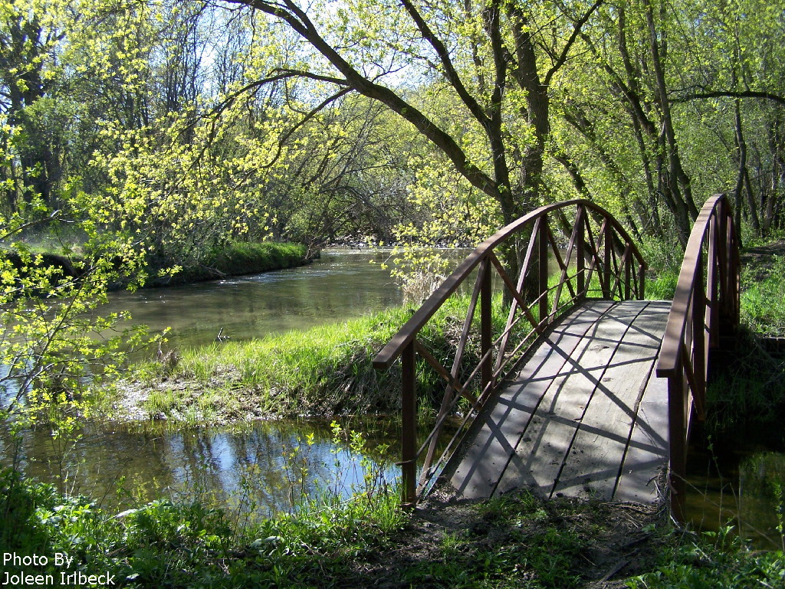
RCRCA 2017 Year-In-Review

Slide 2
Redwood-Cottonwood Rivers Control Area (RCRCA)
8 County and 8 SWCD Joint Powers Organization
pursuant to MN Statutes Section 471.59
Partner Counties:
Brown, Cottonwood, Lincoln, Lyon, Murray,
Pipestone, Redwood and Yellow Medicine
16 Member Board of Directors consisting of an appointed Commissioner and SWCD Supervisor from each county
Funding consists of $75,000
from county appropriations

Slide 3
RCRCA’s Mission Statement
RCRCA, in cooperation with partner groups and individual landowners, works to improve water quality, reduce erosion, and provide enhanced recreational opportunities by providing education, outreach, monitoring and technical assistance within the watershed boundaries.

Slide 4
RCRCA Board of Directors (Commissioner/SWCD Supervisor)
Brown County
Dennis Potter; Greg Roiger
Cottonwood County
Norman Holmen; Clark Lingbeek
Lincoln County
Joe Drietz; Glen Sorensen
Lyon County
Rick Anderson; Mark Meulebroeck
Murray County
Lori Gunnink; Paul Posthuma
Pipestone County
Luke Johnson; Arvin Pater
Redwood County
Lon Walling; Ed Carter
Yellow Medicine County
Glen Kack; Tom Remmele
* Executive Board Members

Slide 5
RCRCA Staff
Kerry Netzke, Executive Director
(4 years of service)
Joy Bruns, Office Manager
(7 years of service)
Bill Moldestad, PE, Watershed Engineer
(15 years of service)
Shawn Wohnoutka, Watershed Technician
(14 years of service)

Slide 6
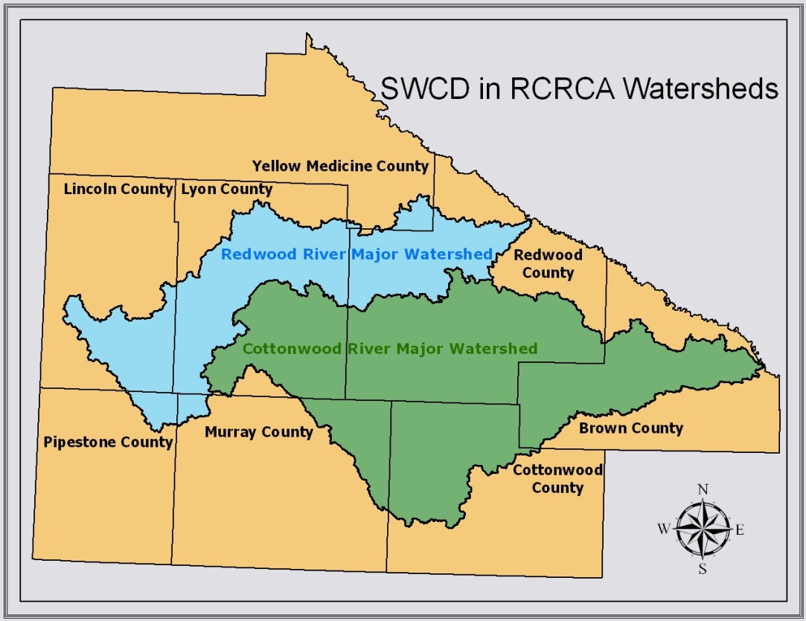
RCRCA
Cottonwood River watershed 838,200 acres Redwood River watershed 452,480 acres
TOTAL 1,290,680 acres
2,017 square miles

Slide 7
Activities
Determine watershed “Priority Areas” based on
GIS, research, and water quality assessments
Accelerate conservation adoption through securing additional funding for BMP cost share,
long-term monitoring, GIS/Outreach and
technical assistance
Track and report BMP successes,
re-evaluate priority areas, and re-focus efforts.

Slide 8
GRANTS
ENDED GRANTS:
Septic Loans (Cottonwood, Murray & Redwood Counties) 6/30/2017
ENDING GRANTS:
$301,024 Redwood River Turbidity Reduction Project (Ends 6/30/2018)
Cost share available: $5,695.77
CONTINUING GRANTS:
$142,257.66 Watershed Pollutant Load Monitoring Network (WPLMN) Grant for Redwood and Cottonwood Watersheds (Ends 6/30/2018, 2-year Amendment until 6/30/2020)
$75,605.17 Surface Water Assessment Grant (SWAG) for Redwood and Cottonwood River Watersheds (12/31/2018)
$77,000 pre-Watershed Restoration And Protection Strategies (WRAPS) Grant
Discovery Farms Minnesota (through 12/31/2023)

Slide 9
GRANTS
NEW GRANTS/AMENDMENTS:
$9,600 MN Department of Agriculture Pesticide Monitoring (2 years)
WPLMN Grant Amendment for Redwood and Cottonwood Watersheds (Ends 6/30/2018, 2-year Amendment until 6/30/2020)
WRAPS – Cottonwood River watershed
WRAPS – Redwood River watershed
GRANT APPLICATIONS:
$ 291,805 BWSR Clean Water Funds – to be announced 12/2017
Cost-share funding, along with administration and technical services, for:
10 WSCBs
4000’ of grassed waterways
1500’ of streambank stabilization
5 grade stabilizations
865 acres of Fall cover crops

Slide 10
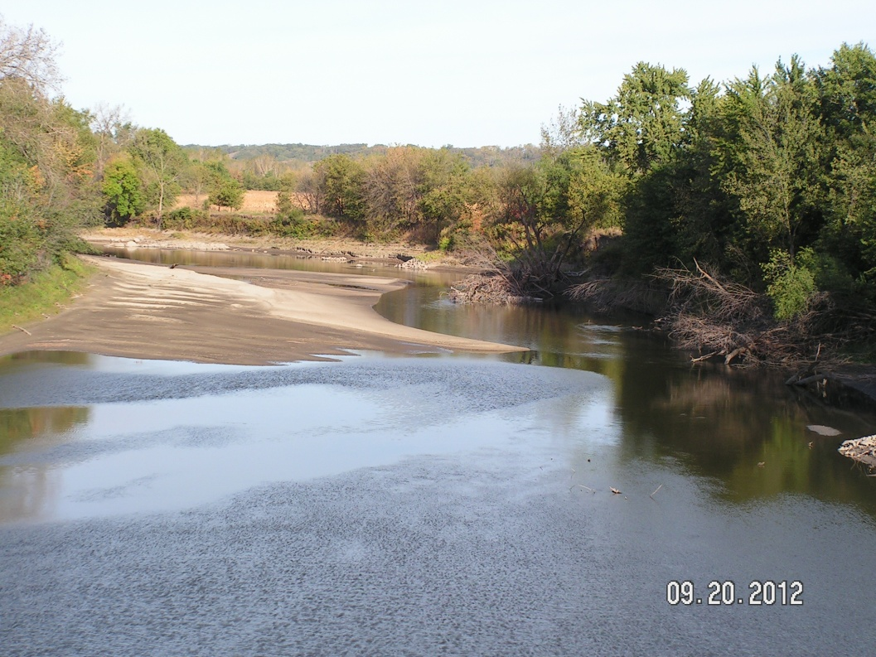
Water Quality Monitoring
Shawn Wohnoutka conducted sampling for 5 separate grants consisting of 799 samples taken in 2017.
(January through December)
192 samples for MPCA’s Watershed Pollutant Load Monitoring Network (WPLMN)
45 samples for MN Department of Agriculture for pesticide residue testing
393 samples for MPCA’s Surface Water Assessment Grant (SWAG)
119 samples for MPCA’s Watershed Restoration & Protection Strategies (WRAPS) Gap Samples
50 samples for Discovery Farms

Slide 11
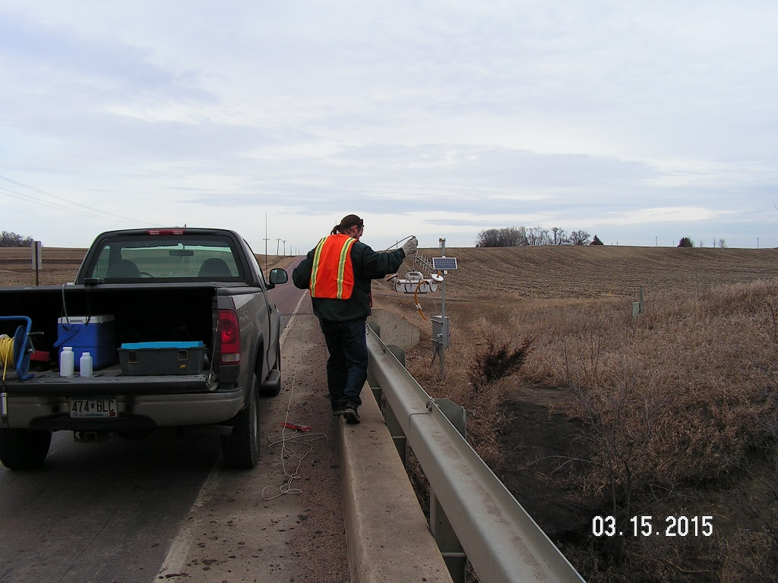
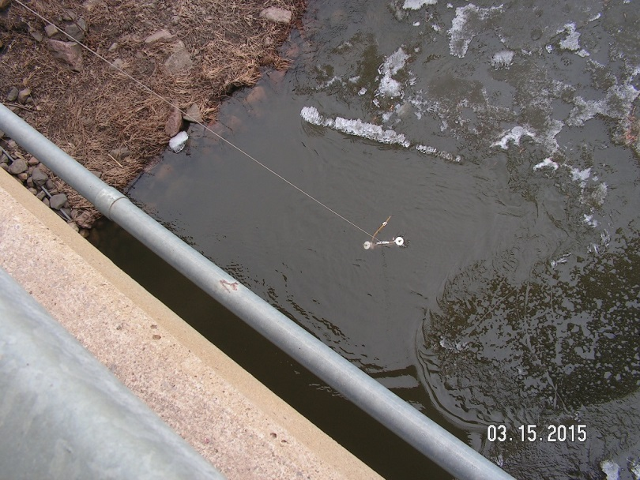
Stream Sampling
Lowering the VanDorn sampler vessel into the water
VanDorn Sampler

Slide 12
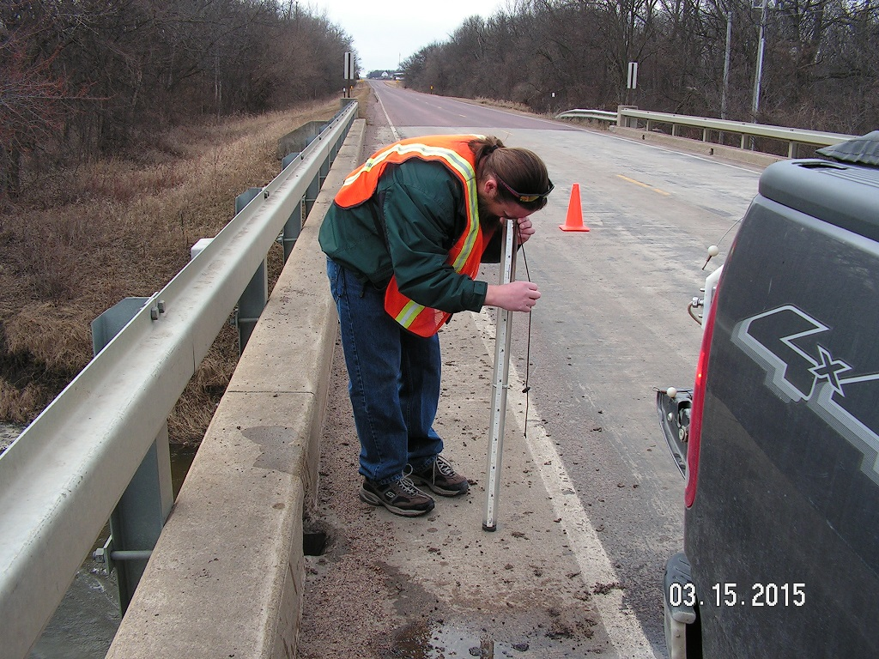
BELOW:
Obtaining the Transparency
Tube (T-Tube) reading which is an indicator of water clarity.
ABOVE:
Filling the sample
collection bottles

Slide 13
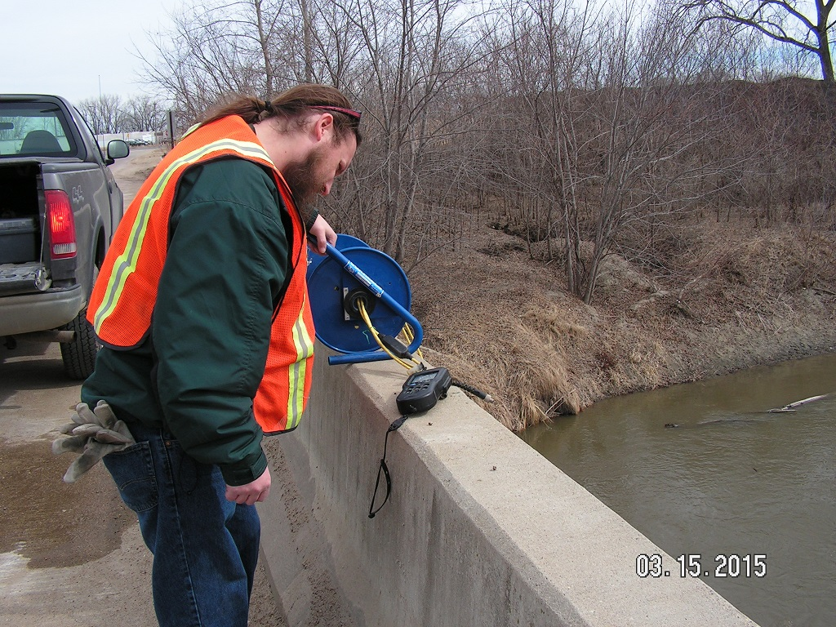
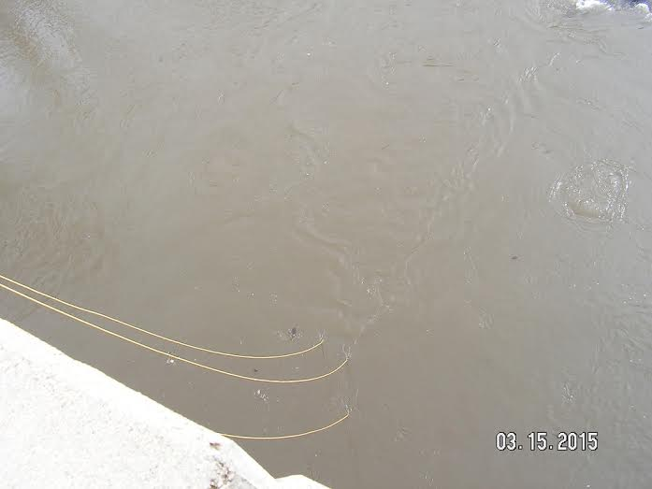
Reading the probes that measure the temperature, pH, dissolved oxygen and specific conductivity.

Slide 14
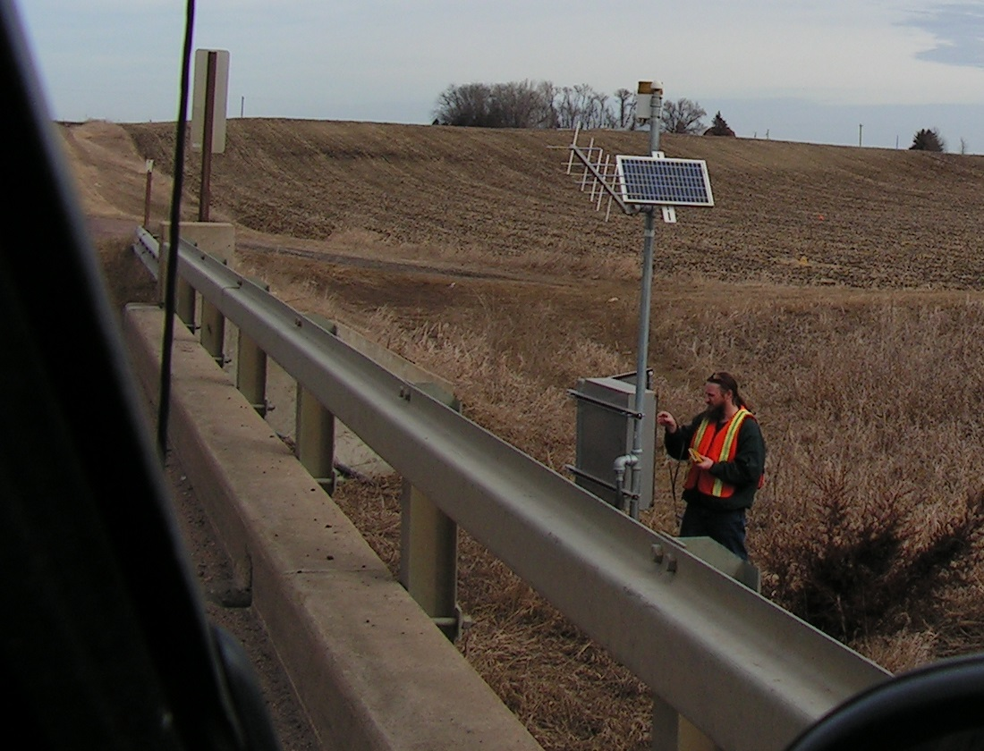
Checking the DNR staff gage which records the water surface elevation and flow.
4 of the 7 sites have a DNR staff gage.

Slide 15
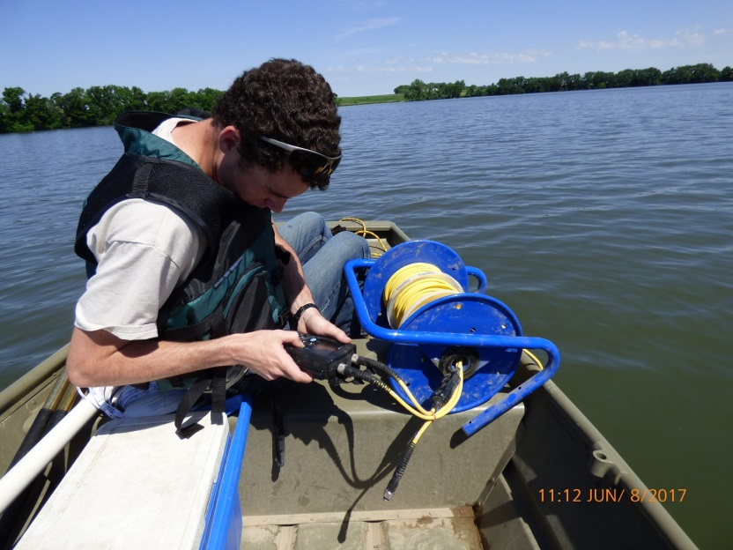
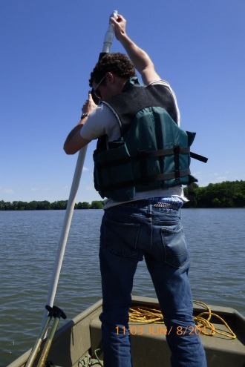
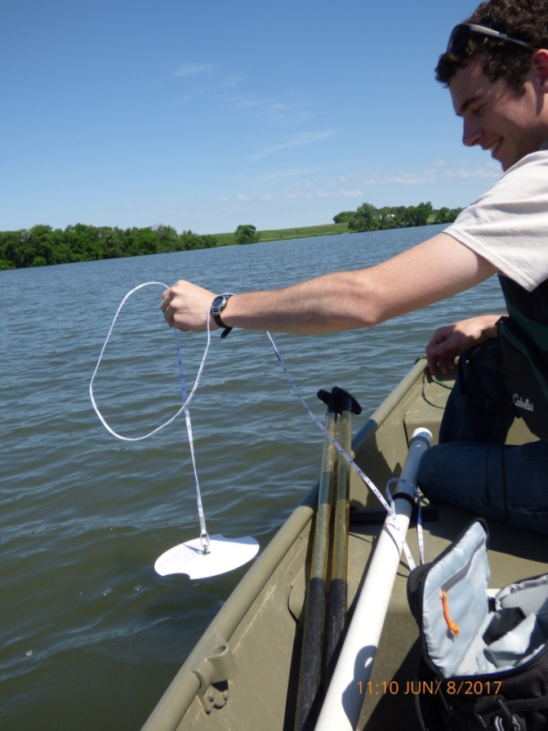
Lake Sampling
Lake Sampling

Slide 16
2017 Monitoring
MPCA’s Watershed Pollutant Load Monitoring Network (WPLMN) continues for the Redwood and Cottonwood watersheds.
Year-round storm-based stream sampling
• 3 sites in the Cottonwood River watershed
• 3 sites in the Redwood River watershed
• 1 site on the Minnesota River (Morton, MN)
peak
rising limb
falling limb
baseline

Slide 17
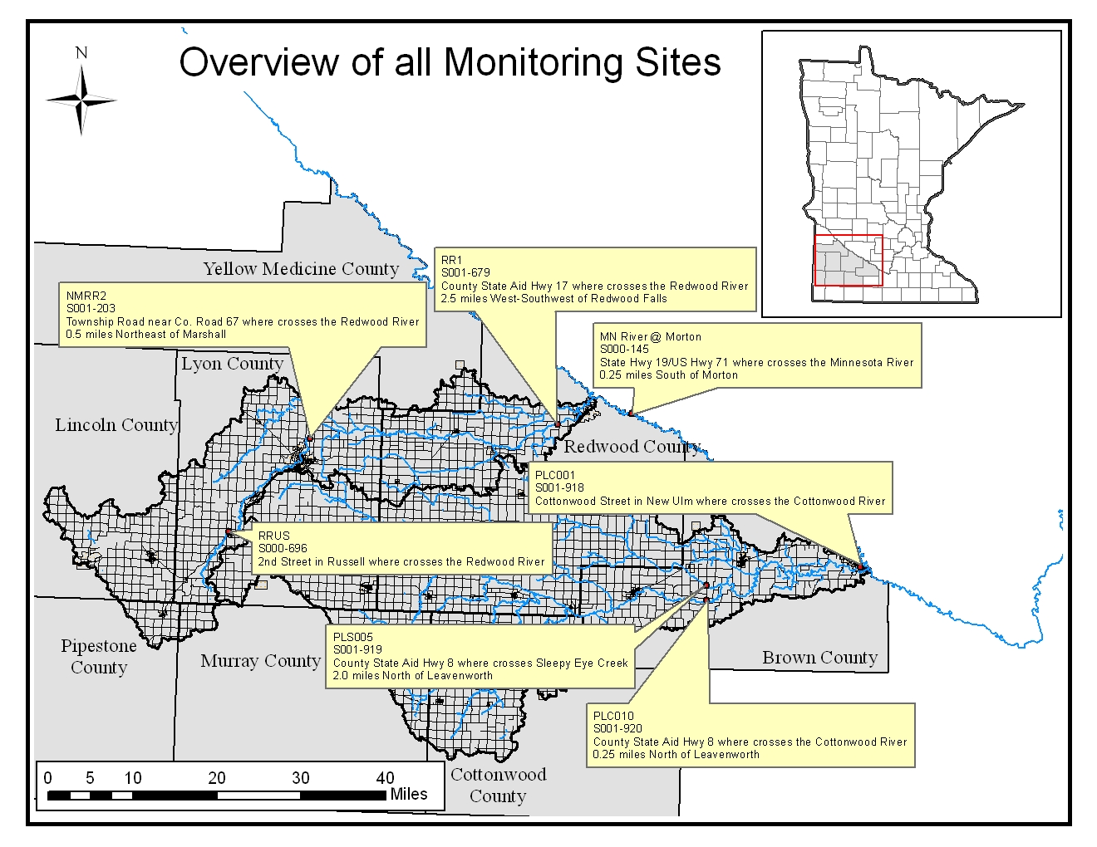
WPLMN MONITORING SITES
AIS

Slide 18
2017 Monitoring
MPCA’s Watershed Restoration and Protection Strategies (WRAPS) began March 2017 for the Redwood and Cottonwood watersheds.
2-Year Surface Water Assessment Grant (SWAG)
May thru September – 2-3 x month stream sampling
16 sites in the Cottonwood River watershed
8 sites in the Redwood River watershed
May thru September – 1 x month lake sampling
7 lakes in the Cottonwood River watershed
3 2 lakes in the Redwood River watershed

Slide 19
Brawner Lake – Feb. 2015
Lake was found to be 5-6 feet lower than normal.

Slide 20
A leak was discovered within the 84” metal conduit pipe.
The leak slowed and eventually healed itself allowing the lake level to stabilize.
Brawner Lake added to priority funding list by DNR Dam Safety Unit.

Slide 21
Brawner Lake – June 10, 2017

Slide 22
Lake was completely drained by June 21, 2017.

Slide 23
Metal conduit completely collapsed causing embankment failure.
2017 Bonding Bill included $350,000 for Brawner Lake.

Slide 26
Lakes over 500 acres in size are sampled by MPCA.

Slide 27
Brawner Lake
Lakes over 500 acres in size are sampled by MPCA.

Slide 28
2017 Monitoring
MPCA’s
Watershed Restoration and Protection Strategies (WRAPS)
2-Year “GAP” Monitoring
Intent is collect additional samples to supplement
the SWAG samples to ensure a satisfactory number
of samples for testing/assessment and prevent
“insufficient findings” in the WRAPS report.
May thru September – 2-3 x month stream sampling
6 sites in the Cottonwood River watershed
7 sites in the Redwood River watershed

Slide 29
2017 Monitoring
Minnesota Department of Ag’s Pesticide Monitoring
May thru August – storm-based stream sampling
Redwood River Watershed:
Three Mile Creek (Green Valley)
Redwood River (Redwood Falls)
Cottonwood River Watershed:
Sleepy Eye Creek (Leavenworth)
Cottonwood River (New Ulm)

Slide 30
MN Dept. Ag Monitoring Sites
Three Mile Creek
near Green Valley

Slide 31
2017 Monitoring
Discovery Farms Minnesota is a farmer-led effort to gather field scale water quality information from different types of farming systems, in landscapes all across Minnesota.
The mission of the Discovery Farms program is to gather water quality information under real-world conditions. The goal is to provide practical, credible, site-specific information to enable better farm management.
The program is designed to collect accurate measurements of sediment, nitrogen and phosphorus movement over the soil surface and through subsurface drainage tiles. This work leads to a better understanding of the relationship between agricultural management and water quality.

Slide 32
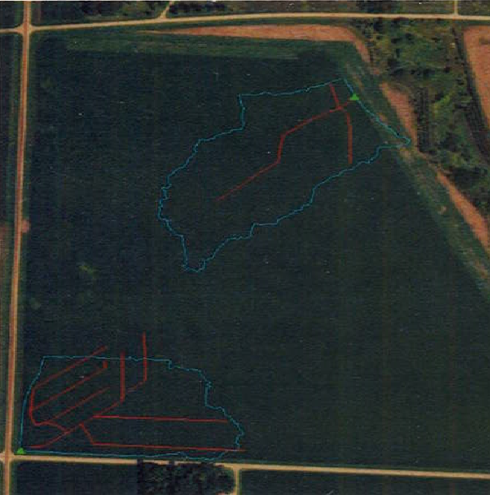
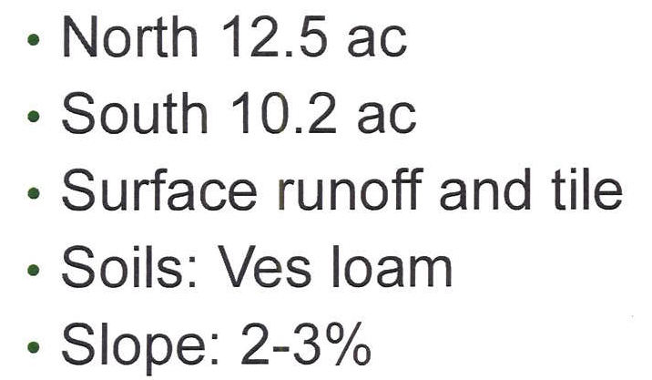
Discovery Farms MN

Slide 33
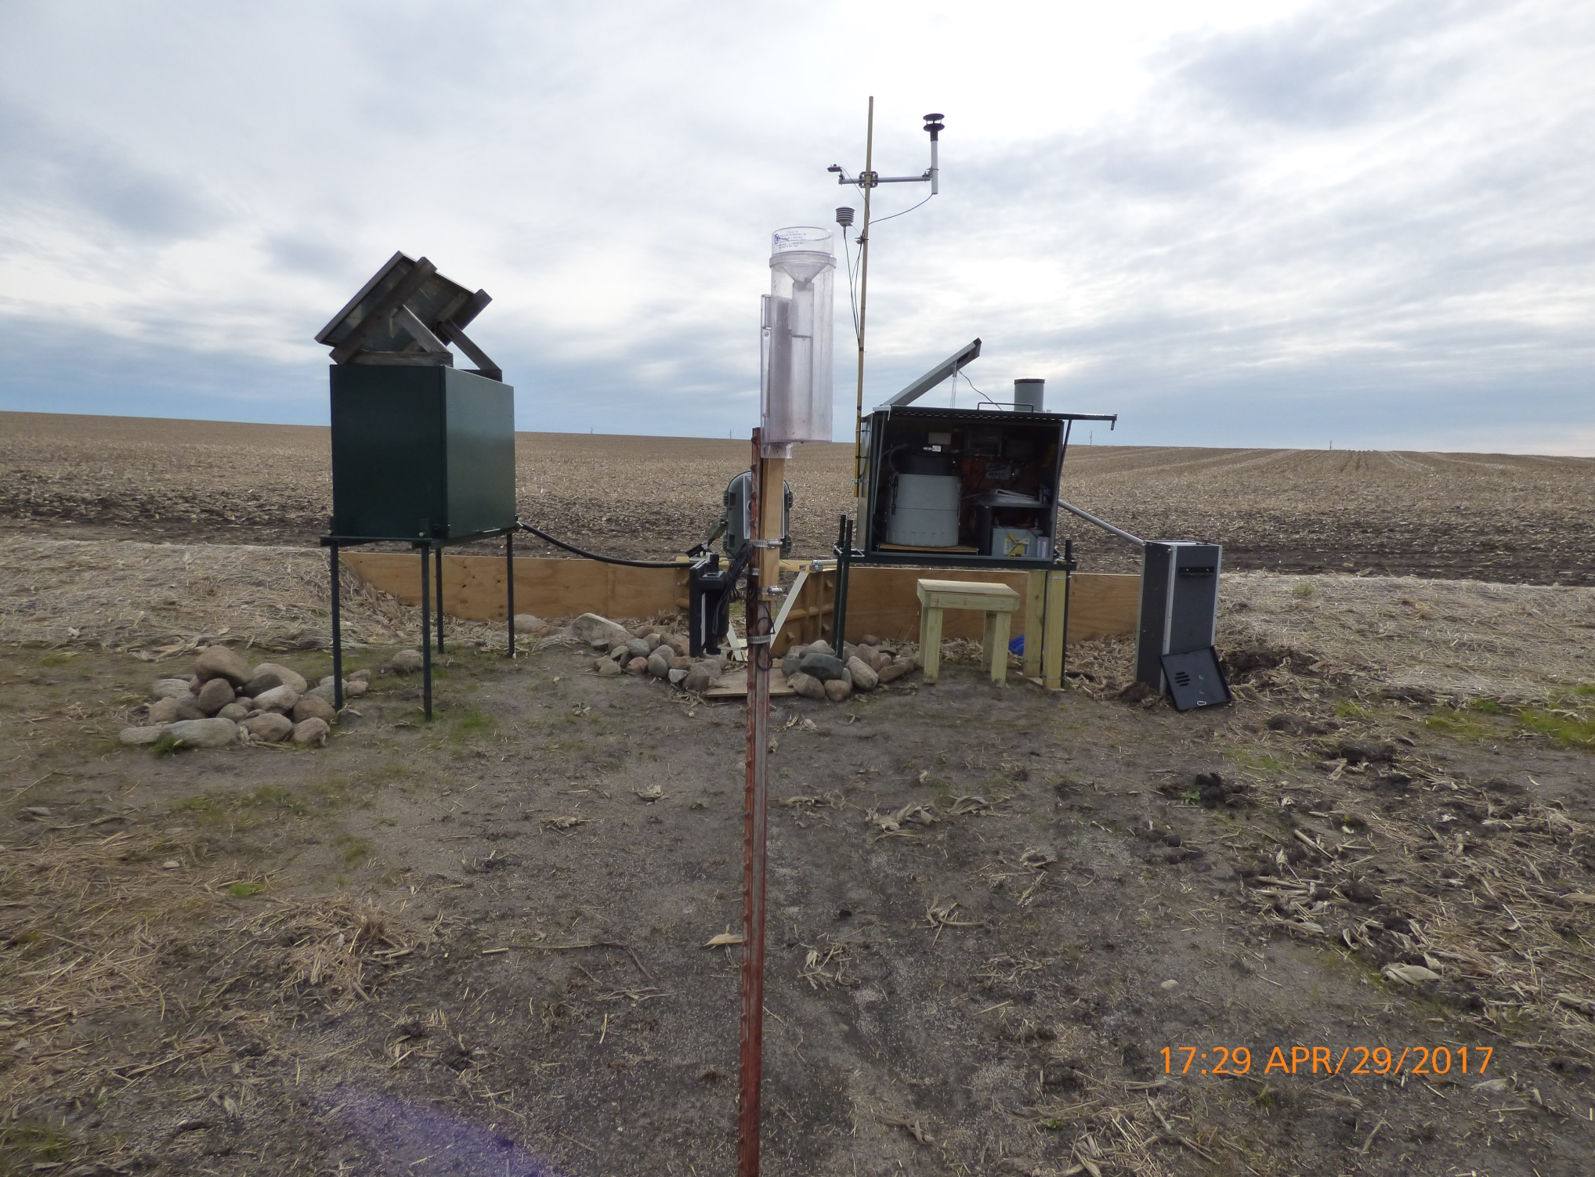
North site

Slide 34
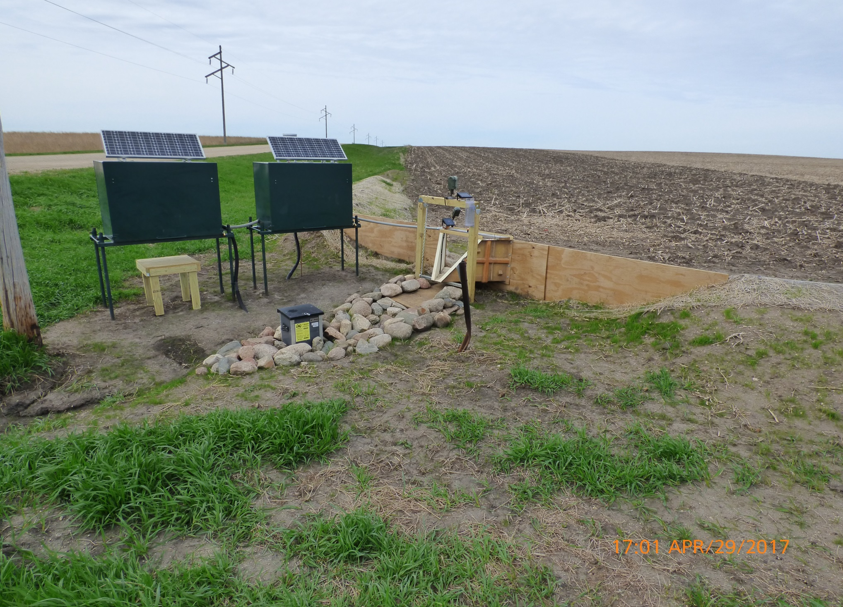
South site

Slide 35
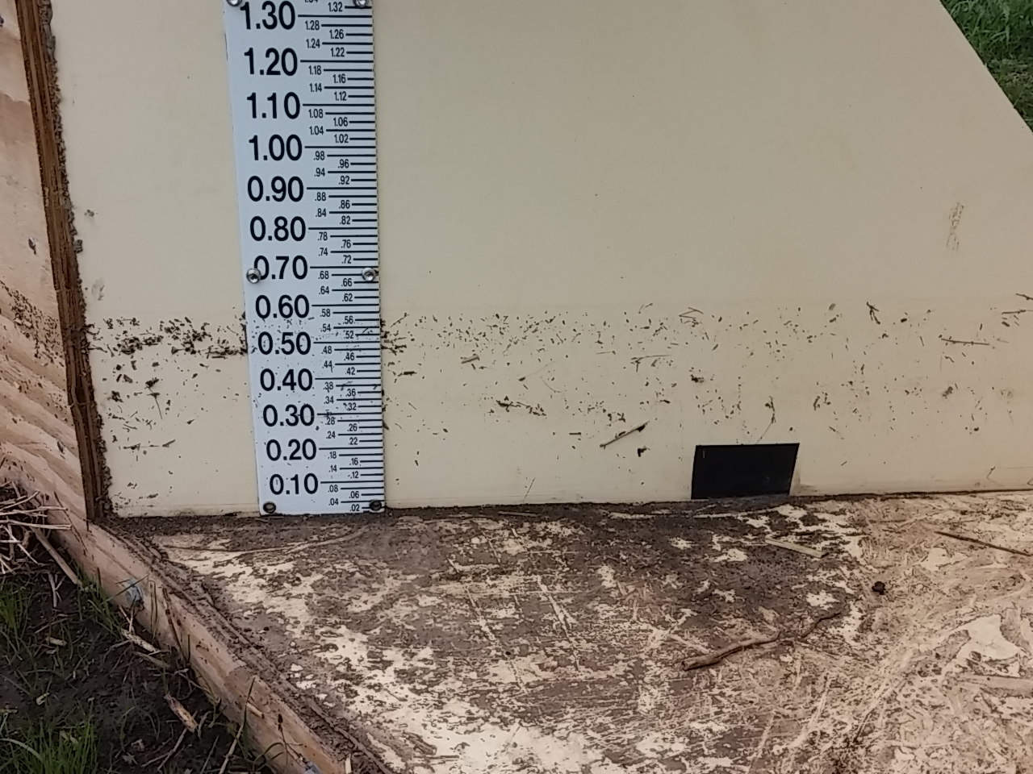
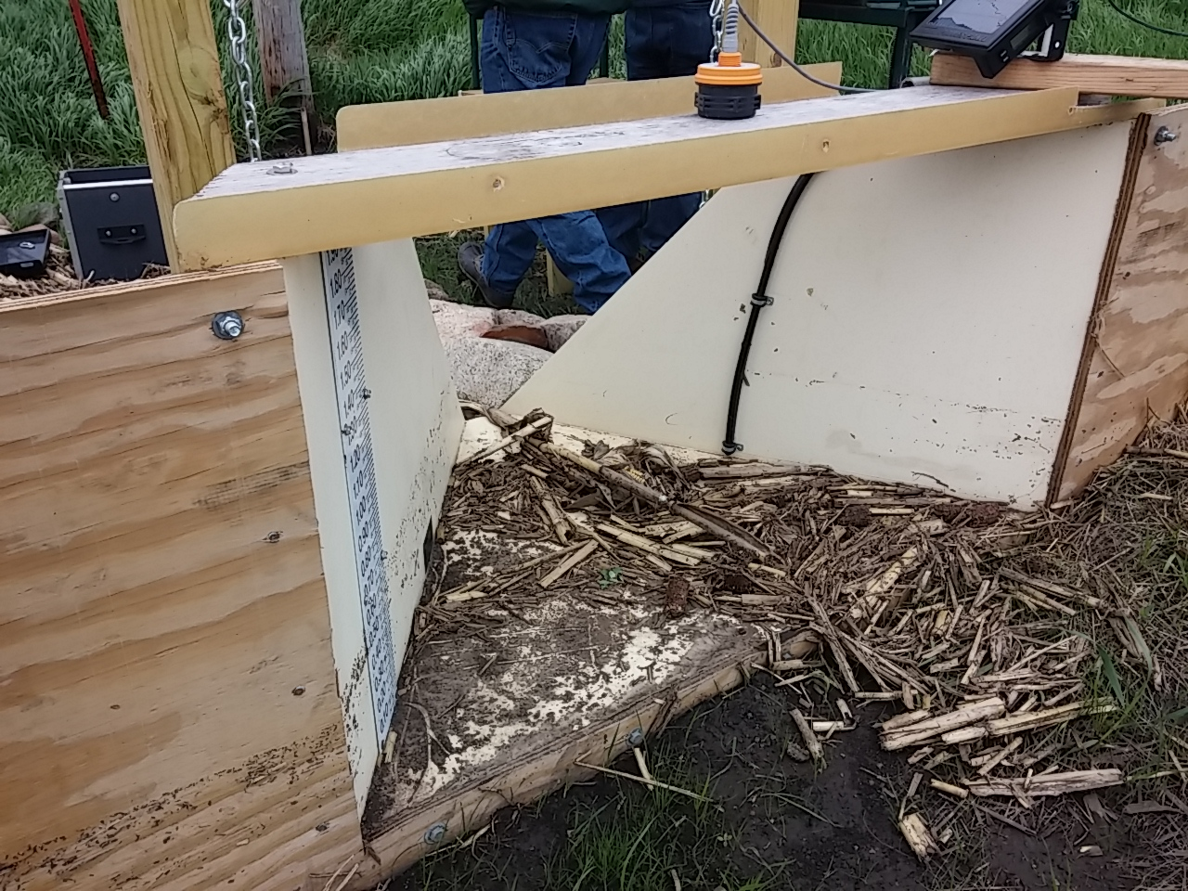
For more information:
https://discoveryfarmsmn.org

Slide 36
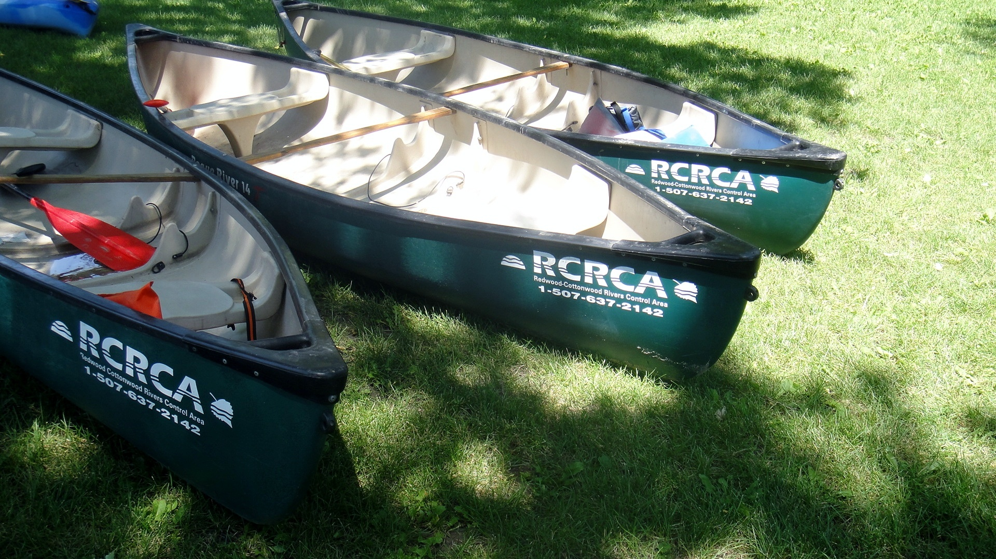
2017 Outreach Activities

Slide 37
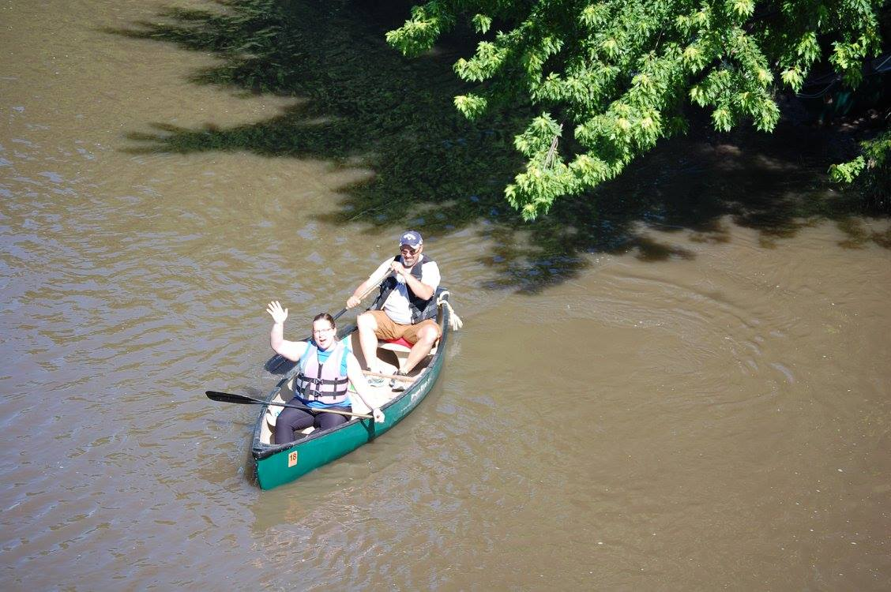
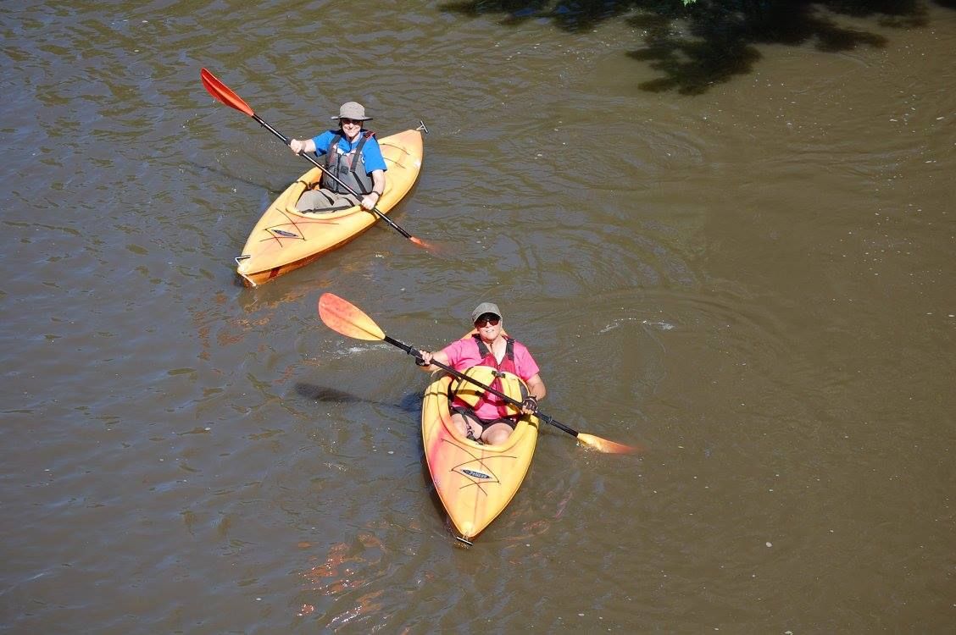
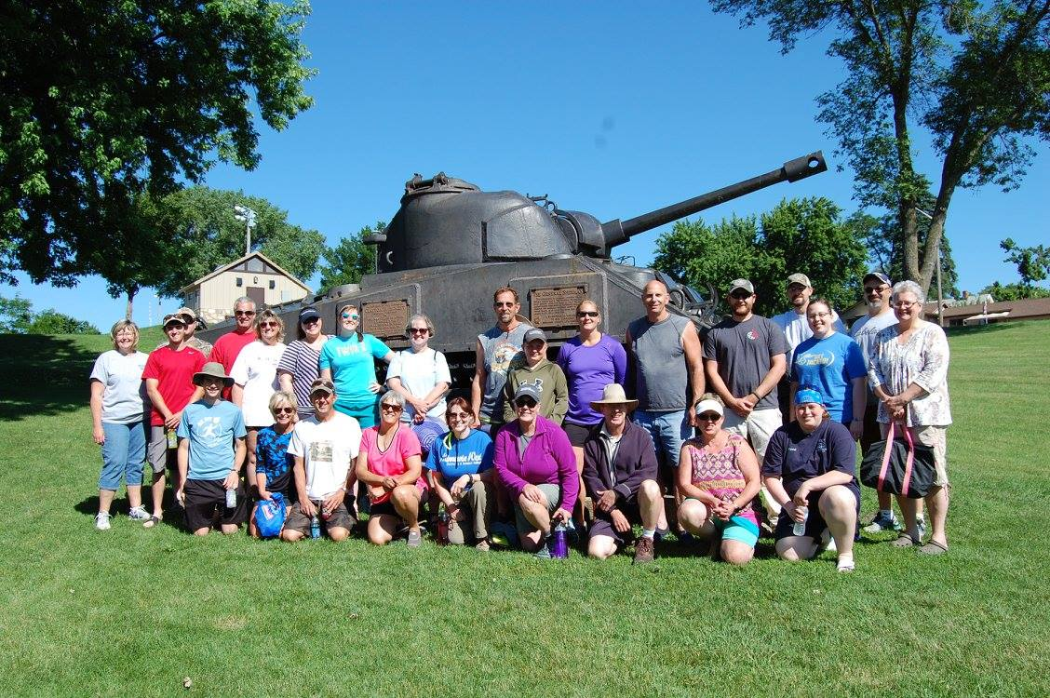
Redwood River Canoe Trip

Slide 38
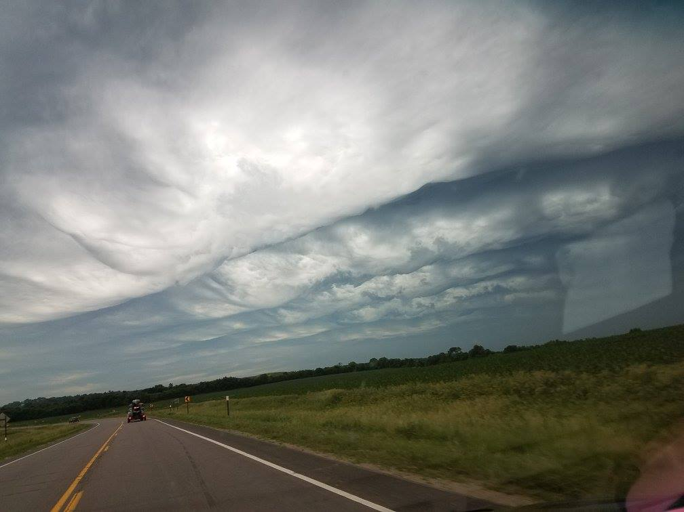
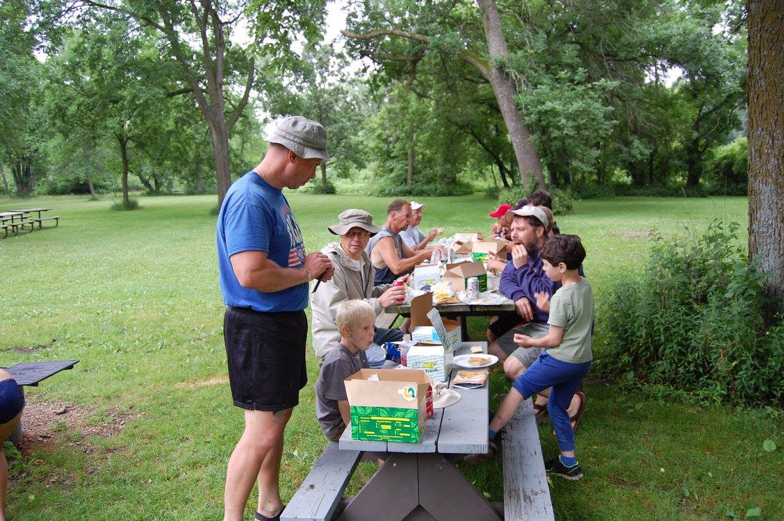
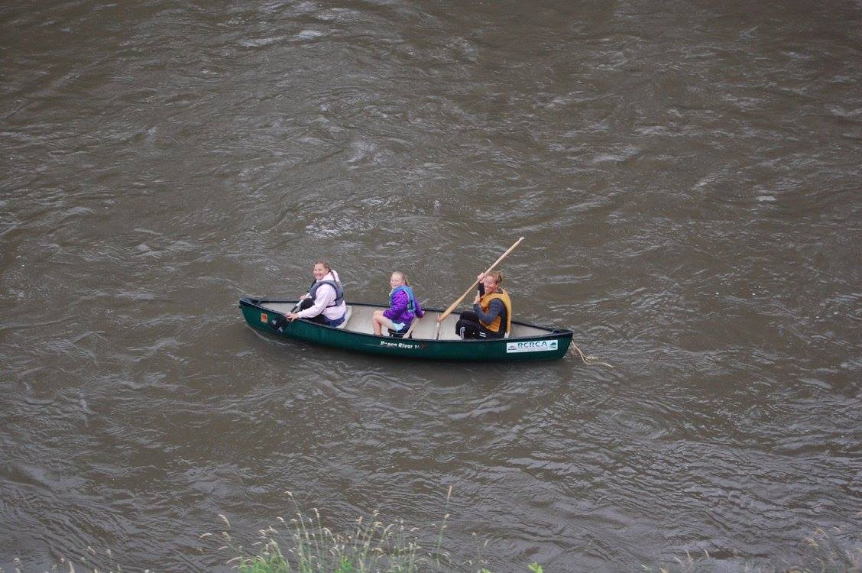
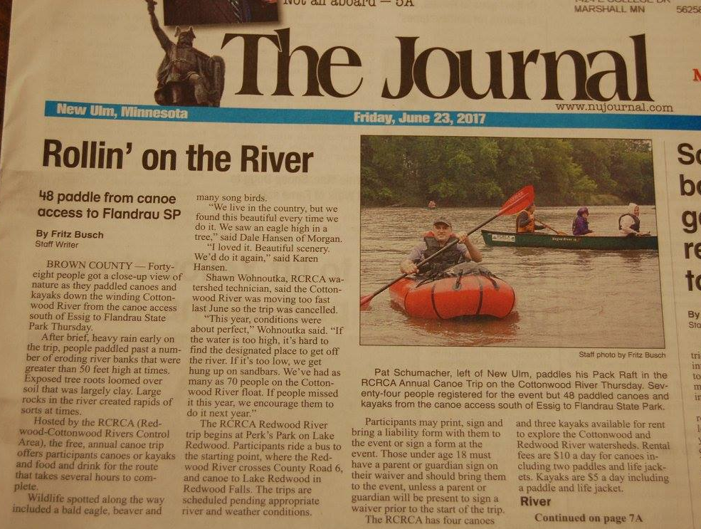
Cottonwood River Canoe Trip

Slide 39
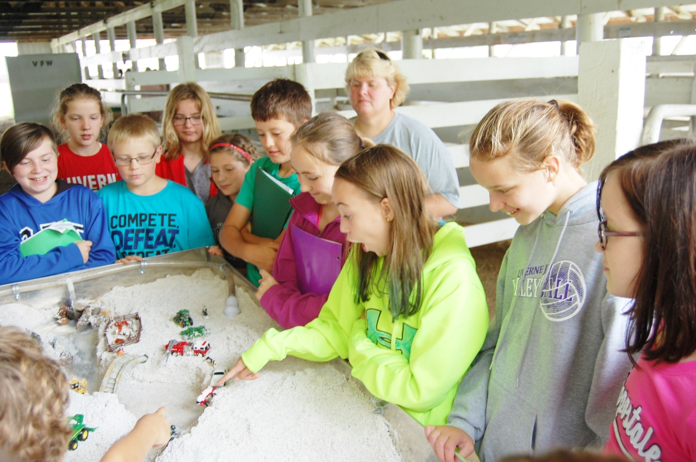
SW Minnesota Environmental Fair
The Environmental Fair gathers 5th and 6th grade students from an 11-county area. The 2-day event provides a fun-filled learning about the world around us through demonstrations and student participation.
Some of the topics covered include: trees, native prairie, ground and surface water, soils, wetlands, watersheds, wildlife and much more!
In 2017, 306 students visited RCRCA’s stream table exhibit.
Shawn speaks about different kinds of pollution and what can be done to protect our land and water.
The stream table shows in 5 minutes the erosion that can happen over a period of 30 years or more.

Slide 40
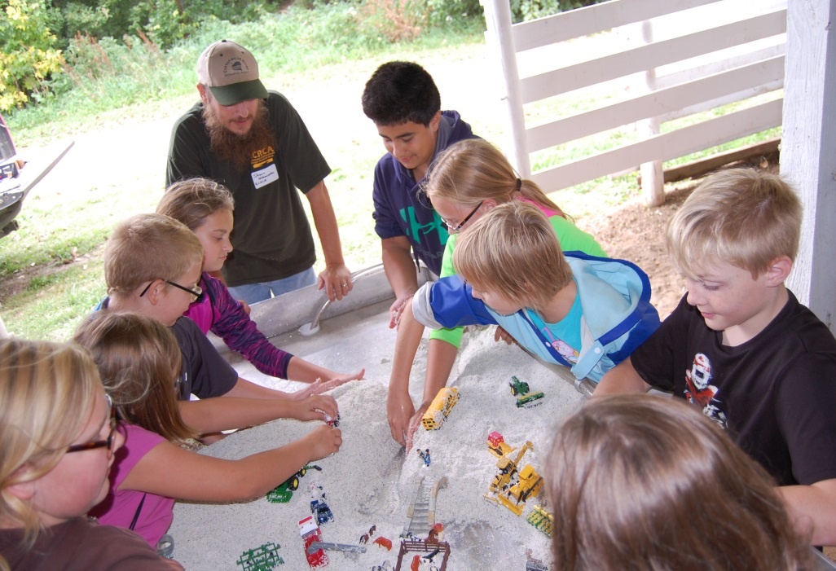
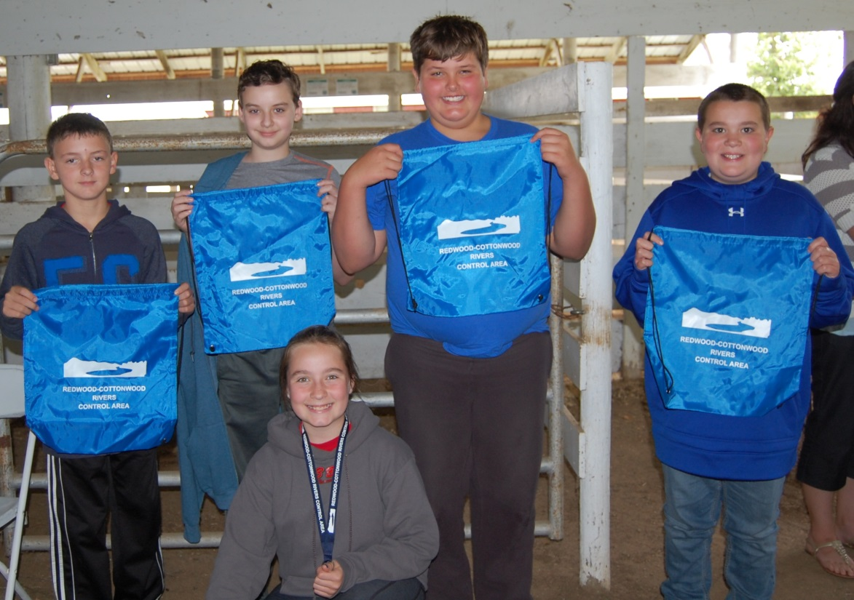
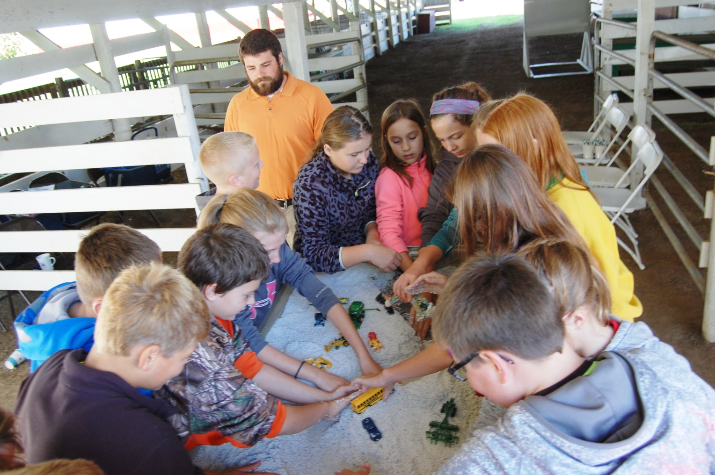
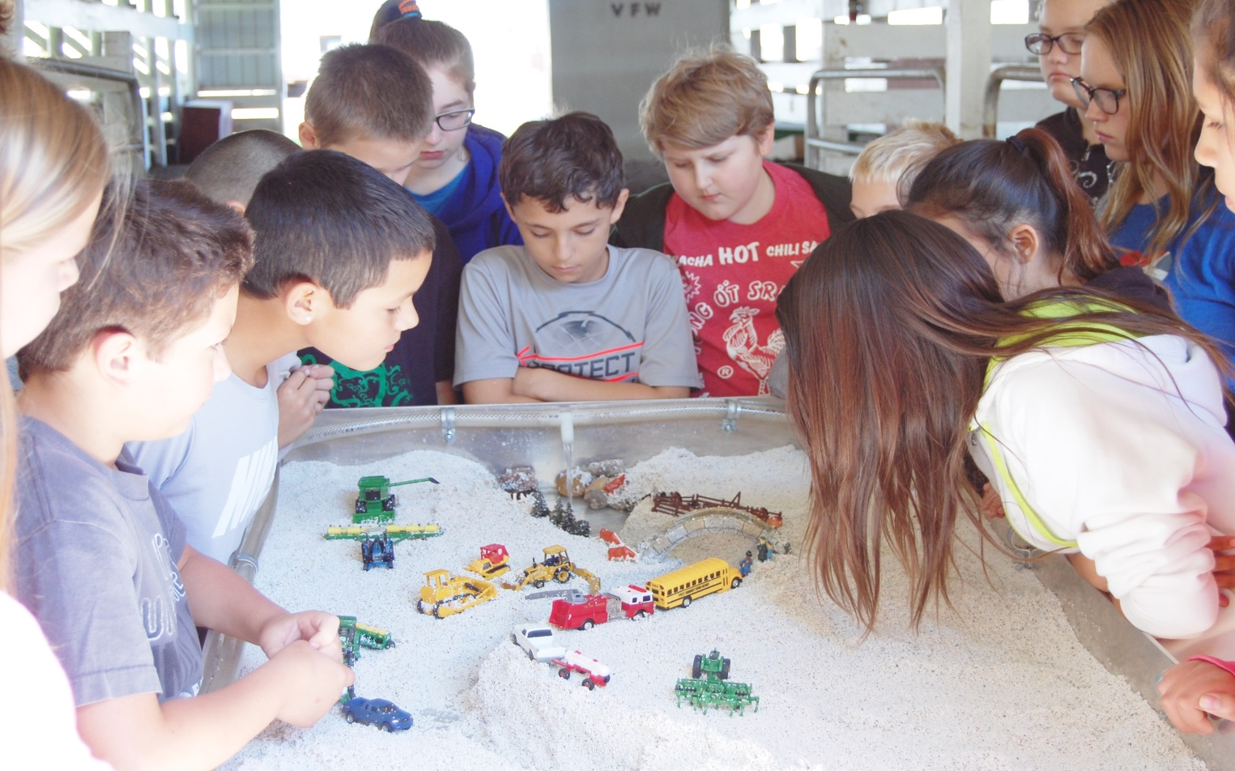

Slide 41
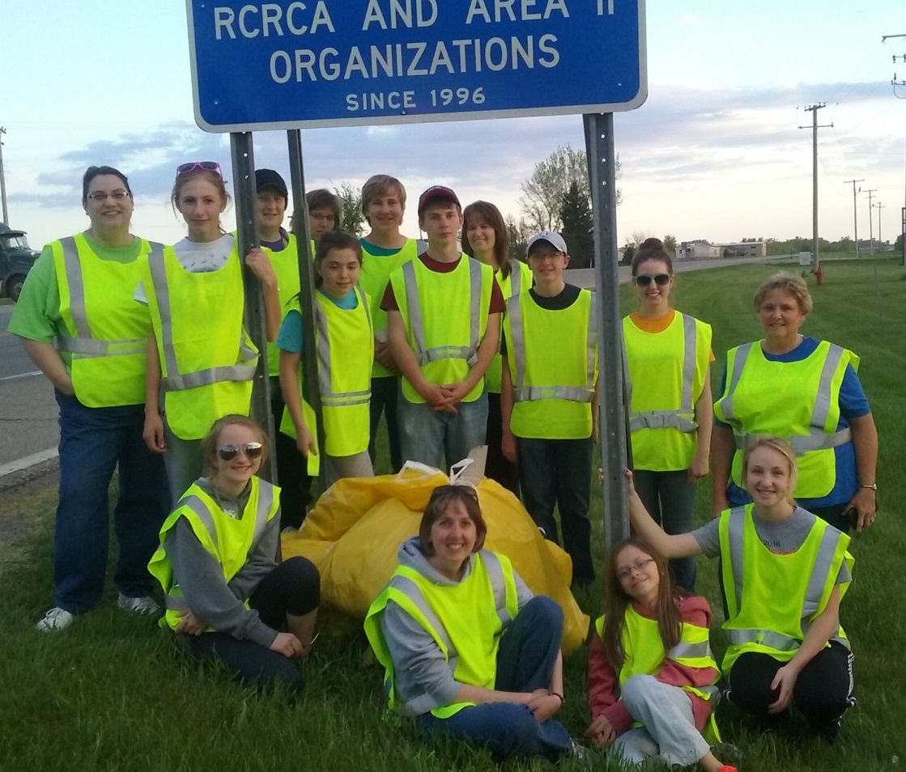
Adopt-A-Highway
In 2017, the St. Matthew Lutheran Youth Group of Wabasso assisted with the clean up effort of the
2-mile stretch of Hwy 19 near Vesta, MN.
RCRCA and Area II proudly presented the group with a $400 donation.

Slide 42
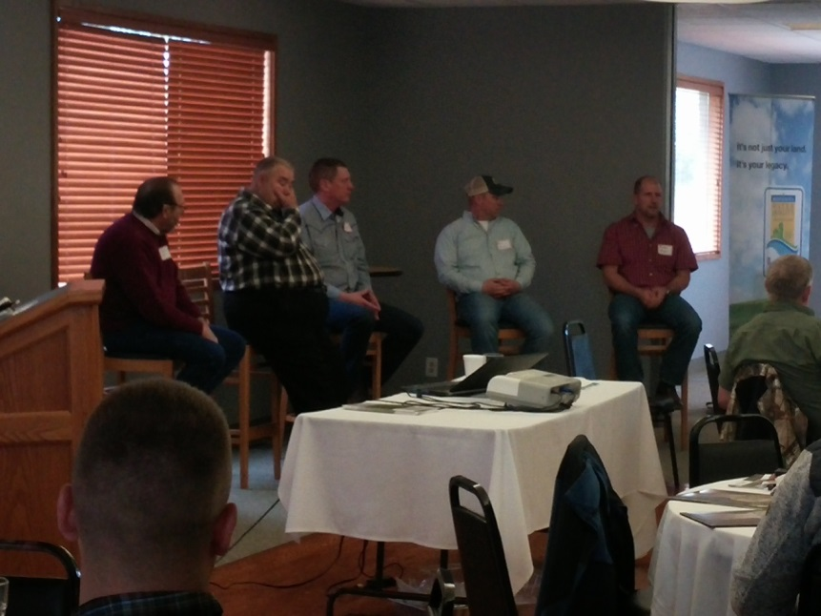
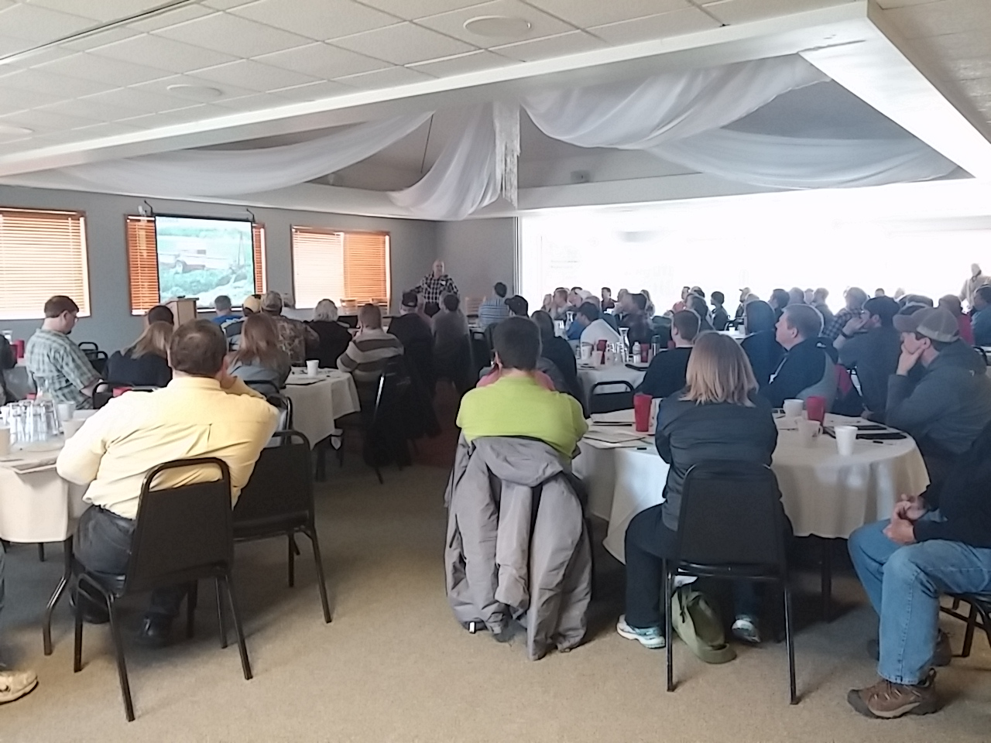
Soil Health Workshop
Co-Sponsors:
NRCS
YMRWD
Saddle Butte Ag, Inc.
Millborn Seeds, Inc.
Prairie Creek Seed
Lincoln, Murray, Lyon SWCDs
MN Grazing Lands Conservation Association
Lyon County Corn Growers Association

Slide 43
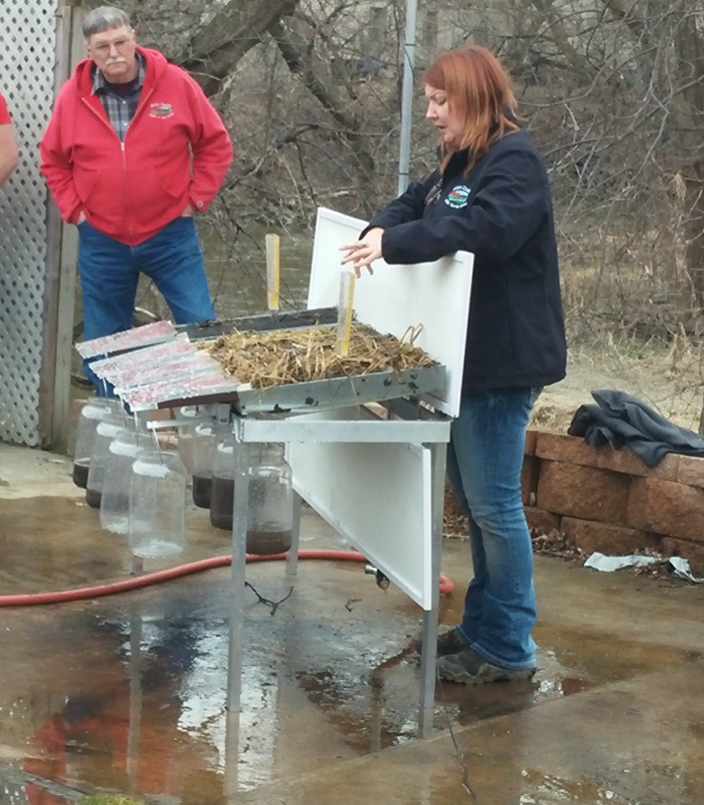
Soil Health Workshop Rainfall Simulator
BEFORE 1” of rainfall added AFTER

Slide 44
For more information about RCRCA, check out our website at www.rcrca.com
THANK YOU for your continued support of both organizations!

