Slide 1
THE BIG PICTURE:
PRODUCING AND DIRECTING
YOUR MARCHING BAND PROGRAM
Ken Snoeck kpsnoeck@comcast.net
Pamela Snoeck pamelasnoeck@comcast.net
#imec2017

Slide 2
Producer:
[pruh-doo-ser, -dyoo-]
a person responsible for all of the financial, administrative, and managerial aspects of a stage, film, television, radio or marching band production;

Slide 3
Director:
[dih-rek-ter, dahy-]
the person responsible for the interpretive aspects of a stage, film, television, or marching band production;
the person who supervises the integration of all the elements, as acting, staging, music and movement, required to realize and communicate the writer's conception

Slide 4
AND MOST IMPORTANTLY…
The person who creates an environment
were the talents of the
Cast and the Crew can flourish!

Slide 5
Step 1: Assess Your Resources Realistically
Winds Percussion Guard
Dancers Singers Equipment
Rehearsal Space Rehearsal Time
Administrative Support & Expectations
Community Support and Expectations
Financial Resources

Slide 6
Realistically Assess
Your Strengths and Those of Your Staff
Arranging Ability Drill Design Ability
Choreographer(s) for Equipment, Dance and Movement
Music, Movement, and Guard Technicians

Slide 7
Deciding on a Concept
Essential Preliminary Questions:
What is my band’s identity?
Where are we in the taxonomy?
What is my band’s audience? (For whom are we designing?)

Slide 8
Where Do You Get Your Ideas?

Slide 9
As you Fine Tune your Possible Ideas,
Ask Yourself:
Will this generate emotion from the audience?

Slide 10
As you Fine Tune your Possible Ideas,
Ask Yourself:
Will this generate emotion from the audience?
Is it interesting and relevant?

Slide 11
As you Fine Tune your Possible Ideas,
Ask Yourself:
Will this generate emotion from the audience?
Is it interesting and relevant?
Is it appropriate?

Slide 12
As you Fine Tune your Possible Ideas,
Ask Yourself:
Will this generate emotion from the audience?
Is it interesting and relevant?
Is it appropriate?
Is it practical?

Slide 13
As you Fine Tune your Possible Ideas,
Ask Yourself:
Will this generate emotion from the audience?
Is it interesting and relevant?
Is it appropriate?
Is it practical?
Is the music copyright license available?

Slide 14
Do you need a “story” to have it understood?

Slide 15
Do you need a “story” to have it understood?
Has it been done before? If so, add your own spin to it.

Slide 16
Do you need a “story” to have it understood?
Has it been done before? If so, add your own spin to it.
Does it contain the potential for a visual “hook?”

Slide 17
Do you need a “story” to have it understood?
Has it been done before? If so, add your own spin to it.
Does it contain the potential for a visual “hook?”
Is there a quantity of material available?

Slide 18
Do you need a “story” to have it understood?
Has it been done before? If so, add your own spin to it.
Does it contain the potential for a visual “hook?”
Is there a quantity of material available?
Will my students connect with the concept?

Slide 19
Some Sample Concepts From The Mummers Parade
CONCEPT: “THE EXPERIMENT”
GROUP: Greater Kensington
Set in a science lab with Doc Moyer and lab assistants, Frankenstein, very large lab rats, minions, and aliens with big brains
Tunes include “Back to the Future”, “Can You Read My Mind”,
Props include lasers, a flux capacitor, a giant brain, a giant X-ray, and a DeLorean

Slide 20
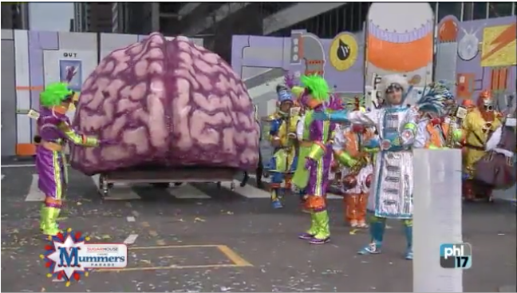
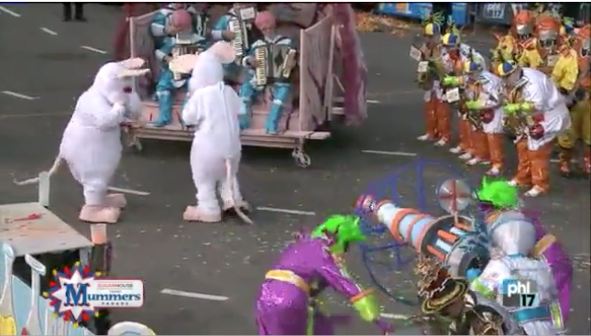

Slide 21
CONCEPT: “THE PERFECT SWARM”
GROUP: Quaker City String Band
Bugs get their due here – performers dressed as blue, black and red ants, mosquitoes, lightning bugs and grasshoppers, bees with their queen
Music includes “Flight of the Bumblebee”, “Summertime”, and “Rhapsody in Blue”
Props include bug zappers and a tap dancing tarantula

Slide 22


Slide 23
The Turn & Talk Activity
Turn to the person closest to you. This is your “Turn & Talk” partner.
Here is how it goes:
Take turns with one person speaking at a time. Listen carefully, as you may need to share your partner’s comment with the group.

Slide 24
Turn & Talk Activity
Think about your past (or future) experience deciding on a show concept.
Considering the questions to ask when fine tuning your concept, what is the most difficult part for you and your staff?
Please share with your Turn & Talk partner. Remember to use good listening techniques.

Slide 25
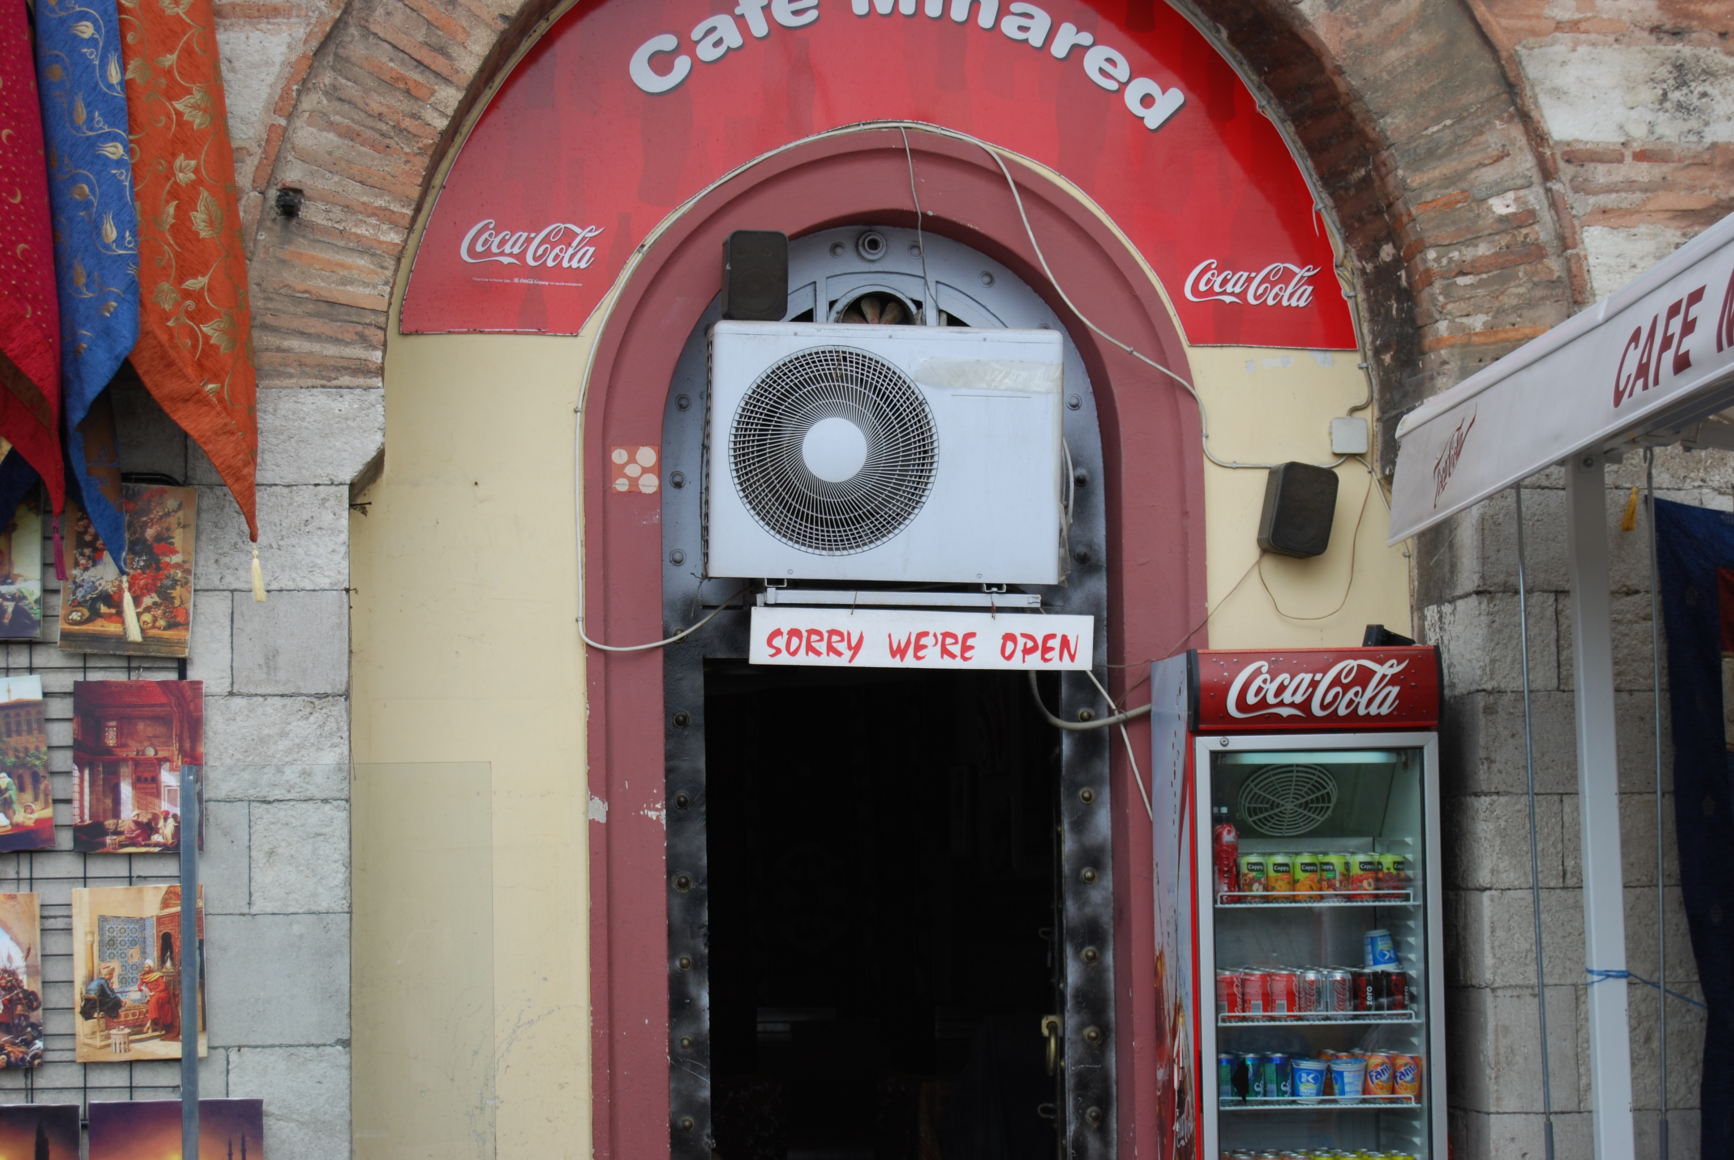
HOW WELL DO YOU COMMUNICATE YOUR VISION?

Slide 26
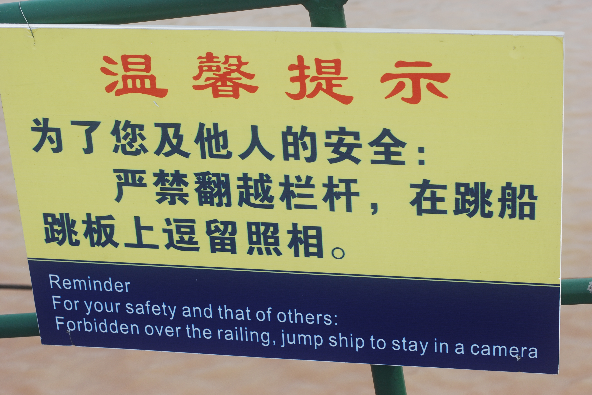

Slide 27
Create a Production Schedule and
Get Items into a Calendar
Music arrangements for Winds – Get Permission Early, then arrange Percussion/Pit parts

Slide 28
Create a Production Schedule and
Get Items into a Calendar
Music arrangements for Winds – Get Permission Early, then arrange Percussion/Pit parts
Discussions re the Details – Props (function, design and placement), costumes for guard, uniform adjustments for wind/percussion, flag designs, alternate equipment

Slide 29
Create a Production Schedule and
Get Items into a Calendar
Music arrangements for Winds – Get Permission Early, then arrange Percussion/Pit parts
Discussions re the Details – Props (function, design and placement), costumes for guard, uniform adjustments for wind/percussion, flag designs, alternate equipment
Discussions re drill/staging Details - ideas for placement, section staging, the when and how of equipment changes, moments of any major special effects, (including forms and choreography)

Slide 30
Discussion of any special skills that need to be developed – dance, gymnastics, martial arts, etc.

Slide 31
Discussion of any special skills that need to be developed – dance, gymnastics, martial arts, etc.
Communicate ALL of items 2-3-4 with the drill designer BEFORE he/she begins the writing process – and then hold them accountable!

Slide 32
Discussion of any special skills that need to be developed – dance, gymnastics, martial arts, etc.
Communicate ALL of items 2-3-4 with the drill designer BEFORE he/she begins the writing process – and then hold them accountable!
Staff PD or Need for Additional Personnel – secure additional support as needed as soon as you know what you are looking for

Slide 33
Discussion of any special skills that need to be developed – dance, gymnastics, martial arts, etc.
Communicate ALL of items 2-3-4 with the drill designer BEFORE he/she begins the writing process – and then hold them accountable!
Staff PD or Need for Additional Personnel – secure additional support as needed as soon as you know what you are looking for
Plan for the distribution of all materials to students well before band camp

Slide 34
Coordinate with Choreographer to start getting equipment/dance skills taught. Even without drill pages, you have already decided where performers will be stationary, so work and dance can be written and taught.

Slide 35
Coordinate with Choreographer to start getting equipment/dance skills taught. Even without drill pages, you have already decided where performers will be stationary, so work and dance can be written and taught.
Incorporate all types of movement that will be in the show into your marching basics’ block from the start

Slide 36
Coordinate with Choreographer to start getting equipment/dance skills taught. Even without drill pages, you have already decided where performers will be stationary, so work and dance can be written and taught.
Incorporate all types of movement that will be in the show into your marching basics’ block from the start
Share the concept with the students and what they need to do communicate that concept with the audience

Slide 37
Turn & Talk Activity
Think about your past (or future) experience planning your “production schedule” and where in the process do you think you and your staff might have gotten derailed.
What are you going do to differently so that might not happen again?
Please share with your Turn & Talk partner. Remember to use good listening techniques.

Slide 38
Rehearsing and Detailing the Program
Have a rehearsal PLAN. Share the plan with everyone. Put it on the board. Follow the plan.

Slide 39
Rehearsing and Detailing the Program
Have a rehearsal PLAN. Share the plan with everyone. Put it on the board. Follow the plan.
All the Staff all the time! Everyone has the responsibility for everything! Any staff should address any problem in any section.

Slide 40
When shaping the show, don’t be afraid to EDIT, EDIT, EDIT!
* Often times, less is more
* Nothing is written in stone
* No matter who wrote/designed/choreographed it,
make it work for your students in your situation
* There is no high art with poor performance

Slide 41
3. When shaping the show, don’t be afraid to EDIT, EDIT, EDIT!
* Often times, less is more
* Nothing is written in stone
* No matter who wrote/designed/choreographed it,
make it work for your students in your situation
* There is no high art with poor performance
4. Filter the feedback you get – avoid kneejerk reactions

Slide 42
3. When shaping the show, don’t be afraid to EDIT, EDIT, EDIT!
* Often times, less is more
* Nothing is written in stone
* No matter who wrote/designed/choreographed it,
make it work for your students in your situation.
* There is no high art with poor performance
4. Filter the feedback you get – avoid kneejerk reactions
Making it better takes planning to make it better – edit the score and “script” to emphasize those dramatic moments

Slide 44
If everything has emphasis,
then nothing has emphasis.
Contrast is a big part of creating interest.

Slide 45
Lastly, Some Final Points to Consider…
The parts of your show, when combined, need to take the audience on a journey.
All of the parts have to have relevance to that journey; otherwise, they interrupt or derail the process.

Slide 46
You need to be the
Band Director!
It all begins and ends with you.

Slide 47
Remember…
Even the very best don’t get it ALL right the first time!

Slide 48
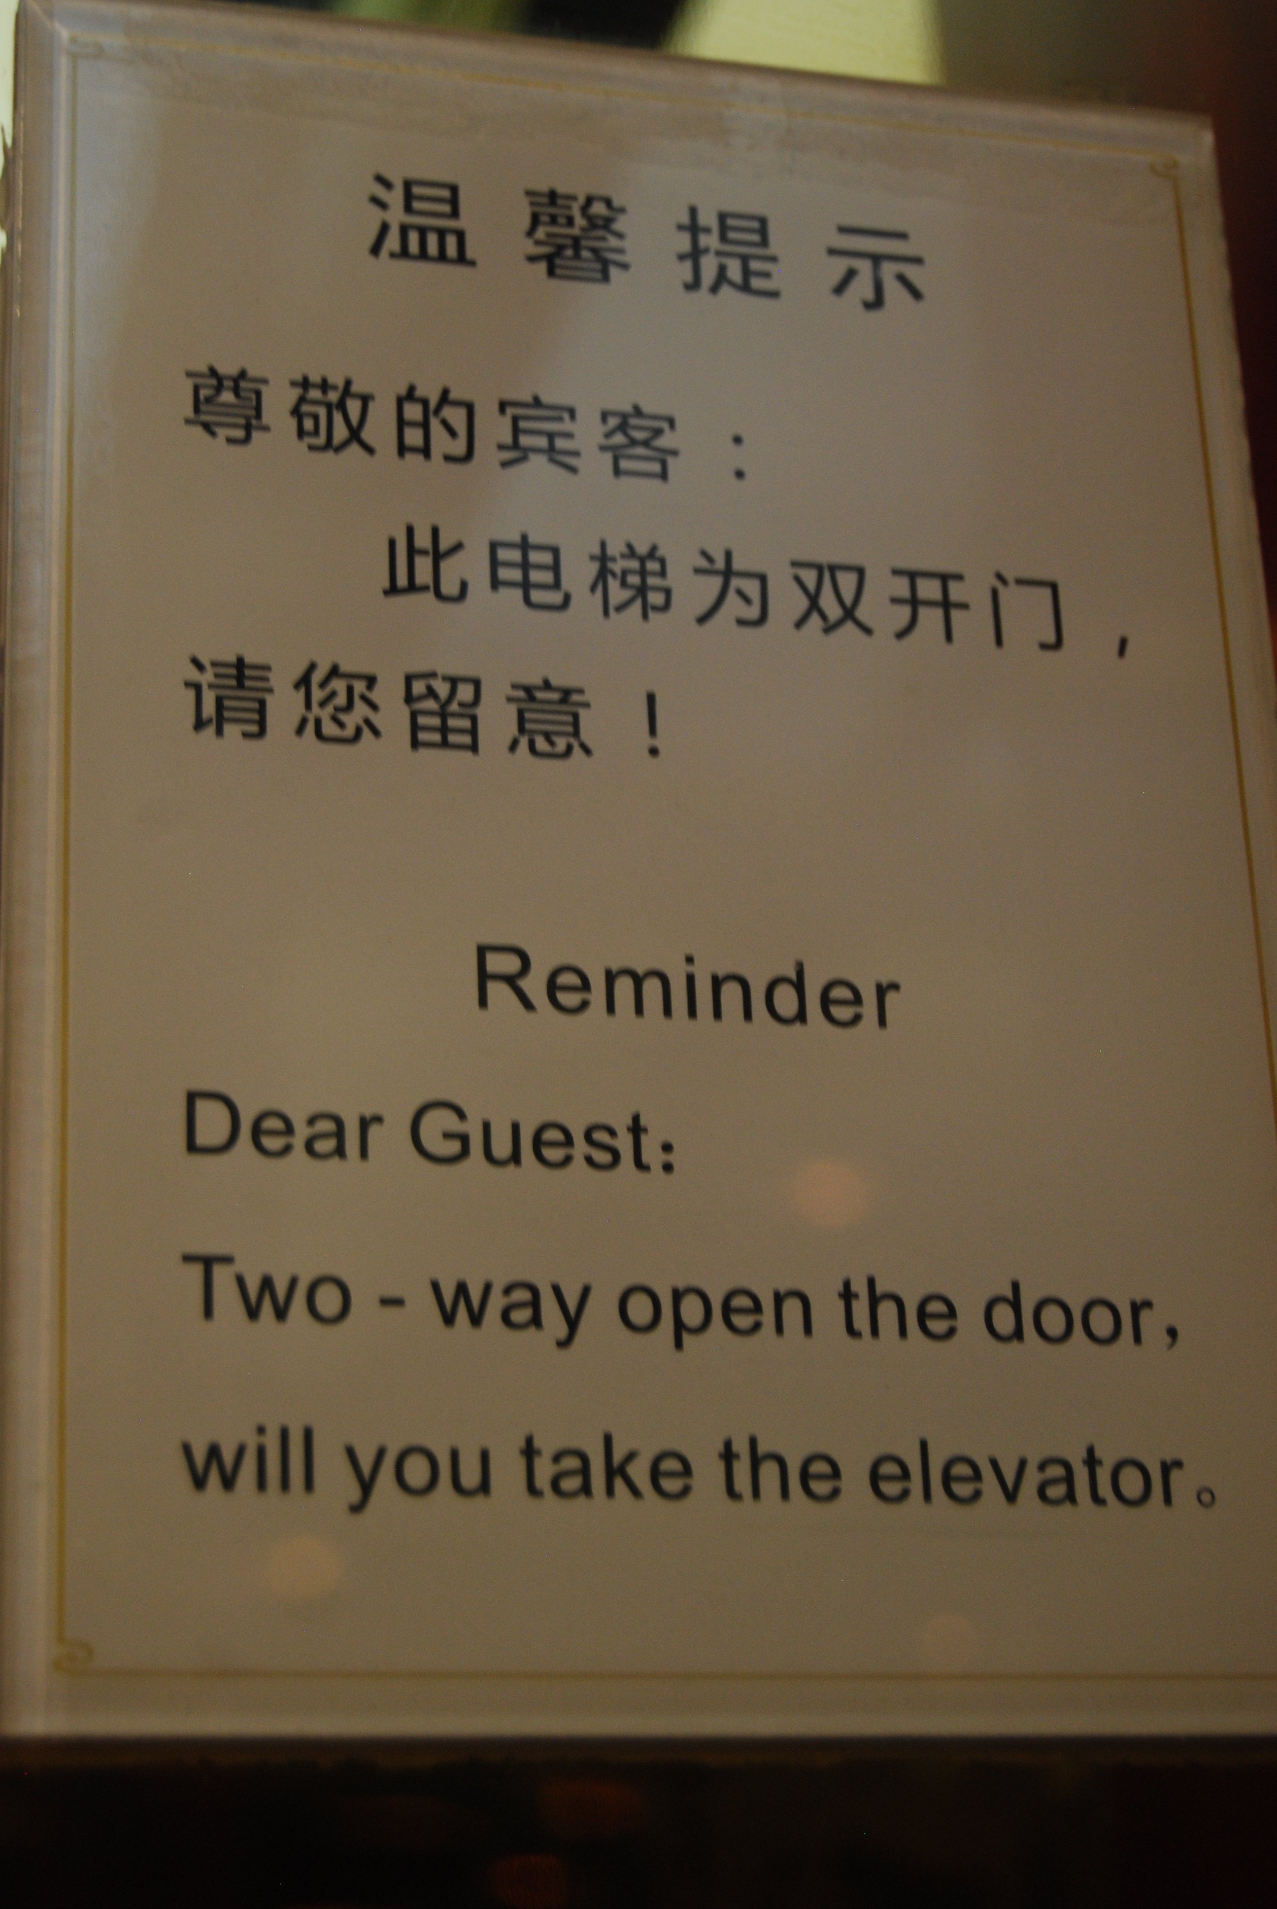
Q
U
E
S
T
I
O
N
S
???

Slide 49
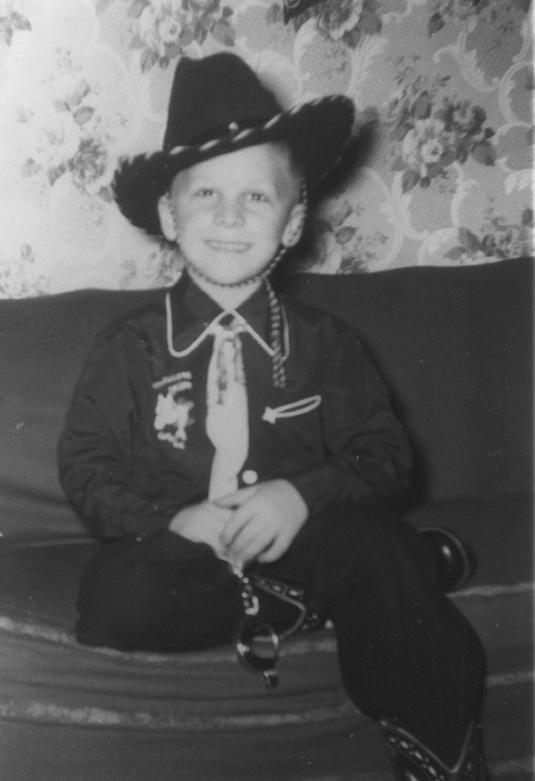
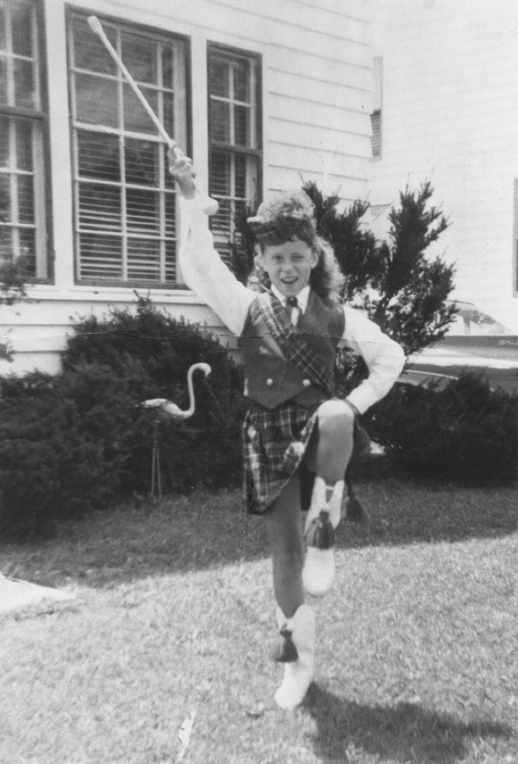
Thanks for Coming Today!

Slide 50
Resources & References
Pixar 22 Rules to Phenomenal Story Telling
http://www.slideshare.net/powerfulpoint/pixar-22rulestophenomenalstorytellingpowerfulpointslideshare
Millenium-2013 World Roller Precision Champions
https://www.facebook.com/photo.php?v=10151835599107730
Quaker City String Band 2016 (The Perfect Swarm)
https://www.youtube.com/watch?v=kwUxKoOAZpc
Simon Sinek on working with Millennials
https://www.youtube.com/watch?v=5MC2X-LRbkE

