Slide 1



Slide 2
The following information is for internal use only.
This is copyrighted material of Xperience Benefits Inc.
Any duplication is prohibited without expressed written consent of Xperience Benefits Inc.

Slide 3
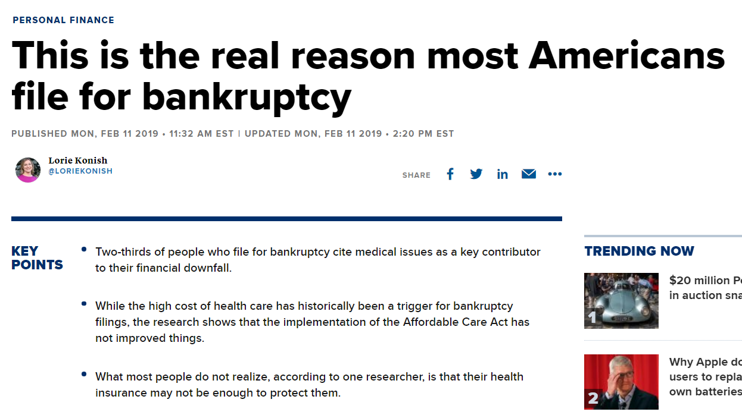
https://www.cnbc.com/2019/02/11/this-is-the-real-reason-most-americans-file-for-bankruptcy.html
Notes:
2/3 of people who file for bankruptcy cite medical issues as a key contributor to their financial downfall.

Slide 4
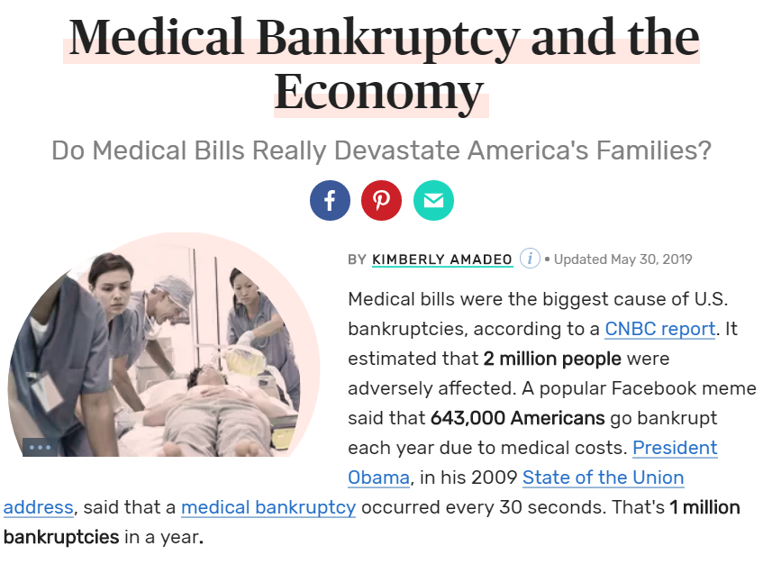
https://www.thebalance.com/medical-bankruptcy-statistics-4154729
Notes:
Do medical bills really devastate America’s families? You be the judge…

Slide 5

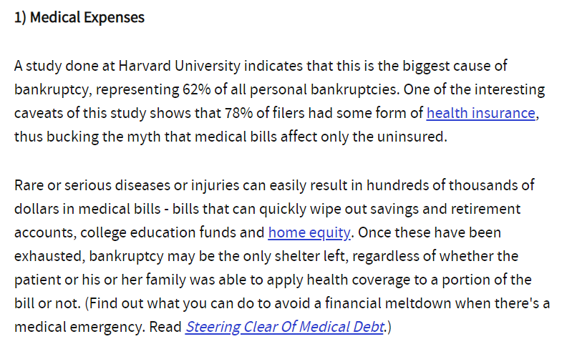
Top 5 Reasons Why People Go Bankrupt
https://www.investopedia.com/financial-edge/0310/top-5-reasons-people-go-bankrupt.aspx
Notes:
A study done at Harvard University indicates that this (medical bills) is the biggest cause of bankruptcy…

Slide 6
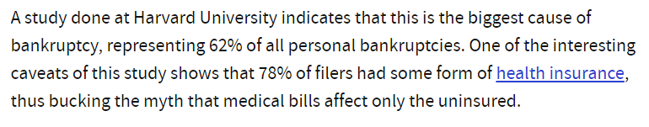
Medical Bills are the #1 Reason for Bankruptcy in America Today
“78% of filers had some form of
health insurance”
https://www.investopedia.com/financial-edge/0310/top-5-reasons-people-go-bankrupt.aspx
Notes:
…and most of them had health insurance. “78% of filers had some form of health insurance.”

Slide 7

Education
Notes:
We believe this epidemic to the financial downfall for American’s today has 1 major factor: lack of education. These programs are complex and confusing and unfortunately, education is greatly lacking in our industry. Xperience Benefits is on a mission to revolutionize the industry through a greater focus on education!

Slide 8

Benefits Counseling
Notes:
We provide benefits counseling for all employees. These sessions are confidential, customized, and complimentary.

Slide 9

Xperience Strategy
Notes:
Our enhanced strategy goes beyond nice messaging and branding. What really separates Xperience Benefits from the rest of the industry, is our enhanced focus on education and world class service. We truly deliver on our promise.

Slide 10
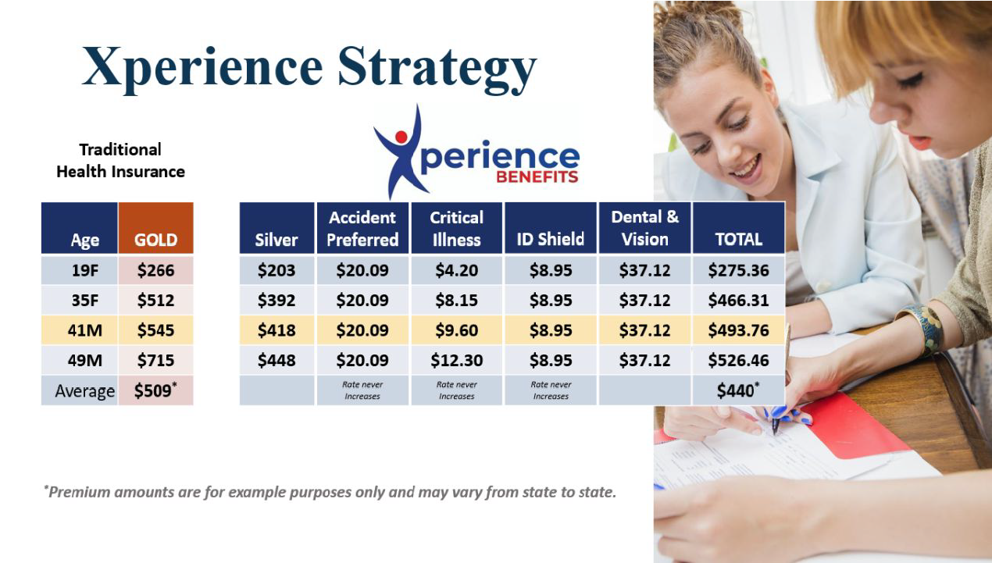
Notes:
Traidtional broker model vs. Xperience Strategy

Slide 11
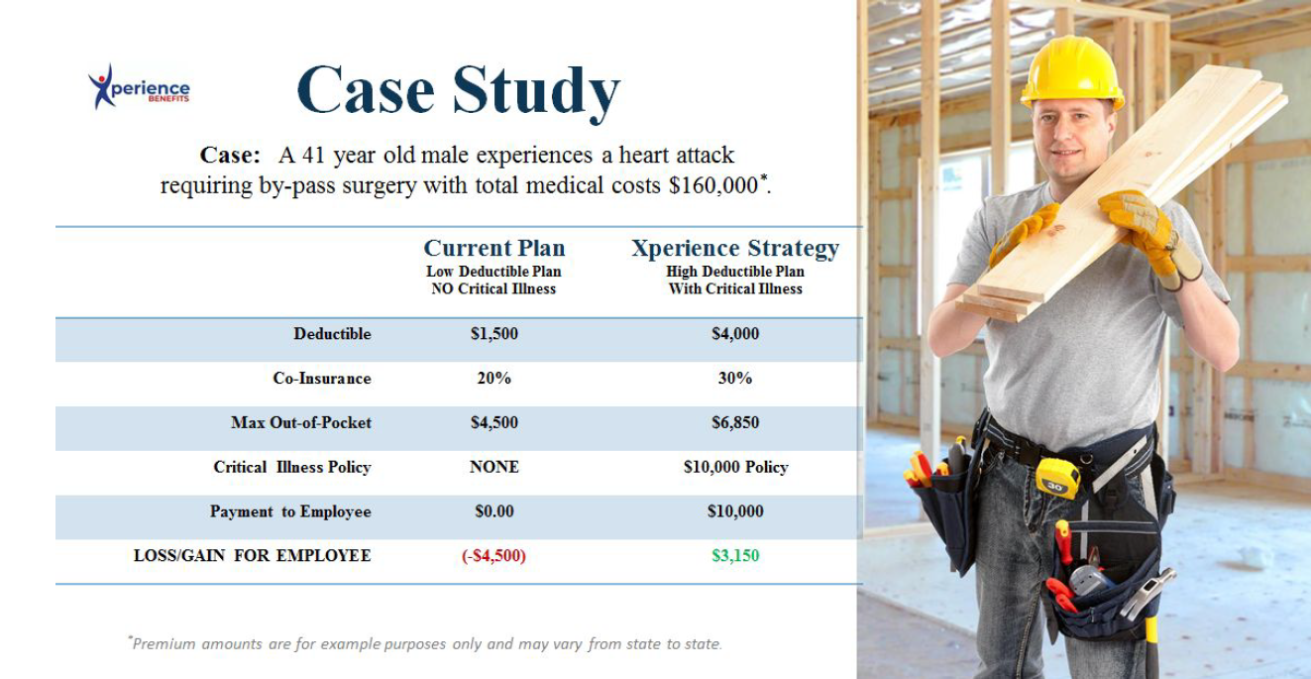
Notes:
This case study shows a side by side comparison of most traditional “health insurance only focus” vs. Xperience Strategy.

Slide 12
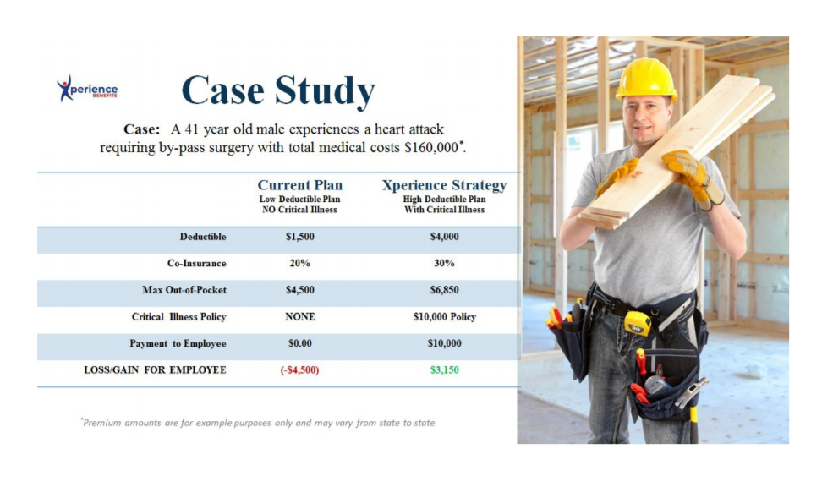
Health Insurance Only
Notes:
Employee is responsible for out of pocket expenses, not covered by health insurance.

Slide 13
Xperience Strategy
Notes:
Employee actually profits from Xperience Strategy!

Slide 14

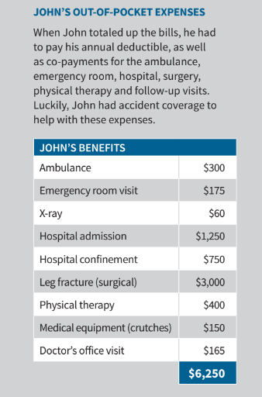
Notes:
Employees get paid cash from Enhanced Supplemental Benefits.

Slide 15

Notes:
Thank you for joining us! Let’s schedule your strategy meeting!

