Slide 1


Slide 2
Benefits | Payroll | HR
Your Employee Benefits Department

Slide 3


Slide 4
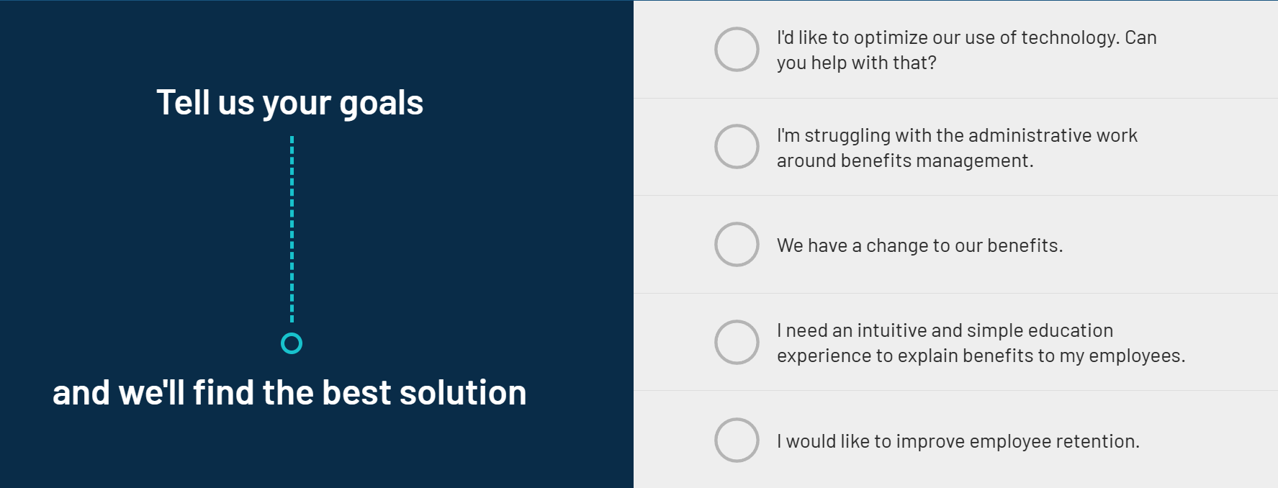
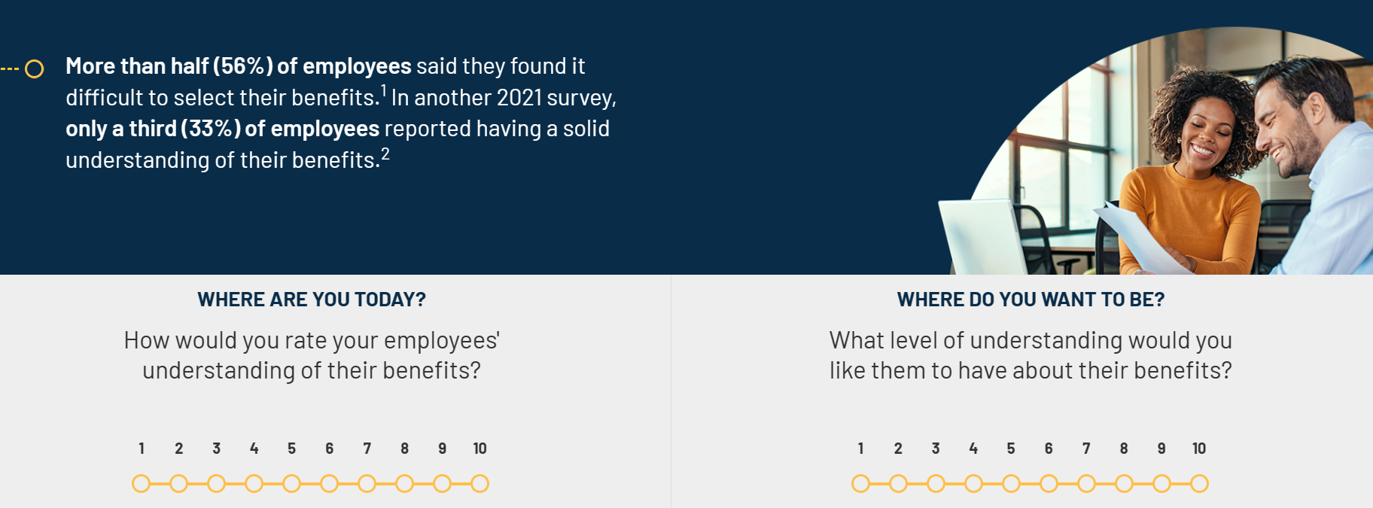

Slide 6



Slide 7
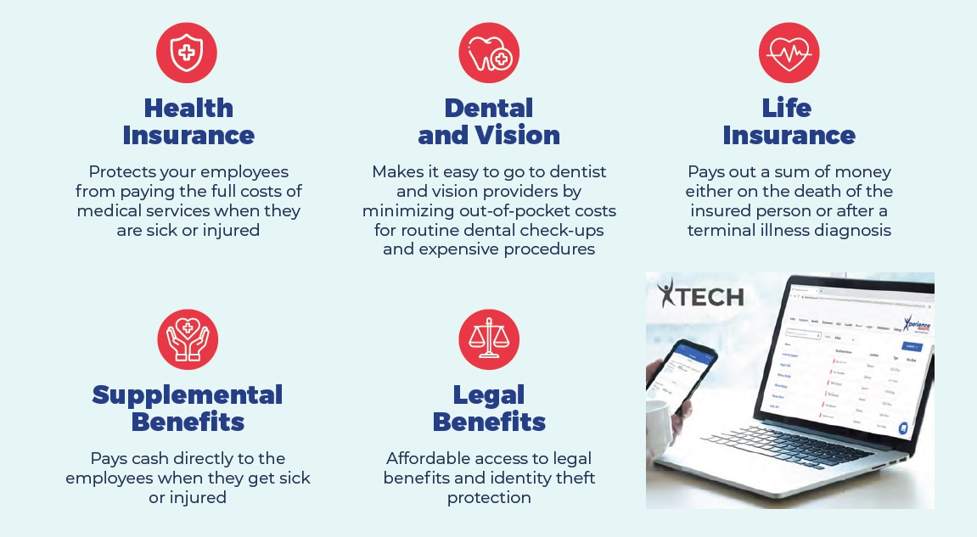

Slide 8


Innovative Modern Strategies
High Tech
High Touch

Slide 9
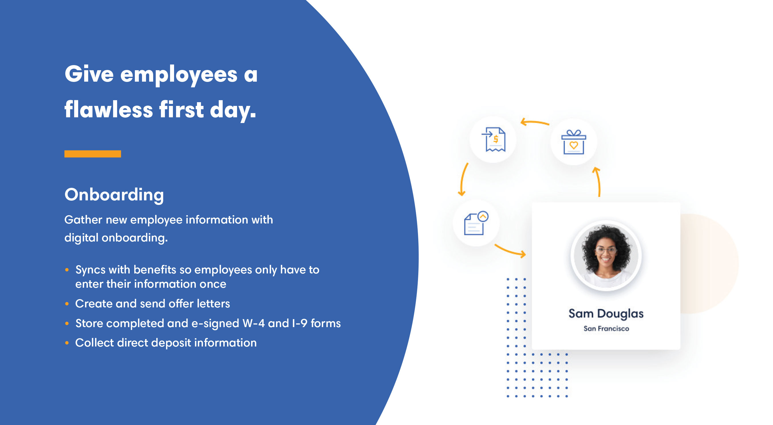

Slide 10
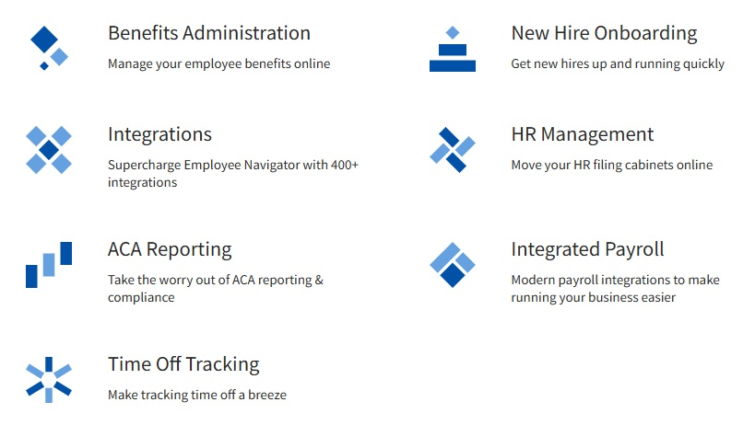
Employee Navigator
Click here to learn more about Employee Navigator

Slide 11

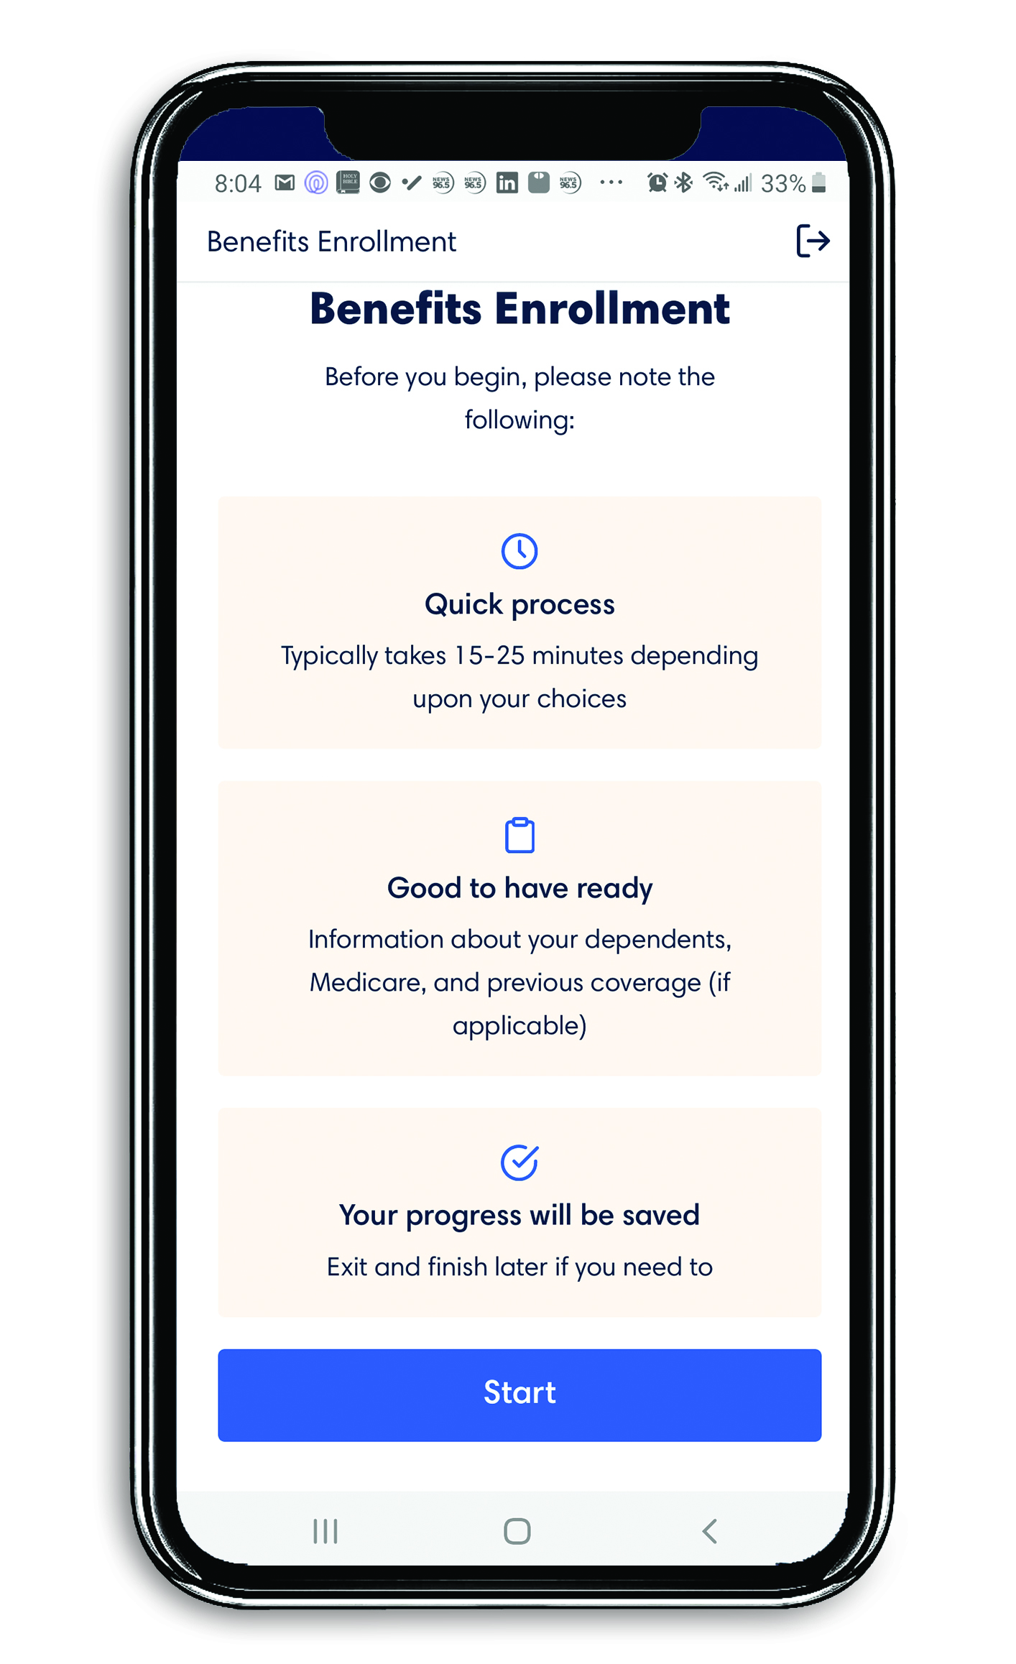
TEAM
TECH
High-Touch
High-Tech
Benefits Consultant
Executive Consultant
Benefits Counselor(s)
Specialist
Coordinator
Area Director

Slide 12

Key responsibilities for our valued clients include:
• Assessing Needs: Analyze a company's employee demographics and current benefits to identify areas for improvement and potential cost savings.
• Benefits Design: Help companies create comprehensive employee benefit packages that meet their budget and employee needs.
• Market Research: Compare plans and pricing from various insurance carriers to find the most suitable options.
• Claims analysis: Monitor claims data to identify trends and potential cost-saving opportunities.
• Negotiation: Negotiate contracts with insurance providers to secure favorable terms and pricing.
• Employee Education: Provide employees with information about their benefits, including how to access and utilize them effectively.
• Open Enrollment Support: Assist with the annual open enrollment process, including communication to employees about plan changes and selection options.
• Compliance Management: Ensure that the company's benefit plans adhere to relevant laws like the Affordable Care Act (ACA) and Employee Retirement Income Security Act (ERISA).

Slide 13

Client Services
Email clientservices@xperiencebenefits.com for any servicing needs for both the company and employees.

Slide 14




Your Employee Benefits Team
Employee Benefits Portal
Digital Benefits Guides
Benefits Counseling

Slide 15
All Available at No Cost!

Slide 16
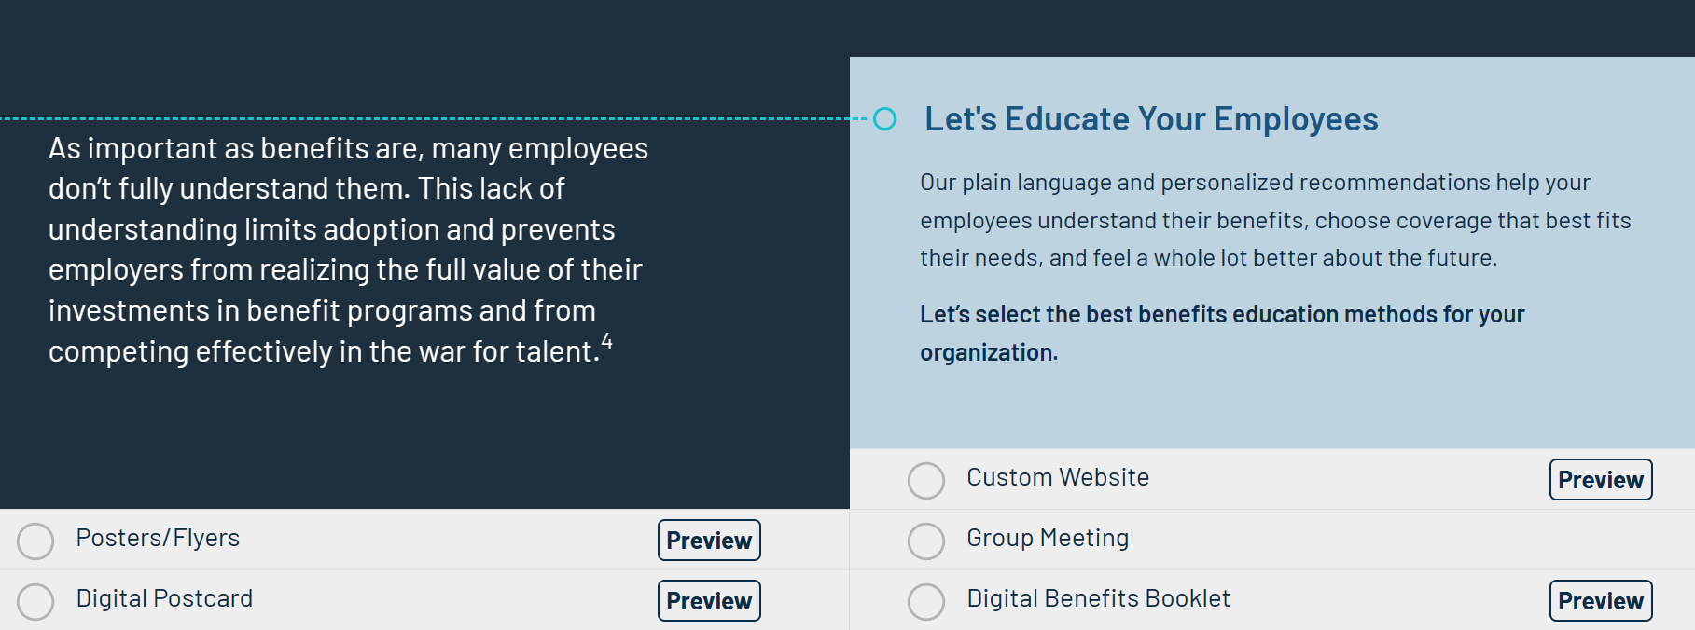

Slide 17
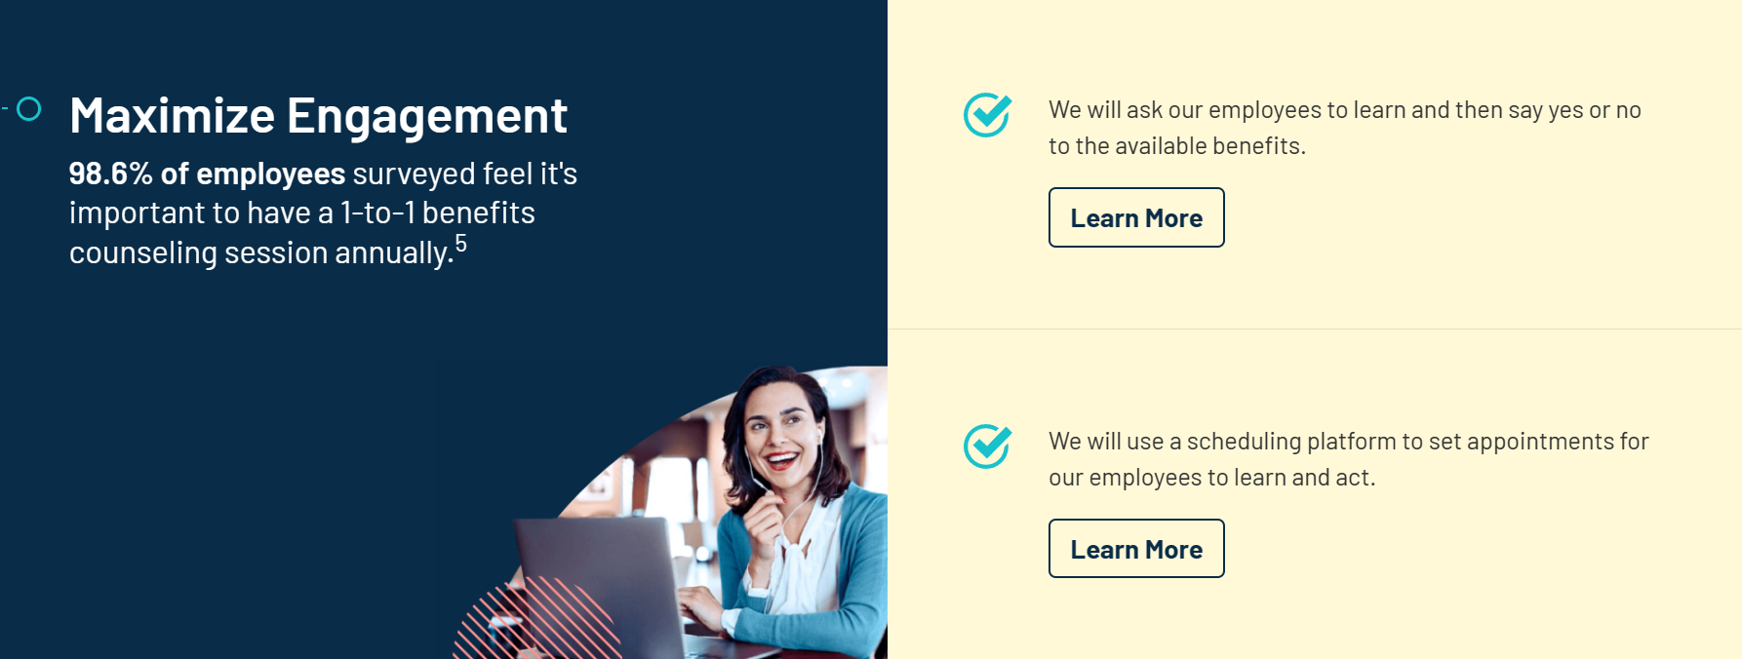
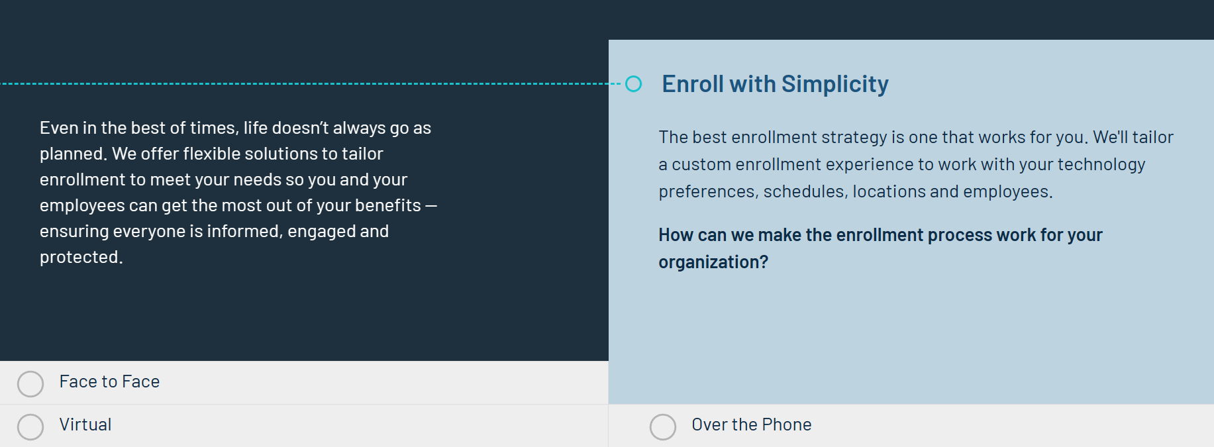

Slide 19
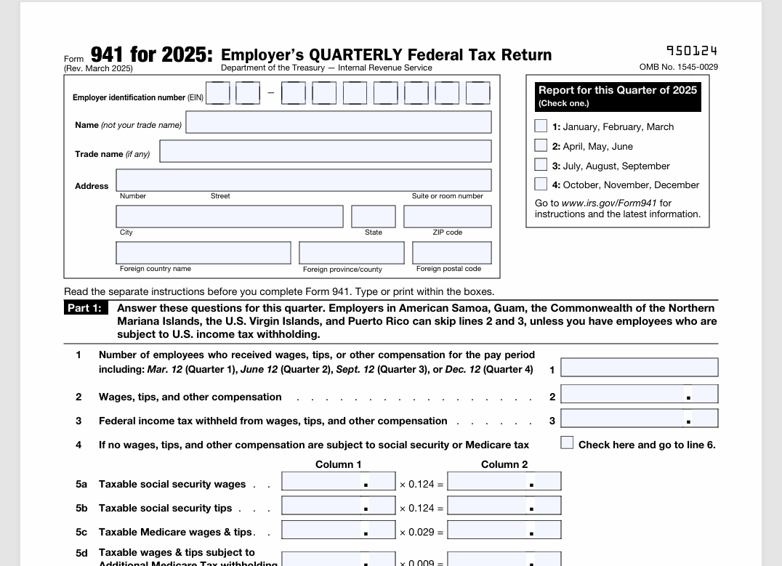
941 Tax and Wage Report
This is always needed for group health plans.

Slide 20
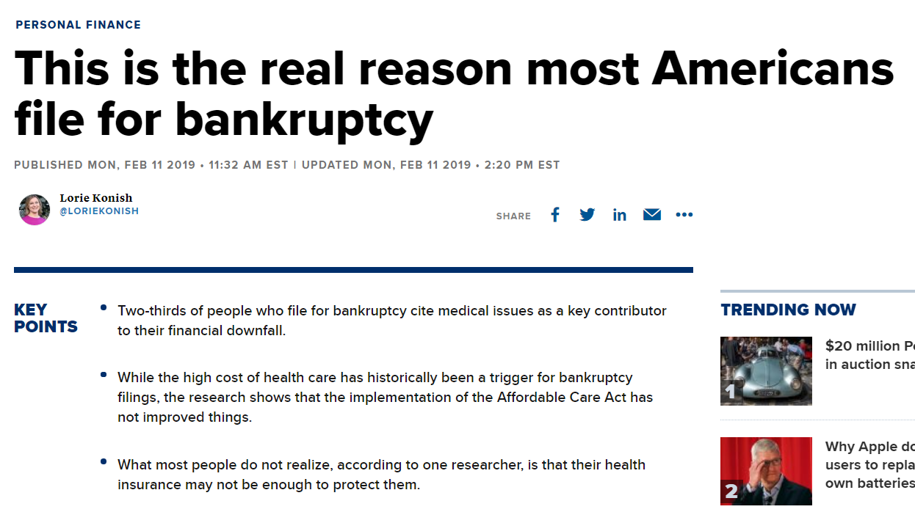
https://www.cnbc.com/2019/02/11/this-is-the-real-reason-most-americans-file-for-bankruptcy.html
Notes:
2/3 of people who file for bankruptcy cite medical issues as a key contributor to their financial downfall.

Slide 21
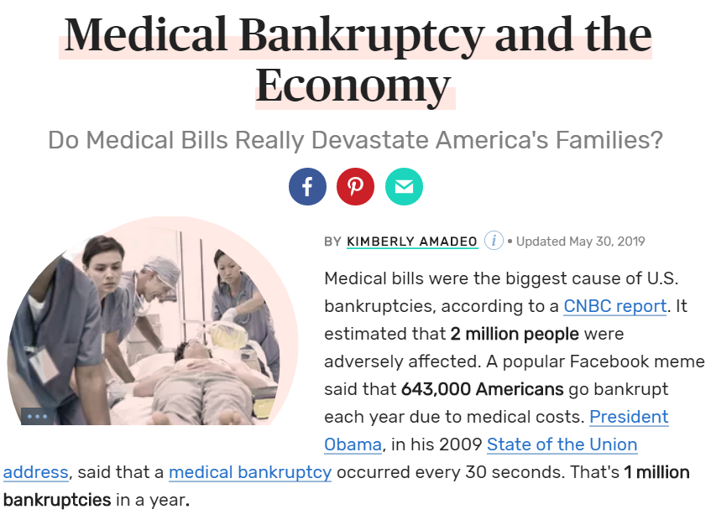
https://www.thebalance.com/medical-bankruptcy-statistics-4154729
Notes:
Do medical bills really devastate America’s families? You be the judge…

Slide 22

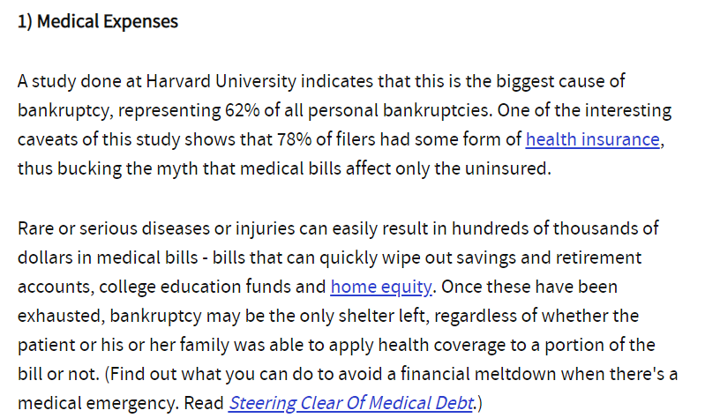
Top 5 Reasons Why People Go Bankrupt
https://www.investopedia.com/financial-edge/0310/top-5-reasons-people-go-bankrupt.aspx
Notes:
A study done at Harvard University indicates that this (medical bills) is the biggest cause of bankruptcy…

Slide 23
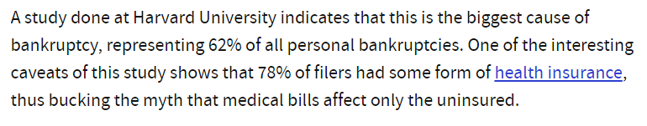
Medical Bills are the #1 Reason for Bankruptcy in America Today
“78% of filers had some form of
health insurance”
https://www.investopedia.com/financial-edge/0310/top-5-reasons-people-go-bankrupt.aspx
Notes:
…and most of them had health insurance. “78% of filers had some form of health insurance.”

Slide 24

Education
Notes:
We believe this epidemic to the financial downfall for American’s today has 1 major factor: lack of education. These programs are complex and confusing and unfortunately, education is greatly lacking in our industry. Xperience Benefits is on a mission to revolutionize the industry through a greater focus on education!

Slide 25

Notes:
We provide benefits counseling for all employees. These sessions are confidential, customized, and complimentary.

Slide 26
Notes:
Our enhanced strategy goes beyond nice messaging and branding. What really separates Xperience Benefits from the rest of the industry, is our enhanced focus on education and world class service. We truly deliver on our promise.

Slide 27
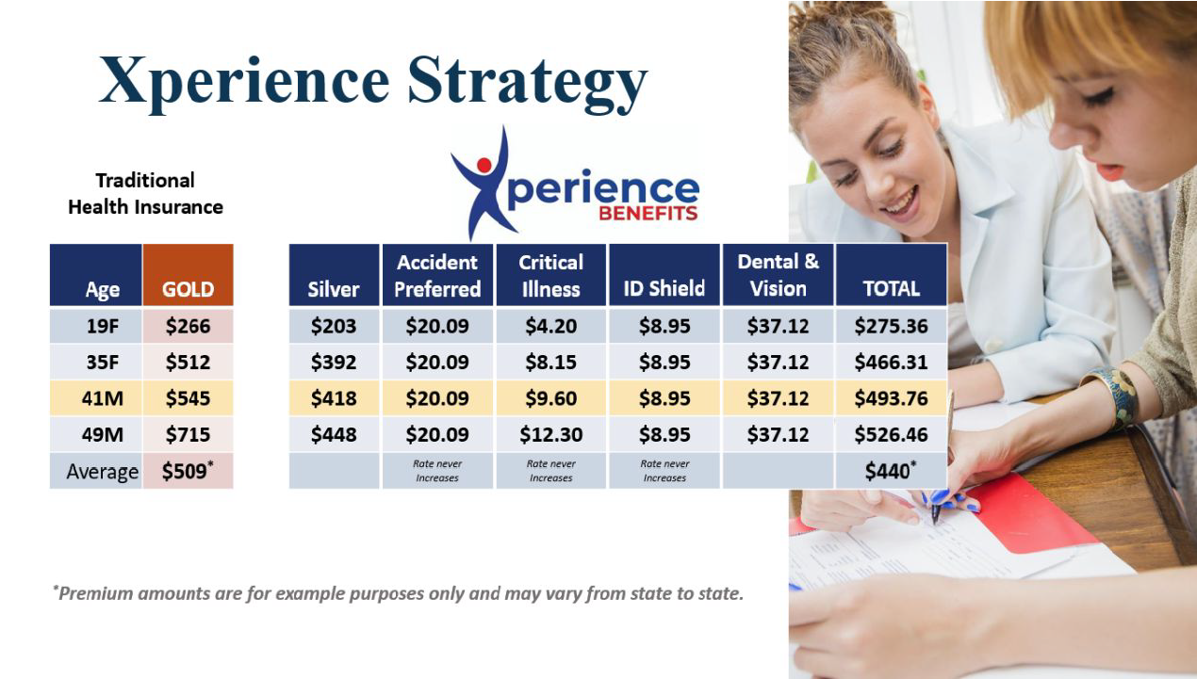
Notes:
Traidtional broker model vs. Xperience Strategy

Slide 28
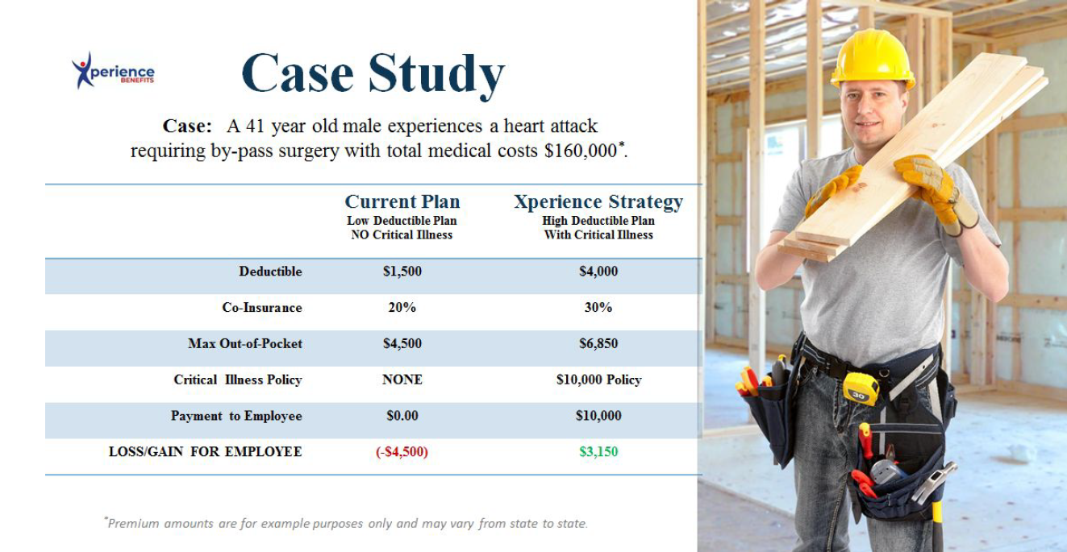
Notes:
This case study shows a side by side comparison of most traditional “health insurance only focus” vs. Xperience Strategy.

Slide 29
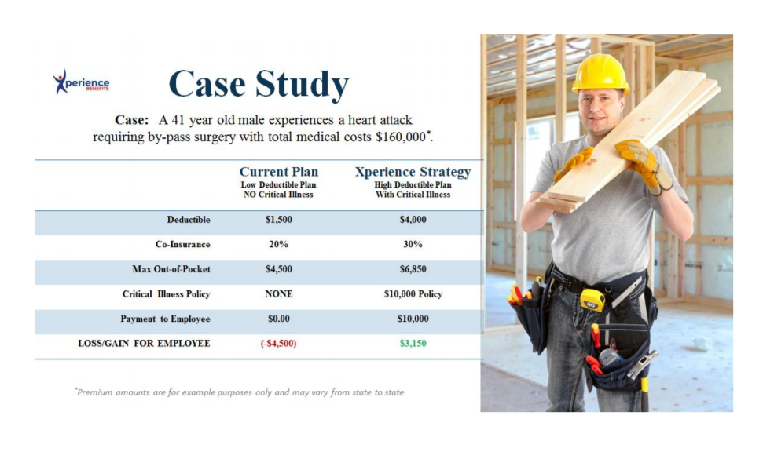
Health Insurance Only
Notes:
Employee is responsible for out of pocket expenses, not covered by health insurance.

Slide 30
Xperience Strategy
Notes:
Employee actually profits from Xperience Strategy!

Slide 31
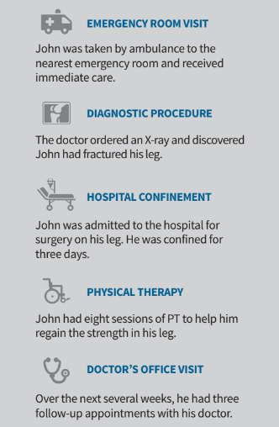
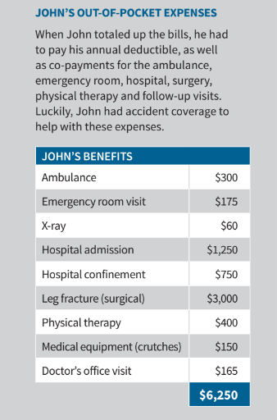
Notes:
Employees get paid cash from Enhanced Supplemental Benefits.

Slide 32
Next Steps
The following information is needed to provide an initial strategy recommendation for a Strategy Meeting:
Employee Census
  Carriers Require this to get Quotes for Pricing
  Template is Provided Upon Request
Current Benefits Carrier Documents (if applicable)
  Most Recent Invoices
  SBCs and Plan Summaries
  Most Recent Carrier Renewals

Slide 33
941 Tax and Wage Report
This is always needed for group health plans.

Slide 34

Notes:
Thank you for joining us! Let’s schedule your strategy meeting!

