Slide 1
Your Opportunity.
Your Journey.

Slide 2
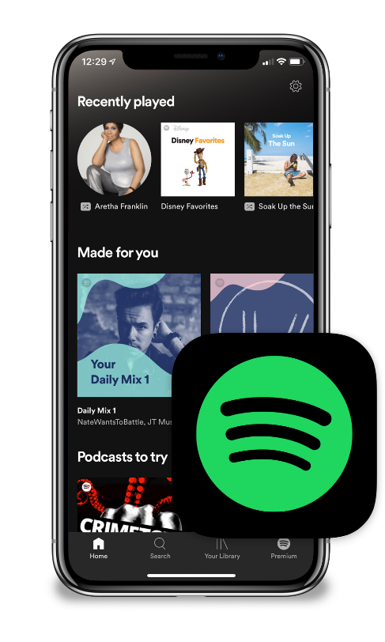
Disruptive Innovation
Simpler. Easier. More Affordable.
REMEMBER
SHOPPING AT THE MALL?
OR
BUYING
CDs?

Slide 3
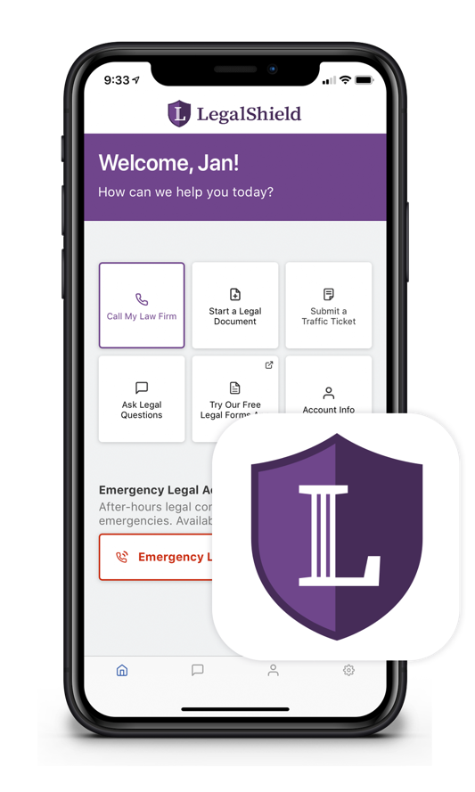
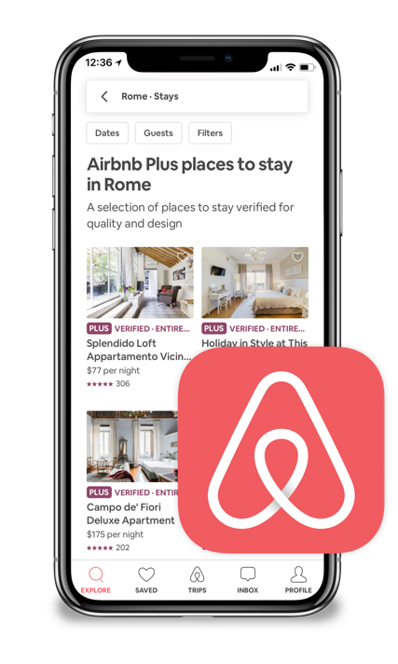
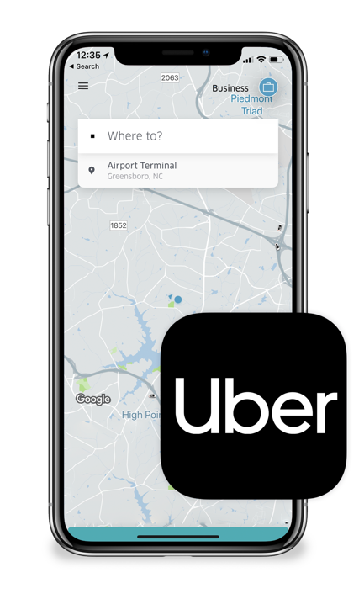
Disruptive Innovation
Simpler. Easier. More Affordable.
What about getting
access to the
JUSTICE SYSTEM?

Slide 4
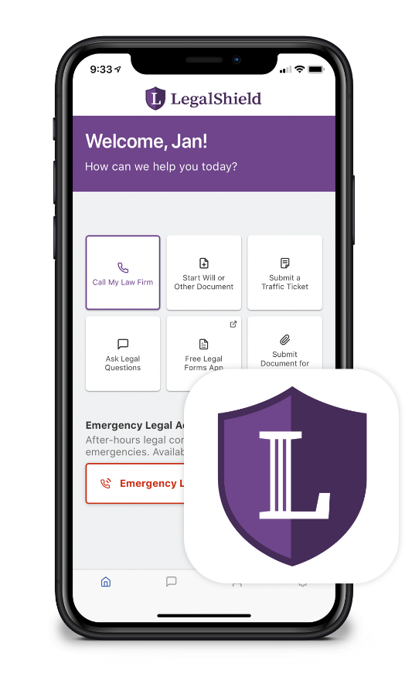
Simpler. Easier. More Affordable.
What about access to
LEGAL
REPRESENTATION?

Slide 5
Our Vision
To build a BETTER WORLD where access to JUSTICE & SECURITY is equal for every human — regardless of gender, race, orientation, education,
social status or personal wealth.

Slide 6
Established in 1972
Protecting approximately 4.4 million lives in the U.S. and Canada
With a dedicated network of quality law firms in all 50 states and all Canadian provinces and territories

Slide 7
Signed a contract or document?
Had a landlord/ tenant issue?
Been overcharged or treated unfairly?
Received a traffic
ticket?
Been concerned about your child’s identity?
Been a victim of identity theft or a data breach?
Had a real estate transaction?
Needed your
Will prepared
or updated?

Slide 8
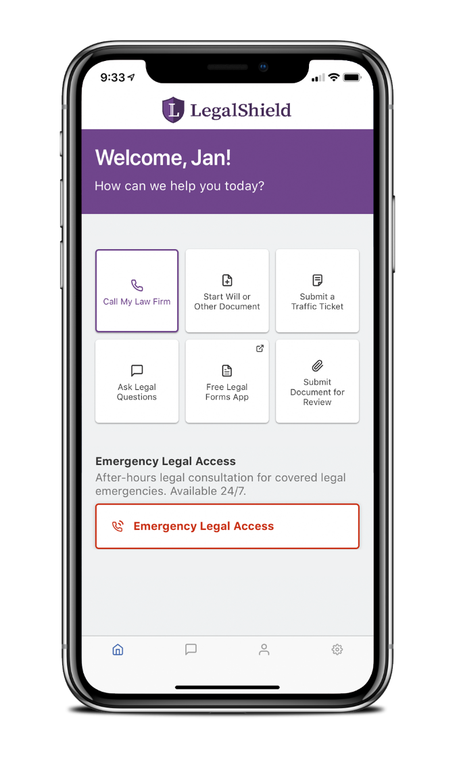
Tap. Call. Equal Access.
Personal Legal Advice Unlimited number of issues
Letters/Calls Made On Your Behalf
Contracts/Documents Reviewed Up to 15 pages each for personal legal matters
IRS Audit Assistance
IRS Audit Assistance is available in NY for $50 an hour and in WA for $200 an hour.

Slide 9
Tap. Call. Equal Access.
Civil Trial Defense For covered situations (Pre-trial/Trial)
Family/Domestic Services (90-day waiting period) Uncontested: divorce, adoption, separation, name change
Document Upload Simple steps to send docs to your lawyer
This is a general overview of the legal plan coverage available from LegalShield for illustration purposes only. See a legal plan contract for specific state of residence for complete terms, coverage, amounts and conditions. Trial defense is not available in all states. LegalShield provides access to legal services offered by a network of provider law firms to LegalShield members through membership-based participation. Neither LegalShield nor its officers, employees or sales associates directly or indirectly provide legal services, representation, or advice.
Civil Trial Defense is available in NY for $50 an hour and in WA for $200 an hour.
Uncontested divorce, adoption, separation and name change are available in NY for $50 an hour.

Slide 10
Traffic Ticket Assistance
Traffic ticket submitted to YOUR law firm
Consultation within 4 BUSINESS HOURS
Emergency Access 24/7 emergency access for covered legal emergencies
Available in NY for $50 each defense and in WA for $25 each defense

Slide 11
Will Preparation
With the push of a button, you’ll start the process to have your Will prepared!
Lawyers prepare your:
Will
Living Will
Healthcare Power of Attorney
Financial Power of Attorney

Slide 12
25% Member’s Only Discount
While over 80% of member usage is for services covered in the monthly fee, additional services are covered by our 25% discount from the provider attorney’s standard hourly rate, such as:
Pre-existing personal legal matters
Bankruptcy
Contested adoption
Contested divorce
DUI

Slide 13
Contingency Cases
WHAT IF YOU are the victim of an auto accident, or other personal injury? Talk to your provider law firm about representing you on a contingency basis, which means you don’t pay hourly rates.

Slide 14
Who’s Covered?
The member
The member’s spouse or domestic partner
Never-married dependent children under age 26 living at home or full-time student
Dependent children under age 18 for whom the member is legal guardian
Physically or mentally disabled children living at home

Slide 15
Which would YOU choose?

Slide 16
Hire a lawyer charging $250/hour?

Slide 17
Or join for $24.95 a month and get access to a national network of law firms?

Slide 18
With all the recent data breaches, there is a HUGE problem that everyone faces:
Criminals don’t want your money. They want your IDENTITY.
Identity Theft

Slide 19
Privacy Management
Reputation Management
Financial Account Monitoring
Cyberbullying Consultation
Monitoring & Alerts
Consultation on Unlimited Number of Identity-Related Issues
$1M Identity Fraud Protection Plan with 3Bureau*
Full-Service Restoration
: *$25K or $1M Identity Fraud Protection Plan depending on the type of identity theft plan: $25K with 1Bureau or $1M with 3Bureau. Certain benefits
are only available with a 3Bureau identity theft plan. For complete terms, coverage, and conditions, please see an identity theft plan.

Slide 20
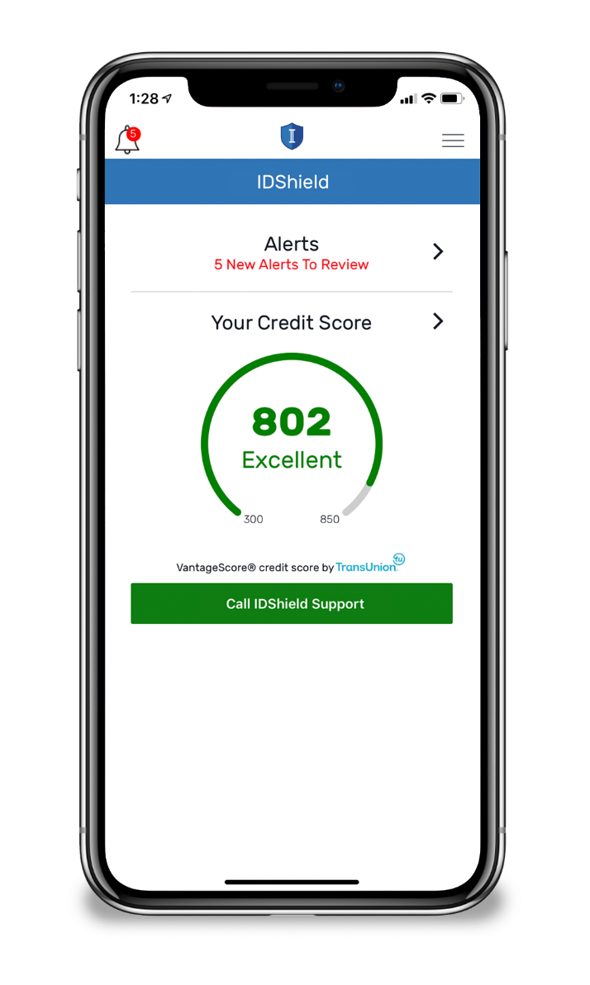
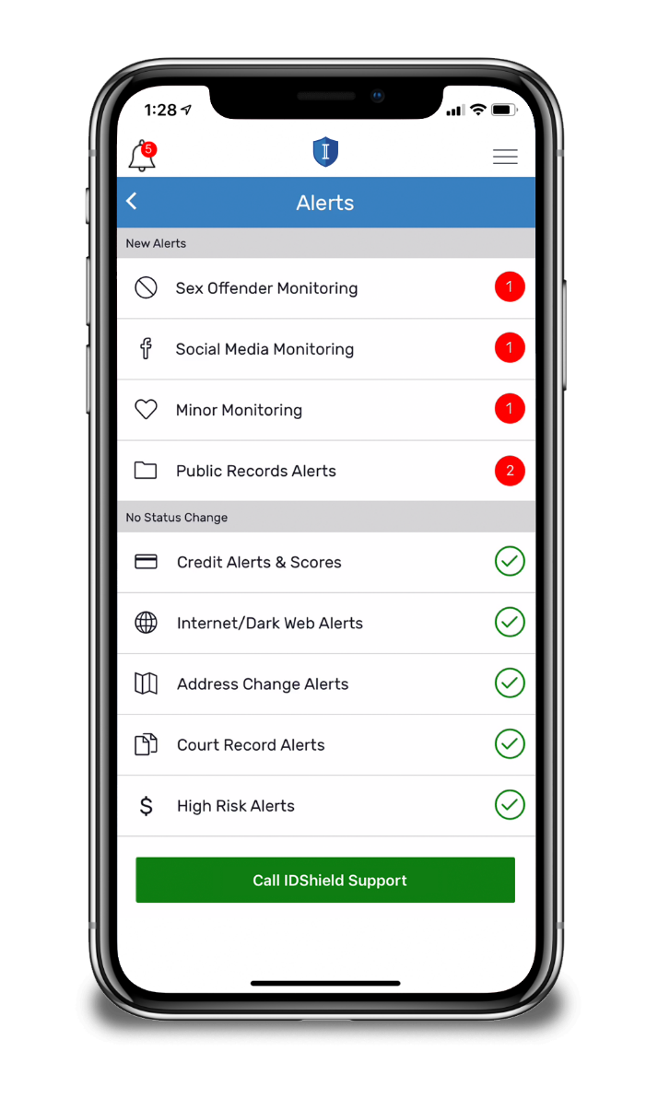
Monitoring & Alerts
Credit Score
1 or 3 Credit Bureau Monitoring**
SSN
Passport
Driver’s License
Email*, Phone, DOB
Medical ID*
Username/Password*
Dark Web
Social Media
**1B or 3B Credit Bureau Monitoring depending on the plan *Up to 10
IDShield is a product of Pre-Paid Legal Services, Inc. d/b/a LegalShield (“LegalShield”). LegalShield provides access to identity theft protection and restoration services. IDShield plans are available at individual or family rates. A family plan covers the named member, named member’s spouse or domestic partner and up to 10 dependent children under the age of 18. Certain benefits are only available with a 3Bureau identity theft plan and are not offered with a 1Bureau identity theft plan. For complete terms, coverage, and conditions, please see an identity theft plan. All Licensed Private Investigators are licensed in the state of Oklahoma. An Identity Fraud Protection Plan (“Plan”) is issued through a nationally recognized carrier. LegalShield/IDShield is not an insurance carrier. This covers certain identity fraud expenses and legal costs as a result of a covered identity fraud event, with the amount of coverage dependent on the type of identity theft plan. See a Plan for complete terms, coverage, conditions, and limitations related to family members who are eligible under the Plan.

Slide 21
Monitoring & Alerts
Credit Cards*
Investment Accounts*
Financial Account Monitoring
401K
Checking/Savings
Loans
Auto Pawns/Title Pawn
Buy Here/Pay Here
Telecom Account Application
Sub-prime loans
*Up to 10

Slide 22
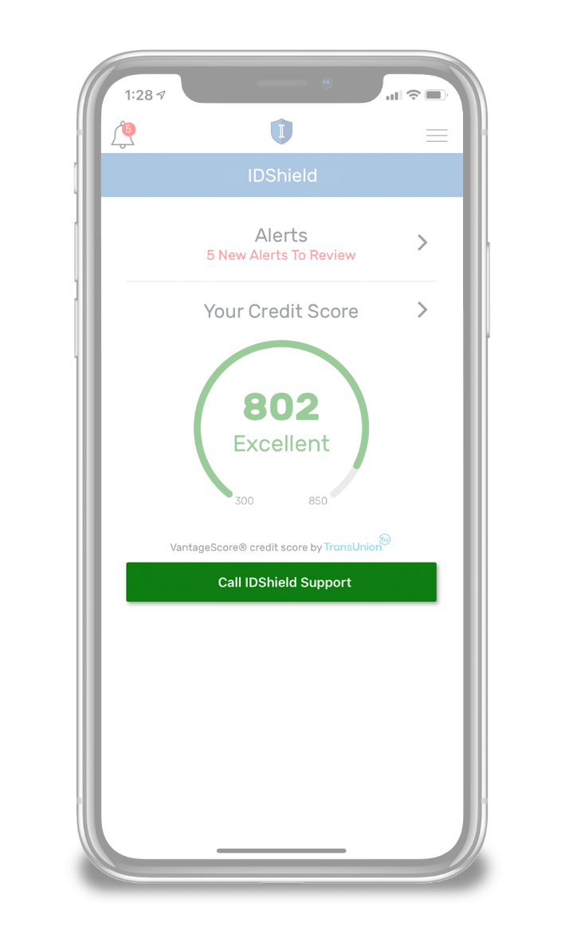
Comprehensive Restoration
$1 Million Identity Fraud
Protection Plan with 3Bureau*
Licensed Private Investigators will:
Do whatever it takes.
Work as long as it takes.
Restore identity to its pre-theft status.
: *$25K or $1M Identity Fraud Protection Plan depending on the type of identity theft plan. The $1 Million Identity Fraud Protection Plan is only available with a 3Bureau identity theft plan. $25K is available with a 1Bureau identity theft plan.

Slide 23
Privacy Management
Monitoring
Consultation
Guidance
Reputation Management*
Social Media Privacy
Voice Assistance Privacy
Data Broker Privacy
Smart TV Privacy
Social Media Privacy
Anti-Bullying
Reputation Management
Password Privacy
Browser Privacy
* Available with 3Bureau Plan only.

Slide 24
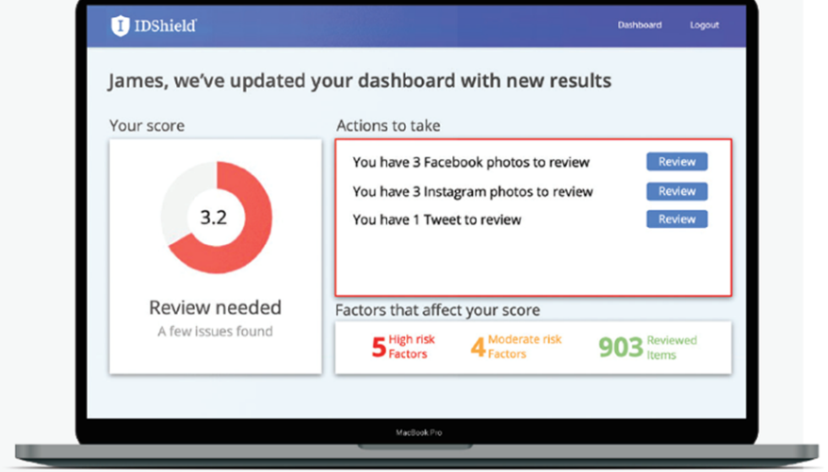
Privacy & Reputation Management*
IDShield’s proprietary technology scans for potential reputation-damaging content on social media accounts such as:
Facebook
LinkedIn
Twitter
Instagram
And More!
Reputation Score*
Ranks a user’s online risk by calculating a score based on content and images found on their social media accounts.
* Privacy & Reputation Management and Reputation Score are available with 3Bureau Plan only. IDShield can provide consultation as to content found on social media but any decision or action related to any such content is up to the member. There is no guarantee that a member will be able to have such an item removed.

Slide 25
Who’s Covered?
Individual plan
The member
Family plan
The member
The member’s spouse or domestic partner
Up to 10 dependent children under the age of 18

Slide 26
3B Family Plan
$54.90/month
($24.95 LegalShield + $29.95 IDShield Family)
3B Individual Plan
$40.90/month
($24.95 LegalShield + $15.95 IDShield Individual)

Slide 27
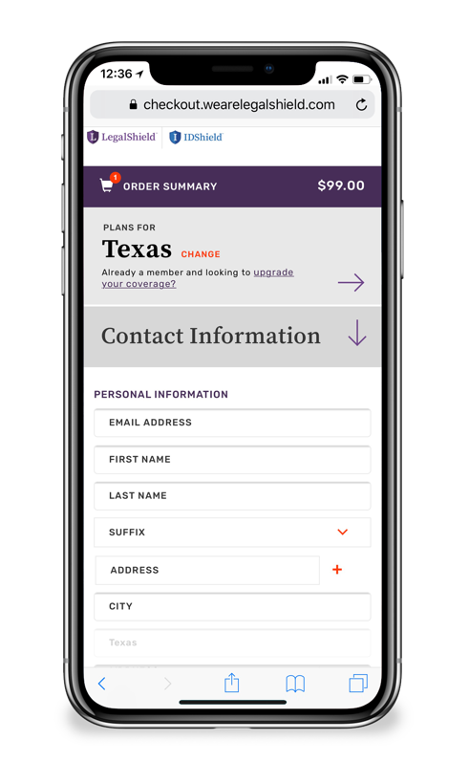
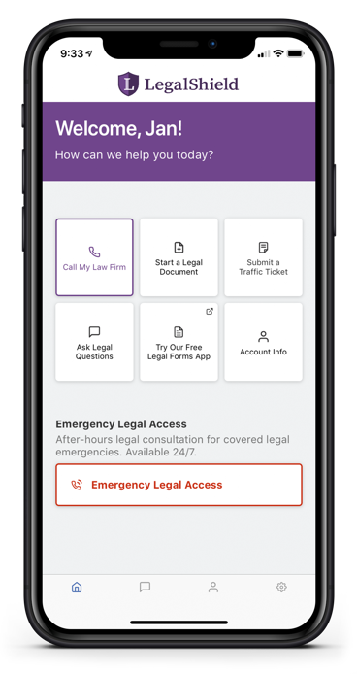
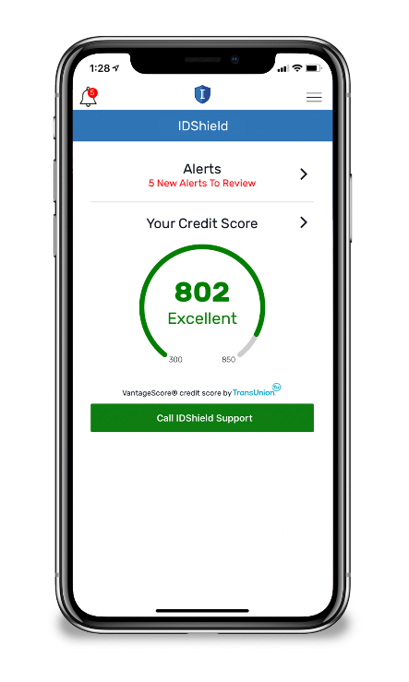
Action Steps
Enroll as a member Get the direct sign-up link from the person who invited you. Sign up and download the apps.
Become an associate Set up your website.
Get trained Fast Start Training Class.
Get paid and promoted Earn Fast Start Bonuses PLUS commissions in your first 45 days!

