Slide 1

Setting Appointments
and
Overcoming Objections

Slide 2
Every call or drop is a sale!!
Either you sold the prospect with the idea to meet you, or they sold you with the reason they can’t meet you!

Slide 3
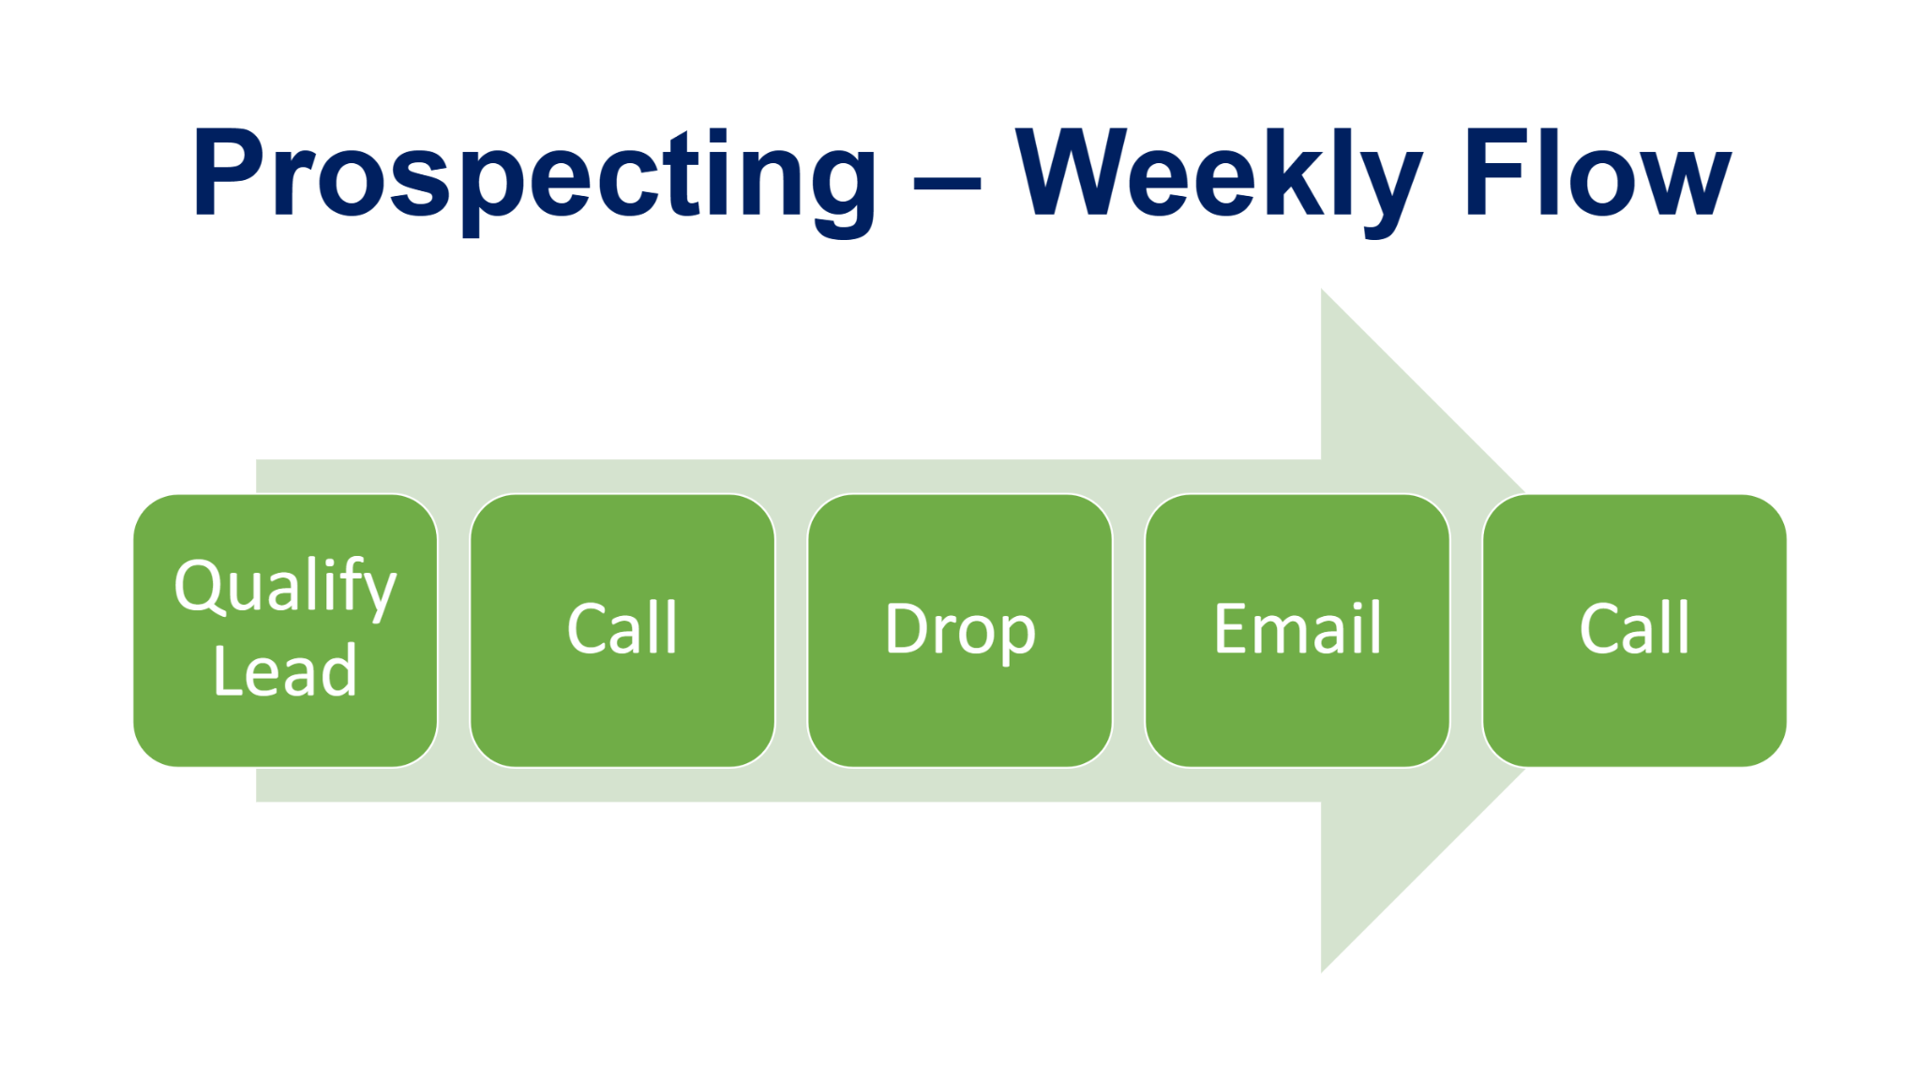

Slide 4
Steps to setting an appointment:
Qualifying the lead.
Calling or dropping intentionally with the decision makers information.
Scheduling an appointment.

Slide 5
Qualifying the lead
What information are we looking for ?
Why do we want to qualify the lead?

Slide 6
How to Schedule a Meeting:
Qualify the Lead:
Verify address
# of employees
Who is in charge of benefits?
Do they offer benefits?
What do they like most about the benefits?
Are they having any challenges with benefits?

Slide 7
Appointment Setting Call Script:
Hi my name is ___ and I’m a benefits consultant with Xperience Benefits. We help local businesses enhance their employee benefits by improving their service and education. Best part is, our services are available at no cost. Have you heard our name thrown around before? (wait for answer, they will likely say no) “We are the premier Employee Benefits Company in (state where you live). I have a couple quick questions…”
Appointment Setting Call Script.pdf (wsimg.com)

Slide 8
Schedule the Appointment
Start with Why - Your mission statement
Then Who - Who is in charge of benefits?
How? – this will be covered in the meeting
What? – we can’t make recommendations until we do a proper
discovery
Schedule location first, then schedule the date and time

Slide 9
Not interested
Objections
Tried it before
Don’t think employees will be interested
Already have benefits/broker
Can’t afford it

Slide 10
The interesting thing about objections, is that the customer is not necessarily saying “no.” They are actually asking for more information because you have not completely satisfied their logical or emotional needs. Most of the time, objections fall within one or more of the following categories below.
Remember: The objections could fall within multiple categories
Money
Time
Need
Video
Link here:
Urgency
Trust
https://youtu.be/siKV9kalIBg

Slide 11
The 3 A’s
Agree
Answer
Ask
Example:
Client: “we are all set”
Agree: “I can totally understand”
Answer:“Most of my clients felt the same. We are not looking to change anything that works for your company”
Ask: “What do you you currently like most about your benefits package?”

Slide 12
Congratulations! you got the appointment !!!
What’s next ?
Schedule it on the Calendly link

Slide 13
How to Schedule using the Calendly link
https://calendly.com/cynthia-benzohar
Title of Calendar Invite
  "Company Name - Employee Benefits"
Select a date & time
Name = Company name
Email = Client’s email address
Add guests
  The agent’s email address
  Bryn’s email address

