Slide 1



Slide 2
The following information is for internal use only.
This is copyrighted material of Xperience Benefits Inc.
Any duplication is prohibited without expressed written consent of Xperience Benefits Inc.

Slide 3



Brokers
What’s in it for you?
Commercial P/C producers
Health/EB producers
Agency Head / Principal
Why consider
Why consider
Why consider
Bring more holistic risk approach to clients
Enhance your profile with clients
Buffer against digital displacement
Entrée into VB conversations without major medical
An additional rationale for VB lines
Don’t leave credit/value on the table
Opportunity to collaborate with commercial P/C producers inside or outside of your agency
Enables account rounding within book
Enables collaboration between P/C and EB producers
Increases overall lines placed
Increases client retention

Slide 4
Replace revenue
Commercial P/C contending with digital displacement
New VB lines bring new revenue streams and help shield against digital displacement
Likelihood of a business to buy one or more commercial policies online direct from carrier
Which commercial lines would likely buyers purchase online?
16%
Very Likely
Somewhat Likely
67%
51%
46%
35%
38%
37%
29%
29%
Not Very Likely
48%
General Liability
Property
BOP
Commercial Auto
Workers Comp
Professional Liability
Source: Deloitte Consulting

Slide 5
Replace revenue
Commercial P/C contending with digital displacement
New VB lines bring new revenue streams and help shield against digital displacement
Likelihood of a business to buy one or more commercial policies online direct from carrier
Which commercial lines would likely buyers purchase online?
16%
Very Likely
Somewhat Likely
67%
51%
46%
35%
38%
37%
29%
29%
Not Very Likely
48%
General Liability
Property
BOP
Commercial Auto
Workers Comp
Professional Liability
Source: Deloitte Consulting

Slide 6

Key question
8x
Key stat
Have the rising cost of deductibles and out-of-pocket expenses on medical plans created an unintentional financial incentive for some employees to report off-job injuries as workplace injuries?
Employees’ health care burden growing 8 times faster than wages.
Source: “Employees’ Share of Health Costs Continues Rising Faster Than Wages.” Insurance Journal. October 8, 2018

Slide 7
Client-Broker expectations
84% of respondents agreed or strongly agreed that an employer should expect their insurance advisor, broker, or consultant help them understand and manage the risk between out-of-pocket costs on their health plan and workers compensation claims.
Agree / Strongly Agree
Reliance on advisors for guidance?
“The broker should have a comprehensive and in-depth understanding of the entire employee benefit plan and how it intersects with all unintended consequences (including WC).”
—HR Executive
Disagree
Strongly Disagree
Source: Colonial Life Research

Slide 8


Where accidents happen
OFF-job vs. on-JOB
3.5
1
to
On average an individual is 3.5 times more
likely to have an accident off-job
than at the workplace.
Away from
work accidents
WORK
ACCIDENT
Source: Are Employers Responsible for Non-Work Related Injuries? Safestart, April 2019

Slide 9

When accidents happen
Avoided treatment
because of
out-of-pocket costs
Self-treated instead of going to doctor
31%
26%
Postponed needed care
Skipped recommended medical test or treatment
21%
An Off-work injury UNTREATED can mean
BRING An accident TO WORK
Source: Data Note: “Americans’ Challenges with Health Care Costs.” KKF.

Slide 10

Are accidents causing accidents?
MIT & WCRI 2019 joint investigation
When worker’s comp claims are reported
Higher Deductibles in Group Health Plans DO increase Injured Workers’ Propensity to File for Workers’ Compensation.
The Most Common Days for Reported Workplace Injuries
#1
“This was a concern and discussed when we moved away from HMO plans to HDHP plan. First year we did see an increase in WC claims.”
—HR Executive
MONDAY
2 3 4 5 6 7
TUES
WED
THURS
FRI
SAT
SUN
Denise Johnson, “NCCI: ACA Had No Major Impact on Monday Workers’ Comp Claims.” Claims Journal. October 1, 2018

Slide 11







What are voluntary benefits?
Sometimes called “supplemental insurance,” these employee-paid benefits can stand alone or help fill gaps in major medical and other insurance coverage.
ACCIDENT INSURANCE
CANCER INSURANCE
CRITICAL ILLNESS INSURANCE
DENTAL INSURANCE
DISABILITY INSURANCE
HOSPITAL INDEMNITY INSURANCE
LIFE INSURANCE
EMPLOYEES USE THEM FOR:
CO-INSURANCE OR CO-PAYS
HOUSEHOLD BILLS
REPLACING WAGES OR SAVINGS
TRAVEL EXPENSES

Slide 12




VB erases financial incentive by
offsetting OOP medical costs
Mia’s Simple Fracture
Plan’s Overall Deductible | $1,500
Specialist Coinsurance | 20%
Hospital (facility) Coinsurance | 20%
Other Coinsurance | 20%
(In-Network Emergency Room Visit & Follow-up Care) This EXAMPLE event includes services like: ER care (including medical supplies) Diagnostic test (x-ray) Durable medical equipment (crutches) Rehabilitation services (physical therapy)
Mia’s Costs
Total Cost | $1,900
Mia would pay:
COST SHARING
Deductibles | $1,500
Copayments | $0
Coinsurance | $80
WHAT ISN’T COVERED
Limits or exclusions | $0
Total Mia would pay: $1,580
Accident Plan Pays Mia
Leg Fracture | $1,800 (non-surgical)
Emergency Room | $150
X-Ray | $60
Crutches | $100
Physical Therapy | $135 ($45/day x 3)
Total Accident Plan pays Mia: $2,245
Source: United Healthcare & Internal Colonial Life data

Slide 13


Who could benefit?
INDUSTRIES WITH HIGH RATES OF ON-JOB INJURIES
EMPLOYERS WITH OR IMPLEMENTING HDHPS
BENEFITS AS A STRATEGIC ASSET

Slide 14
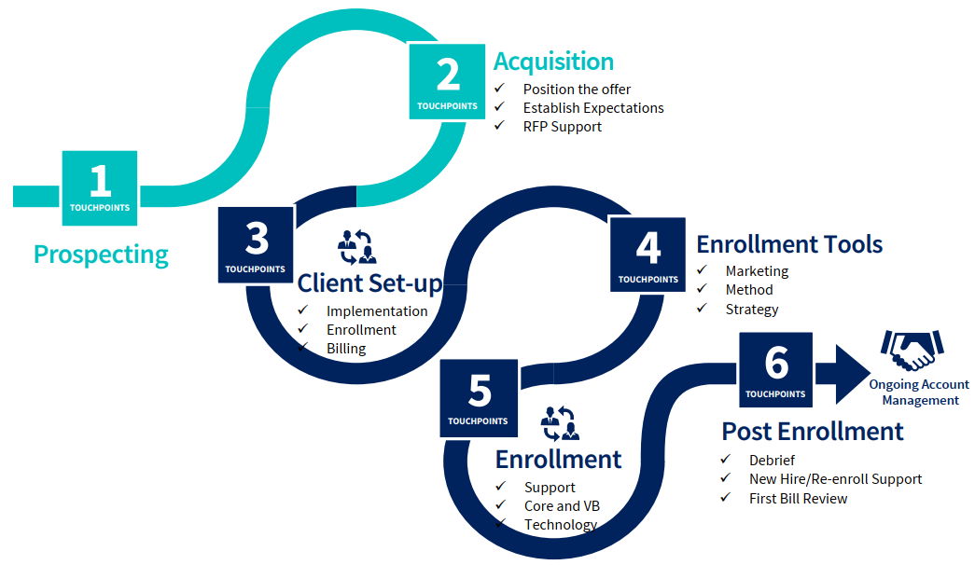
Client acquisition
Referral agent
Xperience Benefits

Slide 15


Slide 16

Your Employee Benefits Department

Slide 17


Innovative Modern Strategies
High Tech
High Touch

Slide 18

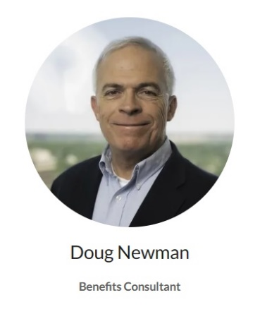
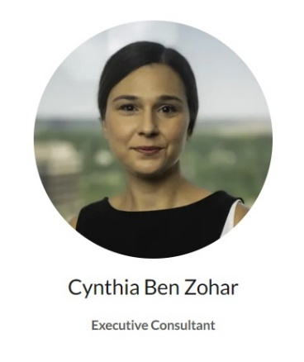
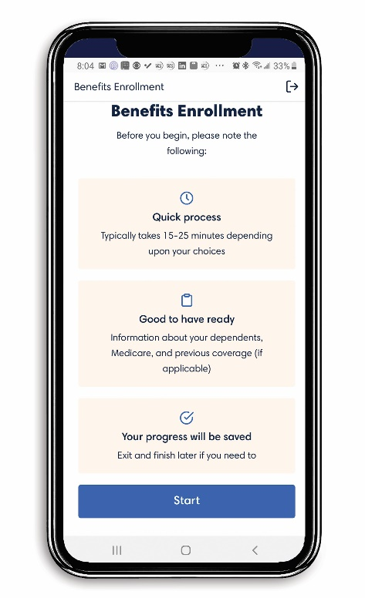

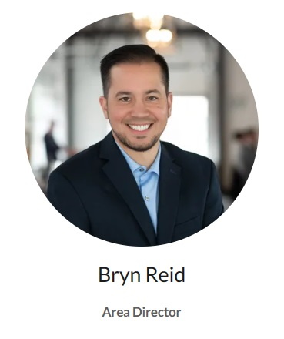
TEAM
TECH
High-Touch
High-Tech

Slide 19

CLIENT SERVICES TEAM

Slide 20
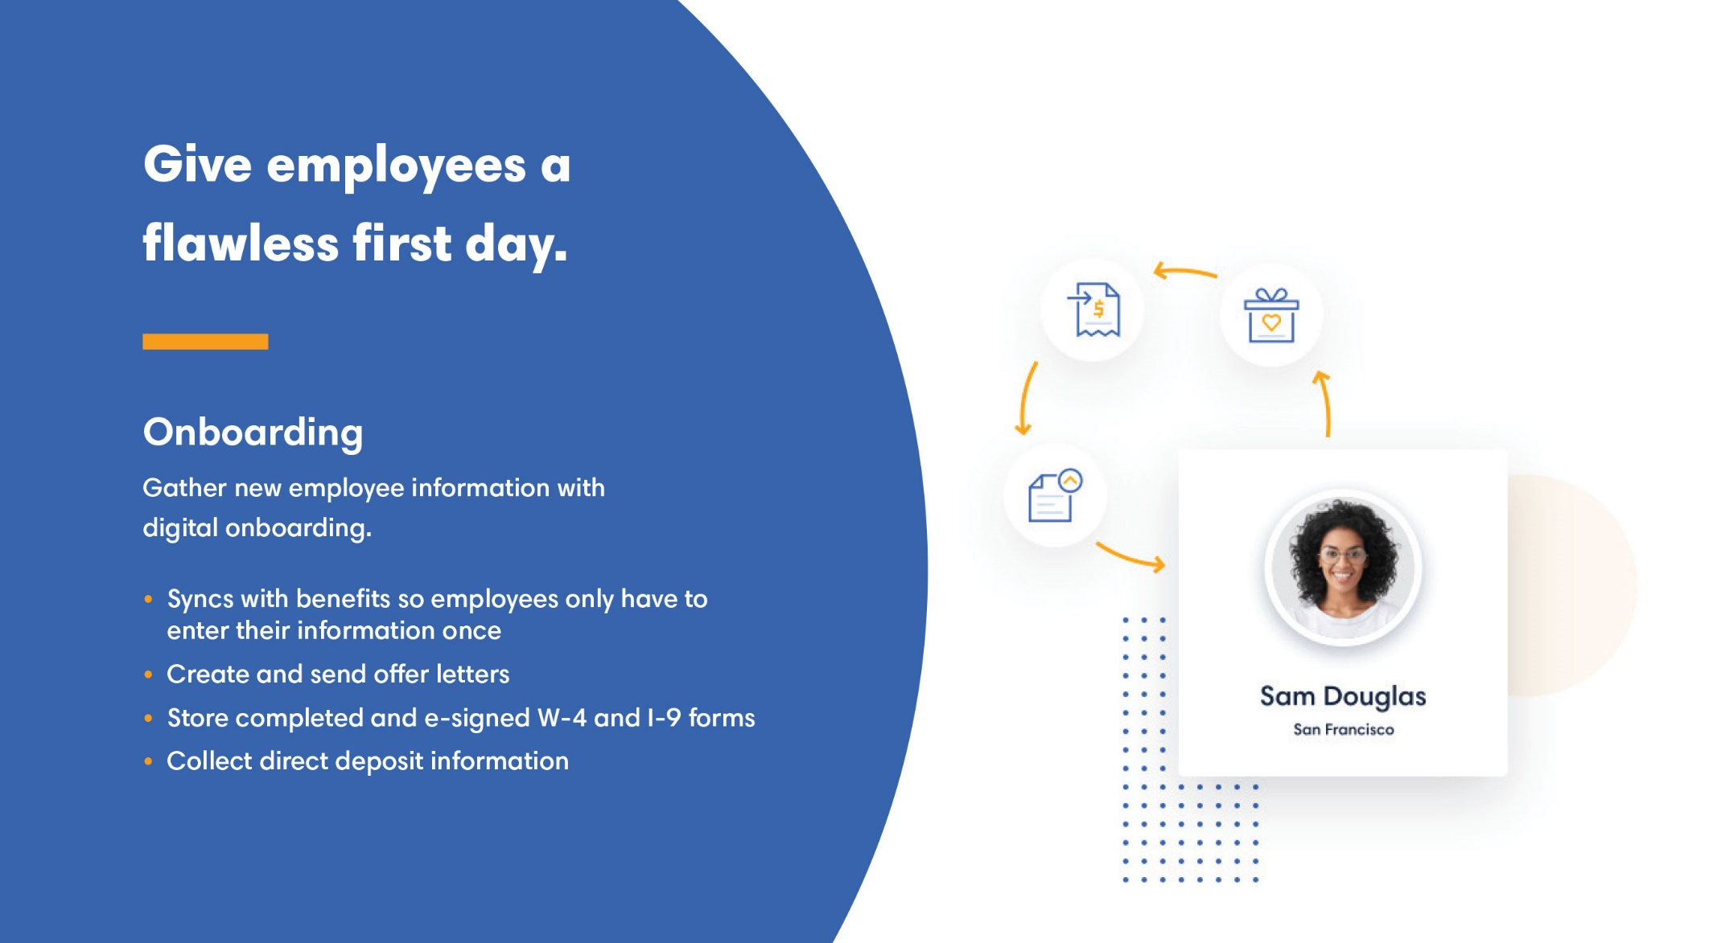

Slide 21
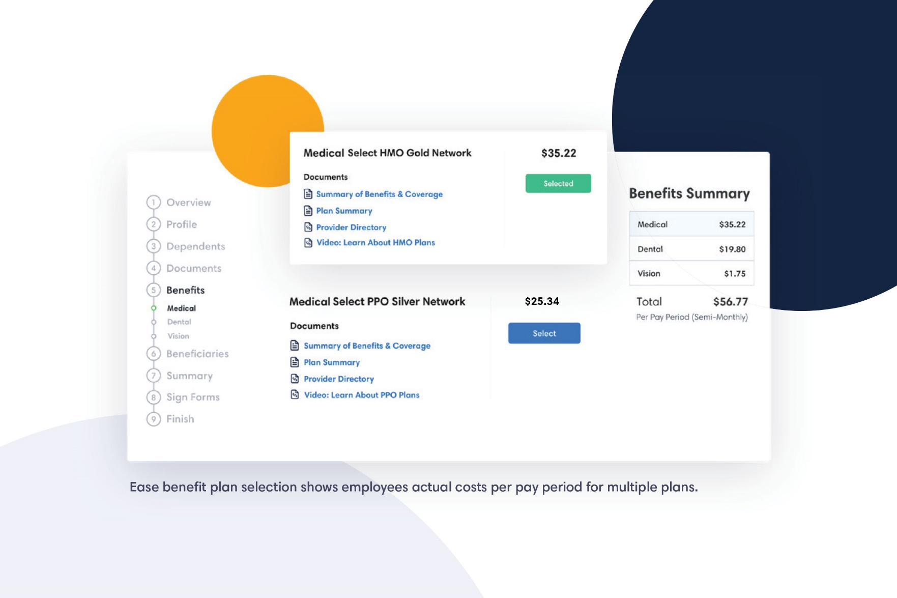

Slide 22
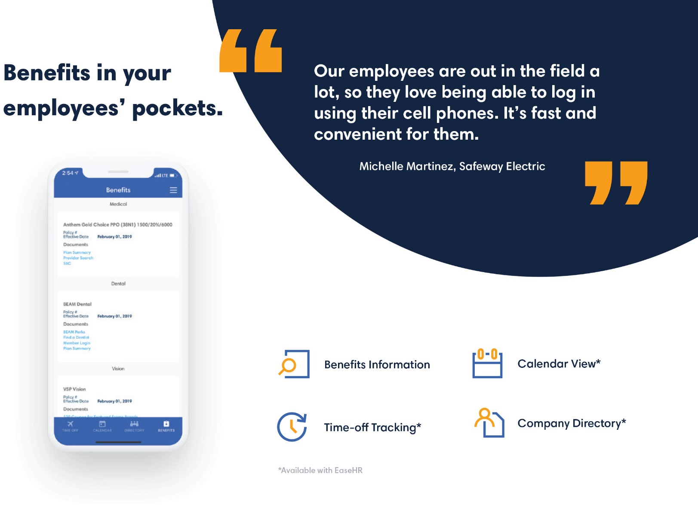

Slide 23



Slide 24

Send an email to ABCtech@xperiencebenefits.com
for any servicing needs for the company and employees.

Slide 25

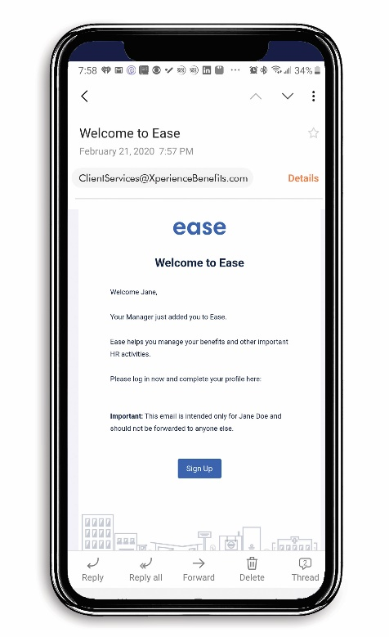
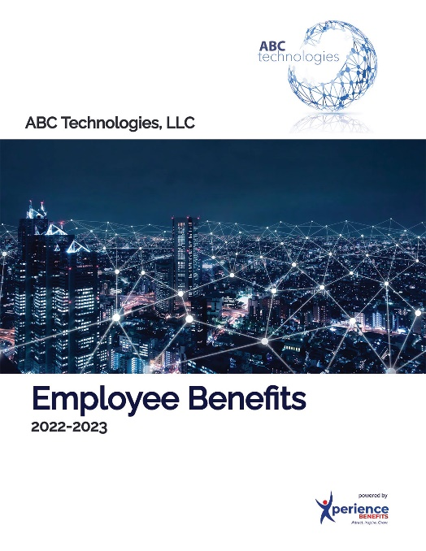

Your Employee Benefits Department
Employee Benefits Portal
Digital Benefits Booklet
Benefits Counseling

Slide 26
All Available at No Cost!

Slide 27


Slide 28

Notes:
Our enhanced strategy goes beyond nice messaging and branding. What really separates Xperience Benefits from the rest of the industry, is our enhanced focus on education and world class service. We truly deliver on our promise.

Slide 29
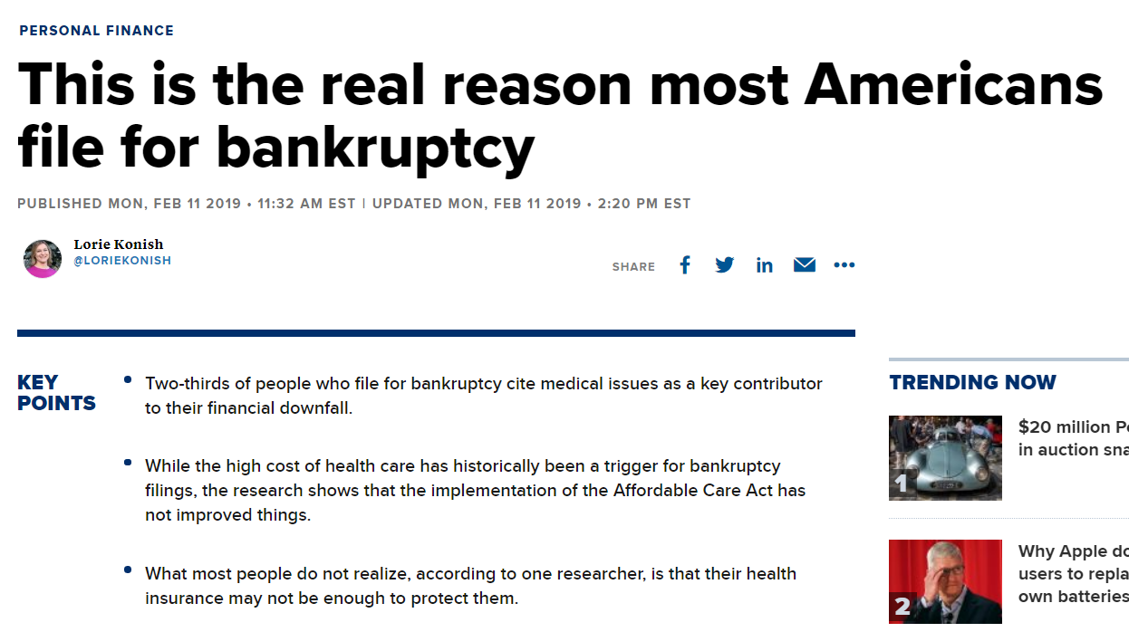
https://www.cnbc.com/2019/02/11/this-is-the-real-reason-most-americans-file-for-bankruptcy.html
Notes:
2/3 of people who file for bankruptcy cite medical issues as a key contributor to their financial downfall.

Slide 30
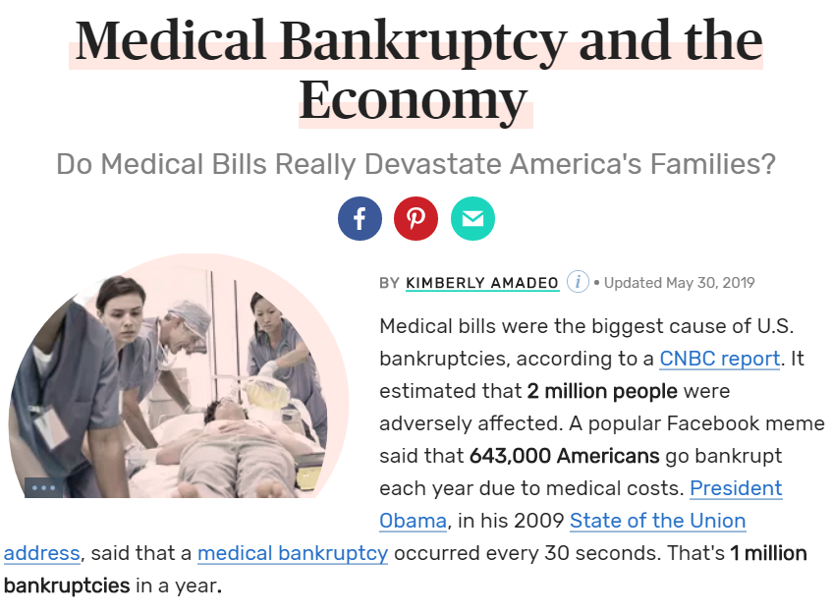
https://www.thebalance.com/medical-bankruptcy-statistics-4154729
Notes:
Do medical bills really devastate America’s families? You be the judge…

Slide 31

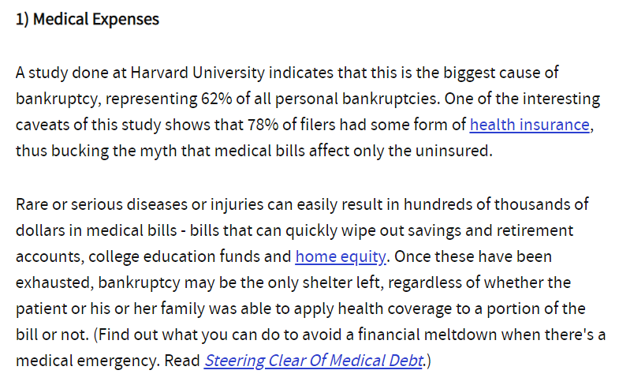
Top 5 Reasons Why People Go Bankrupt
https://www.investopedia.com/financial-edge/0310/top-5-reasons-people-go-bankrupt.aspx
Notes:
A study done at Harvard University indicates that this (medical bills) is the biggest cause of bankruptcy…

Slide 32
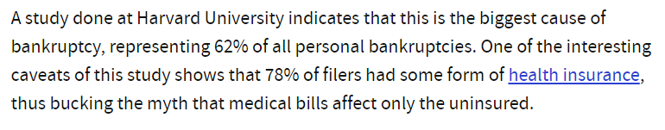
Medical Bills are the #1 Reason for Bankruptcy in America Today
“78% of filers had some form of
health insurance”
https://www.investopedia.com/financial-edge/0310/top-5-reasons-people-go-bankrupt.aspx
Notes:
…and most of them had health insurance. “78% of filers had some form of health insurance.”

Slide 33

Education
Notes:
We believe this epidemic to the financial downfall for American’s today has 1 major factor: lack of education. These programs are complex and confusing and unfortunately, education is greatly lacking in our industry. Xperience Benefits is on a mission to revolutionize the industry through a greater focus on education!

Slide 34

Benefits Counseling
Notes:
We provide benefits counseling for all employees. These sessions are confidential, customized, and complimentary.

Slide 35
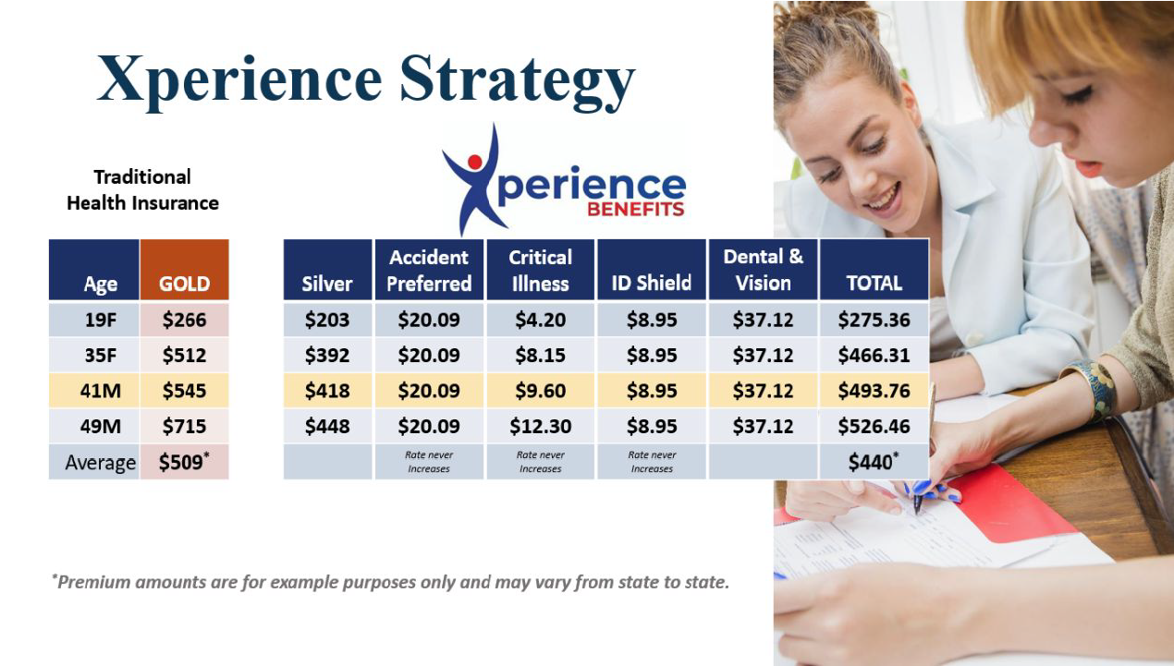
Notes:
Traidtional broker model vs. Xperience Strategy

Slide 36
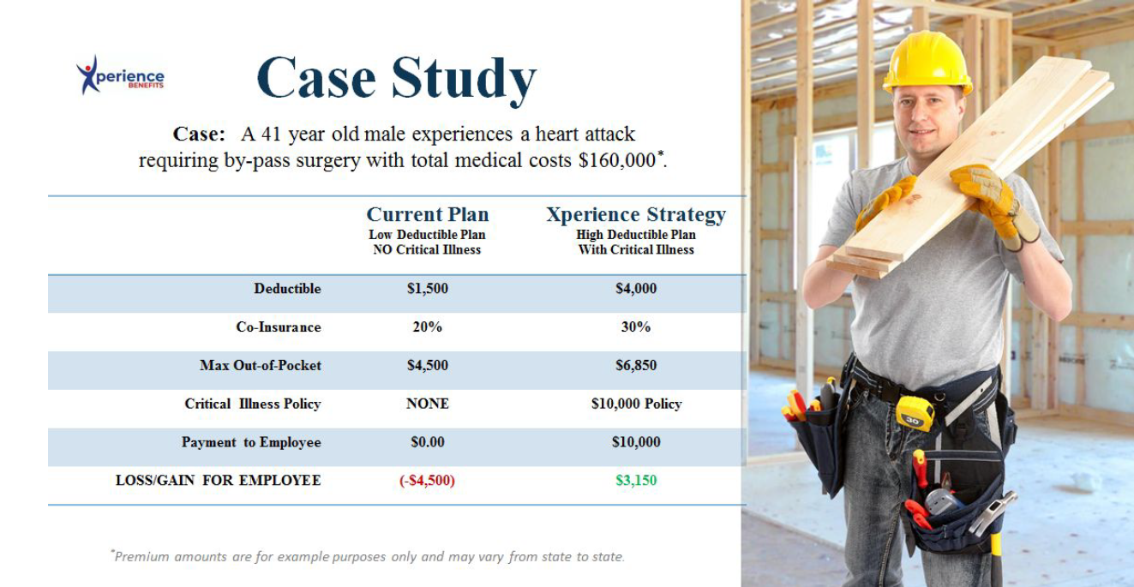
Notes:
This case study shows a side by side comparison of most traditional “health insurance only focus” vs. Xperience Strategy.

Slide 37
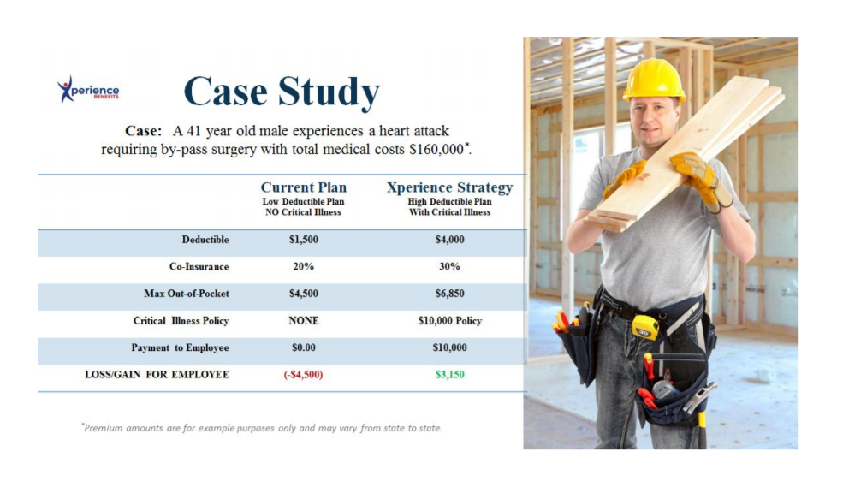
Health Insurance Only
Notes:
Employee is responsible for out of pocket expenses, not covered by health insurance.

Slide 38
Xperience Strategy
Notes:
Employee actually profits from Xperience Strategy!

Slide 39
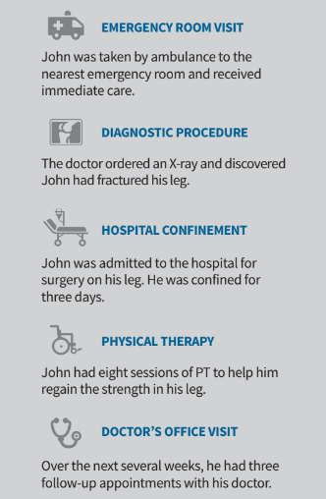
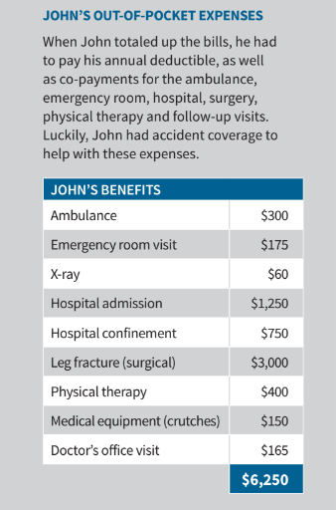
Notes:
Employees get paid cash from Enhanced Supplemental Benefits.

Slide 41

Notes:
Thank you for joining us! Let’s schedule your strategy meeting!

