Slide 1

Benefits | Payroll | HR
Your Employee Benefits Department

Slide 2
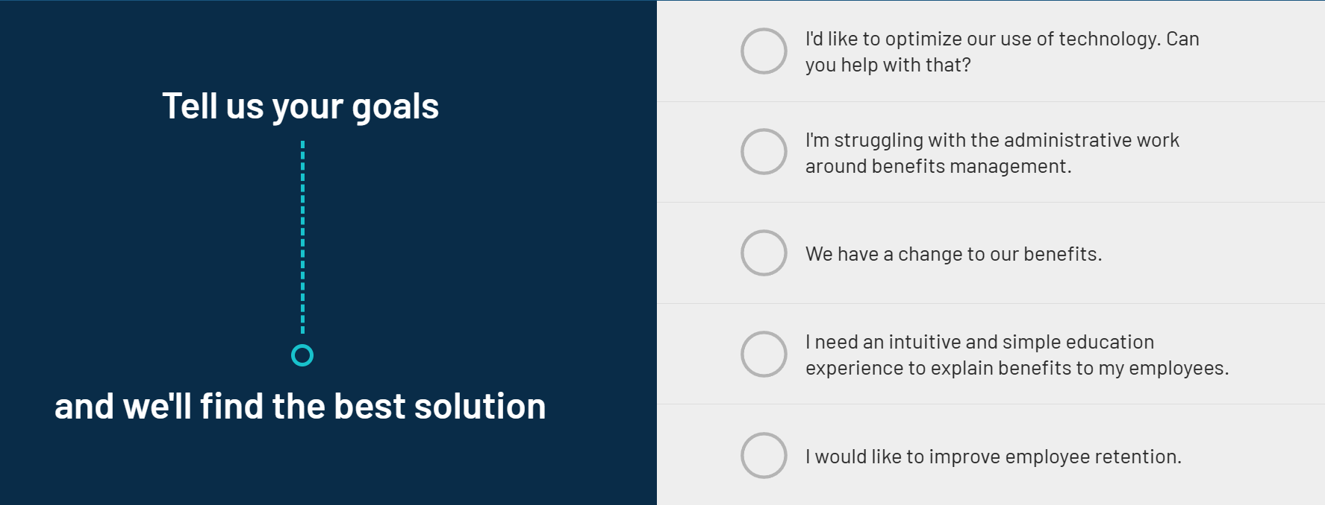
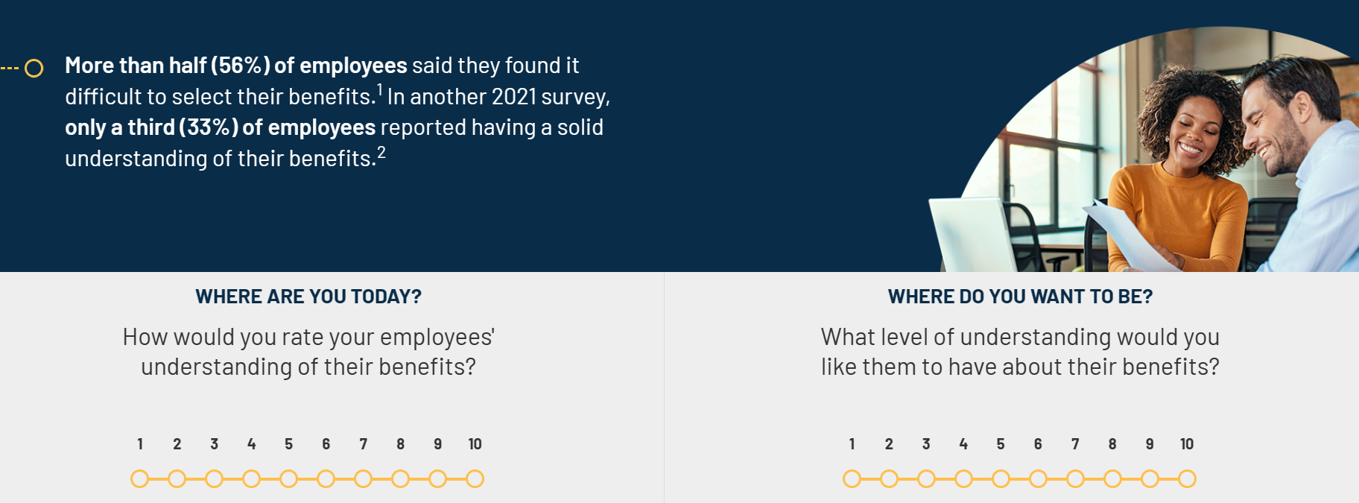

Slide 3


Slide 4



Slide 5
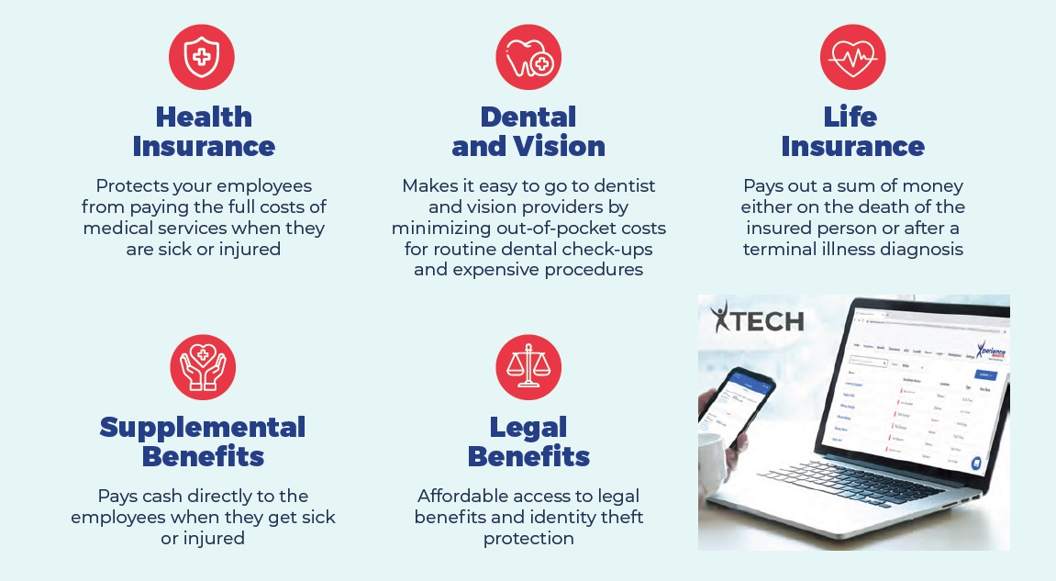

Slide 7
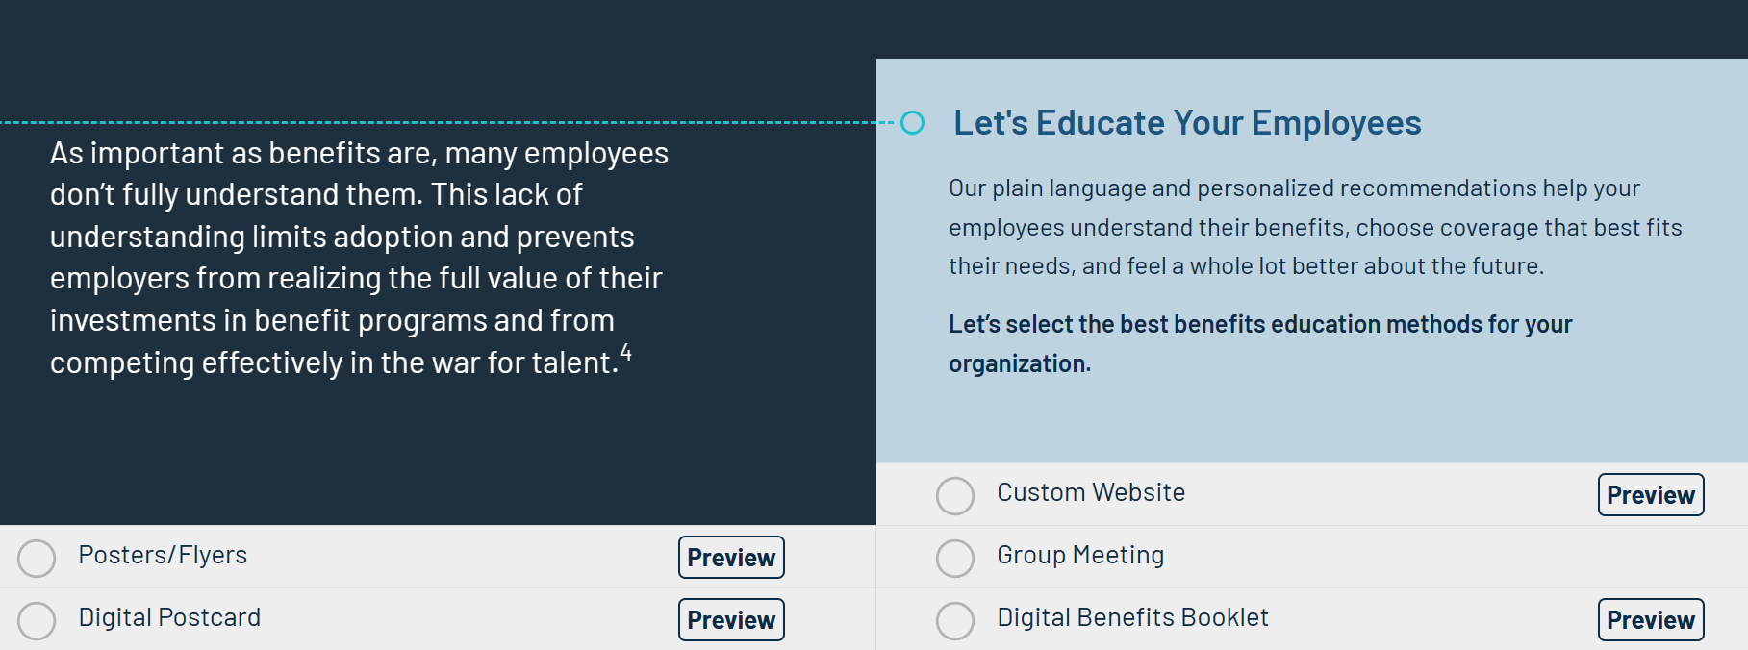

Slide 8
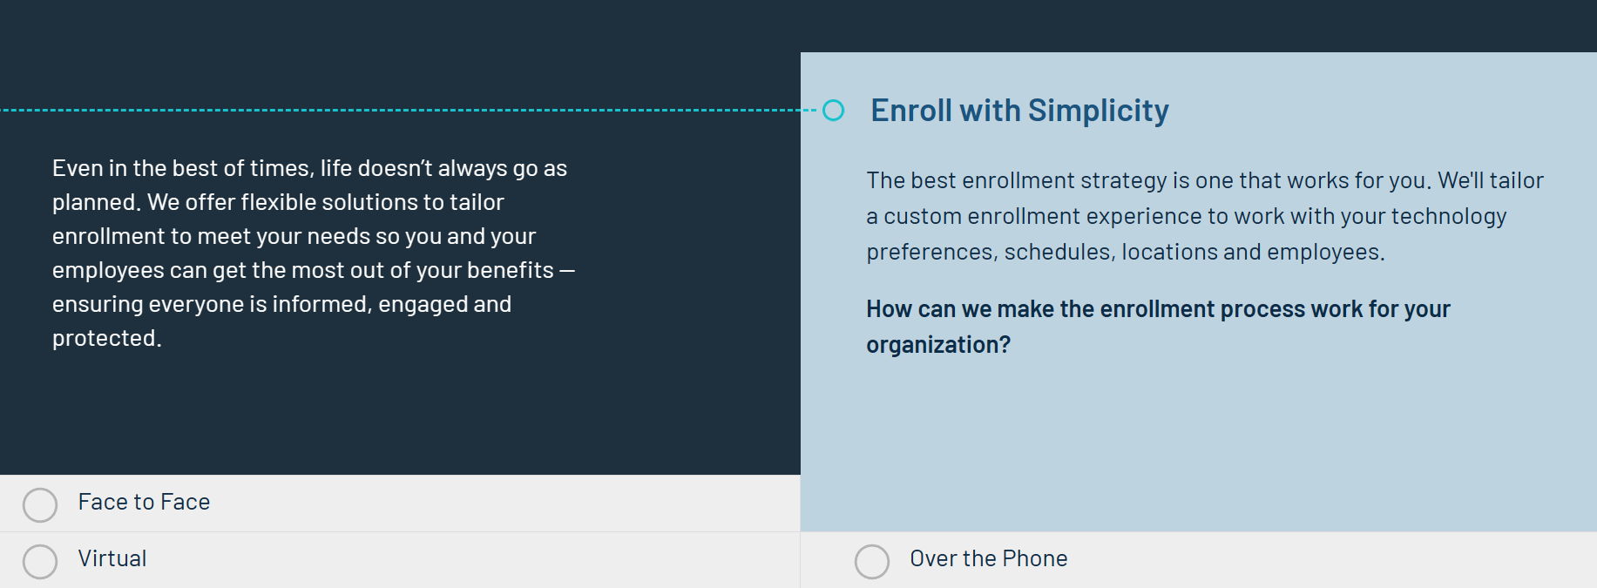

Slide 9
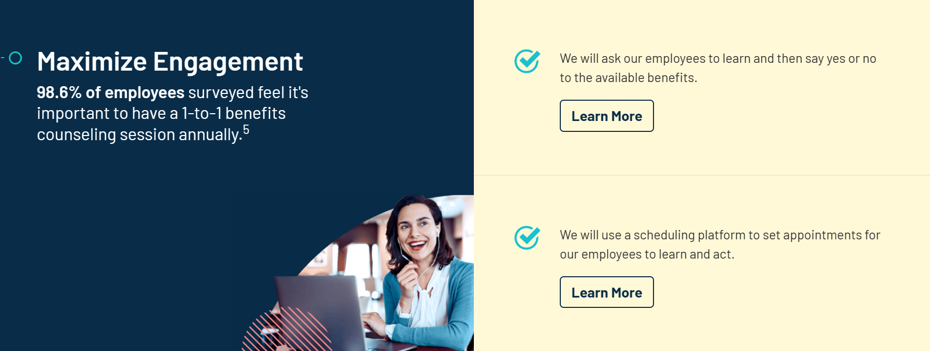

Slide 10
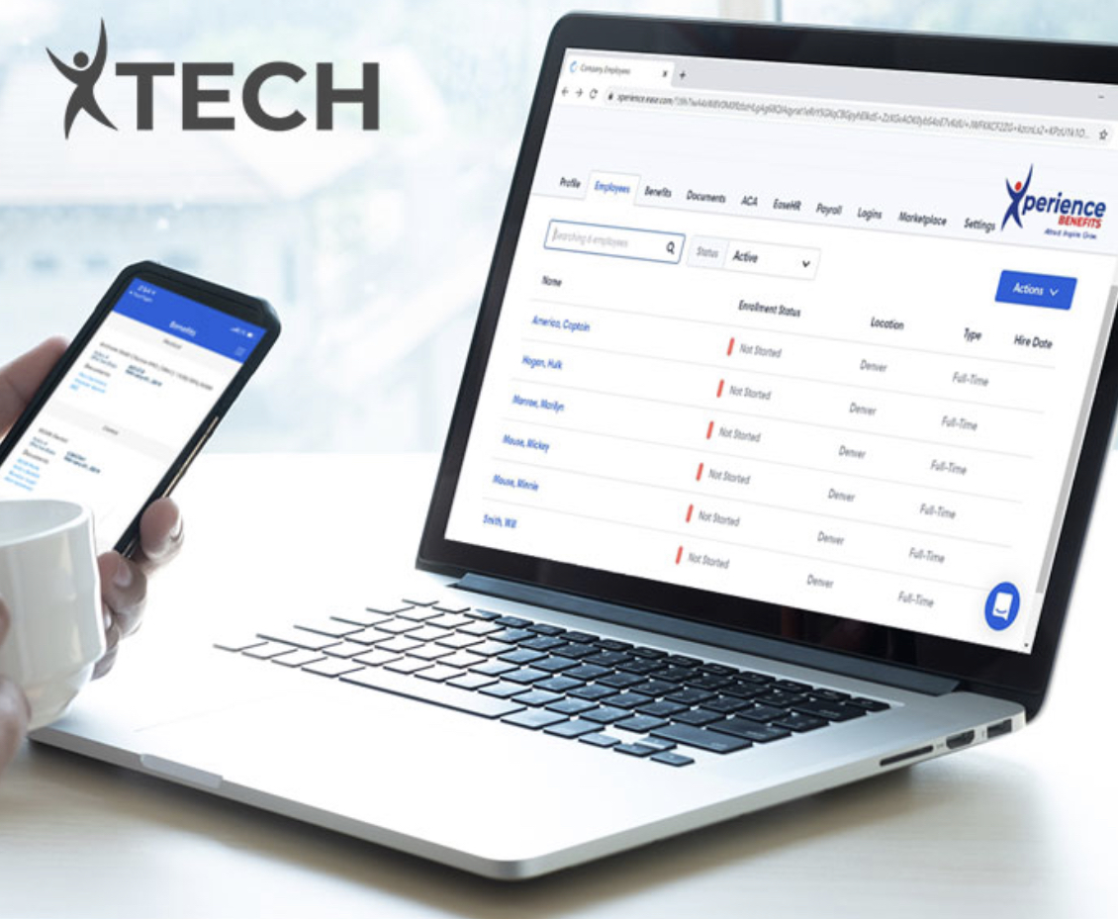

Innovative Modern Strategies
High Tech
High Touch

Slide 11

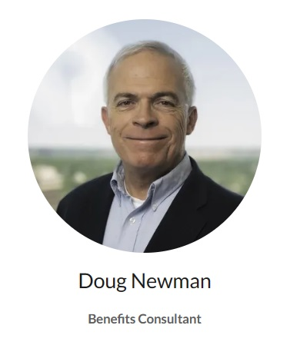
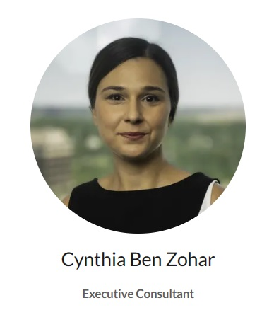
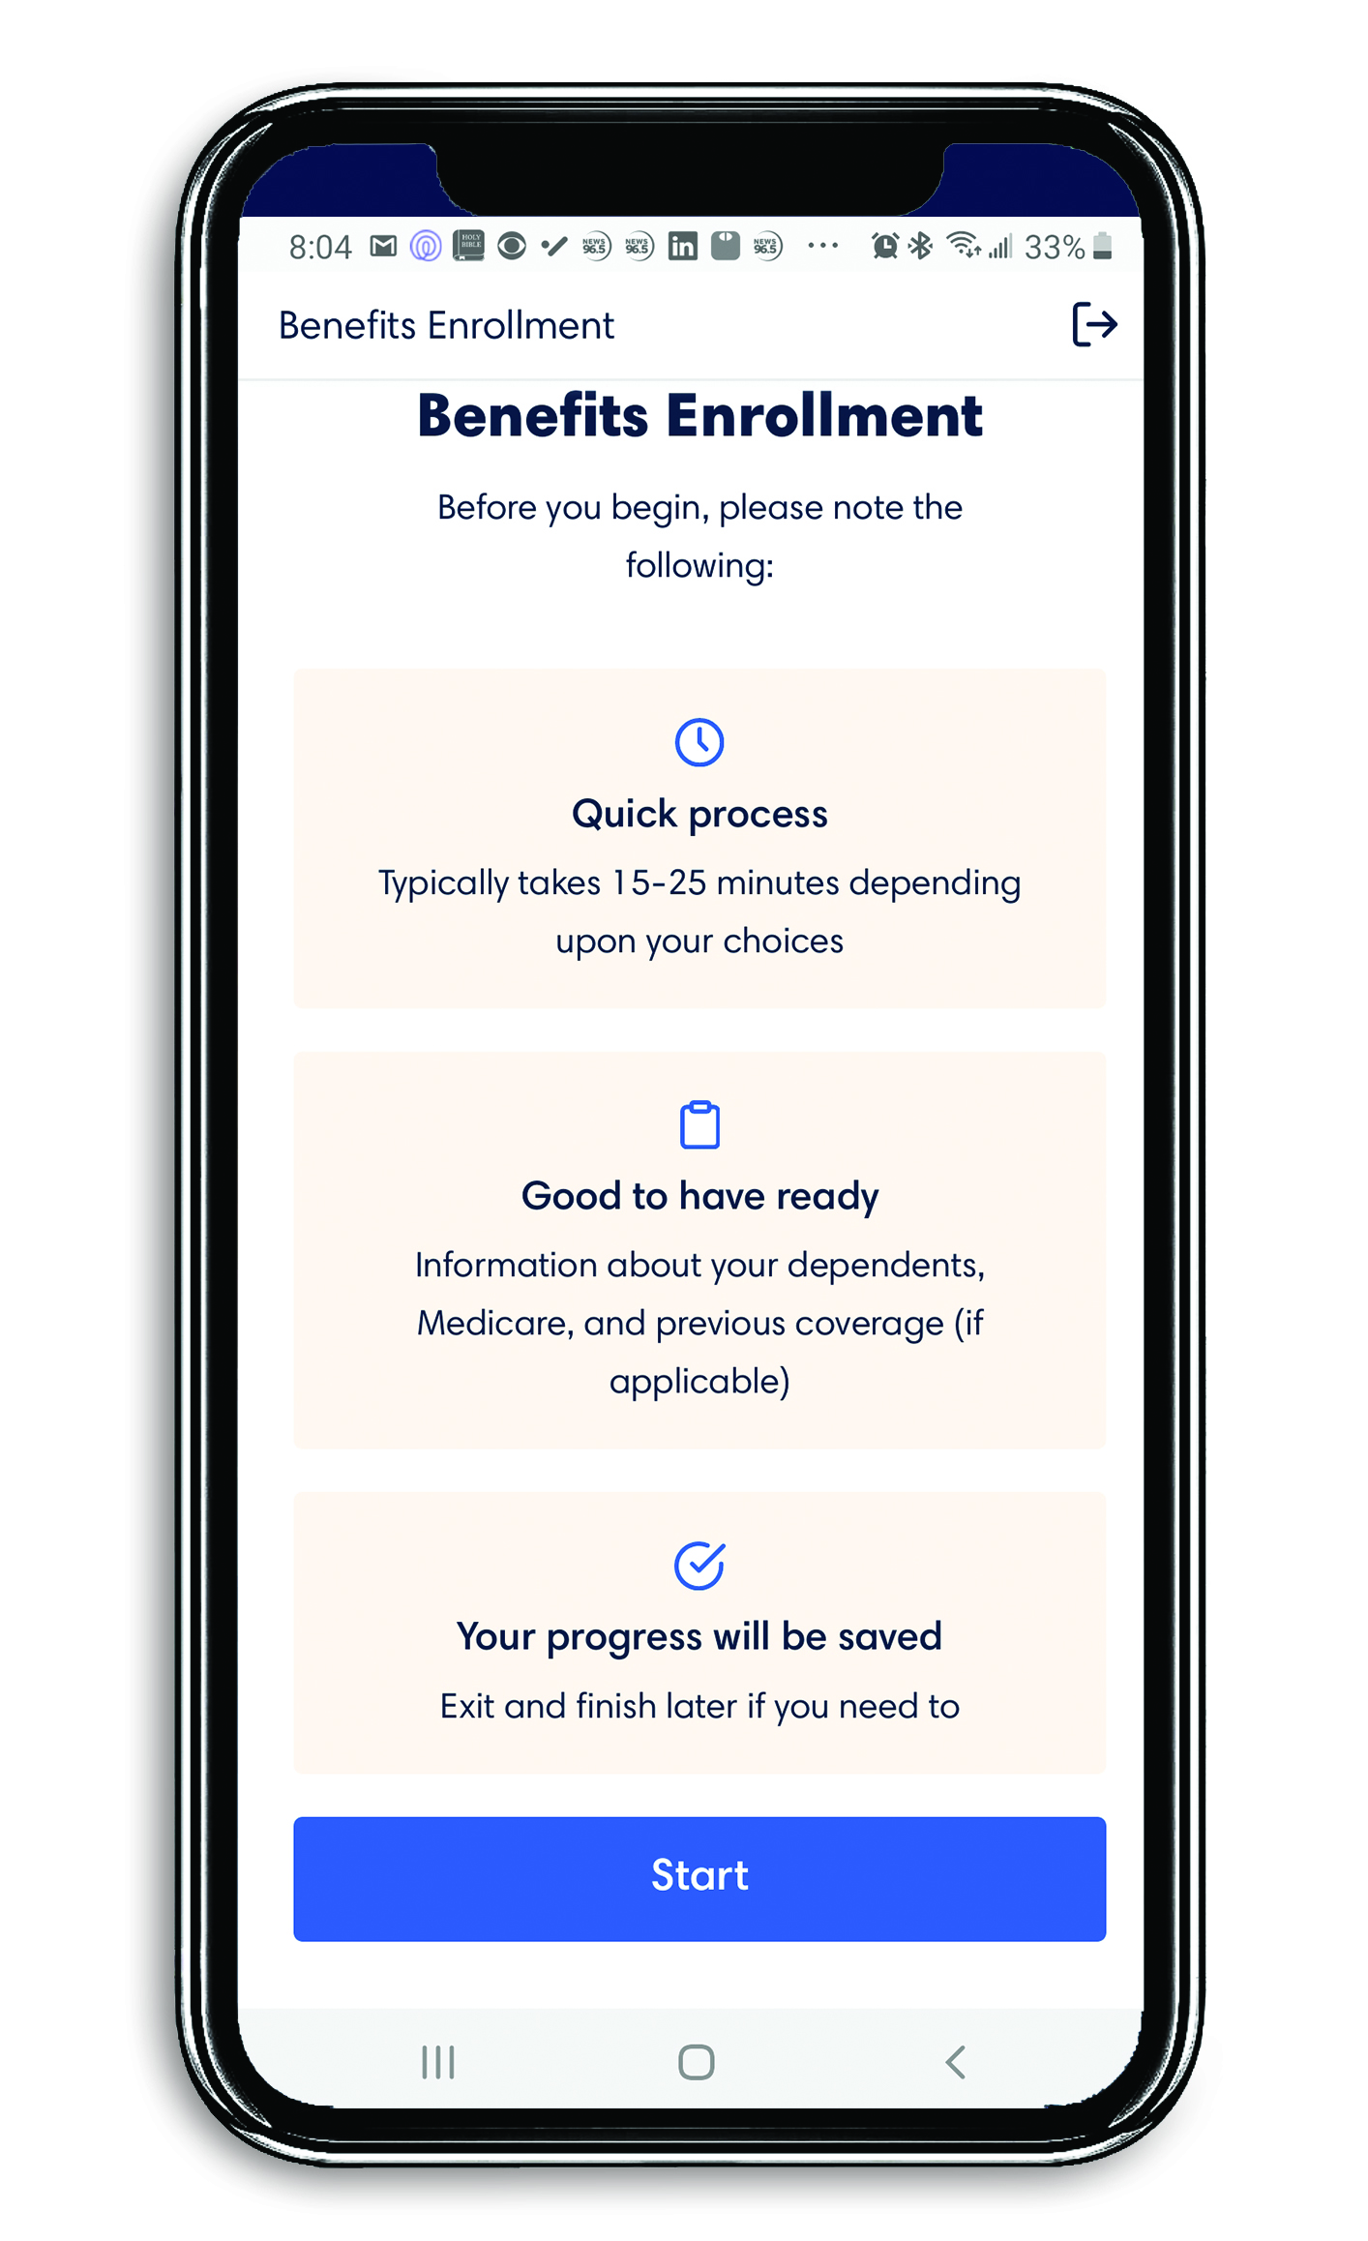

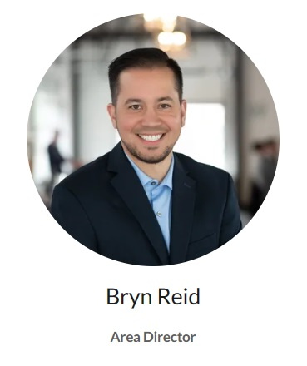
TEAM
TECH
High-Touch
High-Tech

Slide 12
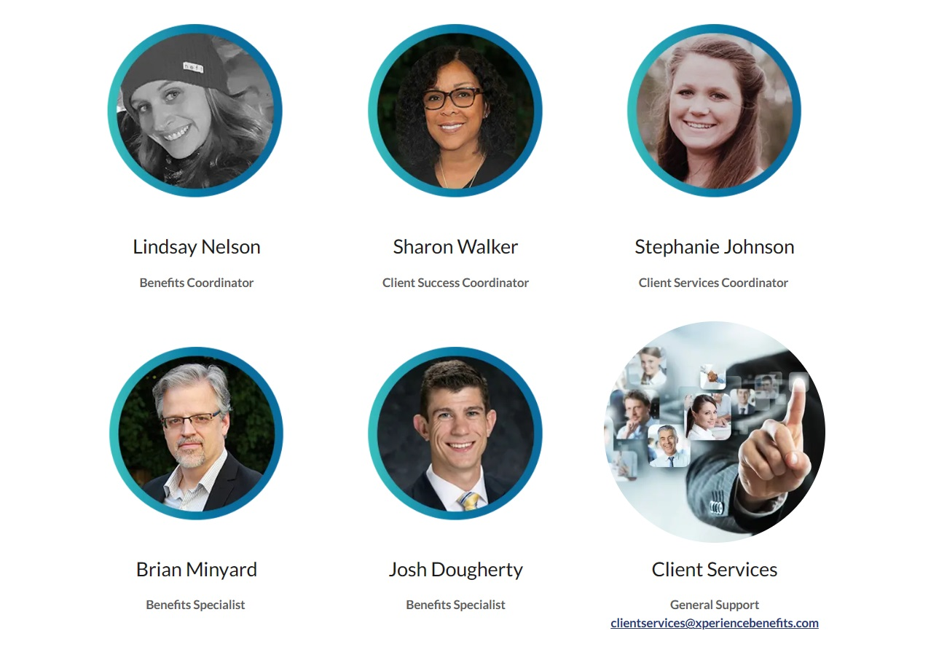
CLIENT SERVICES TEAM

Slide 13
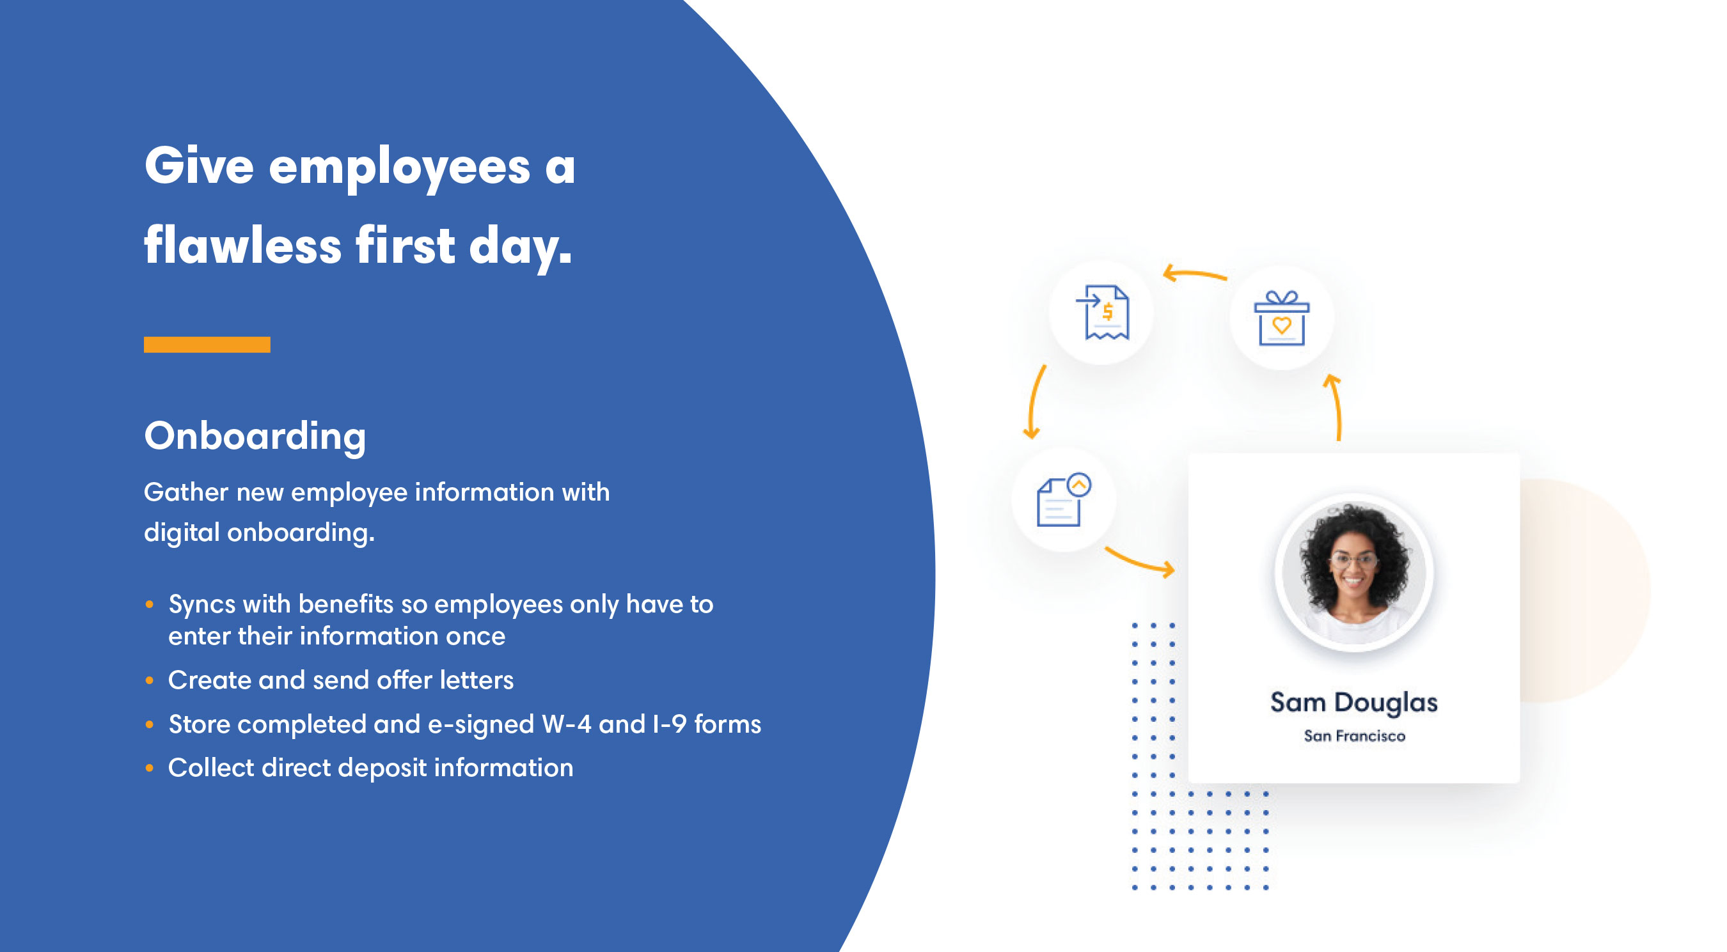

Slide 14
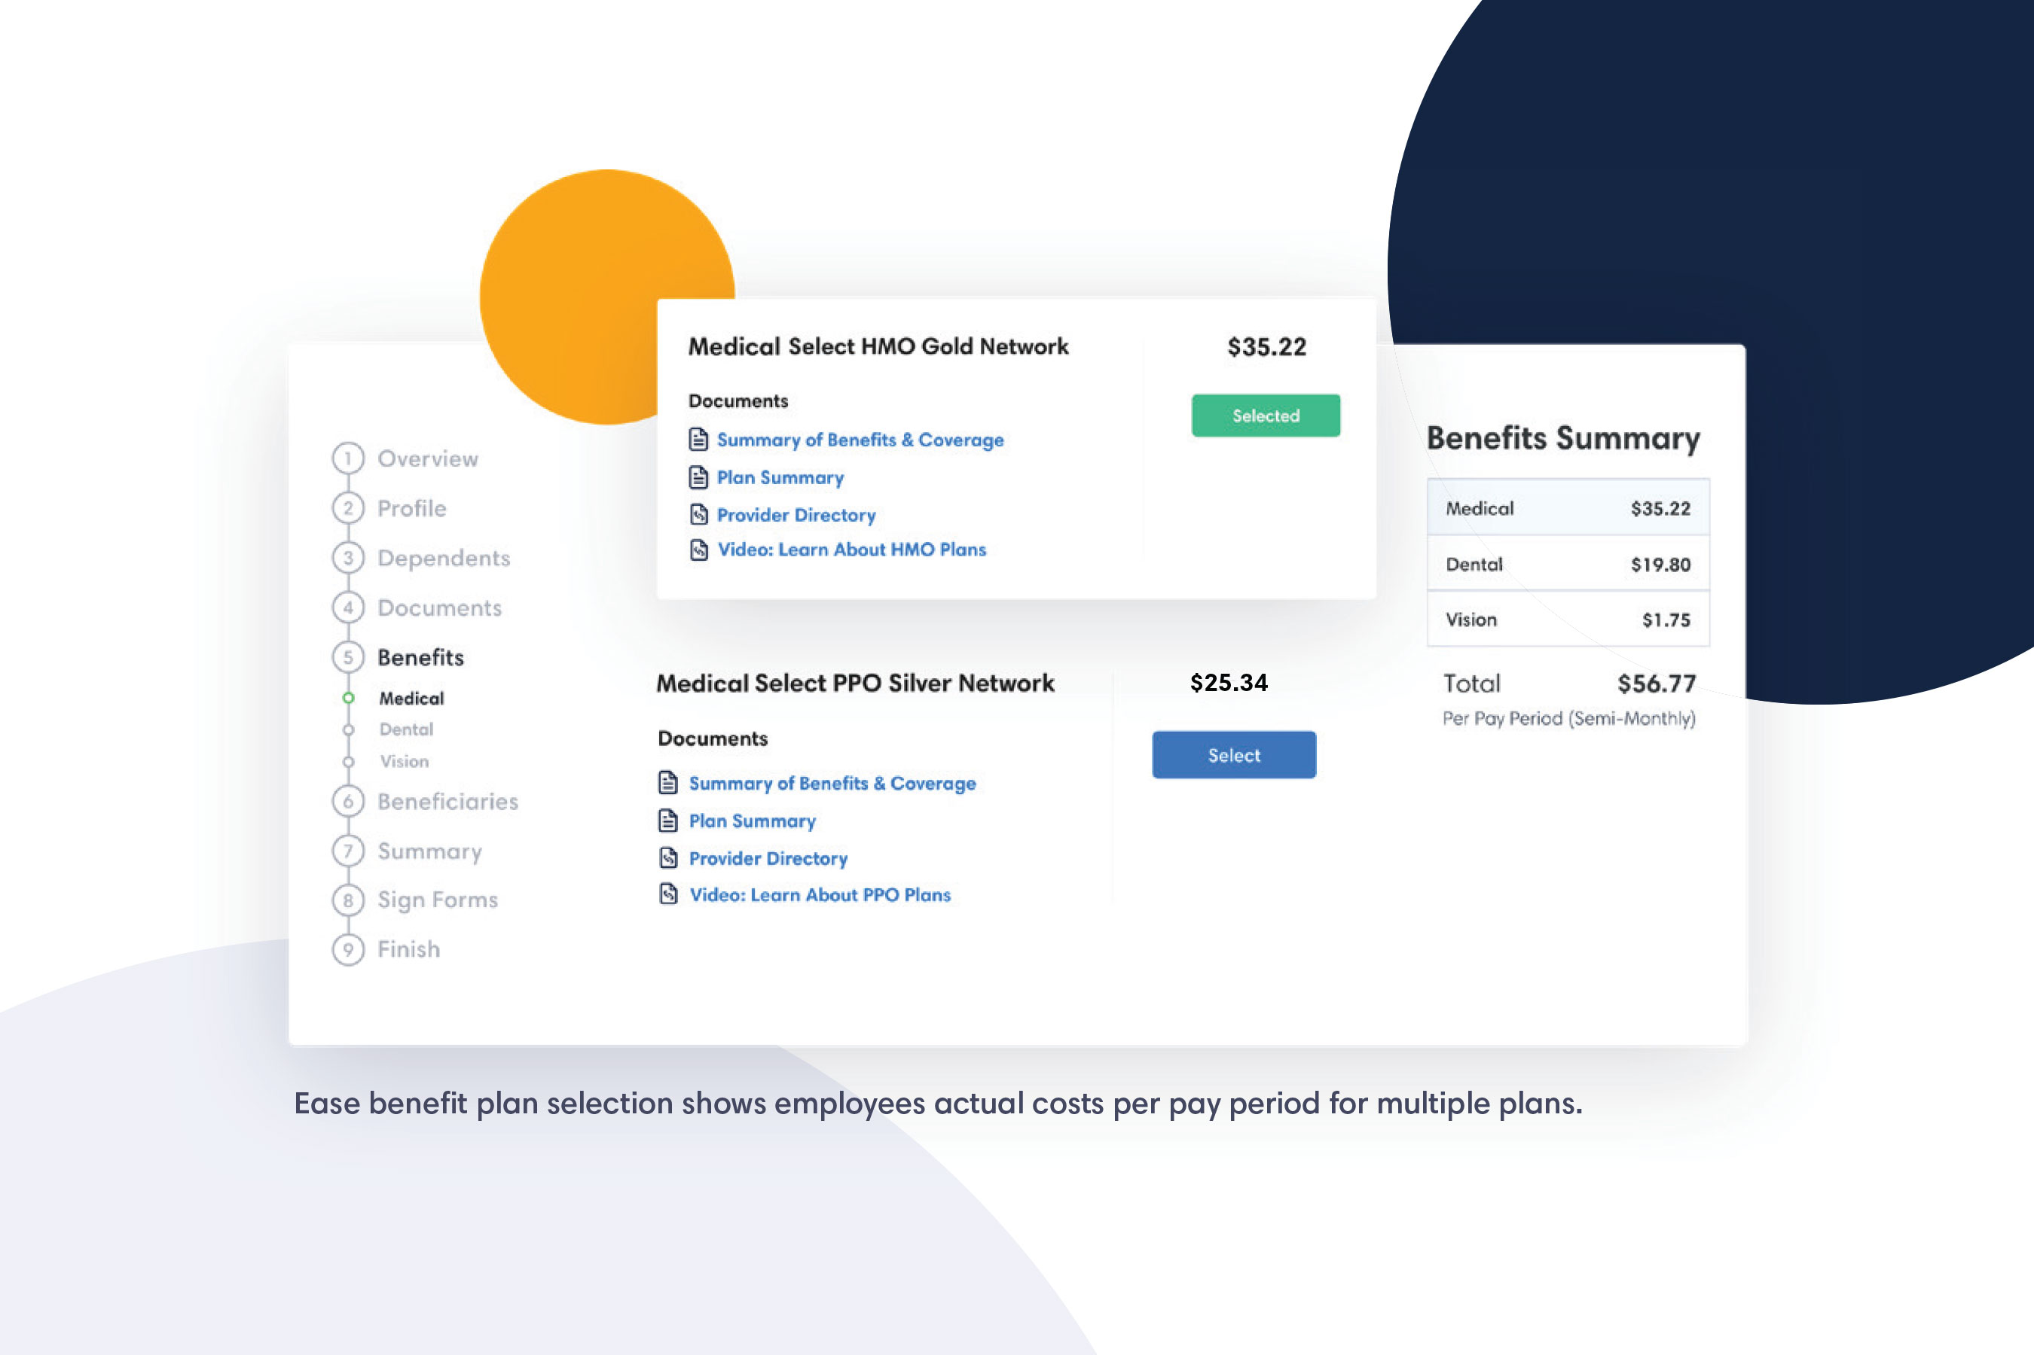

Slide 15
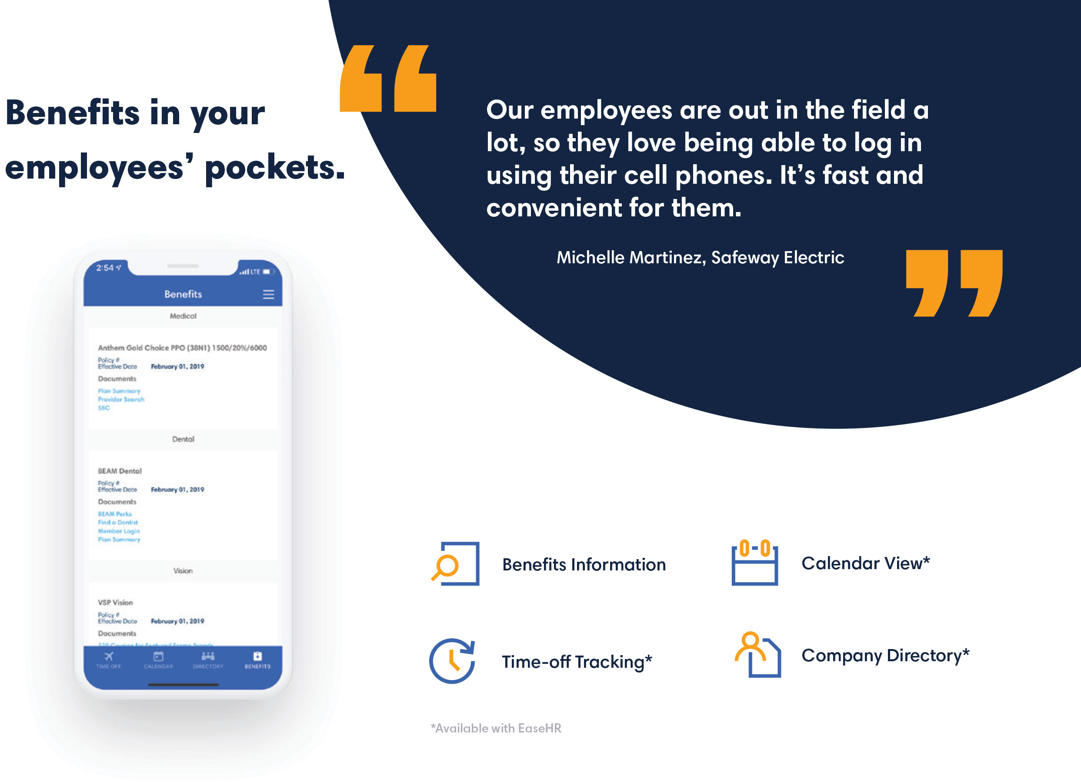

Slide 16


Slide 17

Send an email to ABCtech@xperiencebenefits.com
for any servicing needs for the company and employees.

Slide 18
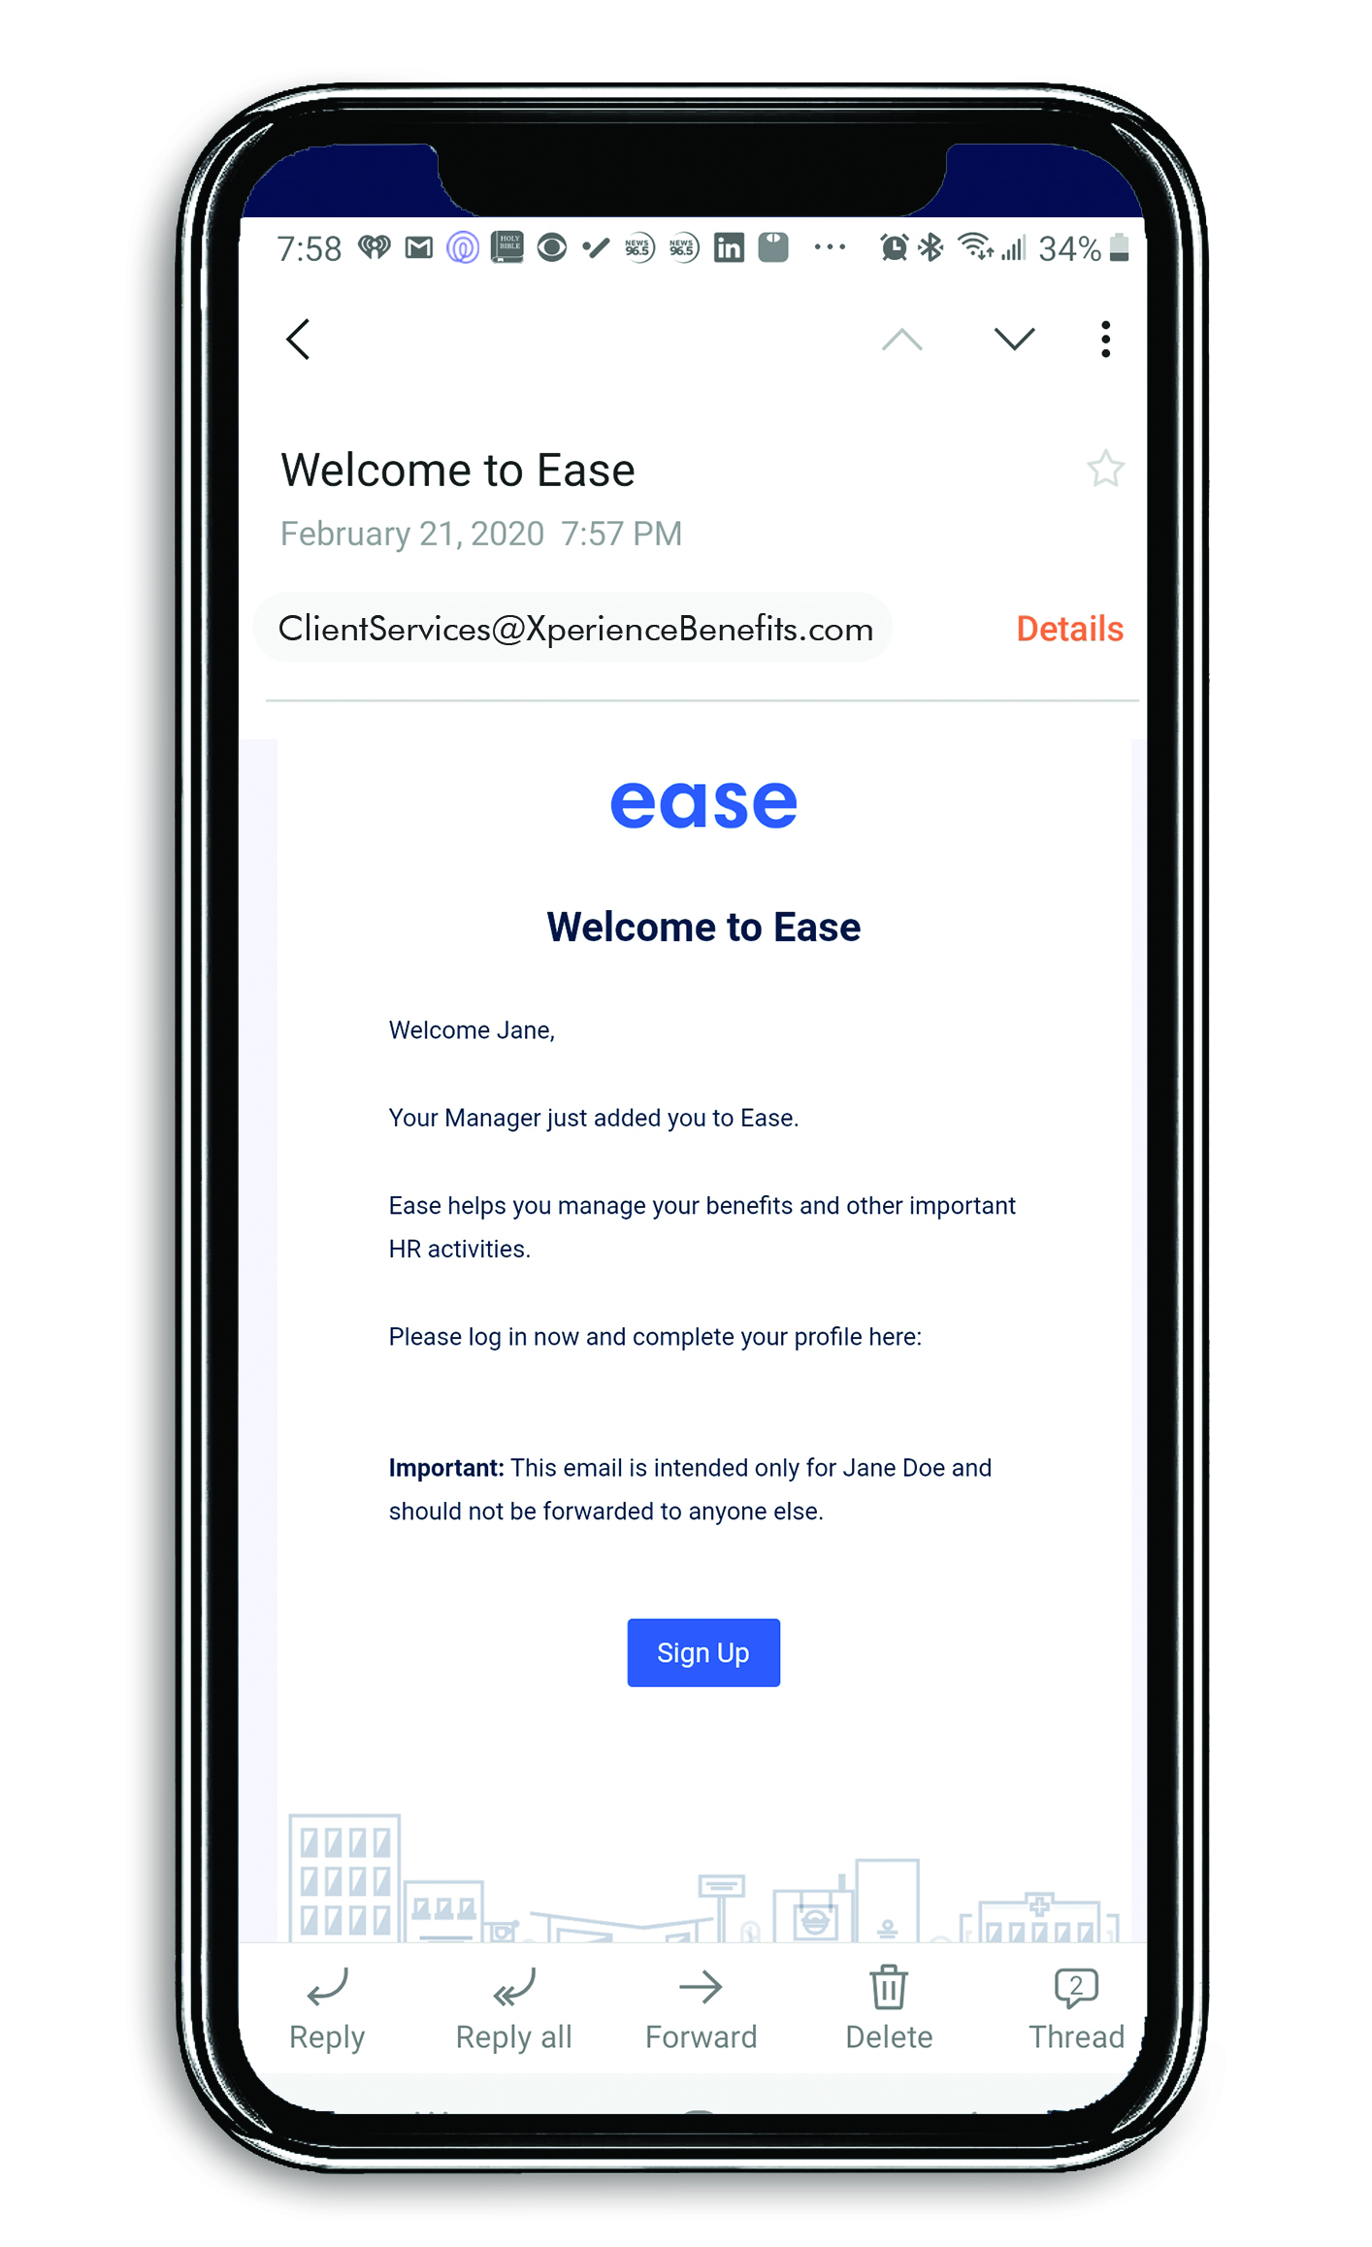


Your Employee Benefits Department
Employee Benefits Portal
Digital Benefits Booklet
Benefits Counseling

Slide 19
All Available at No Cost!

Slide 20
Next Steps
The following steps will be needed to provide an initial strategy recommendation for the Strategy Meeting:
Complete New Client Discovery Form
  This will activate Client Services
Collect Employee Census
  Carriers require this to get quotes for pricing
Collect Carrier Documents (if applicable)
  This will help us perform a cost savings analysis

Slide 21


