Slide 1


Roll-Intuit Training Manual Consult
Setting your expectations and then exceeding them.

Slide 2



Objective:
The purpose of this proposal is to outline the establishment of a training manual that is focused on customer service and operational aspects for Global Household Goods Relocation, including Global Logistics and Global Relocation Pricing. This initiative aims to provide students with a holistic understanding of the intricate processes and considerations involved in international relocation.

Slide 3
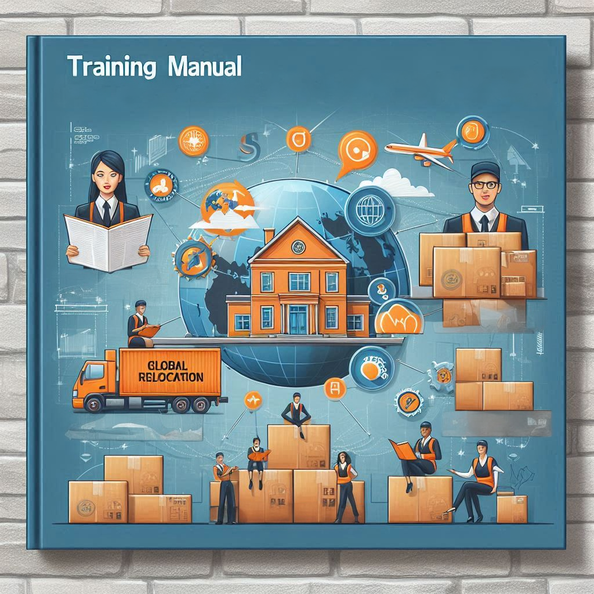
Training Manual Components:
Global Household Goods Relocation, Customer Service & Operational Handling.
Global Logistics.
Global Relocation Pricing.

Slide 4

Global Household Goods Relocation Customer Service & Operational Handling.
In-depth explanation and instructions for customer services and operational handling of full-service household goods relocation.
Understanding customs regulations and documentations for smooth international transit.
Practical insights into handling processes and communications during the relocation process.

Slide 5

Global Logistics.
Comprehensive overview of international shipping methods and logistics networks.
Analysis of supply chain management and optimization for global relocation.

Slide 6

Global Relocation Pricing.
Examination of factors influencing relocation pricing, including weight, volume, mode, origin, and destination.
Strategies for cost estimation and budgeting in global relocation projects.

Slide 7
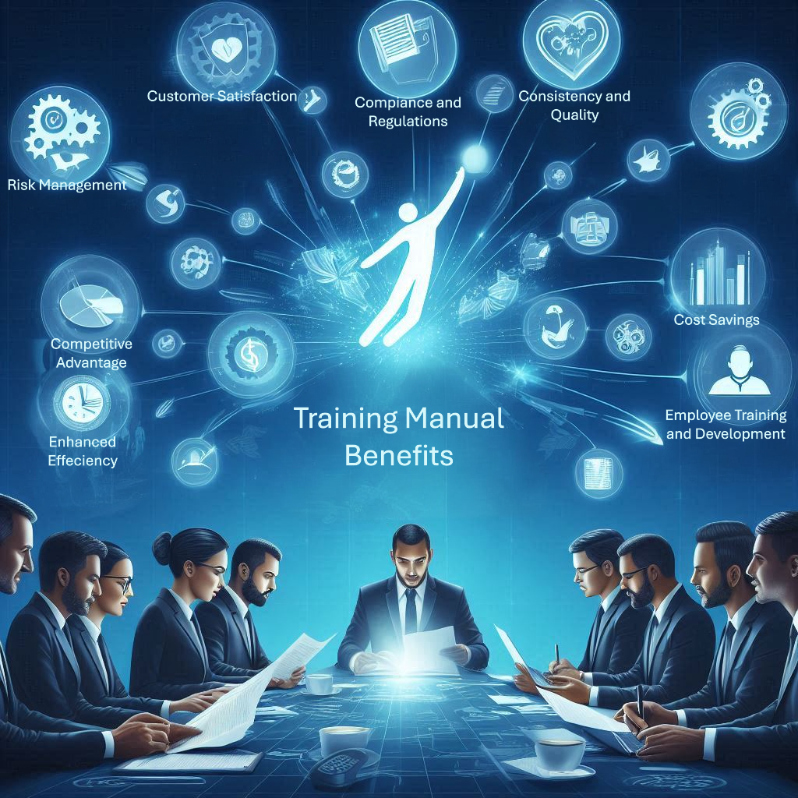
Benefits.
Cost Savings: By optimizing processes and reducing inefficiencies, the manual helps lower operational costs, increasing profitability for your company. The manual also reduces time taken away from your management team required for training new and existing employees.
Enhanced Efficiency: The manual provides detailed procedures and best practices that streamline operations, reducing time and effort required for each relocation task. This leads to faster and more efficient service delivery.
Consistency and Quality: By standardizing processes, the manual ensures that every team member follows the same high-quality protocols, resulting in consistent and reliable service across all relocations.
Employee Training and Development: The manual includes extensive training modules that help new employees quickly get up to speed and existing employees continuously improve their skills. This fosters a knowledgeable and competent workforce.

Slide 8
Benefits continued...
Risk Management: The manual outlines strategies for mitigating common risks associated with international relocations, such as customs issues and logistical challenges. This proactive approach minimizes disruptions and enhances overall reliability.
Compliance and Regulations: It provides up-to-date information on international regulations and compliance requirements, ensuring that your company stays compliant with all industry and legal standards, avoiding costly fines and delays.
Customer Satisfaction: With clear guidelines and best practices, the manual helps ensure that customers receive top-notch service, leading to higher satisfaction rates and repeat business.
Competitive Advantage: Implementing the best practices and strategies outlined in the manual can give your company a competitive edge in the market, attracting more clients and establishing a strong reputation.

Slide 9

Additional Benefits.
Fully customizable training manual carefully curated to fit your company’s processes and moving system(s).
We’re most familiar with the following moving systems: Moveware, Movers Suite, RedSky, and Odyssey.
Quick reference guide for most used terms with definitions, explanations, and insights on how the industry utilizes them to help lessen the confusion of jargon.
Samples of customizable documentations utilized through the entire household goods relocation process.
Hyperlinks to various commonly used websites. (Network of agencies, Customs guides, freight tracking websites, etc.)
Plug and play conversion guide. (LBS to KGS, CUFT to CBM, CUFT to KGS ACW, Etc.)
Last but not least, you’ll be keeping all of the training material within the training manual forever!

Slide 10
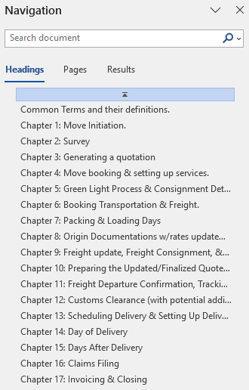
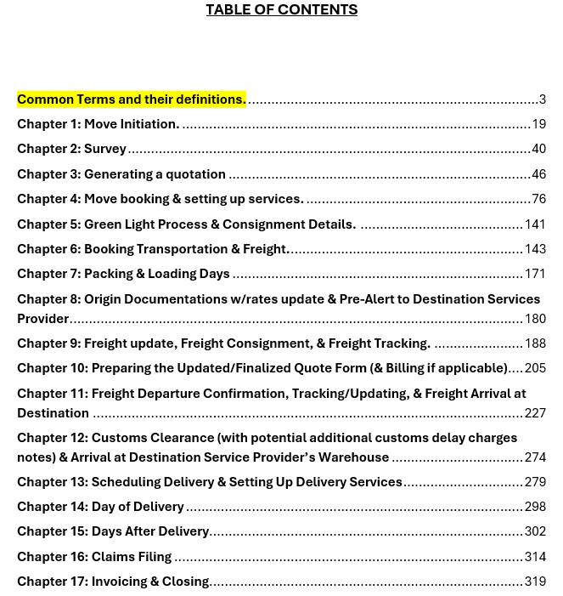
screen shots from the training manual
Not including the common terms and their definitions, this training manual has 17 chapters.
Each chapter is linked to the navigation panel as well as linked to the table of contents.
(A total of 322 pages end to end & still growing.)

Slide 11
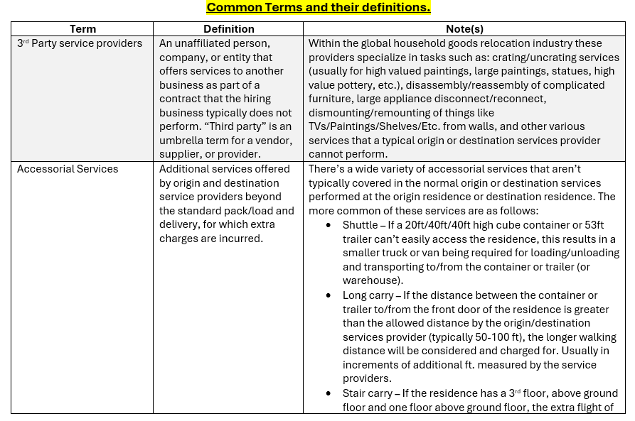
screen shots from the training manual continued…
Common Terms, their definitions, and specialized notes to provide insight beyond the technical definitions.

Slide 12
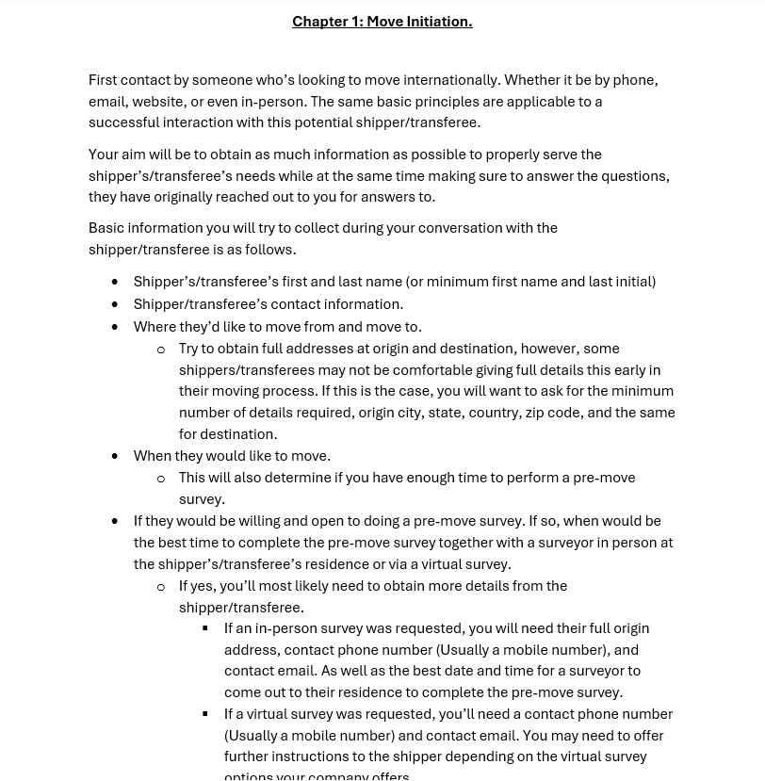
screen shots from the training manual continued…
Each chapter follows the flow of the move process.
Offering not only the basic details but insight as to why each basic detail is important to the move process as a whole.

Slide 13
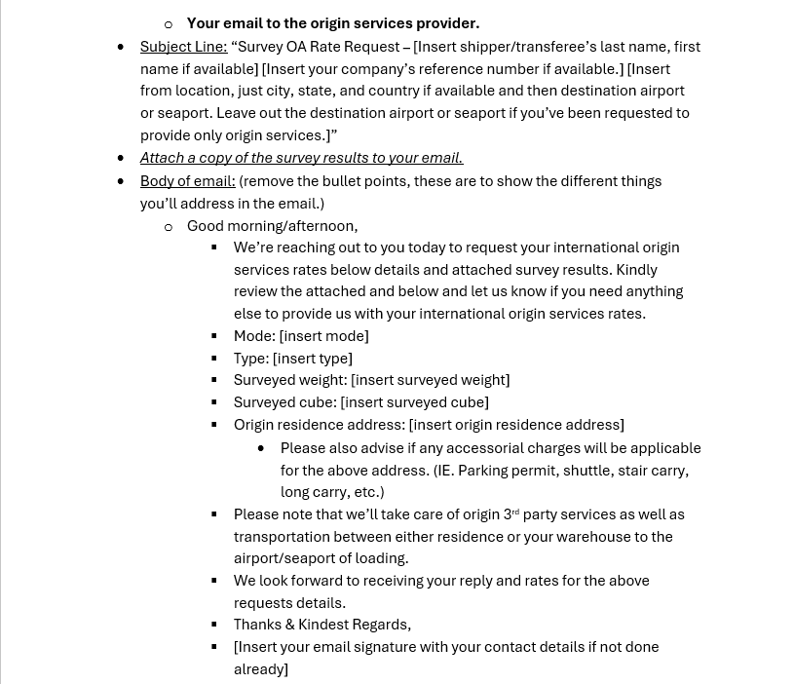
screen shots from the training manual continued…
Customizable email structure instructions throughout the training manual.

Slide 14
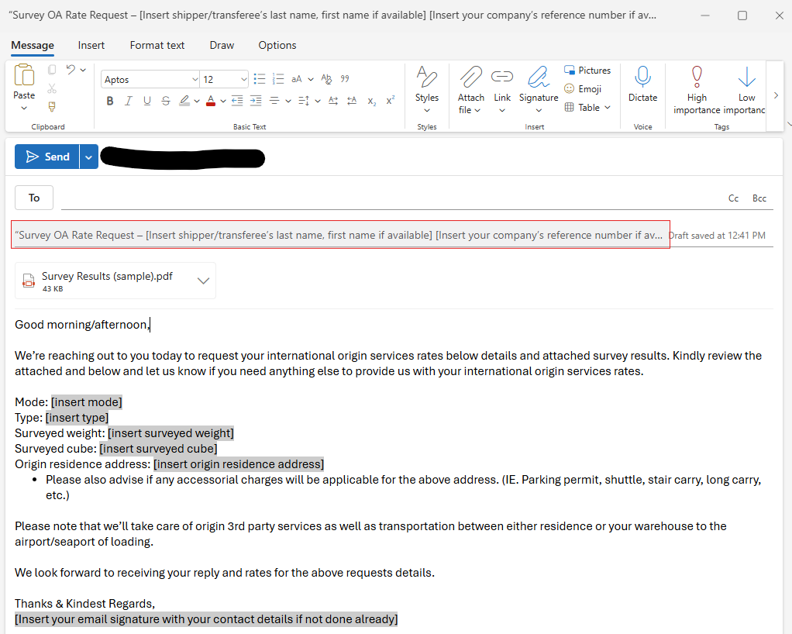
screen shots from the training manual continued…
Screen shots of how the emails would look in an actual email.

Slide 15
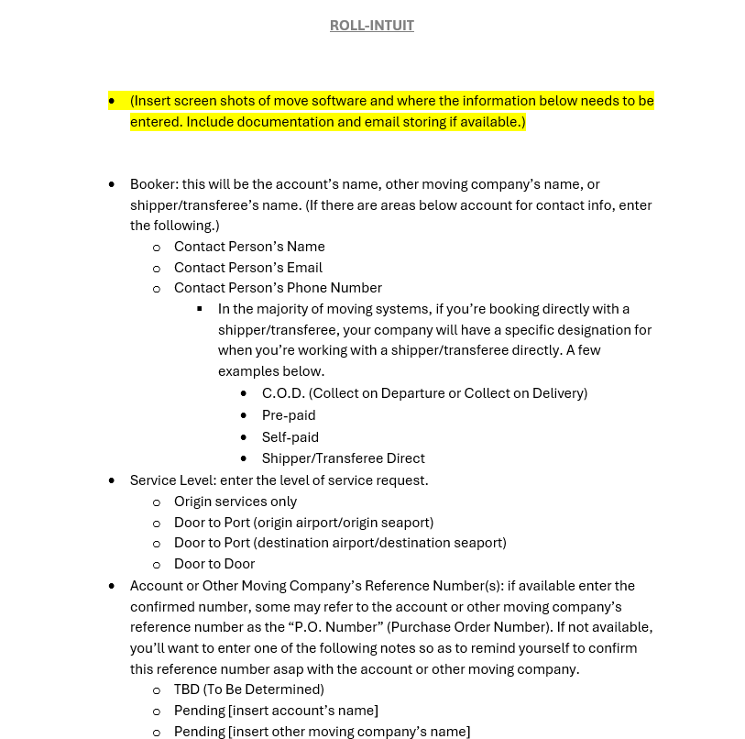
screen shots from the training manual continued…
This manual includes highlighted areas in which screen shots of your own moving system can be input.
This will further enhance your trainee’s ability to see exactly where the data collected during the move process needs to be uploaded/stored.

Slide 16
screen shots from the training manual continued…
This manual includes sample documents that would be used throughout the move process.
Some sample documents are fully customizable and replaceable if you already have specific formats in place.
Other sample documents are included as an example, also replaceable if you have preferred formats you’d like to utilize.

Slide 17
screen shots from the training manual continued…
IAM’s Mobility Exchange: https://mobilityex.com/index.html#/
FIDI website link: https://www.fidi.org/
FIDI customs guide for destination countries: https://www.fidi.org/customs-guides
(currency converter) OANDA: https://www.oanda.com/currency-converter/en/?from=EUR&to=USD&amount=1
(currency converter) XE: https://www.xe.com/currencyconverter/
Air & Sea carrier tracking website links (most common)
Plug & Play conversions calculator
This manual includes hyper links to useful websites.
Agent/Partner searching.
Destination country customs guides.
Air/Sea freight tracking.
Plug and play conversions calculator.

Slide 18

Conclusion:
This training manual aims to bridge the gap between academic knowledge and practical skills, preparing trainees for successful careers in the dynamic field of global household goods relocation, logistics, and pricing. We anticipate positive outcomes for both the trainee and your company.
This training manual is an invaluable resource that can transform your company’s relocation services, making them more efficient, reliable, and customer focused. Investing in this manual is a step towards achieving excellence in the international household goods relocation industry.

