Slide 1
Best Practices and
Officer Responsibilities

Slide 2
What Should I Be Doing Now That I am A Lodge Officer?
Understand the Commitment of Being an Officer – Learn Your Part for Ritual | Learn the Business of the Lodge
Learn Parliamentary Procedure Know your Lodge By-Laws | Work Cohesively with the Lodge Officer Team
Seek out New Committee Candidates | Ask PERs to Mentor or Assist
Attend District Meetings / Clinics and Network with Officers / Members from Other Lodges | Visit Other Lodges and Check Out Their Plans / Programs
See How Other Lodges Do Business | Connect with District Resources
Learn More about Lodge, State and National Programs | Learn the Broad Impact of Elk Programs
LODGE OFFICER
INFORMATION
Reference – TESA Officer Training – Officer Duties and Responsibilities

Slide 3
EXALTED RULER (ER)
Primary Responsibility – PROTECT the Lodge Charter
Executive Officer to Preside Over Lodge Meetings
Enforce the Laws of the Order
Appoint Committee Chairpersons
Appoint Elective Officers
Attend all District Deputy Clinics
Study and Learn By-Laws
Perform Other Duties According to Lodge By-Laws
Serve as Member of Incorporation’s Board of Directors
Administer and Support Grand Lodge Programs
You Got
THIS BABY!
LEADING KNIGHT
Attend District Deputy Clinics*
Offer Support to ER as Needed
Scope for Potential Leaders for Next Year
LOYAL KNIGHT
Conduct Prosecution of the Local Forum, Assisted by Counsel
LECTURING KNIGHT
Examine Membership Cards During Opening of Meeting
ALL KNIGHTS
Assist the Exalted Ruler in the performance of their duties in their absence – by rank
Study the Laws of the Order and the By Laws of the Lodge
Study Ritual and Participate- Opening, Closing & Initiation
Observe Proper Protocol
Support Grand Lodge Programs
Learn as Much as You Can As You Move Through the Chairs
LODGE OFFICER ROLES & RESPONSIBILITIES
**See Lodge By-Laws for More Detailed Info

Slide 4
Appointed Positions
ESQUIRE
Organize the lodge for meetings
Prepare candidates for initiation
Examine and introduce visiting members
Transmit official messages as directed by the ER
Study Ritual / Participate - Opening, Closing and Initiation
CHAPLIN
Study Ritual / Participate- Opening, Closing and
Initiation Rituals
Give Invocation and Benediction as part of various social activities
LODGE OFFICER ROLES & RESPONSIBILITIES
SECRETARY
Receive all monies for the lodge
Create vouchers for payouts and receipts for monies received
Keep correct minutes of meetings
Process membership transactions, notifications, reports
Receive and respond to all communications – read on floor during lodge meetings
File annual membership and charity reports to Grand Lodge timely
TREASURER
Receive all monies from the Secretary
Serve as Treasurer of all committees
Pay bills against the lodge after receiving vouchers signed by (Sec & ER)
Present financial reports during lodge meetings and obtain approval of report
INNER GUARD
Permit no member to enter without previous announcement and permission of the ER
TILER
Stationed at the inner door and permit no person to enter without previous announcement through the Inner Guard
Require all members to show their membership cards
Require visiting members to register
Responsible for lodge property pertaining to lodge meeting
**See Lodge By-Laws for More Detailed Info

Slide 5
OTHER LODGE OFFICER ROLES & RESPONSIBILITIES……
While there are assigned responsibilities for ritual, each lodge can choose to assign areas of responsibility to each chair.
An Officer could be assigned as a new member “advocate”, getting to know new members, understanding their interest, attending orientation and connecting new members with longer term members and offering to stay in touch as new members become more familiar with lodge practices and the organization, as a whole.
Other Duties…
Assign Oversight Responsibility by Chair
By Committee – Fraternal, Activities, Other
By Function – Charity, Youth, Veterans, etc…
Serve as a “connector” between new members and committees
Embrace every opportunity to learn about Elkdom and roles
in the Lodge and Organization
Take initiative and Share your talents
Can be a member of MOST committees
Serve as resource for other officers
Support your lodge and lodge members

Slide 6
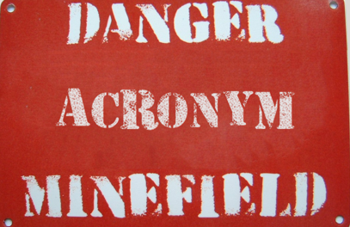
WHAT LANGUAGE DO WE SPEAK?
Acronym OVERLOAD
TESA DD GL
BPOE TECSI ER
TEEI SRDL PBC
ENF HFC PR
This Photo by Unknown Author is licensed under CC BY-NC-ND

Slide 7
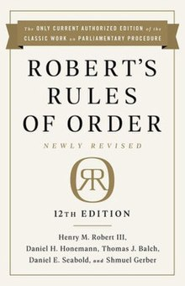
Auditing / Accounting – 3 members
No Secretary, Treasurer, Trustees nor House Committee members can serve
Complete / Submit lodges financial report to Grand Lodge by June 15th
Require use of uniform chart of accounts provided in Sec 4.33 of the Laws of the Order / Grand Lodge Financial System
Review the year to date financial affairs / compliance with the approved budget of the lodge in the months of July, October and January and report at the last regular meeting of those months.
Activities
Drug Awareness, Hoop Shoot, Marketing /Public Relations and other Youth activities.
Supervise all matters pertaining to activities of civic, social and community interested activities / events.
Fraternal
Implement Patriotic activities, Flag Day, indoctrination of candidates / families, investigation of applicants, report on Delinquent members, Elks Memorial Day, publicize ENF and Elks National Veterans Service Commission in the event of a disaster.
Past Exalted Rulers Association – PERs
Serve as advisors to current lodge officers, support newer officers, mentor and train, encourage ideas, thoughts and suggestions to promote the good of the order.
Reference Lodge By-Laws – RULES OF ORDER
ER is responsible for preserving order / deciding vote if votes are split evenly Motions must be clearly stated, 2nd obtained & discussion offered for each motion
STAND and WAIT to be recognized by the ER before speaking Each motion must complete the process before a 2nd motion can be made
One person speaking at a time Members should not exit the meeting with out permission from the ER

Slide 8
BASICS for Running a Successful Lodge
Communicate effectively and respectfully to all
Plan in advance and communicate
Promote activities and good works
Be open to diverse views and opinions. Value ALL!
Get new and/or interested members INVOLVED!
Stay close to the pulse of what is happening in your lodge
Hold officers and committees accountable
Try new things
Ask for help
Fill as many Committees as Possible
Pick the ones most important to your lodge / community
Don’t stress if you can’t fill every position
Utilize resources available – i.e. PERs, District& State Committees / Members & published info on Elks.org & Texaselks.org
ATTEND & NETWORK
Officer Trainings, District Meetings, State and National Conventions, Homecoming & Fall Conference
PLAN & SUPPORT
Flag Day, Elks Memorial & Installation of Officer Events

Slide 9
Charitable Hours
And
Community Investment Grant Reporting
Charitable Reporting
Lodges are required to report charitable and community service program hours for tax status / non profit classification.
Description of Program / Activity
Number of Participants
Number of Elks
Number of Helpers
Total Elk Hours
Total Helper Hours
Elk Miles
Helper Miles
Non-Cash Contributions
Cash Donations
Sweetheart, ENF, Community Grant Activities, Interlodge, Veteran Programs, Hoop Shoot, etc…..
**Forms can be found on line Elks.org – or – see the lodge secretary to obtain a copy!
HOLD YOUR COMMITTEE ACCOUNTABLE FOR REPORTING!!

Slide 10
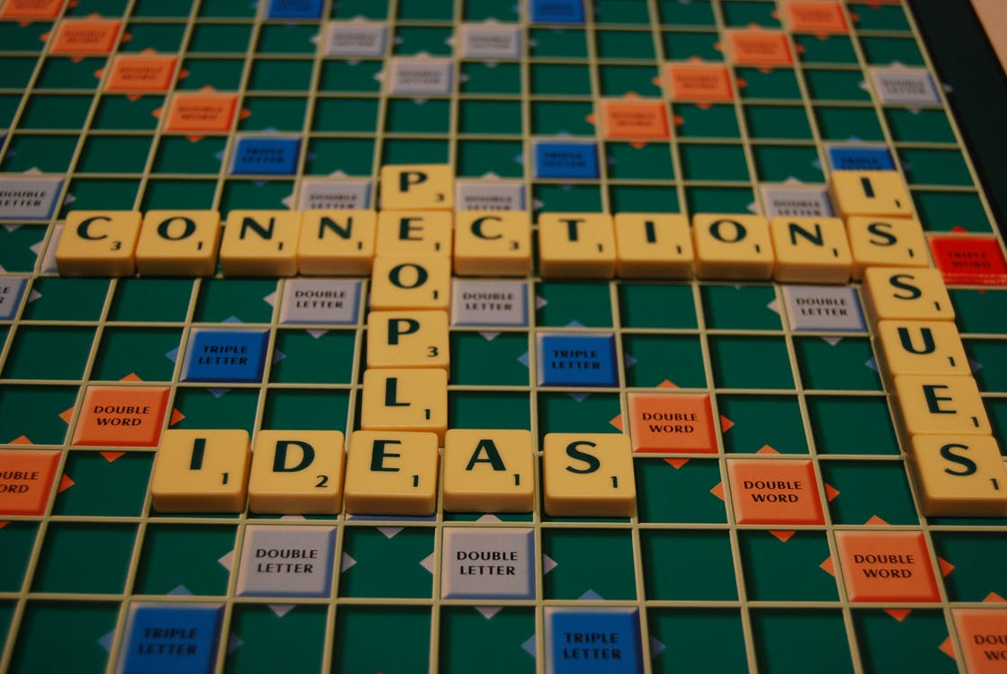
Know Your “On-Line” Resource
Websites
Texaselks.org
Officers & Committee Chairs
Training Information
Marketing / Public Relations Material
Membership Statistics
Scholarship / Hoop Shoot
Information about Summer Camp / Grant Programs
Lodge Locator Links
Dates and locations for upcoming conventions
Much… much… more
Elks.org
Organization History / Current Day Stats
Featured Program Info – Public Relations, Scholarship,
Hoop Shoot, Community Grants, Elks National Foundation
Forms – Audit, contest, By Law Revisions, Membership
Application (online)
Manuals – Auditing / Accounting, Public Relations, How to Manage Employees, Ritual, Drug Awareness, Ritual, etc…
Lodge By Laws
Personal donation access for ENF
Dates and locations of upcoming Grand Lodge Conventions
Message Boards – Share info across the country!

Slide 11
Social Media - Do’s & Don'ts
Facebook Pages to LIKE & FOLLOW
Local Lodge Page (public or private or both)
Northeast District Page
Texas Elks State Association
Texas Elks Children’s Services
Texas Elks
Elks Social Media Network
Grand Lodge Membership & Marketing
Hashtag Campaigns for Texas
#startswithme
#thepowerofone
#texaselkstexasstrong
**ALWAYS ask your followers to “like & share”
Every post / advertising an event, media recognition
And other info that would help promote the good
Works of your lodge.
Reminders – Things NOT TO POST
Do Not include posts that say “Open to the Public”
Use – “Members and Guests of Members” or “Be Our Guest”…..
Do Not post pictures of members smoking, drinking and/or participating in any inappropriate or offensive activities
Do Not post negative comments or information about internal conflicts
Things TO DO
Add settings that require an “administrator” approve posts before they go live
Have more than one administrator
Include a disclaimer on your page that says your lodge has the right to delete posts that are deemed not appropriate due to content, language, negativity, or for any other reason.
Complete “photo release forms” for non members who are included in pictures before they are posted on the lodge Facebook page.

Slide 12
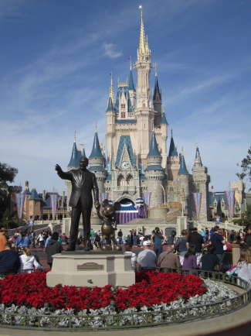
Leadership IS NOT about rank, privilege, titles or money…… Leadership IS RESPONSIBILITY!
To keep leading, you must keep learning. It’s what you learn after you know it all that counts!
A good leader encourages followers to tell him what he needs to know, not what he wants to hear.
Walt Disney said, “Remember, if you can dream it, you can do it.”
Listen Carefully & Understand Others | Compromise During Conflict
Do Their Part; Inspire Others | Show Appreciation for what Others Contribute
Make People Feel Needed; Work Together | Recognizes that Everyone has Something to Give

