Slide 1
Big trouble
What Happens When You Don’t Do Your Job

Slide 2
Big Trouble
Lack of Controls
Cash Management
Over Pour
Food Service
Inventory Records
Bar Policies
Cash Register Tapes
Not using Management Tools

Slide 3
Big Trouble
Lodge Workers
Unpaid Volunteers
Independent Contractors
Tax Laws
Tipped Employees
Hourly Pay
Employee Discipline
Employee Dishonesty

Slide 4
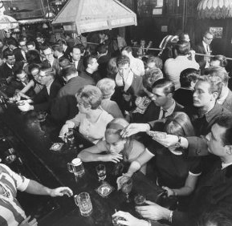
Big Trouble
Open to the Public
Illegal Gambling
Employee Records
Lack of Security

