Slide 1
Club Management

Slide 2
Club Management
Establishment and Management of Home Club
Chair Officers + Trustees
Trustees
House Committee, 3 to 13 members
Board of Directors of a (separate) Corporation

Slide 3
Club Management
Home Club Guidelines and Requirements
Separate Budget
Monthly Reporting
Member of Body CANNOT be employed by it
Monthly Meetings
Facilities are for Members and Guests
Follow State Laws (TABC)
Watch language and conduct

Slide 4
Club Management
Home Club Suspensions
Follow processes in Grand Lodge Statutes
Section 16.041 has guidelines

Slide 5
Club Management
Home Club Suggestions
Friendly Employees
Make Club Inviting
Promote Functions and Activities
Covers Beverage and Food Service
Keep Club Clean

Slide 6
Club Management
Cash Handling
Ring ALL sales in register
Breakout by Liquor, Beer, Wine, Other
Reconcile cash drawers at end-of-shift
Secure daily cash and receipts for Secretary
Record overages, shortages and refunds

Slide 7
Club Management
Purchases
Limit number of buyers
Approve payment methods
Inventory
Conduct Inventory at least annually
Home Club body member(s) conduct inventory

Slide 8
Club Management
Paperwork
Bar workers must be TABC certified
Everything is taxable – including comps
Operational Controls
Cost of Goods at 35%
Employment costs NTE 35%
Club body, not bartender, control inventory

Slide 9
Club Management
Illustration of Cost of Goods Sold
 | BAR INCOME | COG | % COG
Liquor Sales | $53,054 | $10,956 | 21%
Beer Sales | $68,766 | $30,805 | 45%
Wine Sales | $11,089 | $4,964 | 45%
Other
TOTAL | $140,140 | $49,616 | 35%
 | Gross Profit | $90,524
 | Other Expenses | $90,358
 | Net Income | $166

Slide 10
Club Management
PRICING INDIVIDUAL DRINKS
Number of 1.5oz pours 30oz/1.5oz = 20 drinks per bottle (20 pours)
Cost per Cost per
Bottle Drink
Cost per illustration $27.83 $1.39
Assume cost of mix/supplies* $2.17 $ .11
Total cost per bottle $30.00 $1.50
To make 35% recommended cost of sales percentage your price per drink would be:
Cost per drink ÷ % $1.50 ÷ 35% = $4.29
To add sales tax: If you have a 7% sales tax:
$4.25 x 107% = $4.55

Slide 11
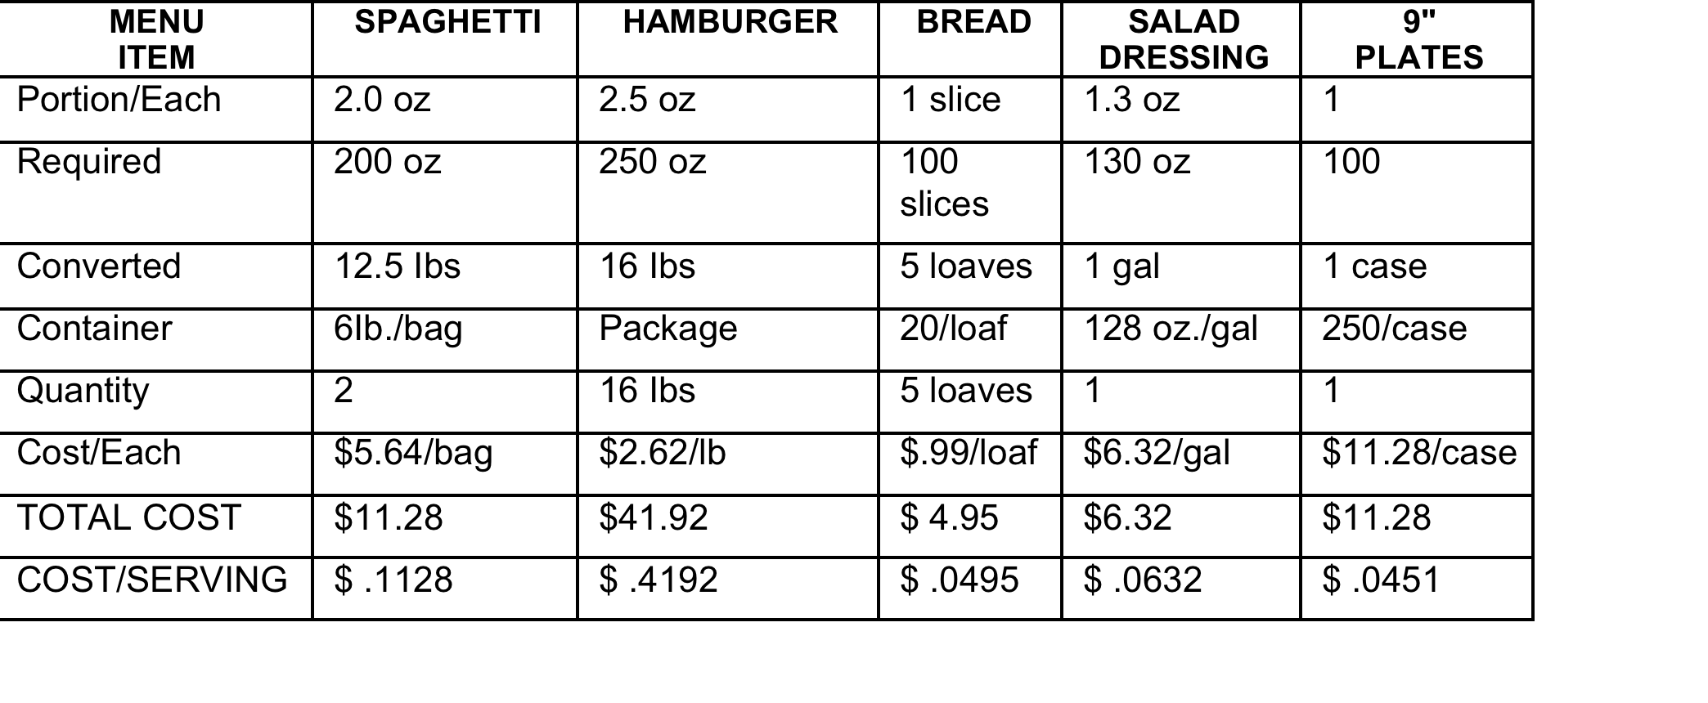
Club Management
Dining Room Costing – Portioning – Pricing
Plan to serve 100 people

Slide 12
Club Management
Other Potential Costs
Labor, Payroll Taxes, Entertainment
Allocation of Overhead
House Rules, Operations
Same approval as Lodge By-Laws
Lodge Floor cannot override employment or prices

Slide 13
Club Management
Public Accommodation
Balance of IRS, TABC & Elk policies
TABC Permit
Know the rules of your permit
Only “stamped” product from authorized seller
UBIT & Employee Tips

