Slide 1
Lodge Budgets
By Harry Woodstrom

Slide 2
Budgets
The Budget is a mythical bean bag. We vote mythical beans into it, and then try to reach in and pull real beans out.
Acknowledgement to Will Rogers

Slide 3
Budgets
To understand budgets, we need to understand accounting.
To help in that understanding, we reference: The Grand Lodge Auditing and Accounting Manual

Slide 4
Accounting Basics
Key Positions
Chart of Accounts (COA)
Balance Sheet
Profit and Loss

Slide 5
Key Positions
The requirement of Sec. 12.050 of the Statutes that the Secretary receives all monies due the Lodge (from any source whatever – G.L.S. 12.050 Opinion 12) and pay them over to the Treasurer.
The requirement of Sec. 12.060 that the Treasurer pays all bills against the Lodge (again from any source whatever – G.L.S. 12.060 Opinion 02).

Slide 6
Key Positions
Grand Lodge Statutes Section 12.070 require a budget be prepared (by the Board of Directors or Board of Trustees) for every entity of the Lodge including Restricted Fund activities and presented to the Lodge for approval no later than the final regular Lodge meeting in April.
The members of the Lodge Auditing & Accounting Committee.

Slide 7
Chart Of Accounts
Account Types: There are five basic account types in the Grand Lodge Chart of Accounts. These basic types control all aspects of the accounting system. The five basic types are:
TYPE Description Financial Statement
Assets What the Lodge owns Balance Sheet
Liabilities What the Lodge owes Balance Sheet
Equity Net worth of the Lodge Balance Sheet
Revenues Income sources of the Lodge Profit and Loss
Expenses Operating costs of the Lodge Profit and Loss

Slide 8
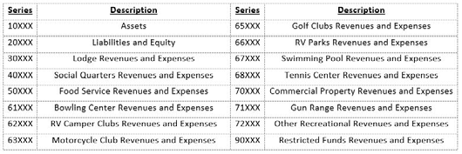
Accounts

Slide 9
Accounts
The use of the Grand Lodge Chart of Accounts (COA) by the Local Lodge is mandatory as stated in G.L.S. Sections 4.330 and 13.040.
The COA is designed using a five-digit “parent” account to allow flexibility for each Lodge to determine what accounts are utilized in the Lodge’s accounting system.
A Lodge should use the minimum number of accounts that will satisfy the following requirements:

Slide 10
Accounts
Properly classify the Lodges Assets, Liabilities, Equity, Revenues and Expenses
Provide useful information to the Board of Directors and business segment managers to make sound financial decisions
Provide detailed information for the accurate completion of the Lodge’s Federal, State and Local Information and Income Tax Returns. This includes the segregation of member versus non-member Revenues and Expenses.

Slide 11
Accounts
30150 Miscellaneous Income
30155 Golf Tournaments Income
30165 Lodge Activities Members Income
30170 Lodge Activities Non-Member UBI Income
30180 Lodge Fund Raisers Income

Slide 12
Accounts
Use of two-character subaccounts is permitted to allow the Lodge to adapt the COA to unique activities within the Lodge
Pair Income and Expense accounts to provide useful management information

Slide 13
Accounts
30180 Lodge Fund Raisers - Income
3018010 Soap Box Derby – Income
30600 Fund Raiser Expense – Expense
3060010 Soap Box Derby Expense – Expense
Numbers and Names must be unique

Slide 14
Balance Sheet
Assets What the Lodge owns Balance Sheet
Liabilities What the Lodge owes Balance Sheet
Equity Net worth of the Lodge Balance Sheet

Slide 15
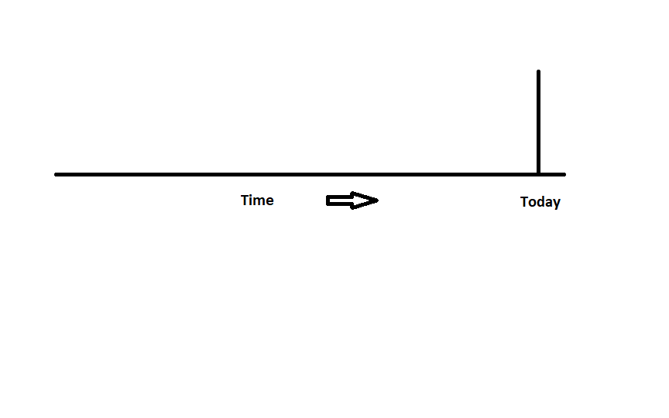
Balance Sheet

Slide 16
Profit & Loss (P&L)
Revenues Income sources of the Lodge Profit and Loss
Expenses Operating costs of the Lodge Profit and Loss
And a special category of Expense
Cost of Goods Sold Purchases of saleable items Profit and Loss

Slide 17
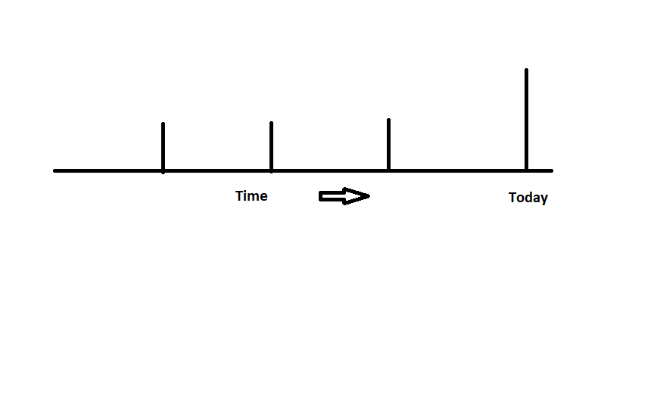
Profit & Loss (P&L)

Slide 18
Budgets
A budget is defined as a financial plan that estimates future Revenues and future Expenses and is used to manage
It is a future P&L.
There are many reasons to have a budget, but the one that should get your attention is that it is required.

Slide 19
Budgets – How to
1. After the February FRS data has been submitted obtain a copy of the year-to-date Actual Profit and Loss Statements compared to the full year budget for all business activities.
2. Review these statements and note any one-time Revenues and Expenses that occurred during the year. These one-time items should not be included in the budget.
3. Prepare the Revenue sections first making reasonable estimates for all anticipated Revenues. The estimates should be both reasonable and conservative.

Slide 20
Budgets – How To
4. Prepare the Cost of Goods Sold (CoGS) sections for those activities that require it. Lodges should use the recommended target CoGS percentages as a starting point.
5. Prepare the Expense sections last. Begin with those expenses that are either fixed (rent, property taxes, mortgage interest, etc.) or semi-variable but required (payroll, utilities, supplies, etc.) and finally those expenses that are not required but that the Lodge wants to incur (charitable donations, Lodge funded scholarships, community activities, etc.). The first two categories are those that the Lodge has little or no control over. The last category of Expenses is “optional” in nature, meaning that the Lodge is not obligated to make the expenditure but will do so if funding is available.

Slide 21
Budgets – How To
6. Review the results on an activity basis. Is the activity generating a profit? If not, what adjustments can be made to reduce the loss from the activity. It is never good financial management to prepare a deficit budget.
7. Review the results on a consolidated basis for the Lodge and all its activities. Is an overall profit being generated? If not, where can Expenses be reduced or what other sources of Revenues can be tapped to close the gap.

Slide 22
Budgets – How To
8. After the March preliminary FRS data is submitted update the current year actuals in the comparison. If necessary, adjust the proposed budget for any significant Revenues or Expenses recorded in the month of March.
9. Finally, prepare an estimate of any capital improvements (Fixed Assets additions) anticipate to take place during the fiscal year. While these are not Expenses of the Lodge, they are an expenditure of cash.

Slide 23
Budgets – How To
Each activity budget must include Depreciation Expense if any of the Lodge’s Depreciable Fixed Assets are used in the activity. The recording of Depreciation and its inclusion in the results of operations provides the surplus of funds necessary in the future to allow for the replacement of the Fixed Asset depreciated. Additionally, other non-Expense expenditures such as mortgage principal or bond redemptions should also be presented to the Lodge.

Slide 24
Budgets – How To
All Lodges should develop a long-term Capital Budget for the replacement of its Fixed Assets and for improvements to the Lodge building and grounds. Funding for the Capital Budget should come from retained profits and Lodge-designated Temporary Restricted Funds. Special savings or investment accounts should be maintained to fund these projects and by-law provisions should be enacted to preserve the intent of these funds.

Slide 25
Budgets – How To
When budgeting for income generating activities such as Bingo, fund-raising events or Lodge activities the budget should always be prepared on a Gross basis. This means that the Revenues and the Expenses for the activity should be budgeted for separately and not simply shown as a net amount from the activity or event.

Slide 26
Budgets – How To
The Board of Directors should coordinate the consolidation of the various budgets to prevent overlap and duplication. Inclusion in the budget of an amount for contingencies will allow for the adjustment of the budget in the event of an unforeseen emergency.

Slide 27
Budgets – How To
Members should recognize the importance that each entity of the Lodge be as financially self-sufficient as possible. To the extent possible each entity budget should generate a profit so that the Lodge can grow and meet it fraternal and charitable and community service objectives. Consideration of the profitability of the Lodge and its objectives should be taken into account when establishing the pricing for any of the business activities undertaken by the Lodge. Remember that the Lodge was formed for fraternal and charitable reasons and that the social quarters and other activities provided are secondary in nature.

Slide 28
Budgets – How To
Amendment of a budget requires Lodge approval and requires re-submission of the budget into the FRS.

Slide 29
Summary
Start with last years actuals
Consider special events for this year and last year
Get everyone involved
Budget gross not net
Budget need not balance, but cannot be negative
Get approvals
Review Monthly for Actual to Budget
Review Quarterly for Budget Modification

Slide 30
Budgets
Questions?

