Slide 1
Navigating the
Statutes
Notes:
THE STATUTES - THE RULES AND REGULATIONS OF OUR ORDER - OUR LAWS
WHAT WE AS ELKS AGREED TO ABIDE BY WHEN WE TOOK OUR OBLIGATION
WE AGREED TO ABIDE BY ALL OF IT - NOT JUST SELECTED PARTS THAT SUIT US
ALSO
WHAT’S IN THE STATUTES - WHAT DOES IT DO FOR US
PROVIDES THE STRUCTURE FOR OUR ORGANIZATIONS & HOW WE OPERATE
PROVIDES AN INCREDIBLE AMOUNT OF INFO ON HOW WE DO OUR JOBS
ALSO PROVIDES AN INCREDIBLE AMOUNT OF INFO ON HOW WE TREAT EACH OTHER

Slide 2
Navigating the Statutes
FIRST PART OF THE BOOK CONTAINS OUR CONSTITUTION
TELLS US ALL ABOUT OUR ORGANIZATION FROM TOP TO BOTTOM
SUPREME LAW OF OUR ORDER
THE CONSTITUTION, BYLAWS, & RITUAL CONSTITUTE OUR LAW

Slide 3
Navigating the Statutes
SECOND PART OF THE BOOK CONTAINS THE LAWS OF THE ORDER
FIRST CHAPTER PROVIDES US WITH DEFINITIONS AS USED BY THE ELKS
Notes:
WHO CAN BE A DDGER - PER SELECTED BY GER AS HIS REP
GRAND LODGE - COLLECTIVE GROUP OF GL MEMBERS
GRAND LODGE MEMBER - MEMBER WHO IS A PER AND HAS
ATTENDED A GL SESSION, ER ATTENDING A GL SESSION OR
A MEMBER OF THE CLERGY WHO IS OR HAS BEEN GRAND CHAPLAIN
CONTUMACY - WILLFUL DISREGARD OF STATUTORY PROVISIONS OR ORDER of the GER

Slide 4
Navigating the Statutes
SECOND CHAPTER TELLS US ABOUT OUR RITUALS
TELLS US ABOUT THE RITUALS AS APPROVED FOR OPENING, CLOSING, AND INITIATION
THIRD CHAPTER TELLS US ALL ABOUT ELECTION OF OFFICERS
FOURTH CHAPTER TELLS US ALL ABOUT GRAND LODGE
Notes:
WHAT ARE TWO OTHER REQUIRED RITUALS
ELKS MEMORIAL DAY - FLAG DAY SERVICES
----
TELLS US ALL THE RULES FROM GRAND LODGE TO LODGE LEVEL REGARDING THE ELECTION OF OUR OFFICERS
----
HOW IT’S ORGANIZED - STRUCTURED
DUTIES OF OFFICERS - RESPONSIBILITIES - WHO DOES WHAT TO WHO
COMMITTEES, COMMISSIONS AND FOUNDATIONS
DEFINES DUTIES OF DDGER AND SDGER

Slide 5
Navigating the Statutes
CHAPTER FIVE EXPLAINS THE FUNDS AND EXPENDITURES OF THE ORDER
CHAPTER SIX DEFINES THE ELKS NATIONAL HOME
THE OPERATION AND MAINTENANCE OF THE HOME AND WHO IS ELIGIBLE TO LIVE THERE
Notes:
GRAND LODGE LEVEL
DETAILS WHERE THE ORDERS MONEY COMES FROM AND WHERE IT GOES AND THE RULES GOVERNING INCOME AND EXPENDITURES

Slide 6
Navigating the Statutes
CHAPTER SEVEN IS ALL ABOUT THE GRAND FORUM
CHAPTER EIGHT IS ABOUT THE SUBORDINATE FORUM
CHAPTER NINE DEFINES OFFENSES AND PENALTIES OF THE ORDER
Notes:
FORUM IS COMPRISED OF SEVEN JUSTICES - ALL LAWYERS
GRAND FORUM HEARS:
COMPLAINTS AGAINST A LODGE BY ANOTHER LODGE
COMPLAINTS AGAINST A LODGE BY A MEMBER
COMPLAINTS FILED UNDER SECTION 9.080 - INVOLVING AN UNAFFILIATED ELK
APPEALS TO THE GRAND LODGE
-----
THE SUBORDINATE FORUM HAS JURISDICTION OVER ALL CASES INVOLVING AN OFFENSE COMMITTED AGAINST THE LAWS OF THE ORDER
CHAPTER EIGHT ALSO EXPLAINS THE PROCESSES OF A SUBORDINATE FORUM
-----
NEGLECT OF DUTIES - REMOVAL OF AN OFFICER
CONTUMACY - CAN’T DEFINE IT - KNOW IT WHEN I SEE IT
CONDUCT INJURIOUS TO THE ORDER
CONDUCT UNBECOMING AN ELK AND ANY VIOLATION OF OBLIGATION

Slide 7
Navigating the Statutes
CHAPTER 10 DEAL WITH PARDONS
CHAPTER 11 REGARDS THE DISPENSATION AND CHARTER PROCESSES
CHAPTER 12 IS ALL ABOUT SUBORDINATE LODGE OFFICERS
Notes:
CHIEF JUSTICE OF THE GRAND FORUM IS THE CHAIRMAN OF THE BOARD OF PARDONS COMMISSIONERS
A PERSON WHO HAS BEEN EXPELLED FROM THE ORDER CAN REQUEST A PARDON
----
FOR RECEIVING A LODGE DISPENSATION AND CHARTER AND MERGING OF LODGES
-----
JOB DESCRIPTIONS - THEIR RESPONSIBILITIES AND AUTHORITIES
TELLS WHAT EVERY OFFICER MUST DO

Slide 8
Navigating the Statutes
CHAPTER 13 - SUBORDINATE LODGE COMMITTEES
CHAPTER 14 - LODGE MEMBERSHIP AND REVENUES
CHAPTER 15 - SUBORDINATE LODGE MEETINGS
Notes:
CHAPTER DEFINES ALL THE COMMITTEES OF THE LODGE
RESPONSIBILITIES OF ALL COMMITTEES - WHAT THEY’RE SUPPOSED TO DO
----
DEFINES MEMBERSHIP REQUIREMENTS
PROCESSES OF MEMBERSHIP - HOW IT TAKES PLACE
APPLICATION, INVESTIGATION, BALLOTING PROCESS
LODGE JURISDICTIONS FOR MEMBERSHIP
----
PRESCRIBES OUR LODGE MEETINGS ORDER OF BUSINESS

Slide 9
Navigating the Statutes
CHAPTER 16 - SUBORDINATE LODGE OPERATIONS
A PRIMARY PIECE OF CHAPTER 16 - IS HOW WE OPERATE OUR SOCIAL QTRS
CHAPTER 17 DEALS WITH AMENDMENTS TO THE CONSTITUTION OF THE ORDER.
CHAPTER 18 DEALS WITH STATE ASSOCIATIONS
Notes:
CHAPTER IS CONCERNED WITH HOW WE ORGANIZE AND OPERATE and to INCORPORATE or NOT INCORPORATE
SPELLS OUT HOW WE ORGANIZE, MANAGE AND OPERATE - 16.040

Slide 10
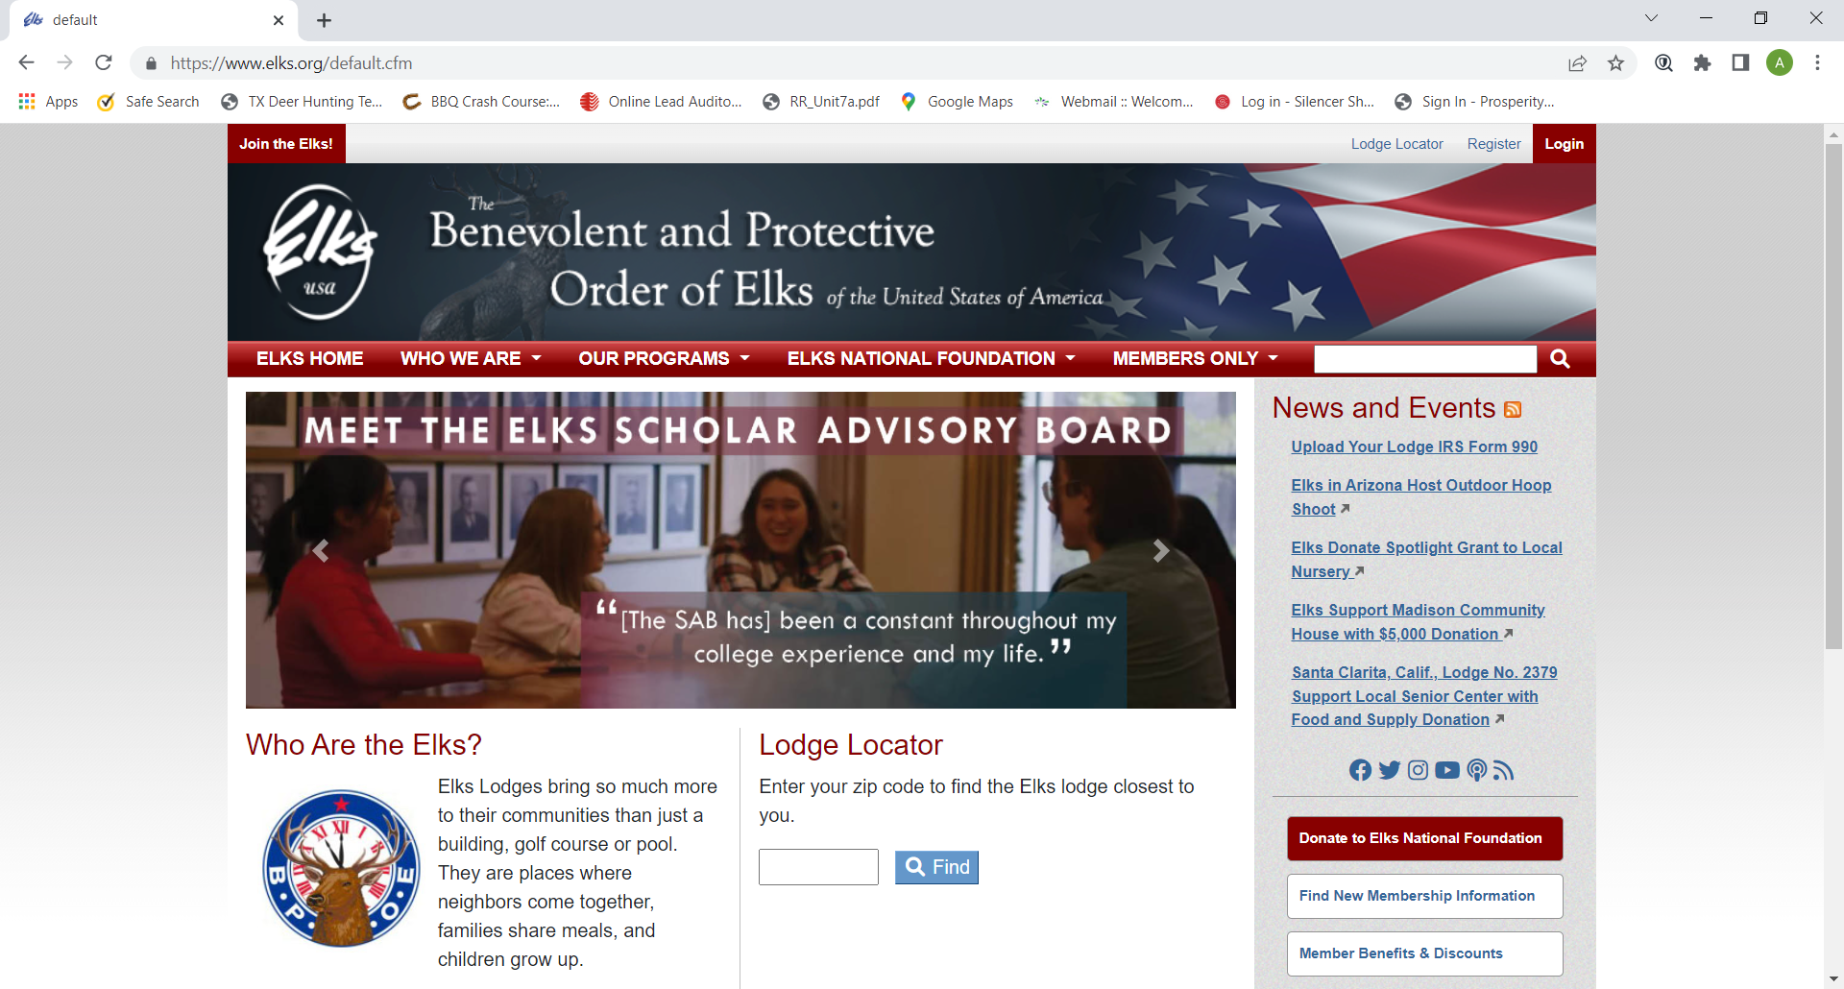

Slide 11
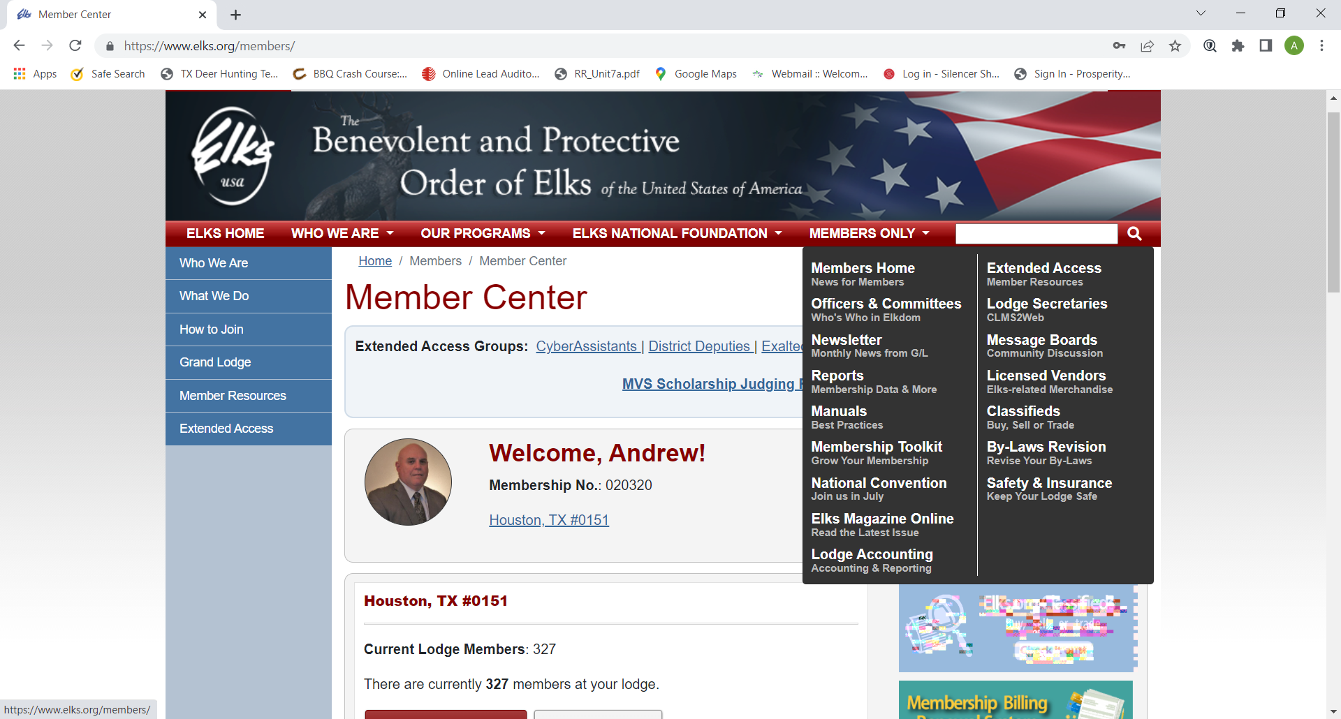

Slide 12
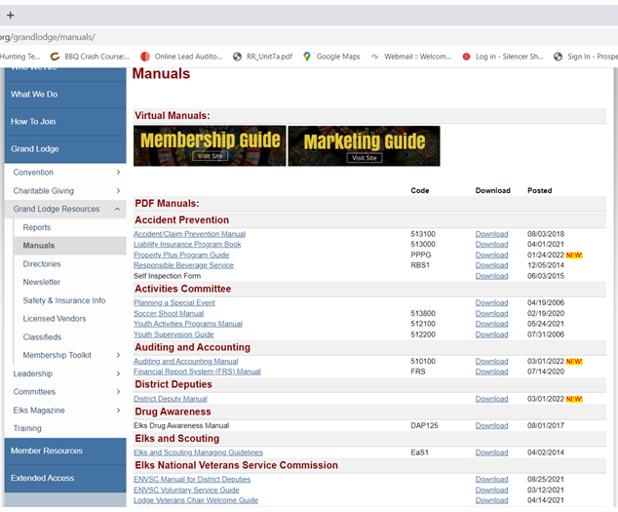

Slide 13
