Slide 1
Public Forum
Social Media, Advertising, Public Relations

Slide 2
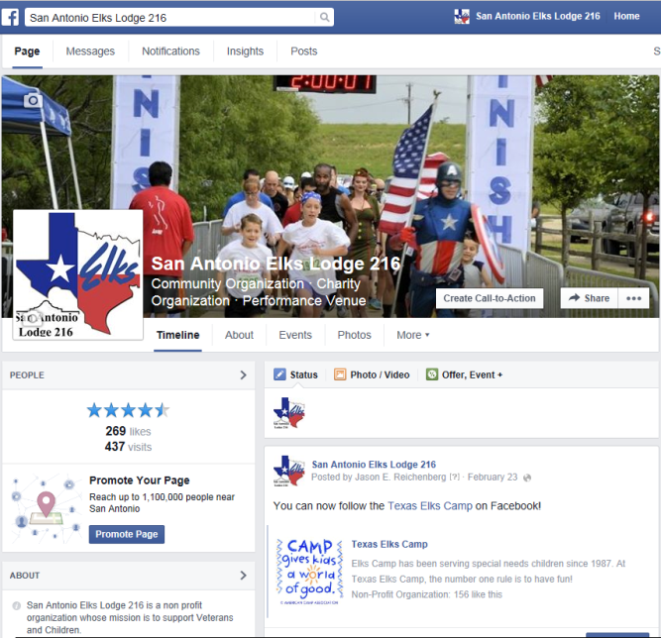
Social Media
Facebook
Twitter
Instagram
YouTube
Notes:
If the Lodge is not incorporated, then the ER is an ex-officio member
In an incorporated Lodge, The Exalted Ruler is the Chief Executive Officer, not an ex-officio member and not necessarily Chairman. The Board will elect the Chairman and the Secretary.
For more information see Section 16.020 and Section 16.030 of Grand Lodge Statues

Slide 3
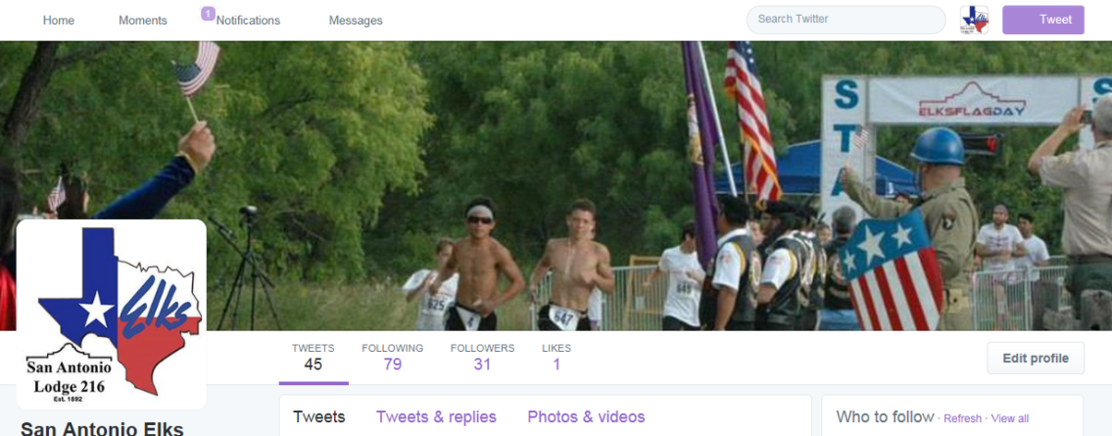
Social Media
Free to use
Actively publicize your content
Update all site
Get your members involved
Notes:
Appointments. Section 010. Before his installation, the Exalted Ruler-elect shall appoint an Esquire, a Chaplain, an Inner Guard, a Tiler, an Organist, and a Vocalist, if an Organist or Vocalist is available, to be installed with the elected Officers of the Lodge and to serve for the term of one year.

Slide 4
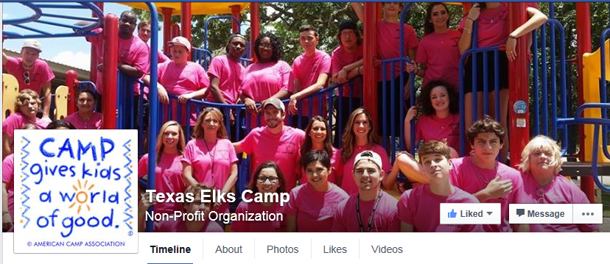
Facebook
Most common used site
Elks only vs. public
Notes:
Section 15.010 - The Officers shall rank in the order named in the Constitution. In the absence of the Exalted Ruler or his designee, the Officer next in rank shall organize the Lodge, and designate the Member(s) who shall serve during the meeting, or until the absent Officer(s) appears.
Statutes Annotated 2015

Slide 5
Facebook as members only site
Facebook “closed” group
Setup more than one administrator
Disseminate internal information
Be careful of what’s posted

Slide 6
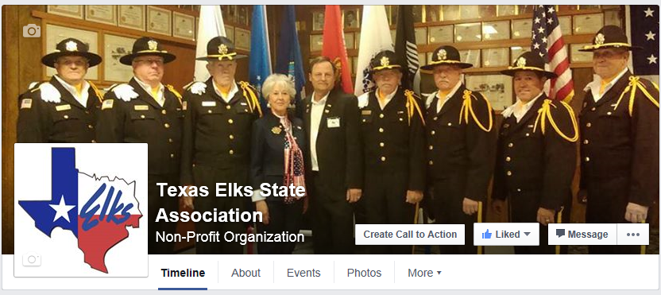
Facebook as lodge billboard
Best use of Facebook
Invite public to “like” it
Have more than one administrator
Make it interesting
Notes:
Local Forum Section 8.090. The Esteemed Loyal Knight is charged with the duties of (1) prosecuting alleged offenders and (2) if necessary, instituting complaints in proper cases.
Examination of membership cards. Constitution Section 1, Opinion 9

Slide 7
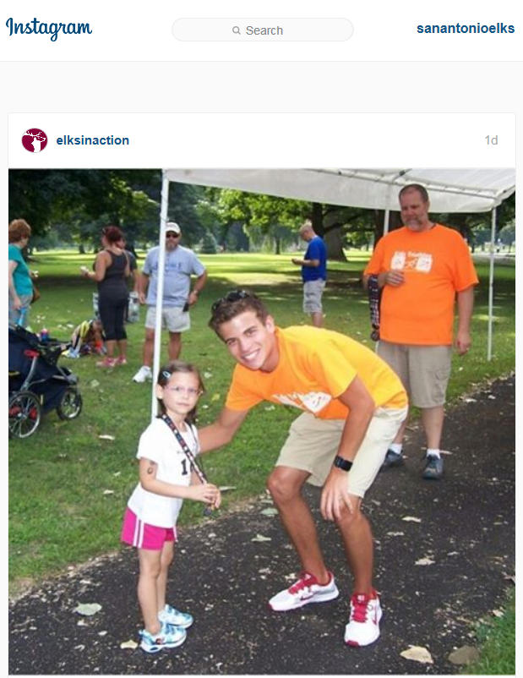
Other social media
Keep abreast of current trends
Experiment with different sites
Create original content
Keep it up to date
Notes:
Section 12.090. The Esquire shall organize the Lodge, prepare candidates for initiation, examine and introduce visiting Members, superintend the ballots, transmit official messages as directed by the Exalted Ruler, and in all public displays shall officiate as Marshal. He shall perform other duties as may be required by the Laws of the Order, or the By-Laws of the Lodge.

Slide 8
Email and text messaging
Respond to emails promptly
Use bulk email and texts
Use Facebook/Twitter messaging
Bad
Good
Notes:
Section 12.100. The Chaplain and the Inner Guard shall perform the duties required of them by the Laws of the Order, or the By-Laws of the Lodge.
Chaplain - Invocations and benedictions as part of the various social activities
Organist - Section 12.110. The Organist shall provide music prescribed by the Rituals and perform other duties required of him. He may receive compensation for his services approved by the Lodge.

Slide 9
Grand Lodge Website – www.elks.org
Registration is required
Must have membership number
Keep it up to date
Each lodge has their own page
Notes:
Section 12.100. The Chaplain and the Inner Guard shall perform the duties required of them by the Laws of the Order, or the By-Laws of the Lodge.
Section 12.115. The Vocalist may perform during each Lodge session and during special services when requested and on special occasions when required by the Lodge. The Vocalist shall perform duties required of them by the Laws of the Order, or by the By-Laws of the Lodge.

Slide 10
Advertising
Lodges are not public places
Hold public events sometimes
Use online advertising tools
Research public grants
Notes:
Tiler Section 12.080. The Tiler shall be stationed at the outer door of the Lodge at all meetings and permit no person to enter without previous announcement through the Inner Guard, and permission of the Exalted Ruler. He shall require all Members to show their membership cards, and require visiting Members to register in the book kept for that purpose.
He shall assume charge of all jewels, regalia and other like Lodge property and see that they are in proper condition for all meetings of the Lodge. He shall furnish all necessary paraphernalia by order of the presiding Officer, have charge of the keys to Lodge doors, and see that all Lodge property is safely stored before leaving the Lodge room.

Slide 11
Public Relations/Community Communication
Your lodge should never be the best kept secret in your community!
Notes:
While there are assigned responsibilities for Ritual, each Lodge can choose to assign areas of responsibility to each Chair. Some Lodges have followed this kind of pattern for many years.
An Officer could be assigned as a “broker”, attending the Orientation and getting new members in touch with Lodge committee chairs to get them to work right away.
“Other Duties as Assigned”
Assign Management Areas by Chair:
by Committee – Fraternal, Activities, Other
by Function – Charity, Youth, Veterans, etc.
Be a “Broker” for Committees
Opportunity to Learn About Elkdom
Take Initiative, Share Your Talents
Can be a Member of Most Committees
Officer Resources

Slide 12
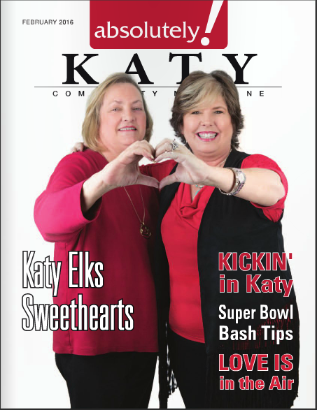
Public Relations
Public Relations is not simply putting out press releases – it also involves finding out what your community needs and wants
Notes:
Bullet 4 - Can be a Member of Most Committees

Slide 13
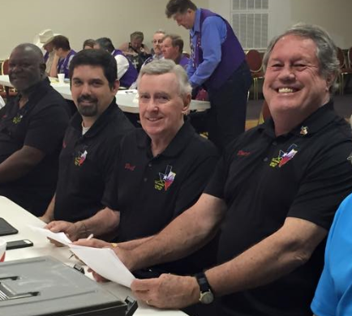
Public Relations
Be familiar with Elk programs
11-second speech
Find a community need
Wear your Elks gear
Notes:
Sec. 13.040(k) prohibit the assigning of the Secretary, Treasurer, Lodge Officers, Board of Trustees, Board of Directors and members of the management Club to the Audit Committee.
Autonomous. The Audit Committee does not report to the Lodge Trustees or Board of Directors. Again, G/L Statutes Sec. 13.040 mandates the duties and responsibilities to the Lodge Auditing & Accounting Committee.

Slide 14
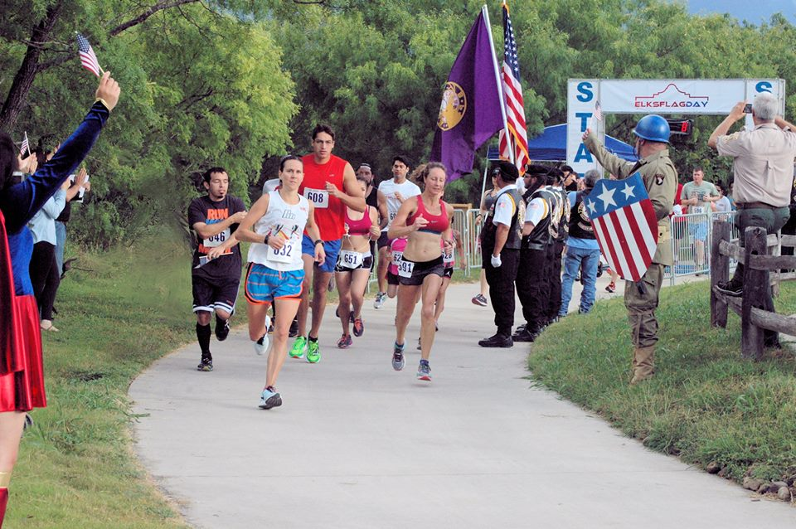
The Local Media
Compile a list of local contacts
Send out press releases
Invite reporters to events
Co-host events with other organizations
Boy Scouts
VFW
Local Running Club
Local costumed character charity
Notes:
Each subtitle will “appear” by pushing enter or using a remote clicker. Refer to word outline for talking points/notes on each of these and the slides that follow this one.

Slide 15
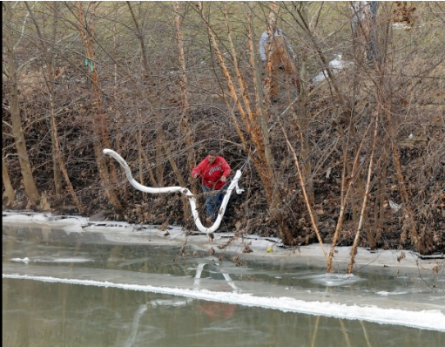
Case Study #1
How did a chemical spill in the Elk River* in West Virginia result in the San Antonio Elks Lodge’s 2014 Hoop Shoot making it onto the local news?
*The name Elk River is merely a coincidence and not germane to the case study

Slide 16
Result #1
Nirenberg interviewed at the Elks lodge
The Elks on the local news
Bottom line: You never know what the media will pick up on so publicize as much as you can!

Slide 17
Case Study #2
How did the San Antonio Elks make it onto a morning talk show to promote their Flag Day event?

Slide 18
Case Study #2
They asked.
*By the way, not the kind of publicity we want.

Slide 19
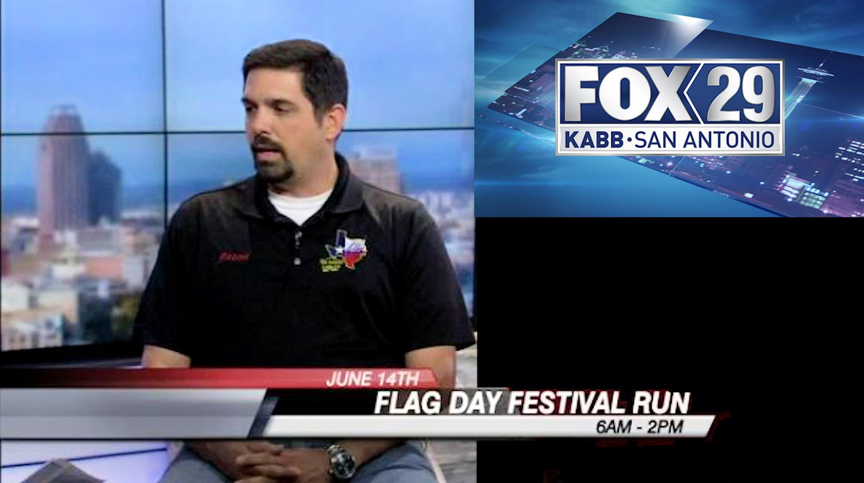
Result #2
Increased awareness of the Elks
Increased attendance at Flag Day event
The world got to see a super cool, handsome Elk!

Slide 20
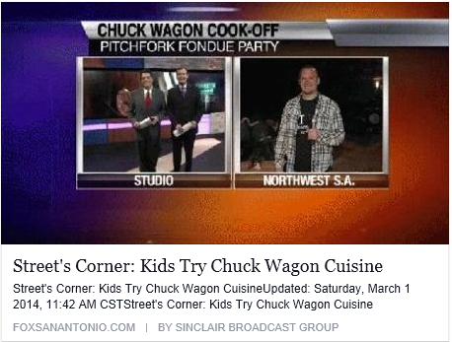
Result #2
Bottom line: Sometimes it’s just that simple. However, if you don’t ask then the answer will always be no.

Slide 21
Case Study #3
Southwest District Facebook page
Promotional video about Homecoming

Slide 22
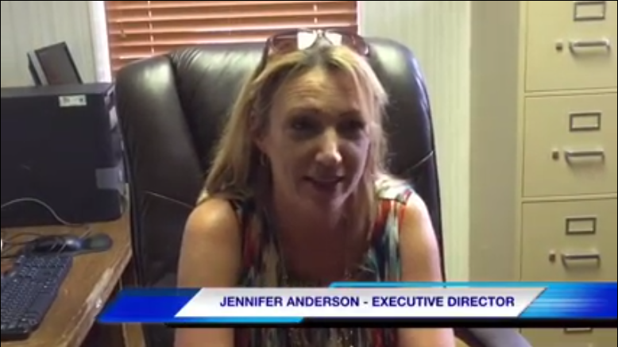
Results #3
Video viewed thousands of times
Available to the public
Short and Interesting

Slide 23
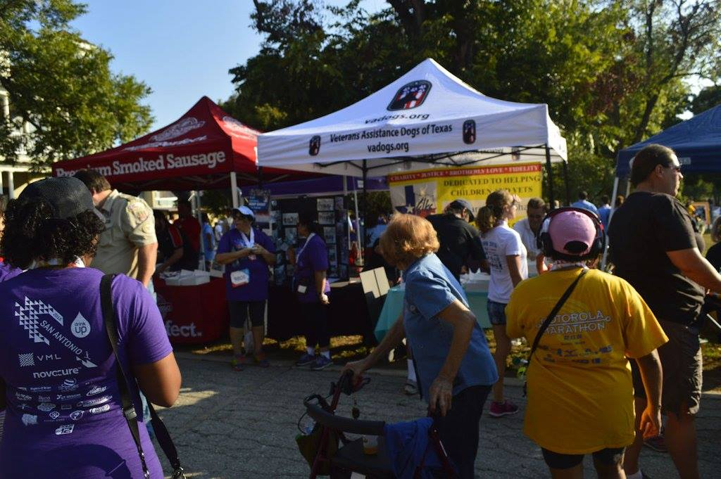
Case Study #4
Partnership with Head for the Cure
San Antonio hosts volunteer event
Elks volunteer at the race
Notes:
Each subtitle will “appear” by pushing enter or using a remote clicker. Refer to word outline for talking points/notes on each of these and the slides that follow this one.

Slide 24
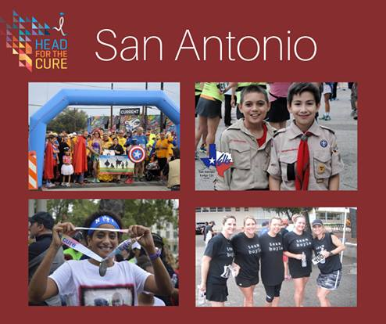
Results #4
HFTC commits to Elks
Elks part of live coverage
VA Dogs of Texas made connections
Photo with lodge logo shared on national HFTC page along with many other photos with San Antonio’s logo as well

Slide 25
Results #4
Bottom line: Find ways to get more involved with local charity events and organizations. The rewards are incalculable.

Slide 26
Summary
Be proud Elks!
We are losing members every year, let’s reverse this trend by getting others excited about joining us. A good Public Forum strategy should be an integral part of your plan.

Slide 27
Summary
They are here to help!
The Public Relations Committee has four members who are ready to help

Slide 28
Summary
So, what can they help with?
Writing press releases
Video editing
Facebook/social media help
Shoot pictures/video

Slide 29
Contact information
Bob Tiffany TESA Marketing Chairman 806-886-3879 bobtiffany@cableone.net | Ella Johnston-Leger TESA newsletter editor 409-658-4280 ellajil@earthlink.net
Jason E. Reichenberg 256-457-0995 jreichenberg@email.com | Gordon Daniels TESA Photographer 210-375-3806 gordondaniels1983@gmail.com
Scott Trepinski scott@trepinski.us 214-298-6362

Slide 30
Website/Facebook pages
TESA
www.texaselks.org
www.facebook.com/tesa
Texas Elks Camp
www.texaselkscamp.org
www.facebook.com/tesa1987
Grand Lodge
www.elks.org
www.facebook.com/ElksNationalFoundation

