Slide 1
Roberts Rules
of
Order - 101

Slide 2
Section 1.130. Parliamentary Authority:—The current version of Robert’s Rules of Order, Newly Revised, shall govern all proceedings unless contravened by the Constitution or Laws of the Order, or the By-Laws of a Lodge.

Slide 3
Cheat Sheet

Slide 4
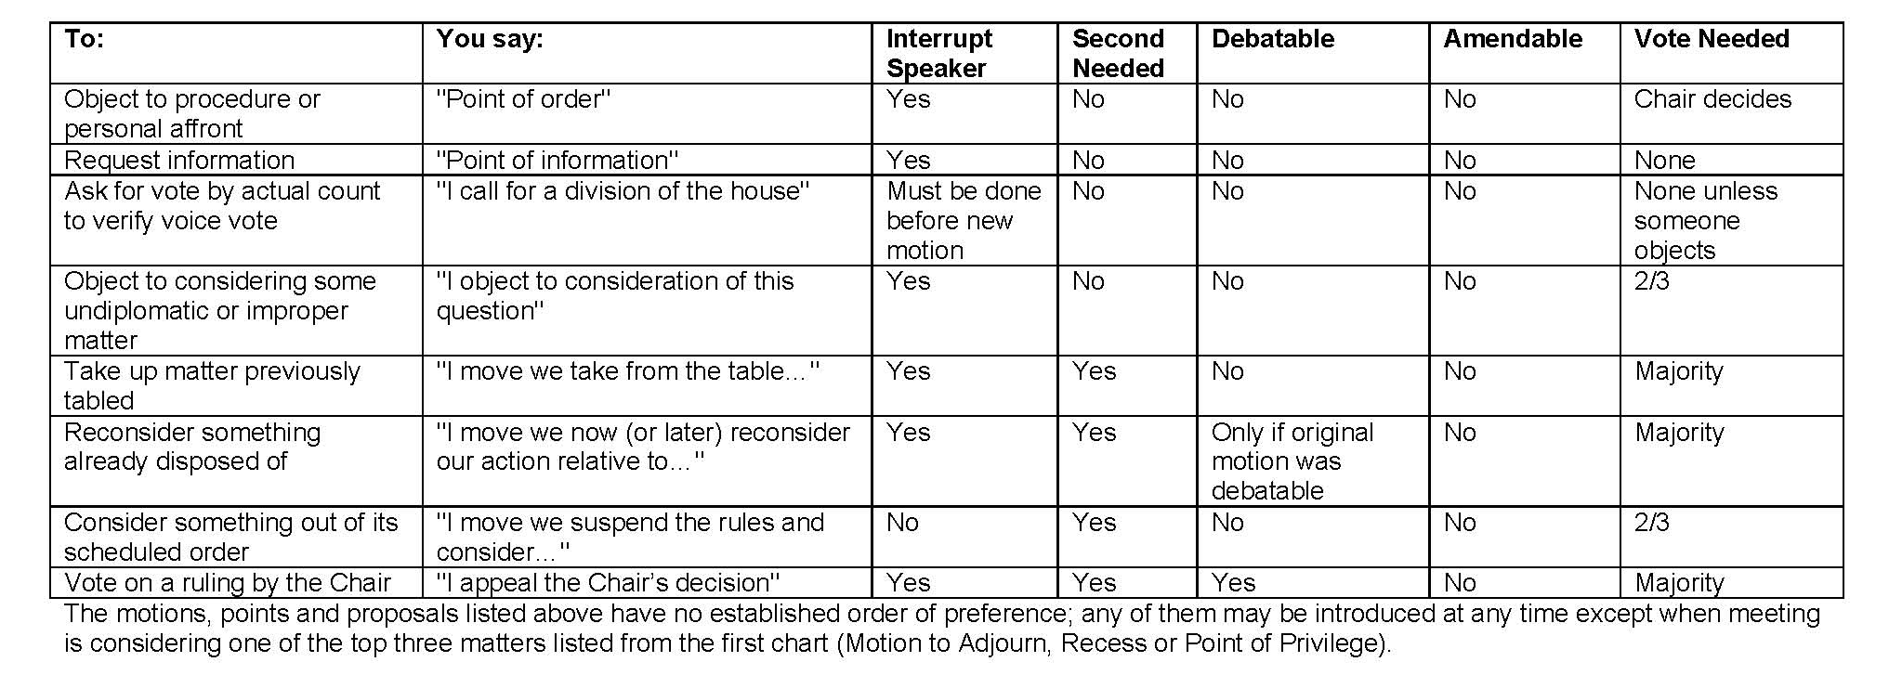
Cheat Sheet

