Slide 1

Rank the District Train the Trainer
Ranked Choice Voting (RCV)
is coming to DC!
Grow Democracy DC Civic Education Fund

Slide 2
Our goals
The Grow Democracy DC Civic Education Fund is the leading nonprofit organization dedicated to educating the DC community about ranked choice voting.
Our work:
Engage DC voters through free in-person trainings, tabling, and community events across all 8 wards, with a focus on seniors, low income communities, youth, and folks with disabilities
Help candidates understand how to run in a ranked choice election
Prepare election administrators to smoothly run a ranked choice election
Collaborate with community organizations to deliver accessible, culturally relevant education materials for their own educational programming

Slide 3
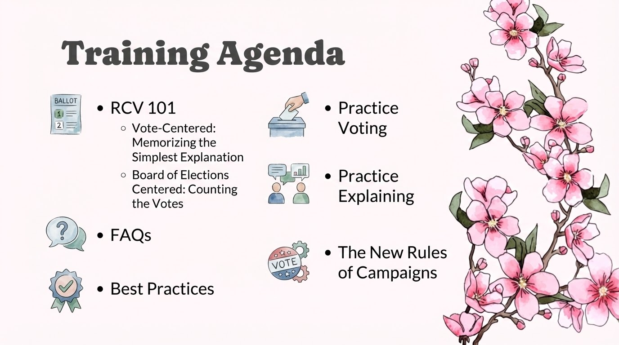

Slide 4
Today’s Training:
Tell
Show
Do

Slide 5
RCV 101
Notes:
FAQs:
Election results by ward:
79.6 – 20.4
75.1 – 25.0
71.3 – 28.7
68.5 – 31.5
71.1 – 28.9
75.1 – 24.9
69.9 – 30.1
72.0 – 28.0
We here to partner with your office in hopes to strategies on how to educate your constituents. You know them best.

Slide 6
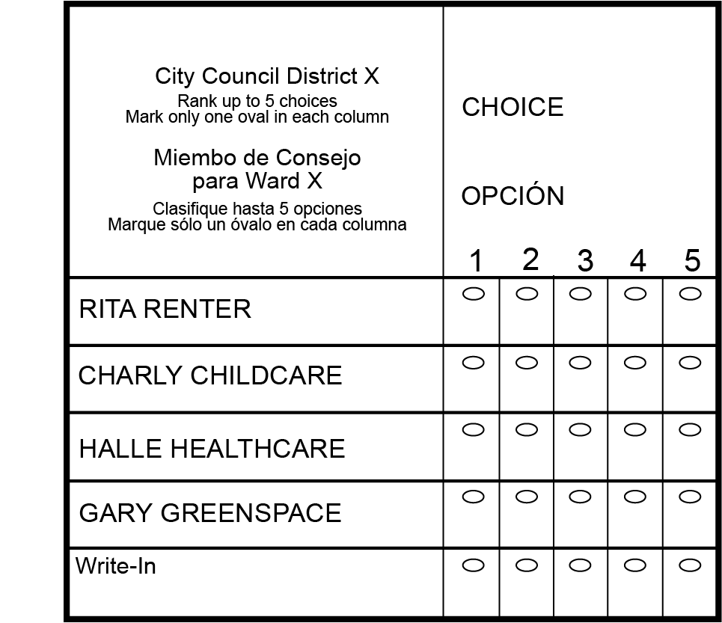
“How does RCV work?”
Voter-Centered explanation
Rank your favorite candidate 1st.
Rank your backup choices (2nd, 3rd, 4th, 5th) - only rank candidates you support!
If your first choice loses , your vote moves to your next choice.”
This repeats until a candidate wins with over 50%
Notes:
If your favorite comes in last, your vote simply counts for your next choice. (rephrase)

Slide 7
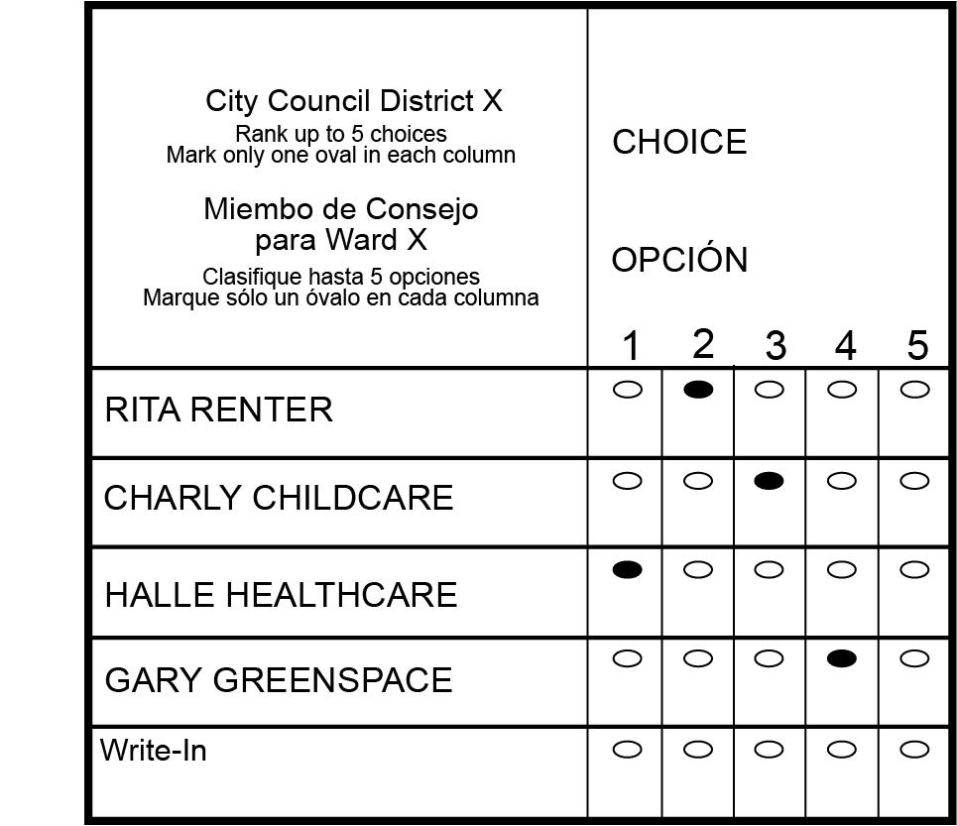
How to fill out your ballot
Notes:
If your favorite comes in last, your vote simply counts for your next choice. (rephrase)

Slide 8
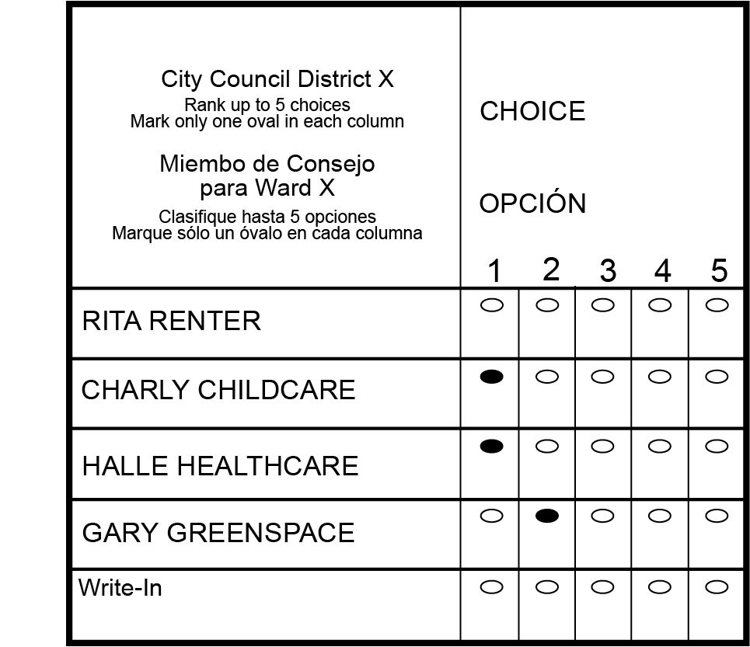
“What not to do!”
Voter-Centered explanation
Notes:
If your favorite comes in last, your vote simply counts for your next choice. (rephrase)

Slide 9
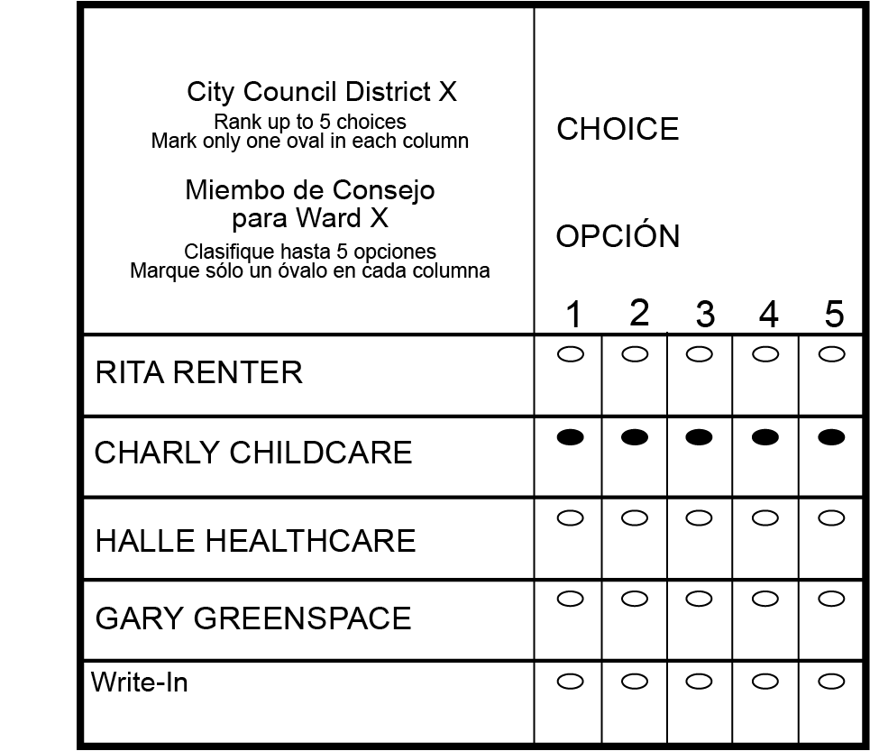
“What not to do!”
Voter-Centered explanation
Notes:
If your favorite comes in last, your vote simply counts for your next choice. (rephrase)

Slide 10
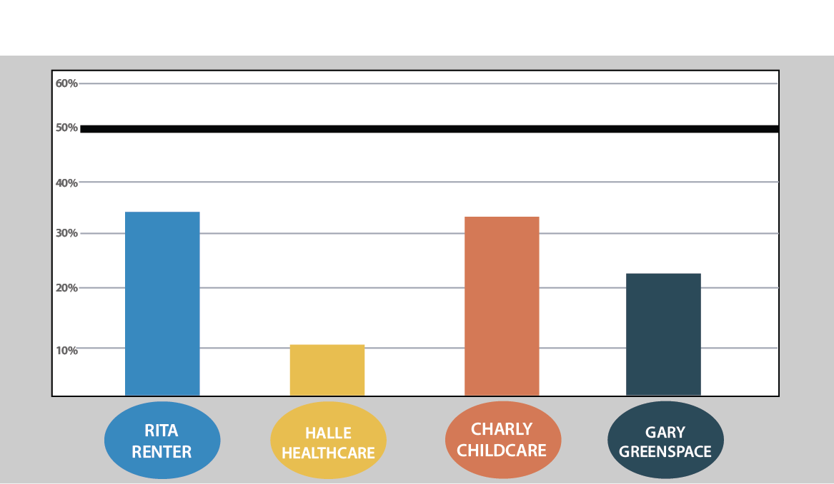
HOW DOES RANKED
CHOICE VOTING WORK?
Notes:
Grace
RCV Mock Election: Slide Time (1 minute)
THE KEY DIFFERENCE BETWEEN RCV AND OUR OLD SYSTEM IS A CANDIDATE NEEDS AT LEAST 50%+1 TO WIN.
To count the votes we start by ONLY counting 1st choices, just like any other election.
Lets say we were in voting in a larger election. Lets go through the counting process. Do any of these candidate have a majority?
NO
So this is when ranked choice voting kicks in. We could have Chili Cheeseburger win with only 36%, that is nowhere near 50%. So...we move on to the next round.

Slide 11
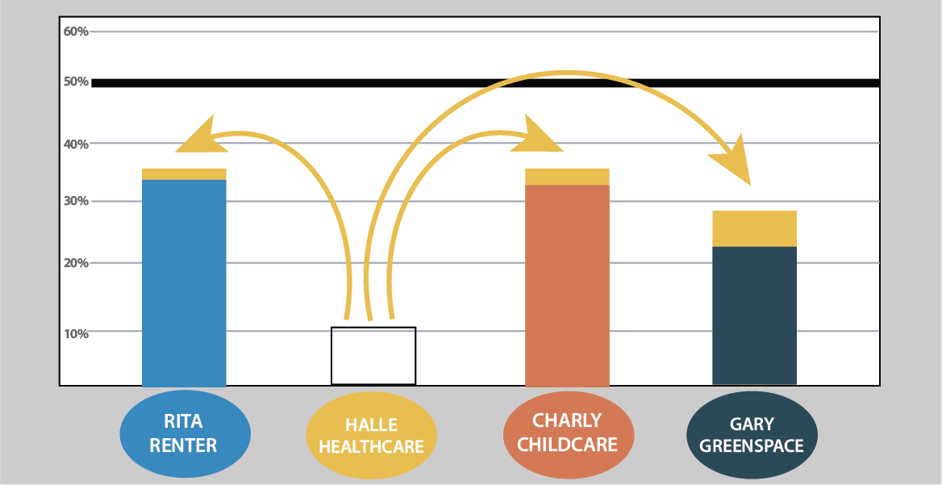
HOW DOES RANKED
CHOICE VOTING WORK?
Notes:
Grace
RCV Mock Election: Slide Time (1 minute)
We eliminated the candidate with the fewest first choices which was our Red Enchiladas. So, I ranked Red Enchiladas as my first choice in this mock election - I loved a fried egg and that is what I’m looking for in my candidate. Now sadly Red Enchiladas didn’t have enough to be viable. But, fortunately for me, I ranked a 2nd choice on my ballot, Frito Pie!
Once we eliminate Red Enchiladas, voters who selected it as their first choice will have their vote immediately go to their 2nd choice.
As we can see, it looks like there were a lot of Enchiladas voters who had Breakfast Burritos or Frito Pies as their 2nd choice.
Do we have a candidate with a majority? NO.
So we repeat the process.

Slide 12
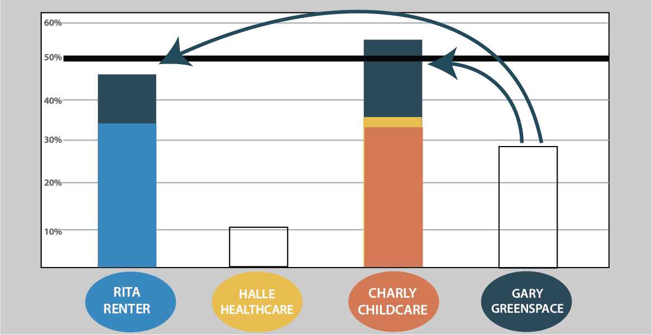
HOW DOES RANKED
CHOICE VOTING WORK?
Notes:
Grace
RCV Mock Election: Slide Time (1 minute)
Which candidate has the fewest votes now?
Indian Taco! Once we eliminate Indian Taco voters who selected it as their first choice will have their vote immediately go to their 2nd choice.
As we can see, it looks like there were a lot of Indian Taco voters had Breakfast Burritos or Frito Pies as their 2nd choice.
Do we have a candidate with a majority? NO.
So we repeat the process.

Slide 13
Frequently Asked Questions?
Notes:
FAQs:
Election results by ward:
79.6 – 20.4
75.1 – 25.0
71.3 – 28.7
68.5 – 31.5
71.1 – 28.9
75.1 – 24.9
69.9 – 30.1
72.0 – 28.0
We here to partner with your office in hopes to strategies on how to educate your constituents. You know them best.

Slide 14
Do I have to rank every candidate?
No. You can rank as many or as few as you’d like, up to 5 candidates.

Slide 15
Does it hurt my 1st choice’s chances if I rank a 2nd choice?
No. Your backup choices will only matter IF your 1st choice is out of the race.

Slide 16
What if I only like one candidate?
If there is only one candidate that you like you can rank them 1st and leave the rest. HOWEVER, if they’re eliminated you don’t have any backups.

Slide 17
What other questions have you heard?

Slide 18
Best Practices
Notes:
FAQs:
Election results by ward:
79.6 – 20.4
75.1 – 25.0
71.3 – 28.7
68.5 – 31.5
71.1 – 28.9
75.1 – 24.9
69.9 – 30.1
72.0 – 28.0
We here to partner with your office in hopes to strategies on how to educate your constituents. You know them best.

Slide 19
Avoid Jargon

Slide 20
Don’t get bogged down in theoreticals, ideology, or “moderation”

Slide 21
“We rank things everyday!”

Slide 22
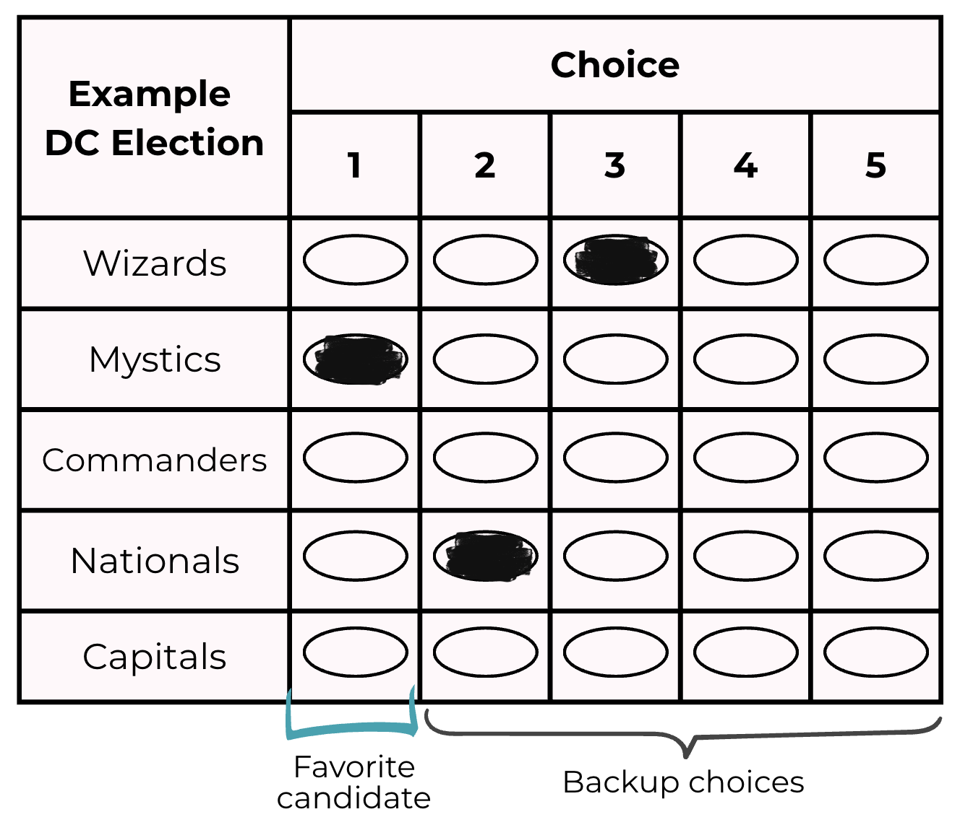
Show, don’t Tell
Voters tend to find RCV intuitive when they see a ballot.
Mock elections are an effective campaign & voter education tool (Rank Your Food, Rank Your Movies, etc.)

Slide 23
It’s important to not “wing” it, but actually take the time now to practice and get it right.

Slide 24
What is different about an RCV campaign?
Notes:
FAQs:
Election results by ward:
79.6 – 20.4
75.1 – 25.0
71.3 – 28.7
68.5 – 31.5
71.1 – 28.9
75.1 – 24.9
69.9 – 30.1
72.0 – 28.0
We here to partner with your office in hopes to strategies on how to educate your constituents. You know them best.

Slide 25
In an RCV election:
A successful candidate should have...
A large number of 1st choices
Depending on the number of candidates, 2nd or 3rd choice on enough ballots from voters who prefer other candidates.
Two important questions to ask:
How can candidates maximize first choices?
How can they be the 2nd, 3rd, etc choices of people who rank other candidates as a first choice?

Slide 26
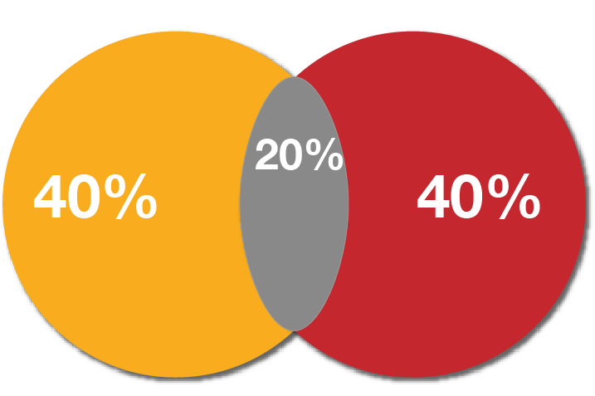
The old way:
Undecided
Base
Base

Slide 27
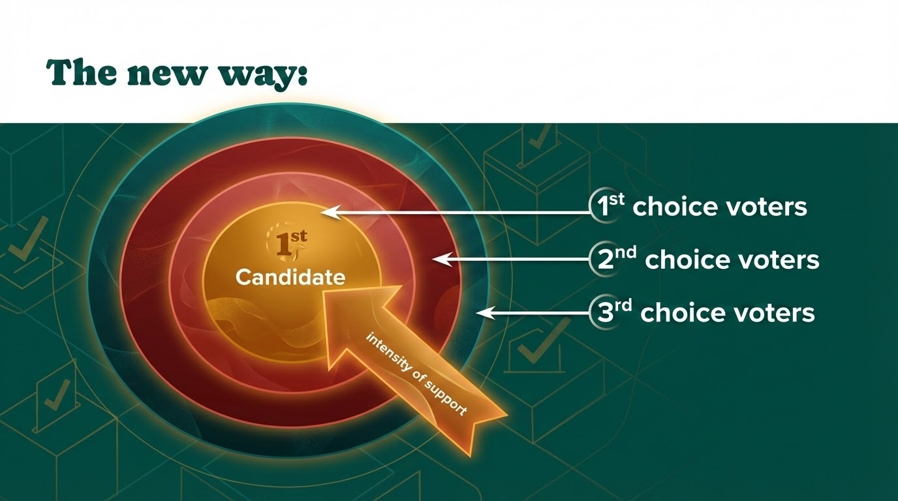
Notes:
Used AI to update the look, but don’t love it lol. Shouldn’t be “1st candidate”, but just “Your Candidate”

Slide 28
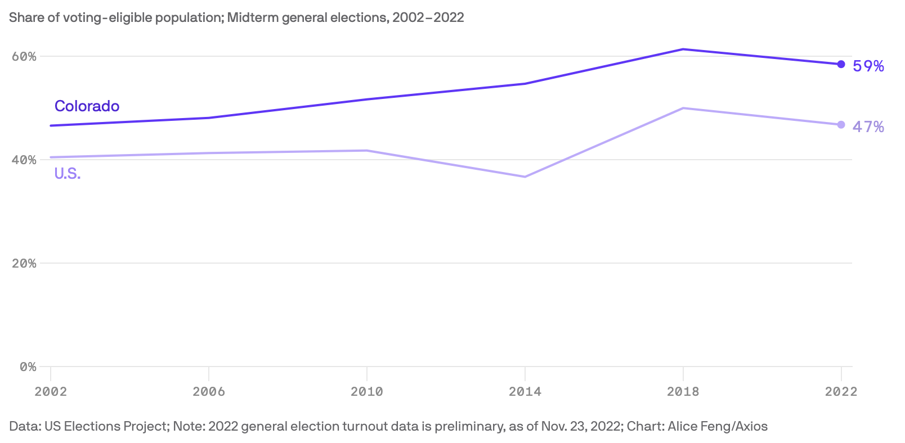
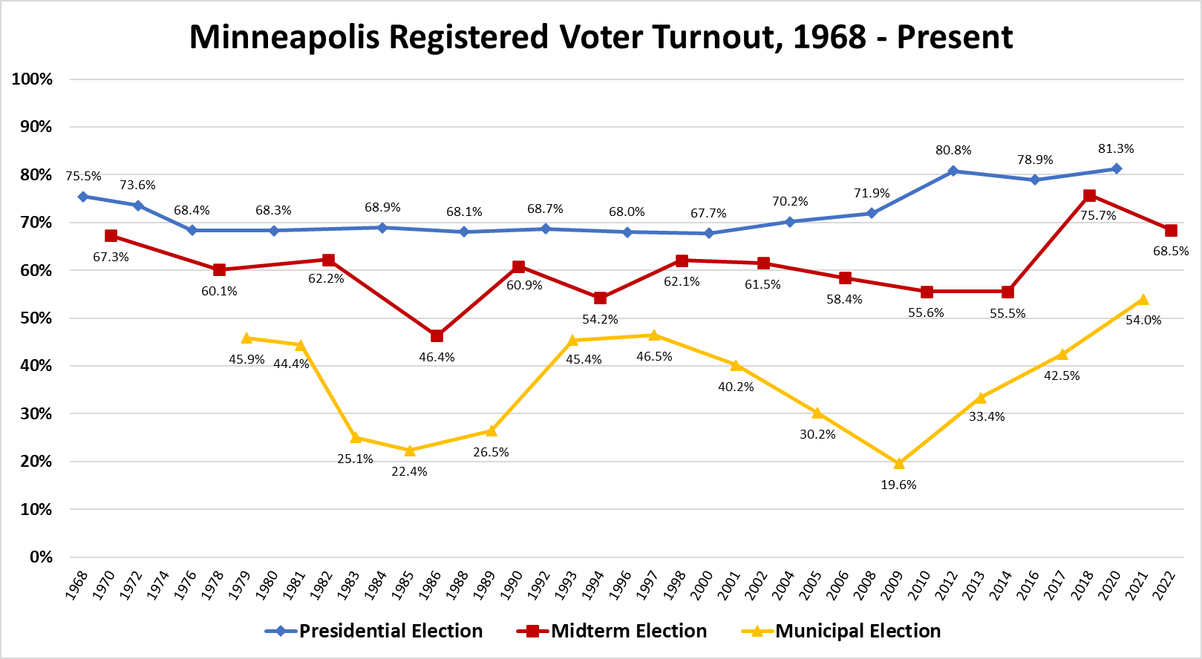
Expected Turnout
First, determine EXPECTED TURNOUT in Ward X
Use the average of 3 or more similar past elections*
Registered Voters = 50,000
Expected Turnout = 53% = 26,500 voters
Other factors to take into account:
Hot (or dead) races above/below you on the ticket
Highly visible/polarizing ballot initiatives
Aggressive voter registration campaigns
Current events or political climate
Candidate/Issue Identity – race, age, ethnicity, gender etc.

Slide 29
Calculate your “win” number
Expected Turnout: 26,500 voters
Then, find your WIN NUMBER (50%+1):
26,500 ÷ 2 + 1 vote = 13,251 votes
+ cushion (e.g. 54%)
= 14,310 Working Win Number
Your campaign needs to convince at least 14,000 people to vote for your candidate or issue to win

Slide 30
How will this impact my campaign strategy?
Notes:
FAQs:
Election results by ward:
79.6 – 20.4
75.1 – 25.0
71.3 – 28.7
68.5 – 31.5
71.1 – 28.9
75.1 – 24.9
69.9 – 30.1
72.0 – 28.0
We here to partner with your office in hopes to strategies on how to educate your constituents. You know them best.

Slide 31

Campaign Planning
Campaign plans are developed to determine how best to use these resources. Ranked choice voting may impact how you prioritize and strategize you efforts.
People
Time
Money

Slide 32
To win a ranked choice voting race you must build a winning coalition.
Which means getting all those 1st choice votes from undecided voters AND all those 2nd and 3rd choice votes from people whose doors you wouldn’t plan on knocking in a traditional non RCV campaign.
So how do you maximize your resources in a RCV race?
PRIORITIZE FIELD AND DIRECT VOTER CONTACT
RANKED ENDORSEMENTS
CANDIDATE COALITION CAMPAIGNING
Budget
Candidate
intensity of support

Slide 33
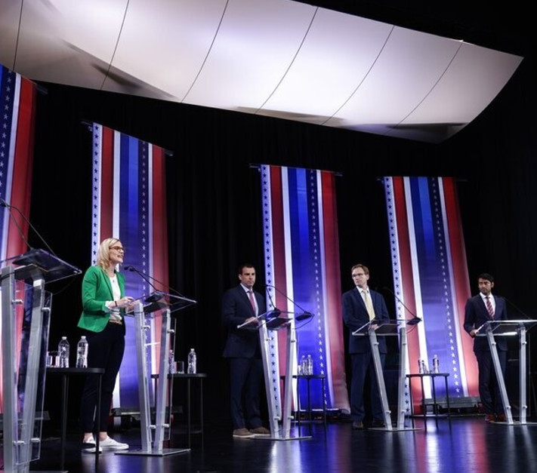
Know the COMPETITION
What issues are guiding this election?
Where do all the candidates stand on the issues?
How does the field of candidates align on your issues?
Where can you find common ground?
Where do you stand out?
Research

Slide 34
Who will be eliminated and in what order?
How do that candidate’s supporters feel about my candidacy?
What issues do we align on? Where do we differ?
Research

Slide 35
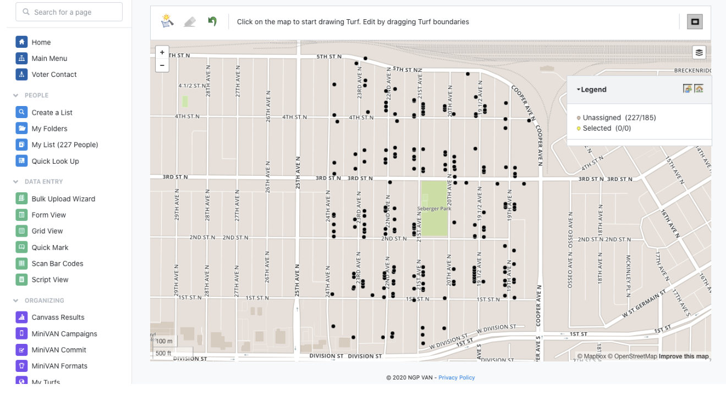
Targeting is the process of prioritizing conversations with voters based on a combination of their likelihood to support your candidacy or to participate in the election.
In a RCV election targeting should be tiered to prioritize 1st choice support then broaden to universes of likely lower ranking support.
Targeting

Slide 36
How will you talk to voters?
1 = Strong Support
2 = Leaning Support
3 = Undecided
4 = Leaning another candidate
5 = Another candidate’s #1
6 = Opposes you
Volunteer, GOTV
Persuasion to 1st choice or 2nd Choice
2nd or 3rd Choice
Off the list,

Slide 37
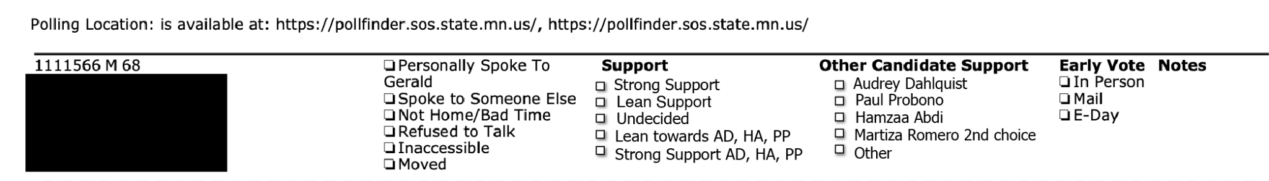
How can your voter database help guide your RCV strategy?
Whether you are using a high or low tech tools to track your campaign’s progress - infusing RCV info into your tracking systems will improve your data and your ability to prioritize

Slide 38
An effective field strategy incorporates RCV education into voter outreach.

Slide 39
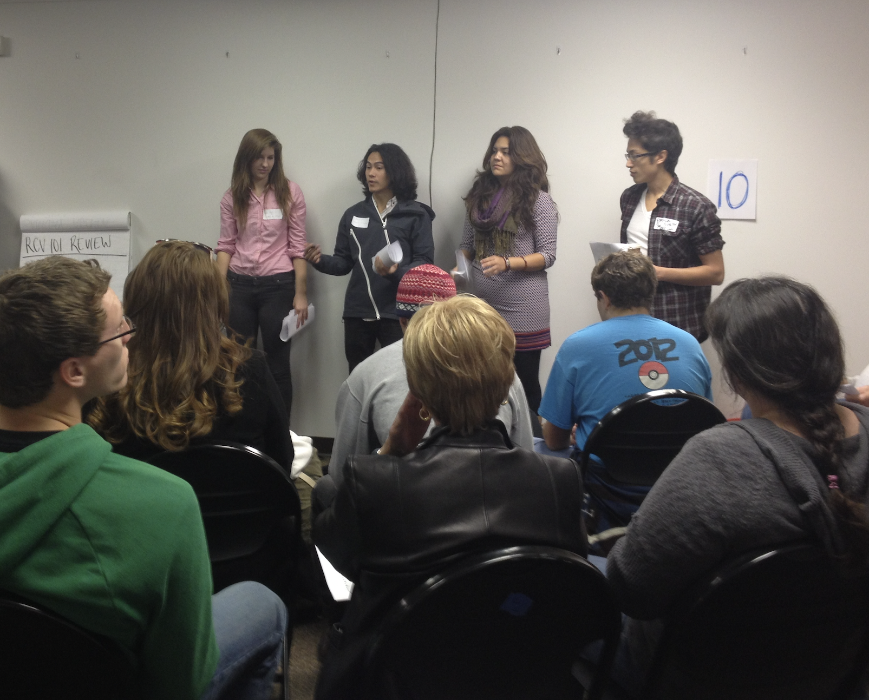
Always include a training on the basics of RCV and how this will effect your campaign. It is important that everybody in your campaign speaks about RCV to voters in a consistent way. Things to think about:
Everyone on your team MUST understand and be able to explain at a very basic level how RCV works.
All volunteers should be able to describe how a ballot works and point to resources that provide more information.
Train your campaign staff and volunteers

Slide 40
How will this impact my communications strategy?
Notes:
FAQs:
Election results by ward:
79.6 – 20.4
75.1 – 25.0
71.3 – 28.7
68.5 – 31.5
71.1 – 28.9
75.1 – 24.9
69.9 – 30.1
72.0 – 28.0
We here to partner with your office in hopes to strategies on how to educate your constituents. You know them best.

Slide 41
An effective RCV communications strategy incorporates asks for lower rankings everywhere.

Slide 42
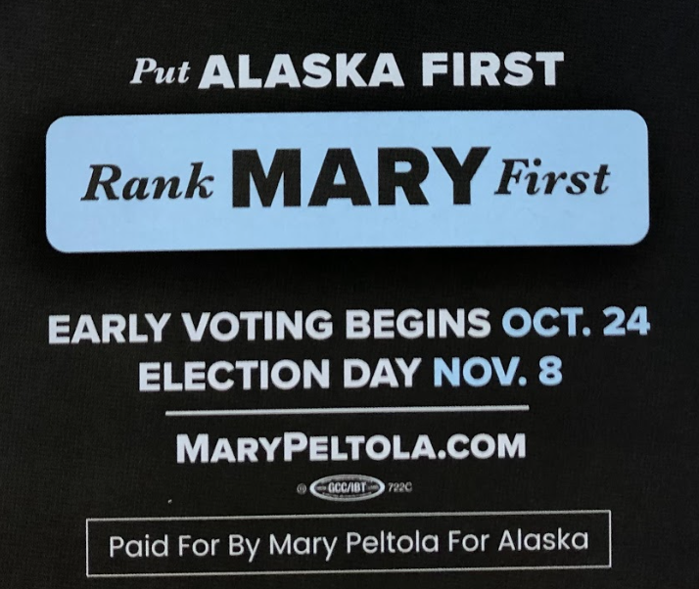
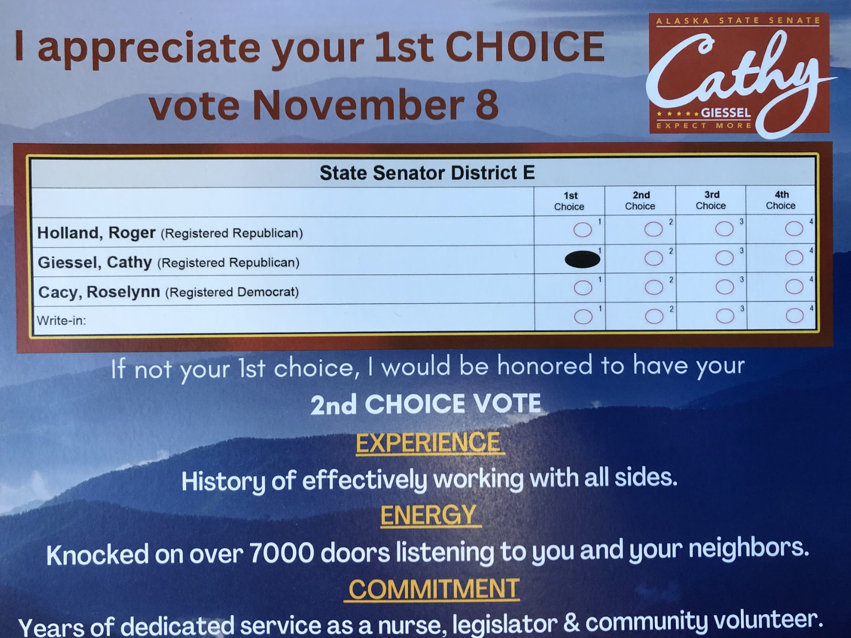
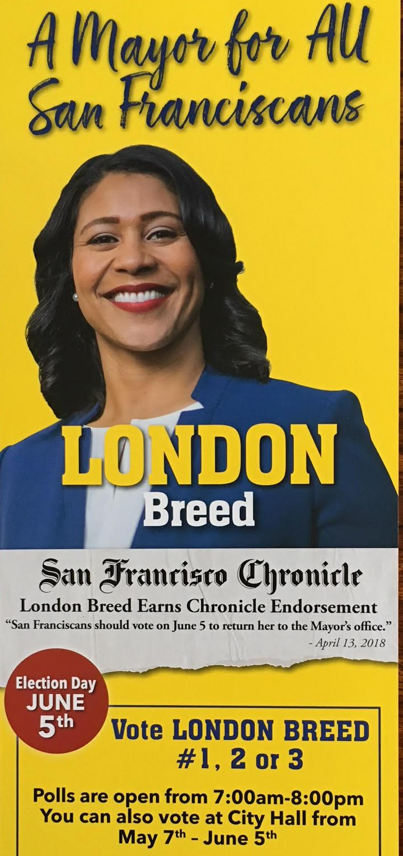

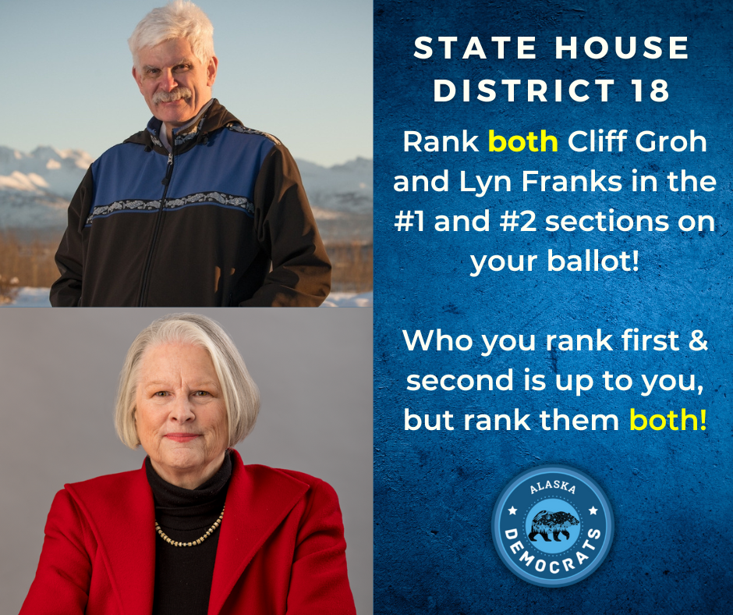




On your (and your fellow candidates’) lit...

Slide 43
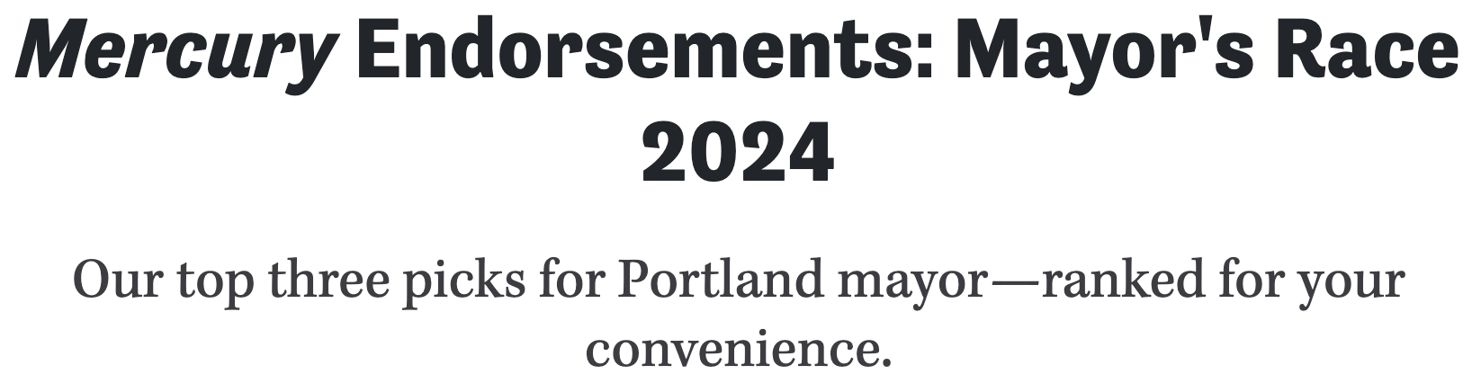
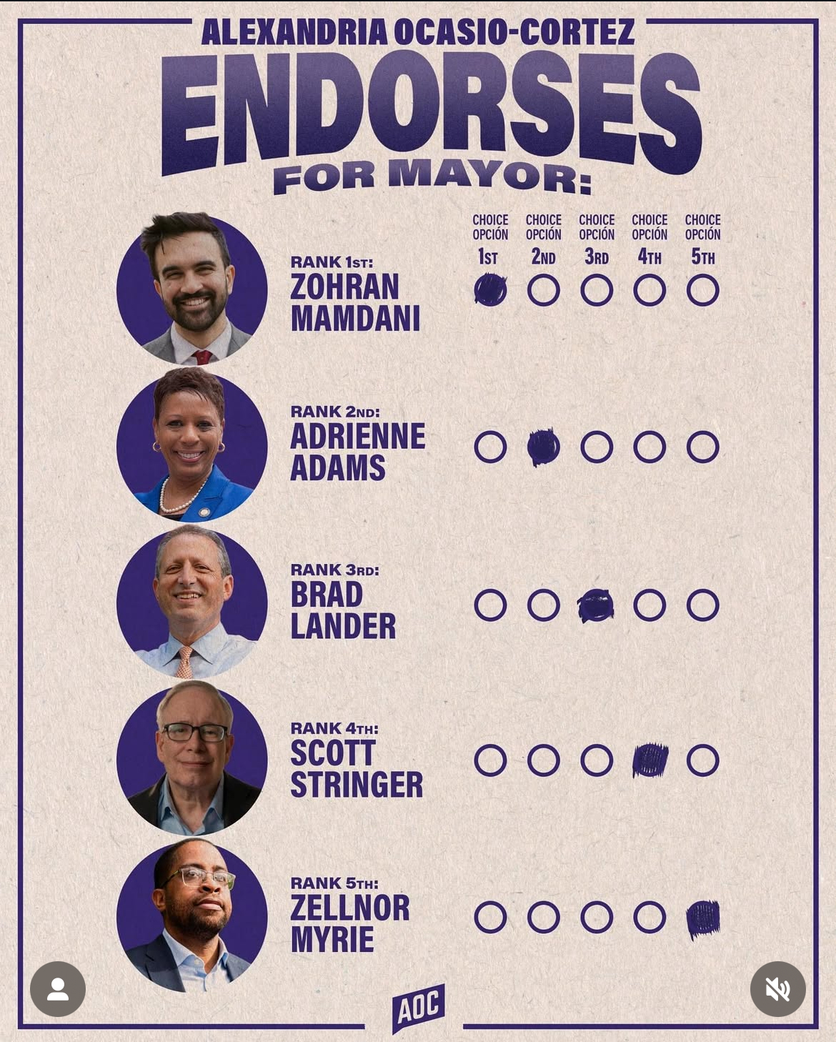
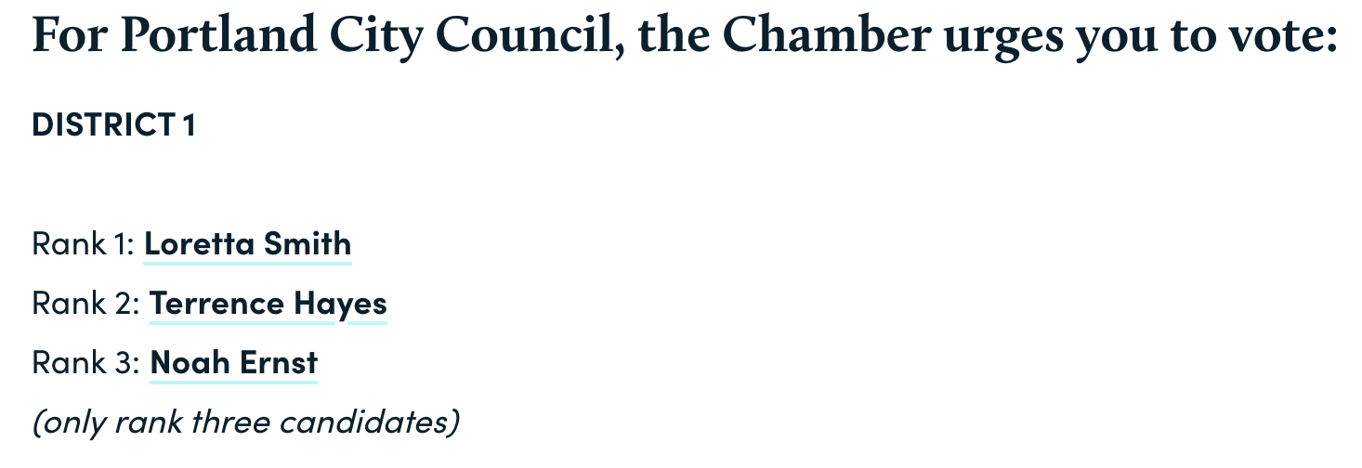
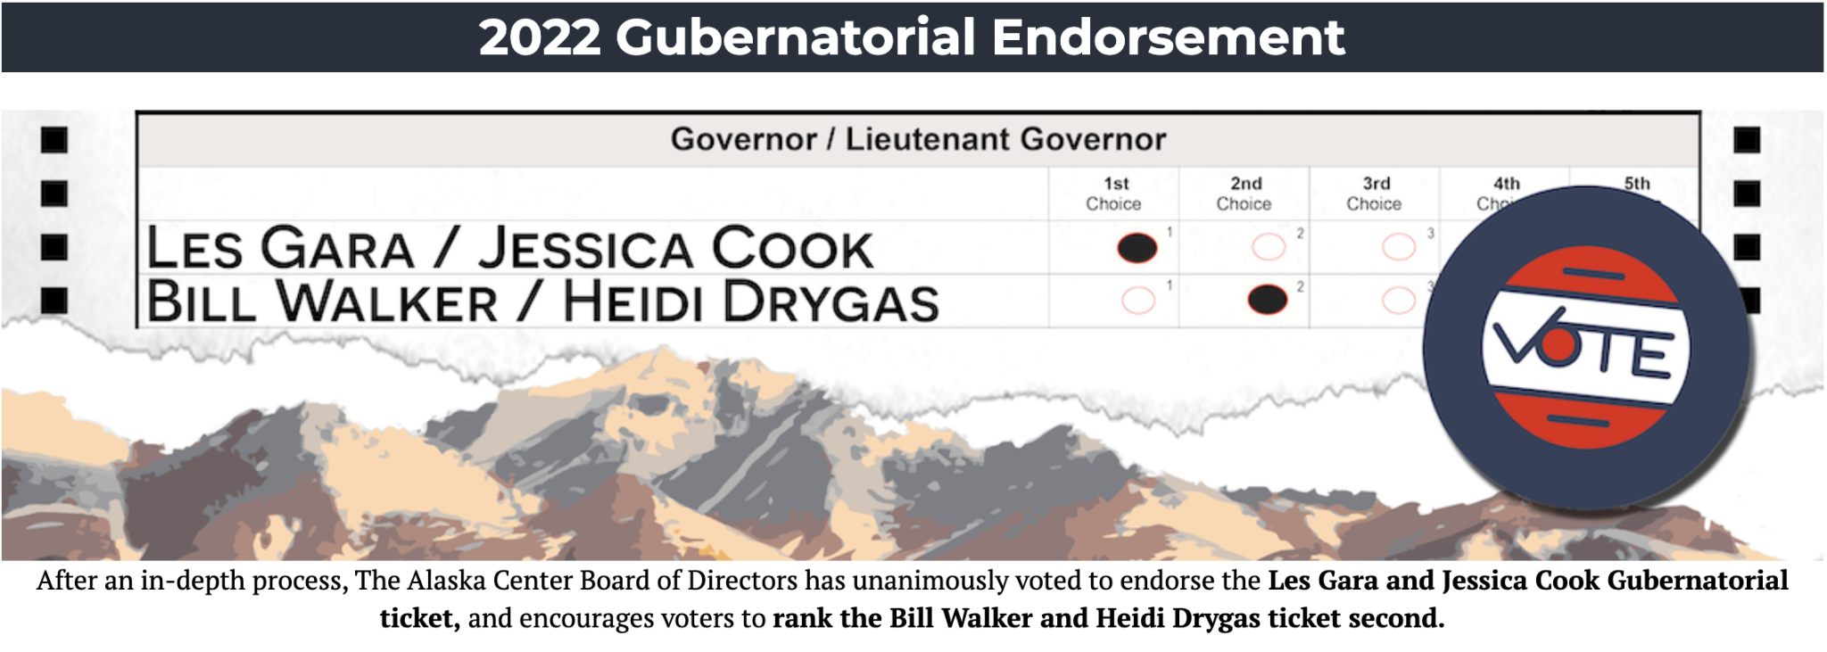
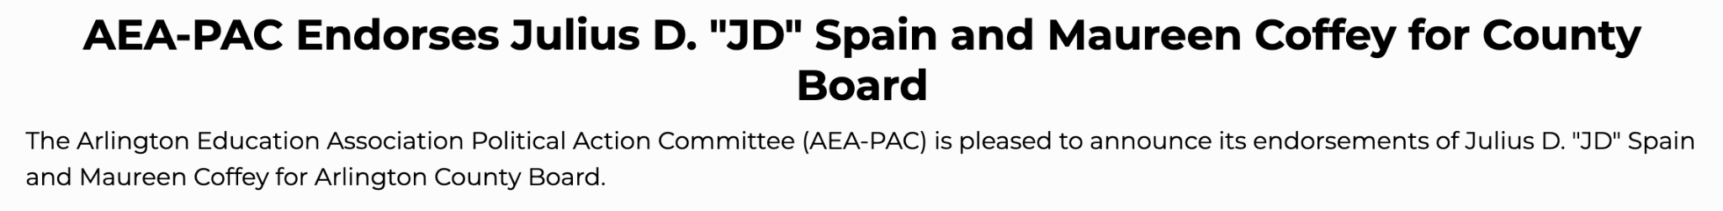
Endorsements...
Many endorsing organizations will change their endorsement process, this is no longer a zero sum game. In other cities with RCV, we’ve seen:
Top two endorsements
Ranked endorsements

Slide 44
Messaging - Distinguish, don’t disparage.
In an RCV election you must give voters a reason to rank you as their 1st (or 2nd) choice. Telling voters to vote “against” other candidates is a losing strategy.
Learning how to ask for a 2nd choice is essential to win - also those conversations can help you govern, if elected.

Slide 45
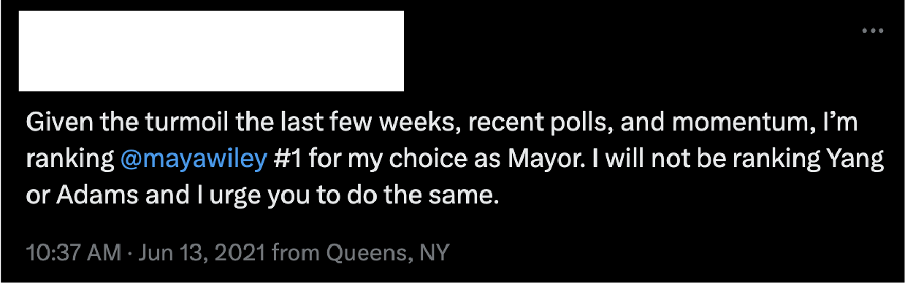
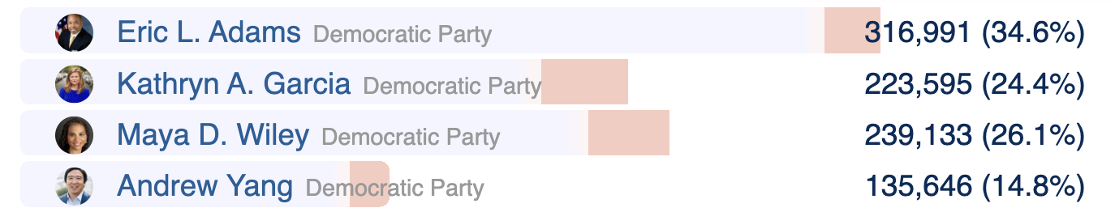
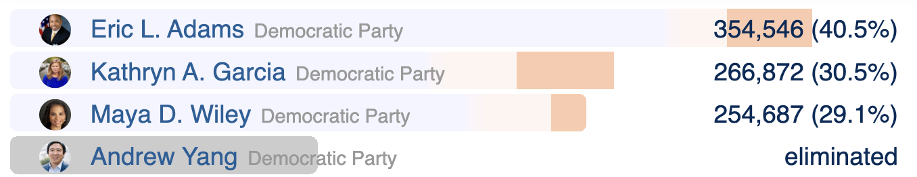
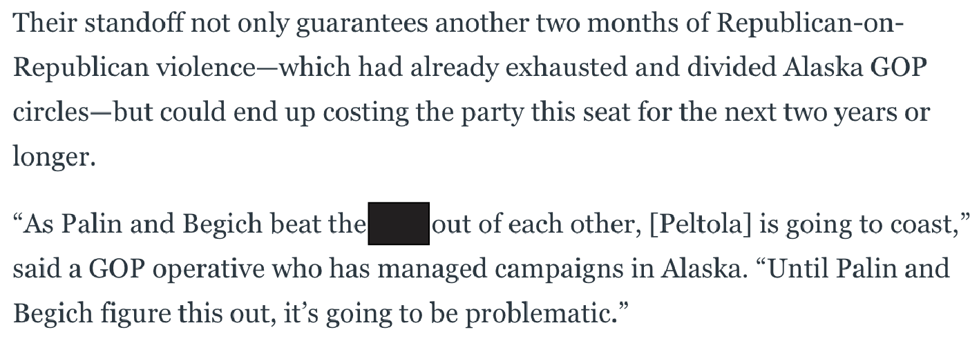
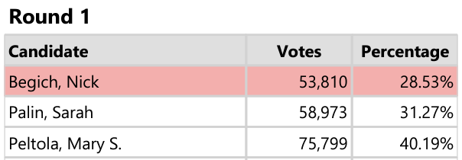
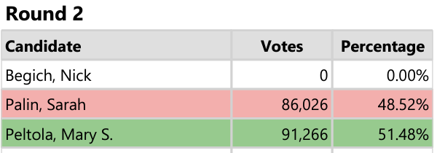
Risks of going negative
You as a candidate determine the tone of your campaign. In an RCV election it is particularly important to instill that tone from the top down and weigh the risks before making changes.
Your campaign should have guidelines and training on:
Understanding the vote-losing risks of going negative/the vote-getting benefits of staying positive
Talking points to find shared values with other candidate’s supporters
Social Media Etiquette - how to engage with those who support other candidates.
New York City
Alaska

Slide 46


Distinguish, Don’t Disparage
Is this piece intended to persuade or dissuade voters from supporting a candidate?
What is the core issue that we’re debating here?
If this were used in a ranked choice voting election (it was), what are the risks of running this ad?

Slide 47
Final Thought
Ignoring RCV, in a RCV election, is a losing strategy.
Notes:
FAQs:
Election results by ward:
79.6 – 20.4
75.1 – 25.0
71.3 – 28.7
68.5 – 31.5
71.1 – 28.9
75.1 – 24.9
69.9 – 30.1
72.0 – 28.0
We here to partner with your office in hopes to strategies on how to educate your constituents. You know them best.

Slide 48
Thank you!
Notes:
FAQs:
Election results by ward:
79.6 – 20.4
75.1 – 25.0
71.3 – 28.7
68.5 – 31.5
71.1 – 28.9
75.1 – 24.9
69.9 – 30.1
72.0 – 28.0
We here to partner with your office in hopes to strategies on how to educate your constituents. You know them best.

Slide 49
How you can educate your community!
Host an educational presentation with your group, community organization or civic association — invite us in for our interactive 7-minute demo + Q&A.
Share our materials — distribute flyers, social posts, and mock ballots to your networks to help educate your community.
Encourage volunteering or serving as a Ward Captain — help us recruit, train and deploy field teams for door-knocking and tabling. Email kenyatta@growdemocracydc.org
Connect us to your community partners — introduce us to local faith-based groups, schools, senior centers or youth programs that would benefit from RCV education.
Promote on your digital channels — post about ranked-choice voting using our ready-made graphics and tag @GrowDemocracyDC; help spread the message city-wide.

Slide 50
Voter education
Our most important task is to ensure that every voter enters the voting booth confident in using ranked choice voting.
Our bedrock is to meet voters where they are.
Community events
Digital & video
On-site sessions
Canvassing
Teach-ins, town halls

