Slide 1



RANK THE DISTRICT
Ranked Choice Voting (RCV) is coming to DC!
rankthedistrict.org

Slide 2



How did we get here?
January 2024: Initiative 83 began collecting signatures to put the question of RCV and semi-open primaries to the voters.
November 2024: DC Voters overwhelmingly voted YES winning with 73% of the vote.
July 2025: DC Council funded Ranked Choice Voting implementation.
June 2026: Will be the first election using RCV in DC.

Slide 3

Our
Goals
Our work:
Engage DC voters through free in-person trainings, tabling, and community events across all 8 wards, with a focus on seniors, hard to reach communities, youth, and folks with disabilities
Help candidates understand how to run in a ranked choice election
Prepare election administrators to smoothly run a ranked choice election
Collaborate with community organizations to deliver accessible, culturally relevant education materials for their own educational programming
The Grow Democracy DC Civic Education Fund is the leading organization dedicated to educating DC voters about ranked choice voting, through our Rank the District project.
01
02
03
04

Slide 4

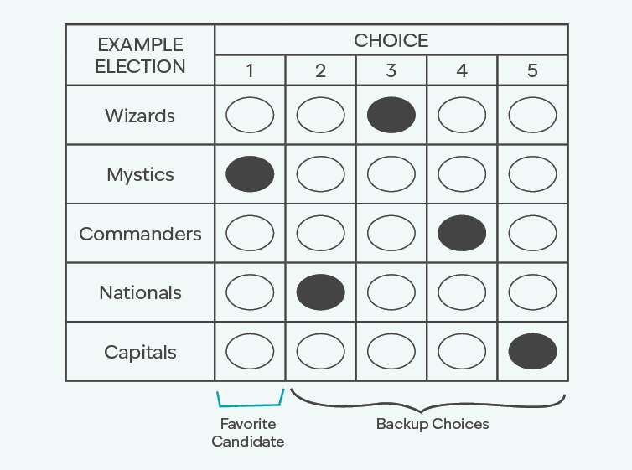
How do I
rank my ballot?
(clearest, simplest explanation)
01
Vote your favorite candidate 1st.
Rank your backup choices
(2nd, 3rd, 4th, 5th) - you don’t have to rank more than 1!
Your vote stays with your 1st choice. If they’re in last place, your vote moves to your next choice.
02
03
This repeats until a candidate wins with over 50%.
Notes:
If your favorite comes in last, your vote simply counts for your next choice. (rephrase)

Slide 5
How do I
rank my ballot?
(clearest, simplest explanation)
01
Vote your favorite candidate 1st.
Rank your backup choices
(2nd, 3rd, 4th, 5th) - you don’t have to rank more than 1!
Your vote stays with your 1st choice. If they’re in last place, your vote moves to your next choice.
02
03
This repeats until a candidate wins with over 50%.
Notes:
If your favorite comes in last, your vote simply counts for your next choice. (rephrase)

Slide 6

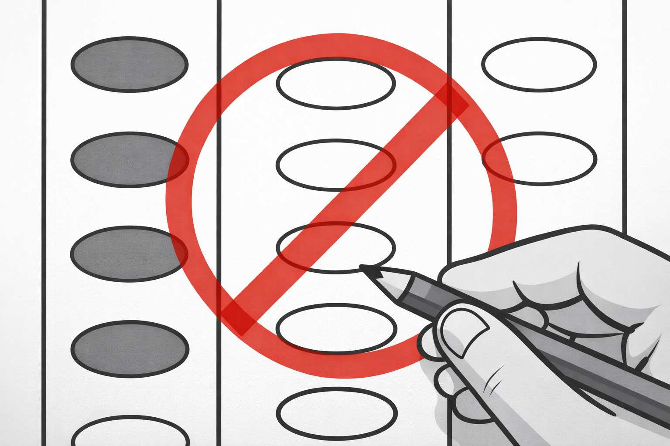
What NOT to do!
Don’t choose more than one candidate in the same column.
Remember, only rank a candidate if you support them!
Notes:
If your favorite comes in last, your vote simply counts for your next choice. (rephrase)

Slide 7

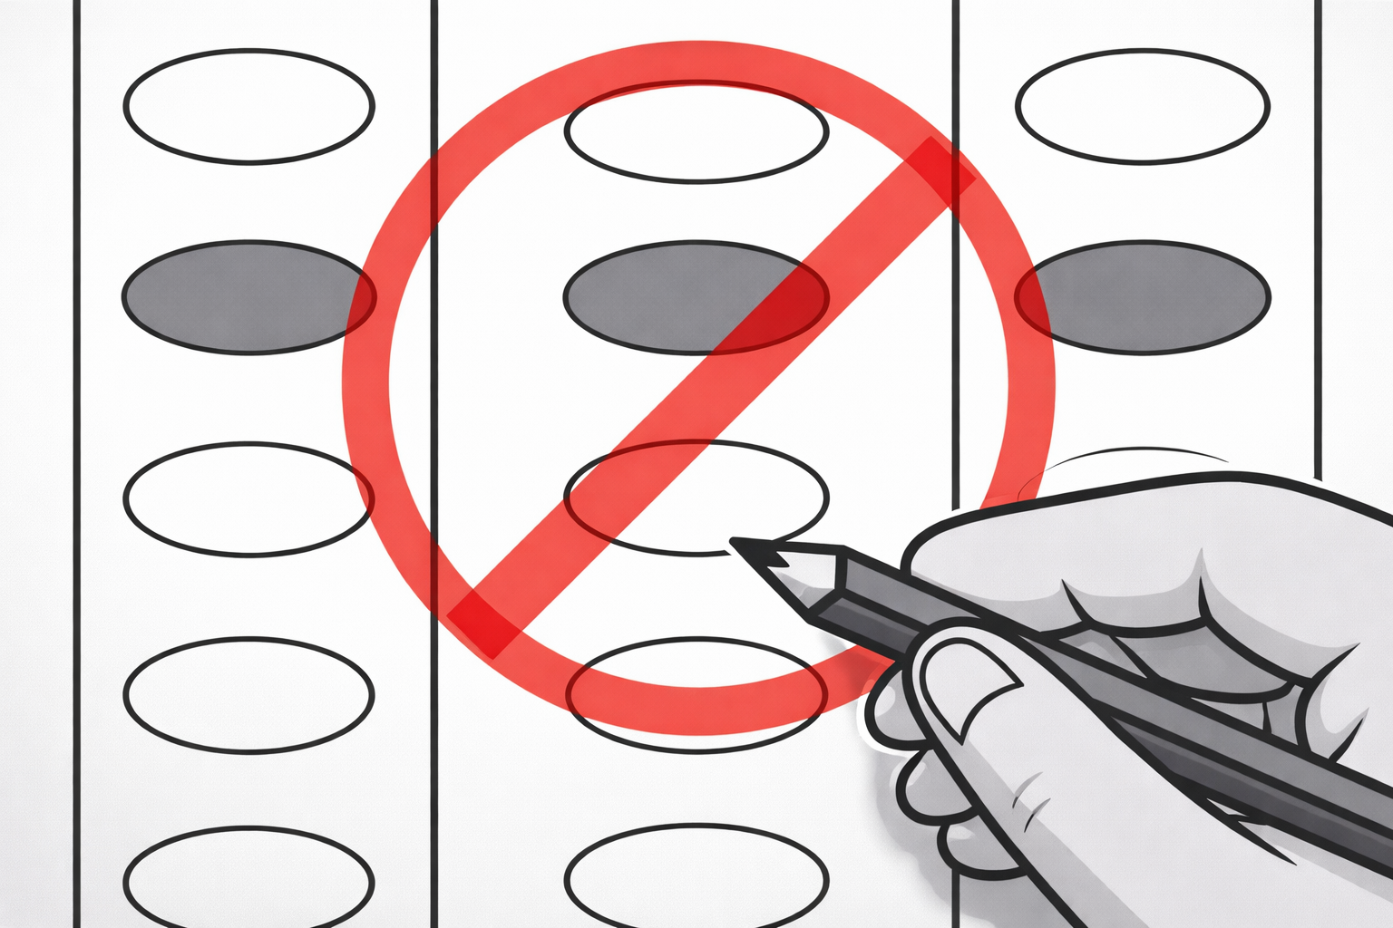
What NOT to do!
Don’t rank the candidates more than once.
Remember, only rank a candidate if you support them!
Notes:
If your favorite comes in last, your vote simply counts for your next choice. (rephrase)

Slide 8
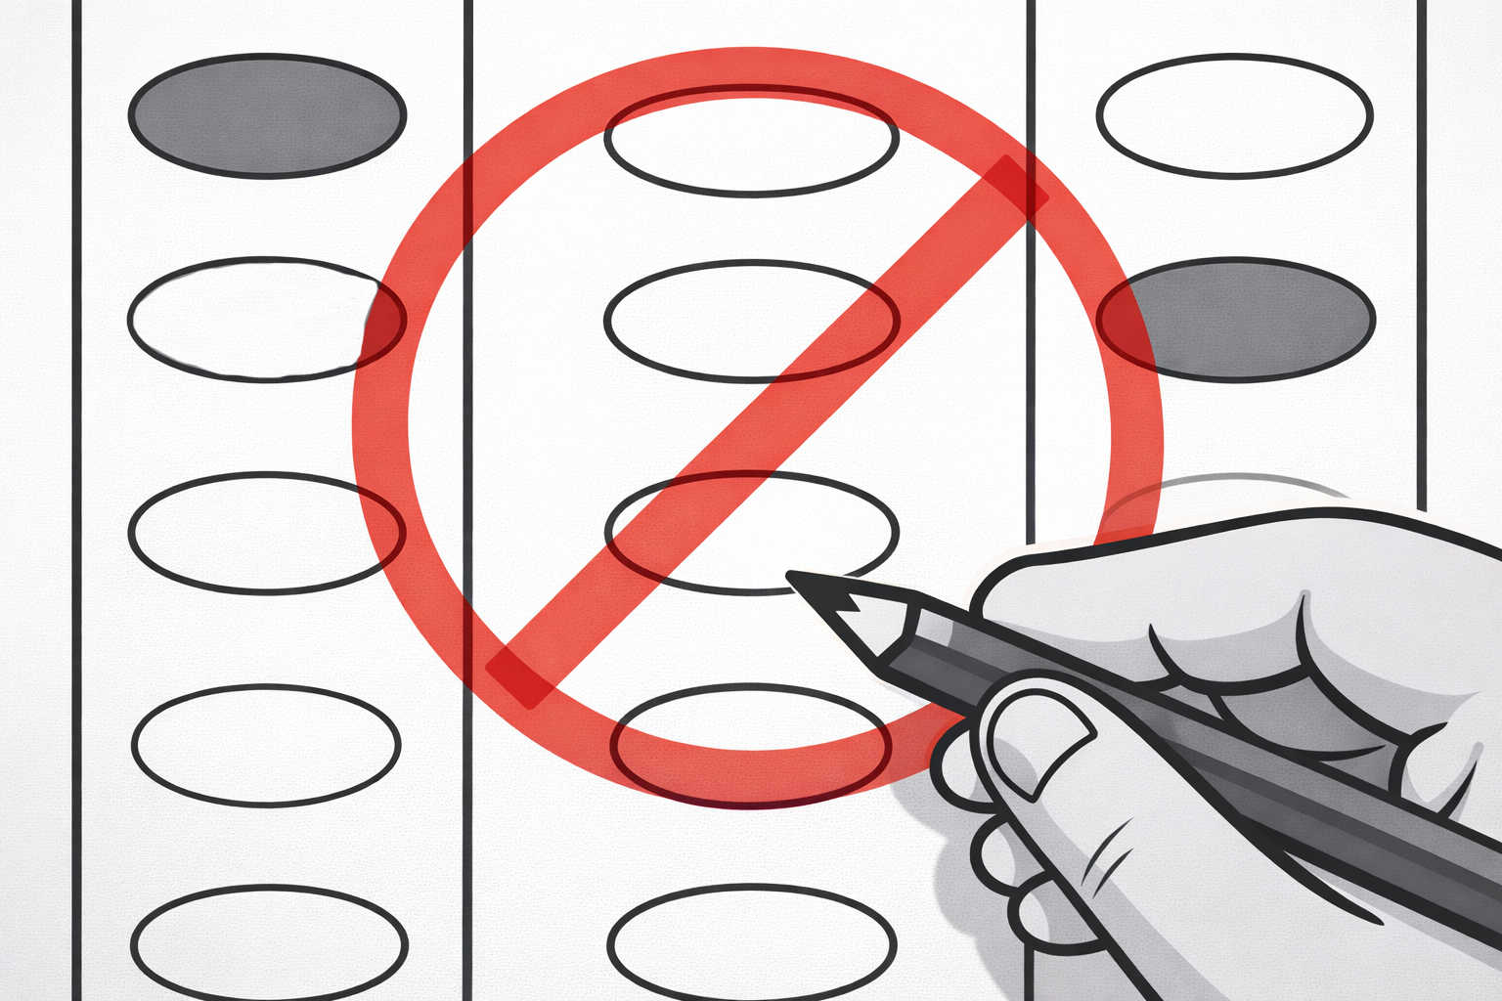
What not to do!
Skipping is allowed, but it’s best to rank in order.
Remember, only rank a candidate if you support them!
Notes:
If your favorite comes in last, your vote simply counts for your next choice. (rephrase)

Slide 9
What to do
Each choice is in a different column and a different row.
Remember, only rank a candidate if you support them!
Notes:
If your favorite comes in last, your vote simply counts for your next choice. (rephrase)

Slide 10
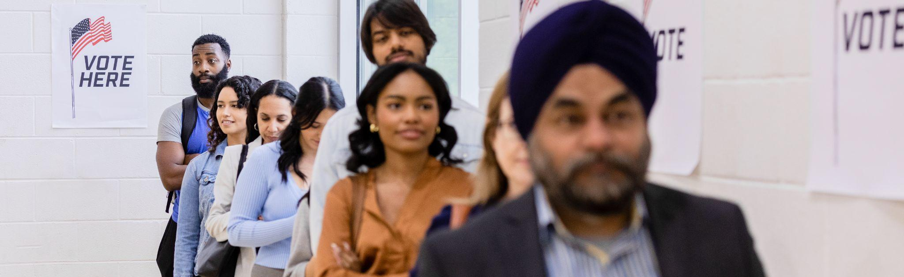
QUESTIONS?
Notes:
FAQs:
Election results by ward:
79.6 – 20.4
75.1 – 25.0
71.3 – 28.7
68.5 – 31.5
71.1 – 28.9
75.1 – 24.9
69.9 – 30.1
72.0 – 28.0
We here to partner with your office in hopes to strategies on how to educate your constituents. You know them best.

Slide 11

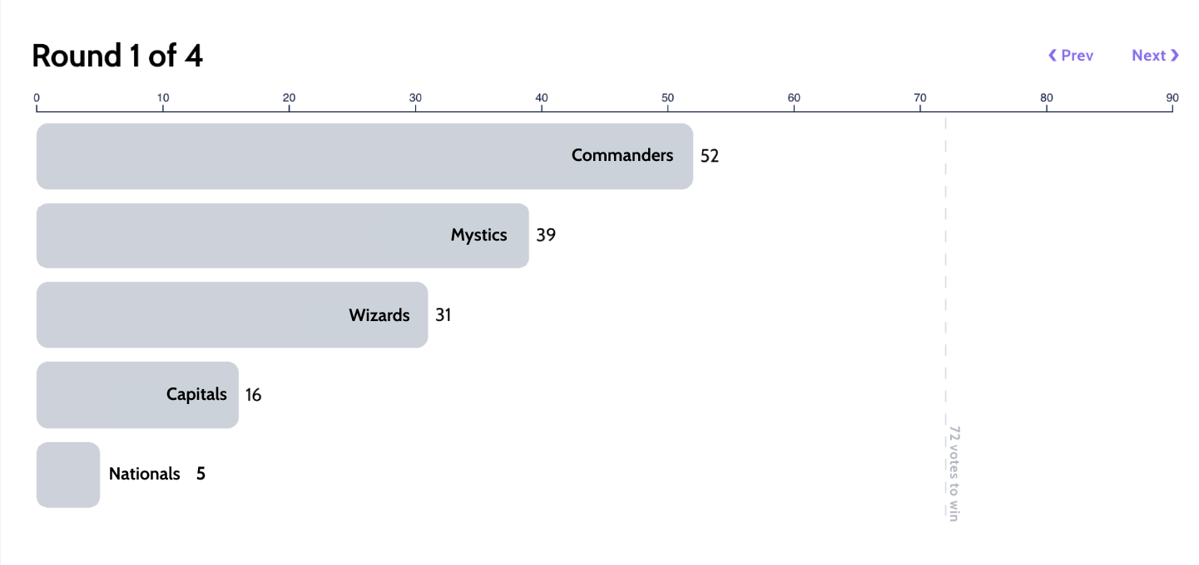
Resultados y tabulación
Results & Tabulation
Round 1 of 4
DC SPORTS:
Rank Your Favorite Team
Winner
Votes to Win
Candidates
Commanders
72 of 143 votes
5
0
10
20
30
40
50
60
70
80
90
Commanders
52
Mystics
39
Wizards
31
Capitals
16
Nationals
5
72 votes to win
Notes:
Show example from rank the female rap artist results - https://app.rankedvote.co/rv/8zf2yxz34qxv5v3885/results

Slide 12
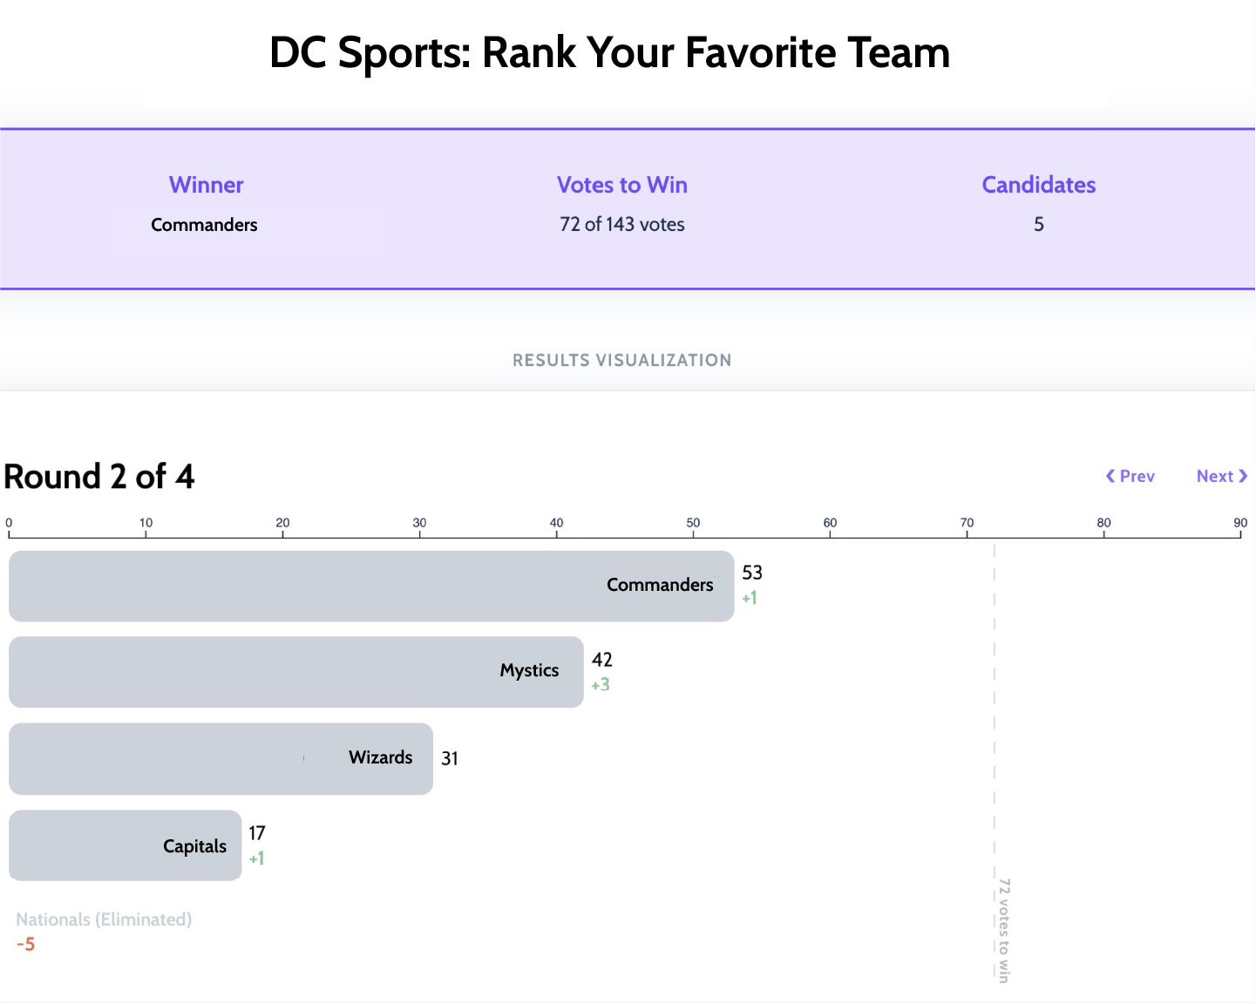
Results & Tabulation
Round 2 of 4
DC SPORTS:
Rank Your Favorite Team
Winner
Votes to Win
Candidates
Commanders
72 of 143 votes
5
0
10
20
30
40
50
60
70
80
90
Commanders
53
+1
Mystics
42
+3
Wizards
31
Capitals
17
+1
Nationals (Eliminated)
-5
72 votes to win
Notes:
Show example from rank the female rap artist results - https://app.rankedvote.co/rv/8zf2yxz34qxv5v3885/results

Slide 13
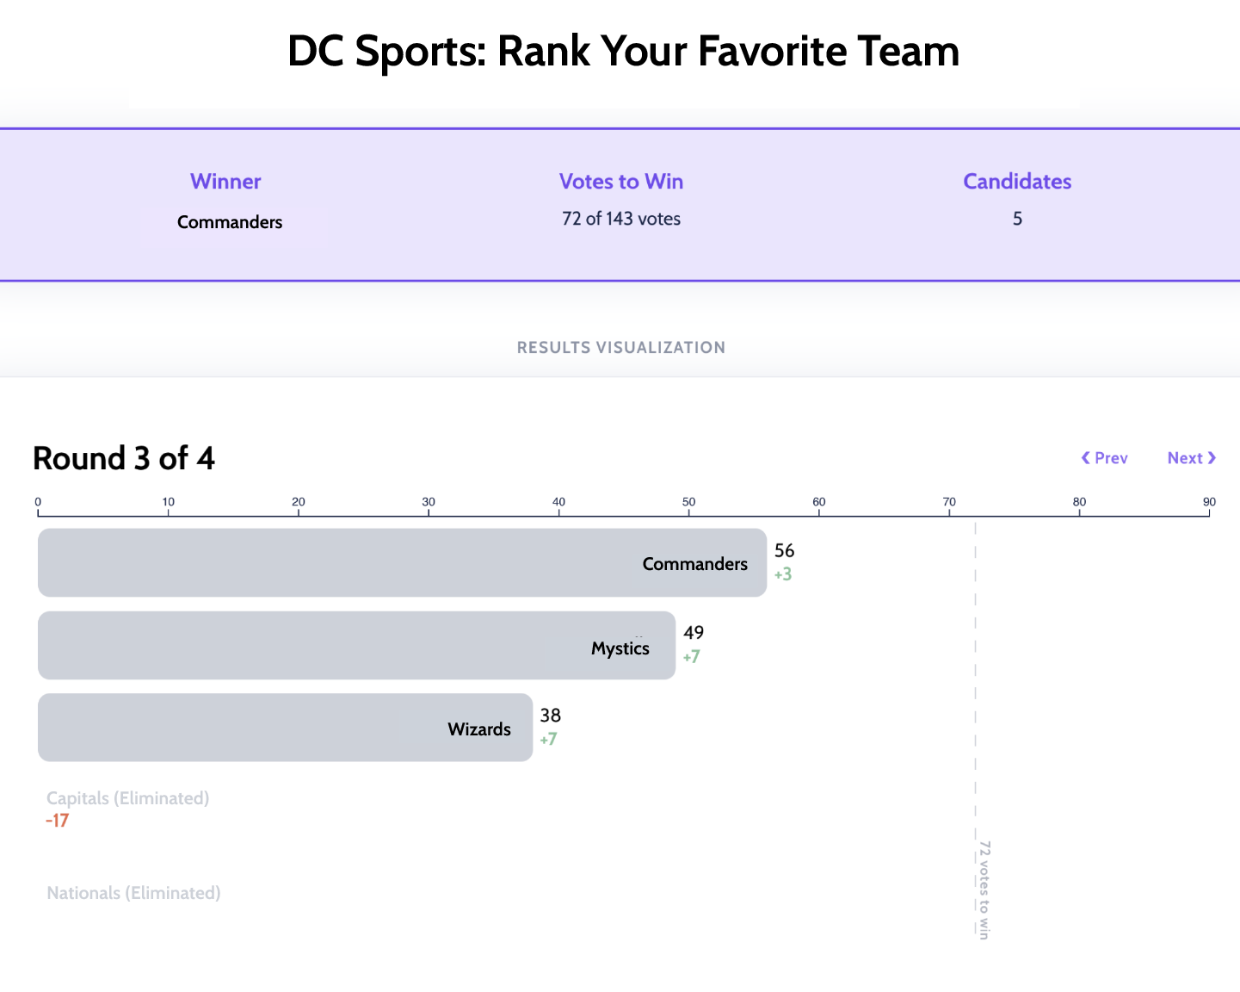
Results & Tabulation
Round 3 of 4
DC SPORTS:
Rank Your Favorite Team
Winner
Votes to Win
Candidates
Commanders
72 of 143 votes
5
0
10
20
30
40
50
60
70
80
90
Commanders
56
+3
Mystics
49
+7
Wizards
38
+7
Capitals (Eliminated)
-17
Nationals (Eliminated)
72 votes to win
Notes:
Show example from rank the female rap artist results - https://app.rankedvote.co/rv/8zf2yxz34qxv5v3885/results

Slide 14
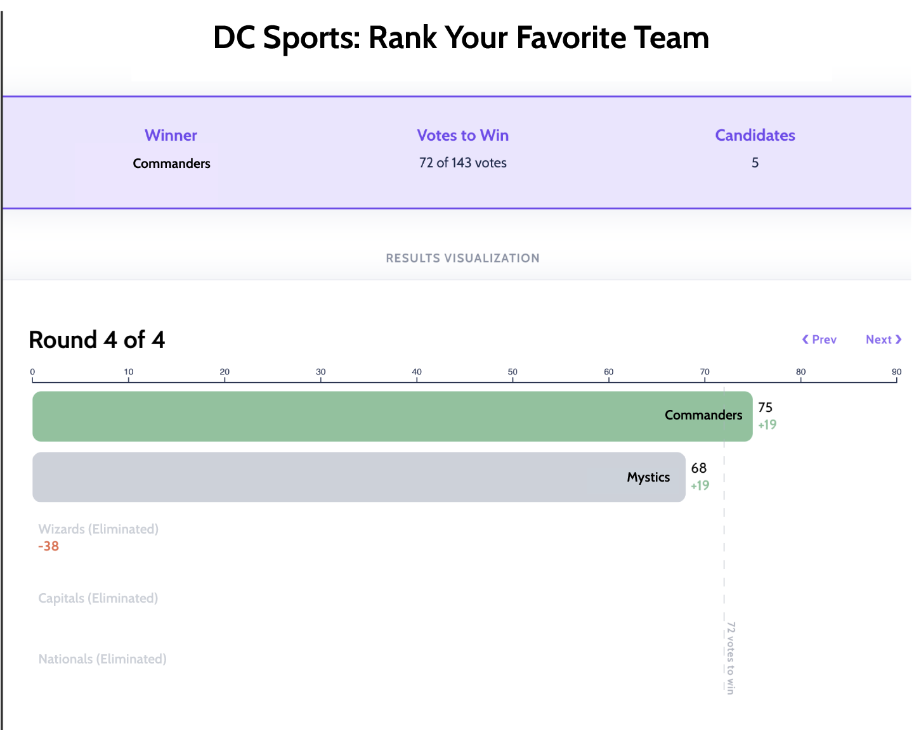
Results & Tabulation
Resultados y tabulación
Round 4 of 4
DC SPORTS:
Rank Your Favorite Team
Winner
Votes to Win
Candidates
Commanders
72 of 143 votes
5
Ronda 4
0
10
20
30
40
50
60
70
80
90
Commanders
75
+19
68
Mystics
+19
Wizards (Eliminated)
-38
Capitals (Eliminated)
Nationals (Eliminated)
72 votes to win
Notes:
Show example from rank the female rap artist results - https://app.rankedvote.co/rv/8zf2yxz34qxv5v3885/results

Slide 15

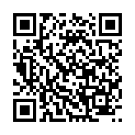
Clasifica tu equipo deportivo favorito de DC
Rank Your Favorite DC Sports Team
Mock ballot can be accessed by scanning the QR code below:
Notes:
Show example from rank the female rap artist results - https://app.rankedvote.co/rv/8zf2yxz34qxv5v3885/results

Slide 16
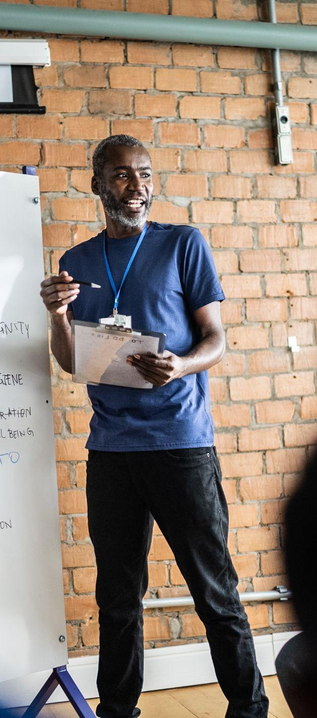
The value of ranked
choice voting
More choices for voters. Vote your values - the candidate you truly want, not worrying about the “lesser evils” or “splitting the vote”
Positive campaigning. Encourages coalition-building, highlighting shared values, and cross-endorsements
Majority support. Winners must earn more than 50% - makes it easier to hold unpopular politicians accountable

Slide 17

How you can educate your community!
Host an educational presentation with your group, ANC, community organization, or civic association — invite us in for our interactive 7-minute demo + Q&A.
Share our materials — distribute flyers, social posts, and mock ballots to your networks to help educate your community. You can also attend a future training for trainers, candidates, and staff: dcrcv.com/trainings
Encourage volunteering or serving as a Ward Captain — help us recruit, train and deploy field teams for door-knocking and tabling. Email kenyatta@growdemocracydc.org
Connect us to your community partners — introduce us to local faith-based groups, schools, senior centers or youth programs that would benefit from RCV education.
Promote on your digital channels — post about ranked-choice voting using our ready-made graphics and tag @rankthedistrict; help spread the message city-wide.

Slide 18

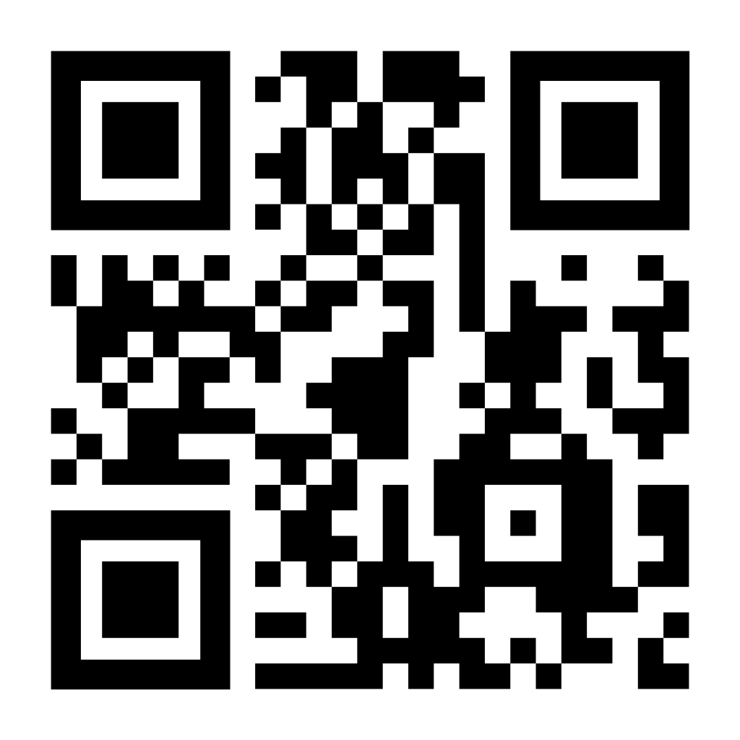
Thank you!
Learn more at Rank the District
Notes:
FAQs:
Election results by ward:
79.6 – 20.4
75.1 – 25.0
71.3 – 28.7
68.5 – 31.5
71.1 – 28.9
75.1 – 24.9
69.9 – 30.1
72.0 – 28.0
We here to partner with your office in hopes to strategies on how to educate your constituents. You know them best.

Slide 19
RCV “201”
Notes:
FAQs:
Election results by ward:
79.6 – 20.4
75.1 – 25.0
71.3 – 28.7
68.5 – 31.5
71.1 – 28.9
75.1 – 24.9
69.9 – 30.1
72.0 – 28.0
We here to partner with your office in hopes to strategies on how to educate your constituents. You know them best.

Slide 20
Which offices does RCV apply to?
Starting in June, RCV will be used for ALL public offices, both federal and local.
Yes, this includes presidential elections!
Party offices (i.e. state committee) are excluded from RCV.
Races must involve three or more candidates for RCV to be used.

Slide 21
Which elections does RCV apply to?
Starting in June, RCV will be used for all DC elections: primaries, generals, AND specials.
Nothing about the “structure” of our party-nominating elections (primaries) will change.
Nonpartisan offices such as State Board of Education and ANCs will also be elected via RCV in general elections.
The two simultaneously-elected At-Large Council seats will use RCV in general elections.

Slide 22
How does RCV work in the At-Large race?
No more “choose two” - the At-Large seats will appear on the ballot just like every other RCV contest, where you can rank up to five.
Tabulation simply continues until two candidates remain, instead of stopping when someone gets 50%.
NOT a system that involves fractions (such as STV/PR).
NOT a sequential system that removes winners and re-tabulates.

Slide 23
Two-winner RCV (for At-Large)
Candidate | Votes | Percentage
Alpha | 2500 | 33.3%
Bravo | 1250 | 16.7%
Charlie | 1200 | 16.0%
Delta | 1000 | 13.3%
Echo | 800 | 10.7%
Foxtrot | 750 | 10.0%

Slide 24
Two-winner RCV (for At-Large)
Candidate | Votes | Percentage
Alpha | 2500 | 33.3%
Bravo | 1250 | 16.7%
Charlie | 1200 | 16.0%
Delta | 1000 | 13.3%
Echo | 800 | 10.7%
Foxtrot | 750 | 10.0%

Slide 25
Two-winner RCV (for At-Large)
Candidate | Votes | Percentage
Alpha | 2900 | 38.7%
Bravo | 1250 | 16.7%
Charlie | 1200 | 16.0%
Echo | 1100 | 14.7%
Delta | 1050 | 14.0%
Foxtrot

Slide 26
Two-winner RCV (for At-Large)
Candidate | Votes | Percentage
Alpha | 2900 | 38.7%
Bravo | 1250 | 16.7%
Charlie | 1200 | 16.0%
Echo | 1100 | 14.7%
Delta | 1050 | 14.0%
Foxtrot

Slide 27
Two-winner RCV (for At-Large)
Candidate | Votes | Percentage
Alpha | 3800 | 50.7%
Bravo | 1300 | 17.3%
Charlie | 1250 | 16.7%
Echo | 1150 | 15.3%
Delta
Foxtrot

Slide 28
Two-winner RCV (for At-Large)
Candidate | Votes | Percentage
Alpha | 3800 | 50.7%
Bravo | 1300 | 17.3%
Charlie | 1250 | 16.7%
Echo | 1150 | 15.3%
Delta
Foxtrot
For single-winner, we would stop here

Slide 29
Two-winner RCV (for At-Large)
Candidate | Votes | Percentage
Alpha | 3800 | 50.7%
Bravo | 1300 | 17.3%
Charlie | 1250 | 16.7%
Echo | 1150 | 15.3%
Delta
Foxtrot
For At-Large, continue eliminations until two remain

Slide 30
Two-winner RCV (for At-Large)
Candidate | Votes | Percentage
Alpha | 4150 | 55.3%
Charlie | 1750 | 23.3%
Bravo | 1600 | 21.3%
Echo
Delta
Foxtrot
For At-Large, continue eliminations until two remain

Slide 31
Two-winner RCV (for At-Large)
Candidate | Votes | Percentage
Alpha | 4150 | 55.3%
Charlie | 1750 | 23.3%
Bravo | 1600 | 21.3%
Echo
Delta
Foxtrot
For At-Large, continue eliminations until two remain

Slide 32
Two-winner RCV (for At-Large)
Candidate | Votes | Percentage
Alpha | 4850 | 64.7%
Charlie | 2650 | 35.3%
Bravo
Echo
Delta
Foxtrot
For At-Large, continue eliminations until two remain

