Slide 1



Ranked Choice Voting (RCV) Refresher
Preparing for the General Election
RankTheDistrict.org | @rankthedistrict

Slide 2

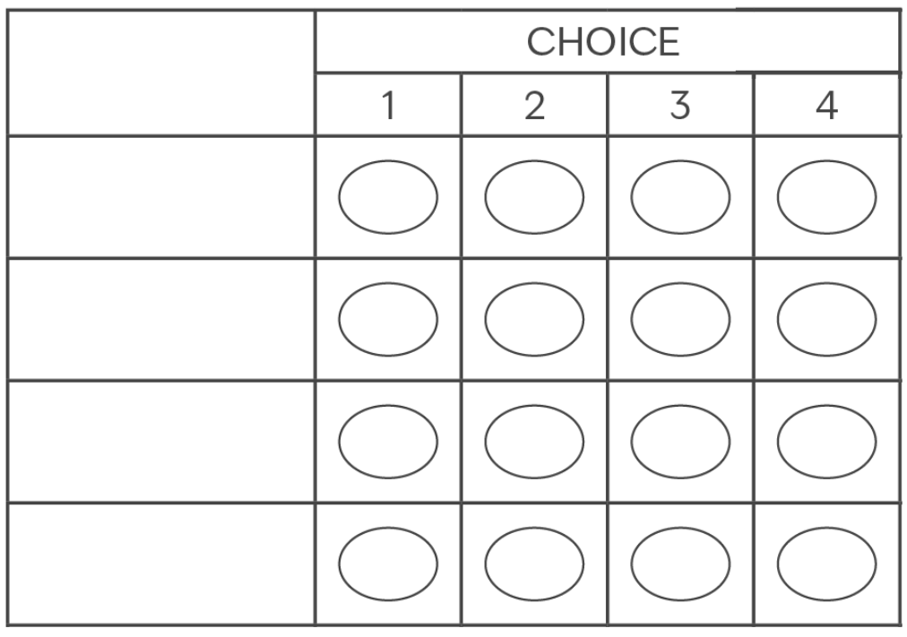
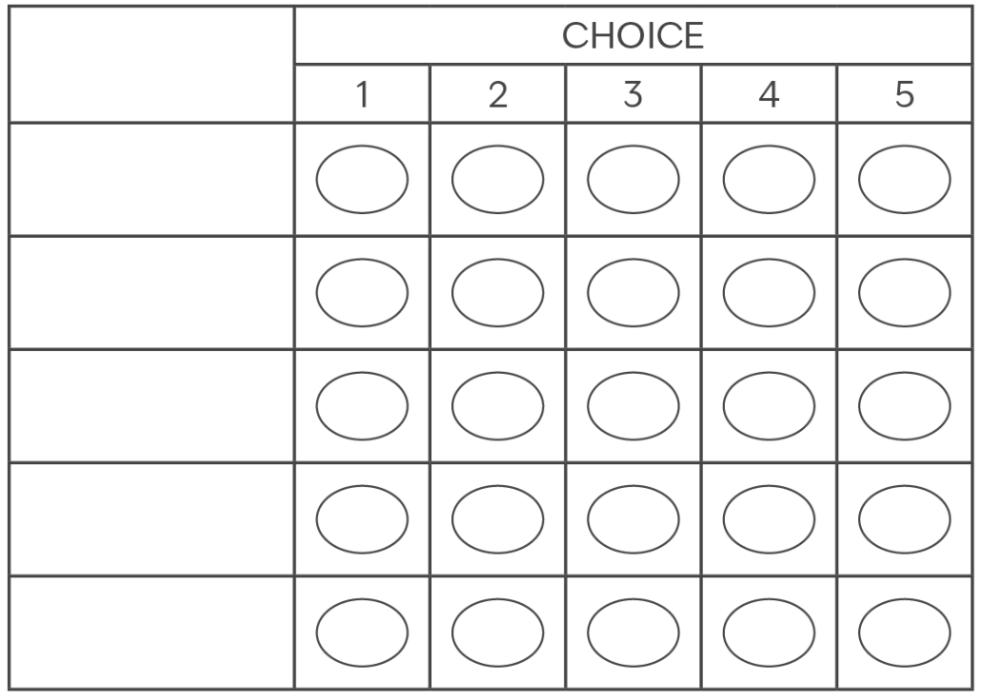
Ballot Sneak Peek:
District-Wide Races
Races using RCV — 3 or more candidates
(Two Winner) At-Large Councilmembers
Delegate
Mayor
Denise Rosado
Republican
Rhonda Hamilton
Independent
Oye Owolewa
Democrat
Robert White
Democrat
Janeese L. George
Democrat
Darryl Moch
DC Statehood Green
Kymone Freeman
DC Statehood Green
Robert L. Gross
DC Statehood Green
Darrell Green
Republican
Elissa Silverman
Independent
_____________
Write-in
_____________
Write-in
_____________
Write-in
Notes:
FAQs:
Election results by ward:
79.6 – 20.4
75.1 – 25.0
71.3 – 28.7
68.5 – 31.5
71.1 – 28.9
75.1 – 24.9
69.9 – 30.1
72.0 – 28.0
We here to partner with your office in hopes to strategies on how to educate your constituents. You know them best.

Slide 3
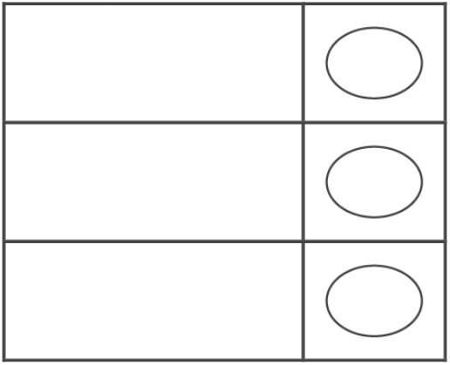
Ballot Sneak Peek:
District-Wide Races
Races Not using RCV — 1-2 candidates
Council Chair
Attorney General
Shadow Senator
Shadow Representative
Phil Mendelson
Democrat
Manuel Rivera
Republican
Robert Simmons
Republican
Ciprian Ivanof
Republican
Abi. Prudent
Republican
Brian Schwalb
Democrat
Paul Strauss
Democrat
Franklin Garcia
Democrat
_____________
Write-in
_____________
Write-in
_____________
Write-in
_____________
Write-in
Initiative 86 — Yes / No
Notes:
FAQs:
Election results by ward:
79.6 – 20.4
75.1 – 25.0
71.3 – 28.7
68.5 – 31.5
71.1 – 28.9
75.1 – 24.9
69.9 – 30.1
72.0 – 28.0
We here to partner with your office in hopes to strategies on how to educate your constituents. You know them best.

Slide 4
Ballot Sneak Peek:
Ward 1 Races
Races using RCV — 3 or more candidates
Ward 1 Councilmember
ANC: 1B03
ANC: 1E02
Jett J. Jasper
Republican
David Seidman
Audra Grant
Ryan Prince
Independent
J. Swiderski
Michael McGarty
Jude Crannitch
DC Statehood Green
Jamie Sycamore
Dominique Satterwhite
Aparna Raj
Democrat
_____________
Write-in
_____________
Write-in
_____________
Write-in
Notes:
FAQs:
Election results by ward:
79.6 – 20.4
75.1 – 25.0
71.3 – 28.7
68.5 – 31.5
71.1 – 28.9
75.1 – 24.9
69.9 – 30.1
72.0 – 28.0
We here to partner with your office in hopes to strategies on how to educate your constituents. You know them best.

Slide 5
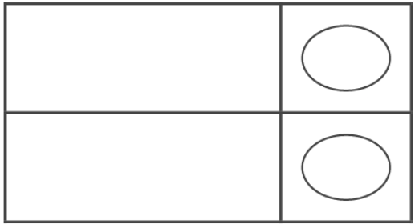
Ballot Sneak Peek:
Ward 1 Races
Races Not using RCV — 1-2 candidates
Ward 1 ANC races
2 Candidates running | 1A04,6 1B05 1D01,6 1E03,4
1 Candidate running | 1A01,3,5,7-10 1B01,2,4,6-9 1C01-9 1D02-5,7 1E05-7
0 Candidates running | 1A02
Ward 1
State Board of Education
Ben Williams
_____________
Write-in
Notes:
FAQs:
Election results by ward:
79.6 – 20.4
75.1 – 25.0
71.3 – 28.7
68.5 – 31.5
71.1 – 28.9
75.1 – 24.9
69.9 – 30.1
72.0 – 28.0
We here to partner with your office in hopes to strategies on how to educate your constituents. You know them best.

Slide 6


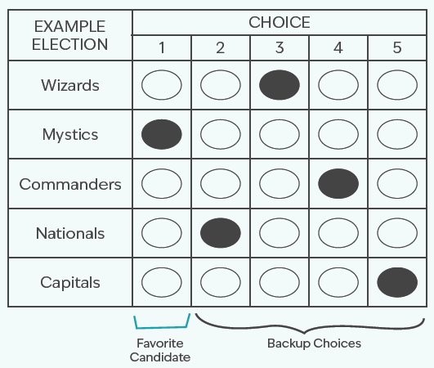
How do I
rank my ballot?
01
Vote your favorite candidate 1st.
Rank your backup choices
(2nd, 3rd, 4th, 5th) - you don’t have to rank more than 1!
Your vote stays with your 1st choice. If they get last place, your vote moves to your next choice.
02
03
This repeats until a candidate wins with over 50%.
Notes:
If your favorite comes in last, your vote simply counts for your next choice. (rephrase)

Slide 7

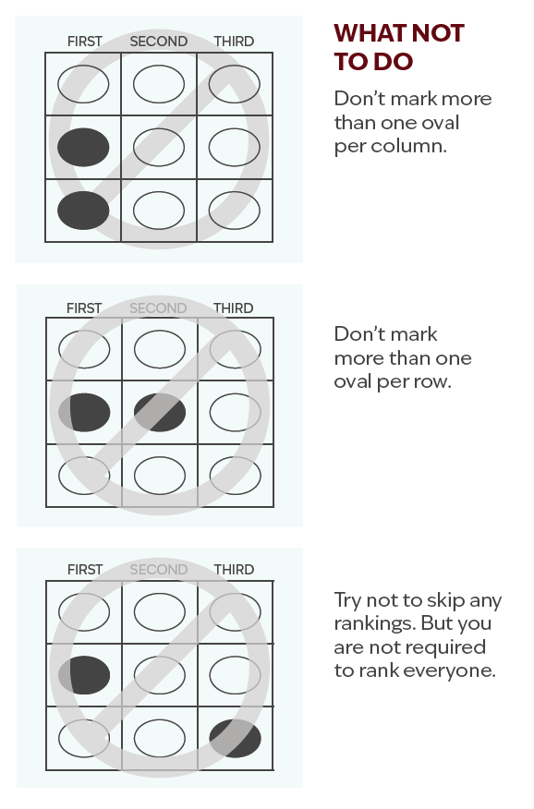
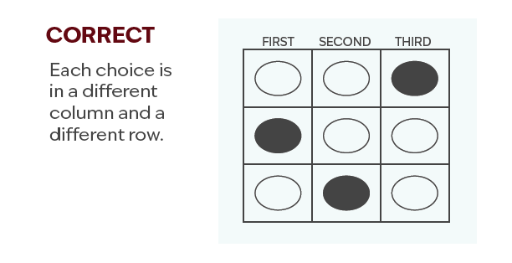
Remember, only rank a candidate if you support them!

Slide 8



Resultados y tabulación
RCV Results & Tabulation
The ranking process is the same for all elections using RCV!
Single-Winner Elections
(50% Threshold)
Two-Winner Elections
(Last 2 Standing)
Notes:
Show example from rank the female rap artist results - https://app.rankedvote.co/rv/8zf2yxz34qxv5v3885/results

Slide 9
Resultados y tabulación
RCV Results & Tabulation
The ranking process is the same for all elections using RCV!
Single-Winner Elections
(50% Threshold)
Two-Winner Elections
(Last 2 Standing)
Mayor, Delegate, Ward Councilmembers, ANCs, Board of Education, Attorney General
At-Large Councilmembers
Notes:
Show example from rank the female rap artist results - https://app.rankedvote.co/rv/8zf2yxz34qxv5v3885/results

Slide 10
Resultados y tabulación
RCV Results & Tabulation
The ranking process is the same for all elections using RCV!
Single-Winner Elections
(50% Threshold)
Two-Winner Elections
(Last 2 Standing)
Mayor, Delegate, Ward Councilmembers, ANCs, Board of Education, Attorney General
At-Large Councilmembers
Notes:
Show example from rank the female rap artist results - https://app.rankedvote.co/rv/8zf2yxz34qxv5v3885/results

Slide 11
Single-Winner Tabulation
Round 1 - First Choices
50% Threshold to Win
50%
Wizards
32
Mystics
30
Commanders
15
Nationals
12
Capitals
11
Notes:
Show example from rank the female rap artist results - https://app.rankedvote.co/rv/8zf2yxz34qxv5v3885/results

Slide 12
Resultados y tabulación
Single-Winner Tabulation
Round 2 - Last place eliminated
50% Threshold to Win
50%
Wizards
32
Mystics
39
+9
Commanders
15
Nationals
14
+2
Capitals
Notes:
Show example from rank the female rap artist results - https://app.rankedvote.co/rv/8zf2yxz34qxv5v3885/results

Slide 13

Resultados y tabulación
Single-Winner Tabulation
Round 3 - We have a winner!
50% Threshold to Win
50%
Wizards
34
+2
Mystics
51
+9
Commanders
15
Nationals
Capitals
Notes:
Show example from rank the female rap artist results - https://app.rankedvote.co/rv/8zf2yxz34qxv5v3885/results

Slide 14
Resultados y tabulación
RCV Results & Tabulation
The ranking process is the same for all elections using RCV!
Single-Winner Elections
(50% Threshold)
Two-Winner Elections
(Last 2 Standing)
Mayor, Delegate, Ward Councilmembers, ANCs, Board of Education, Attorney General
At-Large Councilmembers
Notes:
Show example from rank the female rap artist results - https://app.rankedvote.co/rv/8zf2yxz34qxv5v3885/results

Slide 15
Resultados y tabulación
Two
Single-Winner Tabulation
Round 4 - Just run another round!
Last 2 Standing
Wizards
42
+8
Mystics
58
+7
Commanders
Nationals
Capitals
Notes:
Show example from rank the female rap artist results - https://app.rankedvote.co/rv/8zf2yxz34qxv5v3885/results

Slide 16
Two-Winner Tabulation
Round 1 - First Choices
Last 2 Standing
Mystics
55
Commanders
15
Continue running rounds even if someone already has 50%
Wizards
12
Nationals
10
Capitals
8
Notes:
Show example from rank the female rap artist results - https://app.rankedvote.co/rv/8zf2yxz34qxv5v3885/results

Slide 17
Two-Winner Tabulation
Round 2 - Last place eliminated
Last 2 Standing
Mystics
57
17
+2
Commanders
+2
Wizards
14
+2
Nationals
12
+2
Capitals
Notes:
Show example from rank the female rap artist results - https://app.rankedvote.co/rv/8zf2yxz34qxv5v3885/results

Slide 18
Two-Winner Tabulation
Round 3 - Continue this process…
Last 2 Standing
Mystics
62
+5
Commanders
17
Wizards
21
+7
Nationals
Capitals
Notes:
Show example from rank the female rap artist results - https://app.rankedvote.co/rv/8zf2yxz34qxv5v3885/results

Slide 19
Two-Winner Tabulation
Round 4 - … until 2 winners are left!
Last 2 Standing
Mystics
+7
Commanders
69
Wizards
29
+8
Nationals
Capitals
Notes:
Show example from rank the female rap artist results - https://app.rankedvote.co/rv/8zf2yxz34qxv5v3885/results

Slide 20
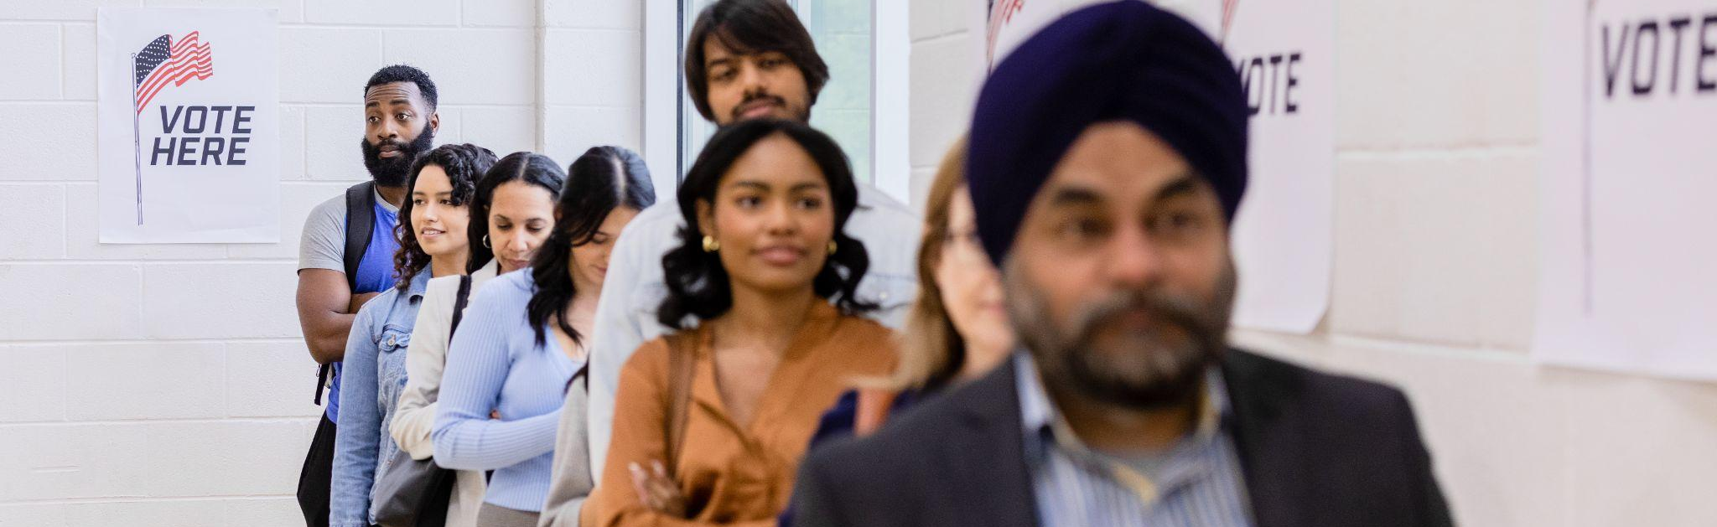
QUESTIONS?
Notes:
FAQs:
Election results by ward:
79.6 – 20.4
75.1 – 25.0
71.3 – 28.7
68.5 – 31.5
71.1 – 28.9
75.1 – 24.9
69.9 – 30.1
72.0 – 28.0
We here to partner with your office in hopes to strategies on how to educate your constituents. You know them best.

Slide 21

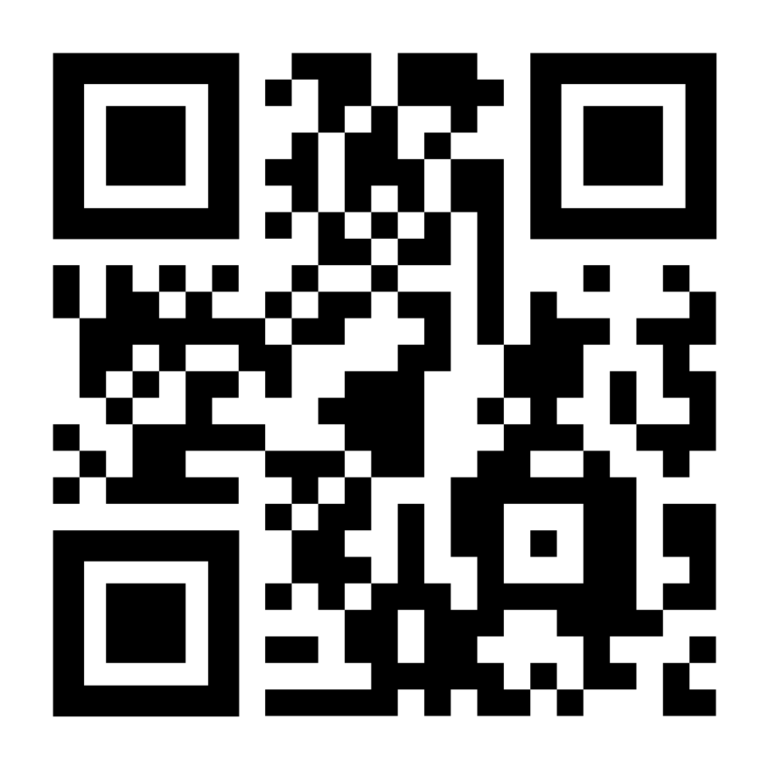
Thank you!
Learn more at RanktheDistrict.org
Notes:
FAQs:
Election results by ward:
79.6 – 20.4
75.1 – 25.0
71.3 – 28.7
68.5 – 31.5
71.1 – 28.9
75.1 – 24.9
69.9 – 30.1
72.0 – 28.0
We here to partner with your office in hopes to strategies on how to educate your constituents. You know them best.

Slide 22
Extra Slides
Notes:
FAQs:
Election results by ward:
79.6 – 20.4
75.1 – 25.0
71.3 – 28.7
68.5 – 31.5
71.1 – 28.9
75.1 – 24.9
69.9 – 30.1
72.0 – 28.0
We here to partner with your office in hopes to strategies on how to educate your constituents. You know them best.

Slide 23
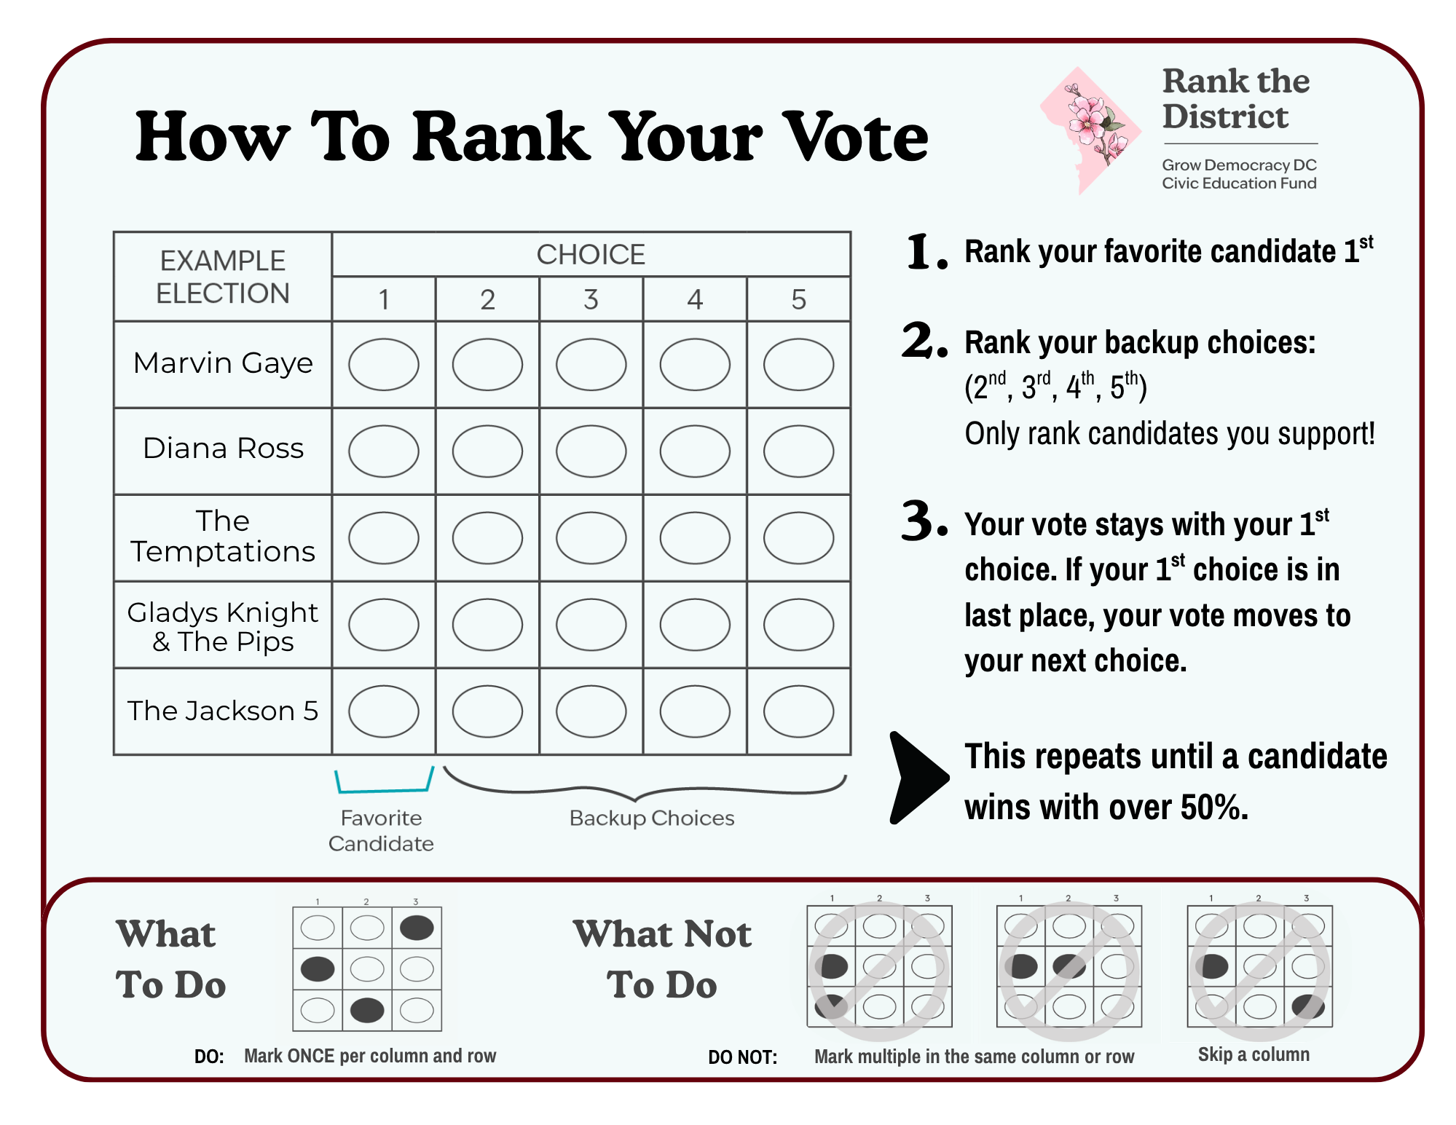

Slide 24

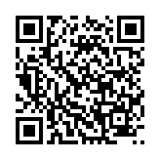
Clasifica tu equipo deportivo favorito de DC
Rank Your Favorite DC Sports Teams
Mock ballot can be accessed by scanning the QR code:
dcrcv.com/practice
Notes:
Show example from rank the female rap artist results - https://app.rankedvote.co/rv/8zf2yxz34qxv5v3885/results

Slide 25

How did we get here?
January 2024: Initiative 83 began collecting signatures to put the question of RCV and semi-open primaries to the voters.
November 2024: DC Voters overwhelmingly voted YES winning with 73% of the vote.
July 2025: DC Council funded Ranked Choice Voting implementation.
June 2026: Will be the first election using RCV in DC.

Slide 26
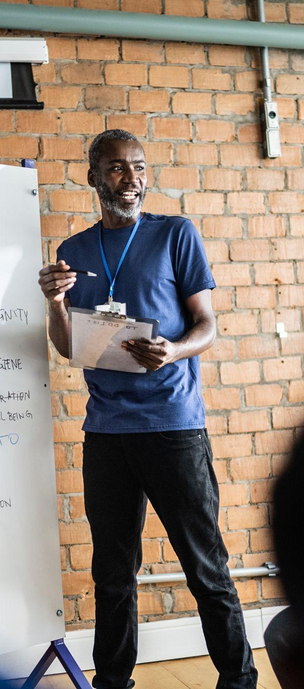
The value of ranked
choice voting
More choices for voters. Vote your values - the candidate you truly want, not worrying about the “lesser evils” or “splitting the vote”
Positive campaigning. Encourages coalition-building, highlighting shared values, and cross-endorsements
Majority support. Winners must earn more than 50% - makes it easier to hold unpopular politicians accountable

Slide 27
What NOT to do
Ballot Errors Explained
Notes:
FAQs:
Election results by ward:
79.6 – 20.4
75.1 – 25.0
71.3 – 28.7
68.5 – 31.5
71.1 – 28.9
75.1 – 24.9
69.9 – 30.1
72.0 – 28.0
We here to partner with your office in hopes to strategies on how to educate your constituents. You know them best.

Slide 28

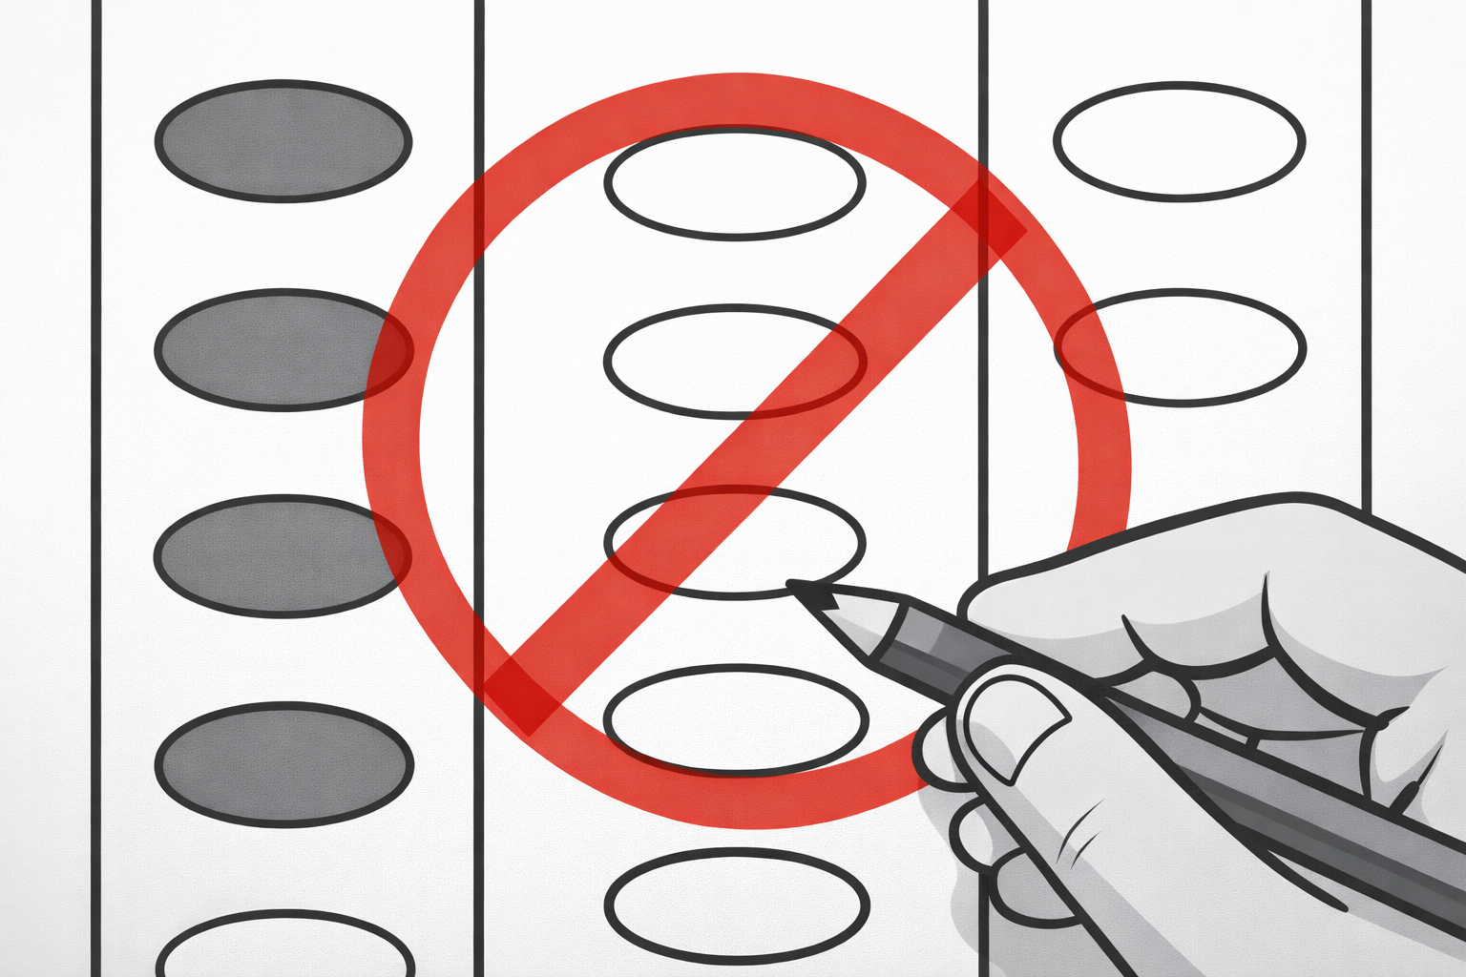
Do NOT Overvote!
Ballot Error: Marking multiple candidates in the same rank = Overvote
BIGGEST NO-NO
Ballot reader cannot determine who you meant to vote for at that ranking
In a given race, at whatever column the Overvote occurs, all rankings at the overvote and after are eliminated
If all rankings before the Overvote are done correctly, they are safe
Does not invalidate your whole ballot

Slide 29
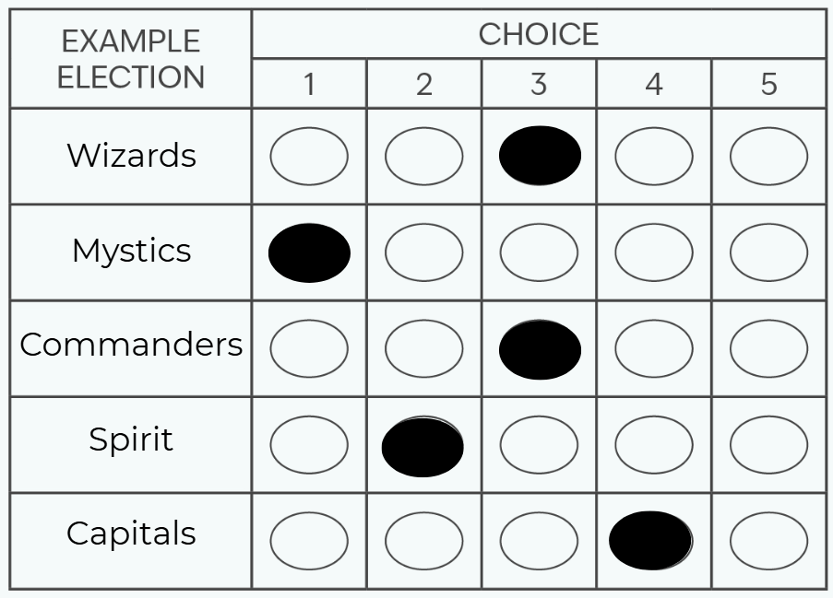
Do NOT Overvote!
Ballot Error: Marking multiple candidates in the same rank = Overvote
BIGGEST NO-NO
Ballot reader cannot determine who you meant to vote for at that ranking
In a given race, at whatever column the Overvote occurs, all rankings at the overvote and after are eliminated
If all rankings before the Overvote are done correctly, they are safe
Does not invalidate your whole ballot

Slide 30
Do NOT Overvote!
Ballot Error: Marking multiple candidates in the same rank = Overvote
BIGGEST NO-NO
Ballot reader cannot determine who you meant to vote for at that ranking
In a given race, at whatever column the Overvote occurs, all rankings at the overvote and after are eliminated
If all rankings before the Overvote are done correctly, they are safe
Does not invalidate your whole ballot

Slide 31

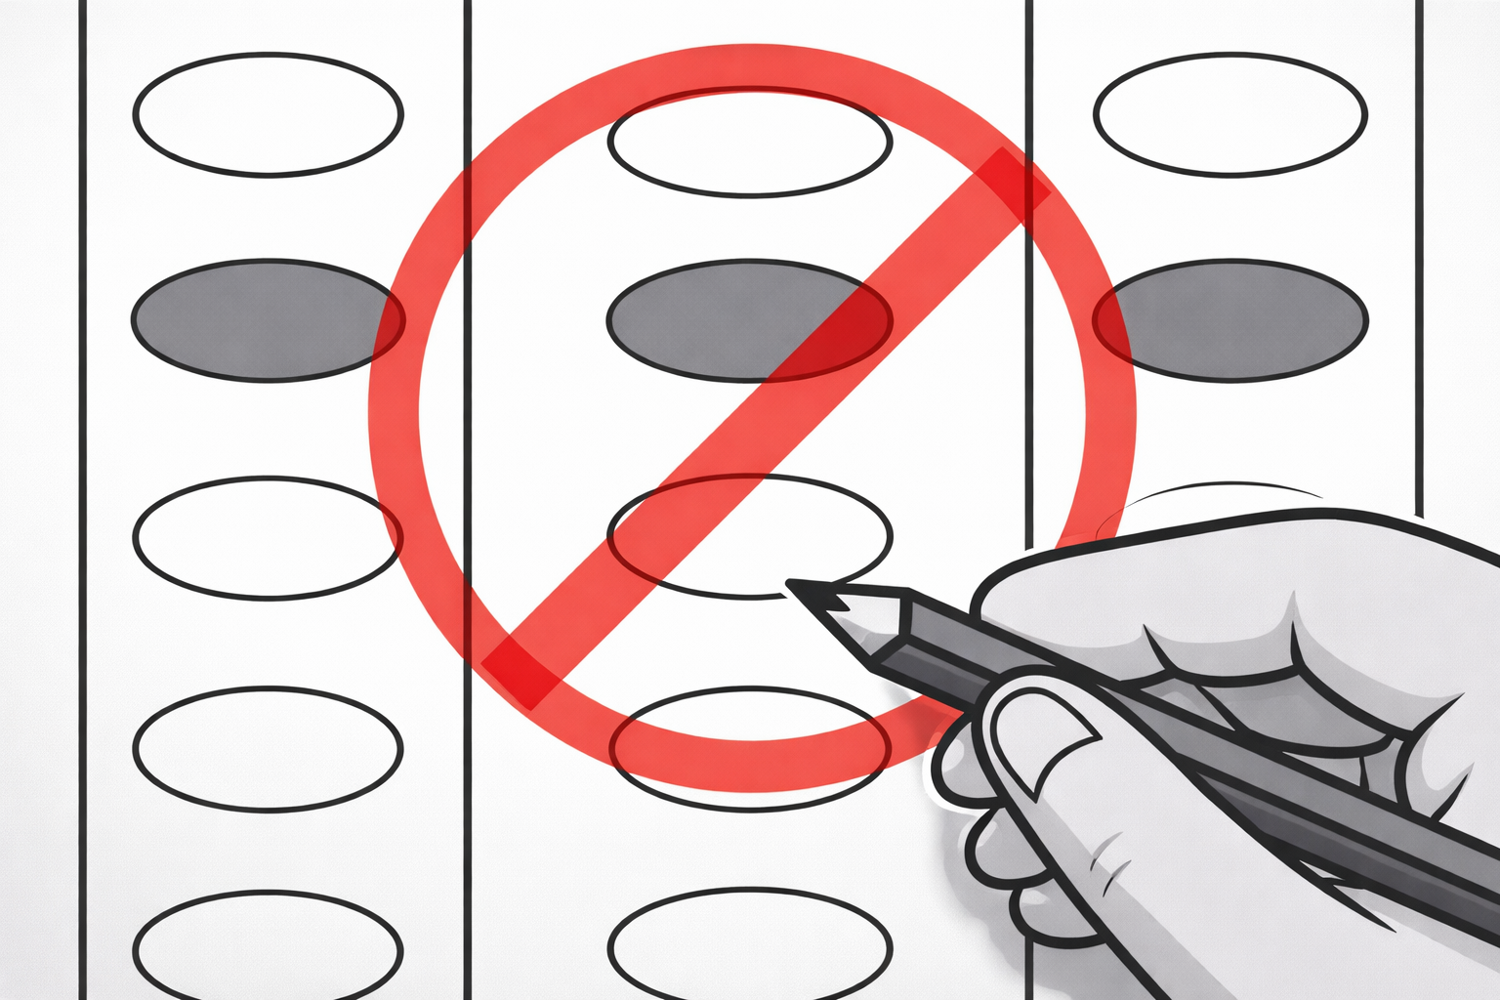
Repeated Rankings
Ballot Error: Marking one candidate with multiple rankings = Repeated Rankings
Not a big deal, but not useful
No votes are eliminated, but the repeated rankings are condensed into one. All other rankings after this are moved up.

Slide 32
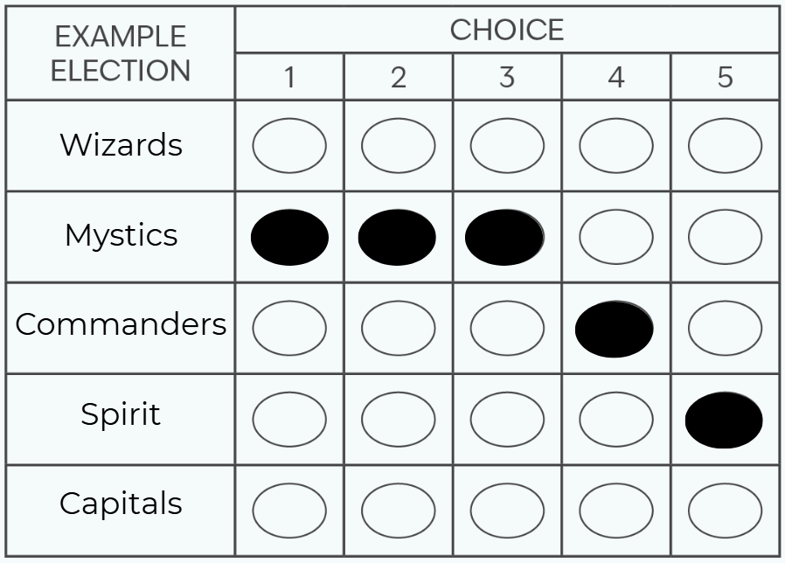
Repeated Rankings
Ballot Error: Marking one candidates with multiple rankings = Repeated Rankings
Not a big deal, but not useful
No votes are eliminated, but the repeated rankings are condensed into one. All other rankings after this are moved up.

Slide 33
Repeated Rankings
Ballot Error: Marking one candidates with multiple rankings = Repeated Rankings
Not a big deal, but not useful
No votes are eliminated, but the repeated rankings are condensed into one. All other rankings after this are moved up.

Slide 34
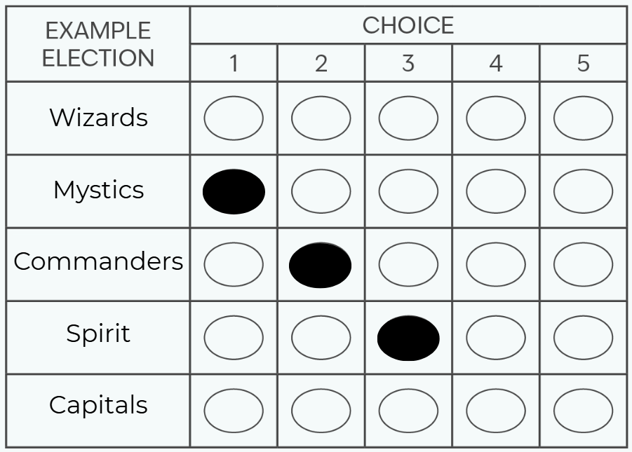
Repeated Rankings
Ballot Error: Marking one candidates with multiple rankings = Repeated Rankings
Not a big deal, but not useful
No votes are eliminated, but the repeated rankings are condensed into one. All other rankings after this are moved up.

Slide 35
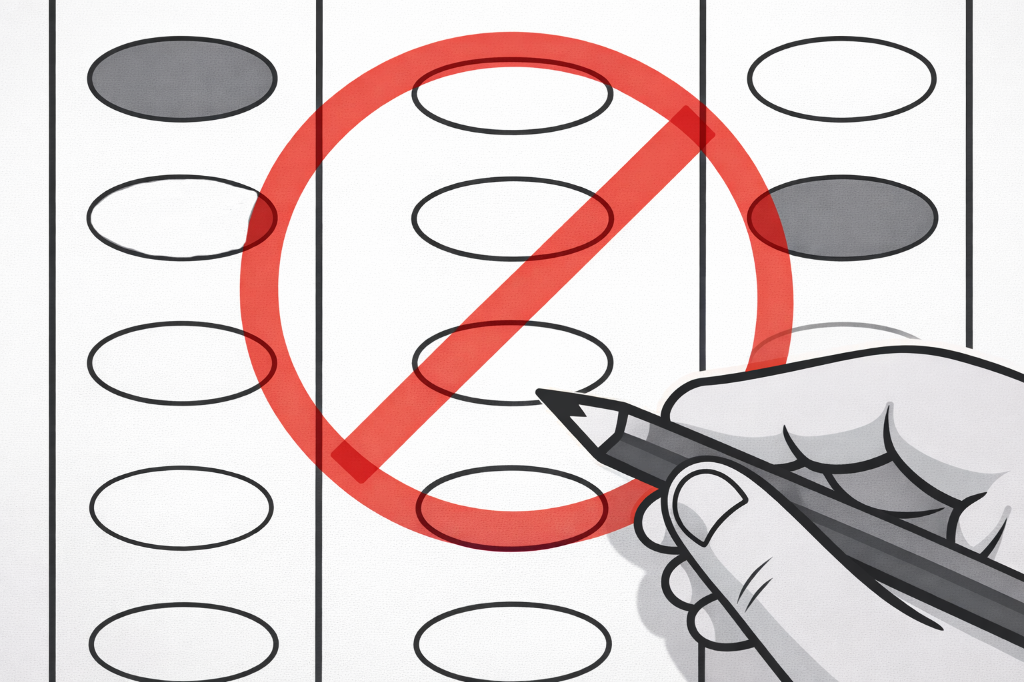
Skipping
Ballot Error: Skipping one or multiple columns
Be careful:
Skipping ONE column is allowed, but not useful. All other rankings after this are moved up, as if the skip was never made.
Skipping TWO CONSECUTIVE columns results in all rankings after the double skip being eliminated (same as Overvote).
If all rankings before the double skip are done correctly, they are safe
Does not invalidate your whole ballot

Slide 36
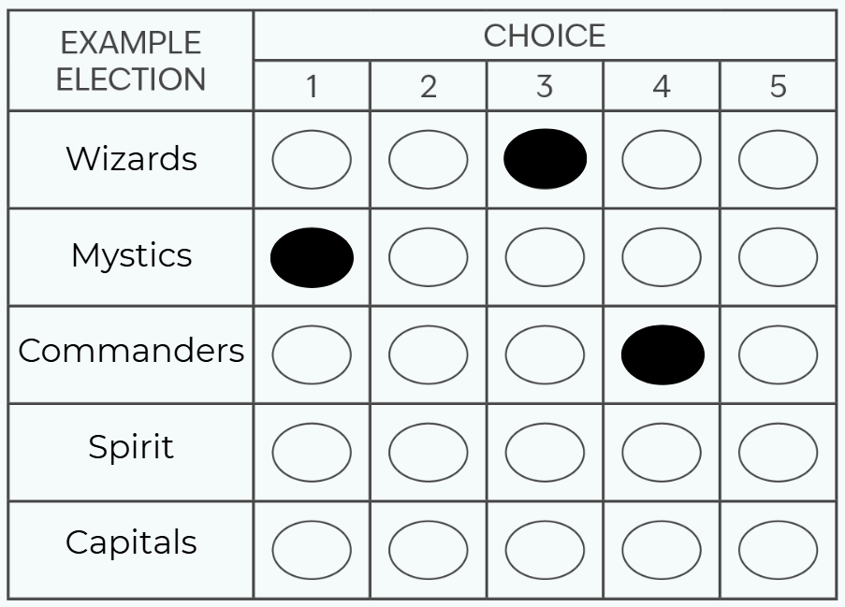
Skipping
Ballot Error: Skipping one or multiple columns
Be careful:
Skipping ONE column is allowed, but not useful. All other rankings after this are moved up, as if the skip was never made.
Skipping TWO CONSECUTIVE columns results in all rankings after the double skip being eliminated (same as Overvote).
If all rankings before the double skip are done correctly, they are safe
Does not invalidate your whole ballot

Slide 37
Skipping
Ballot Error: Skipping one or multiple columns
Be careful:
Skipping ONE column is allowed, but not useful. All other rankings after this are moved up, as if the skip was never made.
Skipping TWO CONSECUTIVE columns results in all rankings after the double skip being eliminated (same as Overvote).
If all rankings before the double skip are done correctly, they are safe
Does not invalidate your whole ballot

Slide 38
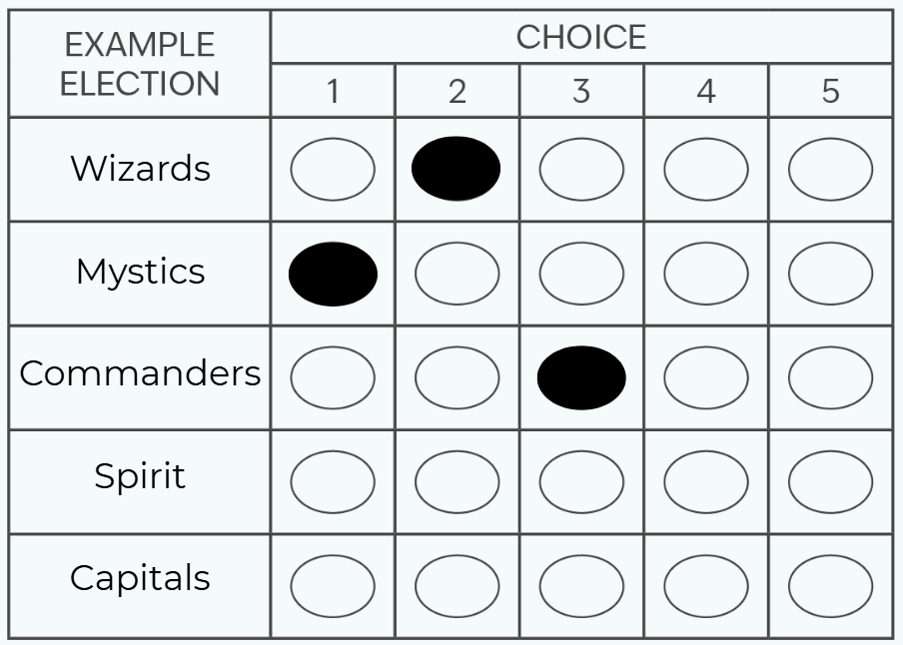
Skipping
Ballot Error: Skipping one or multiple columns
Be careful:
Skipping ONE column is allowed, but not useful. All other rankings after this are moved up, as if the skip was never made.
Skipping TWO CONSECUTIVE columns results in all rankings after the double skip being eliminated (same as Overvote).
If all rankings before the double skip are done correctly, they are safe
Does not invalidate your whole ballot

Slide 39
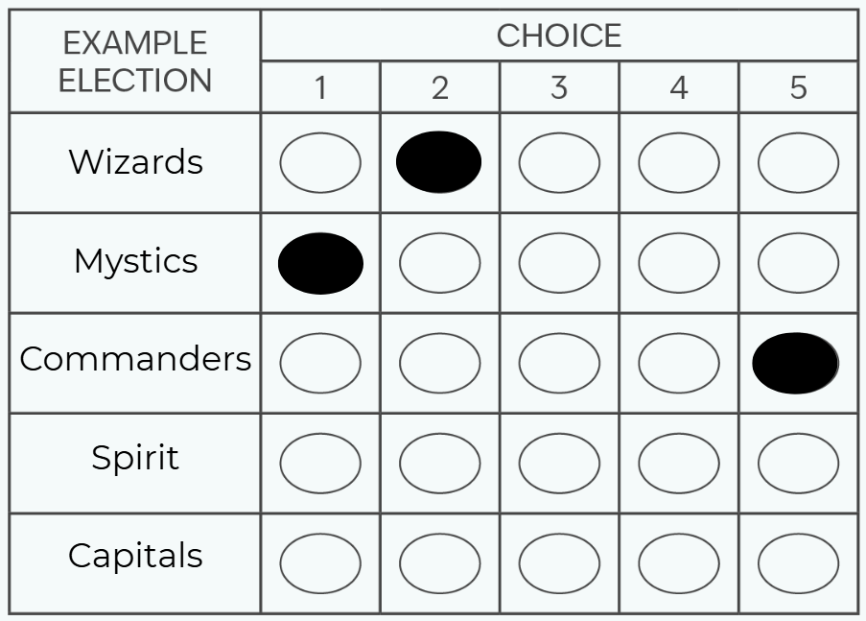
Skipping
Ballot Error: Skipping one or multiple columns
Be careful:
Skipping ONE column is allowed, but not useful. All other rankings after this are moved up, as if the skip was never made.
Skipping TWO CONSECUTIVE columns results in all rankings after the double skip being eliminated (same as Overvote).
If all rankings before the double skip are done correctly, they are safe
Does not invalidate your whole ballot

Slide 40
Skipping
Ballot Error: Skipping one or multiple columns
Be careful:
Skipping ONE column is allowed, but not useful. All other rankings after this are moved up, as if the skip was never made.
Skipping TWO CONSECUTIVE columns results in all rankings after the double skip being eliminated (same as Overvote).
If all rankings before the double skip are done correctly, they are safe
Does not invalidate your whole ballot

Slide 41

How you can educate your community!
Host an educational presentation with your group, ANC, community organization, or civic association — invite us in for our interactive 7-minute demo + Q&A.
Share our materials — distribute flyers, social posts, and mock ballots to your networks to help educate your community.
Visit: rankthedistrict.org
Encourage volunteering or serving as a Ward Captain — help us recruit, train and deploy field teams for door-knocking and tabling. Email kenyatta@growdemocracydc.org
Connect us to your community partners — introduce us to local faith-based groups, schools, senior centers or youth programs that would benefit from RCV education.
Promote on your digital channels — post about ranked-choice voting using our ready-made graphics and tag @rankthedistrict; help spread the message city-wide.

Slide 42
Our
Goals
Our work:
Engage DC voters through free in-person trainings, tabling, and community events across all 8 wards, with a focus on seniors, hard to reach communities, youth, and folks with disabilities
Help candidates understand how to run in a ranked choice election
Prepare election administrators to smoothly run a ranked choice election
Collaborate with community organizations to deliver accessible, culturally relevant education materials for their own educational programming
The Grow Democracy DC Civic Education Fund is the leading organization dedicated to educating DC voters about ranked choice voting, through our Rank the District project.
01
02
03
04

