Slide 1

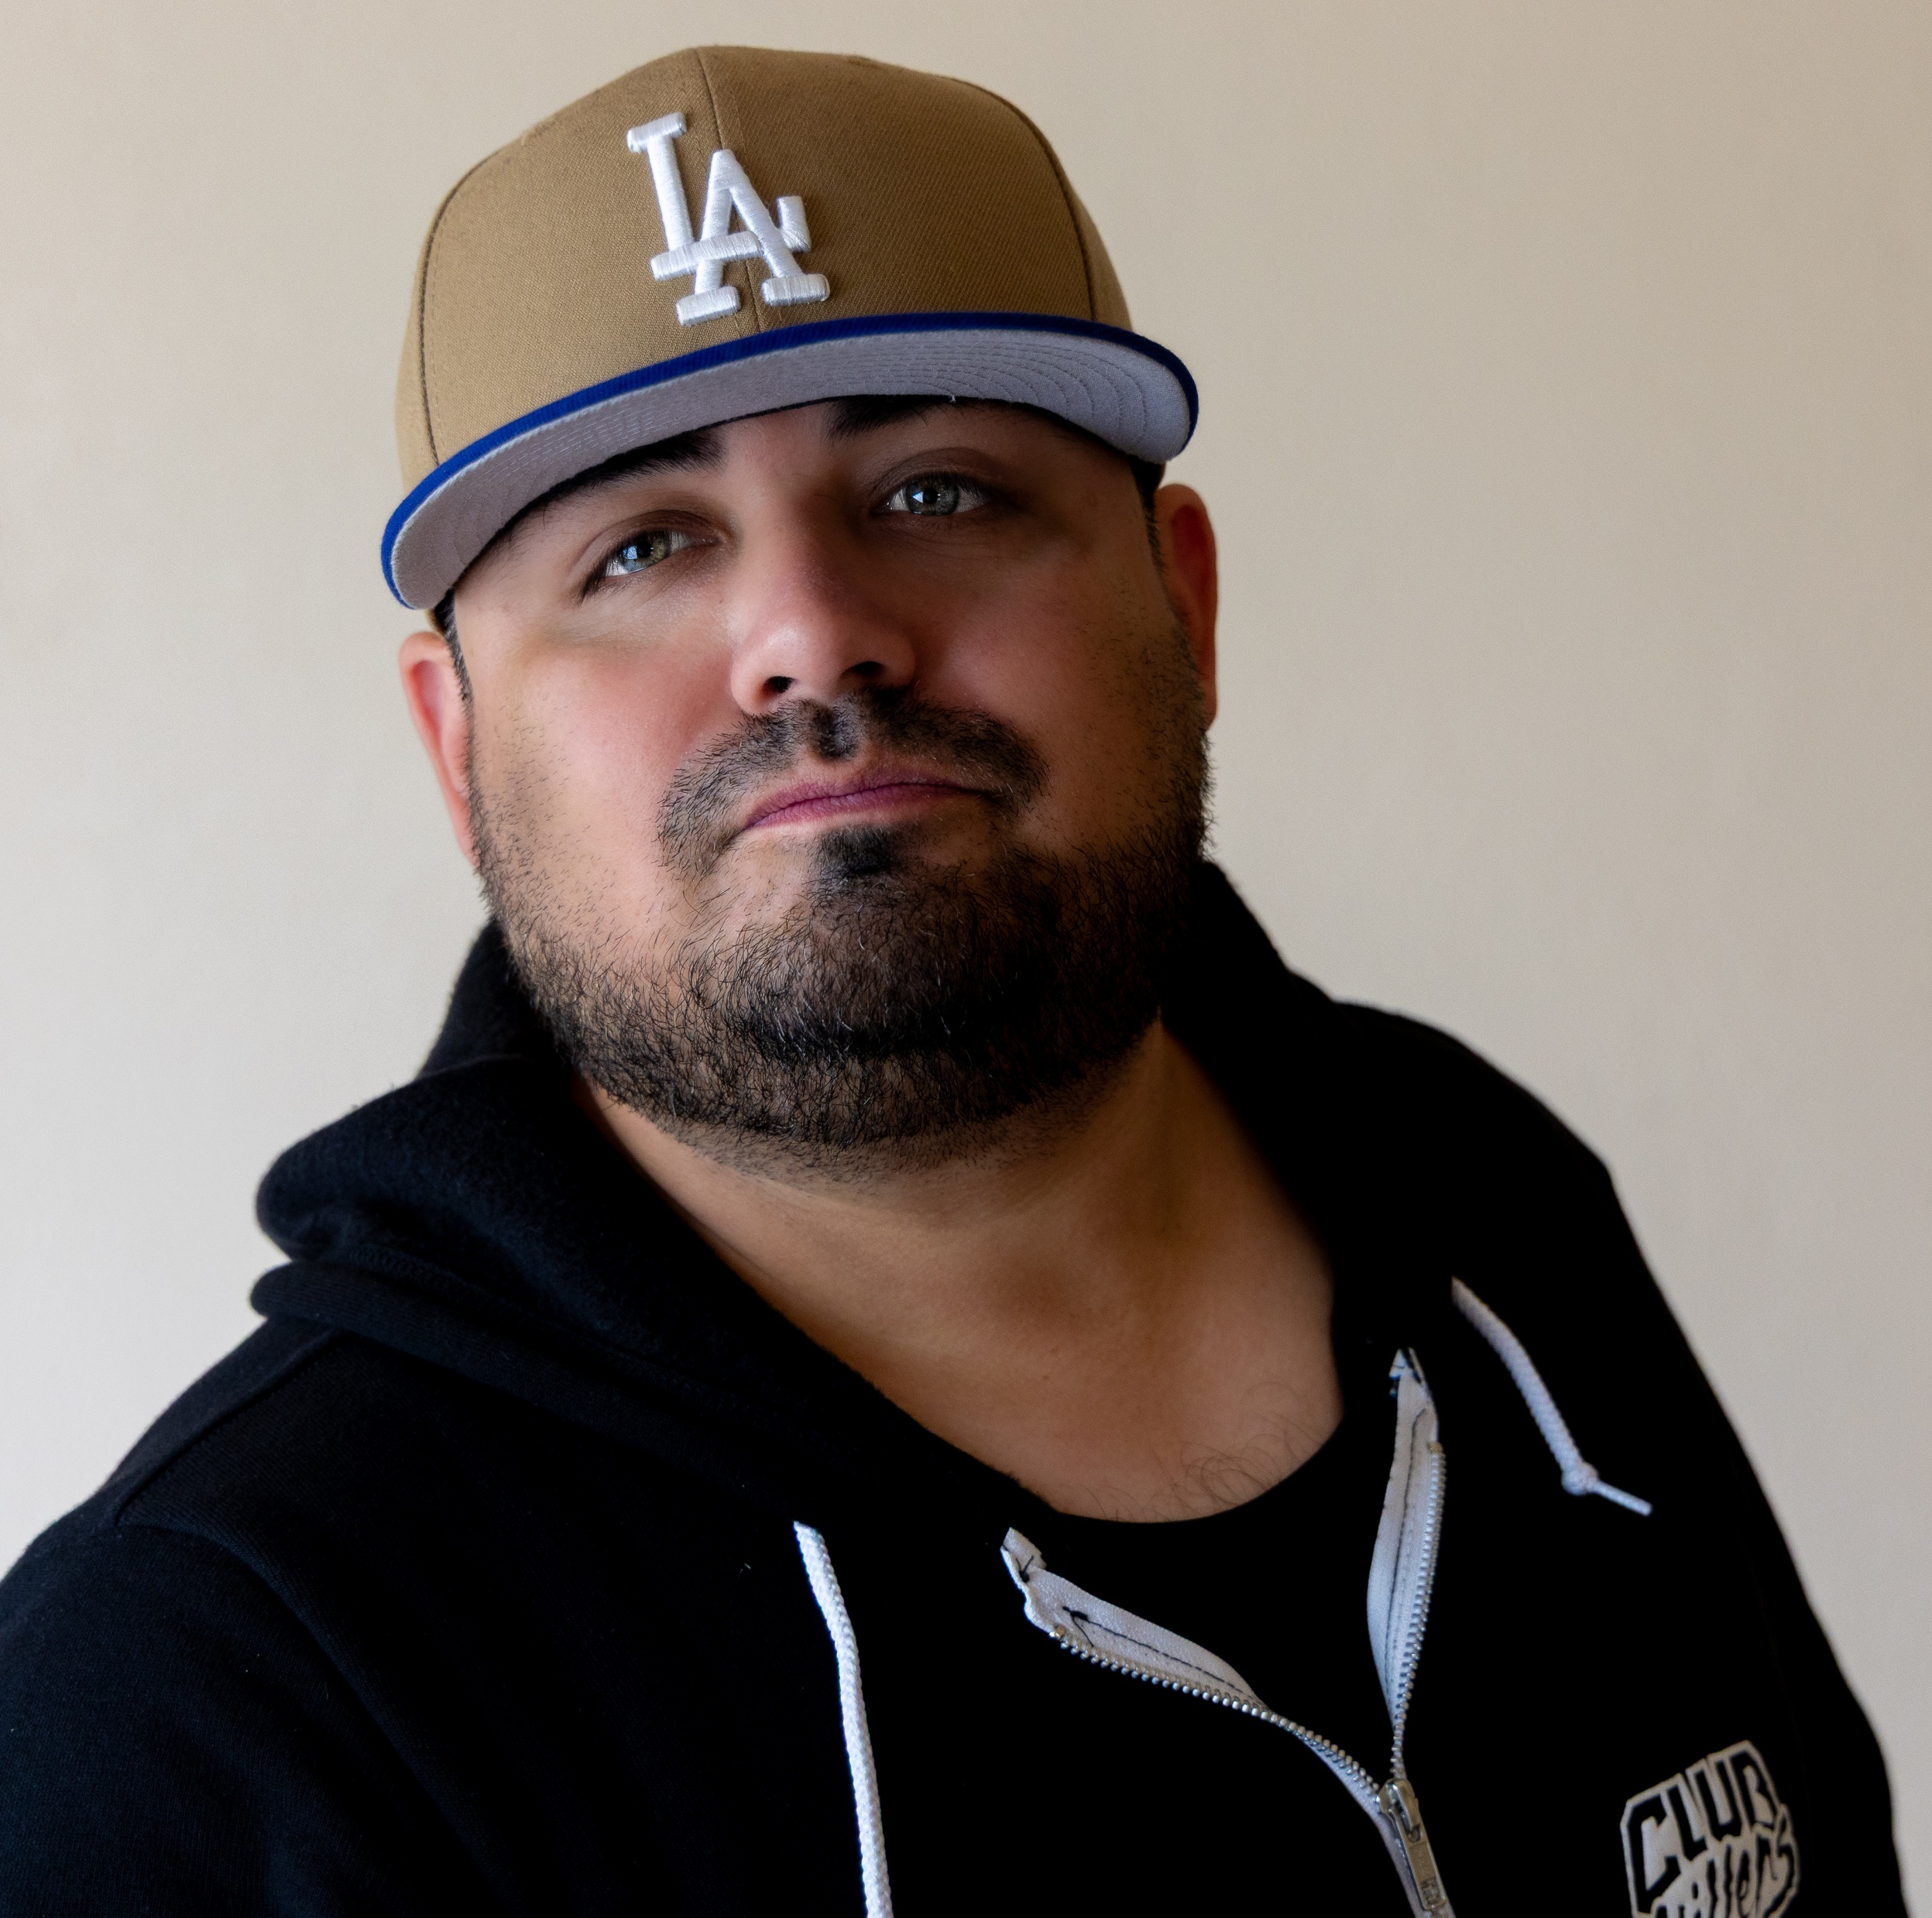
DJ LOOPZ
M-F 10a-2p
104.1 / KBFM-FM / McAllen-Harlingen-Brownsville, Tx
XXXK+
Broadcast listeners
      DJ Loopz has been a part of the radio industry since 2005, beginning his career in promotions and gaining hands-on experience in multiple areas of broadcasting. Through overnight shifts, fill-in opportunities, and a strong work ethic, he built a well-rounded foundation that led to his current role as an on-air personality and mixer.
      A graduate of South Texas College with a background in Communications and Multi-Media Media Specialist training, DJ Loopz remains deeply connected to the culture and community that continues to shape his work. He takes pride in representing the Hispanic community while using his platform to inform, entertain, and engage.
      Outside of radio, DJ Loopz enjoys nature photography and videography, landscaping, online gaming, pop culture, and culinary arts. He is also a dedicated father and uncle who values family and community.
    Interests:
Music, Live Mixing, Photography & Videography, Gaming, Pop Culture, Landscaping, Culinary Arts
7K+
Followers on Facebook
@loopzonair
2K+
Followers on Instagram
@loopzonair
DJ LOOPZ

Slide 2

DJ LOOPZ
M-F 10a-3p
99.9 / KSAB-FM / Corpus Christi, Tx
XXXK+
Broadcast listeners
      DJ Loopz has been a part of the radio industry since 2005, beginning his career in promotions and gaining hands-on experience in multiple areas of broadcasting. Through overnight shifts, fill-in opportunities, and a strong work ethic, he built a well-rounded foundation that led to his current role as an on-air personality and mixer.
      A graduate of South Texas College with a background in Communications and Multi-Media Media Specialist training, DJ Loopz remains deeply connected to the culture and community that continues to shape his work. He takes pride in representing the Hispanic community while using his platform to inform, entertain, and engage.
      Outside of radio, DJ Loopz enjoys nature photography and videography, landscaping, online gaming, pop culture, and culinary arts. He is also a dedicated father and uncle who values family and community.
    Interests:
Music, Live Mixing, Photography & Videography, Gaming, Pop Culture, Landscaping, Culinary Arts
7K+
Followers on Facebook
@loopzonair
2K+
Followers on Instagram
@loopzonair
DJ LOOPZ

