Slide 1
INPUT, OUTPUT & STORAGE
BY OLIVER LAISIKWA

Slide 2
TYPES OF PERIPHERAL DEVICES
Peripheral devices are devices that can be connected to a computer such as a PC or tablet device.
Peripherals can be connected inside or outside a computer and can be grouped into three types.

Slide 3
Input
Output
Storage

Slide 4
INPUT peripherals
INPUT peripherals are devices that send data to a computer. They allow the user to control the computer
Input devices, like a keyboard, allow us to put raw data in a computer which it processes to produce outputs. Input devices can be manual or automatic.

Slide 5
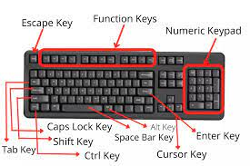
Manual input peripherals
Examples: KEYBOARD
Keyboard is an input device that allows a person to enter letters, numbers, and other symbols

Slide 6
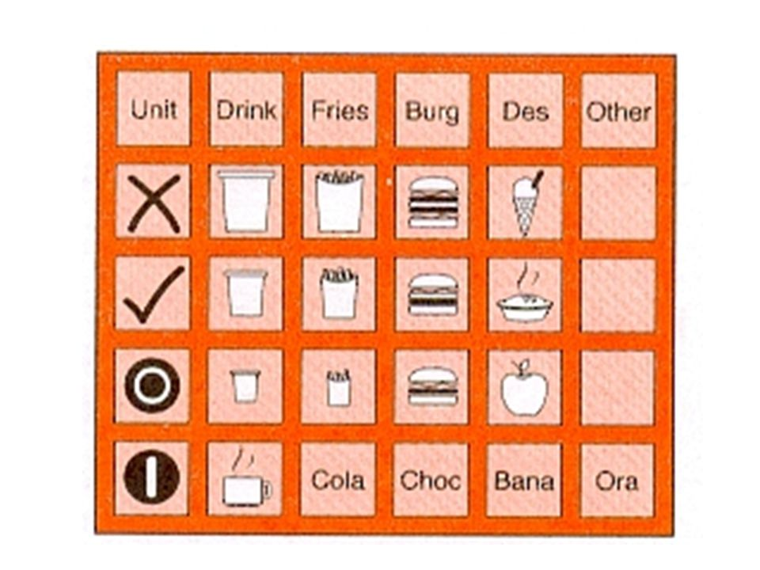
Concept keyboard
Each button on a concept keyboard relates to a particular item or function. Buttons can be labelled with text or a picture.
Fast food restaurants often use concept keyboards because very little training is needed to operate them and they're efficient - a single button can order an entire meal.

Slide 7
Pointing devices
A pointer is used on a screen to select displayed objects. There are several types of pointing devices that allow you to control a Computer.
They include:-

Slide 8
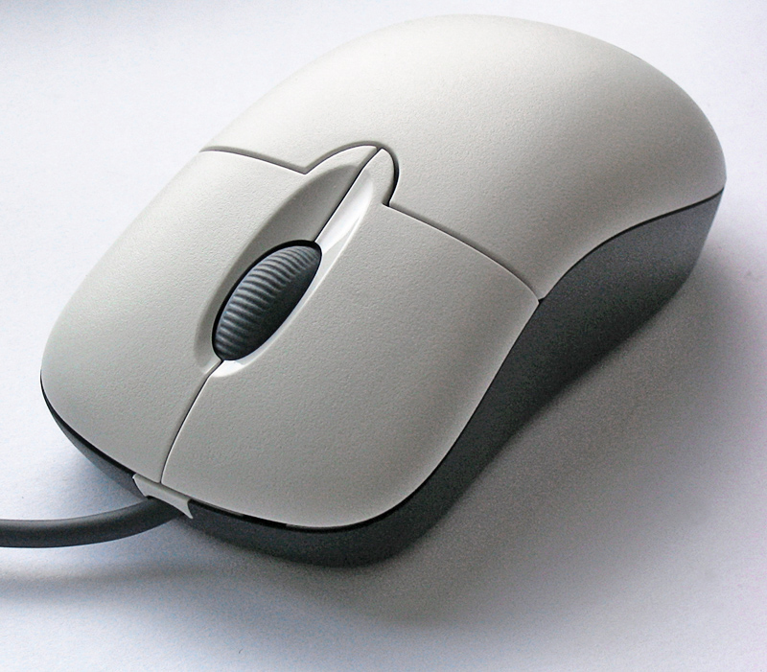
MOUSE
A mouse uses an optical sensor to recognize the movement of the device. Its sensitivity can be affected by the surface upon which it is placed.

Slide 9
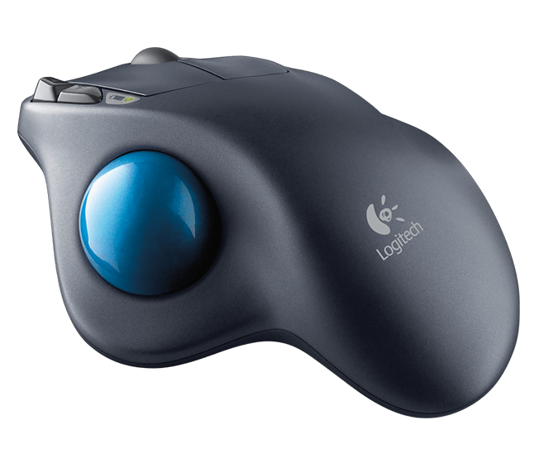
Tracker ball
A tracker ball is rolled to move the pointer; it does not have buttons to press. Its used by physically impaired people.

Slide 10
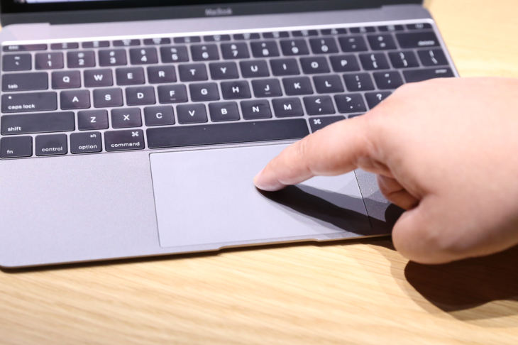
Track pad
The track pad surface senses finger movements, touches and presses and its used mostly on laptops.

Slide 11
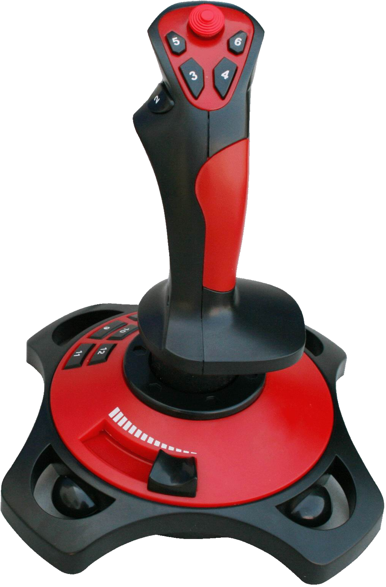
Joystick
Joysticks are commonly used on games controllers to move spites around the game.

Slide 12
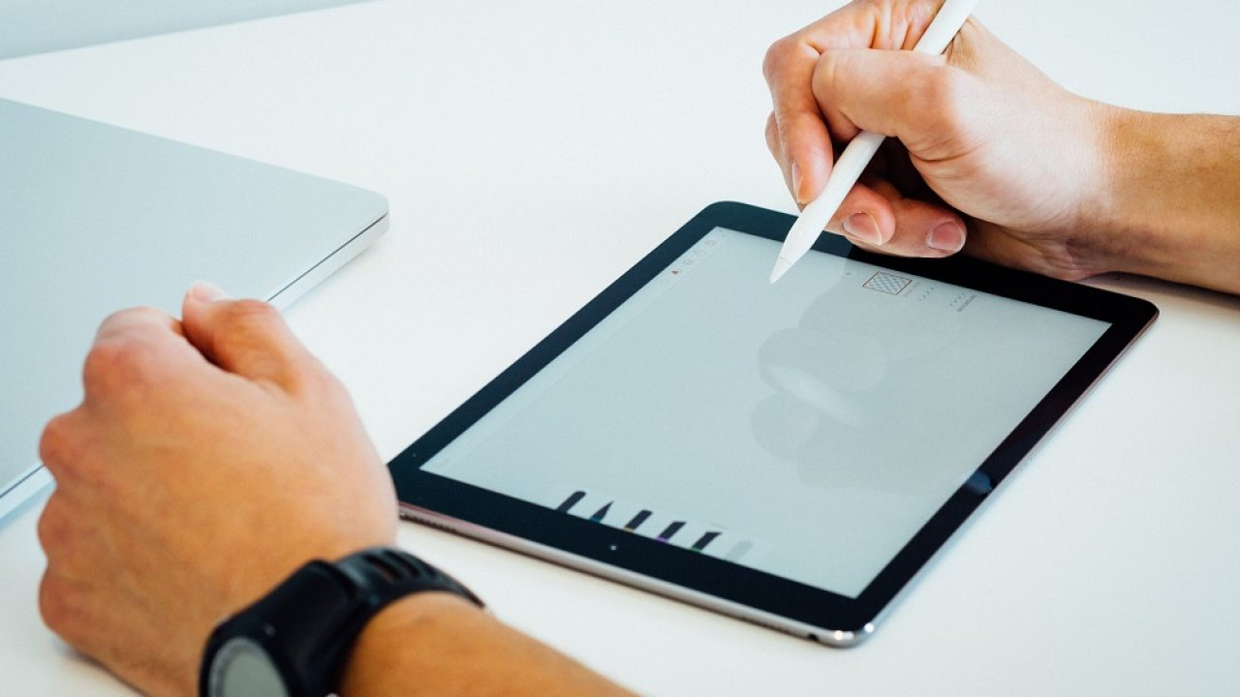
stylus
A stylus pen is a metal tool with a rubber tip that can be used to write, draw, or play games on touchscreen devices.

Slide 13
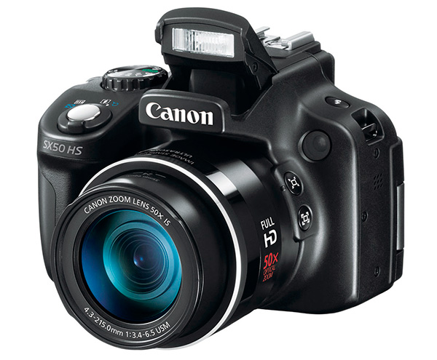
Digital camera
A digital camera takes pictures and can usually record video too. The pictures it takes and the videos it records are stored in files. These files can be copied to a computer and later edited.

Slide 14
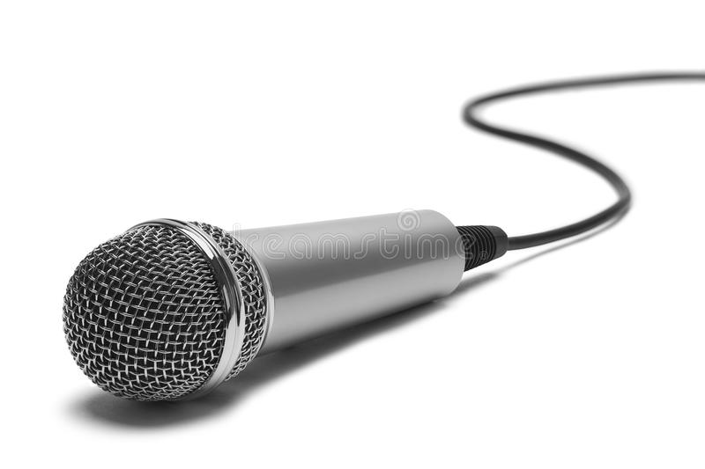
Microphone
Microphones are used to input sound. In computing they can be used with voice recognition software and a word processing application to enter text.

Slide 15
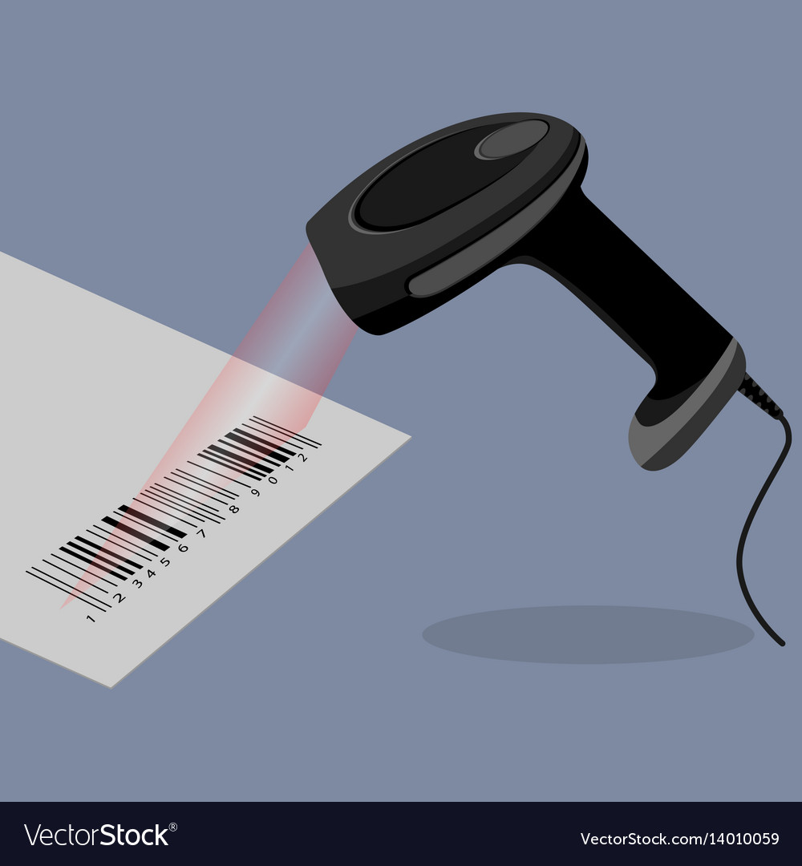
Barcode scanner
A barcode is a pattern of lines and gaps that can be read by barcode scanners. Barcodes are used on parcels, so that they can be tracked.
There are two types of barcodes
Linear
Matrix

Slide 16
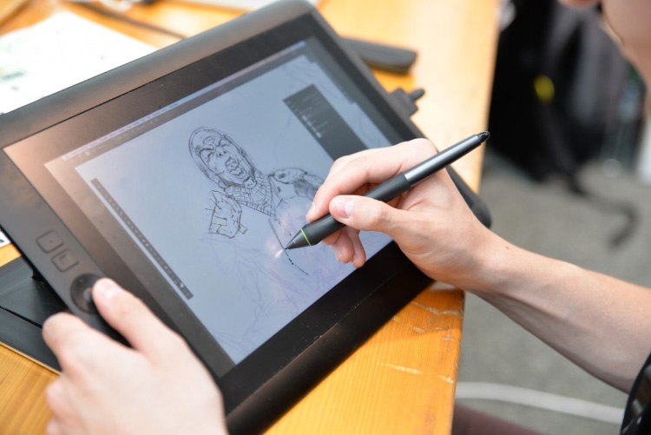
Graphics tablet
A graphics tablet consists of a flat pad (the tablet) on which the user draws with a special pen. As the user draws on the pad the image is created on the screen.

Slide 17
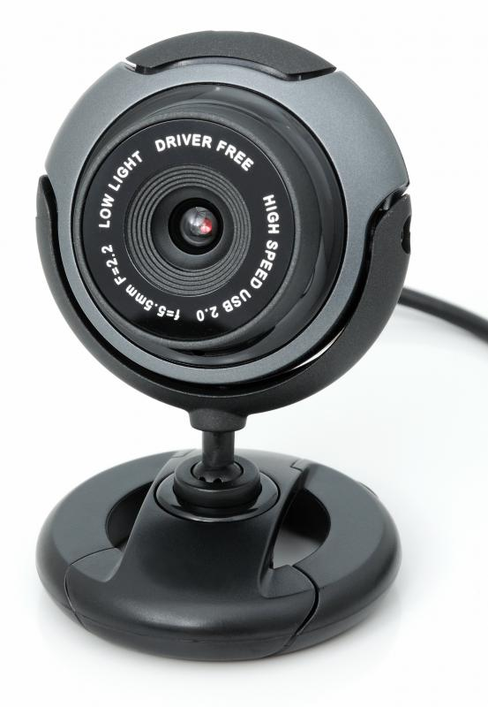
Webcam
Webcams are specialized cameras. They are generally lower quality than camcorders and have built-in microphones to capture sounds.

Slide 18
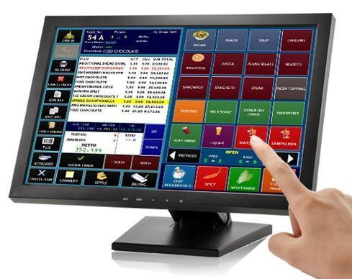
Touch screen
A touch-sensitive visual display unit (VDU) or screen has a grid of light beams or fine wires crisscrossing the screen that are used to detect touch. Many mobile phones use touch screens
There are two types of touch screen
Resistive -
Capacitive

Slide 19
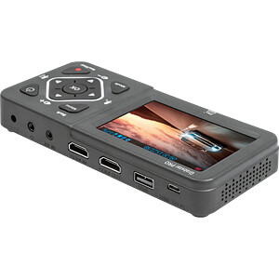
video digitizer
A video digitizer takes an image from a video camera or television and digitizes it so it can be read by, and stored on, a computer.

Slide 20
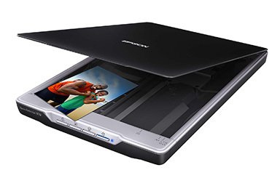
Scanner
A scanner can be used to digitize images.
They're similar to a photocopier but they make a digital copy instead of a physical copy.

Slide 21
Biometric scanner
Biometric scanners work by measuring part of the unique physical characteristics of a user, often multiple times, until a suitable average result is produced. Examples of biometric scanners.

Slide 22
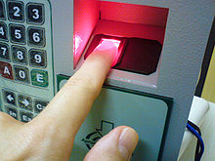
a]Fingerprint recognition
These scanners read the patterns of arches, loops and whorls in a human fingerprint. Fingerprints are unique to each individual person, which makes them useful methods of identification.

Slide 23
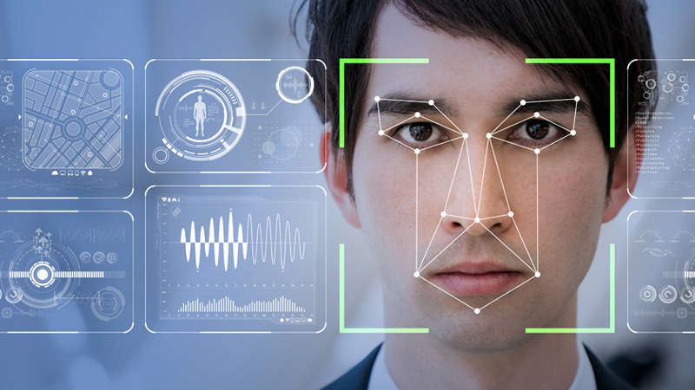
b]Facial recognition
These scanners identify the structure of a human face in order to identify an individual.

Slide 24
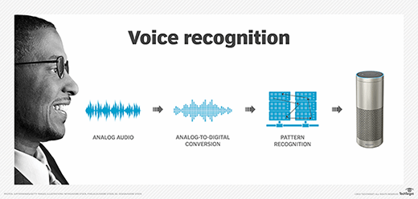
c]Voice recognition
These scanners require a microphone to capture the voice. They compare the voice print against a saved original and check to see whether the two prints match.

Slide 25
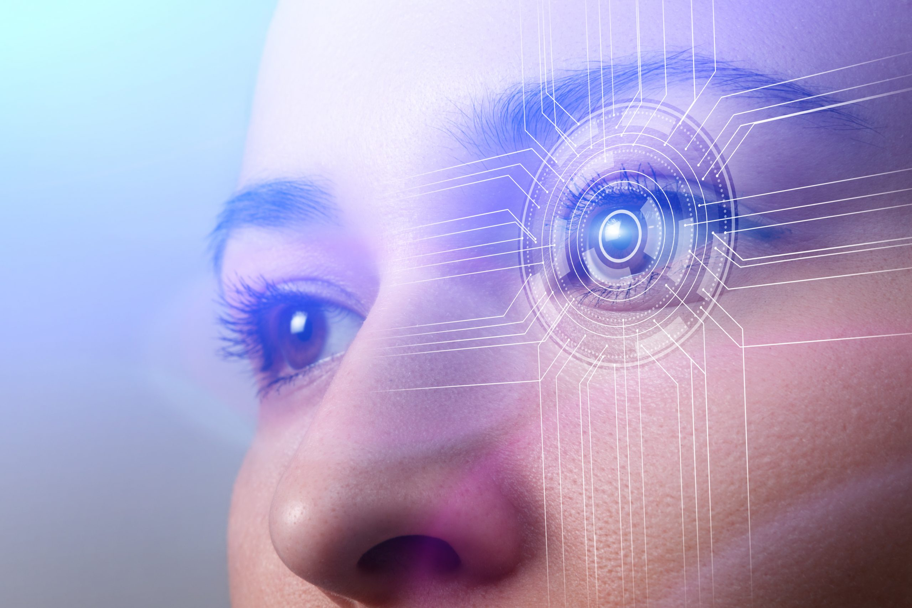
d]Iris recognition
Human iris has a unique pattern and its also used to identify an individual.

Slide 26
Advantages and disadvantages of using biometric scanners
Advantages
Disadvantages
Easier for users than passwords because biometric data cannot be forgotten
More difficult to trick or confuse biometric scanners than some other methods
Can speed up transactions
Are not restricted by language barriers
Cause privacy and security concerns because detailed personal information is stored electronically
Possible to trick or confuse
Expensive to make and buy
Make some feel uncomfortable

Slide 27
CARD READERS
Card readers are used to read data stored on a card that is carried by a user. The data can be used to unlock doors, access secure areas or make payments.
Cards can carry data using three methods. Each methods a specialist type of reader. These methods include.

Slide 28
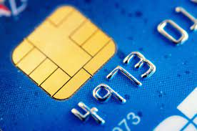
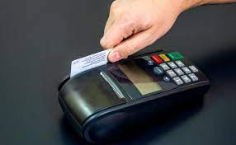
Magnetic strip
Programmable chip
This is the least secure method as the data on the magnetic strip can easily be stolen by criminals who put the card through a card reader without the card owner’s knowledge.
Data on programmable chip is only readable when a correct PIN is entered into the reader.

Slide 29
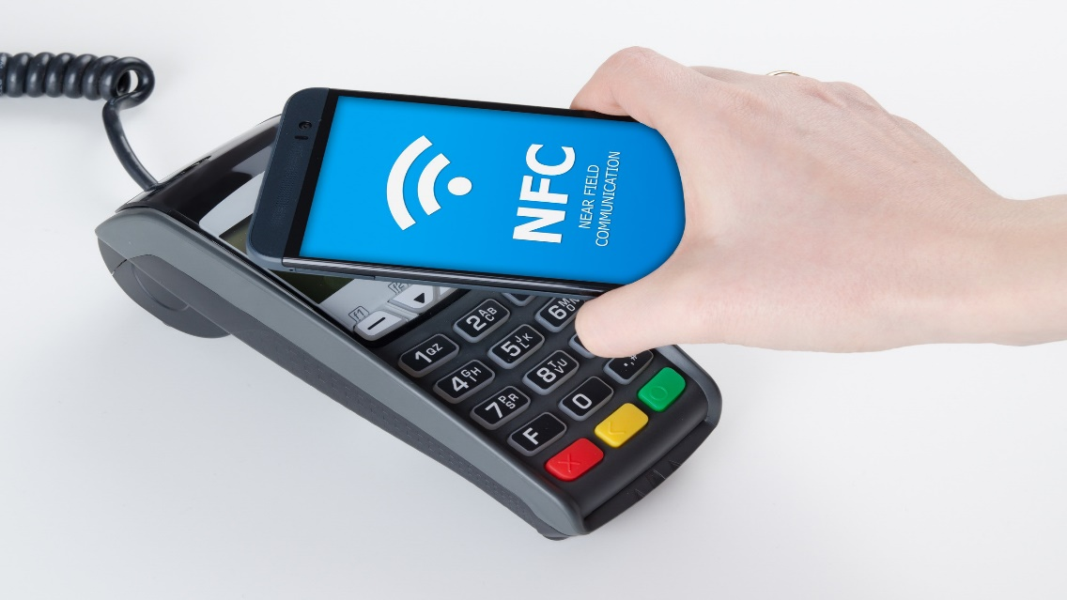
Radio frequency identification (RFID) and Near Field Communication (NFC).
RFID is a short-range wireless communication method, and Near Field Communication (NFC) is a branch of RFID. RFID tags are cheap and small and they can include in a variety of objects such as cards and smartphones. They contain a unique identification number (ID) that is linked to records in database.

Slide 30
SENSORS
Sensors are used to input data about the physical environment. They can automatically input data without the need for human action. Sensors are one of the main features of smart devices such as smartphones and smart environments such as smart homes. Examples of sensors in smartphones are proximity sensor, temperature sensor, motion sensor and button sensor.

Slide 31
Benefits of using sensors
They can be placed in remote or dangerous places
They can monitor continually
They remove the possibility of human error
They can sense things that people cannot (such as small changes in pressure or gas level)
The data is easily (Sometimes automatically) converted to a digital form

Slide 32
There are many different types of sensors to allow for the monitoring of a range of environment factors. Some of these factors are:-
Light
Moisture and humidity
Temperature
Proximity and distance
Motion and movement sensors
Pressure

Slide 33
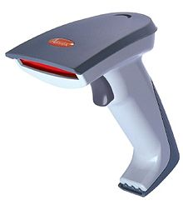
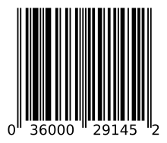
Barcode reader
Barcodes are represented by black vertical bars and are read by a barcode reader. Barcodes are printed on nearly every product you buy; each product has a unique code.

Slide 34
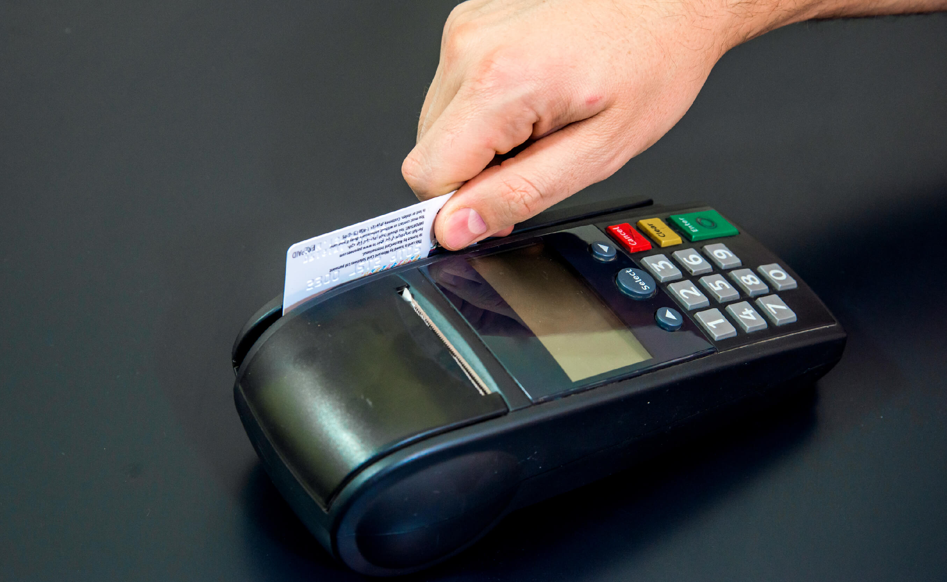
Magnetic strip (or stripe) reader
Magnetic stripes are built into many plastic cards such as debit or credit cards and personal identity cards. The magnetic strip on the back of the card can hold the personal details of the card owner and, with the necessary PIN, will allow access to secure information, eg bank account details. Data stored on the strip is scanned and input into a computer system by a magnetic stripe reader.

Slide 35
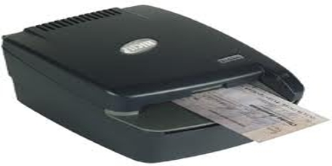
Magnetic Ink Character Reader (MICR)
Magnetic ink characters appear at the bottom of cheques. Banks use MICR to read the numbers from the bottom of cheques to obtain data such as account numbers and bank sort codes. A particular font is used that makes it easy for the machine to discriminate between characters. The ink is magnetized, this makes it immune to creases and dirty marks.

Slide 36
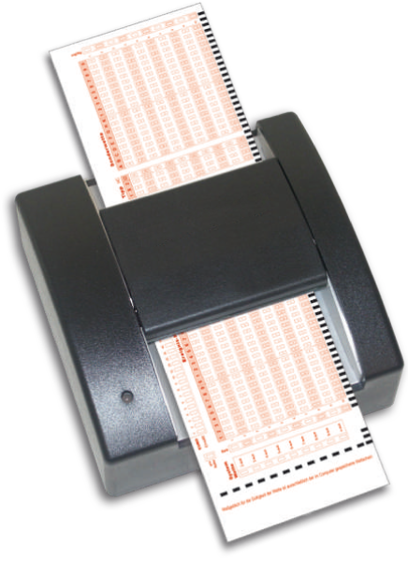
Optical Mark Reader (OMR)
An OMR reads marks made by pencil on a printed form into the computer. OMR systems are suited to reading pre-printed forms and check boxes such as lottery number selection sheets and multiple-choice exam papers.

Slide 37
Output peripherals
Output peripherals are connected to a computer and output the results of computer’s processing in various forms including: -
Electronic display
Printed text
Video
Audio
Tactile (touch) forms
Examples of output peripherals include the following

Slide 38
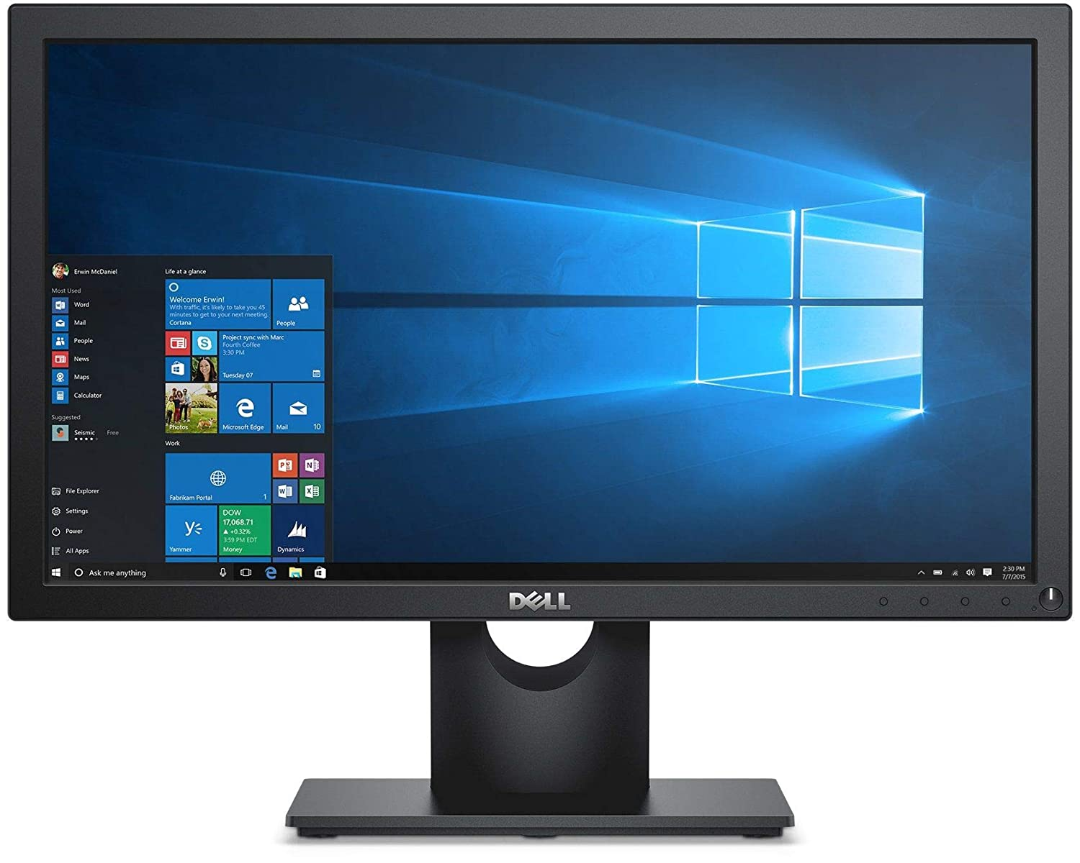
Monitor
The most common output device is the monitor or VDU. Monitors allow users to see the output from the computer on an electronic display. Features of monitors include: -
Screen size, which is measured diagonally
Resolution which is measured in pixels.
Energy efficiency

Slide 39
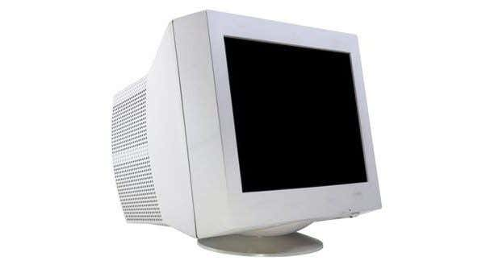
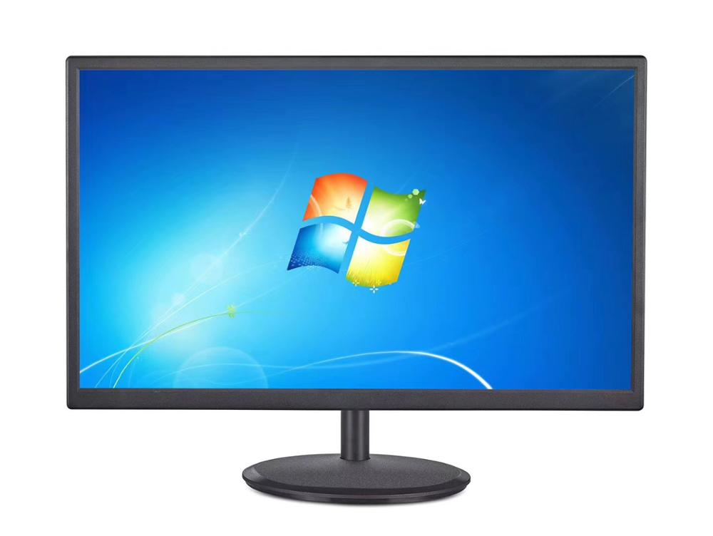
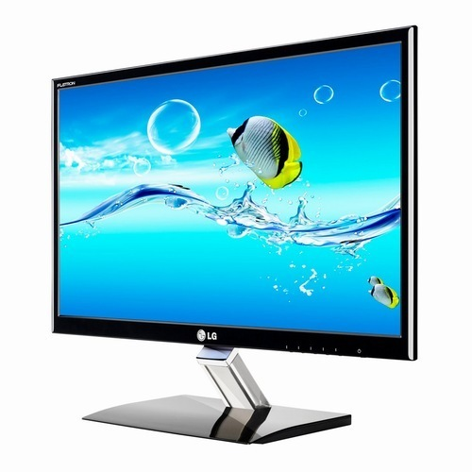
Types of monitors
Cathode Ray Tube (CRT)
Liquid Crystal Displays (LCD)
Thin Film Transistors (TFT) monitors

Slide 40
Printers
There are five types of standard printer:
Laser printers
Inkjet printers
Dot matrix printers
3D Printers
Plotters

Slide 41
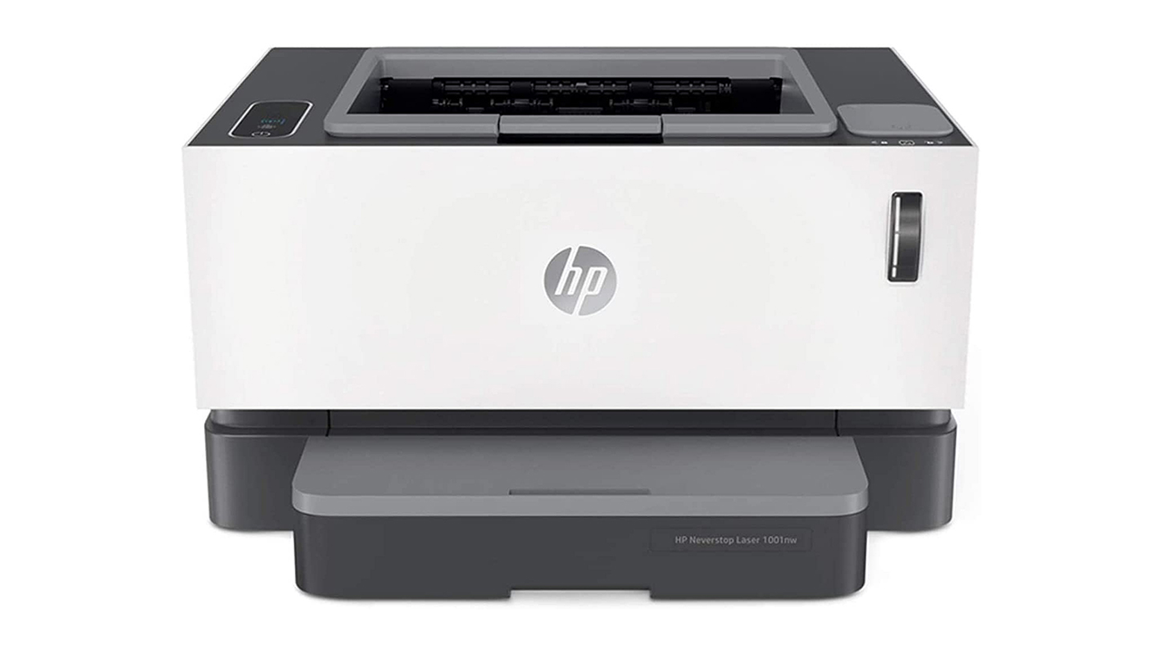
Laser printers
Laser printers are quite expensive to buy and run but produce a high-quality output and are quiet and fast. They use toner (type of ink)

Slide 42
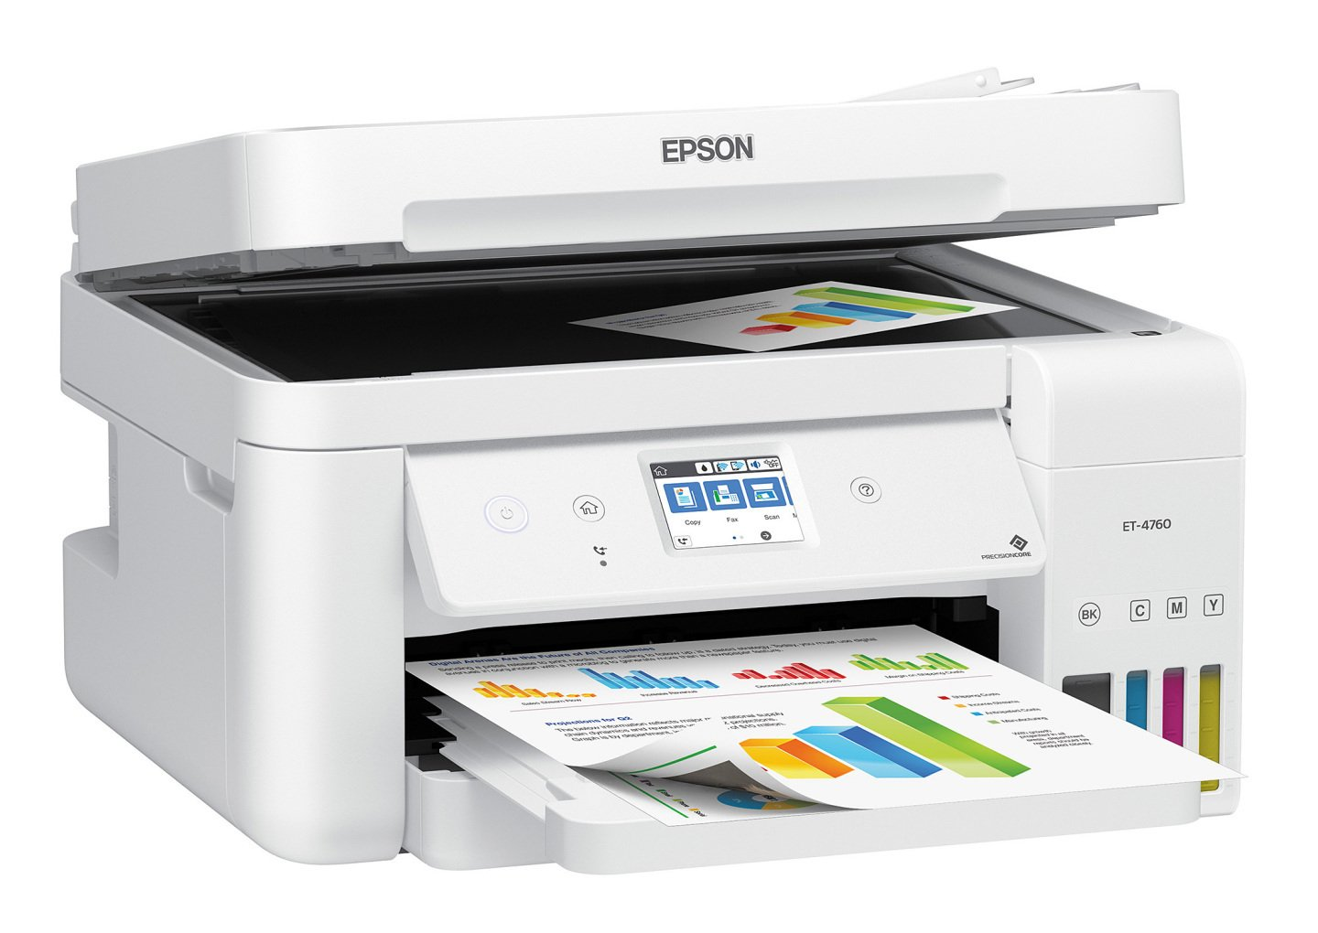
Inkjet printers
Ink-jet printers offer black and white or colour printing with reduced levels of quality and speed. Colour ink jet printers are cheaper to buy than color laser printers. Inkjet colour cartridge is often split into three colors: Cyan, Magenta and Yellow.

Slide 43
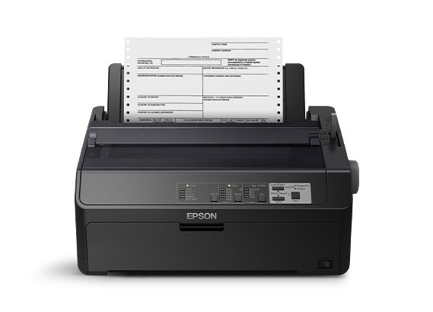
Dot matrix printers
Dot matrix printers are not so common today. These printers are sometimes called ‘Impact’ printers, this is because the print is made by hitting or ‘impacting’ the paper through a ribbon of ink, and this process is very noisy.

Slide 44
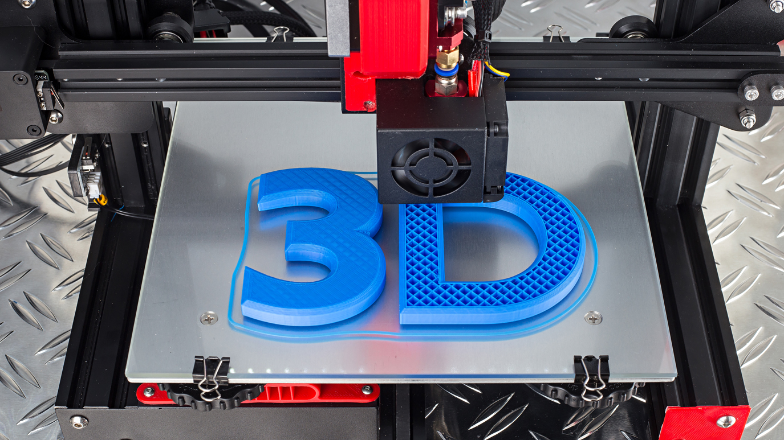
3D Printers
Three-dimensional (3D) printers create real-life versions of digital models. These printers work by adding a layer of heated materials from the bottom of the model all the way to the top.
3D printed models take a long time to create. 3D printers are often used to create complex items, examples of 3D models include Airplane parts, artificial limps, prototype models of cars, and even food such as pasta and chocolate.

Slide 45
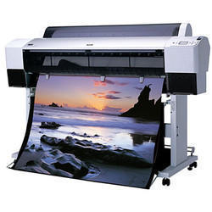
Plotters
A plotter can be used to produce high quality, accurate, A3 size or bigger drawings. They are usually used for Computer Aided Design (CAD) and Computer Aided Manufacture (CAM) applications, such as printing out plans for houses or car parts. Plotters are used by variety of professionals such as product designers, architects, engineers and cartographers (people who draw and produce maps)

Slide 46
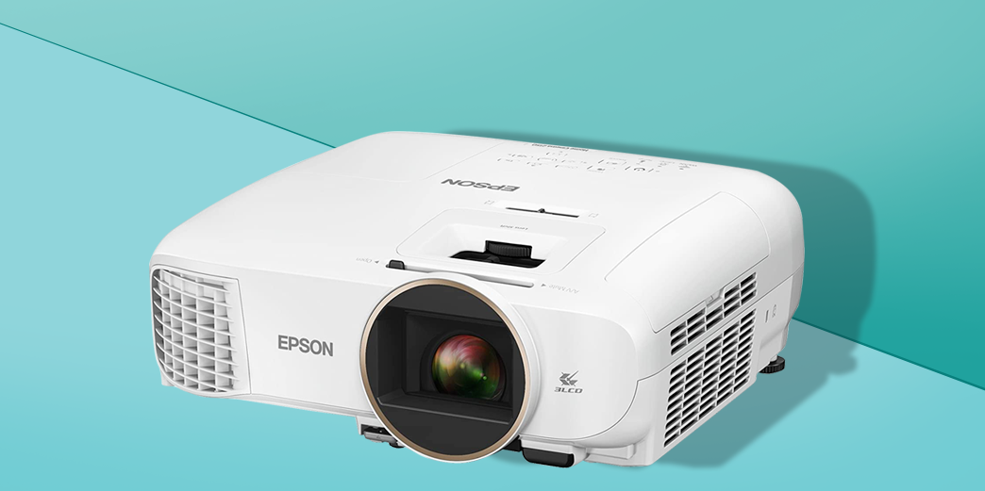
Projectors
Projectors are used for home entertainment such as watching television and playing games and in learning environment. They are portable, have light bulbs to change brightness levels, also they have resolution like monitors and they have zoom functionality.

Slide 47
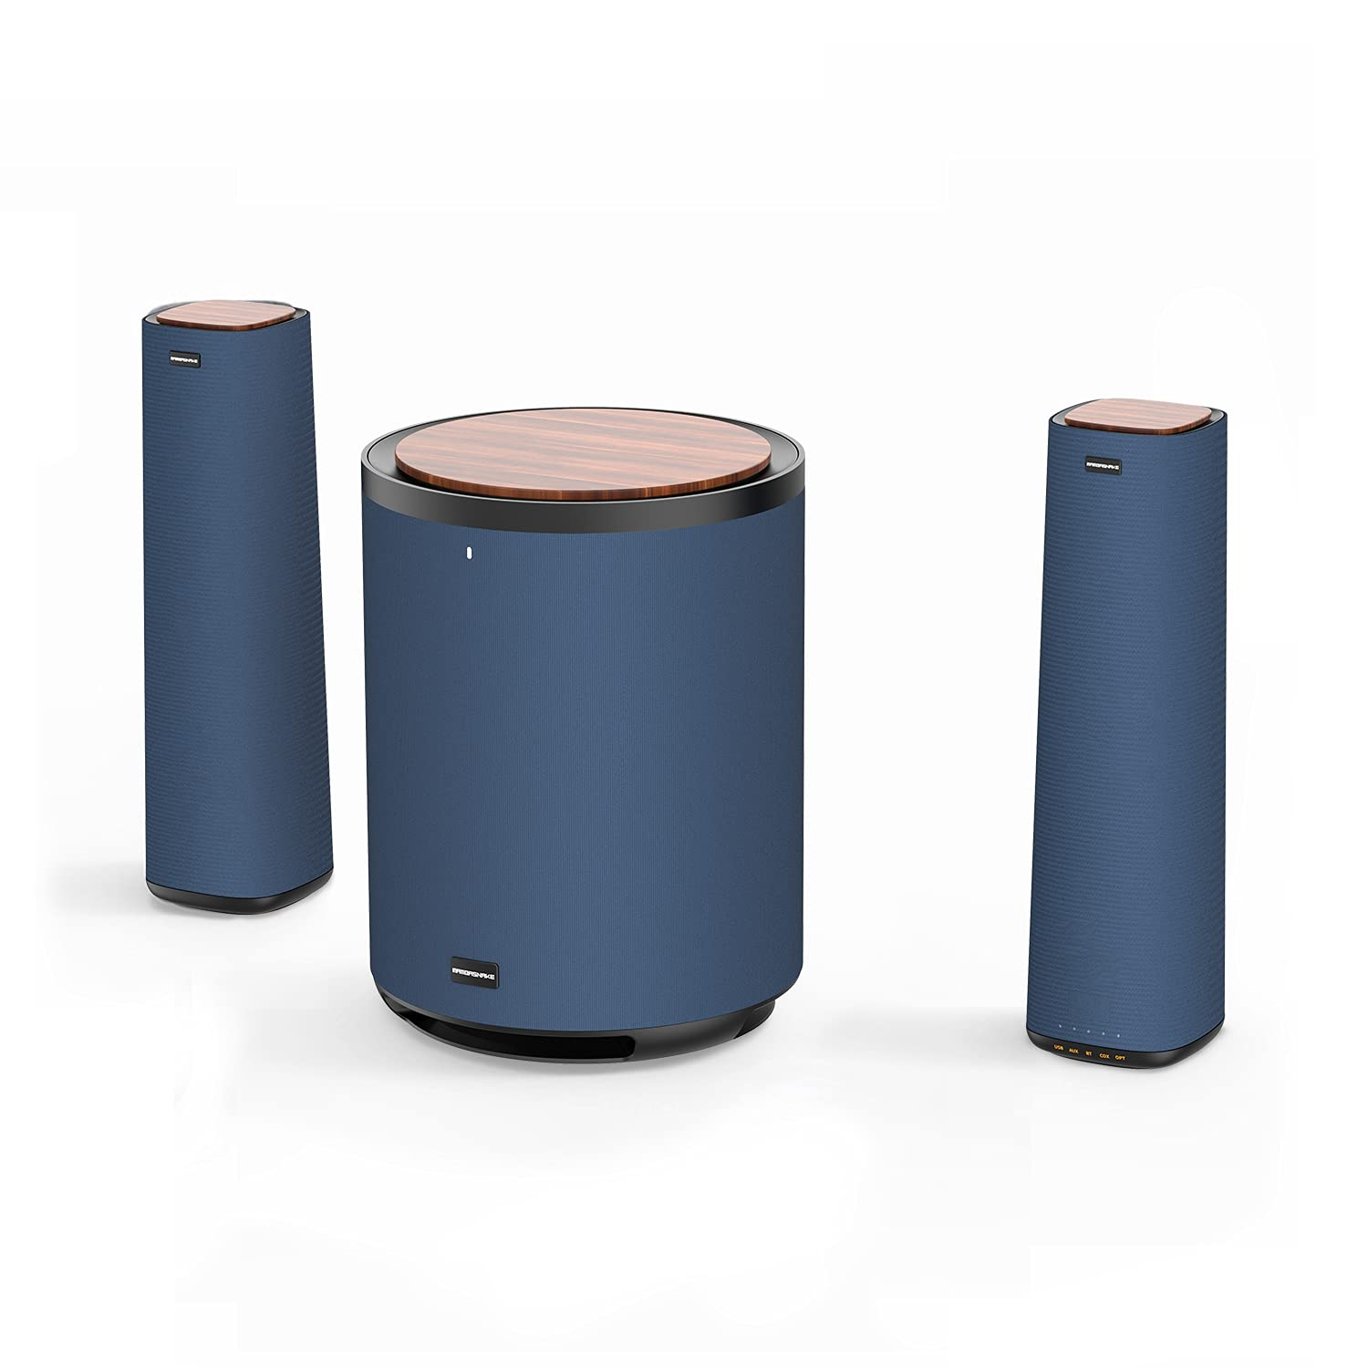
Speakers
Speakers allow the computer to output sound.
Speakers can be connected to other devices using either wired [USB-Universal Serial Bus- Cable] and wireless [e.g Bluetooth]

Slide 48
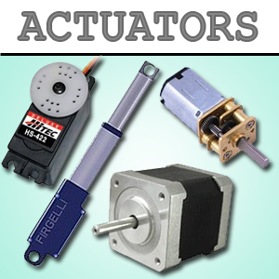
Control device
Control device are also known as actuators, and they are components of a system that make something happen in the real physical world. These devices are often mechanical. Examples of actuators include:
valves
pistons
heaters
coolers
motors

Slide 49
STORAGE
A computer uses two types of storage. A main store consisting of ROM and RAM, and backing storage which can be internal, eg hard disk, or external, eg a USB flash drive.

Slide 50
ROM and RAM
RAM is a fast-temporary type of memory in which programs, applications and data are stored. Here are some examples of what's stored in RAM:
the operating system
applications
the graphical user interface (GUI)
If a computer loses power, all data stored in its RAM is lost.
ROM is memory that cannot be changed by a program or user. ROM retains its memory even after the computer is turned off. For example, ROM stores the instructions for the computer to start up when it is turned on again.

Slide 51
Storage capacity and file size
Storage capacities and file sizes are measured (from lowest to highest) in:
bits
bytes
kilobytes
megabytes
gigabytes
terabytes
An operating system abbreviates these measurements, eg 1 megabyte becomes 1MB (megabyte).
Relationship between measurements from bits (smallest) and terabytes (largest):
Size | Equal to
8 bits | 1 byte
1024 bytes | 1 kilobyte
1024 kilobytes | 1 megabyte
1024 megabytes | 1 gigabyte
1024 gigabytes | 1 terabyte

Slide 52
There are different types of storage device
Hard disk drives (HDD) contain hard disk media. The drives provide a connection from the disk to the motherboard, either directly or using wireless adapter like Wi-Fi or wired port like USB.
Solid state drives (SSD often referred to as flash drives) contain flash memory media. They are otherwise identical to hard disk drives.
Optical disk drives contain optical media. Newer drives are often compatible with older media. For examples. A disk drive that can read Blu-ray media can also read DVD and CD media.

Slide 53
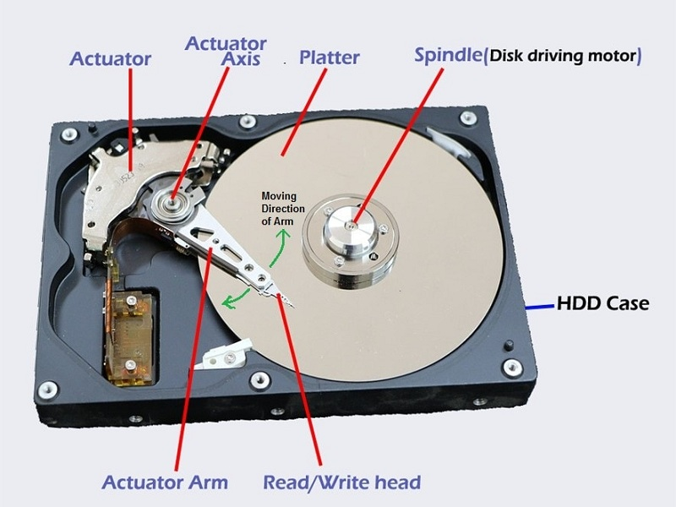
The hard disk
A hard disk store:
The operating system
Software applications or programs
The majority of your data files
Diagram showing parts of the hard disks

Slide 54
Optical media
Types of optical media include:-
CDs
DVDs
Blu-rays
CDs –Compact Disc
They store up to 700MB of data. CDs can be used for multimedia applications such as encyclopedias and can store pictures, sounds and video clips or anything else that will fit.
There are several formats, such as:
CD-ROM - read only, the data is written to them before they are sold.
CD-R - meaning CD-Recordable, the user can write data to the CD once
CD-RW - meaning CD-Re-Writable, the CD can be written and re-written to.

Slide 55
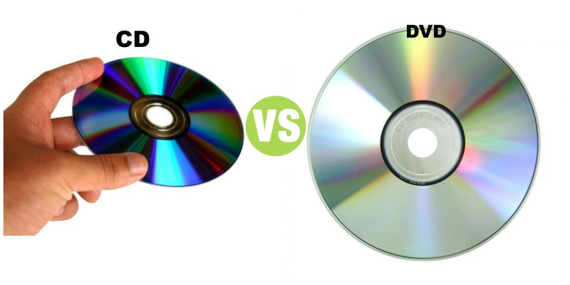
DVD- (Digital Versatile Disc) or [Digital video disc]
DVDs are the same physical size as CDs but hold much more data - a single sided disc can hold up to 4.7 GB.
There are several formats, such as:
DVD-ROMs - read only, the data is written to them before they are sold.
DVD-R - meaning DVD-Recordable, the user can write data to the DVD once
DVD-RW - meaning DVD-ReWritable, the DVD can be written and re-written to.

Slide 56
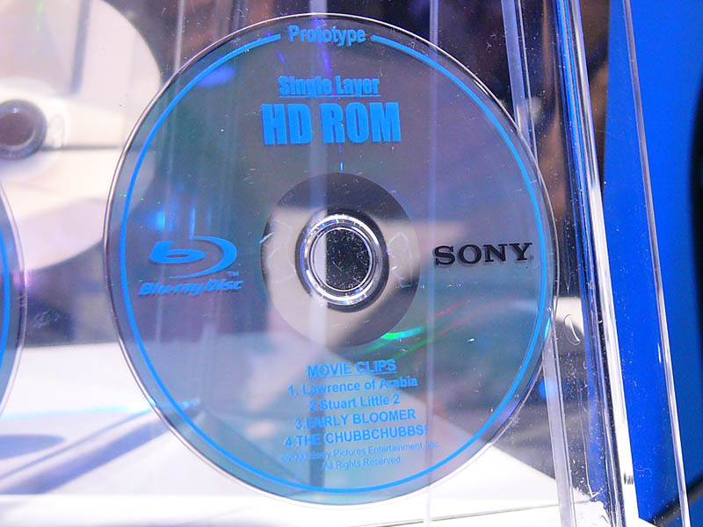
Blu-ray
Blu ray disks similar to CDs and DVDs. They can store 25GB on single -sided disk and double -sided disks can store 50GB
They can be used to store games that have higher capacity.

Slide 57
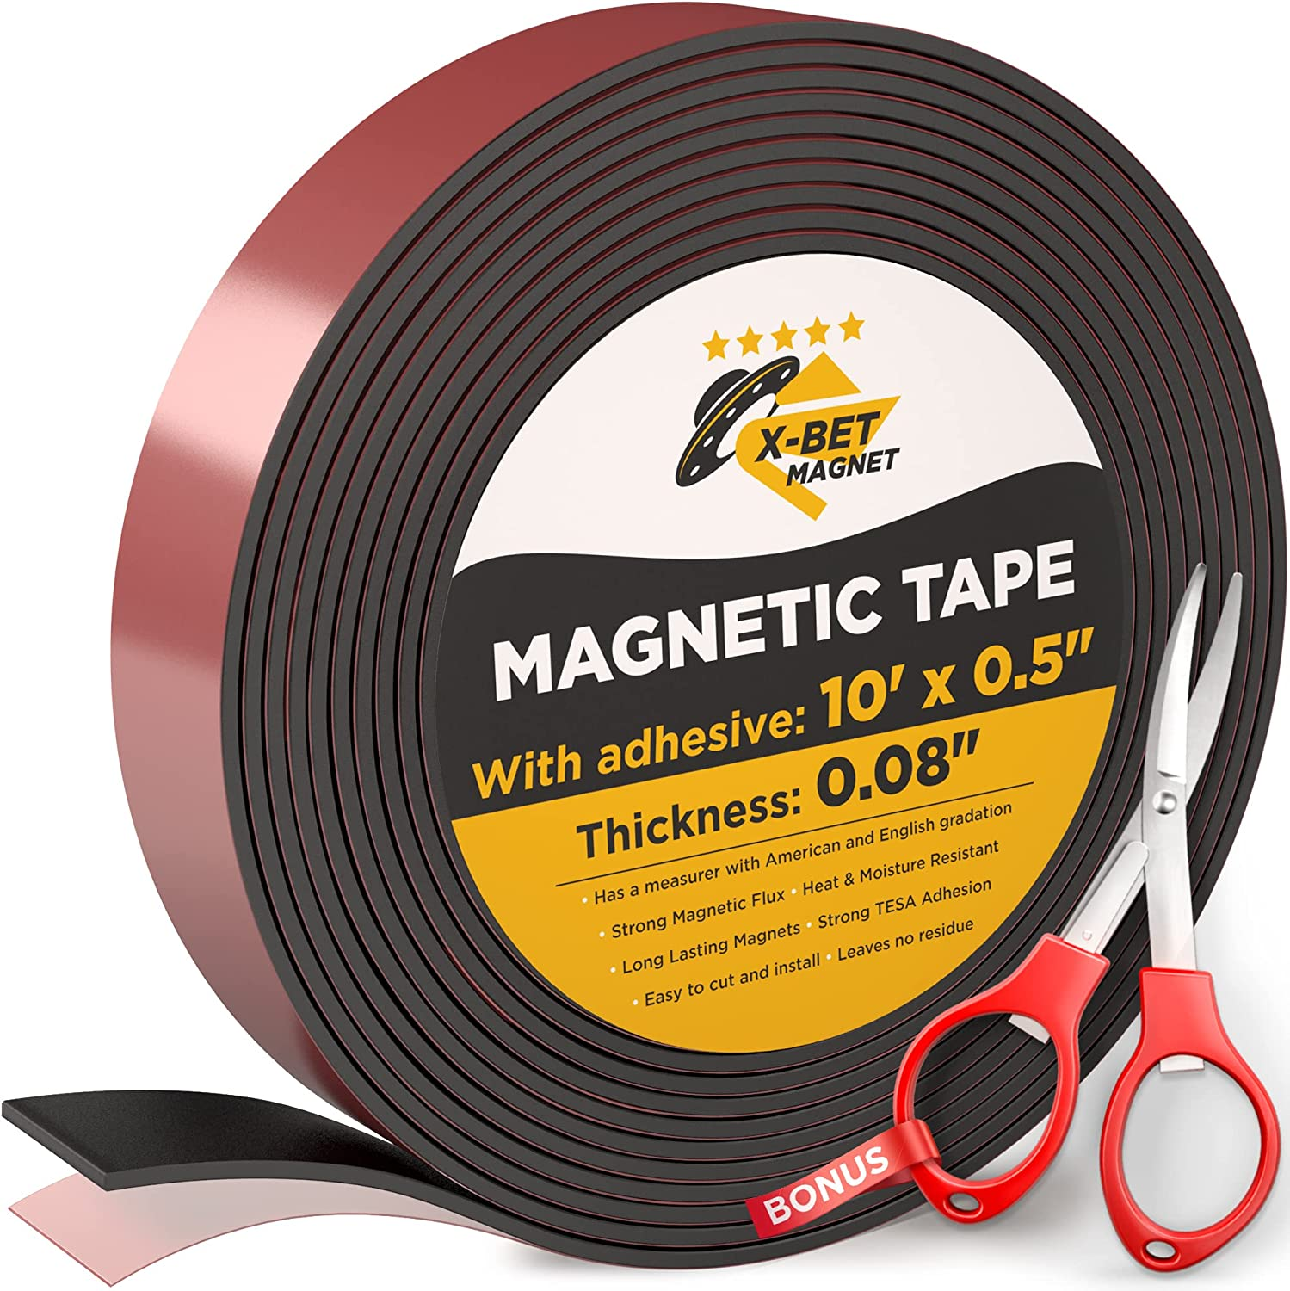
Magnetic tape
They were used for backup of important files from the hard disk and for the long term storage and archiving of data.
Advantage
they are small, robust, portable and provide low cost storage per GB
Disadvantages
they are very slow to write to and read from

Slide 58
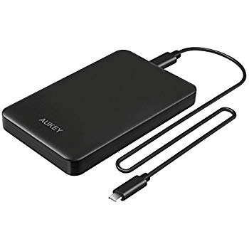
External hard disks
An external hard disk can store very large amounts of data, eg 1TB, and can be plugged into your computer via a USB
Advantage
high capacity, eg 1TB or more so they can be used to backup data Disadvantages
they are often quite large and therefore inconvenient to carry around
they have moving parts so are more likely to break, especially if dropped

Slide 59
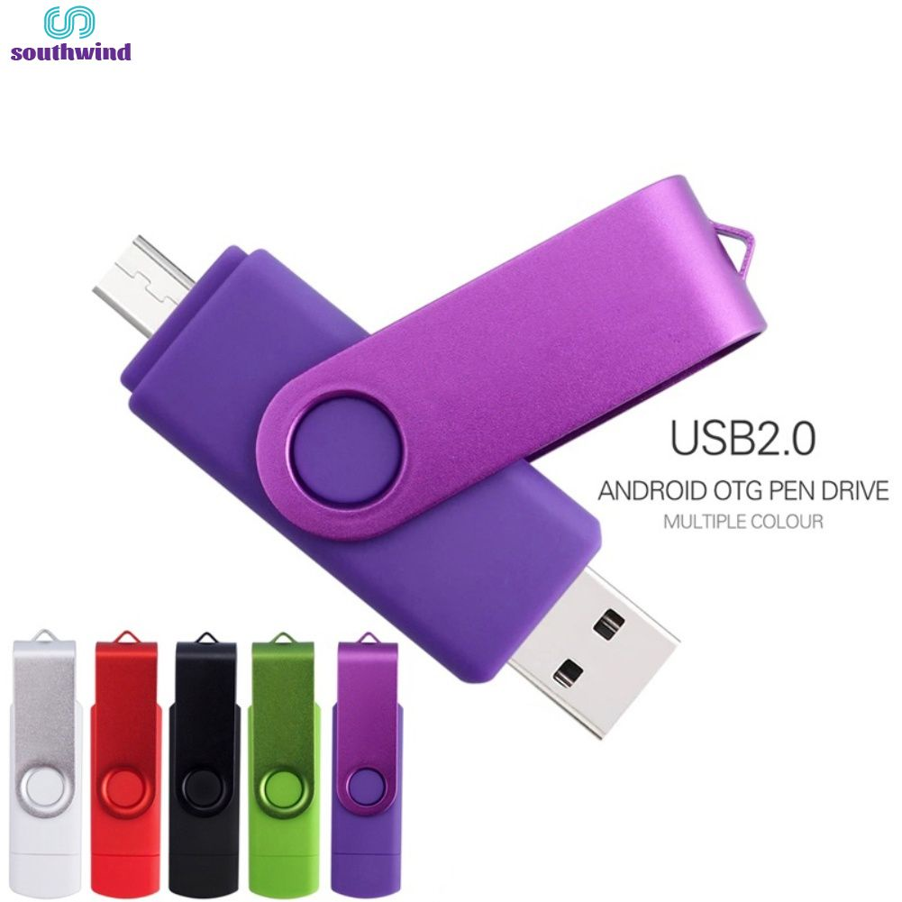
Memory sticks/memory card
A memory stick is a 'pen top' sized USB device
Advantages
memory sticks can hold large data.
they are extremely portable.
they are durable, because they have no moving parts
Disadvantage
They are likely to be lost, stolen or damaged

Slide 60
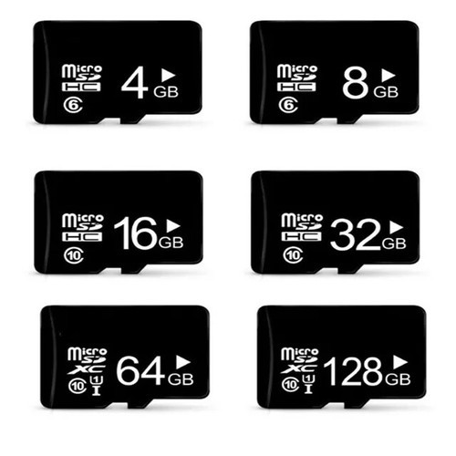
Memory Cards
Advantages
memory cards can hold large quantities of data
they are extremely portable so the user can take them wherever they go
they are durable because they have no moving parts
Disadvantage
Memory cards are smaller storage devices available. This means they are more likely to be lost, stolen or damaged.
All computers do not come with memory card readers built in. Users will often be required to purchase a card reader or USB converter to view the data on a card

