Slide 1


ONLINE GOODS AND SERVICES
ONLINE SERVICES
Before the development of the internet, people were limited in their ability to access services remotely, remote access was possible such as by using the telephone or postal systems for studying, shopping and booking flights. Having these services available online has enabled us to access them anywhere with any connected device.

Slide 2

TYPES OF SERVICES
Many types of online services such as
Shopping,
Banking,
Education and
Entertainment services.

Slide 3
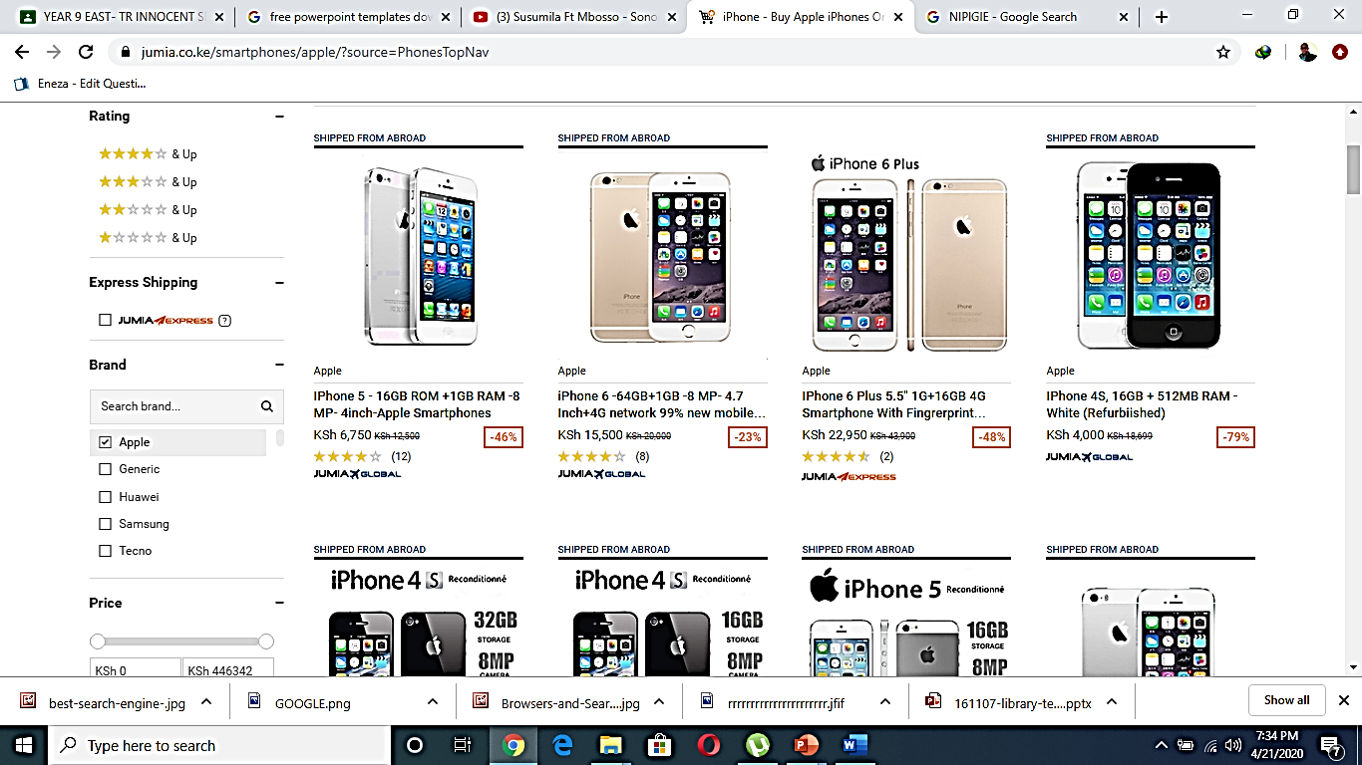
Shopping sites
When a user shops online, they use a product catalogue. For each product, the catalogue can store;
An image of the product
A product description
The product’s price
Ratings by customers, shop staff or other people can view sites
The popularity of the product
A product code
The number of items in stock
.

Slide 4
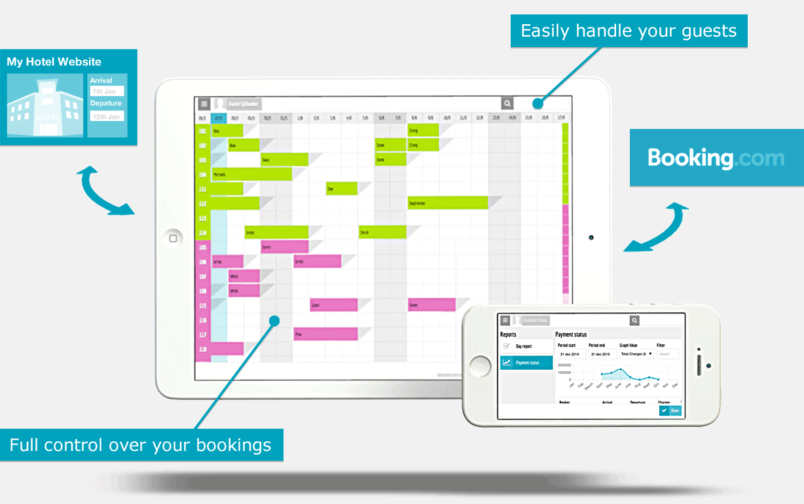
Booking systems
Train tickets, airline tickets and bus tickets can all be purchased online. Customers can choose their travel times, the number of tickets and the types tickets that they wish to buy.
These tickets can also be added to a basket if the customer is buying tickets for more than one trip. The leisure and entertainment can also be purchased online in this way.

Slide 5
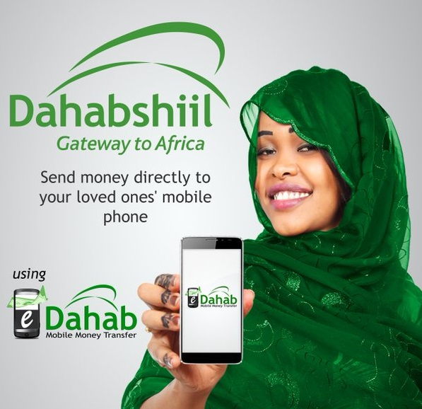
Banks
Banks offer their customers many online services including
Checking balances
Making payments and transfers
Applying for loans and other financial products
Managing alerts and notification of payment
Accessing customer service and help systems
Changing personal information

Slide 6
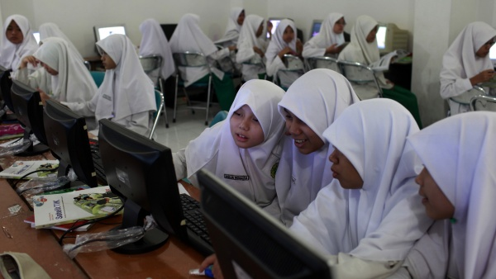
Education and training providers
Online training courses allow learners to access; -
Libraries of online journals and reference archives
Online support from teachers and other learners
Learning and assessment materials

Slide 7
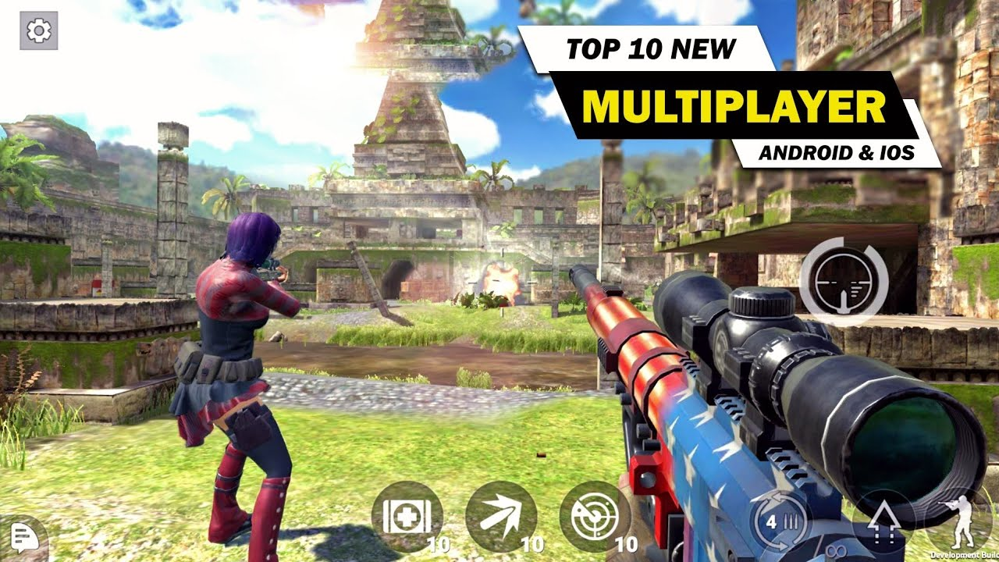
Gaming sites
Gaming sites are online application that allow users to play games that are hosted on a remote server.

Slide 8

News and other information providers
News providers give up to date access to stories using blogs and notification that is sent to subscribers.
Auction sites
Auctions sites allow sellers to list items for sale for certain period of time and allow buyers to offer money for these items.

Slide 9
Transactional Data
An online transaction occurs whenever data is sent between devices on the Internet.
This data is stored in cookies. it’s possible to encrypt cookies when they are transferred between devices online.
Examples of data that can be stored as cookies include
The time and data of the transactions
IP address
The referring website
Buttons pressed by the user
Data entered into web forms, such as name, address and credit card information.

Slide 10
There are different types of cookies
Session cookies
These are only stored until web page is closed in the browsers.
Persistent cookies
These are used to record information about the user’s use of the overtime.
They can be used to keep a user logged into an online account so they do not have to log in every time they visit a website
Third- party cookies
These can be used to personalized user’s online experience or to send targeted adverts that are more relevant to an individual.

