Slide 1
UNIT 2. CHAPTER 4
CONNECTIVITY
Connectivity is a way in which digital devices exchange data and communicate with each other.

Slide 2
DIGITAL COMMUNICATION
The use of digital technology improves and shrinks the planet. They facilitate communication, entertainment, friendship maintenance, and information gathering for us.
Digital communication networks, both wired and wireless, connect the entire world today. These systems have data flows that carry information about our personal and professional life as well as entertainment and news for us.

Slide 3
SPEED AND VOLUME OF DATA TRANSFER
As we transfer more data, it becomes increasingly important to understand how to increase the speed at which we can transfer it. If we don't, transferring more data will result in longer transfer times.
The speed at which devices can transfer data depends on the bandwidth of the connection.
Bandwidth is the number of bits that can be carried by a connection in one second.

Slide 4
Impact on user experience
A larger bandwidth enables the transfer of more data per second. Downloads and uploads get faster as a result. It also enables activities like multiplayer online gaming and high-definition video streaming that call for large amounts of data to be transferred quickly.

Slide 5
When streaming video, all of the data does not need to be downloaded before can start. Instead, a portion of the video data is stored temporarily in an area of memory called a buffer.
The video will not start until there is enough data in the buffer to play a few seconds of video. While those few seconds are playing, more is downloaded to fill up the buffer.
If the buffer is empty, there is no more video to play and it will pause until more data is downloaded.
To avoid the buffer becoming empty, data must be constantly downloaded into the buffer, filling it up at a rate faster than it is emptied.

Slide 6
Buffer is an area of memory used to temporarily store data, especially when streaming video.
In online gaming, the game will play smoothly if the bandwidth is adequate. However, if the latency is high, events in the game will lag and the game will not seem responsive to the player’s commands. When watching live television, high latency will result in delay between the real-time events and the video which slows the overall data transfer rate
The speed of data transfer also depends on the latency.
Latency is the delay in the time it takes to send data between devices.

Slide 7
Factors that affects speed and volume of data transfer
When devices transfer data, they can be affected by many factors that stop bits from reaching their destination
These factors include: -
1. Transfer method
Wireless methods have to work on a limited number of frequencies. In comparison, copper cable can carry more frequencies than wireless methods. This means that cabled methods can have more bandwidth available to them than wireless methods.

Slide 8
2. Interference
Other electromagnetic signals disrupt or interfere with wired and wireless signals, interference can be caused signals from wireless devices router and appliances emitting electromagnetic fields like fridges and microwave ovens. Cabled connections can be shielded (protected) from this interference by having the wires wrapped in a thin layer of metal.
3. Blockages
Walls and furniture reduce the strength of wireless signals. This reduces available bandwidth.
4. Distance
The strength of wired or wireless signals is reduced as the distance that it has to travel increases

Slide 9
DEVICE TO DEVCE COMMUNICATION
Device communication is when Devices connect directly to each other using wired or wireless methods.
Device 1 | Device 2 | Connection between device 1 and device 2 | use
Temperature sensor | Air conditioner | Wired | To turn on the air conditioning when the temperature is too high
Smartphone | Headphone | Minijack | To play music from the smartphone on the headphones
Laptop | External hard drive | USB | To transfer files
Camcorder | Monitor | HDMI | To operate as a security camera
Games controller | Games console | Bluetooth | To control a game

Slide 10
NETWORK COMMUNICATION
A network is created when two or more computers are linked together.
There are four major types of network.
1. Local area network (LAN)
A LAN is a network that connects digital devices that are in a small geographical area like a building or group of buildings that are close to each other
LANs are found in homes, schools and office buildings

Slide 11
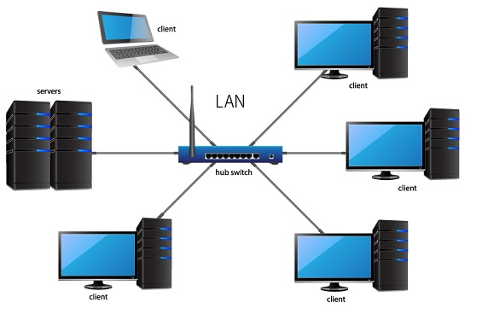

Slide 12
2. Wide area network (WAN)
A WAN is a network that is spread over a large geographical. WANs are often used to connect different buildings owned by national and international business, law enforcement departments, heath and education organizations and government departments.
WANs are use connectivity provided by a third-party telecommunications company, often linking LANs together through the internet. Because of their wider reach, WANs are often have slower transfer speeds than LANs

Slide 13
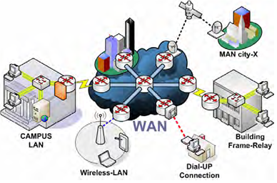

Slide 14
3. Personal area network (PAN)
A PAN is a group of connected devices that are all near an individual user. For example. A user could connect their smartwatch to their smartphones, which is connected to their laptop and home cinema speaker system.
When PAN only uses wireless connectivity, it can also be referred to as a WPAN (wireless personal area network). However, the general term PAN is more commonly used to refer to all types of PAN.

Slide 15
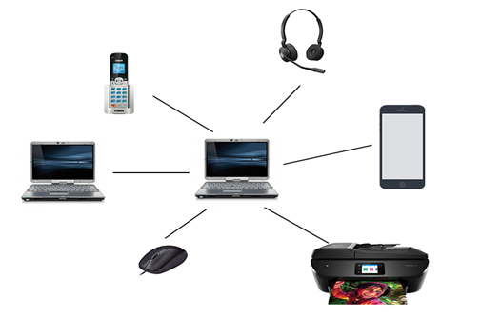

Slide 16
4. TETHERING
Tethering is the process of connecting a host device, such as a smartphone or a tablet device, that uses a mobile broadband connection with one or more device’s broadband connection.

Slide 17
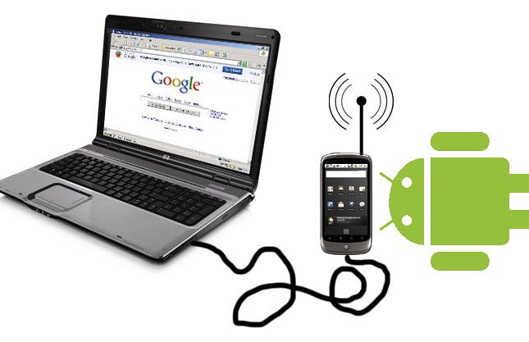

Slide 18
THE WAYS IN WHICH DDIGITAL DEVICES COMMUNICATE
The method that digital devices use to share data and some common uses of these methods as shown below.
Method | Technology | use
Satellite | Radio waves | GPS, Television, Telephone, Military
Broadcast | Radio waves | Television shows, radio shows
Wired | Electrical signals | Networking, connecting peripherals
Wireless | Radio waves | Networking, connecting peripherals

Slide 19
SATELLITE COMMUNICATION
Satellites transmit data to and receive data from digital devices. Digital devices use antennae to receive the radio signals that satellites transmit.

Slide 20
The benefit of satellite communication is that the number of satellites means that the system is always available.
It also cannot be affected by power shortages.
The drawback is that they will not work in areas with tall buildings or in tunnels.
Signals can also be affected by atmosphere weather conditions such as heavy snow or rain

Slide 21
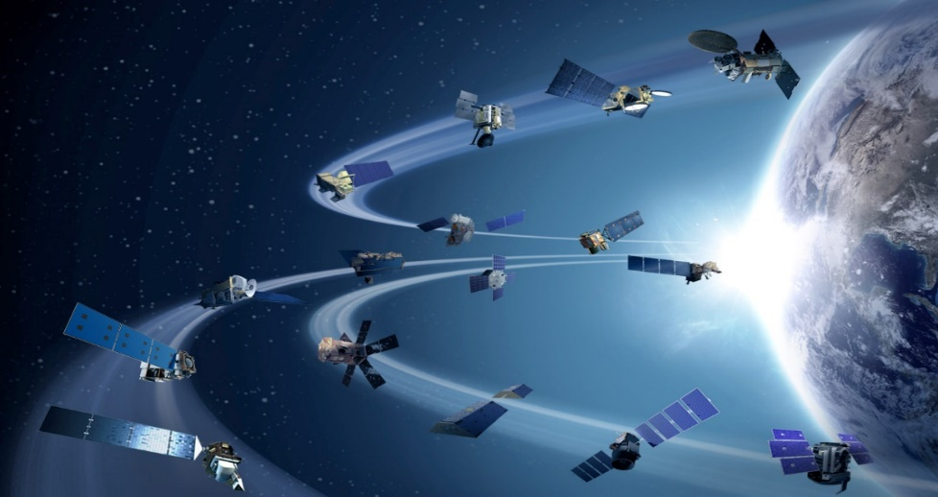

Slide 22
GPS-GLOBAL POSITIONING SATELITTE
Satellite communications are used for GPS. Navigation aids make use of GPS signals to calculate the exact location of a device. GPS signals are sent from a network of 24 satellites orbiting the Earth. At any one time, a device will be within view of approximately 12 of these satellites. However, a view of only four satellites is required to calculate location as shown below.

Slide 23
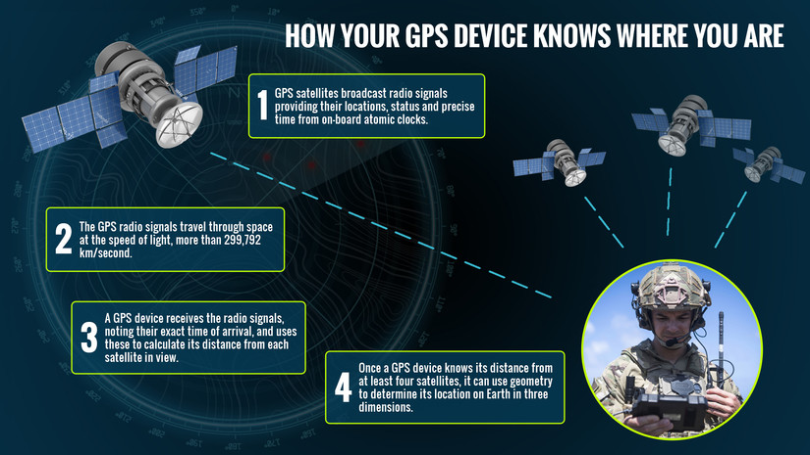

Slide 24
TELEVISION
Digital Video Broadcasting (DVB) is the internationally accepted standard methods of broadcasting digital television. DVB-S (Digital Video Broadcasting-Satellite) of one example of DVB. A video signal from the broadcaster is transmitted using a large antenna on earth to one or more satellites, which then broadcast the signals back down to Earth

Slide 25
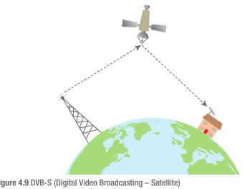

Slide 26
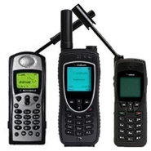
TELEPHONE
Satellite communication is also used to allow people in remote areas to place voice calls using satellite telephone.
Satellite telephones use antennae to transmit data to ( and receive data from) one or more satellite.

Slide 27

MILITARY
The military in many countries use satellites for communication systems, such as the Global Command and Control system.

Slide 28
BROADCAST COMMUNICATION
ANALOGUE TELEVISION RADIO
Transmitters broadcast television and radio signals that are received by a viewer’s antenna.
This antenna sends a signal through a wire to the television or radio receiver, which converts it into images and audio.

Slide 29
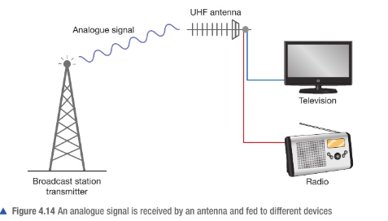

Slide 30
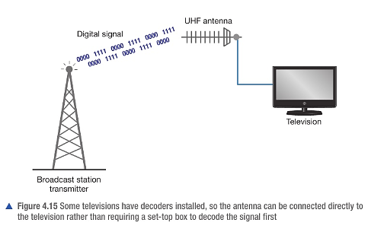
Diagram showing digital signals received by the antenna connected on the TV.

Slide 31
WIRED COMMUNICATION
Devices can use cables to communicate with each other via a wired connection.
There are many different types of wired communication. Some are used for many different purposes, such as USB.
Other are only used to meet one particular need, such as Ethernet.
Ethernet allows a user to connect to wired network
Ethernet-is a network connectivity standard that provides a way for computers to communicate.

Slide 32
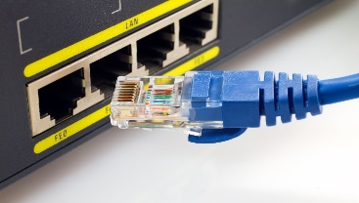
ETHERNET
CABLES

Slide 33
Common wired connection types and their uses
Connection type | use
HDMI | Digital video connections
S/PDIF | Digital audio connections
Minijack | Personal headphones
USB | Storage transfer
Ethernet | Networking

Slide 34
WIRELESS COMMUNICATION
TYPES OF WIRELESS COMMUNICATION
1. WI-FI
WI-FI is used in home, schools and office networks. Some companies provide Wi-Fi access in towns and cities. Wi-Fi is a wireless technology used to connect to a network. That network can itself then be connected to the internet, so that devices connected to the Wi-Fi network can be connect to the internet.

Slide 35
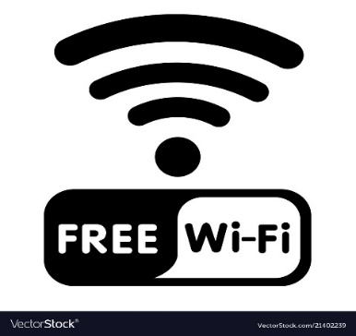

Slide 36

2. BLUETOOTH
Bluetooth is type of wireless connectivity that lets devices connect over short distances. It cannot carry as much data as Wi-Fi.
Bluetooth devices need to be paired (connect two devices-usually only with each other) with each other before they can communicate.
Bluetooth can be used to transfer small files between devices.
It is used to connect devices such as smartphones and laptops to peripherals such as portable speakers, headphones, earphones, keyboards, and mice.

Slide 37
3. 3G and 4G
3G and 4G are sometimes referred to as mobile broadband.
They are used to provide internet access to mobile devices such as smartphones and tablet devices when a Wi-Fi signal is not available.
G stands for “Generation” meaning that 4G is the fourth generation of mobile broadband technology.

Slide 38
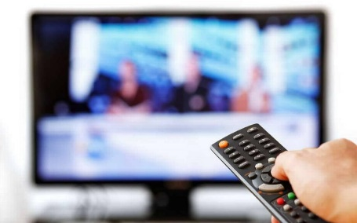
4. INFRA-RED (IR)
Infra-red signals cannot carry much data and only have a short range. Transmitters must have clear line of sight to receivers, because this allows the signal to travel in a straight line between them without being blocked by solid objects like walls. The signal is also affected by sunlight. It is often used in remote -control devices such as television remote control.

Slide 39
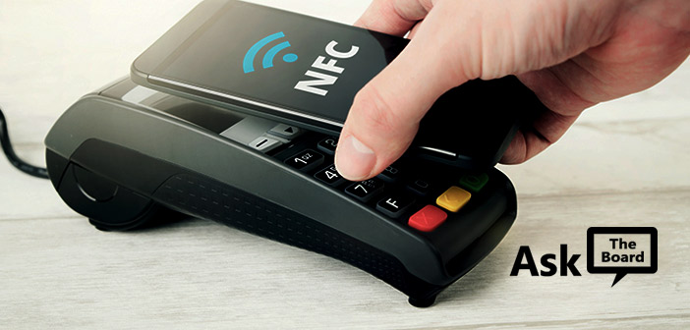
5. NEAR -FIELD COMMUNICATION (NFC)
NFC uses close proximity RFID (Radio Frequency Identification) chips. NFC used in smartphones, payment cards and travel cards

Slide 40
Comparing wired and wireless connectivity
 | Wired | Wireless
Cost | Cables are cheap if purchasing for a small number of devices | No need to buy cables May need a wireless access point for multiple connections
Safety | Risk of tripping over cables | None (though some people worried about the effects of radiation)
Speed | Faster than wireless | Slower than wired
Stability | Less affected by interference than wireless | Affected by interference and objects
Portability | Not portable as limited by connecting device | Potable within signals range
Mess | Can look untidy if lots of cables are used | Tidy
Security | Most secure | Less secure than wired connection because it is easier to intercept a wireless signal
Maintenance | Using cables and ports continuously over a long period of time may damage them | None

Slide 41
BROADBAND, MOBILE BROADBAND AND CELLULAR NETWORK
Broadband networks provide fast access to the internet through a connection to an internet service provider (ISP). They use the fiber optic cable or copper cable network.
Mobile broadband provides high- speed wireless connectivity using 3G and 4G technology to connect to the mobile phone network, which acts as the user’s ISP.
END

Slide 42
UNIT 2-Chapter 5
NETWORKS

Slide 43
WHAT IS A NETWORK?
A network is when two or more computers are connected together
Using a network, a computer can communicate with others and share resources such as hardware, software and data.

Slide 44
REQUIREMENTS FOR CONNECTING TO NETWORKS
In order to connect to a network, computers need to fulfil certain requirements so that they all operate using standard protocols
Protocols are rules that allow the exchange and transmission of data between devices

Slide 45
NETWORK OPERATING SYSTEMS
A network operating system allows a computer to communicate on a network.
It provides additional functionality to a stand-alone operating system, including:
■ passing usernames and passwords to a server for checking when a user logins
■ separating user accounts and ensuring that users cannot access each other's files
■ providing access to network storage and shared resources such as networked printers.

Slide 46
HOW DEVICES ARE IDENTIFIED ON A NETWORK
There are three methods used to identify devices on a network:
■ Internet Protocol (IP)
■ MAC address
■ Device name.

Slide 47
1. INTERNET PROTOCOL (IP)
An IP address is a unique address that networked devices use to send data to each other.
Each piece of data that is sent across a network carries the IP address of the destination, so that each device in the network knows where to send it.
IP addresses can either be assigned by a network administrator or allocated dynamically by a server running Dynamic Host Configuration Protocol (DHCP).
Dynamic Host Configuration Protocol (DHCP) Server a networked Computer that automatically assigns an IP address to other computers when they join the network

Slide 48
IP addresses are made up groups of numbers. There are two main versions of IP in use.
■ IPv4 uses four groups of up to three numbers separated by full stops
(For example, 192.168.1.1).
■ IPv6 uses eight groups of four hexadecimal numbers separated by colons
(For example. 2001:0db8:0000:0042: 0000:8a2e: 0370:7334).

Slide 49
2. MAC ADDRESS
Media access control (MAC) addresses are universally unique Identifiers given to the network interface card (NIC).
MAC addresses are used in devices connected to local area networks (LANs) using Ethernet, Bluetooth or
Wi-Fi.
MAC addresses are assigned by the NIC manufacturer and are generally considered to be fixed addresses.

Slide 50


Slide 51
USES OF MAC ADDRESS
USE | EXAMPLE
Restricting or allowing access to a network | MAC address filtering checks the MAC address of devices attempting to gain access to a network and only grants access to devices with specified MAC addresses
Identifying a device on a network | Some WI-FI hotspot only provide free access for a certain length of time. on a network and they Identity a device using its MAC address in order to work out whether it is trying to access the hotspot for longer than the permitted time
Tracking a device | Some companies and organizations track devices (and therefore their users) by checking which wireless access points have been accessed by specific MAC address
Assigning 'static' or fixed IP address | Each time a device connects to a network, it is identified by a DHCP server (usually using its MAC address) and gives the same IP address as before

Slide 52
N/A MAC addresses can be changed through a process called spoofing, which means using the MAC address of another device.
3. DEVICE NAME
A device name is a descriptive name that helps users to identify computers on a network.
Device names are not used by computers to communicate With each other as they are not always unique. This means that they could cause conflicts if data was to be sent to more than one device with the same name for processing.

Slide 53
COMPONENTS OF WIRED AND WIRELESS SYSTEMS
1. CABLES
Cables are used to connect devices in a wired network.
Cat5e cables are used for Ethernet connections. These cables are able to transfer data at 10 Mbit/s. 100 Mbit/s or 1 Gbit/s.
Cat6 cables can be used to transfer data at 10 Gbit/s. These are more expensive than Cat5e cables and are usually only used by businesses.

Slide 54
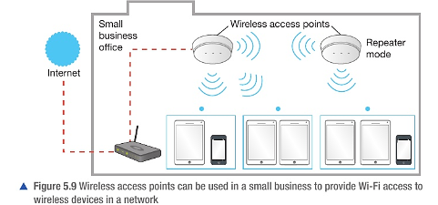
2. WIRELESS ACCESS POINT
A wireless access point allows devices with Wi-Fi connectivity to connect to a wired network.

Slide 55
3. SWITCH
A switch connects devices on a network. It has ports, each of which can be connected to a device using a cable. Connecting a wireless access point to a switch via a cable gives wireless devices access to the wired network. The switch makes sure that data sent from any device gets to the correct device on the network

Slide 56
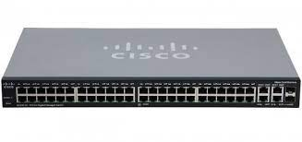

Slide 57
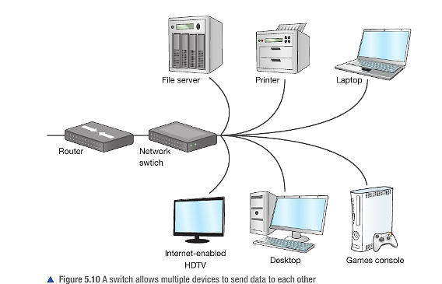

Slide 58
4. ROUTER
A router stores the addresses of all devices that are connected to it so that it can forward network traffic to its destination using the quickest route. Most routers used in homes include a switch and a wireless access point. They also act as gateways, connecting the LAN to the internet. which is a type of WAN.

Slide 59
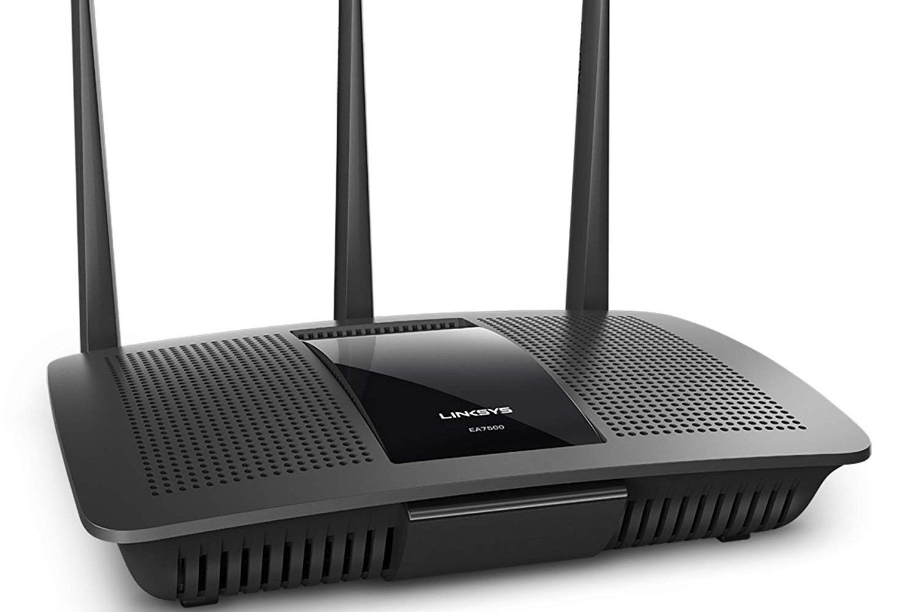

Slide 60
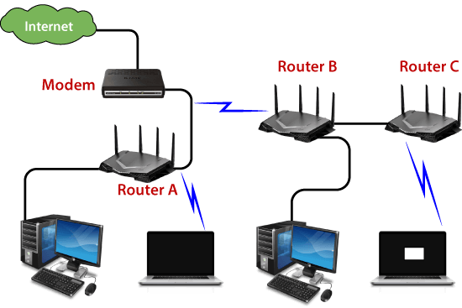

Slide 61
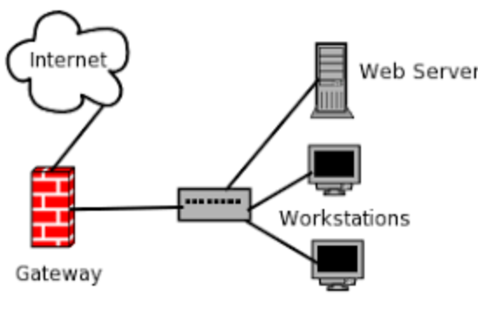
5. GATEWAY
A gateway connects two different types of network. For example. a LAN is connected to a WAN using a gateway.

Slide 62
6. BOOSTER
A booster is used to amplify the signal in a network so that its range can be extended. For homes and offices, wired Ethernet connections often have a maximum range of 100 m.
Wireless signals have limited range, too. Boosters can be used for both wired and wireless connections.

Slide 63
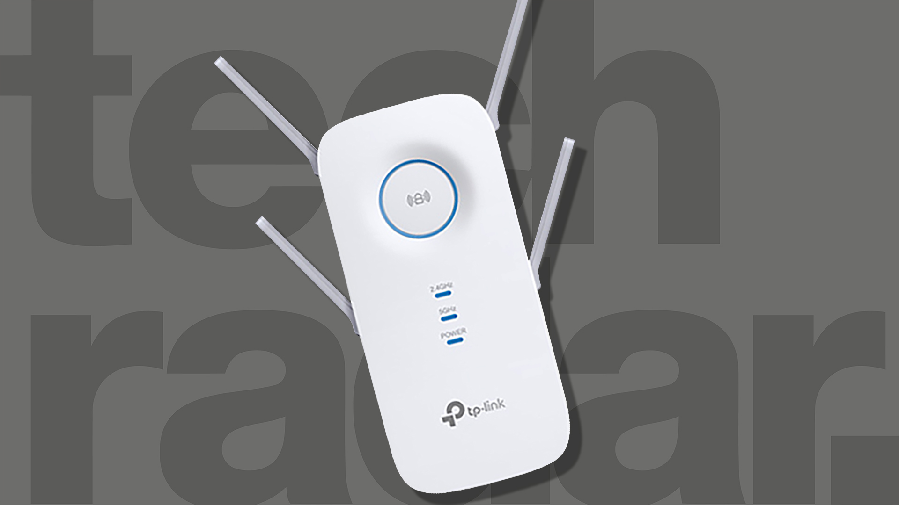

Slide 64
SERVER
A server is a computer that shares its resources with connected devices.
Computers connected to a server are known as clients.
Client is a computer connected to a server
Resources that can be shared by one or more servers include printers, storage and applications.

Slide 65
AUTHENTICATION SERVER
An authentication server checks usernames and passwords.
When a user successfully logs in, the client receives an electronic certificate that it can then use to access various resources, including applications and storage.

Slide 66
PRINT SERVER
A print server manages multiple printers at a time, dealing with print requests from client computer.
Print servers can also monitor and process print requests, making sure that users or departments can be invoiced for the jobs that they send to the printers.

Slide 67
FILE SERVER
File servers allow users to access shared and private storage.

Slide 68
APPLICATION SERVER
Application servers provide clients with access to applications that can be run directly from the server.

Slide 69
WEB SERVER
Web servers process requests for data made via Hypertext Transfer Protocol (HTTP). Together, all of the content stored on all web servers is known as the World Wide Web.

Slide 70
CONNECTING TO AND USING THE INTERNET
Users must be connected to the internet in order to utilize the online services offered by servers and data centers.

Slide 71
INTERNET SERVICE PROVIDER-ISP
To connect to the internet, users need to subscribe to an ISP.
ISPs provide access via mobile telephone networks and landline telephone networks.
Commercial ISPs charge subscription fees for access to the internet.

Slide 72
WEB BROWSER
A web browser is a type of software application used to request and display information. stored on web servers.
Examples of web browsers
Mozilla Firefox,
Google Chrome,
Internet Explorer

Slide 73
SEARCH ENGINE
A search engine provides users with a way to find information in web pages stored on web servers. Users enter keywords that describe the information they want to find.

Slide 74
FILTER SOFTWARE
Filter software prevents users from accessing inappropriate information.
When a user tries to access a web page, the address (URL) and/or the contents of the web page are compared against two lists of URLs and keywords stored

Slide 75
LOCAL AREA NETWORK (LANs)
A LAN is a network contained to a small area, such as a home or office.
Computers in a network can be connected using one of two different models:
PEER-TO-PEER
CLIENT-SERVER.

Slide 76
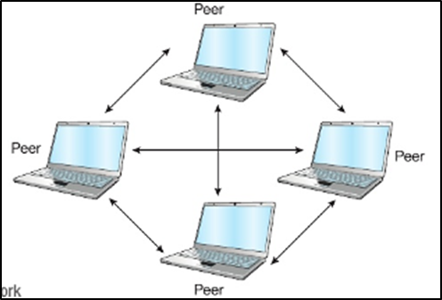
PEER-TO-PEER
Computers in a peer- to-peer network share their resources with other computers in the network, but they do not access servers.

Slide 77
BENEFITS OF USING LANS
Access to shared peripherals
Access to shared storage and data
Flexible access (that is, being able to access peripherals, storage and data from any connected device)
Media streaming (including movies, music and gaming)
Communication (that is, being able to send messages and files to others on the network)
Shared access to the internet

Slide 78
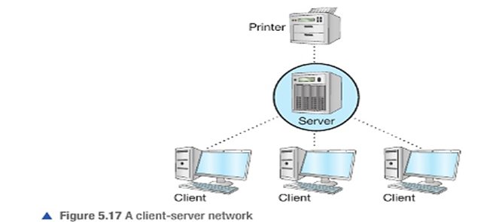
CLIENT-SERVER NETWORKS
Some networks use servers. A network that uses servers and clients is called a client-server network.

Slide 79
BENEFITS OF USING CLIENT-SERVER NETWORKS
Control of user access rights: Users, or groups of users, can be given access to some resources (such as storage or printers) and restricted from accessing others.
Centralized administration: Resources and user accounts can be managed by an individual, or individual group of servers and administrators
Centralized backup: User data is protected from loss because backups can be automated for all users.
Shared software: Application servers can provide access to shared software. Some servers can provide access to operating systems.
Shared storage and file access: The amount of storage available to users can be managed centrally. Sharing storage means that users can make files available to others.
Roaming profiles: This is the ability to log into any computer in an office and see your settings and files.

Slide 80
SECURING DATA ON NETWORKS
Methods used to secure data on networks
1. Usernames and passwords
Users log in to computers on a network to access centrally managed resources.
Without the correct login details, users cannot access the networks and its resources.
An authentication server can be used to manage the authentication of a user to a range of network resource and services.

Slide 81
2. Firewalls
A firewall is used at the gateway to a network.
It controls the network traffic to and from a network, particularly the traffic from the internet.
Firewalls prevent unauthorized users from accessing network devices and resources, such as storage.
Firewalls are available as hardware and software, which can be installed on computers to prevent attacks from within a network.

Slide 82
3.Encryption
Encryption is the process of encoding, scrambling or jumbling data so that unauthorized users are prevented from being able to understand it.
One method used to encrypt text is called a Caesar cipher.
This method shifts each letter to the left by a set number of places.

Slide 83
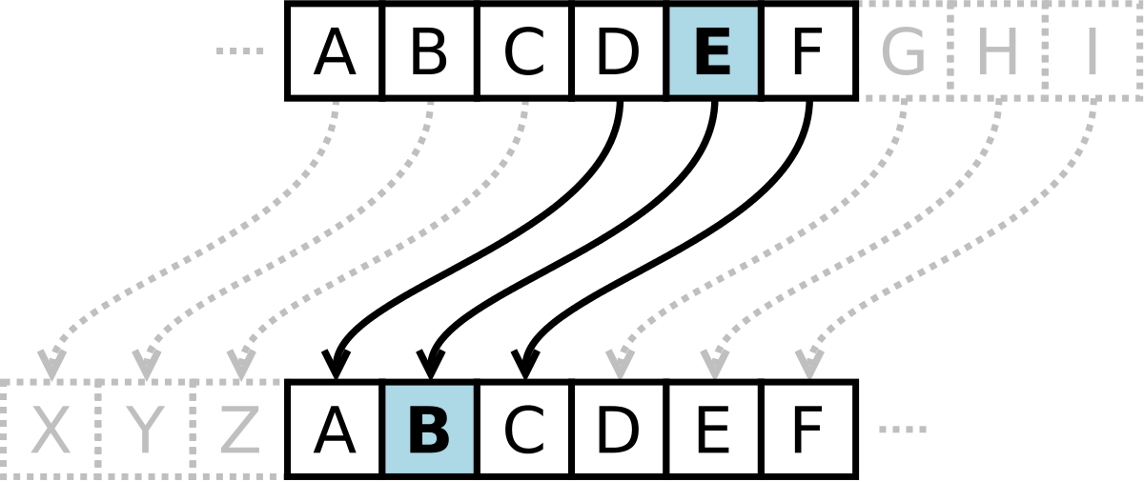

Slide 84
There are two types of encryptions:
A Caesar cipher is quite easy to guess, but most modern encryption is much more secure.
Symmetric key encryption
Public key encryption

Slide 85
Symmetric key encryption uses the same key at both ends of the process, meaning that the same key is used to encrypt and decrypt the data.
Public key encryption uses two mathematically related keys called a key pair. One key is used to encrypt the data and a different key is used to decrypt it.

Slide 86
File access rights
File access rights are also known as file permissions. They can be set for individual files, folders or drives, and they ensure that users are either allowed to read only or allowed to read and write to the file, folder or drive.

Slide 87
Backups
A backup is a copy of one or more files. The backup or backups are usually stored on a different storage device to the original file

Slide 88
Types of backups
1. Full backups
The most basic and complete type of backup operation is a full backup. As the name implies, this type of backup makes a copy of all data to a storage device, such as a disk or tape.
2. Incremental backups
An incremental backup operation will result in copying only the data that has changed since the last backup operation of any type.

Slide 89
3. Differential backups
A differential backup operation is similar to an incremental the first time it is performed, in that it will copy all data changed from the previous full backup, and incremental back up.

Slide 90
WIRELESS ENCRYPTION PROTOCOL (WEP)
It is easier to intercept data in a wireless network than in a wired network. Wireless Encryption Protocol (WEP) is used to secure the wireless transfer of data. It is the least secure wireless data encryption method. This is because every device on the wireless network uses the same key for every transfer.

Slide 91
WI-FI PROTECTED ACCESS (WPA)
This is a security protocol designed to provide better Encryption than WEP. WPA generates a new key for each device on the wireless network. New keys are also provided for each packet of data that is sent.

Slide 92
VIRTUAL PRIVATE NETWORK (VPN)
A VPN provides access to a private LAN from a remote location.
An individual might use a VPN to:
Access their employer's network when working from home
Make secure payments
Prevent surveillance of and access to their web activity.
access computers in a different geographical location, perhaps to avoid
Local restrictions on access to web content (such as due to censorship or Geolocation rights management)

Slide 93
Transaction logs
All network activity can be recorded in a log file. Although this does not directly secure network data, a transaction log can help to identify which computers and network devices have been accessed.
This can allow administrators to identify any unusual activity that might be a threat to data security.
Log is a record of events
Transaction is the exchange of data

